Slide 1
The GW Cancer Center’s Online Academy
Presenter
Date

Slide 2
About the GW Cancer Center
The George Washington University (GW) Cancer Center is a collaboration of the George Washington University, the GW Hospital and the GW Medical Faculty Associates to expand GW’s efforts in the fight against cancer.

Slide 3
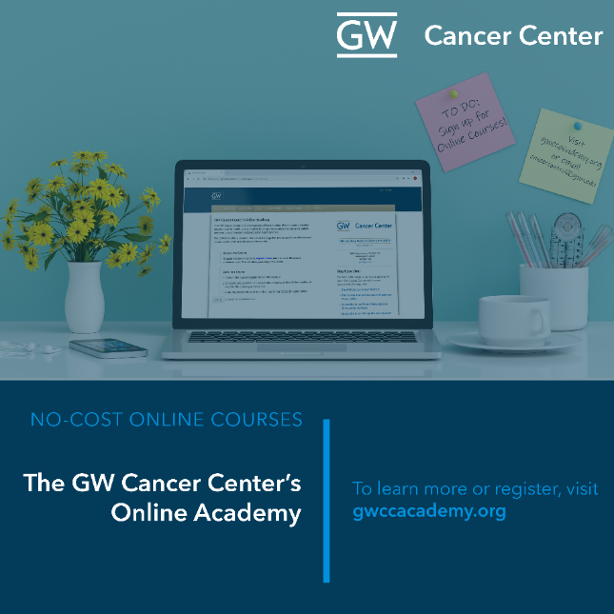
About the Online Academy
The GW Cancer Center offers several no-cost, self-paced online trainings through the Online Academy
Courses are intended for a variety of different audiences, including health care providers, cancer control and public health professionals

Slide 4
Trainings Offered
Current courses include:
Action for Policy, Systems and Environmental (PSE) Change: A Training
Addressing the Need for LGBTQ-Affirming Cancer Care: A Focus on Sexual and Gender Minority Prostate Cancer Survivors
Cancer Survivorship E-Learning Series for Primary Care Providers
Communication Training for Comprehensive Cancer Control Professionals 101 and 102
Executive Training on Navigation and Survivorship
Oncology Patient Navigator Training: The Fundamentals
Together, Equitable, Accessible, Meaningful (TEAM) Training
Visit gwccacademy.org to learn more and find out about no-cost continuing education credits available for all courses.

Slide 5
Action for Policy, Systems and Environmental (PSE) Change: A Training
Audience: Cancer control and public health professionals
This course explores PSE change, from its evidence base to a full-length case study. It provides background information on the PSE change process, worksheets, a PSE action plan template and real-world examples.
Visit gwccacademy.org to enroll

Slide 6
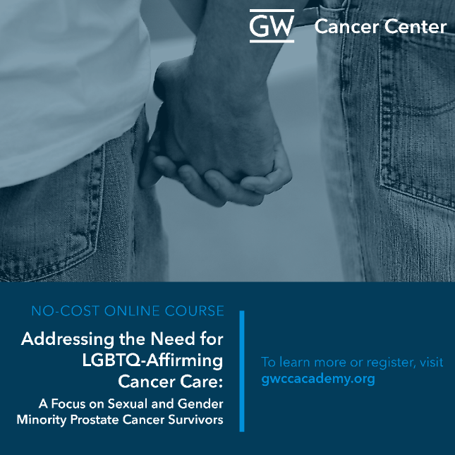
Addressing the Need for LGBTQ-Affirming Cancer Care: A Focus on Sexual and Gender Minority Prostate Cancer Survivors
Audience: Health care providers, social workers and public health professionals
This training aims to improve support for sexual and gender minority cancer patients, with a special focus on the needs of sexual and gender minority prostate cancer survivors.
Visit gwccacademy.org to enroll

Slide 7
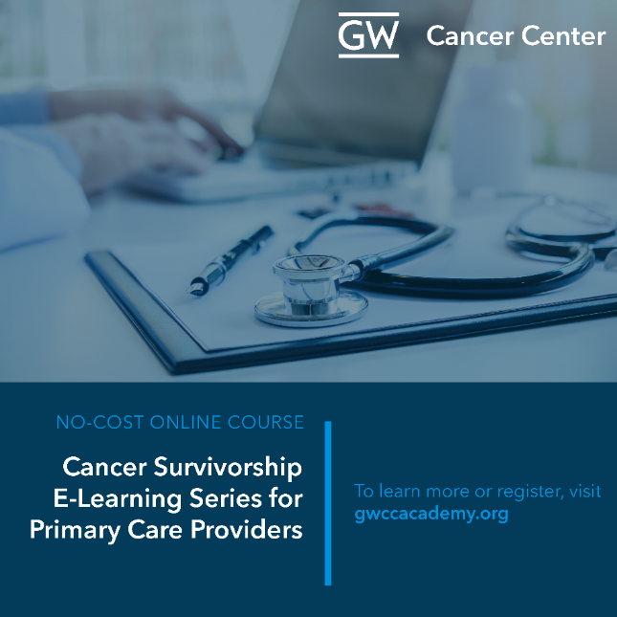
Cancer Survivorship E-Learning Series for Primary Care Providers
Audience: Primary care providers and other who provide follow-up care to cancer survivors
This program provides guidance on caring for cancer survivors and covers late and long-term effects of treatment for a variety of cancer types.
Visit gwccacademy.org to enroll

Slide 8
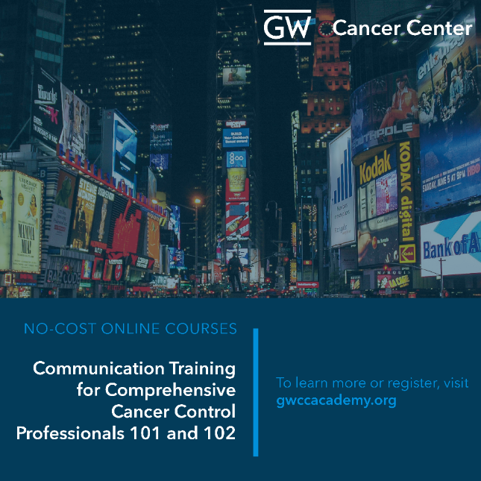
Communication Training for Comprehensive Cancer Control Professionals 101 and 102
Audience: Cancer control and public health professionals
This two-part course covers media planning and media relations as well as planning, implementing and evaluating evidence-based communication campaigns.
Visit gwccacademy.org to enroll

Slide 9
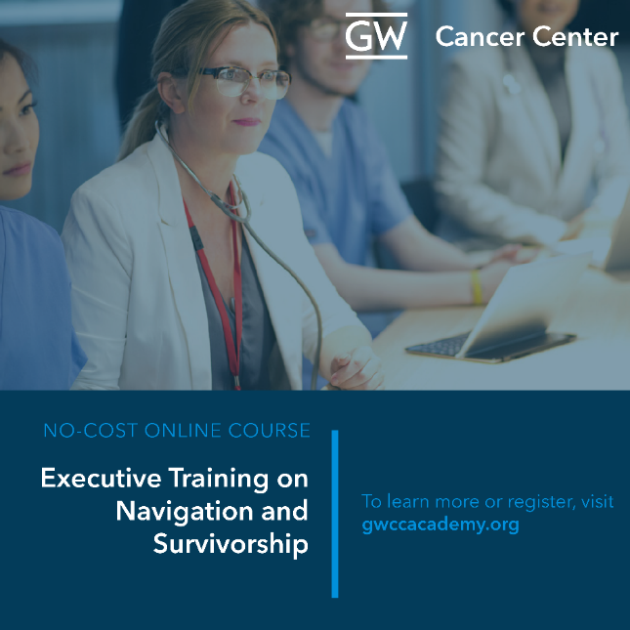
Executive Training on Patient Navigation and Survivorship
Audience: Administrators, heath care providers, cancer control and public health professionals
This program teaches the nuts and bolts of patient navigation and cancer survivorship program development and implementation.
Visit gwccacademy.org to enroll
Visit bit.ly/E-SeriesPromoVid to watch a short promotional video about the E-Series

Slide 10
Oncology Patient Navigator Training: The Fundamentals
Audience: Patient navigators or other health care providers
This competency-based training uses evidence-based information and case studies to prepare patient navigators to effectively address barriers to care for cancer patients and survivors.
Visit gwccacademy.org to enroll

Slide 11
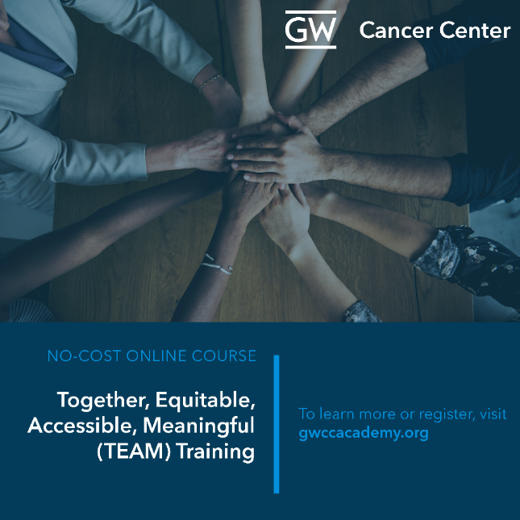
Together, Equitable, Accessible, Meaningful (TEAM) Training
Audience: Health care providers, cancer control and other public health professionals
This training aims to improve the productivity of patient-provider interactions through individual and systems-level approaches. The training also provides strategies to support effective communication and culturally sensitive practices.
Visit gwccacademy.org to enroll

