Slide 1
Lesson 4: Impact of Cancer
Module 3: The Basics of Health Care
Oncology Patient Navigator Training: The Fundamentals

Slide 2
Acknowledgements
This work was supported by Cooperative Agreement #1U38DP004972-02 from the Centers for Disease Control and Prevention. Its contents are solely the responsibility of the authors and do not necessarily represent the official views of the Centers for Disease Control and Prevention.
We would like to thank:
Johns Hopkins University for giving us permission to use their video.
Notes:
We would like to acknowledge the Centers for Disease Control and Prevention for supporting this work. We would also like to thank Johns Hopkins University for giving us permission to use their videos.

Slide 3
Competency
This lesson covers the following Core Competencies for Patient Navigators:
2.5 Identify potential physical, psychological, social and spiritual impacts of cancer and its treatment.
Notes:
This lesson covers the following Core Competencies for Patient Navigators: 2.5 Identify potential physical, psychological, social and spiritual impacts of cancer and its treatment.

Slide 4
Learning Objective
Describe the potential physical, psychological, social and spiritual impacts of cancer
Notes:
After completing this lesson, you will be able to:
Describe the potential physical, psychological, social and spiritual impacts of cancer

Slide 5
Before and During Treatment
We will now look at the potential impacts that may affect patients before and during treatment.
Notes:
We will now look at the potential impacts that may affect patients before and during treatment.

Slide 6
Cancer Diagnosis and Treatment Impacts
Practical
Spiritual
Psychosocial
Physical
Source: American Society of Clinical Oncology, 2014
Notes:
Cancer can impact patients in may ways. Each patient is different and will experience treatment differently, even if they have the same treatment regimen. Cancer diagnosis and treatment impacts can be physical, psychosocial, practical and spiritual. For example, patients may feel scared, uncertain, or angry about the unwanted changes cancer will bring to their lives. These effects may be interrelated, and they may persist after treatment.
Although patient navigators focus mostly on practical impacts, it is important to understand what other things may be impacting a cancer patient so you can better help to address barriers to care.

Slide 7
Potential Physical Impacts
Pain
Fatigue
Anemia
Weight gain/loss
Nausea/vomiting
Self-care and mobility issues
Other treatment side effects
Life-threatening medical emergencies
Source: American Society of Clinical Oncology, 2014
Notes:
Cancer symptoms and treatment side effects can cause changes to the patient’s body which may introduce new needs under all domains. Each patient’s body and medical situation is different, so you cannot be sure how each patient will physically experience any medical procedure, treatment, or disease progression. However, it is good for you to be aware of common symptoms and side effects that cancer patients experience in order to be prepared to help your patient cope. For example, patients may experience pain related to tumor growth or surgery, giving them important pain management needs requiring good communication with the oncologist or pain team. The cancer or treatment could leave patients feeling very tired or anemic or introduce limitations to their mobility, which may mean that they will need extra help with self-care, daily chores, childcare, assistive devices or transportation. Weight changes, nausea, vomiting, diarrhea, and constipation may mean that the patient will need special dietary guidance from their medical team or dietitians. Patients may also need to learn to adjust to treatment-related alterations to their bodies such as surgical sites, implanted Mediports or central lines used for chemotherapy infusions, or radioactive seed implants. Hair loss, skin color changes, and major surgeries could lead to body image and self-esteem issues. Some patients may also experience life-threatening medical emergencies.

Slide 8
Potential Psychosocial Impacts
Body image issues
Anxiety and depression
Changes in relationships and roles in family
Caregiver burden and support needs
Stigma, fear, social isolation
Mental health
Source: American Society of Clinical Oncology, 2014
Notes:
In addition to physical issues, many patients face psychosocial or emotional impacts. The cancer experience can be scary and isolating for the patient and disruptive to his or her relationships with others. Treatment may cause body image issues. For example, a patient who has a major surgery might feel their scar makes them less attractive. The patient might also experience serious anxiety or depression. We will talk more about what symptoms to look out for, but if you are ever concerned a patient is dealing with anxiety or depression, you should refer them to a mental health provider.
Cancer can lead to changes in relationships with spouses, children, parents or peers. Some patients may find that the experience brings them closer to family or peers, while some patients may find new challenges in these relationships or find that they are no longer close to people they were once close to.
Also, cancer does not only impact the patient; it impacts the people close to the patient as well. If the patient was a main provider or support in the family, roles may shift in the family and other family members may become stressed with the burden of taking on new responsibilities and caring for the patient.
A patient might also experience stigma, fear or social isolation. Lung cancer patients report feeling stigma about having cancer because of the perception that people with lung cancer got it from smoking and therefore deserve to have gotten sick. Cancer patients may be fearful that they will die or may be fearful of other uncertainties. Social support is important for all patients, but some of them are isolated and lack this important support.
And patients might suffer from mental health issues, which might impact their ability to get and stay in treatment.

Slide 9
Potential Practical Impacts
Financial
Ability to work
Food, housing, utilities
Legal
Source: American Society of Clinical Oncology, 2014
Notes:
Practical issues can impact patients as well. Cancer can be a major source of financial strain, depending on the patient’s insurance coverage, assets, and employment situation. Patients will have different out of pocket costs depending on what type of insurance coverage they have.
Since cancer patients often need treatment for a prolonged period of time and may be too sick to work during this phase, they might not be able to maintain the income they need to pay for their living expenses and treatment-related costs. This can be especially devastating to patients with no savings, or those who were lower income to begin with, because the interruption of income could mean that they will not be able to pay for rent, utility bills, transportation costs to and from medical appointments, medical bills, or groceries. If a patient has to choose between having a place to live and getting treatment, they may feel the only choice is to have a place to live.
Also, the patient may need legal counsel for a variety of situations that could arise, such as facing eviction during active treatment; needing to draw up advance directives, living will, or will; or addressing immigration status-related issues.

Slide 10
Potential Spiritual Impacts
Finding meaning in illness
Changes in belief
End-of-life
Sources: American Society of Clinical Oncology, 2014; Puchalski et al. 2009; Astrow et al. 2007; Holland et al. 2010; Chochinov et al. 2009
Notes:
Spirituality is the aspect of humanity that refers to the way individuals seek and express meaning and purpose and the way they experience their connectedness to the moment, to self, to others, to nature, and to the significant or sacred.
Spirituality is important to consider in addition to physical, psychosocial and practice impacts. For example, studies have found that 73% of cancer patients expressed at least one spiritual need, 40% of newly diagnosed cancer patients have significant levels of spiritual distress, and cancer patients with low level of spiritual well-being more likely to show significant levels of spiritual distress, including hopelessness and a desire for hastened death.
Some patients look to spirituality or their religious communities for support and to make sense of their illness. Spirituality can help cancer patients find hope, gratitude and positivity in their cancer experience. Spirituality and religion can be a source of strength and guidance for some patients, but each patient is different and this may not be for everyone. Alternatively, it may lead to changes in beliefs.
Since cancer can be life-threatening, it may be the significant event that prompts the patient to consider death for the first time, or to pause and take stock of their lives.

Slide 11
Adolescents and Young Adults
Family dynamics
Managing distress/emotions
Isolation
Peer groups
Disruption to school/work/career
Sexual relationships/dating
Fertility
Sources: National Cancer Institute AYAO PRG, 2006; Nass et al. 2013
Notes:
Adolescents and young adults, or AYAs, face unique challenges that are different from older adults. AYAs are defined as being between 15 and 40 years old. People in this age range have limited personal experience of disease, are working toward important major milestones like marriage, are focused on long-term relations, may be establishing their careers and are entering their reproductive years. Because of these developmental characteristics, they may experience challenges with family dynamics. For example, AYAs might be newly independent but have to go back home after they are diagnosed. There also might be issues with legal decision making or guardianship. Cancer can disrupt school, work or career plans, sometimes permanently.
AYAs might also have trouble dealing with their own distress or emotions because they have had less experience with illness and less life experience than older adults. They also may have trouble dealing with other people’s emotional responses to hearing they have cancer.
Cancer can be especially isolating for AYAs, and they may not feel like they fit into any of their peer groups. For example, some AYAs have found that their friends go away after they are diagnosed, and others feel like the uniqueness of dealing with cancer at that age makes it hard to fit in with others their age.
Sexuality and dating are also important for AYAs, and cancer can make people feel less attractive or impact sexual functioning. Dating can be hard as AYAs struggle with when and how to tell people about their diagnosis. Cancer can also impact AYAs’ fertility, which may be linked with dating.

Slide 12
Living with Advanced Cancer
Psychosocial distress
Emotional support
Information
Decision making and communication
Relief of symptoms
Practical concerns
Source: Metastatic Breast Cancer Alliance. 2014; Pfizer Oncology. n.d.
Notes:
Some people have advanced cancer. Health professionals may mean different things when they use the term advanced cancer, but according to the American Cancer Society, advanced cancer means cancer that cannot be cured. This is different than saying that cancer has metastasized, or spread. For example, some testicular cancers may have spread to other parts of the body but still be very curable So, this would be metastatic cancer but not advanced. And there are certain brain cancers that can't be cured and are life-threatening even though they haven't spread. So, they are considered advanced but not metastatic. Again, people may use these terms differently.
Some people live with advanced cancer for months or years. People with advanced cancer have unique needs as well. Many patients with advanced cancer have psychosocial distress, which is associated with increased physical symptoms, and they may feel isolation and social stigma. They struggle with getting enough emotional support and can’t always find helpful information on treatment options to help them be engaged in the decision-making process. Doctor’s communication with patients might also be vague or overly technical or minimize the seriousness of metastatic cancer.
People living with advanced cancer also need for symptoms, such as pain; fatigue; and sleep problems, to be managed. They also may face practical issues like financial challenges, disability and insurance applications, and work-related issues.
Let’s watch a video from Johns Hopkins University on what it’s like to live with advanced cancer. (https://www.youtube.com/watch?v=Bg02G2a7uHo#t=419 0-6:28)
Video Transcript:
There's some interesting history regarding this particular retreat that we refer to as the “metastatic couples retreat”. For more than a decade, I've been conducting survivor retreats for women
stage zero to three and we've been holding them here at this facility, [UNKNOWN] Spiritual Center, a very relaxing environment, very peaceful environment. But I would get emails from women, some I knew, some I did not, saying, when is the retreat for me? I have metastatic disease.
When I'd throw my little pity party or whatever at the beginning, you know, and I had that moment of, why is this happening to me, you know, why does this have to happen to me? I'm young. I have Two young kinds. Why do I have to be the one going through this? And his response was, it's not happening to you. It's happening to us.
One of the biggest things that they're worrying about as they continue to travel forward, recognizing that eventually they will die of this disease. I think I was in denial. That it's, that it can't just be cured and be over with. And I know it's a, it's a long road ahead. I think that's both our best way of coping with things is through humor which really throws the doctors off and the nurses. And friends.
You know, because yeah, a lot of them say the same thing like you're always happy, you're always smiling, everything was great, you know, you look like you just lost a bet and shaved your head.
Some of the activities that we provide for these couples is an opportunity for them to candidly speak with others in the same situation they have. So, we actually break the couples apart. We'll have women only in one room, men only in another room. I think that the “men only” is one of the most powerful things that we do at this event. Men are thirsty to find other men in the same situation. There is a sense of relief when they hear a husband say, this is how I've been dealing with this. I get in my car and I scream and cry and curse. And to find out that all of them get in their car and scream and cry and curse. That they're not alone.
You never do fully recover. There's always the new normal and then they start coming at a faster pace so as time goes on, it's taking away another chunk of the life you have together. And of what your wife used to be able to do. It's harder and harder to see a positive future. And then in bringing them together, it's who feels comfortable in talking about any of those candid discussions that took place
in the “men's only” and “women's only” room, and one by one, people around the room do speak up and, and do share. We talked in our group about the loss of hair being, you know, something that people lose their public face. But I've lost my public face and body and who is that person? It's, I don't recognize her.
Well, I know it's inevitable but it's hard to, to believe that I actually have it in my bones right now because I feel so good. Right now, I feel like I'm responding to treatment so well that it's almost miraculous. I don't want them to feel like I gave up. You know what I'm saying? I want them to always think that, no matter what, I fought for them, you know? I'd say that my biggest fear is for my husband because, you know, at the end of it all, I'll be dead. That will be easy. It is going to sleep I guess. I mean, I don't know. And we have provided information about how decisions are made and that physicians are not God, but also that physicians are hesitant to speak up and really give a timeframe, even when in some cases they do know the timeframe. Just as I mentioned, I can see how ill some of these women are. I can guestimate how much longer they're going to be here.
I am bedridden for most of the day because of my pain and because of a great deal of fatigue. And, I don't know how close I am to the end. It's, it's hard to face your own mortality. The hardest part for me, I think, is probably the kids. I have a two year and a three-year-old. They were 1 and 2 when I first got diagnosed. And just not knowing if I'm gonna be around to see them grow up, not knowing if I'm gonna be around to even see them in kindergarten, you know, not knowing if they're gonna remember who their mom is at the end of all this. That to me is hard. You know I just, I don't want them to, to forget me. One of the things that we did in the “women's only” group was that I talked about women considering getting cards for their children. Going to the store asking the store manager or their card store and say I'm going to succumb to this disease and I need your help. I want to select birthday cards for my children up through age usually 21 when my child goes to communion for the first time, I want to have a card for that. When they get married, when they have their first child. And writing in those cards, what do you want to tell your child on that day. Is a very powerful way to still be here instilling your values in your children.

Slide 13
After Treatment
Even when patients finish treatment, they still might face impacts.
Notes:
Even when patients finish treatment, they still might face impacts.

Slide 14
The Number of Cancer Survivors
Sources: National Cancer Institute Office of Cancer Survivorship, 2014; American Cancer Society, 2014
Notes:
Due to advances in screening, detection and treatment, many people live beyond cancer. There are about 14.5 million people alive in the U.S. who have ever been diagnosed with cancer according to the American Cancer Society’s Cancer Treatment & Survivorship Facts and Figures. And this chart from the National Cancer Institute shows the projected growth of cancer survivors through the year 2020. As you can see, there are many cancer survivors and the numbers are expected to continue to grow over the next 5 years.

Slide 15
Cancer Survivors
5 years after diagnosis
From the moment of diagnosis through the balance of life
Including family and caregivers
After completion of treatment
Notes:
There are varying definitions of a cancer survivor. Historically, a person was called a cancer survivor once they lived 5 years after diagnosis. Organizations like the National Coalition for Cancer Survivorship and others define a survivor from the moment of diagnosis and through the balance of life because people start surviving cancer from the time they are diagnosed. This definition has evolved to also include family and caregivers. Many times when people are talking about cancer survivors, they mean people who are done with their treatment. As we talk about the needs of cancer survivors here, we are talking about people who are done with treatment.
Also, it is important to note that not all survivors like the word survivor. Some people use words like thriver or even warrior or prefer not to use any particular label at al.
When people finish treatment they continue to have physical, psychosocial, practical and spiritual needs. It used to be that when people finished treatment, people, including doctors, thought that patients should just be happy to be alive. This feeling has changed over the last several years, so more attention is given to survivors’ needs after treatment.

Slide 16
Long-term and Late Effects
Treatment | Long-term side effects | Late side effects
Chemotherapy | Fatigue Premature menopause Sexual dysfunction Neuropathy (tingling in hands/feet) “Chemo brain” Kidney failure | Vision/cataracts Infertility Liver problems Lung disease Osteoporosis (bone weakness) Reduced lung capacity Second primary cancers
Radiation therapy | Fatigue Skin sensitivity Lymphedema | Cataracts Cavities and tooth decay Cardiovascular disease Hypothyroidism Infertility Lung disease Intestinal problems Second primary cancers
Surgery | Sexual dysfunction Incontinence Pain | Functional disability Infertility
Sources: Hewitt et al. 2006; Mayo Clinic, 2014
Notes:
Cancer survivors are at risk for long-term and late effects. A long-term effect is something that started during treatment and lasts even after treatment is over. For example, if a patient has lymphedema after surgery, this might continue even after they are done with all of their treatment. A late effect is something that starts after treatment. Late effects can happen months or even years after treatment is complete.
Long-term and late effects vary based on the cancer type, treatment and individual person. This chart shows some examples of effects from chemotherapy, radiation and surgery. For example, chemotherapy can lead to fatigue or sexual dysfunction, which starts during treatment and last after treatment. “Chemo-brain” is a feeling of mental fogginess or forgetfulness that has recently been recognized as something that can impact patients. Late effects from chemotherapy could include bone weakness, which is called osteoporosis, or even new cancers. Although we know that these problems can happen, for many of these issues we do not know who will have them or when they will happen.

Slide 17
Psychosocial Impacts
Depression
Anxiety
Fear of recurrence
Altered relationships, lack of support
Notes:
Many of the same psychosocial impacts area seen even after treatment. Survivors may feel depressed or anxious about the future. They might fear a recurrence, even if they are not at high risk for recurrence. Their relationships may have changed, and they might see some of their support go away as family and friends think that the survivor no longer needs support because treatment is over. Just as support is important during treatment, it is also important after treatment, so this can be a difficult time for survivors who lose their support system. It may also be difficult for survivors to transition from seeing their healthcare team regularly to seeing them much less often.

Slide 18
Practical Impacts
Financial
Insurance
Work
Notes:
Survivors may have financial problems that started during treatment, or they may be dealing with new issues, like insurance challenges. For example, some patients have trouble dealing with their bills during treatment and wait until after treatment is complete to deal with them. They also might have trouble getting services after treatment paid for if the insurance company does not understand why they are needed.
And treatment may have caused someone to stop working, or they may be disabled from treatment, so after treatment they struggle to find or keep a job.

Slide 19
Cancer and Comorbidities
Heart Disease, Hypertension, Stroke
Psychosocial Stress (anxiety, depression, insomnia, cognitive deficiency)
Cancer
Arthritis
Osteoporosis
Emphysema, Asthma, COPD
Overweight/Obesity
Diabetes
Source: Smith et al, 2008
Notes:
Many people also have other diseases they are dealing with at the same time, which are called comorbidities. For example, 70% of cancer survivors report at least one comorbid condition. For cancer survivors age 65 or over, this increases to 85%. This means that their treatment may have impacted other diseases, or other diseases may interfere with the impacts of cancer. Comorbidities also may impact survivors’ quality of life.
19

Slide 20
Adolescents and Young Adults
Relationships and dating
Fertility/sexuality
Employment/school
Follow-up care
Source: National Cancer Institute AYAO PRG, 2006
Notes:
We talked about AYA needs during treatment, and they have many of the same needs after treatment. They may still struggle with relationships and dating, including when and how to tell people that they had cancer. Fertility and sexuality issues might continue as well as employment or school issues. For example, AYA survivors might find that they have to change careers or they may have difficulty finding a job, which can be especially hard financially on younger people who do not have a long history of earning income.
Follow-up care is also as important, but AYAs may not be getting the care they need. Many people in this age group move around so they may not be getting regular follow up care. Providers, including primary care providers, also may not be aware of AYAs long-term follow-up needs.

Slide 21
Components of Survivorship Care
Prevention and detection of new cancers and recurrent cancer
Surveillance for recurrence or new primary cancers
Interventions for long-term and late effects
Coordination between specialists and primary care providers
Source: Hewitt et al. 2006
Notes:
Survivorship care, which may also be called post-treatment care, is important for cancer survivors. According to the Institute of Medicine, survivorship care should include these 4 components:
Prevention and detection of new cancers and recurrent cancer
Surveillance, or watching, for recurrence or new primary cancers
Interventions for long-term and late effects, such as an early referral to physical therapy to prevent lymphedema, improve range of motion and reduce pain.
Coordination between specialists and primary care providers. Cancer care can be fragmented, with patients seeing providers in different locations, and many times the patient’s primary care provider is not involved in their cancer care. Coordination means that oncology specialists and primary care providers need to communicate about the patient’s condition, expectations and needs for follow up care.
One way to help coordinate is through a Survivorship Care Plan.

Slide 22
Survivorship Care Plans
Treatment summary
Follow-up plan
Survivorship Care Plan
Notes:
Survivorship Care Plans are tools to help cancer survivors after they are done with treatment. A Survivorship Care Plan has two pieces. The first is a treatment summary. This part lists out the treatments a patient had and the doses of treatment. For example, it might have chemotherapy medicines and amounts, a description of the radiation field and amount and a description of the location of the surgery. The second part of a Survivorship Care Plan is a follow-up plan. It has information about what a survivor might be at risk for and tests that are needed, how often and where they are done. It also provides information about healthy behaviors. Survivorship care plans are not only helpful to survivors, but they are also helpful for other providers the survivor may see. For example, it could be given to a specialist that the survivor needs to see, like a cardiologist, who can then provide better care for the patient based on the information in the plan.
Cancer survivors also need the same screenings as people who have not had cancer. For example, survivors still need prostate exams, colonoscopies, mammograms, skin checks, vaccinations and/or other screenings and prevention services. Because care is not always coordinated between oncologists and primary care providers, cancer survivors sometimes don’t receive this needed services.

Slide 23
Checkpoint
Which of the following is NOT true about Survivorship Care Plans?
Prepared by the oncology provider or team
Are the same as discharge summaries
Provided to patient at end of treatment
Should be explained to the patient
Notes:
Checkpoint: Which of the following is NOT true about Survivorship Care Plans?
A Prepared by the oncology provider or team
B Are the same as discharge summaries
C Provided to patient at end of treatment
D Should be explained to the patient
Correct answer is B: Survivorship Care Plans are not the same as discharge summaries. Discharge summaries are usually given at the end of a hospital stay and primarily include information relevant to that particular hospital stay. For example a patient is discharged from the hospital after receiving chemotherapy as an in-patient, that is, while staying in the hospital. He would receive a summary of his stay and that chemo treatment, however, the summary would not include the radiation therapy planned for after the chemotherapy so it doesn’t give the whole picture of treatment. Survivorship Care Plans should be prepared by the oncology provider or team that treated the patient. They are provided to patients at the end of treatment as a roadmap to guide their follow-up care and to help them stay as healthy as possible. They should be given to the patient AND explained to make sure the patient understands what is needed. They provide more detailed information and are in a different format than a discharge summary..
Let’s look at an example Survivorship Care Plan template.

Slide 24
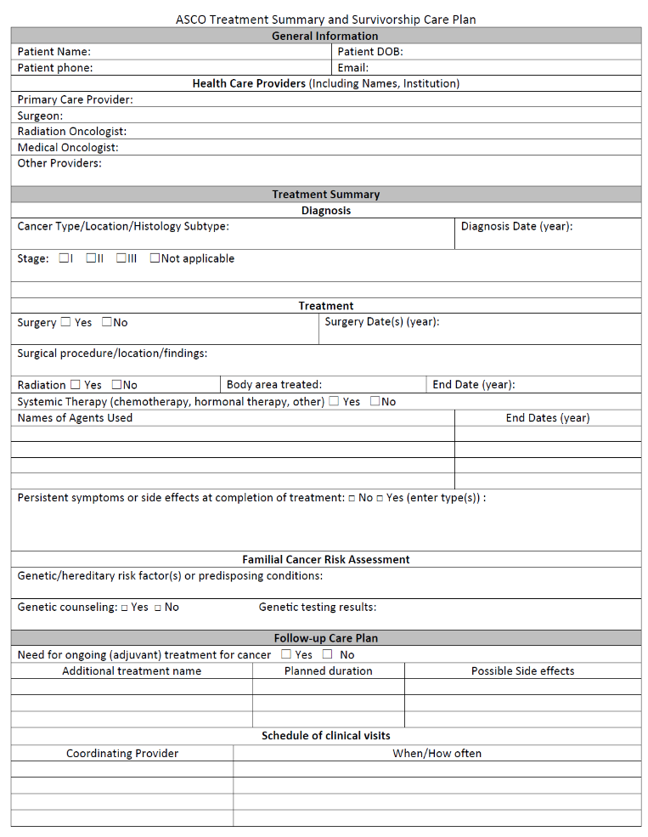
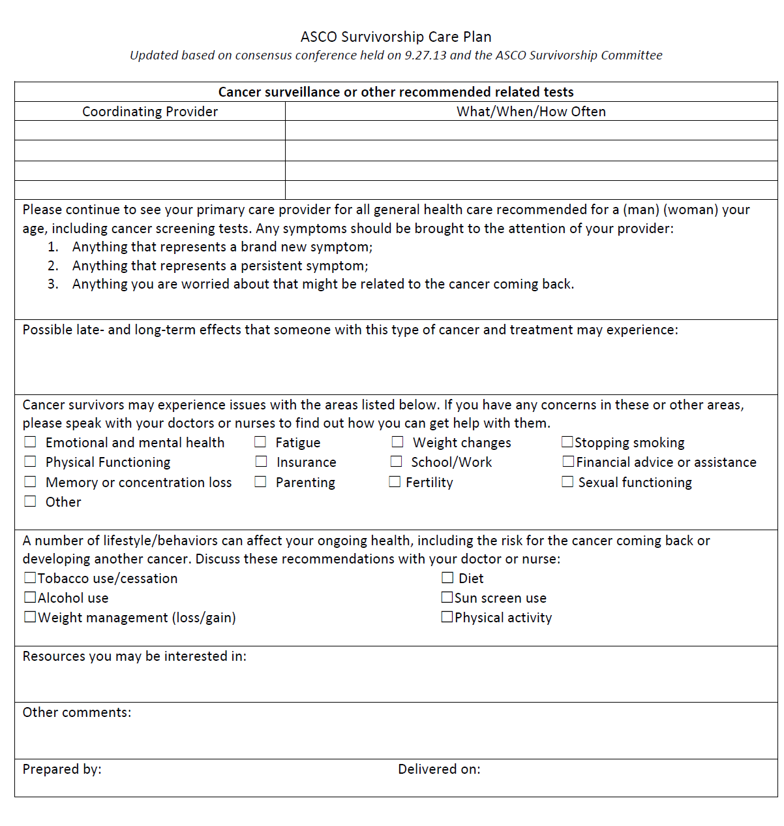
Survivorship Care Plans
Source: Cancer.net, 2014
Notes:
This is an example of a Survivorship Care Plan created by the American Society of Clinical Oncology. It is a short, 2-page document. The first page has general information about the patient, a brief treatment summary and a follow-up plan. The second page has surveillance or other tests needed and how often they are needed. It also includes potential long-term and late effects, possible physical, emotional and practical concerns and recommendations for healthy behaviors to discuss with a doctor or nurse.
There are other care plan templates that may have different information or look different from this one.
http://www.cancer.net/survivorship/follow-care-after-cancer-treatment/asco-cancer-treatment-summaries-and-survivorship-care-plans

Slide 25
End of Life
Pain and symptom management
Psychosocial and spiritual support
Counseling and bereavement support
Hospice care
Advance directives
Source: National Cancer Institute End of Life Care, 2012
Notes:
For some people with advanced cancer that can no longer be controlled, the goal of treatment is no longer to get rid of the cancer. The goal is to manage a patient’s pain and symptoms, provide psychosocial and spiritual support – depending on the preferences of the patient – and provide counseling and bereavement support to family members. Each person has unique informational and support needs. Patients may have questions about their legal and financial affairs, or they may need help communicating with family and friends. Family members may also have questions.
End of life care looks different for patients. Some people stay at home, or some go to a hospital or other facility. Hospice programs provide comprehensive end-of-life care and these programs can be offered in-home or at a medical facility. Many people think that these services are only for the last days or weeks of life. Medicare states that hospice can be used as much as 6 months before death is anticipated. Hospice care includes medical care, counseling, and respite care to help support caregivers. Research has shown that patients and families who use hospice services report a higher quality of life than those who don’t.
Advance directives are important for people at end of life and should be completed before a person gets very sick. Advance directives are documents that have the patient’s wishes for care and list who the patient chooses to make decisions if the patient is unable to decide.
End of life is difficult for patients and their families. It is important that licensed professionals provide counseling and address psychosocial and spiritual concerns.

Slide 26
Conclusion
In this lesson you learned to:
Describe the impacts of cancer and its treatment on the patient and on the family
Notes:
In this lesson you learned to:
Describe the impacts of cancer and its treatment on the patient and on the family.

Slide 27
References
American Cancer Society. (2014). Cancer treatment & survivorship facts & figures 2014‐2015. http://www.cancer.org/acs/groups/content/@research/documents/document/acspc‐ 042801.pdf.
Astrow, A.B., Wexler, A., Texeira, K., He, M.K., & Sulmasy, D.P. (2007). Is failure to meet spiritual needs associated with cancer patients' perceptions of quality of care and their satisfaction with care? Journal of Clinical Oncology, 25(36): 5753‐7. doi: 10.1200/JCO.2007.12.4362.
Cancer.Net. (2015). ASCO Cancer treatment summaries and survivorship care plans. http://www.cancer.net/survivorship/follow‐care‐after‐cancer‐treatment/asco‐cancer‐treatment‐summaries‐and‐survivorship‐care‐plans.
Cancer.Net. (2015). Side effects. http://www.cancer.net/navigating‐cancer‐ care/side‐effects.
Chochinov, W.B., & Breitbart, H.M. (2009). Handbook of psychiatry in palliative medicine. Oxford University Press. ISBN‐10: 0199862869.
Hewitt, M., Greenfield, S., & Stovall, E. (2005). From cancer patient to cancer survivor: lost in transition. The National Academies Press. ISBN‐10: 0309095956.
Holland, J. C., Andersen, B., Breitbart, W. S., Compas, B., Dudley, M. M., Fleishman, S., Fulcher, C. D., Greenberg, D. B., Greiner, C. B., Handzo, G. F., Hoofring, L., Jacobsen, P. B., Knight, S. J., Learson, K., Levy, M. H., Loscalzo, M. J., Manne, S., McAllister-Black, R. Riba, M. B., … & NCCN Distress Management Panel. (2010). Distress management. Journal of the National Comprehensive Cancer Network, 8(4):448-485. doi: 10.6004/jnccn.2010.0034.
Institute of Medicine. (2013). Identifying and addressing the needs of adolescents and young adults with cancer—workshop summary. http://iom.edu/Reports/2013/Identifying‐and‐Addressing‐the‐Needs‐of‐Adolescents‐and‐ Young‐Adults‐with‐Cancer.aspx.

Slide 28
References (cont.)
Johns Hopkins Medicine. (2013). The only metastatic cancer survivor retreat of its kind [Video file]. https://www.youtube.com/watch?v=Bg02G2a7uHo#t=419.
LIVESTRONG Foundation. (2013). Dating and sex: a video series for young adults with cancer [Video file]. https://www.youtube.com/watch?v=IkUIXLQRcoM&index=25&list=PL88EAB22E9D8ACD85.
Mayo Clinic. (2014). Cancer survivors: late effects of cancer treatment. https://www.mayoclinic.org/diseases-conditions/cancer/in-depth/cancer-survivor/art-20045524
Metastatic Breast Cancer Alliance. (2014). Changing the landscape for people living with metastatic breast cancer. http://www.mbcalliance.org/docs/MBCA_Full_Report_Landscape_Analysis.pdf.
Nass, S.J., & Patlak, M. (2013). Identifying and addressing the needs of adolescents and young adults with cancer: a workshop summary. http://www.nap.edu/catalog/18547/identifying‐and‐addressing‐the‐needs‐of‐adolescents‐and‐ young‐adults‐with‐cancer.
National Cancer Institute Office of Cancer Survivorship. (2014). Survivorship‐related graphs. http://cancercontrol.cancer.gov/ocs/statistics/graphs.html.
National Cancer Institute. (2015). End‐of‐life care for people who have cancer. http://www.cancer.gov/cancertopics/advanced‐cancer/care‐choices/care‐fact‐sheet.
Pfizer Oncology. (2014). Breast cancer: a story half told: a call‐to‐action to expand the conversation to include metastatic breast cancer. http://www.pfizer.com/files/news/Statement_ofNeed.pdf.
Puchalski, C. M., Ferrell, B., Virani, R., Otis-Green, S., Baird, P., Bull, J., Chochinov, H., Handzo, G., Nelson-Becker, H., Prince-Paul., M., Pugliese, K., & Sulmasy, D. (2009). Improving the quality of spiritual care as a dimension of palliative care: The report of the consensus conference. Journal of Palliative Medicine, 12(10):885-904. doi:10.1089/jpm.2009.0142.

Slide 29
References (cont.)
Smith, et al. (2008). Cancer, comorbidities, and health-related quality of life of older adults. Health Care Finance.
U.S. Department of Health and Human Services. (2006). Closing the gap: research and care imperatives for adolescents and young adults with cancer. Report of the Adolescent and Young Adult Oncology Progress Review Group. http://planning.cancer.gov/library/AYAO_PRG_Report_2006_FINAL.pdf.

Slide 30
Thank you!
Follow us on Twitter: @GWCancer
www.gwcancercenter.org
Sign-up for the GW Cancer Center’s Patient Navigation and Survivorship E-Newsletter: bit.ly/PNSurvEnews
Sign-up for the GW Cancer Center’s Cancer Control Technical Assistance E-Newsletter: bit.ly/TAPenews

