Slide 1
Assess the Context
Notes:
Welcome to session two of Base Camp.

Slide 2
Disclosure
This session was supported by Cooperative Agreement #NU58DP006461-03 from the Centers for Disease Control and Prevention (CDC). The views expressed in written workshop materials or publications and by speakers and moderators do not necessarily reflect the official policies of the Department of Health and Human Services, nor does the mention of trade names, commercial practices, or organizations imply endorsement by the U.S. Government.
Notes:
This session was supported by a Cooperative Agreement from the Centers for Disease Control and Prevention (CDC). The views expressed in written workshop materials or publications and by speakers and moderators do not necessarily reflect the official policies of the Department of Health and Human Services, nor does the mention of trade names, commercial practices, or organizations imply endorsement by the U.S. Government.

Slide 3

Learning Objectives
Explain the key elements of assessing context
Develop a plan to assess context
Notes:
You will use what you learn in this session to prioritize the needs of your stakeholders so there is a clear shared understanding about the problem your intervention will be addressing. More specifically, you should be able to explain the key elements of assessing context and develop a plan to assess context after this session.

Slide 4

Session Agenda
  Introduce how context is related to focusing on a problem
  Explore a tool for assessing context
  Prepare to analyze fit of Evidence-Based Intervention (EBI)
Notes:
Here is the plan for the session so you can see the road ahead.
First, we will introduce how context is related to focusing on a problem. Then we will explore a tool for assessing context. Next, we will prepare to analyze the fit of an evidence-based Intervention.

Slide 5
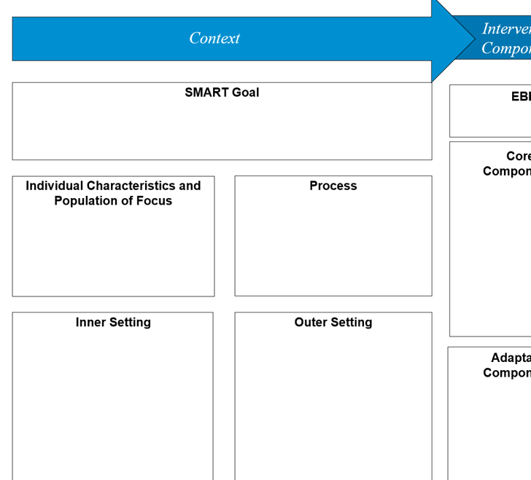
Implementation Blueprint
Notes:
We will be working on the context section of the implementation blueprint.

Slide 6
Why Define the Problem Early?
Allows you to build a team matching the level of the problem
How you define the problem is connected to your implementation goal:
  Behavioral change goals (Attitudes about screening)
  Structural change goals (Accessibility of screening)
Notes:
(Click)
Getting specific early in the process allows you to build a team matching the level of the problem.
(Click)
How you define the problem should be connected to your implementation goal. One level you might include in your plan includes the individual level, where you address behavioral change goals. A barrier you might work on at this level is changing attitudes about colorectal cancer screening. Another level you might work on is the systems level, where you address structural change goals. Maybe you decide to work on the access or financial barriers to screening at this level.
Will you aim for behavioral change or structural change goals? Or both?
Are there stakeholders that are missing from your team that you need to invite in after this Base Camp based on your definition of the problem?

Slide 7
Categorizing Behavioral and Structural Change
Behavioral Change:
Example Bank:
Insurance Claims
Patients have no family history; they think they aren’t at risk and don’t have to be screened.
Availability of transportation to screening sites
Patients are concerned about the cost
Patients think the test is difficult or painful, and they may be embarrassed to discuss colorectal cancer screening with their doctor
Patients think screening is only for those who have symptoms
Patients have no family history; they think they aren’t at risk and don’t have to be screened.
Patients think the test is difficult or painful, and they may be embarrassed to discuss colorectal cancer screening with their doctor
Patients are concerned about the cost
Patients think screening is only for those who have symptoms
Structural Change:
Insurance Claims
Availability of transportation to screening sites
Notes:
Here we will play a game to drive home the point that it is important to understand the level of a barrier so that you can address it accordingly. We will start on the right with each barrier from the example bank and you can take a moment to determine if it is a behavioral change level barrier, or a structural change level barrier. Let’s start with insurance claims. Insurance claims are a structural change barrier. (Continue down list)
(Click)

Slide 8
Multiple Levels & Context
Counseling and Education
Population
Impact
Effort Needed
Clinical Interventions
Long-Lasting Protective
Interventions
Changing the Context to Make
Individuals’ Default Decisions Healthy
Socioeconomic Factors
Frieden, 2010
Notes:
Another way of thinking about behavioral and structural change is the health impact pyramid. We can see here the base is socio-economic factors. These and other factors near the bottom of the pyramid have high population impact.
As you move up the pyramid, increasing individual effort is needed, similar to behavioral change interventions. Ideally you are working on many of these levels together in multi-level interventions.

Slide 9
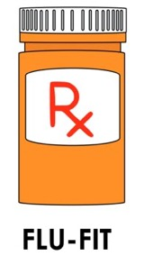
Identify the Problem
Create a specific problem statement
  Specify level of the problem
Quantify the issue so measuring improvements is possible
Do research with community stakeholders
  Find existing data on problem in larger context
  Collect new data at your site/ community
Jacobs et al., 2014
Notes:
(Click)
The first step in mapping context is to get specific about the problem. Try to draft a statement that clearly lays out the scope of the problem you will work on. Your stakeholders should all be in agreement about the levels of the problem you will address with your intervention.
(Click)
If possible, quantifying the issue will help you measure any improvements that come from your intervention.
(Click)
Your team can also perform research with community stakeholders to uncover existing data on the problem, or collect new data to help understand the problem more clearly.
See an example of a problem statement the companion materials for the FLU-FIT case study.

Slide 10
Understand the System
System: Complex whole with interacting parts
What elements of the system are critical to the implementation of your cancer screening objective?
  Federally Qualified Health Center serving Ward 7 is too overwhelmed to introduce a new screening program at this time
  Pharmacies are currently offering flu shots
  Most pharmacies do not have baseline data on screening rates of their customers
Ramsey et al., 2016
Notes:
A problem like cancer screening is complex and requires a systems perspective to really make wide impactful change.
Let’s back up and determine what a system really is. A system is a complex whole with interacting parts.
Work with your team early on to narrow down the elements of the system that are critical to your goals.
This can be overwhelming without specific goals in mind, as well as a framework to keep your assessment organized.
From the Case Study, we can see stakeholders learned that the health center in their location is too overwhelmed to introduce a new screening program.
They also observed an increase in flu shot acceptability at pharmacies.
By using systems thinking, they identified an opportunity to expand screening through pharmacies
However, no baseline data is currently available in pharmacy health records, so this will be a challenge going forward

Slide 11
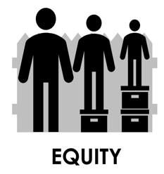
Ward 7 & Population of Focus
Colorectal Cancer Screening Rate in Ward 7: 48%
Black: 91.7% of the population
Families Below Poverty: 23.3% of the population
Colorectal Cancer Screening Rate at each pharmacy location in Ward 7: Unknown at this time
Notes:
Zooming down on the population of focus, we can see some demographic data about Ward 7 from our hypothetical case study as well.
Of concern is the 48% screening rate in the Ward. With almost 92% of the area being Black, and 23% of the families living below the poverty rate, this raises a lot of issues from an equity standpoint.
Remember we want to include a health equity approach EARLY on, because a fundamental premise of our work is that there is no quality without equity.

Slide 12

Methods for Contextual Mapping
Community input
  Needs assessment tools: listening sessions, surveys, mapping, photovoice, etc.
Engaged implementation research: involve stakeholders in the implementation process​
Formative evaluation: evaluate context to inform intervention, evaluate process of intervention
Fernandez et al.. 2018
Vanderpool et al., 2016
Community Toolbox Chapter 3, n.d.
Notes:
(Click)
Community input via a needs assessment can help you map your context.
Needs assessment tools such as listening sessions, surveys, mapping, photovoice, etc. can help with this. Some of these tools are available at the Community Toolbox link located in the supplemental resources.
Two ways to include stakeholders in this context mapping as part of your intervention are included here:
(Click)
Engaged implementation research: which is involving stakeholders in the implementation process and
(Click)
Formative evaluation: evaluate context to inform intervention, evaluate process of intervention

Slide 13

Stakeholder Engagement
Develop and maintain trusting, equitable relationships
Build a shared understanding
Encourage dialogue and new ideas
Achieve buy-in for both the evidence and the use of implementation science to put evidence into practice
Notes:
Doing context assessments is a chance to engage many different stakeholders quickly, early on in the intervention process.
To engage stakeholders authentically, trusting and equitable relationships need to be developed.
The earlier you can build a shared understanding the better in the long term.
Getting as many ideas on the table from as many points of view means the most creative solutions will be liberated.
Authentic stakeholder relationships built between researchers and practitioners will also mean higher trust and buy in for the evidence base at the foundation of your
intervention including the use of an implementation science approach.

Slide 14
Goals of Contextualization
Ensure match between EBI and values, needs, skills and resources
  Consider stakeholders delivering interventions and patients/ populations benefiting
Reflect on root causes to allow barriers and assets to be identified
Design tailored strategies for implementation
Horner et al., 2014
Hamilton et al., 2007
Notes:
Socrates is famous for saying “Know thyself”. This could be changed to “Know thy context” in implementation.
(Click)
You really are aiming to ensure a match between the intervention and the needs and resources of the setting you are working with.
Consider the stakeholders who will be delivering and benefitting from the interventions you are working on.
(Click)
Spending significant time reflecting on the root causes of your problem will help barriers and assets to be identified-meaning you can
(Click)
Tailor specific strategies to make implementation better.

Slide 15

Session Agenda
  Introduce how context is related to focusing on a problem
  Explore a tool for assessing context
  Prepare to analyze fit of EBI
Notes:
Next, we will explore a tool for assessing context.

Slide 16
How Do I Achieve These Goals?
Use the Consolidated Framework for Implementation Research (CFIR) to help:
  Ensure match between EBI and context
  Diagnose barriers
  Design implementation strategies
Notes:
The use of the Consolidated Framework for Implementation Research (or CFIR) will help:
-Ensure a match between your intervention, or EBI and the context you are working in
-Diagnose barriers to implementation and
-Design implementation strategies to overcome those barriers

Slide 17
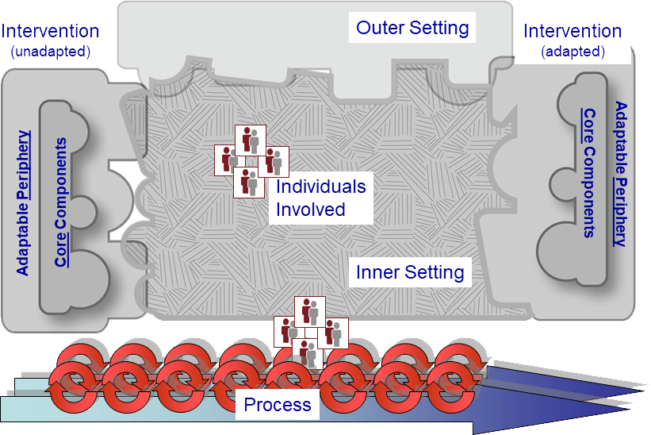
Case Example: CFIR
CFIR Research Team-Center for Clinical Management Research, 2021
Notes:
This is one of many frameworks to help map context. The CFIR is visually demonstrated here and we will walk through each of the domains in this session.

Slide 18
Diagnostic Analysis
Barriers: Elements of your context that may impede implementation of your chosen EBI
Facilitators: Elements of your context that may support implementation of your chosen EBI
Notes:
One use of your context map is a diagnosis of the problem in your unique setting.
Barriers are elements of your context that may impede implementation and are marked with a downward pointing arrow.
Facilitators, also called assets, are elements of your context that may support implementation and are marked with an upward pointing arrow.
Approaching this process with a health equity lens will allow you to identify barriers/facilitators connected to health disparities when mapping your context.

Slide 19
Case Example: CFIR
Determinants
Intervention characteristics
Inner setting
Outer setting
Individuals involved in implementation
  Population(s) of Focus
Process of implementation
CFIR Research Team-Center for Clinical Management Research, 2021
Notes:
We will now walk through the Consolidated Framework.
Follow along with the blue star. First, we will look at characteristics of the intervention itself.

Slide 20
Intervention Characteristics
Key aspects of the EBI itself that influences implementation outcomes
Examples:
  Complexity
  Relative advantage
  Evidence strength and quality
CFIR Research Team-Center for Clinical Management Research, 2021
Notes:
One important first step is looking closely at the key aspects of the EBI itself. For example:
Complexity: how difficult do people perceive a new intervention to be? This taps into how long the change will take, the scope of change required, radicalness or disruptiveness of the innovation, and the number of steps required to implement.
Relative Advantage: This is the stakeholders’ perception of the advantage of implementing the intervention versus an alternative solution.
Evidence Strength and Quality: This is the stakeholders’ perceptions of the quality and strength of evidence supporting the belief that the intervention will actually have the desired results.
Working with EBIs in detail will be addressed in the next session in a lot more detail, but it is worth noting that part of mapping context is determining what your setting is implementing in detail.

Slide 21
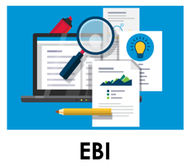
Getting Specific about EBIs
What exactly are you implementing?
Example: Colorectal Cancer Screening Intervention
  Program: Screening awareness program
  Product: FLU-FIT kits
  Policy: Paid time off for screening
  Practice: Coordinate transportation to screening
Notes:
You should work hard to get specific about what exactly is being implemented.
This level of detail helps you determine implementation strategies that will enhance health outcomes.
Maybe you know you are working on a colorectal cancer screening intervention generally, but that can can mean an educational program, a new product, a policy change, or a practice such as coordinating transportation.
In our case study we will focus on the implementation of FLU-FIT Screening kits.

Slide 22
Case Example: CFIR
Determinants
Intervention characteristics
Inner setting
Outer setting
Individuals involved in implementation
  Population(s) of Focus
Process of implementation
CFIR Research Team-Center for Clinical Management Research, 2021
Notes:
Next, we will explore how to map the inner setting as part of your context map.

Slide 23

Inner Setting
Examples:
  Organizational structure
  Internal network & communications
  Power structures
  Implementation culture & climate
  Readiness
CFIR Research Team-Center for Clinical Management Research, 2021
Notes:
The inner setting refers to context factors within the organization where an EBI is being implemented.
For example:
Organizational structure: The hierarchy, age, maturity, and size of an organization are important to understand when implementing new interventions.
Internal networks and communications: The nature and quality of webs of social networks and formal and informal communications within an organization.
The bottom three highlighted in blue as we are going to explore then in more detail.

Slide 24

Understand Power Structures
Resistance to change is normal!
Stems from fear:
    "My work routine is going to change"
    "My relationships to colleagues will change"
    "Our patients/ clients will be affected"
Gesme & Wiseman, 2010
Notes:
Understanding power structures helps build empathy with resistance to change, which is normal in hierarchies.
This resistance stems from fear that work, relationships, or patient health will change negatively.
These fears can be addressed and lessened by not changing everything at once.
Develop a cycle of work that can be undone if not successful for example.
Spread and scale successful results as you move into sustainability planning.

Slide 25

Relationships Matter
Empathy
Active Listening
Growth-Oriented Relationships
People are experts in their own systems
Listen for concerns that can help adapt the plan
Model humility, transparency and accountability
Notes:
Growth-oriented relationships can fuel implementation support
Be empathetic
Active listening can get at the “why” of resistance
People are experts in their own systems
Listen for concerns that can help adapt the plan
Model humility, transparency, and accountability

Slide 26
Implementation Climate
The extent to which employees collectively perceive that the adoption and implementation of an innovation is expected, rewarded and supported by the organization
How important is the intervention to the organization?
Ramsey et al., 2016
Notes:
Implementation climate is the extent to which employees as a group think that the adoption and implementation of an innovation is expected, rewarded, and supported by the organization.
Things like tension for change, relative priority, learning climate, and clear goals with feedback all affect implementation climate.
Maybe you can map out through discussions with folks at the organization their capacity for change in past projects.

Slide 27

Case Study
Implementation Climate – Pharmacists:
  Can be stressed by quickly changing too many things
  Need peer training for new programs
  Feel supported and rewarded for innovation
Notes:
In this case, how might the implementation climate affect the FLU-FIT intervention?
How would feeling stressed impact implementation of FLU-FIT?
How might training affect the level of stress people are feeling?
How would feeling rewarded impact implementation of FLU-FIT?

Slide 28
R=MC²
Readiness results from interplay between three components:
  Motivation
    Recent coverage of FLU-FIT and billing system changes at pharmacies
    Interest in community risk reduction and equity
  General Capacity
    Recent turnover in pharmacy staff
  Innovation-Specific Capacity
    Pharmacy is ramping up flu vaccine program
Wandersman Center, n.d.
Livet et al., 2020
Walker et al., 2020
Notes:
It is worth considering whether the organization is READY for this type of undertaking.
Readiness comes down to: Are you and your organization willing and able to change?
Implementation of change often includes collective change and multilevel systems redesign.
There are many tools for assessing readiness already developed such as the online decision support tool available in your supplemental resource list.
A fun equation to think about readiness is R=MC squared.
Readiness for change equals=
Motivation
General Capacity
Innovation-Specific Capacity
Some examples from the FLU-FIT case study. Motivation: The incentive of recent coverage of FLU-FIT and billing change systems creates a readiness for change. There is also a reported interest in community risk reduction and health equity concerns.
The general capacity for change might be weakened by recent turnover in staff.
Innovation specific capacity may be increased due to increases in FLU vaccines which are paired with FIT kits in the intervention’s product.

Slide 29
Case Example: CFIR
Determinants
Intervention characteristics
Inner setting
Outer setting
Individuals involved in implementation
  Population(s) of Focus
Process of implementation
CFIR Research Team-Center for Clinical Management Research, 2021
Notes:
Next, we will examine the outer setting elements to be mapped as part of a context assessment.

Slide 30

Outer setting
Social influences outside of the organization affecting implementation outcomes
Examples:
  Patient needs and resources
  External partnerships
  External policies and incentives
  Peer pressure
CFIR Research Team-Center for Clinical Management Research, 2021
Notes:
Outer setting refers to social influences outside of the organization affecting implementation outcomes
Some examples include:
Patient needs and resources: The extent to which patient needs, as well as barriers and facilitators to meet those needs, are accurately known and prioritized by the organization.
External partnerships: The degree to which an organization is connected with other external organizations.
External policies and incentives: Strategies to spread interventions, including policy and regulations (governmental or other central entity), external mandates, recommendations and guidelines, pay-for-performance, collaboratives, and public or benchmark reporting.
Peer pressure: competitive pressure to implement an intervention; typically because key peer or competing organizations have already implemented or are in a bid for a competitive edge

Slide 31
Case: Colorectal Cancer Screening
Outer Setting – Patient Needs and Resources
“And I hate to say it, but I do [delay the FIT test] … I may delay a FIT test for six months or so until they’re financially able to do it.”
– Staff H
Zoellner et al., 2020
Notes:
An example of patient needs in a community as an outer setting influence from a case study:
“And I hate to say it, but I do [delay FIT test]. I’ve done that a couple of times because like if they’re in between jobs, it’s hard. I mean this is a poverty area here. I have some patients a lot of patients who don’t have any income coming in... I may delay a FIT test for six months or so until they’re financially able to do it.”
We can see here this outer setting (outside of the organization’s control) element is acting as a barrier to full implementation.

Slide 32

Case: Lung Cancer Screening
Outer Setting – External Policies
“I think really the key was when Medicare said they would start paying for it [lung cancer screening].”
– Screening Facility Director
Allen et al., 2020
Notes:
External policies can also influence what happens with implementation. For example from a case study on lung cancer screening:
“I think really the key was when Medicare said they would start paying for it. At that point, it really became something that people could take advantage of. I think that’s really when we started being able to get substantial referrals.”
This is an example of a facilitator for implementation.

Slide 33
Case Example: CFIR
Determinants
Intervention characteristics
Inner setting
Outer setting
Individuals involved in implementation
  Population(s) of Focus
Process of implementation
CFIR Research Team-Center for Clinical Management Research, 2021
Notes:
Next, we will look at the Individuals involved in implementation and populations of focus.

Slide 34

Individuals
The actions and behavior of individuals ripples outward and affects networks and organizations in settings
Examples:
  Individual stage of change
  Knowledge & beliefs about EBI
  Belief in ability to succeed
CFIR Research Team-Center for Clinical Management Research, 2021
Notes:
We shouldn’t gloss over the power of individuals in creating change. The actions and behavior of individuals ripples outward and affects networks and organizations.
Some examples include:
Individual stage of change: Identifying the phase of change an individual is in, as he or she progresses toward skilled, enthusiastic, and sustained use of the intervention.
Knowledge and beliefs about the EBI: Individual attitudes toward and value placed on the intervention as well as familiarity with facts, truths, and principles related to the intervention.
Individual belief in their own capabilities to execute courses of action to achieve implementation goals and succeed.

Slide 35



Populations of Focus
Equity Reflection:
  Are there subpopulations of interest in your context you want to focus on?
  Is there historical segregation, discrimination or implicit bias?
  Are there specific health disparities that you want to address?
Comprehensive Cancer Control National Partnership, 2021
Notes:
Another important aspect of individuals in the context is determining your population of focus. Starting with reflecting on equity concerns is a good place to start. For example:
Are there subpopulations in your context you want to focus on?
Is there a history of segregation, discrimination or implicit bias that needs addressed?
Are there specific health disparities you want to include in your goals?

Slide 36
Case Example: CFIR
Determinants
Intervention characteristics
Inner setting
Outer setting
Individuals involved in implementation
  Population(s) of Focus
Process of implementation
CFIR Research Team-Center for Clinical Management Research, 2021
Notes:
Finally, we will look at the setting’s process for implementing changes in evidence-based practices.

Slide 37
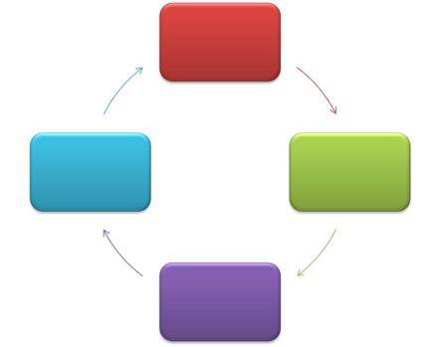
Process
Organization’s methods of carrying out change performed
in repeated and incremental steps, refined over time
and necessary for implementation success
Examples:
  Planning
  Engaging
  Executing
  Reflecting and Evaluating
CFIR Research Team-Center for Clinical Management Research, 2021
Notes:
Mapping an organization’s processes for change management can help plan for successful implementation.
Process includes the methods of carrying out change performed in repeated and incremental steps, refined over time. and necessary for implementation success
We will match each of these step in the change process with its definition as part of a game.

Slide 38
Match the word to its definition
Words:
Planning
Engaging
Executing
Reflecting and Evaluating
Definitions:
Attracting and involving appropriate individuals in the implementation and use of the intervention through a combined strategy of social marketing, education, role modeling, training and other similar activities
Quantitative and qualitative feedback about the progress and quality of implementation accompanied with regular personal and team debriefing about progress and experience
Carrying out or accomplishing the implementation according to plan
The degree to which a scheme or method of behavior and tasks for implementing an intervention are developed in advance and the quality of those schemes or methods
Notes:
Let’s match the word on the left to the definition on the right. First, planning (continue down the list)
(Click)

Slide 39
Case Example: Lung Cancer Screening
Process – Planning
“We took a lot of time on the front end to plan the process steps and the flow. And we tweaked it as we’ve gone along, but we didn’t go live until we got all our ducks in a row.”
– Imaging Manager
Allen et al., 2020
Notes:
We can see some examples of a facilitator for implementation from a real case study of lung cancer screening program that had a well-defined planning process within a Federally Qualified Health Center setting.
“We took a lot of time on the front end to plan the process steps and the flow. And we tweaked it as we’ve gone along, but we didn’t go live until we got all our ducks in a row.”

Slide 40
Case Example: Lung Cancer Screening
Process – Planning
“I think that may have been one part that was left out of the training, because I think a lot of the staff felt like … are we trained? So how do we really do it? How could it look?”
– Primary Care Physician
Allen et al., 2020
Notes:
Another example shows how lack of planning can be a barrier to implementation. Once again this is similar program in a different FQHC that had less success implementing lung cancer screening.
“I think that may have been one part that was left out of the training, because I think a lot of the staff felt like … are we trained? So how do we really do it? How could it look?”

Slide 41
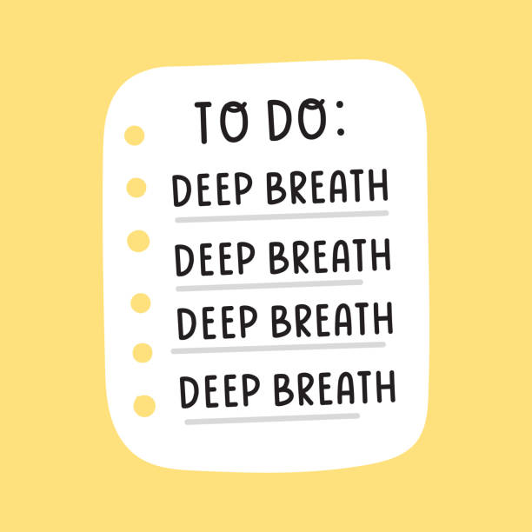

To do
Notes:
At this point, you have assessed your context and you have may start to be overwhelmed by the amount of information you gathered.
A suggestion for moving forward is to slow down and begin to reflect on what all of this information means.

Slide 42
Session Agenda
  Introduce how context is related to focusing on a problem
  Explore a tool for assessing context
  Prepare to analyze fit of EBI
  Team Huddle: Mapping your context
Notes:
The next section will help you prepare to analyze the fit of the EBI to your setting.

Slide 43
Reminder: Goals of Contextualization
Ensure match between EBI and values, needs, skills and resources
  Consider stakeholders delivering interventions and patients/ populations of focus
Reflect on root causes to allow barriers and assets to be identified
Design tailored strategies for implementation
Horner et al., 2014
Hamilton et al., 2007
Notes:
Remember we are trying to ensure a match between the EBI you will implement and the needs, values, skills, and resources of your setting.
It is also a good idea to continually stay aware of context as you are implementing new interventions. Context is dynamic and elements of the system or culture will change and require flexibility.

Slide 44


Equity Reflection
How has our understanding of the problem evolved?
  What upstream causes are better understood?
  What assumptions are we taking for granted?
  What practice-based evidence has been uncovered?
  Do all stakeholders agree on the conclusions of the assessment that will guide the next steps?
Ward et al., 2012
Rohweder et al., 2017
Notes:
Some questions to reflect on how your understanding of the problem is evolving:
What upstream causes are better understood?
What assumptions are we taking for granted?
What practice-based evidence has been uncovered? Has talking to clinical or community health partners demonstrated a need for clarity or adjustment?
Do all stakeholders agree on the major findings of the assessment?

Slide 45
Support Stakeholders in Prioritizing Needs and Opportunities
Why?
  Encourage a shared purpose
When?
  Prioritize after a contextual assessment in terms of which gaps/problems to focus on
Who?
  Involve multiple stakeholders with diverse agendas at many levels
How?
  Narrow goals based on readiness, power dynamics, data, context and fit
  Use methods to gather feedback from multiple levels
Notes:
Often stakeholders may agree on the findings generally, but do not have the same feelings about the relative priority of the problems and solutions.
Often organizations are not clear on their priorities, or not all levels of the organization are aware or in consensus about the priorities. You may find yourself supporting stakeholders in prioritizing needs together in an engaged and transparent way as part of implementation. Maybe your context turned up behavioral and structural sources of the problem and stakeholders are not sure which to tackle with their intervention.
(Click)
Why Prioritize?
Prioritizing encourages a shared purpose
(Click)
When?
Prioritize after a contextual assessment in terms of which gaps/problems to focus on
(Click)
Who?
Involve multiple stakeholders with diverse agendas at many levels
(Click)
How?
Repeated process narrowing goals based on readiness, power dynamics, data, context, and fit
Use facilitation methods to gather feedback from multiple levels

Slide 46

Case Example
Inequities across neighborhoods in large urban areas
Colorectal cancer screening rates are 48% in Ward 7
Community input shows the need for a focus on more accessible EBIs for screening
                Implementing FLU-FIT program at a more accessible location such as a pharmacy could help
Notes:
Some takeaways from our hypothetical case study context map:
There are significant cancer inequities across neighborhoods in large urban areas
Colorectal cancer screening rates are 48% in Ward 7 of Washington, D.C.
Community input shows the need for a focus on more accessible EBIs for screening
This map shows implementing a FLU-FIT program at a more accessible location such as a pharmacy could help solve the problem, demonstrating a fit between the EBI and the context.

Slide 47

Partnerships for Accessible Sites
Reminder: Who is critical to the implementation of your cancer screening objective?
  Nurses/ medical assistants
  Pharmacies
  Community health centers
  Seasonal flu clinics
    Drop-in clinics
    Primary Care visits
Notes:
Brainstorming partnerships at this point after a context assessment can really help you identify who else needs to be at the table.
Examples from our FLU-FIT example include:
Nurses/medical assistants
Pharmacies
Community health centers
Seasonal flu clinics
Drop-in clinics
Primary Care visits

Slide 48
Case: Colorectal Cancer Inequalities
System: Federally Qualified Health Center in Ward 7 is too overwhelmed to introduce FLU-FIT
Culture: Pharmacies are looking for new preventive services to offer customers
Climate: Pharmacists often need lead time with peer training for new programs; Change = Stress
Notes:
A higher-level map of context might summarize the situation like this:
System: FQHC: New program is not a good match right now due to other priorities, current capacity.
Culture: Pharmacies are looking for new preventive services to offer customers
Climate: Pharmacists often need lead time with peer training for new programs; Change = Stress

Slide 49
Tools and Supplemental Resources
Action for PSE Change: Steps 2-4
Ariadne Labs: Implementation Context Assessment Organization
Consolidated Framework for Implementation Research (CFIR) Tool
Community Toolbox: Chapter 3 Assessing Community Needs and Resources
Community Toolbox: Chapter 4 Collecting Information About the Problem
National Collaborating Centre for Methods and Tools: Selecting a Tool to Assess Organizational Readiness
Tools to Assess Readiness
Using CFIR-informed interviews to evaluate the implementation of a multilevel intervention
Wandersman Center
Washington University Institute of Clinical and Translational Sciences Dissemination & Implementation Barriers & Facilitators Measurement Toolkit
Notes:
All of these tools are located in the companion guide for your use in your projects.

Slide 50
References
Allen CG, Cotter MM, Smith RA, Watson L. Successes and challenges of implementing a lung cancer screening
program in federally qualified health centers: a qualitative analysis using the Consolidated Framework for
Implementation Research. Transl Behav Med. 2021;11(5):1088-1098. doi:10.1093/tbm/ibaa121
CFIR Research Team-Center for Clinical Management Research. (n.d.). Consolidated framework for implementation
research. https://cfirguide.org/.
Community Toolbox. (n.d.) “Chapter 3: Assessing Community Needs and Resources.” https://ctb.ku.edu/en/table-of-
contents/assessment/assessing-community-needs-and-resources
Comprehensive Cancer Control National Partnership. (2021). Health equity: Tip sheet. https://www.acs4ccc.org/wp-
content/uploads/2021/04/Cancer-Plan-Tip-Sheet_Health-Equity_FINAL.pdf.
Fernandez ME, Walker TJ, Weiner BJ, et al. Developing measures to assess constructs from the Inner Setting domain
of the Consolidated Framework for Implementation Research. Implement Sci. 2018;13(1):52. Published 2018 Mar 27.
doi:10.1186/s13012-018-0736-7
Frieden, T. R. (2010). A framework for public health action: The health impact pyramid. American Journal of Public
Health, 100(4):590-5. doi: 10.2105/AJPH.2009.185652.
Gesme, D., & Wiseman, M. (2010). How to implement change in practice. Journal of Oncology Practice, 6(5), 257-259.
doi: 10.1200/JOP.000089
Hamilton, S., McLaren, S. & Mulhall, A. (2007). Assessing organisational readiness for change: Use of diagnostic
analysis prior to the implementation of a multidisciplinary assessment for acute stroke care. Implementation
Science, 2(21). https://doi.org/10.1186/1748-5908-2-21
Holt, D. T., Helfrich, C. D., Hall, C. G., & Weiner, B. J. (2010). Are you ready? How health professionals can
comprehensively conceptualize readiness for change. Journal of General Internal Medicine, 25(Suppl 1), 50-55.
doi: 10.1007/s11606-009-1112-8
Horner, R., Blitz, C., & Ross, S. (2014). The importance of contextual fit when implementing evidence-based
Interventions. U.S. Department of Health & Human Services: Office of the Assistant Secreatry for Planning and
Evaluation. https://aspe.hhs.gov/report/importance-contextual-fit-when-implementing-evidence-based-
Interventions
Notes:
As well as references for your use as needed.

Slide 51
References
Jacobs, J. A., Duggan, K., Erwin, P., Smith, C., Borawski, E., Compton, J., D'Ambrosio, L., Frank, S. H., Frazier-
Kouassi, S., Hannon, P. A., Leeman, J., Mainor, A., & Brownson, R. C. (2014). Capacity building for evidence-
based decision making in local health departments: scaling up an effective training approach. Implementation
Science, 9(124). https://doi.org/10.1186/s13012-014-0124-x
Khan, S., Timmings, C., Moore, J. E. Marquez, C., Pyka, K., Gheihman, G., & Strauss, S. (2014). The
development of an online decision support tool for organizational readiness for change. Implementation
Science, 9(56).https://doi.org/10.1186/1748-5908-9-56
Liang, S., Kegler, M. C., Cotter, M., Emily, P., Beasley, D., Hermstad, A., Morton, R., Martinez, J., & Riehman,
K. (2016). Integrating evidence-based practicesfor increasing cancer screenings in safety net health
systems: A multiple case study using the Consolidated Framework for Implementation Research.
Implementation Science, 11(109). https://doi.org/10.1186/s13012-016-0477-4
Livet, M., Yannayon, M., Richard, C., Sorge, L., & Scanlon, P. (2020). Ready, set, go!: Exploring use of a
readiness process to implement pharmacy services. Implementation Science Communications,
1(52). https://doi.org/10.1186/s43058-020-00036-2
Ramsey, A., Lawrence, K., Prusaczyk, B., Baumann, A., Kryzer, E., & Proctor, E. (2016) Organizational
Measures. St. Louis, MO: Washington University. Eight toolkits related to Dissemination and
Implementation. Available from https://sites.wustl.edu/wudandi
Rohweder, C. L., Laping, J. L., Diehl, S. J., Moore, A. A., Isler, M. R., Scott, J. E., Enga, Z. K., Black, M. C.,
Dave, G., Corbie-Smith, G., & Melvin, C. L. (2016). Bridging research, practice, and policy: The "Evidence
Academy" conference model. Journal of Public Health Management and Practice, 22(2), 200–203.
doi: 10.1097/phh.0000000000000230

Slide 52
References
Vanderpool, R. C., Moore, S. C., Stradtman, L. R., Carman, A. L., Kurgat, H. L., & Fain, P. (2016). Adaptation of an
evidence-based intervention to improve preventive care practices in a federally qualified health center in
Appalachian Kentucky. Journal of Health Care for the Poor and Underserved, 27(4A), 46–52.
doi: 10.1353/hpu.2016.0185
Walker, T. J., Brandt, H. M., Wandersman, A. Scaccia, J., Lamont, A., Workman, L., Dias, E., Diamond, P. M., Craig,
D. W, & Fernandez, M. E. (2020). Development of a comprehensive measure of organizational readiness
(motivation × capacity) for implementation: A study protocol. Implementation Science Communications, 1(103).
https://doi.org/10.1186/s43058-020-00088-4
Wandersman Center. (n.d). “Readiness Building Center” https://www.wandersmancenter.org/defining-readiness.html
Ward, V., Smith, S., House, A., & Hamer, S. (2012). Exploring knowledge exchange: A useful framework for practice
and policy. Social Science & Medicine, 74(3):297-304. doi: 10.1016/j.socscmed.2011.09.021
Weiner, B. J. (2009). A theory of organizational readiness for change. Implementation Science, 4(67).
https://doi.org/10.1186/1748-5908-4-67
Zoellner J, Porter K, Thatcher E, Kennedy E, Werth JL Jr, Grossman B, Roatsey T, Hamilton H, Anderson R, Cohn W.
A Multilevel Approach to Understand the Context and Potential Solutions for Low Colorectal Cancer (CRC)
Screening Rates in Rural Appalachia Clinics. J Rural Health. 2021 Jun;37(3):585-601. doi: 10.1111/jrh.12522. Epub
2020 Oct 7. PMID: 33026682; PMCID: PMC8238123.

Slide 53
Acknowledgments
PI:
Mandi L. Pratt-Chapman PhD
Staff:
Sarah Adler
Joseph Astorino
Leila Habib
Sarah Kerch
Workgroup Members:
Shauntay Davis-Patterson
Caleb Levell
Notes:
Thank you to all those listed here who helped in developing this training.

