Slide 1
Evaluation
Notes:
Welcome to the Evaluation session of the Base Camp.

Slide 2
Disclosure
This session was supported by Cooperative Agreement #NU58DP006461-03 from the Centers for Disease Control and Prevention (CDC). The views expressed in written workshop materials or publications and by speakers and moderators do not necessarily reflect the official policies of the Department of Health and Human Services, nor does the mention of trade names, commercial practices, or organizations imply endorsement by the U.S. Government.
Notes:
This session was supported by a Cooperative Agreement from the Centers for Disease Control and Prevention (CDC). The views expressed in written workshop materials or publications and by speakers and moderators do not necessarily reflect the official policies of the Department of Health and Human Services, nor does the mention of trade names, commercial practices, or organizations imply endorsement by the U.S. Government.

Slide 3

Learning Objectives
Describe a framework's use in evaluation
Explore and identify measurable outcomes of implementation quality
Notes:
Our main learning objectives are to describe a framework's use in evaluation and to explore and identify measurable outcomes of implementation quality.

Slide 4

Session Agenda
  Introduce Reach, Effectiveness, Adoption, Implementation, Maintenance (RE-AIM) evaluation framework
    Give overview of evaluation
    Examine each element of evaluation framework in detail
    Case examples
Notes:
Here is the map for the session.
First, we will introduce the RE-AIM framework for evaluation.

Slide 5
Implementation Logic Model
Notes:
Here is the section of the blueprint we will be working through.

Slide 6


Reminder: Practitioners to Involve in Evaluation Process
Comprehensive Cancer Control Program Director
National Breast and Cervical Cancer Early Detection Program project level staff
National Colorectal Cancer Control Program project level staff
Coalition member/ leader
Clinician
Executive leadership
Researchers and evaluators
Anyone else critical to implementation of your objective
Notes:
Listed here are the practitioners you can involve in evaluating your implementation.
Reminder: You can invite any other stakeholders critical to implementation to become involved in evaluation process.

Slide 7
Value of an Implementation Science Approach
Identify:
  WHEN something works: Context
  HOW something works: Strategies
  HOW something was changed: Adaptations
  IF something works: Outcomes
More likely to achieve cancer control SMARTIE objectives
Notes:
The value of implementation science approach is that it helps you map out when something works, how something works, and document any changes made as part of the adaptation process.
Now, one of the most important elements—if your intervention worked! Let’s look at outcomes.

Slide 8

Building Context Around Evaluation
Integrate with SMARTIE objectives
Choose metrics that make sense
More is not always better!
Work with existing quality improvement efforts
Run improvement cycles
Involve community and provider stakeholders
Rubin Means & Wagenaar, 2018
Rohweder et al., 2019
Notes:
To build a context around evaluation activities you can:
Integrate any evaluation work with SMARTIE objectives
Choose metrics that make sense
Remember that more is not always better!
Work with existing quality improvement efforts
Run improvement cycles
Involve community and provider stakeholders
Also:
You also don’t have to address every category of an evaluation framework. Think about where you are in your program – do you know it is effective already?
Are you mostly concerned with sustaining the intervention? If so, focus on evaluating maintenance.
Focus on the implementation outcomes most important to your evaluation questions. If you already know the innovation is acceptable, focus on cost or penetration for example.
You don’t want your eval to take more time than the intervention itself!

Slide 9
Session Agenda
  Introduce RE-AIM evaluation framework
    Give overview of evaluation
    Examine each dimension of evaluation framework in detail
    Case examples
Notes:
Next, we will examine each dimension of the RE-AIM framework in detail.

Slide 10
Framework: RE-AIM
Reach into the population
Effectiveness or efficacy of the intervention
Adoption by settings or staff
Implementation consistency and cost of delivery
Maintenance of intervention effects in individuals and settings over time
Holt et al., 2014
Notes:
A framework can help you decide which aspects of implementing an intervention are important to understanding so you can uncover why something worked or didn’t work. We will introduce RE-AIM here, a very common framework in public health.
(Click)
R stands for Reach, reach into the population
(Click)
E is for Effectiveness or efficacy of the intervention
(Click)
A is for Adoption by settings or staff
(Click)
I is for Implementation consistency and cost of delivery
(Click)
And M is for Maintenance of intervention effects in individuals and settings over time

Slide 11

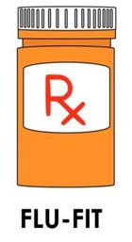
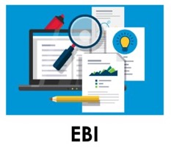
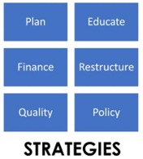
Case Example
EBI: FLU-Fecal Immunochemical Test (FLU-FIT)
Implementation Strategy: Train-the-Trainer for Pharmacists
SMARTIE Objective: Increase colorectal cancer screening among Black residents in Ward 7 of Washington D.C. from 48% to 63% in one year by conducting a train-the-trainer program with 10 pharmacists across 5 pharmacies and including partnerships with 5 community leaders to overcome institutional racism causing colorectal cancer disparities
Chatterjee et al., 2015
Notes:
For our case example:
The EBI is the: FLU-Fecal Immunochemical Test (FLU-FIT)
The Implementation Strategy is the: Train-the-Trainer for Pharmacists
And our SMARTIE Objective is: Increase colorectal cancer screening among Black residents in Ward 7 of Washington D.C. from 48% to 63% in one year by conducting a train the trainer program with 10 pharmacists across 5 pharmacies and including partnerships with 5 community leaders to overcome institutional racism causing colorectal cancer disparities

Slide 12
MATCH CRITERIA to the Objective
SMARTIE Criteria
Specific
Measurable
Achievable
Realistic
Timely
Inclusive
Equitable
Objective
To overcome institutional racism causing colorectal cancer disparities
Black residents in Ward 7 of Washington D.C.
From 48% to 63%
In one year
10 pharmacists across 5 pharmacies
Conducting a train-the-trainer program with 10 pharmacists
Including partnerships with 5 community leaders
Notes:
Let’s work through matching the SMARTIE criteria with the objective.
To start, “Specific…” (go through the list) (Click)

Slide 13
Case Example: FLU-FIT Intervention REACH
You are evaluating the FLU-FIT intervention.
How do you start?
Notes:
Each of the aspects of RE-AIM can be addressed using several relatively simple techniques I will speak about next.
These are just models of tracking tools used to teach – you might want to add more detail or less.

Slide 14
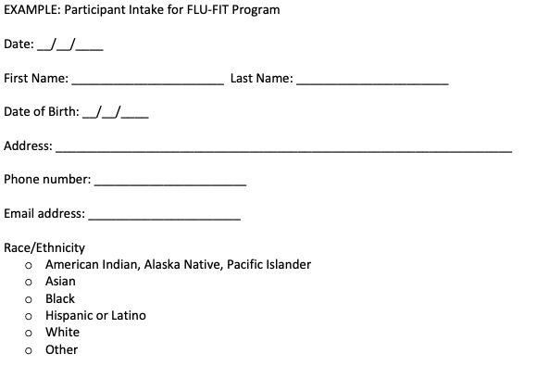
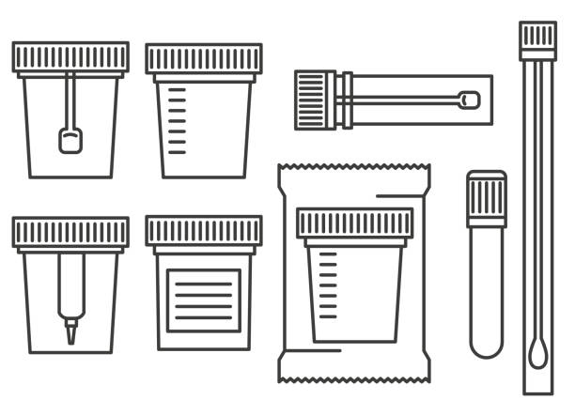
Kit and Intake Form
Notes:
Some elements of your evaluation to consider:
The kits themselves and the intake forms.

Slide 15
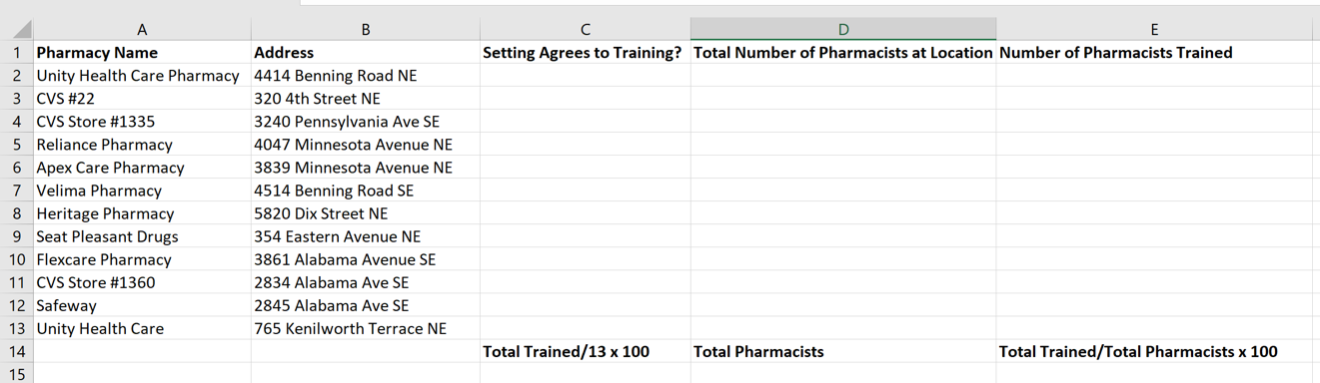
Tracking Logs for Pharmacy and Train- the-Trainer Program
Notes:
Also, Tracking Logs for evaluating the adoption of the program by pharmacists and the training program for pharmacists.

Slide 16
Ward 7 & Population of Focus
Black: 91.7% of the population
Families Below Poverty: 23.3% of the population
Colorectal Cancer Screening Rate in Ward 7: 48%
Colorectal Cancer Screening Rate at each pharmacy location in Ward 7: Unknown at this time
Notes:
Remember that early on, we spoke about the case study context being that the Federally Qualified Health Center was too overwhelmed to take on a new screening program at the moment. This choice of partnering with pharmacies came with one weakness being a lack of baseline screening rate data.

Slide 17
Health Equity Outcomes
Who was included as the Population(s) of Focus?
How did your project consider the history of the issue within the community?
How was the Population(s) of Focus:
    Affected?
    Engaged and included in the planning?
    Included in the dissemination of results?
Comprehensive Cancer Control National Partnership, 2021
Notes:
Remember to reflect on equity early on in the process.
How would you evaluate if your intervention moved the needle on health equity? You can ask yourself and your team:
(Click)
Who was included as the Population(s) of Focus? (Click)
How did your project consider the history of the issue within the community? (Click)
How was the Population(s) of Focus: (Click)
Affected?
Engaged in the planning?
Included in the dissemination of results?
You can also reflect on who wasn’t involved in this specific project but should be included now that we know what we know.

Slide 18
Health Equity Approach
How did the initiative:
  Remove unfair social, economic or environmental disadvantages for certain groups?
  Increase access to resources or opportunities?
  Strengthen support systems?
  Reduce bias and discriminatory actions among providers?
  Increase skills and abilities?
Comprehensive Cancer Control National Partnership, 2021
Notes:
Also, some some more complex questions should be asked.
You can ask: how did the initiative:
Remove unfair social, economic, or environmental disadvantages for certain groups?
Increase access to resources or opportunities?
Strengthen support systems?
Reduce bias and discriminatory actions among providers?
Increase skills and abilities?

Slide 19
Session Agenda
  Introduce RE-AIM evaluation framework
    Give overview of evaluation
    Examine each dimension of evaluation framework in detail
    Case examples
Notes:
What does RE-AIM stand for?
What do you think the R in RE-AIM stands for?

Slide 20

Evaluate Reach
Characteristics for eligibility in program
Characteristics of participants in program
Characteristics of participants vs. non-participants
Understanding why some people participated and others did not
National Cancer Institute, 2012
Notes:
Reach examines
Characteristics for eligibility in program/population of focus
Characteristics of participants in program: age, race, gender/gender identity, sexual orientation
Characteristics of participants compared to non-participants
Understanding why some people participate and others do not

Slide 21
Case Example: Eligibility Criteria
What were your eligibility criteria?
Notes:
A tracking log example is shown here. Based on your eligibility criteria, you might track race, gender/gender identity, and sexual orientation for example.

Slide 22
Case: Characteristics of People Returning Kits
Notes:
Here is an intake form or survey (paper or electronic) to collect demographic information
Reminder that we are still talking about the case example so remember these are examples and not specifically what you have to be doing in your projects!
For example, you may be interested in screening for social determinants of health and want to include questions related to housing instability, food insecurity, employment status, and transportation challenges.

Slide 23
Case: Subpopulation Reach
Year 1: Black individuals screened=501
Year 2: Black individuals screened=871
Notes:
Here is a Tracking log example:
Here you see year 1 with 501 Black individuals screened and year 2 at 871 showing an increase

Slide 24

Why did some people participate?
Why did some people return the kits & others do not?
Notes:
Focus Groups can uncover the reason why some returned the kits and others did not.
Next slide--What do you think the E in RE-AIM stands for?

Slide 25
Evaluate Effectiveness
Percent of people screened by program compared to SMARTIE objective
Did your FLU-FIT program achieve your objective?
  How close did you get?
How confident can you be about the results?
Measure of quality and health outcomes
Who stayed involved and completed the program?
National Cancer Institute, 2012
Notes:
Effectiveness gauges:
Percent of people screened by program compared to SMARTIE objective
Did your FLU-FIT program achieve your objective?
How close did you get?
How confident can you be about the results?
Measure of service and patient outcomes
Who stayed involved and completed the program?

Slide 26
Case: Effectiveness & SMARTIE Objective Achievement
Year 1: 48%
Year 2: 60%
Notes:
Here is the area of the Tracking log where you can see effectiveness data:
One pharmacy was able to share data with an insurance company to gather the 48% baseline rate for returning CRC FLU-FIT Kits among their patients before the intervention (i.e. before there was a pharmacy partnership program).

Slide 27
Case: Did you reach your SMARTIE objective?
SMARTIE Objective: To increase colorectal cancer screening among Black residents in Ward 7 of Washington D.C. from 48% to 63% in one year by conducting a train-the-trainer for 10 pharmacists across 5 pharmacies
SMARTIE Objective: 63%
Actual: 60%
Notes:
The percentage of people being screened have increased, but the project did not reach goal-it was very close though!
Next, we are going to focus on the second aspect of the objective, that of reaching 10 pharmacies.
What do you think the A in RE-AIM stands for?

Slide 28
Evaluate Adoption
Penetration: Percent of pharmacies approached that participate
Characteristics of participating vs. non-participating pharmacies
Percentage of pharmacists invited that participate
Why did some pharmacies (and pharmacists) not participate?
Pharmacies excluded
National Cancer Institute, 2012
Notes:
Adoption: is the decision to make full use of an innovation, intervention, or program as the best course of action available.
Some ways to think about this include:
Penetration: Percent of pharmacies approached that participate
Characteristics of participating vs. non-participating pharmacies
Percentage of pharmacists invited that participate
Why did some pharmacies (and pharmacists) not participate?
Pharmacies excluded for any reason

Slide 29
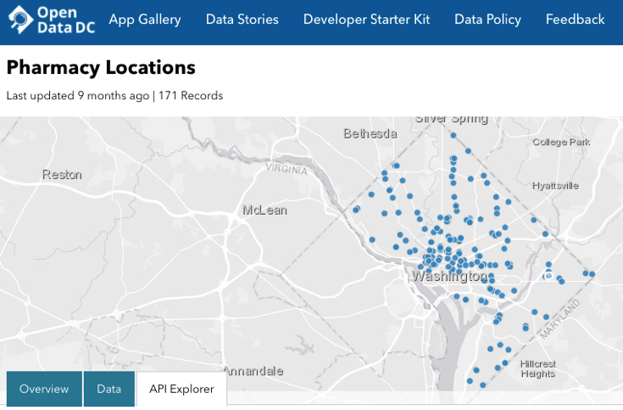
Inventory Pharmacies in Ward 7
Unity Health Care Pharmacy
CVS
Reliance Pharmacy
Apex Care Pharmacy
Velima Pharmacy
Heritage Pharmacy
Seat Pleasant Drugs
Flexcare Pharmacy
Notes:
A map is shown here of Ward 7 Pharmacies.

Slide 30
Case Example: Penetration
Percent of
pharmacies trained
Percent of
pharmacists trained
Notes:
You can see here the percent of pharmacies and pharmacists trained. This penetration metric can help us understand the degree of adoption of the program.
What do you think the I in RE-AIM stands for?

Slide 31
Case Example
EBI: FLU-Fecal Immunochemical Test (FLU-FIT)
Implementation Strategy: Train-the-Trainer for Pharmacists
SMARTIE Objective: Increase colorectal cancer screening among Black residents in Ward 7 of Washington D.C. from 48% to 63% in one year by conducting a train-the-trainer program with 10 pharmacists across 5 pharmacies.
Chatterjee et al., 2015
Notes:
Next, we will look at how to evaluate the implementation process itself, rather than the EBI.

Slide 32
Case: Implementation Strategy
Train-the-Trainer for Pharmacists about FLU-FIT
  Develop or identify highly visual, low literacy educational materials on FIT
  Conduct train-the-trainer
  Make training dynamic
  Conduct outreach visits
  Provide ongoing consultation
Notes:
For this example, our hypothetical implementation team chose to use strategies to educate pharmacists. Specifically, they used the concept of a Peer Training Program. The five tactics listed here were used in the implementation intervention approach.

Slide 33
Evaluate Implementation
How acceptable/ appropriate was the FLU-FIT intervention for this population?
How feasible was the FLU-FIT intervention for pharmacists to deliver?
Fidelity: To what extent did pharmacists implement the protocol as instructed? How consistently was protocol followed?
What adaptations were made to the protocol? When and why were they made? By whom?
How much additional time did the program take compared to time typically needed to just vaccinate a patient? How much did that extra time cost to the pharmacy?
National Cancer Institute, 2012
Notes:
Some questions to ask about evaluating the implementation of the intervention: (Click)
How acceptable/appropriate is the FLU-FIT intervention for this population? (Click)
How feasible is the FLU-FIT intervention for pharmacists to deliver? (Click)
Fidelity: To what extent did pharmacists implement the protocol as instructed? How consistently is the protocol followed? (Click)
What adaptations were made to the protocol? When and why were they made? By whom? (Click)
How much additional time did the program take compared to time typically needed to vaccinate a patient? How much does that extra time cost to the pharmacy? (Click)

Slide 34
Case Example: Feasibility
Focus: Pharmacist’s experience of intervention
 | Completely Disagree | Disagree | Neither Agree nor Disagree | Agree | Completely Agree
The FLU-FIT program is user-friendly.
Our pharmacy is equipped to carry out the FLU-FIT program.
Our pharmacy is satisfied with FLU-FIT.
There are barriers to the adoption of the FLU-FIT program at our site.
1
2
3
4
5
1
2
3
4
5
1
2
3
4
5
1
2
3
4
5
Notes:
Here is an example of a way to measure feasibility. This survey could be given to pharmacists and asks them to confirm their level of agreement with some statements.
For example: Our pharmacy is equipped to carry out the FLU-FIT program.

Slide 35

Case: Fidelity & Feasibility
Understand the degree to which an intervention is implemented as intended
  Review checklist of core components with pharmacists shortly after training
  Host focus group with trained pharmacists
    What adaptations were needed? Why? When? By whom?
    What were patient reactions to receiving the FIT kit?
    How much extra time did it take you on average?
    How consistently were you able to implement the checklist of core components?
Notes:
Understanding the degree to which an intervention is implemented as intended is important.
You could review a fidelity checklist with pharmacists shortly after the training
You could host a focus group with trained pharmacists. This might ask:
What adaptations were needed? Why? When? By whom?
What were patient reactions to receiving the FIT kit?
How much extra time did it take you on average?
How consistently were you able to implement the protocol?
What do you think the M in RE-AIM stands for?

Slide 36
Evaluate Maintenance: Patients
Baseline screening rates for pharmacy (if available)
% of FLU-FIT kits returned correctly
Patient satisfaction with ease of using and returning kits
Characteristics of participants vs. non-participants over the long-term
National Cancer Institute, 2012
Notes:
Maintenance is the next dimension of RE-AIM. It can help understand:
Baseline screening rates for pharmacy (if available)
% of FLU-FIT kits returned correctly
Patient satisfaction with ease of using and returning kits
Characteristics of participants vs. non-participants over the long-term
Remember you don’t have to track EVERYTHING. If you want data about who and to what extent pharmacists are continuing the intervention after the official program ends, ask pharmacists to continue their tracking log and to send you the log without patient names 6 months after the end of your intervention. This will tell you which pharmacies and pharmacists are still providing FIT kits and how often
Because this is a seasonal program, so you might also send a reminder the following year and assess maintenance based on response to repeat the program without your support

Slide 37
Acceptability & Feasibility - Part 1
Weiner et al., 2017
Notes:
Example of a validated measure: Weiner BJ, Lewis CC, Stanic C, et al.
Validated questions have been tested with a sample representative of the general population and have been shown to have consistent results when given repeatedly. They also are demonstrated to be accurate ways to actually measure what you are trying to measure.
If you want to add new questions based on your intervention, have other team members review them for clarity and relevance. More is not always better with a survey.

Slide 38
Acceptability & Feasibility - Part 2
Notes:
Use the same intake form to collect demographic information to measure acceptability and feasibility.

Slide 39
Evaluate Maintenance: Pharmacies
Did pharmacies and pharmacists continue to implement the FLU-FIT program in subsequent years?
How was program adapted long term?
Did program fit into organizational mission and workflow?
Use qualitative methods to understand if setting-level institutionalization occured
National Cancer Institue, 2012
Notes:
Some questions you can ask to understand the long-term maintenance of your intervention:
Did pharmacies and pharmacists continue to implement the FLU-FIT program in subsequent years?
How was the program adapted long term?
Does the program fit into the organizational mission and workflow?
Use qualitative methods to understand setting level institutionalization

Slide 40
Survey Pharmacy Leads
Does this program align with your pharmacy’s mission?
Has an administrative-level individual within the pharmacy been actively involved in advocating for this program’s continuation?
Have permanent staff been assigned to implement this program?
What adaptations have been needed to integrate FLU-FIT into your workflows?
Goodman et al., 1993
Notes:
This was taken from a larger survey of level of institutionalization of change that available in the supplemental tools. While maintenance is similar to sustainability, it is not the same thing. Rather, it is a shorter-term measure of institutionalization, and can be seen as on the way towards long term sustainability.
Does this program align with your pharmacy’s mission?
Has an administrative-level individual within the pharmacy been actively involved in advocating for this program’s continuation?
Have permanent staff been assigned to implement this program?
What adaptations have been needed to integrate FLU-FIT into your workflows?

Slide 41
Process
Insurance Companies
Community Pharmacies
Cancer Screening Status Data Sharing
Eligibility status for FLU-Fit Kits
Notes:
Not all pharmacies may not have baseline data to compare colorectal cancer screening rates before and after the intervention. If this is the case, you may determine whether you could build infrastructure to share data between insurance companies and pharmacies and help build capacity for quality improvement and evaluation in the future.
Having the pharmacy and insurance company share data could be a daunting and expensive undertaking, but there could be benefits for both the pharmacy and overall patient health.
Examples: Brings patients to the pharmacy and potentially allows them to bill for new services
Reduces the health system demand for GI specialists given the need to catch up from limited screening during COVID and the likelihood of reducing the age for CRC screening from 50 to 45 (adding 5 more years worth of patient population)

Slide 42

Using Evaluation Data & Results
Use data to measure whether you are achieving goals
Use results to inform which implementation strategies to use in future
Distribute results to stakeholders to improve future implementation
Metz et al., 2020
Notes:
Most important is how you use evaluation data once it is collected and analyzed. For example, you could:
Use data to regularly measure whether you are achieving goals
Use results to inform which implementation strategies to use in future
Distribute results to stakeholders to improve future implementation

Slide 43
Tools and Supplemental Resources
Grid-Enabled Measures Database
Proctor, E., Silmere, H., Raghavan, R., Hovmand, P., Aarons, G., Bunger, A., Griffey, R., & Hensley, M. (2011). Outcomes for implementation research: Conceptual distinctions, measurement challenges, and research agenda. Administration and Policy in Mental Health, 38(2), 65-67
Implementation Outcome Repository
RE-AIM Tool
Washington University Institute of Clinical and Translational Sciences Implementation Outcomes Toolkit
Notes:
Tools listed here are all located in your companion guide.

Slide 44
References
Chatterjee S., Chattopadhyay, A., & Levine, P. (2015). Between-ward disparities in colorectal cancer incidence and
screening in Washington DC. Journal of Epidemiology and Global Health, 5(4 Supplement 1), S1-S9.
doi: 10.1016/j.jegh.2015.08.001
Comprehensive Cancer Control National Partnership. (2021). Health equity tip sheet.
https://www.acs4ccc.org/wp-content/uploads/2021/04/Cancer-Plan-Tip-Sheet_Health-Equity_FINAL.pdf
Goodman, R. M., McLeroy, K. R., Steckler, A. B., & Hoyle, R. H. (1993). Development of level of institutionalization
scales for health promotion programs. Health Education Quarterly, 20(2):161-78
doi: 10.1177/109019819302000208
Holt, C. L., Tagai, E. K., Scheirer, M. A., Santos, S. L., Bowie, J., Haider, M., Slade, J., Wang, M., & Whitehead, T.
(2014). Translating evidence-based interventions for implementation: Experiences from Project HEAL in African
American churches. Implementation Science, 9(1). doi: 10.1186/1748-5908-9-66
Metz, A., Louison, L., Burke, K., Albers, B., & Ward, C. (2020). Implementation support practitioner profile: Guiding
principles and core competencies for implementation practice. Chapel Hill, NC: National Implementation Research
Network, University of North Carolina at Chapel Hill.
https://nirn.fpg.unc.edu/resources/implementation-support-practitioner-profile.
National Cancer Institute. (2012). http://re-aim.org/wp-content/uploads/2016/09/checklistdimensions.pdf
Rohweder, C., Wangen, M., Black, M., Dolinger, H., Wolf, M., O'Reilly, C., Brandt, H., & Leeman, J. (2019)
Understanding quality improvement collaboratives through an implementation science lens. Prevention
Medicine, 129S:105859. doi: 10.1016/j.ypmed.2019.105859
Rubin Means, A., & Wagenaar, B. (2018). An introduction quality improvement. The ImpSci UW Blog.
https://impsciuw.org/an-introduction-to-quality-improvement/
Notes:
As well as references.

Slide 45
References
Smith, J. D., Li, D. H. & Rafferty, M. R. (2020). The Implementation Research Logic Model: A method for planning,
executing, reporting, and synthesizing implementation projects. Implementation Science, 16(84).
https://doi.org/10.1186/s13012-020-01041-8
Weiner, B. J., Lewis, C. C., Stanick, C., Powell, B., Dorsey, C., Clary, A., Boynton, M., & Halko, H. (2017).
Psychometric assessment of three newly developed implementation outcome measures. Implementation Science,
12(108). https://doi.org/10.1186/s13012-017-0635-3

Slide 46
Acknowledgments
PI:
Mandi L. Pratt-Chapman PhD
Staff:
Sarah Adler
Joseph Astorino
Leila Habib
Sarah Kerch
Workgroup Members:
Heather Brandt
Polly Hager
Notes:
Thank you to all those listed here who helped in developing this training.

