Slide 1
Introduction to Cancer Control Implementation Science Base Camp
Notes:
Welcome to the Cancer Control Implementation Science Base Camp from the GW Cancer Center.
I am…

Slide 2
Disclosure
This session was supported by Cooperative Agreement #NU58DP006461-03 from the Centers for Disease Control and Prevention (CDC). The views expressed in written workshop materials or publications and by speakers and moderators do not necessarily reflect the official policies of the Department of Health and Human Services, nor does the mention of trade names, commercial practices, or organizations imply endorsement by the U.S. Government.
Notes:
This session was supported by a Cooperative Agreement from the Centers for Disease Control and Prevention (CDC). The views expressed in written workshop materials or publications and by speakers and moderators do not necessarily reflect the official policies of the Department of Health and Human Services, nor does the mention of trade names, commercial practices, or organizations imply endorsement by the U.S. Government.

Slide 3
Welcome
Let’s work together to learn how to optimize cancer screening interventions to reduce health disparities!
From this training, you will:
Learn a lot about implementation science
Be prepared to bring this back to your unique context
Notes:
We are excited to share this new training program with you.
The training is called Cancer Control Implementation Science Basecamp because it aims to provide you with all of the supplies and tools you need to pack your bag and head up the mountain of implementation. We know putting evidence based interventions into practice can be challenging, like climbing a mountain, but with the right tools you and your partners can learn how to optimize cancer screening interventions to reduce health disparities.
From this training, you will:
Learn a lot about implementation science
Be prepared to bring this back to your unique context

Slide 4
Purpose
Increase cancer control practitioners’ knowledge of and capacity for implementing and optimizing cancer screening evidence-based interventions (EBIs) that fit within their unique context
Provide the knowledge, tools and hands-on experience for learners to conduct implementation science in their settings
Notes:
The purpose of the Base Camp is to increase CCC practitioner’s knowledge of and capacity for implementing and optimizing cancer screening EBIs (evidence-based Interventions) that fit with each of their contexts.
For the purposes of this training, we consider a Cancer Control practitioner to be any of the following:
Comprehensive Cancer Control Program Directors
National Breast and Cervical Cancer Early Detection Program project level staff
National Colorectal Cancer Control Program project level staff
Coalition member/leader
Clinicians
Executive leadership
Researchers and evaluators
We also want to provide knowledge, tools, and and experience for you to use Implementation Science approaches to optimize cancer control in your own settings

Slide 5
Session Agenda
Intro to Cancer Control Implementation Science Base Camp
Notes:
This quick session’s agenda includes an introduction to the foundation of implementation science in order to help you navigate the Base Camp.

Slide 6
Learning Objectives
Define basic implementation science terms
Establish a high-level understanding of how implementation science can be used to improve cancer screening
Describe how to implement evidence-based interventions through a health equity lens
Notes:
The 3 main learning objectives of this session are listed here.
We will begin to describe how to implement EBIs through a health equity lens in this session by incorporating equity elements into SMARTIE objective development – a spin on the commonly used SMART objective. You will also notice this theme of health equity throughout the entire Base Camp training. An important part of climbing a mountain is preparing for everyone to make it up together—you can use this vision to guide your equity work where everyone has the tools to achieve their goals.
Likely you have already begun this process and are not starting from scratch. Take your time to really integrate this new material into your current initiatives.

Slide 7
Implementation Science
Implementation science is the study of ________ to promote the adoption and integration of _________________, interventions, and policies into routine ___________and ________________ settings to improve our impact on _________________________ (2019)
Methods
Word Key:
Health Care
Evidence-based Practices
Evidence-based Practices
Health Care
Population Health
Public Health
Methods
Population Health
Public Health
National Cancer Institute, 2019
University of Washington, n.d.
Notes:
Let’s see if you can help us fill in the blank here with words from the right to help define what implementation science is.
Click through each word/animation: (Do activity-advance each word and pause as learners think about this)

Slide 8
Implementation is Transdisciplinary
Anthropology and Sociology
Economics and Finance
Public Health Epidemiology and Statistics
Policy Analysis
Psychology
Organization Studies
Health Promotion
Implementation Science
Kislov et al., 2019
Schackman, 2010
Birken et al., 2017
Bauer et al., 2015
Notes:
There are quite a number of disciplines that together inform the field of implementation science. Some of them are listed here.

Slide 9
Maybe you have been thinking about the challenges to achieving your goals…
“I want to get more people screened for colorectal cancer, but I want to provide options for screening that are equitable, accessible and acceptable by a certain population in my region”
Notes:
Do you remember the animation where you may have first learned about Base Camp?
Like Talia, maybe you have been thinking about the challenges to achieving your goals.
Like her, maybe you have been deeply considering how to provide interventions that are intentionally designed with equity at the center.
Although this training is focused on improving cancer screening, the ideas in implementation science can be used for many other areas across the cancer continuum such as risk reduction, treatment, survivorship, and palliative care.

Slide 10
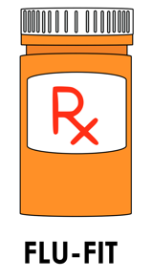
Case Study
Notes:
You will notice this FLU-FIT Pharmacy Logo in the top right of the slide. We want you to be able to use this Base Camp training immediately in your work, so anytime you see this image think “applied case study”.
In the companion material you will find an extended write up of a fictional case study that is woven throughout the Base Camp to illustrate all of the different elements of implementation science. This case study focuses on two areas of Washington DC with high colorectal cancer disparities; in fact, the neighborhoods in the wards we focus on have less than 50% of their population screened for colorectal cancer and documented racial disparities. Preliminary contextual assessment demonstrates that the Federally Qualified Health Center serving the area does not have the capacity to take on new screening interventions due to COVID-19, causing a backlog of work.
Engagement events are uncovering that many pharmacies in the neighborhood are currently taking on the majority of flu shots given because these settings are more accessible than other healthcare sites. This is resulting in more equitable distribution of the vaccine.
What would you do to implement this innovation?
You learn how implementation strategies such as train-the trainer and the use of local champions can enhance the intervention’s effectiveness.

Slide 11
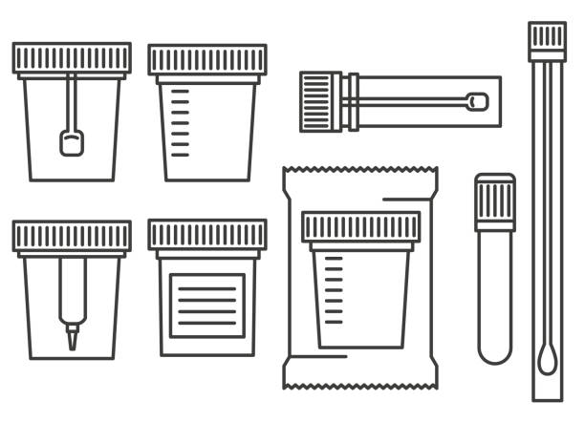
Case Study
Notes:
An implementation team considers these context factors and identifies the FLU-FIT intervention as an evidence-based intervention that just might fit well for the community.
This hypothetical case study walks through an innovative intervention that partners with community-based pharmacies to distribute FLU-FIT kits as a way to increase the accessibility and acceptability of colorectal cancer screening. In the first year of the program, some pharmacies have been successful in introducing FLU-FIT and have preliminary data, but there is no coordinated effort to centralize training and implementation planning.
A clinical champion from the team searches an EBI library to find a bundled package for new FLU-FIT programs. This helps them decide what are the necessary, or core components, of the intervention.
The stakeholder group also uncovers that the pharmacists in the local system respond best to changes that are introduced by their peers who are considered natural leaders in the profession. The team decides to design a strategy to make this program work, by building a train-the-trainer model with local champions becoming the backbone of the intervention.

Slide 12
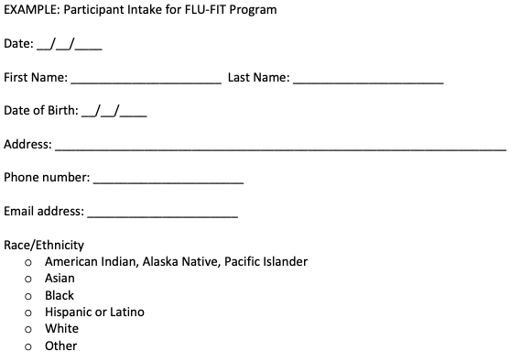
Case Study
Notes:
Initial feasibility evaluation data show that patients find the intervention acceptable and it takes minimal extra time for the technicians to implement.
The team does realize they will need to implement some new strategies to share data between providers and pharmacies to increase the reach and adoption of the program in the future to help institutionalize the change.
The team decides to perform a sustainability assessment and discovers that there are some factors showing the program is sustainable, although there are some indicators that demonstrate a need for planning for extended sustainability into the future.
Follow along with the case study throughout this whole training to see implementation in action.

Slide 13
Base Camp Can Help With:
Implementing cancer screenings projects
Implementing projects across the cancer continuum
Notes:
This training is designed to help coalitions implement cancer screening better by:
Engaging stakeholders in developing a focused objective
Planning interventions that best fit your unique location
Designing an implementation blueprint to guide your process
Proactively planning for sustainability
(Click) Although this training is focused on improving cancer screening, the ideas in implementation science (Click) can be used for many other areas across the cancer continuum such as risk reduction, treatment, survivorship, and palliative care.

Slide 14
Why Are You Learning This?
Practitioners become increasingly important as research moves from effectiveness to implementation on the knowledge pipeline
You are the key to bridging the gap!
Proctor et al., 2013
University of Washington, n.d.
Notes:
There is a significant gap between what we know works and what we actually do in practice. The key to bridging this is you—practitioners! Researchers can only take you so far. Next you will see a visual of this process as a pipeline.

Slide 15
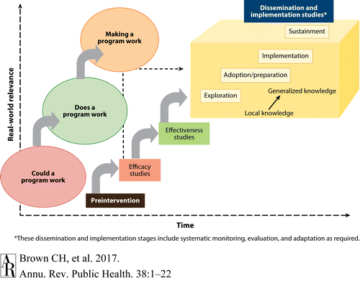
Knowledge Pipeline
Meissner et al., 2013
Bauer et al., 2015
Beidas et al., 2018
Brown, C.H., 2017
Singal et al., 2014
Notes:
You can see in this figure as time goes on real world relevance increases.
First is answering the questions ”if a program could work” and “does it work”, which are the major questions in efficacy and effectiveness research.
Efficacy: Efficacy can be defined as the performance of an intervention under ideal and controlled circumstances
Effectiveness: Effectiveness refers to its performance under ‘real-world' conditions
HOW to make a program work is the focus of this training.

Slide 16
What Do We Do?
Help you elevate your unique context and integrate evidence by putting your needs at the center
Start
Ask:
Could a program work?
Does a program work?
Once we know it works, what happens next is up to you!
Notes:
Another way to think about this is shown in this diagram.
(Click)
Much research is done to establish the efficacy and effectiveness of an intervention.
(Click)
This is done by asking: could/does a program work?
But once we know it works, what happens next (Click) is up to you in terms of making a program work. This is the “HOW” of making a program work.
This Base Camp will help you unpack how to incorporate your unique context into the planning of how to make an intervention work.

Slide 17
Making a Program Work
Facilitate change by:
Preparing individuals and systems for change if they are not ready
Adapting the intervention without changing its effectiveness
Adjusting the environment to integrate the intervention
Notes:
The real world is complicated and sometimes it might feel like you are trying to fit puzzle pieces together that just don’t go together!
Implementation Science has an impressive toolkit to help you see the big picture and facilitate change by:
Preparing those involved for change if they are not ready
Adapting the intervention without changing its effectiveness
Adjusting the environment to integrate the intervention

Slide 18
Case: Designing a SMARTIE Objective
Specific
Measurable
Achievable
Realistic
Timely
Inclusive
Equitable
SMARTIE Objective: Increase colorectal cancer screening among Black residents in Ward 7 of Washington D.C. from 48% to 63% in one year by conducting a train the trainer program with 10 pharmacists across 5 pharmacies and including partnerships with 5 community leaders to overcome institutional racism causing colorectal cancer disparities
Notes:
In your companion guide the first box of the logic model is a space for reflection on your SMARTIE objective that can include a health equity component.
Health equity occurs when every person has the opportunity to attain their full health potential and no one is disadvantaged from achieving this potential because of social position or other socially determined circumstances. In terms of the Base Camp model—you can think of it as working to get everyone up the mountain.
Health equity is a great foundation to start in the planning process required to make a program work well. If not addressed early on in the process, it is at risk of becoming an afterthought. This can lead to community members not fully buying into your intervention at best, and mistrusting change at worse. If you can integrate health equity approaches into your objectives, your team will be held accountable for the outcomes of your process.
You see here a SMARTIE objective example that demonstrates all the elements of the acronym.
SMARTIE Objective: Increase colorectal cancer screening among Black residents in Ward 7 of Washington D.C. from 48% to 63% in one year by conducting a train the trainer program with 10 pharmacists across 5 pharmacies and including partnerships with 5 community leaders to overcome institutional racism causing colorectal cancer disparities

Slide 19
Base Camp Basics
Context
Adaptation
Sustainability
Evidence-Based Interventions
Implementation Strategies
Implementation Outcomes
Beidas et al., 2018
Lewis et al., 2020
University of Washington, n.d.
Notes:
The training is built around the following skill bundles.

Slide 20
Base Camp Basics
Context
Adaptation
Sustainability
Evidence-Based Interventions
Implementation Strategies
Implementation Outcomes
Beidas et al., 2018
Lewis et al., 2020
University of Washington, n.d.
Notes:
Context: The unique factors in a setting that influence the outcomes of implementing an EBI.

Slide 21
Context Matters
Every setting contains unique elements that can help or hinder changes from becoming integrated consistently
Consolidated Framework for Implementation Research (CFIR) will be used to assess context
Bauer and Kirchner, 2020
Notes:
Every setting contains unique elements that can help or hinder changes in becoming integrated consistently.
We will use a popular framework here to assess context. The logo on the top right refers to the Consolidated Framework for Implementation Research or CFIR. Anytime you see this image, you can bet we are referring to context!

Slide 22
Context Considerations
Intervention characteristics
Inner setting
Outer setting
Individuals involved in implementation
Population(s) of Focus
Process of implementation
CFIR Research Team-Center for Clinical Management Research, 2021
Notes:
This framework examines 5 domains commonly accepted to influence the quality of implementation.
Intervention characteristics
Inner setting at the site where intervention is happening
Outer setting, which examines forces external to the setting where the intervention is happening
Individuals involved in implementation, including if there is a population of focus which could be tied with health equity goals
Lastly, factors related to the process of implementation

Slide 23
Multilevel Problems
Paskett et al., 2020
Notes:
Taking context seriously into consideration requires us to examine the multiple levels of the problem. For example, this model came out of a collaborative project on cervical cancer disparities in Ohio and Kentucky. We see the upstream factors such as social conditions that affect these disparities, as well more individual level downstream factors such as risk factors and biology.

Slide 24
Multilevel Solutions
Executives
Cancer Coalition representatives
Comprehensive Cancer Control Program Directors
Clinical providers and public health professionals
Community members and patients
An implementation plan should incorporate multiple levels of your context
Notes:
An implementation plan should incorporate multiple levels of your context. That is why we designed this training for teams taking on implementation challenges together.

Slide 25
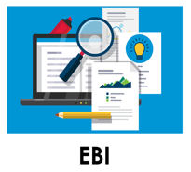
Base Camp Basics
Context
Adaptation
Sustainability
Evidence-Based Interventions
Implementation Strategies
Implementation Outcomes
Beidas et al., 2018
Lewis et al., 2020
University of Washington, n.d.
Notes:
Evidence-based Interventions (EBIs): These are the ”what” of implementation science and can take many different forms.

Slide 26
The ABCs of EBIs
Evidence-Based Interventions:
Health-focused intervention, practice, program or guideline with evidence demonstrating the ability of the intervention to change a health-related behavior or outcome
Beidas et al., 2018
Lewis et al., 2020
University of Washington, n.d.
Notes:
An EBI is a health-focused intervention, practice, program, or guideline with evidence demonstrating the ability of the intervention to change a health-related behavior or outcome.
These are often included in resources such as the Community Guide or the Evidence-Based Cancer Control Programs database from the National Cancer Institute.
You will notice this image on the top right when we are referring to specific evidence-based interventions.

Slide 27
Base Camp Basics
Context
Adaptation
Sustainability
Evidence-Based Interventions
Implementation Strategies
Implementation Outcomes
Beidas et al., 2018
Lewis et al., 2020
University of Washington, n.d.
Notes:
Adaptations: Everyone knows cookie-cutter interventions and one size fits all approaches just won’t work for the diversity of populations we need to support in our comprehensive cancer control work.

Slide 28
What is Adaptation?
The degree to which an EBI is changed or modified by a user during adoption and implementation to suit the needs
of the setting or to improve the fit to local conditions
Beidas et al., 2018
Lewis et al., 2020
University of Washington, n.d.
Notes:
That is why we include skills related to the adaptation. This is the degree to which an evidence-based intervention is changed or modified by a user during adoption and implementation to suit the needs of the setting or to improve the fit to local conditions.
That is why we chose the chameleon for the image to refer to anytime we are talking about adaptation. Like a chameleon, your intervention will change to fit into its contextual setting.

Slide 29
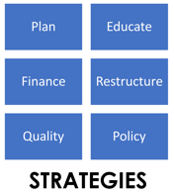
Base Camp Basics
Context
Adaptation
Sustainability
Evidence-Based Interventions
Implementation Strategies
Implementation Outcomes
Beidas et al., 2018
Lewis et al., 2020
University of Washington, n.d.
Notes:
Implementation strategies: Methods or techniques used to operationalize the adoption, implementation, and sustainability of a clinical program or practice.

Slide 30
Implementation Strategies
Planning
Educating
Restructuring
Quality Management
Financial & Policy Changes
Notes:
These can include strategies related to planning, educating, restricting, quality management, as well as financial and policy changes in the inner and outer settings where the intervention is occurring.
You will notice this blue grid made of these categories of strategies anytime we are referring to specific documented strategies known to help implement EBIs.

Slide 31
Facilitating Implementation
Brings together context, strategies and evaluation
Implementing Cancer Screening Interventions: Stories From the Field
Notes:
Facilitating implementation is where the rubber meets the road. We will highlight several screening case studies that exemplify this process during this session of the Base Camp. Stories from the field will bring together strategies and evaluation with real world stories of implementation from a range of different contexts.

Slide 32
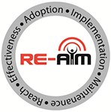
Base Camp Basics
Context
Adaptation
Sustainability
Evidence-Based Interventions
Implementation Strategies
Implementation Outcomes
Beidas et al., 2018
Lewis et al., 2020
University of Washington, n.d.
Notes:
Implementation outcomes are the effects of deliberate and purposive actions to implement new treatments, practices, and services. These outcomes often serve as indicators of implementation success. We often can’t achieve health outcomes without first achieving these markers of quality.

Slide 33
Implementation Outcomes
RE-AIM Framework
Reach
Effectiveness
Adoption
Implementation
Maintenance
Notes:
To organize the process of evaluating implementation outcomes—we will introduce another framework called RE-AIM. Each letter of RE-AIM represents an implementation outcome of interest. When you see the logo for RE-AIM shown here in the top right, you will know that we are referring to the evaluation process.

Slide 34
Base Camp Basics
Context
Adaptation
Sustainability
Evidence-Based Interventions
Implementation Strategies
Implementation Outcomes
Beidas et al., 2018
Lewis et al., 2020
University of Washington, n.d.
Notes:
Sustainability is defined as the extent to which an evidence-based intervention can deliver its programming and its intended benefits over an extended period of time after external support is ended.

Slide 35
Sustainability Elements
Environmental Support
Funding Stability
Partnerships
Organizational Capacity
Evaluation
Adaptation
Strategic Planning
Communication
Notes:
When you see the recycle logo, you will know we are talking about the long-term maintenance of an intervention.
Here are some of the elements we will explore related to sustaining an intervention after initial adoption.

Slide 36
Tools and Supplemental Resources
Cancer Prevention and Control Research Network
The Center for Implementation
Center for Participatory Research: Engage for Equity Toolkit
Comprehensive Cancer Control National Partnership Health Equity Tip Sheet
Dissemination and Implementation Resource Guide and Glossary
Freakonomics Postcast: Policymaking Is Not a Science (Yet)
Implementation Science: An Introductory Workshop for Researchers, Clinicians, Policy Makers and Community Members
The Journal of Public Health Management and Practice Implementation Science Podcast with Randy Schwartz and Justin Moore
National Cancer Institute Cancer Facts and Figures 2021
National Cancer Institute Dispatches from Implementation Science at NCI
Notes:
Finally, here are tools, resources, and references to help continue your work in Implementation Science

Slide 37
Tools and Supplemental Resources
National Cancer Institute Implementation Science Practice Tools
National Cancer Institute Implementation Science Webinars Series
National Cancer Institute Newsletter: Opportunities to Advance Health Equity through Implementation Science
National Cancer Institute Orientation to the Science of Dissemination and Implementation Training
National Cancer Institute Training Institute for Dissemination and Implementation Research in Cancer (TIDIRC) Facilitated Course
National Implementation Research Network
State Implementation and Scaling-Up of Evidence-Based Practices
University of California San Francisco Implementation Science Mini Course
The Veterans Affairs Quality Enhancement Research Initiative (QUERI) Program

Slide 38
References
Bauer, M. S., Damschroder, L., Hagedorn, H., Smith, J., & Kilbourne, A. (2015). An introduction to implementation
science for the non-specialist. BMC Psychology, 3(1):32. doi: 10.1186/s40359-015-0089-9
Bauer, M.S. & Kirchner, J., (2020). Implementation science: What is it and why should I care? Psychiatry Research,
283:112376. doi: 10.1016/j.psychres.2019.04.025
Beidas, R., Lewis, C., & Powell. B. (2018). Orientation to dissemination and implementation research in health:
Resource guide. https://cancercontrol.cancer.gov/sites/default/files/2020-05/Orientation-to-DI-Research-in-Health-
Resource-Guide.pdf
Birken, S. A., Powell, B. J., Shea, C. M. Haines, E. R., Kirk, M. A., Leeman, J., Rohweder, C., Damschroder L.,&
Presseau, J. (2017). Criteria for selecting implementation science theories and frameworks: Results from an
international survey. Implementation Science 12(124). https://doi.org/10.1186/s13012-017-0656-y
Brown, C. H., Curran G., Palinkas, L., Aarons, G. A., Wells, K. B., Jones, L., Collins, L. M., Duan, N., Mittman, B.,
Wallace, A., Tabak, R., Ducharme, L., Chambers, D., Neta, G., Wiley, T., Landsverk, J., Cheung, K., & Cruden, G.
(2017). An overview of research and evaluation designs for dissemination and implementation.
Annual Review of Public Health, 38:1, 1-22.
CFIR Research Team-Center for Clinical Management Research. (n.d.). Consolidated framework for implementation
research. https://cfirguide.org
Kislov, R., Pope, C., Martin, G.P., & Wilson, P. (2019). Harnessing the power of theorising in implementation
science. Implementation Science, 14(103). https://doi.org/10.1186/s13012-019-0957-4
Lewis, C. C., Boyd, M. R., Walsh-Bailey, C., Lyon, R., Beidas, R., Mittman, B., Aarons, G., Weiner, B., & Chambers, D.
(2020). A systematic review of empirical studies examining mechanisms of implementation in health.
Implementation Science, 15(21). https://doi.org/10.1186/s13012-020-00983-3

Slide 39
References
Meissner, H. I., Glasgow, R. E., Vinson, C. A., Chambers, D., Brownson, R., Green, L., Ammerman, A., Weiner, B.,
Mittman, B. (2013). The U.S. training institute for dissemination and implementation research in health.
Implementation Science, 8(12). https://doi.org/10.1186/1748-5908-8-12.
National Cancer Institute. (2019). Implementation science at a glance: A guide for cancer control practitioners. https://cancercontrol.cancer.gov/sites/default/files/2020-07/NCI-ISaaG-Workbook.pdf
Paskett, E. D., Pennell, M. L., Ruffin, M. T., Weghorst, C. M., Lu, B., Hade, E. M., Peng, J., Bernardo, B. M., &
Wewers, M. E. (2020). A Multi-level Model to Understand Cervical Cancer Disparities in Appalachia. Cancer
prevention research (Philadelphia, Pa.), 13(3), 223–228.
Proctor, E. K., Powell, B. J. & McMillen, J. C. (2013). Implementation strategies: Recommendations for specifying and
reporting. Implementation Science, 8(139). https://doi.org/10.1186/1748-5908-8-139
Schackman, B. R. (2010). Implementation science for the prevention and treatment of HIV/AIDS. Journal of Acquired
Immune Deficiency Syndromes, 55 Suppl 1(Suppl 1):S27-31. doi: 10.1097/QAI.0b013e3181f9c1da
Singal, A. G., Higgins, P. D., & Waljee, A. K. (2014). A primer on effectiveness and efficacy trials. Clinical and
Translational Gastroenterology, 5(1), e45. doi: 10.1038/ctg.2013.13
University of Washington (n.d). What is implementation science?
https://impsciuw.org/implementation-science/learn/implementation-science-overview/.

Slide 40
Acknowledgments
PI:
Mandi L. Pratt-Chapman PhD
Staff:
Sarah Adler
Joseph Astorino
Leila Habib
Sarah Kerch
Workgroup Members:
Shauntay Davis-Patterson
Caleb Levell
Notes:
Thank you to all those listed here who helped in developing this training.

