Slide 1
Optimizing REaL and SOGI Data
Morgan Black, MPA

Slide 2
Background
About me:
  Clinical quality improvement at the Mount Sinai Health System,
  COVID-19 vaccine and testing at the Tacoma-Pierce County Health Department,
  Current role: Director, Advancing Healthcare Excellence and Inclusion, HANYS.
Advancing Healthcare Excellence and Inclusion provides hospitals and health systems with tools and technical support to help identify and address disparities.
AHEI objectives:
Improve collection and use of patient demographic data, (REaL, SOGI and SDoH)
Build partnerships with community-based organizations and address shared priorities
Implement best practices in diversity, equity and inclusion
Align with health equity regulatory requirements
  The views, information, content and/or opinions presented are solely those of the author and do not represent the policy or position of HANYS.

Slide 3
Definitions
  REaL: race, ethnicity and language.
  SOGI: sexual orientation and gender identity.
  Healthcare disparities are preventable differences between population groups defined by sociodemographic characteristics, such as race, ethnicity, primary language, sexual orientation, and gender identity. Disparities manifest as differences in life expectancy, mortality, disease and disability. In the hospital, we can identify disparities by looking for preventable differences in health outcomes and patient experience data.
  Data stratification is the process of separating data into distinct or non-overlapping groups. Comparing quality outcomes, such as readmissions or patient experience, across sociodemographic groups, reveals disparities.

Slide 4
Why collect REaL and SOGI data?
We want to remove barriers to optimal health.
Collecting patient demographic data helps us:
  Understand who our patients are,
  Identify disparities and the drivers of these disparities,
  Connect with community organizations that work on similar issues,
  Tailor interventions to best meet our patients’ needs.
To understand our whole patient population, we need to
ask every patient about their race, ethnicity, language, sexual orientation, and gender identity.

Slide 5
Engage leadership
Leadership may be eager to get started analyzing the data to identify disparities.
Ask these questions before stratifying outcomes data by REaL and SOGI:
  Who in leadership is accountable for the accurate, complete collection of REaL and SOGI data?
  Which data elements do we collect? Are they standardized across the organization?
  Which roles are responsible for the collection and documentation of REaL and SOGI data?
  Where does REaL and SOGI information live in the patient’s chart? Who can access it?
  How do we measure whether patients’ REaL and SOGI data is accurate and complete?
  How do we measure improvement?
Engage leadership
Develop a standardized workflow
Train staff
Measure improvement
Educate and engage patients
Validate data

Slide 6
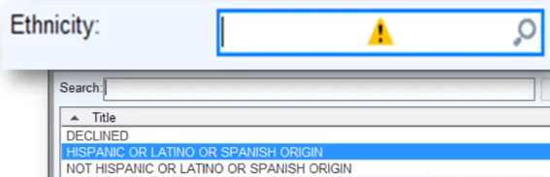
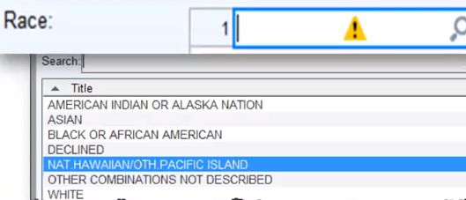
Develop a standardized workflow
  Develop a standardized list of data elements to be
  collected in all locations, departments, and care settings.
  Determine order of questions in the EHR.
  Enable users to select multiple options for race.
  Map the patient journey and identify each patient-staff
  interaction.
  Using the patient journey map, identify which staff
  member should be responsible for collecting data.
Engage leadership
Develop a standardized workflow
Train staff
Measure improvement
Educate and engage patients
Validate data

Slide 7
REaL data workflow
  Collect REaL data at the initial visit during registration and update annually.
  Recommended question:
  To provide our patients with the highest quality of care, we are asking all patients about their race, ethnicity and preferred language. How would you like your race and ethnicity recorded in our system? What is your preferred language?
  Alternate questions:
  Are you of Hispanic background?
  What race do you associate with?
  What is your preferred language?
Engage leadership
Develop a standardized workflow
Train staff
Measure improvement
Educate and engage patients
Validate data

Slide 8
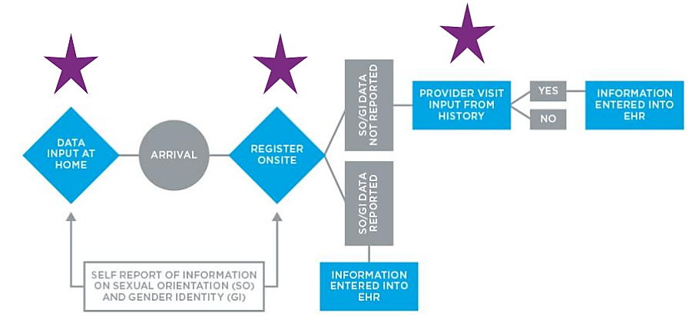
SOGI data workflow
Collect SOGI data at the initial visit and
update annually.
Recommended questions:
What is your current or preferred name?
What gender pronouns do you use?
Do you think of yourself as (lesbian, gay
or homosexual, straight or heterosexual, bisexual, pansexual, something else)?
What is your gender identity (male, female, transgender man/assigned female at birth, transgender woman/assigned male at birth, genderqueer, non-binary, something else)?
What are the genders of your sexual partners?
What is your sex assigned at birth or on your birth certificate?
Source: Fenway Guide to Lesbian, Gay, Bisexual and Transgender Health, Fenway Institute National LGBT Health Education Center.
Engage leadership
Develop a standardized workflow
Train staff
Measure improvement
Educate and engage patients
Validate data

Slide 9


We Ask Because We Care
  Starting with leadership, teach staff to ask patients for
  their REaL and SOGI information.
  We Ask Because We Care is a national campaign created
  by the Henry Ford Health System to improve the
  collection of race, ethnicity, and language data.
  Use these conversations to build trust with each
  patient.
  Explain why you are asking them to share their
  REaL and SOGI information.
  Recommended reading: Building the Foundations
  for Equitable Care, Shapiro A., et. al., 2021.
Engage leadership
Develop a standardized workflow
Train staff
Measure improvement
Educate and engage patients
Validate data

Slide 10
Handling common staff concerns
Staff may worry that patients might respond poorly to demographic questions.
In a survey of about 1,500 patients, 90% responded that they are willing to answer SOGI questions. (Haider et. al., 2017).
In a survey of 301 patients, 77% agreed that SOGI data is important for their medical provider to know. (Cahill et. al., 2014).
In a survey of 220 patients, 80% agreed that providers should collect race and ethnicity information. (Baker et. al., 2005).
Engage leadership
Develop a standardized workflow
Train staff
Measure improvement
Educate and engage patients
Validate data

Slide 11
Handling common staff concerns
Staff may worry that they will say or do the wrong thing.
Recommendations from the Mount Sinai Health System
Use a warm handoff to ensure that your patient is introduced correctly.
Preferred name and pronouns should be clearly labeled/highlighted in the EHR.
When verifying a patient’s legal name:
  Explain that you are required to do this for safety reasons.
  Speak softly when in earshot of other staff or patients.
  Ask patients to show you their ID instead of confirming their legal name verbally.
Step in when your patient needs help! This may include communicating with pharmacies, labs, and insurers on the patient’s behalf. Insurers will often lift denial of coverage.
Engage leadership
Develop a standardized workflow
Train staff
Measure improvement
Educate and engage patients
Validate data

Slide 12



Addressing common challenges
Challenge: how do I incorporate patient self-reporting into the clinical workflow?
Challenge: REaL and SOGI data fields are often left blank.
Challenge: many of our patients decline to answer REaL and SOGI questions.
Opportunity: add REaL and SOGI questions to paper forms, patient-facing screens during registration, kiosks, and any online portal.
Opportunity: make these fields required in the EMR but include “decline” as an option.
Opportunity: ask patients to answer these questions annually. Explain why you are asking for this information.

Slide 13
Self-reporting ensures that REaL and SOGI information is accurate and up-to-date.
Your patients are the most accurate and consistent source of REaL and SOGI information.
Employees should never guess based on a person’s name or appearance.
Patients more consistently select the same categories to describe themselves than employees who are guessing.

Slide 14
Lessons learned
Validate the data:
Check your inputs! Ensure that REaL and SOGI data are self-reported.
Ask patients to complete their information through online portals or paper forms, observe staff-patient interactions, and ask staff to demonstrate their data collection processes.
Measure improvement:
Track documentation compliance (percent of patients with REaL and SOGI data in their chart).
Department leaders report on documentation compliance each month.
Aim for 80-90% of patients to have REaL and SOGI information in their chart within the first year.
Watch for these red flags:
A high percentage of responses are “decline to answer,” “other” or “unknown.”
Most patients with SOGI information documented are LGBTQ+.
Most patients have race information, but very few have ethnicity information documented.
Engage leadership
Develop a standardized workflow
Train staff
Measure improvement
Educate and engage patients
Validate data

Slide 15
Case study 1
“99% of our patients have race and primary language documented in their medical record, but only 62% of patients have ethnicity documented. What is going on?”
Staff walked us through their data collection process
“It is harder to figure out someone’s ethnicity than their race or preferred language.”
The hospital’s REaL data was not self-reported, which meant that it was inaccurate.
Staff completed additional training on collecting patient-reported data
We emphasized the importance of asking, never assuming.
We provided patient education materials to help patients feel more comfortable sharing this information.
Engage leadership
Develop a standardized workflow
Train staff
Measure improvement
Educate and engage patients
Validate data

Slide 16
Case study 2
“Over half of our patients have their race listed as ‘other’. What is going on?”
We reviewed census data for the hospital’s service area
52% of patients have “race = other” in their charts.
37% of people in the service area identify as “some other race,”
according to census data.
We discussed opportunities for improvement
Census data tells us that the hospital serves a diverse population.
The discrepancy between census and hospital data indicated
the need for additional staff training.
The hospital expanded its race and ethnicity options to better
capture the diversity of the patient population.
Race
White
Black or African American
Asian
American Indian or Alaska Native
Native Hawaiian or Other Pacific Islander
Other Middle Eastern North African Haitian Filipino
Unknown
Engage leadership
Develop a standardized workflow
Train staff
Measure improvement
Educate and engage patients
Validate data

Slide 17
Case study 3
“Most patients with SOGI information identify as LGBTQ+. What is going on?”
We reviewed department-level reports
Overall, documentation compliance was improving, but it was improving primarily in clinics that served a high number of LGBTQ+ patients.
One clinic had SOGI data documented for every patient.
Most departments and service lines were not documenting SOGI data at all.
Staff completed additional training
Department-specific training focused on asking all patients for SOGI information.
The health system began capturing SOGI data by asking all patients to provide or verify this information before their appointments.
Engage leadership
Develop a standardized workflow
Train staff
Measure improvement
Educate and engage patients
Validate data

Slide 18
Measuring improvement for 36 hospitals, 2022-2023
Since 2022:
100% of our hospitals are now collecting self-reported REaL data, up from 83%
78% are now collecting self-reported SOGI data, up from 39%
19% expanded their list of options for REaL and/or SOGI
20.4% decrease in patients classified as “race = other”
Engage leadership
Develop a standardized workflow
Train staff
Measure improvement
Educate and engage patients
Validate data

Slide 19
You are collecting good data. What’s next?
Stratifying data to identify and address disparities

Slide 20
Data stratification examples
Compare quality outcomes across demographic groups and note any disparities.
Patient satisfaction measures stratified by sexual orientation*
 | All Patients | Lesbian, Gay or Homosexual | Straight or Heterosexual | Bisexual | Other
Overall recommendation | 66% | 64% | 70% | 62% | 63%
Nurse communication | 74% | 81% | 74% | 68% | 65%
Doctor communication | 71% | 58% | 84% | 76% | 70%
Medication information | 65% | 62% | 70% | 64% | 62%
Discharge information | 58% | 50% | 62% | 53% | 52%
*Not actual HCAHPS data. For demonstration purposes only.
30-day readmissions stratified by race and ethnicity
 | All Patients* | White | Asian | Black | Native Hawaiian/ Other Pacific Islander | American Indian/ Alaska Native | Two or More Races | Other Race | Hispanic
Total discharges | 7,424 | 536 | 200 | 4,924 | 3 | 1 | 50 | 1,710 | 1,083
Total readmissions | 941 | 60 | 10 | 635 | 0 | 0 | 26 | 210 | 160
30-day readmission rate | 12.7% | 11.2% | 5% | 12.9% | 0% | 0% | 52% | 12.3% | 14.8%

Slide 21
Identifying and addressing disparities
Our hospitals are working on the following projects:
Data stratification
C-section rates by race and ethnicity
Mental health of LGBTQ+ youth and adolescents
Social isolation and mental health of older adults living in rural areas
Findings
Black patients have higher c-section rates than patients in other racial groups. C-section rates are relatively similar across ethnic groups.
LGBTQ+ youth and adolescents have worse mental health outcomes than their straight/heterosexual peers.
Rural older adults are more socially isolated and have worse mental health than older adults living in urban or suburban areas.
After identifying a disparity, discuss potential drivers and next steps:
Is this disparity the result of clinician bias?
Is it indicative of a larger structural inequity?
Is this something we can address in the hospital?
Is there an opportunity to engage patients in finding a solution?
Is there an opportunity to engage community partners?

Slide 22

Thank you!
Morgan Black, MPA
Email: mblack@hanys.org

