Slide 1
Oncology Patient Navigator Training: The Fundamentals
Introduction
Notes:
Welcome to the introduction of the Oncology Patient Navigator Training: The Fundamentals course. My name is PRESENTER NAME AND TITLE.

Slide 2
GW Staff
Mandi Pratt-Chapman Principal Investigator MA, PhD, Hon-OPN-CG
Kelly Angell Associate Director, Technical Assistance
Elisbeth Gallardo Administrative Assistant
Diana Aguilera-Jandres, MPH, MPP Evaluation Associate
Liza Fues, JD Technical Assistance Coordinator
Ari Smith, M.Ed Program Manager, Training & Education
Annie McDonnell Training & Education Assistant
Notes:
At the time this training was developed, here are the GW Cancer Center Technical Assistance and Training staff members who contributed to the production of this training.

Slide 3
Acknowledgments & Disclosures
This work was supported by Cooperative Agreement #NU58DP007539 from the Centers for Disease Control and Prevention. Its contents are solely the responsibility of the authors and do not necessarily represent the official views of the Centers for Disease Control and Prevention.
All presenters and content experts who developed this training have no relevant financial relationships with ineligible companies to disclose.
Notes:
We also want to acknowledge the Centers for Disease Control and Prevention for supporting this work. Its contents are solely the responsibility of the authors and do not necessarily represent the official views of the Centers for Disease Control and Prevention.

Slide 4
Learning Objectives
Explain how to use the GW Patient Navigation Training
Explain how the training was developed
Identify required parts of the training
List the different competencies associated with each lesson
Describe how the training relates to the CMS required competency areas
Explain expected outcomes from taking this training
Notes:
After taking this introduction lesson, you will be able to:
Explain how the training was developed
Explain how to use the GW Patient Navigation Training
Identify required parts of the training
List the different competencies associated with each lesson
Describe how the training relates to the CMS required competency areas
Explain the expected outcomes from taking this training

Slide 5
Training Purpose and Use
Provides oncology patient navigators with competency-based, evidence-based information
Meets training requirement for Medicare Principal Illness Navigation reimbursement
Prepares patient navigators to address barriers for people with cancer and survivors
For accessibility accommodation to assist in your use of the materials, please complete the Accessibility Feedback Form
Training provides a foundation for all patient navigators working with those affected by cancer and is not specialized for tumor type or age at the time of cancer diagnosis
Notes:
This competency-based training uses evidence-based information and case studies to prepare patient navigators to address barriers to care for people affected by cancer. All presenters and content experts who developed this training have no relevant financial relationships with ineligible companies to disclose. This training aligns with the Centers for Medicare and Medicaid requirements for training in order to bill for principal illness navigation services through Medicare.
For accommodations to assist in using this training please use our feedback form. We also would like to note that training is intended to provide foundational information to people navigating others through the cancer care continuum. Additional specialized training based on the characteristics of patients navigated and the context of where navigation is occurring is strongly recommended. Ask your supervisor for what kind of specialized and context-specific training is best for you.

Slide 6
Customization and Adaptation
Please include the following acknowledgment if materials are adapted:
This content was adapted from the GW Cancer Center the Oncology Patient Navigation Training: The Fundamentals (PI: Pratt-Chapman) developed and maintained by CDC cooperative agreements #NU38DP004972, #5NU58DP006461 and #NU58DP007539. The content added, changed, or adapted by our organization do not necessarily represent the views of the GW Cancer Center or the CDC.
Notes:
If you would like to adapt the training content or any of the supplemental resources to customize to your local context to help document eligibility for reimbursement for your navigation program, Powerpoint decks covering this training content are freely available to download for your use and adaptation as long as it is used for educational purposes and no fees are collected from learners. Visit our website cancercontroltap.org for the downloadable lesson presentations. If you adapt or use these materials include the following acknowledgement in your adapted content:
This content was adapted from the GW Cancer Center the Oncology Patient Navigation Training: The Fundamentals (PI: Pratt-Chapman) developed and maintained by CDC cooperative agreements #NU38DP004972, #5NU58DP006461 and #NU58DP007539. The content added, changed, or adapted by our organization do not necessarily represent the views of the GW Cancer Center or the CDC.

Slide 7
Training Structure and Requirements
 | Lesson Title | Estimated Completion Time
 | Pre-evaluation (2 min)
1 | Cancer Basics: Continuum of Cancer Care | 1hr 30 min
2 | Medical Terminology | 15 min
3 | What is Patient Navigation & What does a Navigator do? | 1 hr
4 | Team-Based Navigation and Role Delineation | 55 min.
5 | US Healthcare System, Payment and Financing | 1 hr
 | Lessons 1-5 Quiz (20 min) post-evaluation (2 min)
 | Lesson Title | Estimated Completion Time
 | Pre-evaluation (5 min)
6 | Professional Development and Practice-Based Learning | 1hr 30 min
7 | Communication with Patients and Caregivers | 1hr 30 min
8 | Shared Decision-Making with Patients and Caregivers | 1 hr
9 | Patient Advocacy | 40 min
10 | Addressing Barriers to Care with Strengths-based Community and Individual Assessments | 2 hrs
 | Lesson 6-10 Quiz (30 min) post-evaluation (5 min)
Notes:
There are 14 lessons included in this training. Before each section there is a pre-lesson evaluation to measure your confidence concerning the teachings in the lesson. After each section there is a multiple choice question quiz and post-lesson evaluation. Lessons one through five focus on cancer and navigation basics in the context of the U.S. healthcare system. Lessons six through ten provide instruction to build competence and skills in navigating patients.

Slide 8
Training Structure and Requirements
 | Lesson Title | Estimated Completion Time
 | Pre-evaluation (2 min)
11 | Ethics and Patient Rights | 1 hr
12 | Program Evaluation and Quality Improvement | 30 min
13 | Clinical Trials | 55 min
14 | Value of Patient Navigation | 10 min
 | Lesson 11-14 Quiz (15 min) post-evaluation (2 min)
 | Overall Course Evaluation (2 min)
Notes:
Lessons eleven through fourteen include important considerations for patient navigators, including attention to ethics, quality improvement, clinical trials and demonstrating navigation value.

Slide 9
Completion and Available Credits
All lessons, evaluations and quizzes are required for completion and receipt of credits
Fast forwarding of lesson videos will result in incomplete status
This nursing continuing professional development activity was approved by Maryland Nurses Association, an accredited approver by the American Credentialing Center’s Commission on Accreditation.
Credit Type | Accrediting Body | Credit Hours
Nursing Contact Hours | Maryland Nurses Association (MNA) | 14
AMA PRA Category 1 Credit™ | George Washington University School of Medicine and Health Sciences | 14
Certified Health Education Specialist (CHES®/MCHES®) | National Commission for Health Education Credentialing (NCHEC) | 14
Completion | George Washington University School of Medicine and Health Sciences | 14
Notes:
After completing all of the required components of this training, learners will be able to receive either nursing contact hours, AMA PRA Category 1 credit hours, Certified Health Education Specialist credits or a certificate of completion. Please note that in order to be considered complete, each lesson must be viewed in full. If lessons are skipped or fast forwarded, the learner will not advance to the next lesson. A learner can progress through content at their own pace. The learning management system will track the progress made.

Slide 10
Training Development
Expert and literature review
Write Competencies
Create Training
Notes:
This training was first developed in 2013 and launched in 2015 to help learners obtain high quality, factual and expert reviewed content. The development of the first training followed 3 steps. The first step was to clarify and develop consensus on the roles and responsibilities of patient navigators. So we embarked on a collaborative project and convened a steering committee of experts in navigation to create a role-delineation framework for patient navigation to guide the development of patient navigator–specific competencies.
Ultimately, the project findings were used to support the standardization of patient navigation practice through the development of competency-based training. This revised training provides you with the most up-to-date information on evidence from patient navigation research and practice.

Slide 11
Why Competencies?
Creates professional standards
Provides framework for training
Clarifies function and importance to
Grantors
Organizations
Payors
Policymakers
Notes:
Before we get into what you will find in the training, let’s talk about why is it important to have Patient Navigator competencies to serve as a foundation for standardized training. Competencies help to create professional standards by clearly defining the role of the patient navigator. They show what patient navigators are expected to do, which helps to distinguish the role from other healthcare professionals and educate other professionals about what navigators do.
Competencies also provide a framework for training. We broke down each competency into learning objectives, and then we developed the curriculum and course content to go with the learning objectives. In this revised training, you will see a focus on the learning objectives to clarify what each lesson will cover.
Finally, competencies help to make clear what Patient Navigators do to different stakeholders, including grantors, or people who provide funding for the program; organizations where patient navigators work; payors or insurance companies; and policymakers. For example, in the past, many patient navigation programs were funded by grants. Going forward, Medicare has specified functions a navigator can perform for reimbursement. Having competencies can help organizations communicate with funders about what the program and staff do, which is important to document for both grantmakers and payors.

Slide 12
GW Competency Development
Academy of Oncology Nurse & Patient Navigators
Oncology Nursing Society
National Association of Social Workers
Association of Oncology Social Workers
Association of Community Cancer Centers
Patient navigators and CHWs
Source: Pratt-Chapman et al. (2015). Core Competencies for Non-Clinically Licensed Patient Navigators. Journal of Oncology Navigation & Survivorship.
Notes:
It was important to us to include different perspectives in this project. These are the project partners that had representation on the original development steering committee and helped guide the process.
The Academy of Oncology Nurse & Patient Navigators,
The Oncology Nursing Society,
The National Association of Social Workers,
The Association of Oncology Social Workers,
The Association of Community Cancer Centers and
Patient navigators and community health workers or CHWs.

Slide 13
Development and Milestones of Training
Form committee of navigation stakeholders to review literature
Create a simplified framework for each functional area domain across the 3 navigator types
Create Oncology Patient Navigator Training: The Fundamentals
Phase 1
Phase 3
Phase 5
Phase 2
Phase 4
Map content to functional area domains in a draft comprehensive framework
Develop and validate competency statements for oncology patient navigators
Notes:
The development of the training occurred over 5 phases. In order to create the competency framework, in Phase 1 my team convened a steering committee to review literature and currently available research. The literature review included published and/or public patient navigation training curricula, community health worker or CHW certification competencies, and journal articles discussing the roles, responsibilities, tasks, competencies and/or activities of the people performing navigation duties across the cancer care continuum.
After that, in phase 2 the committee mapped the content to functional area domains in a framework. In phase 3, the framework was refined to focus on the similarities and differences across navigator types. The focus was on the patient navigator’s unique role compared with the other navigator types because the other roles, such as social workers and community health workers, had already been defined prior to the emergence of patient navigation as a field.
For example, one of the competencies identified by the state of Minnesota for CHWs was the ability to define their scope of practice. This requirement was mapped to the framework by identifying the functional area domain (Professional Roles and Responsibilities) and entering the competency statement into the box for CHWs. When this draft framework was complete, additional researchers with patient navigation expertise reviewed the framework to attain consensus on the mapping process.
In phase 4, the researchers collaboratively reorganized the content by combining similar competencies, moving content to different domains, and collapsing several domains. The finalized framework included 65 competencies across 12 domains.

Slide 14
GW Functional Domains
Professional Roles/
Responsibilities
Communication
Patient Empowerment
Cultural competency
Ethics & Professional Conduct
Education, Prevention & Health Promotion
Psychosocial Support Services / Assessment
Barriers to Care / Health Disparities
Community Resources
Outreach
Care Coordination
Advocacy
Source: Pratt-Chapman et al. (2015). Core Competencies for Non-Clinically Licensed Patient Navigators. Journal of Oncology Navigation & Survivorship.
Notes:
These are 12 functional domains for patient navigators we published in 2015.

Slide 15
GW Competencies Domains
Patient Care (6)
Knowledge for Practice (6)
Practice-Based Learning (7)
Interpersonal and Communication Skills (8)
Professionalism (8)
Systems-Based Practice (3)
Interprofessional Collaboration (3)
Personal and Professional Development (4)
Source: Pratt-Chapman et al. 2015
Notes:
We used the American Association of Medical Colleges’ common framework for medical and other health professional education to further organize the competencies. We also looked at the competencies from our colleagues at the Oncology Nursing Society to make sure our competencies aligned.
These consensus-based 65 core competencies were then validated through a national survey of 525 patient navigators and patient navigation stakeholders across the U.S. and were published in the Journal of Oncology Navigation and Survivorship. This process resulted in reducing some of the statements to a 45 final core competency statements which were then organized into domains. The Core Competencies for Oncology Patient Navigators included 8 domains that intentionally mirrored the domains recommended for health care professions by the Accreditation Council of Graduate Medical Education. These common domains included: 1) Patient Care, 2) Knowledge for Practice, 3) Practice-Based Learning and Improvement, 4) Interpersonal and Communication Skills, 5) Professionalism, 6) Systems-Based Practice, 7) Interprofessional Collaboration, and 8) Personal and Professional Development. A list of the full competencies is provided in the resources section.

Slide 16
Major Roles from the View of Patient Navigators
Advocacy
Barriers
Basic skills
Care coordination
Communication
Cultural sensitivity
Ethics
Evaluation
Patient assessment
Patient education
Program development
Resources
Role delineation
Source: Pratt-Chapman et al. 2015
Notes:
After creating the competencies, we talked with 21 patient navigators from across the country to ask them what they thought the main roles and responsibilities for patient navigators are and what would be important to include in a training, which was the final stage of the training development. Themes from those discussions were related to:
Advocacy
Barriers
Basic skills
Care coordination
Communication
Cultural sensitivity
Ethics
Evaluation
Patient assessment
Patient education
Program development
Resources and
Role delineation

Slide 17
Original Training Response
Notes:
Since the original GW Oncology Patient Navigator Training: The Fundamentals opened in 2015, there have been over 12,000 learners who have enrolled in this course and over 6,000 of those learners who completed the full course.

Slide 18
Training Revision and Update
Updates made but content remained similar
Visual optimization
Alignment with CMS requirements
Notes:
Throughout the 10 years of the availability of the training, regular updates have been made to the content, however a comprehensive revision was needed given the strides made in the field of patient navigation since 2015. The GW Cancer Center Technical Assistance and Training team began revision of the Oncology Patient Navigator Training in January 2024. A steering committee of 18 subject matter experts reviewed training components, suggested updates, and provided new resources to guide best practices in patient navigation.
The GW Cancer Center Technical Assistance Program team conducted an extensive literature review to update content, further revised the training based on subject matter expert feedback, and optimized the format of the training to improve the learner experience. The final content was submitted for accreditation bodies for continuing education credit.

Slide 19
Core Competency Development
Source: Baileys et al, 2018, Community Health Worker Core Consensus Project, 2022, Oncology Nursing Society 2013, Pratt-Chapman et al., 2015, Valverde et al., 2019 Varanasi et al., 2024
Notes:
Another reason the original training needed revision is because over the last decade, a number of initiatives have informed the scope of practice of various navigating professions.
In 2013, the Oncology Nursing Society published the first Oncology Nurse Navigator Core Competencies. ONS included 4 categories for Oncology Nurse Navigator Competencies: 1) Professional Role, 2) Education, 3) Coordination of Care, and 4) Communication. In 2018, ONS published updated core competencies that added a domain for Expert Oncology Nurse Navigators.
As mentioned, in 2015, my team at GW collaborated with representatives from the Academy of Oncology Nurse and Patient Navigators, the Association of Oncology Social Workers, the Oncology Nursing Society, the Association of Cancer Care Centers, and community health workers and navigators serving patients in community-based organizations to build core competencies for oncology patient navigators. These consensus-based core competencies were validated through a national survey of 525 patient navigators and navigation stakeholders across the U.S. and were published in the Journal of Oncology Navigation and Survivorship. The Core Competencies for Oncology Patient Navigators included 8 domains that intentionally mirrored the domains recommended for health care professions by the Accreditation Council of Graduate Medical Education. These common domains included: 1) Patient Care, 2) Knowledge for Practice, 3) Practice-Based Learning and Improvement, 4) Interpersonal and Communication Skills, 5) Professionalism, 6) Systems-Based Practice, 7) Interprofessional Collaboration, and 8) Personal and Professional Development.
In 2016, the C3 project defined the roles, skills and qualities of community health workers, and that project continues to refine that work. CHW Competencies include 1) communication skills, 2) interpersonal and relationship-building skills, 3) service coordination and navigation skills, 4) capacity building skills, 5) advocacy skills, 6) education and facilitation skills, 7) individual and community assessment skills, 8) professional skills and conduct, 9) evaluation and research skills, and 10) knowledge base. Note that C3 continues to build on a long and rich history of CHW competency work that preceded nurse navigator and patient navigator work in the U.S.
In 2019, a workgroup with the American Cancer Society National Navigation Roundtable published revised competencies for patient navigation and defined patient navigator levels as Entry, Intermediate and Advanced.

Slide 20
Professional Oncology Navigation Task Force (PONT)
Qualifications
Knowledge
Cultural and Linguistic Humility
Interdisciplinary and Interorganizational Collaboration
Communication
Professional Development
Supervision
Mentorship and Leadership
Self-care
Prevention, Screening and Assessment
Treatment, Care Planning and Intervention
Psychosocial Assessment and Intervention
Survivorship
End of Life
Advocacy
Operational Management
Practice Evaluation and Quality Improvement
Evidence-Based Care
Source: Franklin et al., 2022
Notes:
Building on the prior work of ONS, GW, C3 and the social work profession, the Professional Oncology Navigation Task Force issued standards of oncology navigator professional practice in 2022.
The standards intend to provide benchmarks for healthcare employers and information for policy and decision makers.
The standards provide guidance for application to professional practice.
Listed here are the 19 domains referenced in the Professional Oncology Navigation Task Force standards - you may hear these referred to as PONT standards.

Slide 21
GW Core Competencies 8 Domains 45 statements | Patient Care Knowledge of Practice Practice-Based Learning and Improvement Interpersonal and Communication Skills Professionalism Systems-Based Practice Interprofessional Collaboration Personal and Professional Development
CMS Requirements 9 Competencies | Patient and family communication Interpersonal and relationship-building Patient and family capacity building Service coordination and systems navigation Patient advocacy Facilitation Individual and community assessment Professionalism and ethical conduct Knowledge base, including certification or training on the serious, high-risk condition being addressed
PONT Standards 19 Standards | Ethics Qualifications Knowledge Cultural and Linguistic Humility Interdisciplinary and Interorganizational Collaboration Communication Professional Development Supervision Mentorship and Leadership Self-care Prevention, Screening and Assessment
Treatment, Care Planning and Intervention
Psychosocial Assessment and Intervention
Survivorship
End of Life
Advocacy
Operational Management
Practice Evaluation and Quality Improvement
Evidence-Based Care
Source: Franklin et al., 2022, Pratt-Chapman et al., 2015, Varanasi et al., 2024
Notes:
With all of these initiatives, it can be confusing to sort out how patient navigator core competencies, standards and training options relate to CMS requirements. Here is a summary of the 2015 GW Core Competency Domains, 2024 CMS requirements and 2022 PONT standards. As these standards continue to evolve over time, it is not critical that you memorize every competency and standard. What is important is that you know what to reference to ensure your navigation program is aligned with CMS requirements and that the scope of practice of navigators align with their education and credentialing.
You can download the ONS Core Competencies for Oncology Nurse Navigators, the GW Core Competencies for Oncology Patient Navigators, and the PONT standards from the references section of this lesson.

Slide 22
CMS Training Requirement
“In States that do not have applicable licensure, certification, or other laws or regulations governing the certification or training of auxiliary personnel, we proposed to require auxiliary personnel providing PIN services be trained to provide all service elements. Training must include the competencies of patient and family communication, interpersonal and relationship-building, patient and family capacity building, service coordination and systems navigation, patient advocacy, facilitation, individual and community assessment, professionalism and ethical conduct, and the development of an appropriate knowledge base, including specific certification or training on the serious, high-risk condition/illness/disease addressed in the initiating visit.”
Source: Centers for Medicare & Medicaid Services, 2023
Notes:
It is important to remember that the Centers for Medicare and Medicaid Services, or CMS, first defers to state-based credentialing requirements, which vary broadly.
Some states have standards for credentialing for Community Health Workers, but it is currently unclear whether oncology patient navigators need to fulfill their state’s CHW requirement given their more specific role in assisting people with cancer as compared to the more general scope of practice of many CHWs.
While it may be more than is required, there are some “safe” pathways to documenting credentialing.

Slide 23
How do I find my state’s requirements?
https://chwtraining.org/core-competencies-to-start-your-chw-program/
https://nashp.org/state-tracker/state-community-health-worker-policies/
Notes:
First, if your state has CHW credentialing standards, get credentialed through your state program.

Slide 24
CMS Required Domain
Relevant Lesson in GW Oncology Patient Navigator Training: The Fundamentals
CMS Required Domain
Relevant Lesson in GW Oncology Patient Navigator Training: The Fundamentals
Patient and family communication
Communication with patients and Caregivers
Shared Decision-Making with Patients and Caregivers
Patient advocacy
Patient Advocacy
Patient and family capacity building
Shared Decision-Making with Patients and Caregivers
Strengths-based Individual and Community Assessments to Address Barriers to Care
Individual and community assessment
Strengths-based Individual and Community Assessments to Address Barriers to Care
Program Evaluation and Quality Improvement
Professionalism and Ethical Conduct
Professional Development and Practice-Based Learning
Team-Based Navigation and Role Delineation
Ethics and Patient Rights
Interpersonal and relationship- building
Team-Based Navigation and Role Delineation
Professional Development and Practice-Based Learning
Communication with patients and Caregivers
Shared Decision-Making with Patients and Caregivers
Facilitation
Professional Development and Practice-Based Learning
Team-Based Navigation and Role Delineation
Service coordination and systems navigation
Team-Based Navigation and Role Delineation
US Healthcare System, Payment and Financing
Clinical Trials
Strengths-based Individual and Community Assessments to Address Barriers to Care
Cancer Basics: Continuum of Cancer Care
Medical Terminology
What is Patient Navigation & What does a Navigator do?
Team-Based Navigation and Role Delineation
US Healthcare System, Payment and Financing
Clinical Trials
Value of Patient Navigation
Knowledge Base
Source: Pratt-Chapman et al., CMS Payment for Principal Illness Navigation: How do I Credential My Navigators? Journal of Oncology Navigation & Survivorship. 2024
Notes:
Second, CMS expects that people billing for principal illness navigation, or PIN services, have training that includes competencies of patient and family communication, interpersonal and relationship-building, patient and family capacity building, service coordination and systems navigation, as well as patient advocacy, facilitation, individual and community assessment, professionalism and ethical conduct. It is important to emphasize that CMS does not require CERTIFICATION in the 2024 rule. Rather it specifies expectations for training that would reasonably result in navigator competency in the areas mentioned.
Third, CMS expects that navigators develop an appropriate knowledge base. This will look different for navigators based on whom they are assisting for services. The chart pictured on the screen shows the alignment of CMS required domains for competency and the content in the updated GW Oncology Patient Navigator Training: The Fundamentals. Obtaining a certificate of completion for this training is one way for you and your institution to document alignment with the training areas CMS requires in the event of an audit. To our knowledge, this is the only free training available that meets the CMS requirements for training documentation.

Slide 25
Competency Alignment
 | Lesson Title | CMS | PONT | GW | C3 | ACS
1 | Cancer Basics: Continuum of Cancer Care | Knowledge base | Knowledge Prevention, Screening and Assessment Evidence-based care | Knowledge of Practice | Knowledge Base Building Individual and Community Capacity | Health Knowledge
2 | Medical Terminology | Knowledge base | Knowledge | Knowledge of Practice | Knowledge Base Communication Skills | Health Knowledge
3 | What is Patient Navigation & What does a Navigator do? | Knowledge base | Knowledge Qualifications | Knowledge of Practice | Knowledge Base Service Coordination and Navigation Skills | Client Care and Care Team Interaction
4 | Team-Based Navigation and Role Delineation | Knowledge base Service coordination and systems navigation Facilitation Professionalism and ethical conduct | Knowledge Interdisciplinary and Interorganizational Collaboration Operational Management Professional Development | Knowledge of Practice Interprofessional Collaboration Interpersonal and Communication skills Systems-Based Practice Personal and Professional Development | Interpersonal & Relationship-Building Skills Professional Skills and Conduct Service Coordination & Navigation Skills | Communication/Interpersonal Skills Practice-Based Learning Client and Care Team Interaction
5 | US Healthcare System, Payment and Financing | Knowledge base Service coordination and systems navigation | Knowledge Operational Management | Knowledge of Practice | Knowledge Base | Health Knowledge
6 | Professional Development and Practice-Based Learning | Professionalism and ethical conduct Interpersonal and relationship-building Facilitation | Professional Development Mentorship and Leadership Interdisciplinary and Interorganizational Operational Management Self-care | Practice-Based Learning and Improvement Professionalism Personal and Professional Development | Service Coordination and Navigation Skills Interpersonal and Relationship-Building Skills Professional Skills and Conduct | Health Knowledge Practice-Based Learning Patient Care Coordination Client and Care Team Interaction Ethical, Cultural, Legal, and Professional Issues
Source: Community Health Worker Core Consensus Project, 2022, Franklin et al., 2022, Pratt-Chapman et al., 2015, Varanasi et al., 2024
Notes:
Our team compared all of the core competencies from leading organizations of CMS, PONT, our GW Competencies, the National C3 Council for Community Health Workers, and the American Cancer Society’s Navigation Job Performance Behaviors and aligned them accordingly to the content you will find in each of these lessons. You can also find more information about our learning objectives and competency alignment in our resources section for this training.

Slide 26
Competency Alignment
 | Lesson Title | CMS | PONT | GW | C3 | ACS
7 | Communication with patients and Caregivers | Patient and family communication Interpersonal and relationship-building Patient and family capacity building Facilitation | Cultural and Linguistic Humility Communication Evidenced-based care | Patient care Interpersonal and communication skills | Interpersonal and Relationship-Building Skills Communication Skills | Communication/Interpersonal Skills Client and Care Team Interaction
8 | Shared Decision-Making with Patients and Caregivers | Patient and family communication Interpersonal and relationship-building patient and family capacity building Facilitation | Communication Prevention, screening and assessment Treatment, care planning and intervention Psychosocial assessment and intervention Survivorship | Patient care Interpersonal and communication skills | Communication Skills Interpersonal and Relationship-Building Skills Capacity building skills | Patient Care Coordination Client and Care Team Interaction Communication/Interpersonal Skills
9 | Patient Advocacy | Patient Advocacy | Advocacy | Patient care Interpersonal and Communication skills | Advocacy Skills Capacity building skills Interpersonal and Relationship-Building Skills | Patient Care Coordination Systems-Based Practice
10 | Strengths-based Individual and Community Assessments to Address Barriers to Care | Interpersonal and relationship-building Patient and family capacity building Service coordination and systems navigation Facilitation Individual and Community Assessment | Prevention, Screening and Assessment Treatment, Care Planning and Intervention Psychosocial Assessment and Intervention Survivorship End of Life Evidence-Based care | Patient care Interpersonal and communication skills Interprofessional collaboration | Interpersonal and relationship-building skills Capacity building skills Individual and community assessment Outreach Skills | Patient Care Coordination Systems-Based Practice Communication/Interpersonal Skills
Source: Community Health Worker Core Consensus Project, 2022, Franklin et al., 2022, Pratt-Chapman et al., 2015, Varanasi et al., 2024

Slide 27
Competency Alignment
 | Lesson Title | CMS | PONT | GW | C3 | ACS
11 | Ethics and Patient Rights | Professionalism and Ethical Conduct | Ethics Operational Management | Patient care Professionalism | Professional Skills and Conduct | Ethical, Cultural, Legal and Professional Issues Systems-Based Practice
12 | Program Evaluation and Quality Improvement | Service Coordination and Systems Navigation Individual and Community Assessment | interdisciplinary and Interorganizational Collaboration Operational Management Practice Evaluation and Quality Improvement | Practice-Based Learning and Improvement Professionalism Personal and Professional Development | Evaluation and Research Skills Professional Skills and Conduct | Practice-Based Learning Patient Care Coordination
13 | Clinical Trials | Knowledge base Service Coordination and Systems Navigation | Knowledge Survivorship Evidence-based care | Knowledge of Practice Interprofessional collaboration | Service Coordination and Navigation Skills ​Knowledge Base | Health Knowledge Patient Care Coordination
14 | Value of Patient Navigation | Knowledge Base | Knowledge Operational Management | Knowledge of practice | ​Knowledge Base Professional Skills and Conduct | Health Knowledge
Source: Community Health Worker Core Consensus Project, 2022, Franklin et al., 2022, Pratt-Chapman et al., 2015, Varanasi et al., 2024

Slide 28
2024 Revision Committee
Alex Hurst, MHA | National Council for Mental Wellbeing
Erika Bergeron, MPH | Gallaudet University
Flint Huffman, MEd | National LGBT Cancer Network
Janette Merrill, HDA, CHES | American Society of Clinical Oncology
Jess Quiring, CN-BA, OPN-CG | Patient Navigation Advisors
Julie McMahon, MPH | Susan G. Komen
Katie Garfield, JD | Harvard Law School
Laurie Kierstein, MD, FACS | American College of Surgeons, Commission on Cancer
Marcela Gaitán, MPH, MA | Nuestras Voces, National Alliance for Hispanic Health (The Alliance)
Monica Dean, HON-OPN-CG | Academy of Oncology Nurse and Patient Navigators
Nancy Peña, OPN-CG, CMI | Navegación de Pacientes Internacional, Inc. (NPI)
Reesa Sherin, MBA, MSN, RN | Association of Cancer Care Centers
Shonta Chambers, MSW | Patient Advocate Foundation
Va'a Tofaeono, MBA | American Samoa Community Cancer Coalitions
Zarek Mena, OPN-CG | Patient Navigation Advisors
Notes:
The revision committee was important to the our systematic approach to updating this training. The diversity in their professional backgrounds, training and experience enhanced this training to be well rounded and added real world perspective.

Slide 29
Presenters by Lesson
Lesson 1: Cancer Basics: Continuum of Cancer Care Lesson 11: Ethics and Patient Rights | Reesa Sherin, MSN, RN Association of Cancer Care Centers (ACCC)
Lesson 2: Medical Terminology Lesson 4: Team-Based Naigation and Role Delineation Lesson 12: Program Evaluation and Quality Improvement | Kelly Angell GW Cancer Center
Lesson 3: What is Patient Navigation & What does a Navigator do? Lesson 8: Shared Decision-Making with Patients and Caregivers | Zarek Mena, OPN-CG Patient Navigation Advisors
Lesson 5: US Healthcare System, Payment and Financing | Katie Garfield, JD Harvard Law School
Lesson 6: Professional Development and Practice-Based Learning | Nancy Peña Navegación de Pacientes Internacional (NPI)
Lesson 7: Communication with Patients and Caregivers | Shonta Chambers, MSW Patient Advocate Foundation
Lesson 9: Patient Advocacy Lesson 10: Strengths-based Individual and Community Assessments to Address Barriers to Care | Jess Quiring, CN-BA, OPN-CG Patient Navigation Advisors
Lesson 13: Clinical Trials | Janette Merrill, HDA, CHES American Society of Clinical Oncology
Lesson 14: Value of Patient Navigation | Mandi Pratt-Chapman, MA, PhD, Hon-OPN-CG GW Cancer Center
Notes:
We’d like to thank the professionals in various navigation and education professions who provided the recordings for these lessons.

Slide 30
Special Thanks…
Accreditation Review
Emily Quaglieri, MS, RN, OCN Elizabeth Rohan, PhD, MSW Nurse Planner for Accreditation Social Worker
Overall Training Revision and Review
Zarek Mena, OPN-CG Patient Navigation Advisors
Jess Quiring, OPN-CG, CN-BA, CDP Patient Navigation Advisors
Reesa Sherin. MSN, RN Director, Clinical Strategy Association of Cancer Care Centers (ACCC)
Notes:
Thank you to the professionals in oncology patient navigation who assisted with additional review for accreditation and finalization.

Slide 31
Resources Section
Notes:
Please download and use resources to supplement your training. All resources are used with permission from the originating source.

Slide 32
Patient Navigation Guides in English & Spanish
Notes:
The GW Cancer Center has developed a guide to accompany this training and it is available in our resources section which you can find as a link outside of the training. It is freely available in English and Spanish.

Slide 33
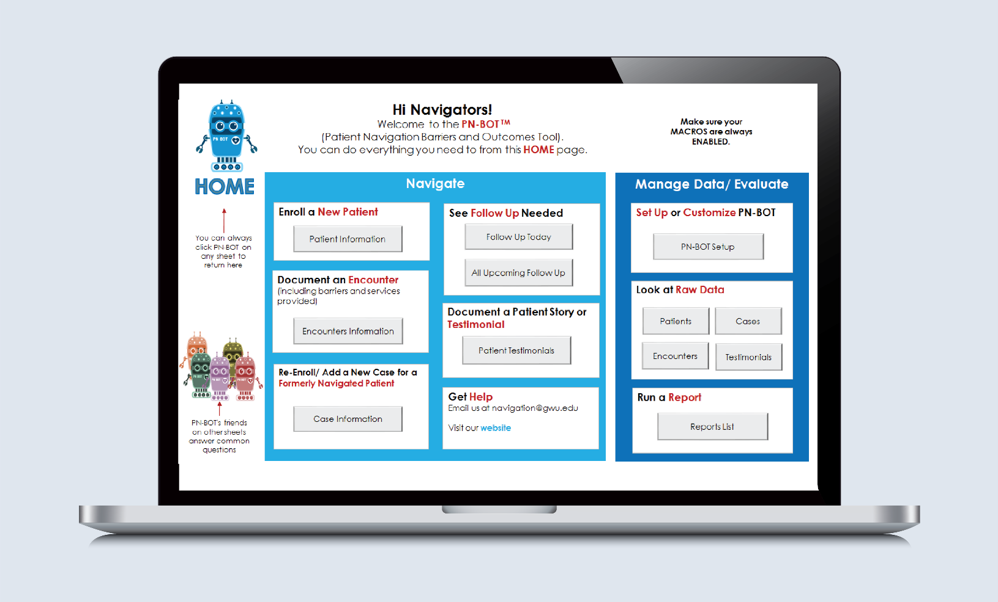
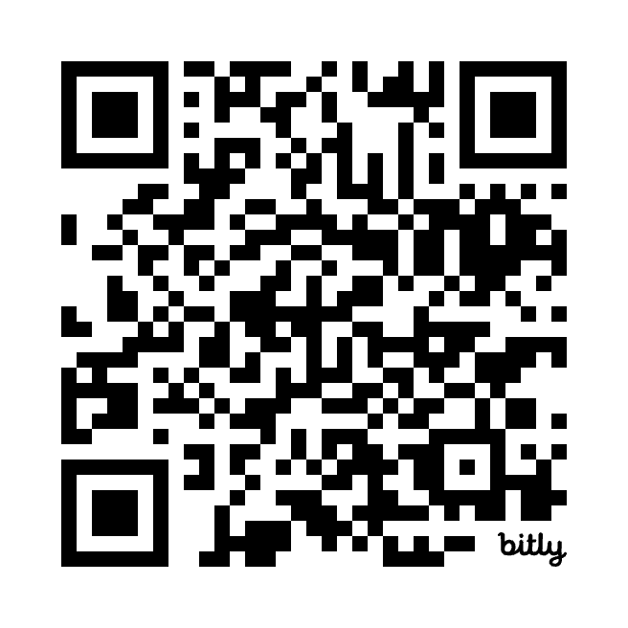
PN-BOTTM: A Free Resource for Data Tracking
bit.ly/PN-BOT
Created with support from Genentech.
Resource: GW Cancer Center. (n.d.) Patient Navigation Barriers and Outcomes Tool (PN-BOT). https://smhs.gwu.edu/gwci/BarriersTool
Notes:
The Patient Navigation Barriers and Outcomes Tool or PN-BOT(TM), is freely available and includes worksheets and a barriers list to track specific types of barriers – logistical, insurance-related, financial or employment. More specific logistical categories include transportation, housing, utilities, dependent care, food and nutrition, clothing and immigration status. Specific insurance barriers include being uninsured, underinsured or having high deductibles or co-pays. Specific financial barriers might be a need for financial planning, low financial literacy or other non-medical financial needs. Employment barriers include being unemployed, needing job accommodations, not being able to work through treatment or having family members with employment difficulties.
This tool provides fields to track when you identified this was a barrier for the patient, the date it was resolved, the action you took to address or resolve the barriers and the time it took you to resolve the barrier. This could be minutes or hours.

Slide 34
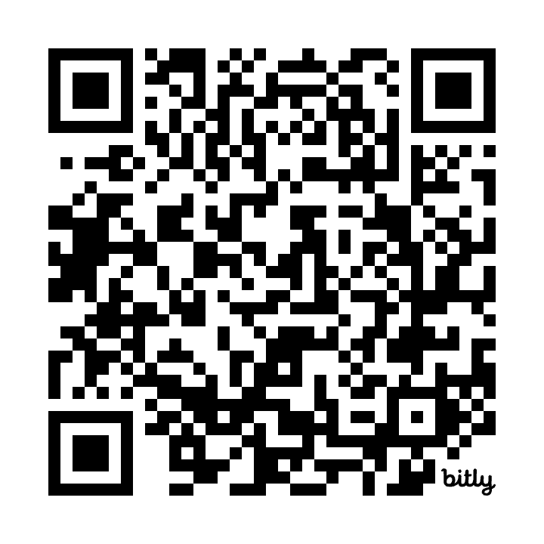
TEAM Training & I Want You to Know Cards
bit.ly/GWCCTEAMtraining
bit.ly/TEAMPatientCards
Notes:
GW also offers cards available to patients to help with communication to their healthcare team about their preferences. This tool is an easy way to ask patient’s information about their name, pronouns, religious beliefs, who they want involved in their care, etc. GW also offers the Together, Equitable, Accessible and Meaningful Training. This free training aims to improve health equity by supporting organizational changes at the systems level. It can help organizations implement quality improvements to advance equitable, accessible and patient-centered cancer care through improved patient-provider communication, cultural sensitivity, shared decision-making and attention to health literacy.

Slide 35
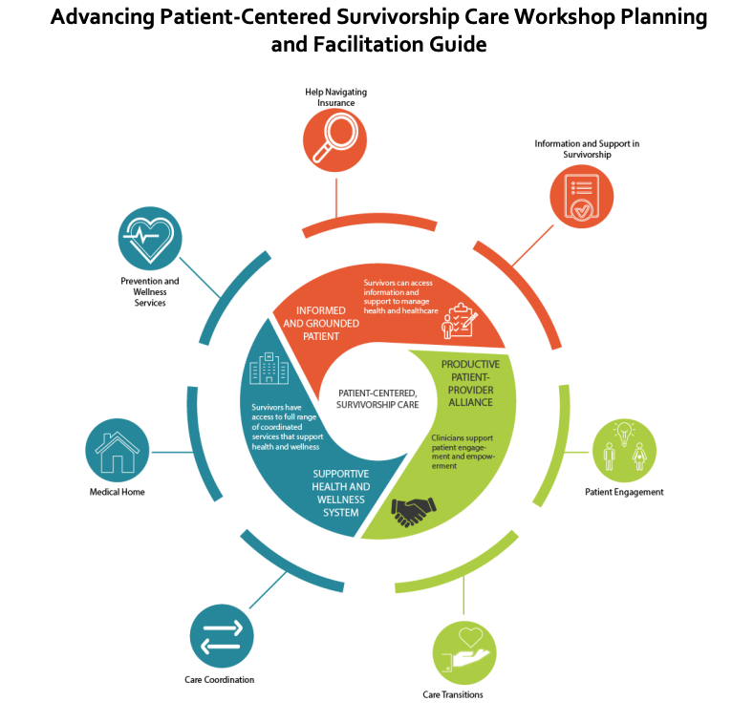
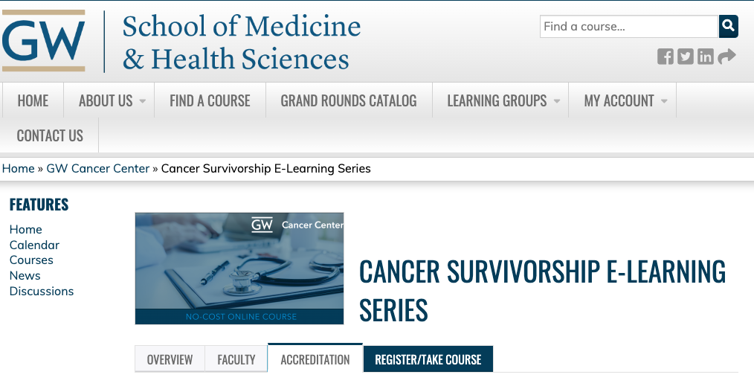
Cancer Survivorship Toolkits & Training
Notes:
There are many other patient focused and survivorship toolkits found on our GW Technical Assistance Program website at cancercontroltap.org.

Slide 36
Conclusion
Explain how to use the GW Patient Navigation Training
Explain how the training was developed
Identify required parts of the training
List the different competencies associated with each lesson
Describe how the training relates to the CMS required competency areas
Explain expected outcomes from taking this training
Notes:
This concludes the Introduction of the GW Oncology Patient Navigation Training: The Fundamentals course. In this introduction, you learned how to:
Explain how the training was developed
Explain how to use the GW Patient Navigation Training
Identify required parts of the training
List the different competencies associated with each lesson
Describe how the training relates to the CMS required competency areas
Explain the expected outcomes from taking this training
As you navigate through the course, we encourage you to refer to the resources provided to further enhance your knowledge and understanding of the presented topics. If you have any questions or require support at any point, please do not hesitate to contact us. We thank you for your interest in this training and hope you enjoy the course.

Slide 37
References
Baileys, K. A., McMullen, L., Lubejko, B., Christensen, D., Haylock, P. J., Rose, T., Sellers, J. B., & Srdanovic, D. (2018). Nurse navigator core competencies: An update to reflect the evolution of the role. Clinical Journal of Oncology Nursing, 22(3), 272-281. doi: 10.1188/18.CJON.272-281.
Centers for Medicare & Medicaid Services. (2023). 88 C.F.R. 78818. https://www.federalregister.gov/documents/2023/11/16/2023-24184/medicare-and-medicaid-programs-cy-2024-payment-policies-under-the-physician-fee-schedule-and-other
CHW Core Consensus Project. (2022). Community Health Worker Core Consensus Project. Retrieved December 12, 2024, from https://www.c3project.org/
Franklin, E., Burke, S., Dean, M., Johnston, D., Nevidjon, B., Booth, L. (2022). Oncology Navigations Standards of Professional Practice. Academy of Oncology Nurse & Patient Navigation. Vol 13:3. https://www.jons-online.com/jons-categories/282:navigation-standards
Pratt-Chapman, M., Willis, A., & Masselink, L. (2015). Core competencies for oncology patient navigators. Journal of Oncology Navigation & Survivorship. 6(2). Retrieved August 8, 2024, from https://www.jons-online.com/issues/2015/april-2015-vol-6-no-2/1320-core-competencies-for-oncology-patient-navigators.
Varanasi, A. P., Burhansstipanov, L. B., Dorn, C., Gentry, S., Capossela, A., Fox, K., Wilson, D., Tanjasiri, S., Odumosu, O., Ferrer, E. L. S. (2024). Patient navigation job roles by levels of experience: Workforce Development Task Group, National Navigation Roundtable. Cancer 130(9), 1549-1567. doi.org/10.1002/cncr.35147
Valverde, P. A., Burhansstipanov, L., Patierno, S., Gentry, S., Dwyer, A., Wysocki, K. L., Patterson, A. K., Krebs, L. U., Sellers, J., & Johnston, D. (2019). Findings from the National Navigation Roundtable: A call for competency-based patient navigation training. Cancer, 125(24), 4350–4359. doi: 10.1002/cncr.32470.

Slide 38
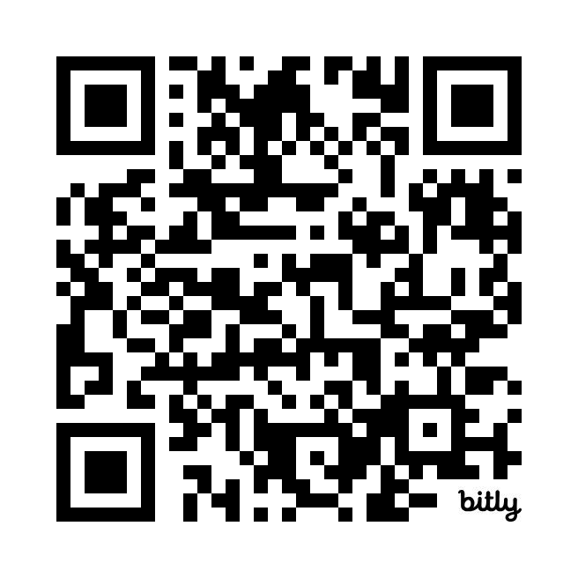
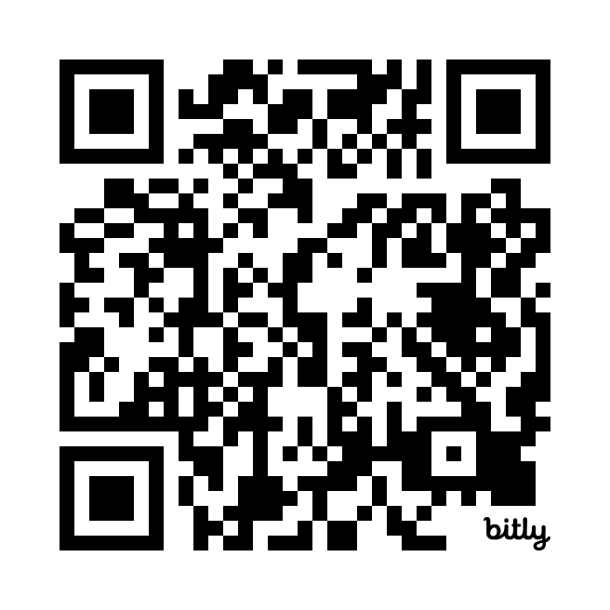
Thank you!
Sign up for the GW Cancer Center’s Patient Navigation and Survivorship E-Newsletter:
PNS Subscription
Sign up for the GW Cancer Center’s Cancer Control Technical Assistance E-Newsletter:
TAP Subscription
Notes:
Finally, we would like to thank you for investing your time in our training. Cancer negatively impacts people in so many ways and is a burden on public health. It is our hope that the learners like you who take this training feel appreciated in any role that is helping those who are affected by cancer. Thank you for all that you do.

