Slide 1
Cancer Basics: Continuum of Cancer Care
Oncology Patient Navigator Training: The Fundamentals
Notes:
Welcome to Cancer Basics: Continuum of Cancer Care, part of the GW Oncology Patient Navigator Training: The Fundamentals course. My name is ________________________________and I will be your presenter for this lesson.

Slide 2
Acknowledgements
This work was supported by Cooperative Agreement #NU58DP007539-01 from the Centers for Disease Control and Prevention. Its contents are solely the responsibility of the authors and do not necessarily represent the official views of the Centers for Disease Control and Prevention.
We would also like to thank the following for their help with revising this training:
Alex Hurst, National Council for Mental Wellbeing
Laurie Kirstein, Memorial Sloan Kettering Cancer Center
Janette Merrill, American Society of Clinical Oncology
Jess Quiring, Patient Navigation Advisors
Zarek Mena, Patient Navigation Advisors
Reesa Sherin, Association of Cancer Care Centers
Notes:
Before we begin, we would like to acknowledge the Centers for Disease Control and Prevention for supporting and funding this work. Its contents are solely the responsibility of the authors and do not necessarily represent the official views of the CDC.
Portions of this video are adapted from the National Cancer Institute’s Understanding Cancer presentation, which is available free of charge for educational purposes. Other content is taken from educational websites and cited accordingly.
We would also like to thank the following for their help with revising this training:
Alex Hurst, National Council for Mental Wellbeing
Laurie Kirstein, Memorial Sloan Kettering Cancer Center
Janette Merrill, American Society of Clinical Oncology
Jess Quiring, Patient Navigation Advisors
Zarek Mena, Patient Navigation Advisors
Reesa Sherin, Association of Cancer Care Centers

Slide 3
Learning Objectives
Describe what cancer is
Describe current cancer screening guidelines and tests to detect cancer
Summarize basic cancer treatment options
Identify supportive care services
Identify professional resources
Describe potential physical, psychological, social and spiritual effects of cancer and cancer treatments
Notes:
After completing this lesson, you will be able to:
Describe what cancer is
Describe current cancer screening guidelines and tests to detect cancer
Summarize basic cancer treatment options
Identify supportive care services
Identify professional resources
Describe potential physical, psychological, social and spiritual effects of cancer and cancer treatments
Please join me in the next video where we will begin this lesson by learning about what cancer is and the various kinds of cancer.

Slide 4
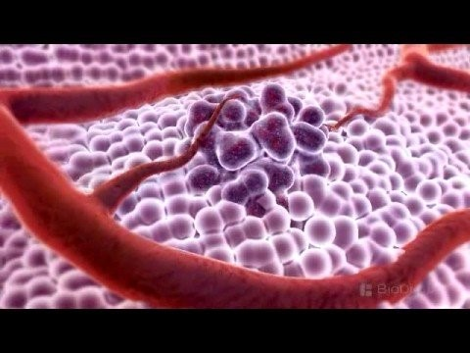
What is Cancer?
Click here to watch the video
Source: BioDigital Inc., 2008
Notes:
Let’s begin with learning what cancer is and how it affects the body. There are more than 100 different types of cancer that can begin almost anywhere in the body. Let’s take a look at this visual explanation.
3D Medical Animation - What is Cancer? (youtube.com)

Slide 5
Checkpoint
What is cancer? Choose one:
Foreign cells
Uncontrolled cell growth
Interacting cells
Lack of cells
Notes:
In this section, we will learn about what cancer is and the various kinds of cancer.
[CHECKPOINT]: Take a moment and ask yourself “What is cancer?” Is it:
Foreign cells
Uncontrolled cell growth
Interacting cells
Lack of cells
Choose an answer on the screen that you think best answers the question.

Slide 6
Checkpoint Answer
What is cancer? Choose one:
b) Uncontrolled cell growth
Notes:
The correct answer is B. Cancer is the uncontrolled growth of abnormal cells that divide and invade others within a person’s body. Everyone has trillions of cells in their body that grow and divide and make new cells and die in a controlled way. Cancer happens when cells become abnormal and start to grow out of control. This might mean that cells that are supposed to die don’t die when the cells are no longer needed. Or it could mean that abnormal cells replicate too rapidly and grow into other tissues. Growing out of control and growing into other tissues make cells cancerous.
Choice A is incorrect. Cancer is made up of our own cells that have mutated, or changed, to become abnormal and invasive.
Choice C is also incorrect. Normal cells also interact.
Choice D is incorrect- it is not a lack of cells.

Slide 7
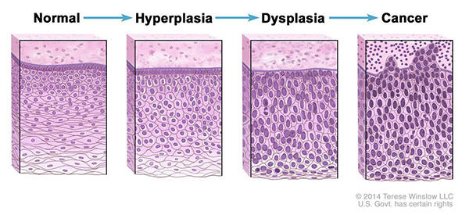
Normal Cells vs Cancer Cells
Source: National Cancer Institute What Is Cancer?, 2021
Notes:
[NORMAL CELLS VS CANCER CELLS]: Normal cells in the body can become cancer cells by going through abnormal changes called hyperplasia and dysplasia. In hyperplasia, this is an increase in the number of cells in an organ or tissue. These cells still appear normal under a microscope. In dysplasia, the cells look abnormal under a microscope but are not considered cancer cells. Hyperplasia and dysplasia may or may not become cancer.

Slide 8
Benign vs Malignant Tumors
Benign
Malignant
Non-cancerous
Do not grow into other tissue
Cancerous
Invade tissue or spread
Source: National Cancer Institute What is Cancer?, 2021
Notes:
[BENIGN V MALIGNANT TUMORS]: A tumor is an abnormal mass, or group, of cells. Tumors are benign—or non-cancerous—if they do not grow into other tissue. Benign tumors can still cause problems by putting pressure on other organs if they grow large, so even benign tumors may need to be removed surgically in some cases.
Tumors are malignant—or cancerous—if they are made up of abnormal cells, invade tissue, and/or spread to other places in the body. This spread of cancer is known as "metastasis," which occurs when cancer cells travel to a site other than where they first started.
The most common sites where cancers spread are the liver, lungs, bones, and brain. For example, breast cancer cells might be found in the liver if they metastasize.

Slide 9
Types of Cancer
Carcinomas
Start in the cells that cover external and internal organs or glands. Common carcinomas in the United States include lung, breast, prostate and colorectal cancers
Sarcomas
Start in cells of the supporting tissues of the body, such as bone, cartilage, fat, connective tissue and muscle
Lymphomas
Start in the lymph nodes and tissues of the body’s immune system
Leukemias
Start in the immature blood cells that grow in the bone marrow
Source: National Cancer Institute What is Cancer?, 2021
Notes:
[DIFFERENT KINDS OF CANCER]: There are several different kinds of cancer.
Carcinomas are the most common types of cancer. They start in the cells that cover external and internal organs or glands. The most common carcinomas in the United States include lung, breast, prostate, and colorectal cancers.
Sarcomas begin in the cells of the body's supporting tissues, such as bone, cartilage, fat, connective tissue, and muscle.
Lymphomas originate in the lymph nodes and tissues of the body's immune system.
Leukemias are cancers of immature blood cells that grow in the bone marrow and often accumulate in large numbers in the bloodstream.

Slide 10
How are cancers named?
adeno-
gland
chondro-
cartilage
erythro-
red blood cell
hemangio-
blood vessels
hepat(o)-
liver
lipo-
fat
lympho-
lymphocyte
melano-
pigment cell
myelo-
bone marrow
myo-
muscle
nephro-
kidney
bone
osteo-
Bone
Source: National Cancer Institute SEER, 2024
Notes:
Cancer can start almost anywhere in the body. Scientists use a variety of names to distinguish the different types of carcinomas, sarcomas, lymphomas, and leukemias. Many of these names use different Latin and Greek prefixes that stand for the location where the cancer began. For example, the prefix “osteo” means bone, so a cancer starting in bone is called an osteosarcoma. Similarly, the prefix “adeno” means gland, so a cancer of a gland cell is called adenocarcinoma--a breast adenocarcinoma for example.

Slide 11
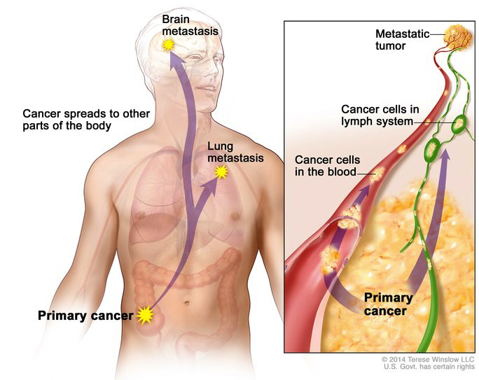
Invasion and Metastasis
Source: National Cancer Institute What is Cancer?, 2021
Notes:
Cancers are capable of spreading throughout the body by two mechanisms: invasion and metastasis. Invasion refers to the direct migration and penetration of cancer cells into neighboring tissues. Metastasis refers to the ability of cancer cells to penetrate into lymphatic and blood vessels, circulate through the bloodstream or lymphatic system, and then invade normal tissues elsewhere in the body. It is important to note that the new, metastatic tumor is the same type of cancer as the primary tumor. For example, if breast cancer spreads to the lung, the cancer cells in the lung are breast cancer cells, not lung cancer cells.

Slide 12
Source: National Cancer Institute, 2017
Notes:
Let’s check out this brief video by the National Cancer Institute to understand more about how cancer spreads throughout the body.
https://www.youtube.com/watch?v=fQwar_-QdiQ

Slide 13
Checkpoint
What modifiable factors may increase risk for cancer? Choose one:
Tobacco use
Nutrition
Alcohol consumption
Physical inactivity
All of the above
Source: National Cancer Institute, 2024
Notes:
[CHECKPOINT]: Now that we have discussed the different types of cancer and their origins, let's explore the modifiable factors that may increase the risk for cancer. Understanding these risk factors can help us identify ways to potentially reduce our chances of developing the disease.Question: What modifiable factors may increase risk for cancer?
a) Tobacco use b) Nutrition c) Alcohol consumption d) Physical inactivity f) All of the above

Slide 14
Checkpoint Answer
What modifiable factors may increase risk for cancer?
e) All of the above
Source: National Cancer Institute, 2024
Notes:
The choice e is correct. All of the above are modifiable factors that may increase a person’s risk for cancer. Cancer is often thought of as a disease that strikes for no apparent reason. While scientists don’t yet know all the reasons, many factors that may lead to cancer have been identified. Some of the factors, like the ones listed here—tobacco use, alcohol use, certain foods - like processed foods, and physical activity—are things that people have some control over, even though it can often be very hard to change behaviors that have become habits. It can also be challenging to change the types of foods we eat depending on how accessible fresh food is to where we live and work and the cost of foods. Often foods that are not as good for us are cheaper to buy. It can be harder to exercise if we do not have safe places to walk or bike, but remember that physical activity can include household chores and taking the stairs instead of an elevator when you have a choice.

Slide 15
Cancer Risk Reduction
Although there is no way to completely prevent a diagnosis of cancer, healthy behaviors can reduce the risk for cancer.
Behaviors to Avoid
Healthy Behaviors
Avoid smoking and e-cigarettes
Avoid exposure to carcinogens
Consume fruits and vegetables
Avoid alcohol
Avoid excessive sun/UV exposure
Exercise regularly
Source: Chidharla, A., et al. (2022)
Notes:
[CANCER RISK REDUCTION]: According to the National Cancer Institute, tobacco products are the single largest cause of cancer death and are implicated in roughly one out of every three cancer deaths. Cigarette smoking is responsible for many, but not all, cases of lung cancer and has been linked to cancers of the mouth, larynx, esophagus, stomach, pancreas, kidney, and bladder. Smoking also increases cardiovascular side effects of radiation or chemotherapy, reduces quality of life, and increases mortality. A recent study found that up to two-thirds of smokers will die from the habit if they continue smoking. Pipe smoke, cigars, and smokeless tobacco are also risky. E-cigarettes, while often marketed as a safer alternative, are not safe and still pose significant health risks. The aerosol produced by e-cigarettes contains nicotine and other harmful substances that contribute to lung disease, heart disease, and cancer. Recent studies indicate that e-cigarette users have a 2.2 times higher risk of developing cancer compared to non-smokers. Additionally, although e-cigarette users have a lower prevalence of cancer compared to traditional smokers, they are diagnosed with cancer at a younger age. Avoiding all forms of tobacco is the single most effective lifestyle decision any person can make to prevent cancer.
Drinking alcohol is linked to an increased risk for several kinds of cancer, especially those of the mouth, throat, and esophagus. The combination of alcohol and tobacco is particularly dangerous and significantly increases the risk of cancer more than each factor alone.
While some sunlight is beneficial for health, excessive exposure can cause skin cancer, including a serious form of skin cancer called melanoma. Melanomas are potentially lethal tumors. The risk of melanoma and other skin cancers can be significantly reduced by avoiding excessive sun exposure, using sunscreen, and wearing protective clothing to shield the skin from ultraviolet radiation. This also includes not using indoor tanning beds: No amount of UV exposure is considered safe from indoor tanning.
What we eat also affects our cancer risk. While fats and calories appear to increase cancer risk, other dietary components may decrease our risk for cancer. Eating fruits and vegetables has been strongly correlated with reduced cancer risk. Consuming five to nine servings of fruits and vegetables each day is recommended.
Regular exercise also reduces cancer risk. Lack of physical activity and being overweight are risk factors for cancers of the breast, colon, esophagus, kidney, and uterus.

Slide 16
Additional Cancer Risk Factors
Some infections: HPV, Hepatitis B, HIV
Immunosuppressive medicine
Radiation (sun, UV, radon)
Environmental exposures
Inherited genes
BRCA 1
BRCA 2
Lynch Syndrome
Source: National Cancer Institute, 2024; Centers for Disease Control and Prevention, 2024
Notes:
In addition to avoiding tobacco and alcohol, eating fresh foods that have not been processed, and moving more, other ways to reduce cancer risk include getting the human papillomavirus (or HPV) vaccination to reduce risk for HPV-associated cancers like cervical cancer, anal cancer and head and neck cancers.
Hepatitis B is a risk factor for liver cancer. And people with HIV are at a higher risk for several cancers, including Kaposi sarcoma, aggressive B-cell non-Hodgkin lymphoma, and cervical cancer. Other cancers that are more prevalent among people living with HIV include anal cancer, Hodgkin lymphoma, lung cancer, mouth and throat cancers, skin cancer and liver cancer.
There are several types of carcinogens that can put a person at greater risk for cancer that may be hard to avoid.
For example, immunosuppressive medicines, often used for organ transplants, can increase a person’s risk for cancer.
Exposure to radiation from the sun, medical radiation, or radon gas is another cancer risk factor.
Occupational carcinogens, and those found in daily living environments may damage healthy cells and cause cancer. For example, construction workers exposed to asbestos have cancer rates ten times higher than normal. Firefighters are exposed to volatile organic compounds (VOCs) that put them at greater risk for cancer. Carcinogens can also be found in old homes with asbestos, radon gas, and uranium mines. Environmental pollution is also a carcinogen.
Genetics can also play a significant role in the development of cancer. The National Cancer Institute estimates that inherited gene mutations—genes passed from one family member to another—are major risk factors in 5-10% of cancers. Scientists are discovering more and more inherited mutations that predispose individuals to various types of cancer.
For example:
BRCA 1 and BRCA 2: These gene mutations, often referred to as "BRCA 1" and "BRCA 2," increase the risk of female breast and ovarian cancers.
Lynch Syndrome: This genetic condition elevates the risk of developing colorectal cancers.
Understanding these risk factors can help us take preventive measures and seek appropriate screenings.

Slide 17
Cancer Risk Reduction
In the United States, 4 out of 10 cancer cases and almost half of all deaths from cancer are associated with preventable risk factors
Source: American Cancer Society, 2024; AACR Cancer Progress Report, 2018
Notes:
[CANCER PREVENTION]:
It’s estimated that 40% of the cancer cases diagnosed in the United States and nearly half of all deaths from cancer are caused by things we can change.
Many cancer risk factors are also risk factors for other chronic diseases, such as cardiovascular disease, respiratory diseases, and diabetes. This is why public education and policy initiatives to reduce or eliminate exposure to potentially modifiable cancer risk factors may also reduce risk for many diseases, including cancer. Most U.S. adults are still unaware of the significant cancer risks associated with obesity and alcohol use. This points to the continued need to raise awareness about what we know from science that can reduce cancer risk. Navigators, community health workers, social workers and nurses play an important role in educating the public about cancer risk reduction.
Potential Anticancer Effects of Food-Related Components - Scientific Figure on ResearchGate. Available from: https://www.researchgate.net/figure/Risk-factors-of-cancer_fig2_361532656 [accessed 7 Nov 2024]

Slide 18
Signs and Symptoms
Breast changes: Lump or firm feeling in the breast or under the arm, nipple changes or discharge, skin that is itchy, red, scaly, dimpled or puckered Bladder changes: Trouble urinating, pain when urinating, blood in the urine Bleeding or bruising: Occurring for no known reason Bowel changes: Blood in the stool, changes in bowel habits Cough or hoarseness: Does not go away Eating problems: Pain after eating (heartburn or indigestion that doesn’t go away), trouble swallowing, belly pain, nausea and vomiting, appetite changes Fatigue: Severe and lasting
Source: National Cancer Institute Symptoms of Cancer, 2019
Notes:
[SIGNS AND SYMPTOMS]: Shown here are some common symptoms of cancer, which can help in early detection and prompt referral to healthcare professionals. These symptoms include:
Breast changes: Lump or firm feeling in the breast or under the arm, nipple changes or discharge, skin that is itchy, red, scaly, dimpled or puckered
Bladder changes: Trouble urinating, pain when urinating, blood in the urine
Bleeding or bruising for no known reason
Bowel changes: Blood in the stool, changes in bowel habits
Cough or hoarseness that does not go away
Eating problems: Pain after eating (heartburn or indigestion that doesn’t go away), trouble swallowing, belly pain, nausea and vomiting, appetite changes
Fatigue that is severe and lasts

Slide 19
Signs and Symptoms Cont.
Fever or night sweats: Occurring for no known reason Mouth changes: A white or red patch on the tongue or in the mouth, bleeding, pain or numbness in the lip or mouth Neurological problems: Headaches, seizures, vision changes, hearing changes, drooping of the face Skin changes: A flesh-colored lump that bleeds or turns scaly, a new mole or a change in an existing mole, a sore that does not heal, jaundice (yellowing of the skin and whites of the eyes) Swelling or lumps: Appearing anywhere, such as in the neck, underarm, stomach or groin Unintentional weight gain or weight loss: Occurring for no known reason
Source: National Cancer Institute Symptoms of Cancer, 2019
Notes:
[SIGNS AND SYMPTOMS CON’T]:
Fever or night sweats: Occurring for no known reason
Mouth changes: A white or red patch on the tongue or in the mouth, bleeding, pain or numbness in the lip or mouth
Neurological problems: Headaches, seizures, vision changes, hearing changes, drooping of the face
Skin changes: A flesh-colored lump that bleeds or turns scaly, a new mole or a change in an existing mole, a sore that does not heal, jaundice (yellowing of the skin and whites of the eyes)
Swelling or lumps: Appearing anywhere, such as in the neck, underarm, stomach or groin
Unintentional weight gain or weight loss: Occurring for no known reason
Additionally, there are symptoms that may vary depending on the type of cancer.
It is very important to always refer people to a clinician or the healthcare team for an accurate explanation of symptoms or diagnosis. Proper evaluation by a professional is essential for appropriate diagnosis and treatment.

Slide 20
Early Cancer May Not Have Any Symptoms
Some people may visit the doctor only when they feel pain or when they notice changes like a lump in the breast or unusual bleeding or discharge. However, early cancer may not have any symptoms, which is why routine screenings and doctor’s visits are so important for early detection.
Notes:
[EARLY CANCER MAY NOT HAVE ANY SYMPTOMS]: Some people may visit the doctor only when they feel pain or notice changes like a lump in the breast, or unusual bleeding or discharge. However, it is important to note that early-stage cancer may not have any symptoms at all. This is why routine screenings and regular doctor’s visits are important. While screening doesn’t PREVENT cancer, it helps find cancer early. This is called “early detection.” The way early detection works is by finding cancer when it is localized and less likely to be metastatic. Early-stage cancer is easier to treat and outcomes from treatment tend to be better.

Slide 21
Cancer Detection and Diagnosis
Cancer can be diagnosed with biopsies, blood tests, urine tests, colonoscopies or sigmoidoscopies, X-rays, ultrasounds, bone scans, CT scans, MRIs and/or surgery
When cancer is found, a doctor will determine what type it is and how fast it is growing
Finding cancer early may decrease a person’s risk of dying from the cancer. For this reason, improving methods for early detection is a high priority
Source: National Cancer Institute Diagnosis and Staging, 2023
Notes:
[CANCER DETECTION AND DIAGNOSIS]: The methods used to diagnose cancer depend on the type of cancer in question. Diagnosis can be achieved through various procedures, including biopsies, blood tests, urine tests, colonoscopies, sigmoidoscopies, x-rays, ultrasounds, bone scans, CT scans, MRI scans, and/or surgery. Often, several methods are used in combination to confirm a diagnosis.
When cancer is detected, a doctor will determine the type of cancer and assess how fast it is growing. They will also check if cancer cells have invaded nearby healthy tissue or spread to other parts of the body. Early detection can reduce a person's risk of dying from cancer. Therefore, improving our methods for early detection is a high priority in cancer research and healthcare.

Slide 22
Screening for Early Detection
U.S. Preventive Services Task Force (USPSTF)
American Cancer Society (ACS)
American College of Obstetricians and Gynecologists (ACOG)
Screening is important for early detection of:
Cervical cancer
Breast cancer
Prostate cancer
Colorectal cancer
Lung Cancer
Source: National Cancer Institute, 2024
Notes:
[SCREENING]: In general, screening tests are based on recommendations from national guideline-setting organizations like the U.S. Preventive Services Task Force, the American Cancer Society, or the American College of Obstetricians and Gynecologists. It is important to be aware of which guidelines your clinic or program follows.
The screening tests a person may need depend on their age, sex, personal or family history of disease, and other risk factors.
Screening is especially important in the early diagnosis of:
Cervical cancer
Breast cancer
Prostate cancer
Colorectal cancer
Lung cancer
Screening tests are performed to detect a condition or chronic disease early, which can make them easier to treat and decrease a person's risk of dying or minimize the need for more toxic treatments. Primary care doctors often perform or recommend screening tests. Community health workers and patient navigators play an important role in helping people adhere to screening guidelines by linking people with doctors and helping to address barriers to screening.

Slide 23
Source: Iowa Cancer Consortium Screening Toolkit, 2023; Prevent Cancer Foundation, 2024
Notes:
[SCREENING GUIDES 1]: Cancer screening guidelines change as we gather more evidence through science. It can be confusing to keep up with current recommendations. Screenings guidelines issued by state or national programs can be helpful educational tools to summarize current recommendations. Be mindful that any guide you use should have the most up to date recommendations. Here are two examples of educational guides created to summarize recommendations for cancer screenings.

Slide 24
Source: American Cancer Society, 2023
Notes:
[SCREENING GUIDES 2]: Here is another screening recommendation tool that can be printed and provided to patients to help clarify when basic screenings are recommended. You will notice that guidelines are different across different guideline-setting organizations. Here, the American Cancer Society recommends screening starting at age 25. Iowa’s screening guide used the U.S. Preventive Task Force recommendation for cervical cancer screening starting at age 21. These differences can be confusing to people. When guidelines are conflicting, CHWs and navigators can explain to people that experts interpret the scientific evidence in different ways and direct them to speak to their doctor about what screening is right for them based on their personal risk factors.

Slide 25
Screening for Transgender and Intersex Persons
Cancer Screening | Transgender men / transmasculine spectrum | Transgender women / transfeminine spectrum | Intersex persons
Breast | See American College of Radiology guidelines | See American College of Radiology guidelines | See American College of Radiology guidelines
Cervical | Screen with trauma-informed approach to care; Consider HPV self-testing | Not indicated | Screen with trauma-informed approach to care; Consider HPV self-testing
Prostate | Not indicated | Individualize screening based on risk factors (e.g., >50 years of age, African American) Prostate-specific antigen 1 ng/mL is upper limit of normal if person is on estrogen therapy | Individualize based on risk and benefits if person has a prostate
Source: Caughey et al. (2021); Expert Panel on Breast Imaging et al. (2021); Pratt-Chapman & Potter (2019)
Notes:
Current guidelines are not generally responsive to the queer community in general and the gender expansive community in particular. However, this is changing. Going forward, the US Preventive Services Task Force will use gender-neutral language to communicate screening for people with specific body parts rather than by gender. While more research needs to be done, here we summarize what we know now about how screening might be tailored for transgender and intersex people.
Of course, all people, regardless of gender or sex assigned at birth, should be screened for colorectal cancer and lung cancer based on general population guidelines.

Slide 26
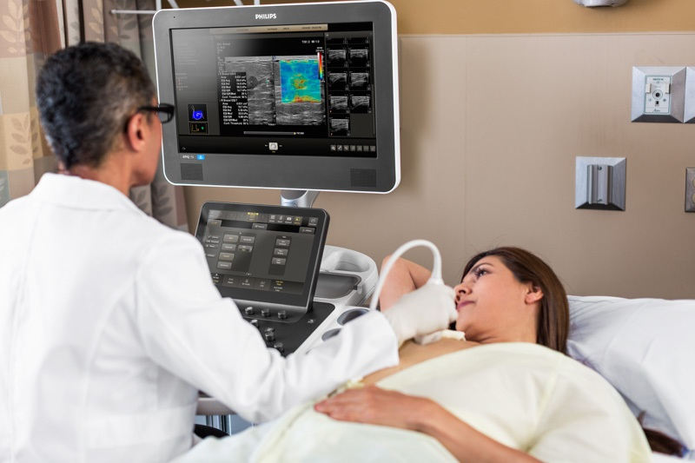
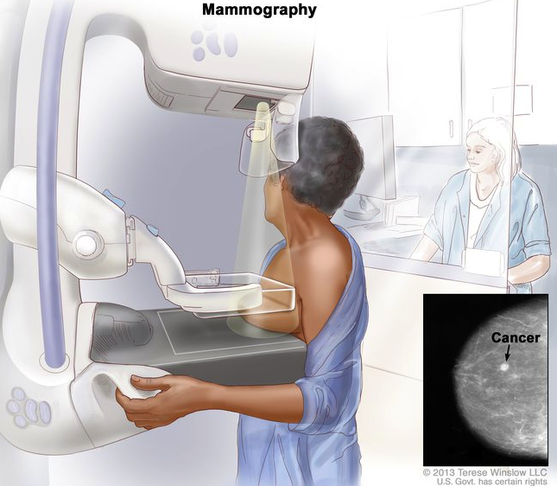
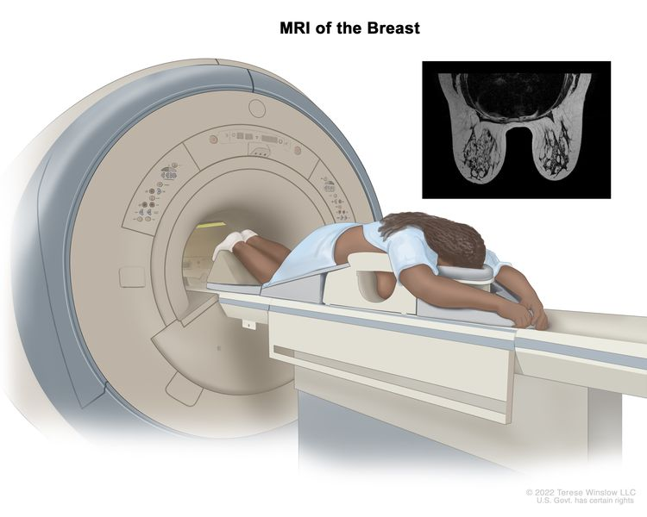
Breast Cancer Screening
Source: National Cancer Institute Breast Cancer Screening (PDQ®)--Health Professional Version, 2023
Notes:
Let’s explore the various screening options by type of cancer in more detail.
[BREAST CANCER SCREENING]: Breast cancer can sometimes be detected in its early stages using a mammogram, which is an X-ray of the breast. Mammography is most beneficial for people with breast tissue as they age and undergo menopause. It is a screening tool that can detect the possible presence of an abnormal tissue mass. However, by itself, it is not accurate enough to confirm whether breast cancer is present. If a mammogram indicates the presence of an abnormality, further tests such as ultrasounds, a breast MRI, or biopsy must be done to determine whether breast cancer does exist.
People with extremely dense breasts are recommended to undergo a screening ultrasound or additional testing such as breast MRIs and biopsies. Together, these additional tests can detect approximately 90% of breast cancers.

Slide 27
Breast Screening for Transgender Persons
Transfeminine person age 25 or older with genetic predisposition to breast cancer | Usually appropriate
Transfeminine person or transgender woman with no hormone use or hormone use less than 5 years of any age | Usually not appropriate
Transgender man with bilateral mastectomies (“top surgery”) at any age | Usually not appropriate
Transgender man with reduction mammoplasty or no chest surgery, age 40 or older, average risk | Usually appropriate
Transmasculine person with reduction mammoplasty or no chest surgery age 25 or older with genetic predisposition to breast cancer | Usually appropriate
Source: Expert Panel on Breast Imaging et al. (2021)
Notes:
Shown on the screen is a simplified summary of the American College of Radiology’s 2021 guidelines for breast cancer screening in transgender persons. In the additional resources section below, you may reference various case scenarios from the American College of Radiology to inform breast and chest screening for transgender persons.

Slide 28
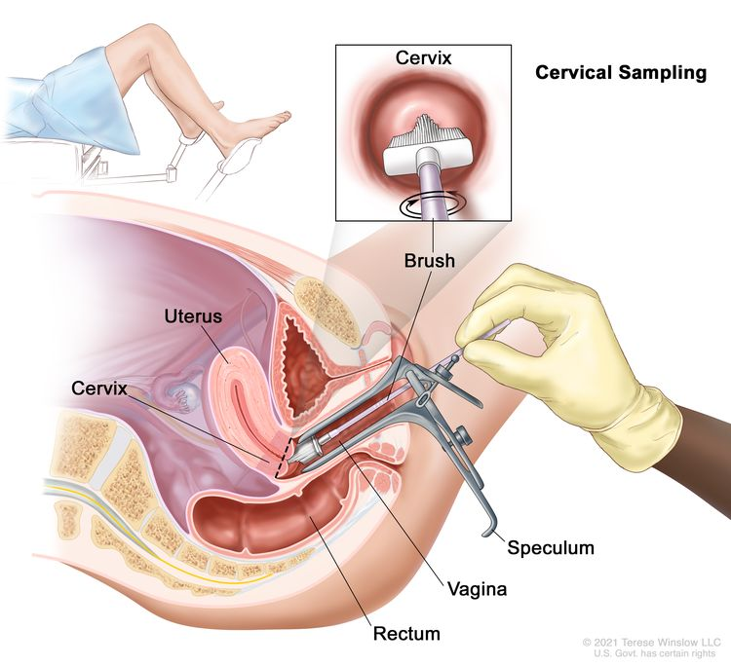
Cervical Cancer Screening
There are 13 high-risk types of HPV recognized as major causes of cervical cancer.
Source: National Cancer Institute, 2024; The American Society of Clinical Oncology Post Staff, 2024; Welsh et al. (2021)
Notes:
[CERVICAL CANCER SCREENING]: A screening technique called the Pap test (or Pap smear) can detect cervical cancer. The cervix is the narrow portion of the uterus that extends into the upper part of the vagina. During this procedure, a doctor uses a small brush or scraper to remove a sample of cells from the cervix and upper vagina. These cells are then placed on a slide or in a liquid and sent to a laboratory, where they are examined for abnormalities. Since the 1930s, the Pap test has contributed to a more than 75 percent reduction in the death rate from cervical cancer.
If abnormalities are found, additional tests or procedures may be necessary. Currently, there are 13 high-risk types of HPV recognized as major causes of cervical cancer. Tests are available to detect these high-risk types of HPV. Some tests can identify the presence of any of these high-risk types, while others are more specific to HPV strains 16 and 18, which cause the majority of cervical cancer cases in the U.S.
These tests can sometimes detect the virus before it causes any visible changes to the cervical cells. This is why cervical screening recommendations now provide options for Pap OR HPV testing or both. In 2024, the Food and Drug Administration (FDA) approved HPV self-testing, which is a major win for the LGBTQI community given gender dysphoria associated with Pap testing for transgender men and nonbinary people with a cervix. All cervical cancer screening should take a trauma informed approach, and navigators and clinicians should be aware that this is especially important for LGBTQI populations given historical experiences with healthcare that reinforce trauma.

Slide 29
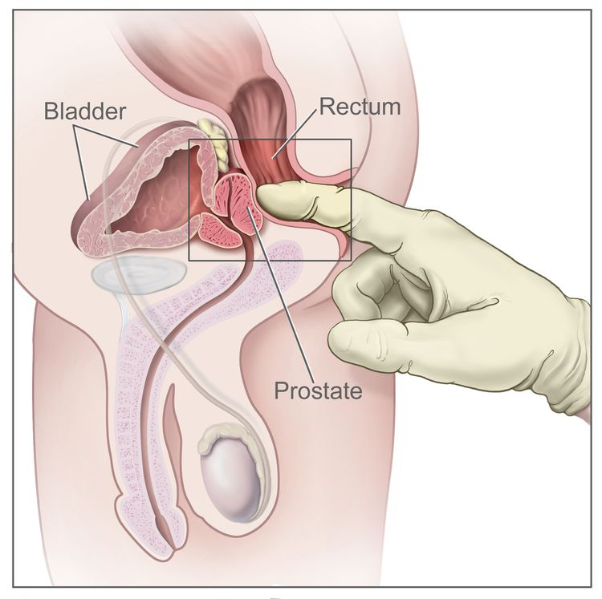
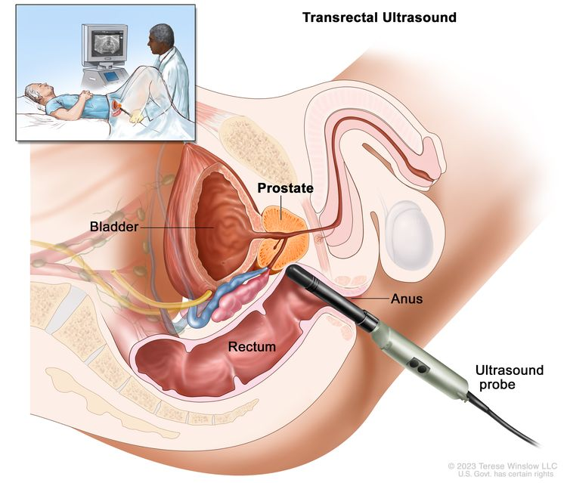
Prostate Cancer
Source: Pratt-Chapman & Potter (2019); National Cancer Institute Prostate Cancer Treatment (PDQ®)–Patient Version, 2024; Nik-Ahd et al. (2024)
Notes:
[PROSTATE CANCER]: Doctors often use the Prostate-Specific Antigen (PSA) test and Digital Rectal Exam (DRE) as prostate cancer screening tests. Prostate-specific antigen, or PSA, is a protein produced by cells of the prostate gland. The PSA test measures the level of PSA in a person’s blood. In a Digital Rectal Exam, the doctor inserts a gloved, lubricated finger into the rectum to feel for lumps or other abnormalities. Together, these tests can help doctors detect prostate cancer in people who have no symptoms of the disease.
Importantly, while a PSA level of 4.0 ng/ML is generally considered normal for cisgendered men, a PSA level of less than 1.0 ng/ML is normal for transgender women who are on hormonal therapy. A 2024 study cited 2.0 ng/ML as the average PSA level for transgender women receiving estrogen.

Slide 30
Colorectal Cancer Screening
Stool test: Fecal occult blood test (FOBT)
Detects small amounts of blood in stool
Sigmoidoscopy
Uses lighted instrument in rectum and lower colon
Colonoscopy
Uses lighted instrument in colon, including upper colon, polyp removal
Blood-based DNA test (liquid biopsy)
A blood test for adults 50+ years who have a history of not completing colorectal cancer screening
Virtual Colonoscopy
X-ray (a CT scanner) produces pictures of the colon and the rectum from outside the body
Source: National Cancer Institute Screening Tests to Detect Colorectal Cancer and Polyps, 2021; Centers for Disease Control and Prevention Screening for Colorectal Cancer, 2024
Notes:
[COLORECTAL CANCER SCREENING]: There are several types of tests to screen for colorectal cancer. The most common are fecal occult blood test (FOBT), sigmoidoscopy, colonoscopy, blood-based DNA tests, and virtual colonoscopy (CT scan screening).
A fecal occult blood test (FOBT) detects invisible amounts of blood in the feces or stool, which is a possible sign of several disorders, including colorectal cancer. The test is painless and can be done at home or in the doctor’s office along with a rectal exam. With an applicator stick, a dab of a stool specimen is smeared on a chemically treated card, which is tested in a laboratory for evidence of blood. Generally, several samples are needed for accurate testing. If blood is confirmed in the stool, more tests may be done to find the source of the bleeding.
Sigmoidoscopy uses a lighted instrument called a sigmoidoscope to find precancerous or cancerous growths in the rectum and lower colon.
A Colonoscopy uses a lighted instrument called a colonoscope to find precancerous or cancerous growths throughout the colon, including the upper part. This is similar to flexible sigmoidoscopy, except the doctor uses a longer, thin, flexible, lighted tube to check for polyps or cancer inside the rectum and the entire colon. During the test, the doctor can find and remove most polyps and some cancers. Colonoscopy is also used as a follow-up test if anything unusual is found during one of the other screening tests.
Blood-based DNA tests are a newer method of screening for colorectal cancer that can detect certain DNA markers associated with cancer in a blood sample.
Virtual colonoscopy, or CT colonography, uses a CT scan to produce detailed images of the colon and rectum to identify any abnormal growths or polyps.
The decision about which test to have usually takes into account several factors, including:
The person’s age, medical history, family history, and general health
The potential harms of the test
The preparation required for the test
Whether sedation may be needed
The follow-up care needed after the test
The convenience and the cost of the test and the availability of insurance coverage

Slide 31
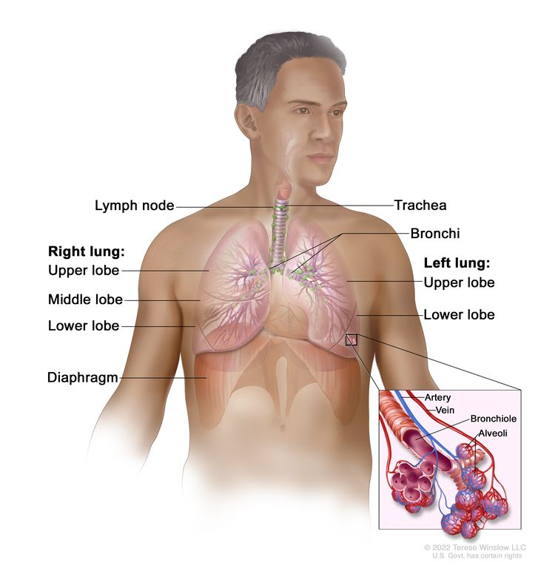
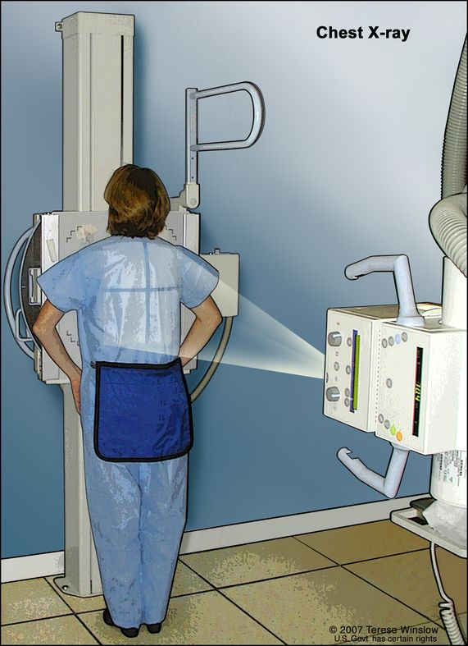
Lung Cancer Screening
Source: US Preventive Services Task Force, 2021; National Cancer Institute, 2023
Notes:
[LUNG CANCER SCREENING]: Screening with low-dose computed tomography (LDCT), also known as a low-dose CT scan, can help detect lung cancer. This screening is recommended for adults within certain age ranges who have an extensive smoking history and who either still smoke or have quit smoking within the past 15 years. During this test, an x-ray machine scans the person’s body and creates detailed images of the lungs using low doses of radiation.

Slide 32
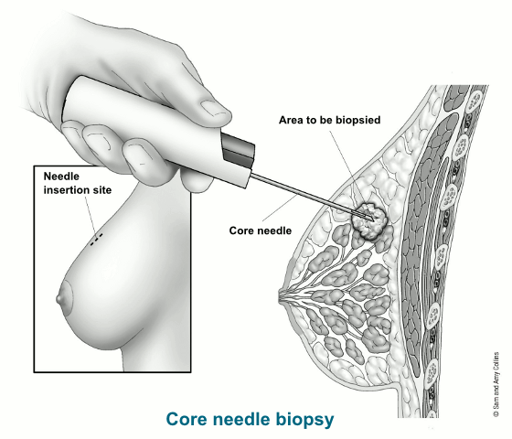
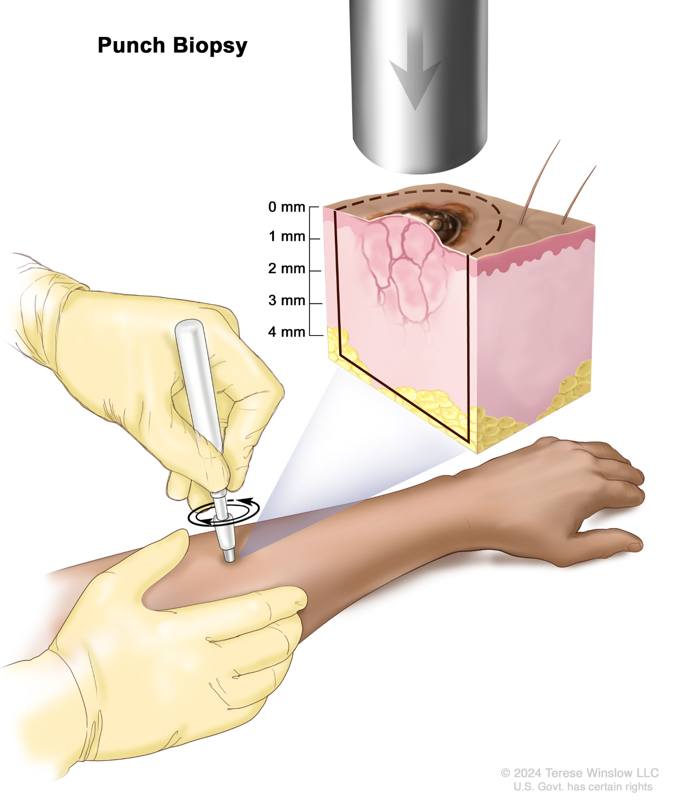
Biopsy
Source: National Cancer Institute, 2024; National Cancer Institute, 2019
Notes:
[BIOPSY]: To diagnose the presence of cancer, a doctor generally must examine a sample of the affected tissue under a microscope. When preliminary symptoms, Pap test, mammogram, PSA test, FOBT, or other screening tests indicate the possible existence of cancer, a doctor must then perform a biopsy. A biopsy involves the surgical removal of a small piece of tissue for microscopic examination. For example, during a colonoscopy, any polyps or abnormal growths found are removed and biopsied at that time, so a separate biopsy is generally not needed. For leukemias, a small blood sample serves the same purpose. This microscopic examination will tell the doctor whether abnormal cells are present and, therefore, whether a tumor is malignant or benign.
In addition, microarrays, which are small pieces of DNA, may be used to determine which genes are turned on or off in the sample. Proteomic profiles, which provide information about proteins in the blood, other body fluids, or tissues, may also be collected. This information helps doctors make a more accurate diagnosis and can inform treatment planning.
There are various different kinds of biopsies. The first image on the slide shows a core needle biopsy, the second image shows punch biopsy.

Slide 33
Microscopic Appearance of Cancer Cells
Normal connective tissue
Cancerous connective tissue
Source: National Cancer Institute Dr. Cecil Fox (Photographer)
Notes:
[MICROSCOPIC APPEARANCE OF CANCER CELLS]: Cancer tissue has a distinctive appearance under the microscope. The doctor looks for several key traits, including a large number of irregularly shaped dividing cells, variation in the size and shape of the cell's nucleus, variation in overall cell size and shape, loss of specialized cell features, disruption of normal tissue organization, and a poorly defined tumor boundary.

Slide 34
Tumor Grading
General Relationship Between Tumor Grade and Prognosis
100%
Low grade
Patient
Survival
Rate
High grade
1
2
3
4
5
Years
Source: National Cancer Institute Tumor Grade, 2022
Notes:
[TUMOR GRADING]: Tumor grading is a system used to evaluate the likely behavior of a tumor and its responsiveness to treatment based on its microscopic appearance. During microscopic examination, doctors assess how abnormal the cancer cells look and how many cells are dividing. Cancers with highly abnormal cell appearances and large numbers of dividing cells tend to grow more quickly, spread to other organs more frequently, and be less responsive to therapy than cancers whose cells have a more normal appearance.
Based on these differences, doctors assign a numerical "grade" to most cancers. In this grading system, a lower number grade (grade I or II) refers to cancers with fewer cell abnormalities, whereas higher number grades (grade III or IV) indicate cancers with more significant abnormalities and a more aggressive behavior.

Slide 35
Cancer Staging
Is helpful to a doctor when planning the appropriate treatment
Is used when estimating a person’s chance of recovery
Can aid in identifying appropriate clinical trials that are suitable
Is used to help care providers exchange information about a person and any results of clinical trials
Source: Amin et al. (2017); Cleveland Health Clinic, 2022
Notes:
[CANCER STAGING]: Cancer staging is an important part of cancer diagnosis because it affects treatment planning. A cancer's stage depends on the tumor's size, the number of tumors, and how far it has spread from the original site. This spread can be categorized as local (confined to the original organ), regional (spread to nearby tissues or lymph nodes), or metastatic (spread to distant parts of the body).
Staging is very important for doctors when planning the appropriate treatment and estimating a person’s chance of recovery. It helps identify suitable clinical trials and facilitates communication among care providers about a person’s condition and the results of clinical trials.

Slide 36
TNM Staging System
T
Primary Tumor
N
Lymph nodes
M
Metastasis (spread)
TX: no info, unknown or can’t assess
T0: No evidence of primary tumor
Tis: Carcinoma in situ
T1-T4: primary tumor, increasing size, increasing local extention or both
NX: No info, unknown or can’t assess
N0: no regional LN involvement, for some cancers non-nodal regional disease
N1-N3: evidence of regional node involvement, increasing # of nodes, group of nodes, size of node, non-nodal regional disease
M0: No evidence of distant metastasis
M1: Distant metastasis, specified further by location (lung, liver, brain, etc.)
Source: Amin et al. (2017), Cleveland Health Clinic, 2022
Notes:
[TNM STAGING SYSTEM]: Most, but not all, types of cancer use the TNM Staging System, as updated in the AJCC 8th Edition Staging Manual. The TNM system determines a cancer's stage based on three factors: the size or amount of the tumor (T), whether it has spread to the lymph nodes (N), and whether it has metastasized to other parts of the body (M). A number is added to each letter to indicate the size or extent of the primary tumor and the extent of cancer spread.
These letters and numbers are then used together to classify a tumor. For example, if bladder cancer is classified as T3 N2 M0, it means there is a tumor large enough to be seen on imaging tests (T3), it has spread to nearby lymph nodes and fatty tissue (N2), but it has not spread to other parts of the body (M0).
Some people with cancer may be confused by a staging system that describes their illness with a formula of letters and numbers. Navigators and health care colleagues can reduce confusion by taking the time to explain the staging system.

Slide 37
TNM Staging System
Stage 0
Carcinoma in situ, noninvasive without tumor extension
Stage 1
Invasive tumor confined to the primary site with no evidence of regional lymph node involvement
Stage II, Stage III
Invasive tumor that may be due to regional extension with involvement of regional lymph nodes
Greatest tumor involvement or distant metastasis
Stage IV
Source: National Cancer Institute. 2022
Notes:
[TNM STAGING SYSTEM CON’T]: The T, N, and M classifications can then be used to describe the stage of cancer for most types. The criteria for each stage vary based on the type of cancer.
Stage 0 reflects carcinoma in situ, which is cancer that has stayed where it started and has not spread to nearby tissues. It is noninvasive without tumor extension.
Stage I indicates an invasive tumor in the primary site with no evidence of regional lymph node involvement.
Stages II and III reflect an invasive tumor that may have regional extension with involvement of regional lymph nodes.
Stage IV indicates either the greatest tumor involvement or distant metastasis, meaning cancer has spread to another organ.
As the stage numbers increase, the extent of the disease becomes more significant. By Stage III, the tumor is larger and/or has spread to lymph nodes. By Stage IV, cancer has spread to another organ.
Outcomes are generally better for people at earlier stages when the stage numbers are lowest.

Slide 38
Tumor Registrars
Healthcare professionals can collaborate with tumor registrars to:
Verify staging information and ensure its accuracy
Access comprehensive data that may assist in treatment planning and clinical decision-making
Stay informed about the latest staging guidelines and updates
Source: National Cancer Registrars Association, n.d.
Notes:
[ADDITIONAL SLIDE: TUMOR REGISTRARS]: Tumor registrars are specially trained professionals who collect and analyze data on cancer diagnoses, treatment, and outcomes. They play an role in accurately staging cancer, which is essential for determining the most effective treatment plans and for tracking patient progress.
Tumor registrars verify that all relevant information about people who have cancer is documented, including tumor size, lymph node involvement, and the presence of metastasis. They use standardized staging systems, such as the TNM system, to categorize and record this information. This data not only helps in individual care but also contributes to population-level cancer research and public health knowledge.
Healthcare teams can collaborate with tumor registrars to:
Verify staging information and confirm its accuracy.
Access data that may assist in treatment planning and clinical decision-making.
Stay informed about the latest staging guidelines and updates.
By working closely with tumor registrars, healthcare teams can enhance the quality of cancer care and provide clear, accurate information about their diagnosis and treatment options. This collaborative approach helps in delivering personalized care and improving overall patient outcomes.

Slide 39
Personalized Medicine
Source: American Society of Clinical Oncology, 2021; NewYork-Presbyterian Health Matters, 2017
Notes:
[PERSONALIZED MEDICINE]: In the past, most people with cancer received the same medicine for the same type of cancer, but people who had the same treatment did not necessarily have the same results or outcomes. Researchers have discovered that genetic testing can identify who may be at higher risk for certain cancers, who might respond better to specific treatments based on their genes or the genetic makeup of their tumor, and how their body might process a particular drug. This means that two people with the same diagnosis and stage might receive different treatments that are best suited for them.
These advances have led to what is known as “personalized” or “precision” medicine. Precision medicine uses information about a person’s genes, proteins, and environment to prevent, diagnose, and treat disease. For example, targeted therapy, which we will discuss in more detail in the treatment portion of this presentation, is a strategy of personalized medicine that uses drugs or other substances to precisely identify and attack cancer cells, usually while doing little damage to normal cells.
Precision medicine allows doctors to make treatment decisions based on the genetic makeup of a person’s tumor. By examining the DNA of the tumor, they can identify cancer-causing genes and find drugs that target these genes, improving the effectiveness of treatment.

Slide 40
Genetics vs Genomics
Genetics
Study of DNA
Focusing on inherited traits
Predispositions to certain diseases
Genomics
Analysis of the tumor DNA
Identifying mutations that cause the cells to become cancerous
Insights that guide treatment decisions, helping to tailor therapies that target the genetic abnormalities of the tumor
Source: NewYork-Presbyterian Health Matters, 2017
Notes:
[GENETICS V GENOMICS]:
It’s important to distinguish between genetics and genomics when discussing personalized or precision medicine. Genetics refers to the study of DNA, focusing on inherited traits and predispositions to certain diseases. Genomics pertains to the analysis of the tumor's DNA, specifically identifying mutations that cause the cells to become cancerous. By examining these mutations, genomics can provide insights that guide treatment decisions, helping to tailor therapies that target the genetic abnormalities of the tumor.

Slide 41
How are genetic tests used?
Gene mutations play a role in the development of all cancers
In some cases, inherited mutations may play a major role
Source: National Cancer Institute, 2024
Notes:
[HOW ARE GENETICS TESTS USED]: Genetic mutations play a role in how cancers start. Most mutations occur during a person’s lifetime, but some can be inherited from a person’s parents. Based on a person’s family and personal history of cancer and the characteristics of the tumor, they may be referred to a genetic counselor to discuss if genetic testing is appropriate.
For example, if a young woman is diagnosed with breast cancer and their mother and aunt were also diagnosed with breast cancer at a young age, the doctor may order genetic testing or refer her to a genetic counselor. If they find a hereditary genetic mutation, such as BRCA1 or BRCA2, that person may be at increased risk for a recurrence or ovarian cancer. This information helps the care team determine the best treatment for optimal outcomes and assists family members in making decisions about their own risk.

Slide 42
Cancer Treatment
Photodynamic Therapy
Hyperthermia
Hormone Therapy
Depends on cancer type and stage
Surgery
Radiation
Chemotherapy
Targeted therapy
Palliative treatment
Immunotherapy
Source: National Cancer Institute, n.d.
Notes:
[CANCER TREATMENT]: Now that we’ve discussed how genetic mutations contribute to cancer development, the role of genetic counseling, and how cancer is prevented, found, and diagnosed, let’s move on to explore the various ways cancer can be treated.
Cancer treatment depends on the type and stage of cancer. Treatment options include surgery, radiation, chemotherapy, targeted therapy, immunotherapy, hormone therapy, and other methods. Often, treatments are combined. For instance, some tumors are surgically removed, followed by radiation or chemotherapy to kill remaining cancer cells. Sometimes, radiation or chemotherapy is used before surgery to shrink a tumor. It's important to note that not all cancers can be completely eradicated. In some cases, treatments are used to ease a person’s symptoms or suffering, known as palliative care.

Slide 43
Surgery
Remove the entire tumor Surgery removes cancer that is contained in one area
Debulk a tumor Surgery removes some, but not all, of a cancer tumor. Debulking is used when removing an entire tumor might damage an organ or the body. Removing part of a tumor can help other treatments work better
Ease cancer symptoms Surgery may be performed to remove tumors that are causing pain or pressure
Source: National Cancer Institute Surgery to Treat Cancer, 2015
Notes:
[SURGERY]: Surgery is a key treatment option for cancer, involving an operation to remove a tumor. There are several types of surgeries, each suited to different situations.
One type is aimed at removing the entire tumor, which is effective when cancer is contained in one area, allowing complete removal.
Another type is debulking surgery, where only part of the tumor is removed. This approach is used when removing the entire tumor might damage an organ or other parts of the body. By removing a portion, other treatments like chemotherapy or radiation can work more effectively.
Surgery can also be used to ease symptoms, such as when a tumor is causing pain or pressure, improving the patient's quality of life.
There are two main surgical techniques: open surgery and minimally invasive surgery. Open surgery involves making one large cut to remove the tumor, some healthy tissue, and possibly nearby lymph nodes. Minimally invasive surgery, however, uses a few small cuts instead of one large one. A laparoscope, a long, thin tube with a tiny camera, is inserted through one of these small cuts. The camera projects images onto a monitor, allowing the surgeon to see inside the body and use special tools to remove the tumor and some healthy tissue. This technique generally means less recovery time.

Slide 44
Neo-Adjuvant and Adjuvant Treatment
Neo-adjuvant: This treatment is given before the main treatment, typically to shrink a tumor before surgery, involving various therapies depending on the cancer type and treatment plan.
Adjuvant: This treatment is additional therapy given after the primary treatment, usually surgery, to lower the risk of cancer returning.
Notes:
Additionally, the terms 'neo-adjuvant' and 'adjuvant' treatments are important. Neo-adjuvant treatment is given before the main treatment, typically to shrink a tumor before surgery, involving various therapies depending on the cancer type and treatment plan. Adjuvant treatment is additional therapy given after the primary treatment, usually surgery, to lower the risk of cancer returning. This can include various therapies tailored to the individual’s needs. Almost any treatment can be administered before or after surgery, based on the specific requirements of the case.
In summary, surgery can involve removing the entire tumor, debulking a tumor, or easing symptoms. With advancements in surgical techniques, patients have more options and generally quicker recoveries. The use of neo-adjuvant and adjuvant treatments can enhance the effectiveness of surgery.

Slide 45
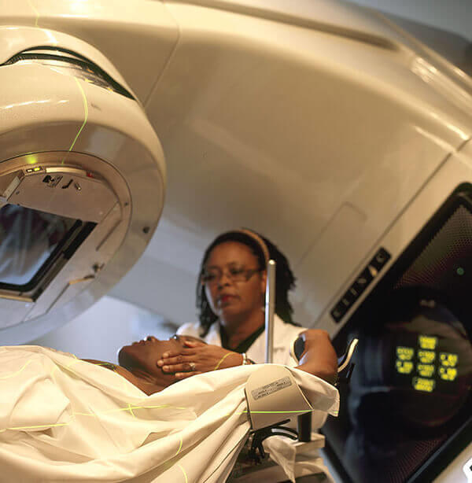
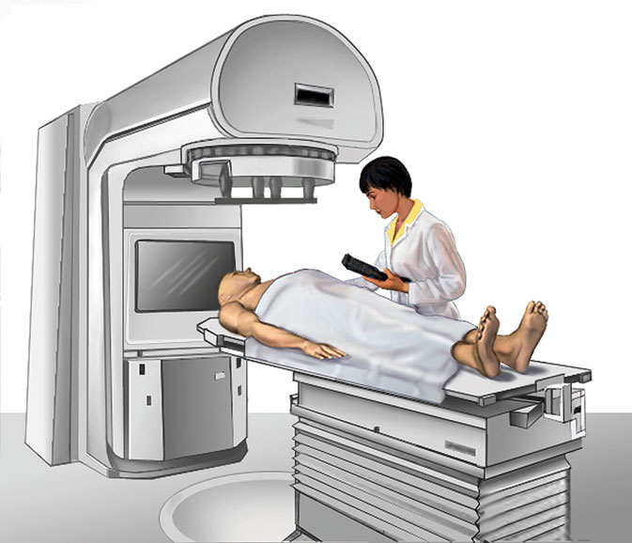
Radiation
Source: National Cancer Institute Radiation Therapy to Treat Cancer, 2019
Notes:
[RADIATION]: Radiation therapy uses high-energy radiation to shrink tumors and kill cancer cells. However, radiation can also damage normal cells, leading to side effects such as swelling, skin changes, and fatigue. Radiation can be delivered in several ways: it can be beamed at the cancer from a machine outside the body, as shown in the picture here; it can also be swallowed, injected, or placed near the tumor as a radioactive "seed."

Slide 46
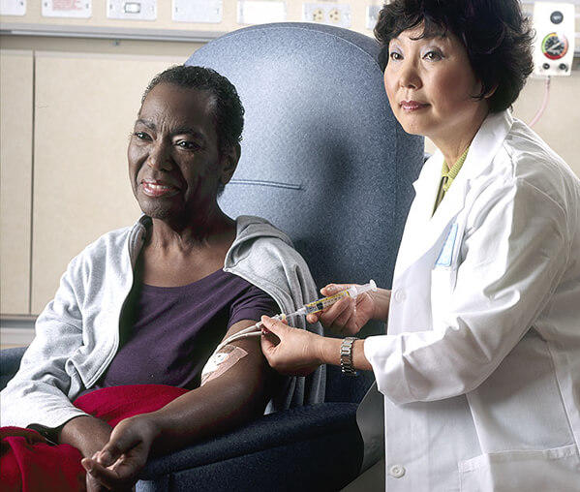
Chemotherapy
Works by stopping or slowing the growth of cancer cells
Can be used to cure cancer, lessen the chance it will return, or stop or slow its growth
Can be used to shrink tumors that are causing pain and other problems
Source: National Cancer Institute Chemotherapy to Treat Cancer, 2022
Notes:
[CHEMOTHERAPY]: Chemotherapy is a type of treatment that includes drugs that can either kill cancer cells or slow or stop them from growing. However, chemotherapy can also harm healthy cells. Side effects vary for different people depending on the type and amount of drug received. Chemotherapy can be administered in several ways: orally as a pill or liquid, injected as a shot, applied on the skin as a cream, or given through a needle in a vein or artery. There are many possible side effects, which we will discuss later in this lesson.

Slide 47
Targeted Therapy
“Molecularly targeted drugs” or “precision medicines”
Tumor tissue is tested
Different from standard chemotherapy
Some types of targeted therapies:
- angiogenesis inhibitors, immunotherapies, monoclonal antibodies
Source: National Cancer Institute Targeted Cancer Therapies, 2022
Notes:
[TARGETED THERAPY]: Targeted therapies treat cancer by targeting specific molecules that control how cancer cells grow, divide, and spread. These therapies are sometimes called “molecularly targeted drugs” or “precision medicines.”
Usually, a sample of the tumor tissue is tested to see if any known targets are present in that particular tumor. If so, the person may be a candidate for targeted therapy.
Standard chemotherapy drugs act against all rapidly dividing cells, both normal and cancerous. In contrast, targeted therapies act specifically on cancer-associated targets. However, targeted therapies can also have side effects, depending on the drug.
There are many types of targeted therapies approved for different types of cancer, including angiogenesis inhibitors (which block the blood supply to the tumor) and monoclonal antibodies (which deliver toxic molecules to cause the cancer cells to die).

Slide 48
Immunotherapy
Helps immune system fight cancer
Stimulates immune system to work harder and smarter to attack cancer
Provides immune system with components, such as man-made immune system proteins
Effective for certain types of cancer and can be used alone or in combination with other cancer treatments
Source: National Cancer Institute, 2019
Notes:
[IMMUNOTHERAPY]: Immunotherapy is a type of cancer treatment that helps your immune system fight cancer. The immune system helps your body fight infections and other diseases. Immunotherapy can work in several ways: by stimulating your immune system to work harder or smarter to attack cancer cells or by providing your immune system with components, such as man-made immune system proteins. This type of treatment can be particularly effective for certain types of cancer and can be used alone or in combination with other cancer treatments. Immunotherapy can help control cancer growth, relieve symptoms, and enhance the body’s natural defenses against cancer cells.​

Slide 49
Hormone Therapy
Drugs given to block the body’s natural hormones to slow or stop the growth of cancer
Side effects depend on the drug used
Breast cancer
Prostate cancer
Source: National Cancer Institute, 2022; National Cancer Institute, 2021
Notes:
[HORMONE THERAPY]: Hormones, which naturally occur in our bodies, can help some cancers grow, such as certain types of breast and prostate cancers. Hormone therapy is used to stop or slow the growth of these cancers. It may also be used to prevent breast cancer in people at high risk and can be prescribed for 5-10 years after a breast cancer diagnosis to prevent recurrence in hormone-sensitive cancers.
These therapies can have side effects, which can vary based on the drug. For cisgender women taking hormonal therapies for breast cancer, side effects may include hot flashes, night sweats, and vaginal dryness. For cisgender men undergoing hormonal therapy for prostate cancer, possible side effects include loss of interest in sex, erectile dysfunction, hot flashes, and loss of bone density, depending on the treatment.

Slide 50
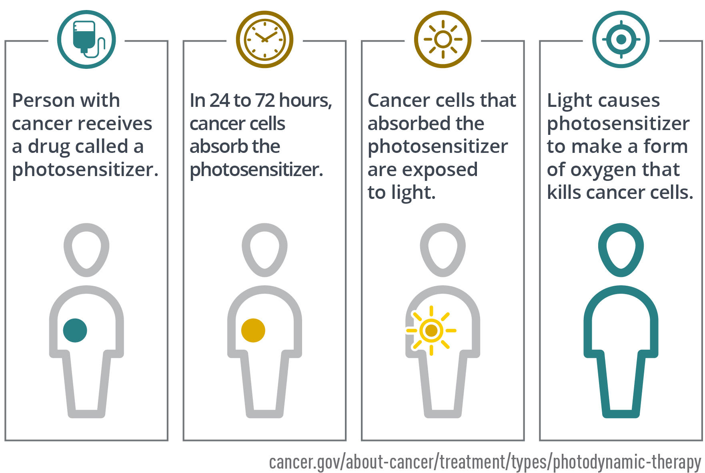
Photodynamic Therapy
Uses a drug that is activated by light, called a photosensitizer or photosensitizing agent, to kill cancer cells
PDT is usually done as an outpatient procedure but is sometimes combined with surgery, chemotherapy or other anti-cancer drugs, or radiation therapy
Source; National Cancer Institute, 2021; American Cancer Society, 2021
Notes:
[PHOTODYNAMIC THERAPY]: Photodynamic therapy, or PDT, is a treatment that uses a special drug, known as a photosensitizer or photosensitizing agent, which is activated by light to kill cancer cells. The light source can be a laser or LEDs.
When cancer cells that have absorbed into the photosensitizer are exposed to a specific wavelength of light, the photosensitizer produces a type of oxygen, called oxygen radical, that kills the cells. PDT may also damage the blood vessels in the tumor, cutting off the blood supply it needs to grow. Additionally, it can trigger the immune system to attack tumor cells, even in other parts of the body.
The photosensitizing agent can be administered either through a vein or applied to the skin, depending on the area being treated. After the drug is absorbed by the cancer cells over a specific period, light is applied to the treatment area. This light causes the drug to react from an oxygen molecule that kills the cells.
The time between administering the drug and applying the light is known as the drug-to-light interval, which can range from a few hours to a few days, depending on the specific drug used.
PDT is typically an outpatient procedure, though it can sometimes be combined with other treatments like surgery, chemotherapy, or radiation therapy. The kind of light used, whether lasers or LEDs, depends on the type and location of the cancer.
Photodynamic therapy is increasingly recognized as a valuable option for treating certain types of localized cancers, helping patients live longer and improving their quality of life.

Slide 51
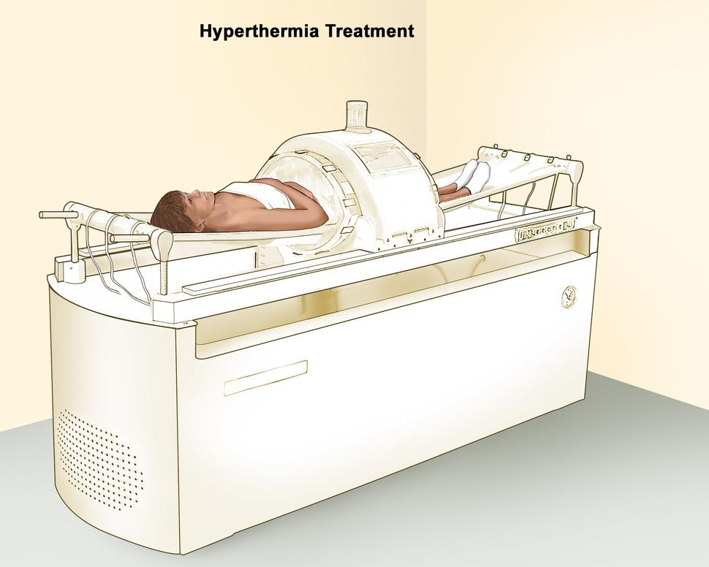
Hyperthermia
Body tissue is heated to as high as 113 °F (45 °C) to kill cancer cells with little or no harm to normal tissue
Hyperthermia to treat cancer is also called thermal therapy, thermal ablation, or thermotherapy
Almost always used with other forms of cancer treatment
Source: National Cancer Institute. Hyperthermia to Treat Cancer. 2021
Notes:
[HYPERTHERMIA]: Hyperthermia, also known as thermal therapy, thermal ablation, or thermotherapy, is a treatment where body tissue is heated to around 113 °F (45 °C) to kill cancer cells with minimal harm to normal tissue.
There are several techniques to generate heat for hyperthermia treatment, including:
Probes that generate energy from microwaves
Radio waves, also known as radiofrequency
Lasers
Ultrasound
Heating fluids such as blood or chemotherapy drugs and introducing them into the body, a method called perfusion
Placing the entire body in a heated chamber or hot water bath, or wrapping the body with heated blankets
Research and clinical trials have demonstrated that hyperthermia, when combined with other treatments like radiation therapy and chemotherapy, can effectively shrink tumors and enhance the ability of these treatments to kill cancer cells. However, hyperthermia treatment requires specialized equipment and expertise, making it less widely available. Only a limited number of hospitals and cancer centers across the country have the skilled doctors and the necessary machines to perform hyperthermia.

Slide 52
Stem Cell Transplants
Distinction between a bone marrow transplant and a stem cell transplant is how the cells were collected
Procedures that restore blood stem cells in people who have had theirs destroyed by the high doses of chemotherapy or radiation therapy
Treats people with cancers that affect blood cells
Used for other blood disorders, such as aplastic anemia, sickle cell disease, and autoimmune diseases
Restores the body's ability to produce new blood cells after treatment with the very high doses of chemotherapy and maybe other treatments, such as radiation therapy, that are used to destroy cancer cells
Source: National Cancer Institute Stem Cell Transplants in Cancer Treatment, 2023; Dana-Farber Cancer Institute, 2012
Notes:
[STEM CELL TRANSPLANTS]: Stem cell transplants are procedures designed to restore blood stem cells in individuals whose own stem cells have been destroyed by high doses of chemotherapy or radiation therapy, often used to treat certain cancers, blood disorders, and autoimmune diseases. These blood-forming stem cells are crucial because they develop into various types of blood cells. While stem cell transplants don't usually target cancer directly, they enable the body to produce new blood cells after aggressive treatments that destroy cancer cells.
There are different types of stem cell transplants, each named based on the source of the stem cells. A bone marrow transplant (BMT) uses cells from the bone marrow, a peripheral blood stem cell transplant (PBSCT) uses cells from the bloodstream, and an umbilical cord blood transplant (UCBT) uses cells from umbilical cord blood collected at birth. Essentially, the distinction lies in how the stem cells are harvested.
In the case of leukemia, a stem cell transplant can directly combat cancer. This occurs when donor white blood cells attack remaining cancer cells.
During a stem cell transplant, healthy blood-forming stem cells are infused into a person's bloodstream through a needle. Once in the bloodstream, the stem cells travel to the bone marrow to replace cells destroyed by prior treatments.
There are three main types of stem cell transplants:
Autologous Transplants: The stem cells come from the patient themselves.
Allogeneic Transplants: The stem cells come from a donor, who may be a relative or a closely matched unrelated person.
Syngeneic Transplants: The stem cells come from an identical twin.
Each type has its own benefits and risks. Autologous transplants reduce the risk of immune rejection, but there's a chance of reintroducing cancer cells. Allogeneic transplants offer the graft-versus-tumor effect but require a close match to prevent rejection.
Additionally, there are specialized types of transplants:
Mini-transplants: These use lower doses of chemotherapy and do not destroy all blood-forming stem cells but still target some cancer cells.
Tandem transplants: This involves two rounds of high-dose chemotherapy followed by two stem cell transplants, spaced weeks or months apart.
Deciding on the right type of stem cell transplant depends on several factors, such as the type and stage of cancer, the availability of the patient’s own stem cells or a matching donor, their overall health, and previous treatments.
Citations:
Dana-Farber Cancer Institute. (2012, November 6). What’s the difference between a stem cell transplant and a bone marrow transplant? Insight Blog. Retrieved June 27, 2024, from https://blog.dana-farber.org/insight/2012/11/stem-cell-bone-marrow-transplant-difference/
National Cancer Institute. (2023). Stem cell transplants in cancer treatment. Retrieved June 27, 2024, from https://www.cancer.gov/about-cancer/treatment/types/stem-cell-transplant
Dana-Farber Cancer Institute. (n.d.). Stem cell transplantation. Retrieved June 27, 2024, from https://www.dana-farber.org/cancer-care/treatment/stem-cell-transplantation

Slide 53
Palliative Medicine
Source: Institute for Healthcare Improvement, 2015
Notes:
[PALLIATIVE MEDICINE]: Now that we've discussed various cancer treatments and their potential side effects, it's important to address another important aspect of cancer care: palliative care. Palliative care focuses on improving the quality of life for people by managing symptoms and providing support. To learn more about how palliative care can benefit people with cancer and their families, let’s review this informative video.

Slide 54
Supportive Care Services
Psychosocial support services
Rehabilitation
Lymphedema therapy
Physical therapy
Occupational therapy
Speech therapy
Spiritual support
Palliative care
Hospice
Hospice
Source: National Cancer Institute, 2024; Silver et al. (2013); Livestrong Foundation (n.d.)
Notes:
[SUPPORTIVE CARE SERVICES]: In addition to pain management and palliative care, there are other supportive care services and options generally available. Psychosocial support services help with emotional and social issues, such as financial concerns causing stress or family issues increasing anxiety.
Up to 90% of people with cancer could benefit from some form of rehabilitation, which includes:
Lymphedema Therapy: Alleviates swelling and decreases pain to improve movement.
Physical Therapy: Helps people recover strength, flexibility, endurance, and mobility.
Occupational Therapy: Assists people in resuming usual activities such as bathing, dressing, and returning to work.
Speech Therapy: Addresses language comprehension, expression, and swallowing issues.
Spiritual support, including services like Chaplaincy or Native American Traditional healing, may also be available.
Integrative therapies, known as Complementary and Alternative Medicine (CAM), treat the mind, body, and spirit, focusing on holistic care. Integrative therapies can be helpful to many patients. The National Center for Complementary and Integrative Health (NCCIH) defines integrative therapies as “a group of diverse medical and health care systems, practices, and products that are not generally considered part of conventional medicine.” Conventional medicine, sometimes referred to as mainstream medicine, is the type of medicine commonly practiced in the United States.
Hospice care, focused on end-of-life support, is used when cancer treatment no longer controls the disease, helping to manage pain and other symptoms.
Additional supportive services under the umbrella of palliative care can include:
Survivorship Wellbeing: Enhances quality of life post-treatment.
Dietary/Nutritional Support: Provides proper nutrition and dietary management.
Oral Care/Dentistry: Maintains oral health, which can be affected by cancer treatment.
Support Groups: Provide a sense of community and shared experience.
Family/Caregiver Support: Offers resources and support for those caring for people being treated for cancer.

Slide 55
Complementary and Alternative Medicine (CAM)
Complementary and alternative medicine (CAM) is the term for medical products and practices that are not part of standard medical care.
Mind–body therapies: These combine mental focus, breathing, and body movements to help relax the body and mind
Biologically-based practices: Vitamins, supplements, sources found in nature
Manipulative and body-based practices: These are based on working with one or more parts of the body.
Energy healing: Based on the belief that energy flows through the body, the goal is to balance the energy flow.
Whole medical systems: These are healing systems and beliefs that have evolved over time in different cultures and parts of the world.
Source: Jun J. Mao et al. (2022); National Cancer Institute 2024
Notes:
[COMPARING COMPLEMENTARY AND ALTERNATIVE MEDICINE]: Integrative therapies, as mentioned previously, can enhance conventional treatments and improve outcomes by addressing physical, emotional, and spiritual needs.
Integrative therapies often combine complementary and alternative medicine, but these terms describe different concepts. “Complementary” refers to using a non-mainstream approach alongside conventional medicine. For example, acupuncture may be used for pain management in conjunction with medication and physical therapy. “Alternative” refers to using a non-mainstream approach instead of conventional medicine. For instance, traditional medicine from other cultures may be used to treat cancer instead of chemotherapy, radiation, or surgery recommended by a medical doctor. However, most people use non-mainstream approaches alongside conventional treatments.
The National Center for Complementary and Integrative Health (NCCIH) now prefers the term “complementary health approaches” when discussing practices and products studied for various health conditions. Complementary medicine includes natural products, such as dietary supplements, herbs, and probiotics, as well as mind and body practices, such as meditation, chiropractic care, acupuncture, and massage. These approaches aim to support overall well-being and can be integrated into conventional cancer care plans to enhance treatment efficacy and comfort.
Some of these therapies have strong evidence for supporting people with cancer; other approaches do not. It is extremely important to consult healthcare providers before starting any complementary or alternative therapies.

Slide 56
Possible Benefits of Complementary Approaches
Improve response to standard medical treatment
Manage side effects of cancer treatment
Prevent or manage cancer symptoms
Improve survival
Enhance a sense of well-being and quality of life
Source: Smith Center for Healing and the Arts 2022
Notes:
[POSSIBLE BENEFITS OF COMPLEMENTARY APPROACHES]: There are many benefits for people with cancer by integrating complementary health approaches to reduce negative effects of treatment. Observations indicate these therapies may:
Improve response to standard medical treatment
Manage side effects of cancer treatment
Prevent or manage cancer symptoms
Improve survival
Enhance a sense of well-being and quality of life
In addition, complementary health approaches can include practices like yoga, tai chi, and mindfulness-based stress reduction, which have been shown to help manage stress and improve quality of life for people affected by cancer. These therapies can play an important role in a comprehensive cancer care strategy.

Slide 57
Possible Risks of Complementary Approaches
Few studies on safety and effectiveness
No approaches work beyond a shadow of doubt
Can be harmful
Can interfere with drugs
Source: National Center for Complementary and Integrative Health 2016, National Cancer Institute Complementary and Alternative Medicine 2024,
City of Hope, 2022
Notes:
[POSSIBLE RISKS OF COMPLEMENTARY APPROACHES]: Though some therapies have undergone evaluation and have proven safe and effective, others have been found to be less effective, harmful, or interact negatively with medications. Natural products, such as botanicals, supplements, and vitamins may sound helpful, but in the context of cancer care, these can sometimes be harmful. For example, grapefruit or grapefruit juice can decrease the production of enzymes that metabolize drugs, including chemotherapy. Acai berries have antioxidant properties that could reduce the effectiveness of some chemotherapy and radiation therapies. Green tea extract may reduce the effectiveness of an antineoplastic injection given to people with multiple myeloma.
As a navigator, direct any questions about the use of complementary and alternative medicine (CAM) to that person’s doctor. If someone mentions their use of complementary approaches, inform the clinician so they can discuss the possible risks. Even practices with evidence of benefit, like yoga, should be supervised by a doctor. You can help the person prepare questions and provide resources for more information.

Slide 58
Evidence-based Cancer Information
American Cancer Society
cancer.org
American Society of Clinical Oncology
cancer.net
Centers for Disease Control and Prevention
cdc.gov/cancer
U.S. Department of Health and Human Services - Healthy People 2030
https://health.gov
National Cancer Institute
cancer.gov
U.S. Preventive Services Task Force
http://www.uspreventiveservicestaskforce.org
Notes:
[EVIDENCE-BASED CANCER INFORMATION]: For reliable information about cancer or details on specific types of cancer, it’s important to visit reputable websites. Excellent starting points include the Centers for Disease Control and Prevention, American Cancer Society, the American Society of Clinical Oncology, and the National Cancer Institute.
For specific screening recommendations, the US Preventive Services Task Force is the gold standard guideline setting organization in the U.S. Under the Affordable Care Act, all screenings that receive an A or B rating from the US Preventive Services Task Force must be covered by insurance.

Slide 59
Effects of Cancer Diagnosis and Treatment
Physical
Psychosocial
Spiritual
Practical
Notes:
[EFFECTS OF CANCER DIAGNOSIS AND TREATMENT]: Cancer can affect people in many ways. Each person is different and will experience treatment uniquely, even if they have the same regimen. The effects of cancer diagnosis and treatment can be physical, psychosocial, practical, and spiritual. For example, someone may feel scared, uncertain, or angry about the change cancer brings to their lives. These effects can be interrelated and may persist after treatment.
Although patient navigators focus mainly on practical needs, understanding the full range of needs that a person with cancer may experience can help the healthcare team to address those needs more holistically.

Slide 60
Physical Concerns
Pain
Fatigue
Anemia
Weight gain/loss
Nausea/vomiting
Self-care and mobility issues
Other treatment side effects
Life-threatening medical emergencies
Source: American Cancer Society 2024
Notes:
[POTENTIAL PHYSICAL CONCERNS]: Cancer symptoms and treatment side effects can cause changes to the body, introducing new needs in various domains. Each person’s experience is unique, so it’s important to be aware of common symptoms and side effects to help people cope effectively.
People may experience:
Pain: Related to tumor growth or surgery, requiring effective pain management and communication with the oncologist or pain team.
Fatigue and Anemia: Treatment can cause fatigue and anemia, necessitating extra help with self-care, daily chores, childcare, assistive devices, or transportation.
Digestive Issues: Weight changes, nausea, vomiting, diarrhea, and constipation may require special dietary guidance from the medical team or dietitians.
Skin and Hair Changes: People with cancer may need to adjust to treatment-related changes such as hair loss and skin color changes, which can affect body image and self-esteem.
Mobility Limitations: Introduced by the cancer or treatment, which may mean that they will need extra help with mobility and daily activities.
Medical Emergencies: Some people with cancer may also experience life-threatening medical emergencies.
People may also need to learn to adjust to treatment-related alterations to their bodies such as surgical sites, implanted Mediports or central lines used for chemotherapy infusions, or radioactive seed implants.

Slide 61
Psychosocial Concerns
Body image concerns
Anxiety and depression
Changes in relationships and roles in family
Caregiver burden and support needs
Stigma, fear, social isolation
Mental distress
Source: American Cancer Society 2024
Notes:
[POTENTIAL PSYCHOSOCIAL CONCERNS]: In addition to physical issues, people with cancer may face psychosocial or emotional challenges. The cancer experience can be scary and isolating for someone and disruptive to their relationships with others. Treatment may cause body image concerns, such as feeling less attractive due to scars from major surgery. People with cancer might also experience serious anxiety or depression. We will discuss symptoms to look out for, but if you are ever concerned someone is dealing with anxiety or depression, you should refer them to a mental health professional.
Cancer can lead to changes in relationships with spouses, children, parents, or peers. Some people with cancer may find that the experience brings them closer to family or friends, while others may encounter new challenges or drift apart from those they were once close to.
Cancer affects not only the person but also those close to them. If the person with cancer was a primary provider or support in the family, roles may shift, and other family members may become stressed with new responsibilities and caregiving duties.
People with cancer might also experience stigma, fear, or social isolation. For example, people diagnosed with lung cancer may feel stigmatized due to the perception that their illness is self-inflicted through smoking. They may fear dying or other uncertainties. Social support is important for all people with cancer, but some may be isolated and lack this important support network.
Mental distress can also arise, affecting a person’s ability to get and stay in treatment. It is essential to provide comprehensive support services to address these emotional and psychological challenges.

Slide 62
Practical Concerns
Financial
Ability to work
Food, housing, utilities
Legal
Source: American Cancer Society 2024
Notes:
[POTENTIAL PRACTICAL CONCERNS]: Practical challenges can also significantly affect people with cancer. Cancer can be a major source of financial strain, depending on insurance coverage, assets, housing and employment situation. Out-of-pocket costs will vary based on the type of insurance coverage someone has.
People being treated for cancer often require prolonged treatment and may be too ill to work during this period, leading to a loss of income needed to cover living expenses and treatment-related costs. This financial burden can be especially devastating for someone without savings or those with lower incomes, as the interruption of income might prevent them from paying for rent, utility bills, transportation to medical appointments, medical bills, and groceries. When faced with choosing between essential living expenses and treatment, people may feel forced to prioritize immediate needs like housing.
Additionally, someone with cancer may need legal counsel for various issues, such as facing eviction during treatment, needing to draw up advance directives, living wills, or wills, and addressing immigration status-related concerns.

Slide 63
Spiritual Concerns
Finding meaning in illness
Changes in belief
End-of-life
Source: American Cancer Society 2024
Notes:
[POTENTIAL SPIRITUAL CONCERNS]: Spirituality is the aspect of humanity that refers to how individuals seek and express meaning and purpose and how they experience their connectedness to the moment, to self, to others, to nature, and to the significant or sacred.
Spirituality is important to consider in addition to physical, psychosocial, and practical challenges. Research suggests that 73% of people diagnosed with cancer express at least one spiritual need, 40% of newly diagnosed people with cancer have significant levels of spiritual distress, and those with low levels of spiritual well-being are more likely to experience significant distress, including hopelessness and a desire for hastened death.
Many people look to spirituality or their religious communities for support and to make sense of their illness. Spirituality can help someone find hope, gratitude, and positivity in their cancer experience. It can be a source of strength and guidance for some, although it may not be for everyone. Alternatively, it may lead to changes in beliefs.
Cancer, being a life-threatening condition, may prompt someone to consider death for the first time or to pause and reflect on their lives. Spiritual care, therefore, becomes an integral part of comprehensive cancer care, helping people navigate their journey with a sense of peace and purpose.

Slide 64
Adolescents and Young Adults
Family dynamics
Disruption to school/work/career
Managing distress/emotions
Isolation
Peer groups
Sexual relationships/dating
Fertility
Source: National Cancer Institute AYA, 2024
Notes:
[ADOLESCENTS AND YOUNG ADULTS]: Adolescents and young adults (AYAs), defined as individuals between 15 and 40 years old, face unique challenges that differ from those of older adults. This age group often has limited personal experience with disease, is working towards significant milestones such as marriage, establishing long term relationships, building careers and entering reproductive years. Due to these developmental characteristics, AYAs may experience challenges with family dynamics. For instance, AYAs who have recently gained independence may need to move back home after a cancer diagnosis. Additionally, there may be issues related to legal decision-making or guardianship.
Cancer can be especially isolating for AYAs, as they may feel disconnected from their peer groups. For example, AYAs find that their friends distance themselves after the diagnosis, while others feel that the unique challenges of dealing with cancer at a young age make it hard to relate to their peers.
Sexuality and dating are also important aspects for AYAs. Cancer can affect one's sense of attractiveness and sexual functioning. Dating can be challenging as AYAs struggle with when and how to disclose their diagnosis. Additionally, cancer and cancer treatment might affect fertility, which can be a significant concern for AYAs and may be intertwined with their dating and relationship decisions.
This age group often faces unique hurdles that can significantly affect their lives.
Emotional and Psychological Challenges:
AYAs are in a complex stage of developing their identity, independence, and establishing future goals. A cancer diagnosis can severely disrupt this process, leading to feelings of isolation, anxiety, and depression. Young adults might struggle with the emotional burden of the disease, feeling out of place among both their healthy peers and older people with cancer.
Social and Relational Challenges:
Cancer can strain relationships with family, friends, and romantic partners. AYAs might find that their friends withdraw due to discomfort or a lack of understanding about their situation. Additionally, young adults may face difficulties in dating and maintaining romantic relationships, as they navigate when and how to disclose their diagnosis and manage issues related to fertility and sexual health.
Educational and Career Disruptions:
AYAs are often in the midst of their education or starting their careers. Cancer treatment can cause significant interruptions, leading to delays in achieving academic or professional milestones. The physical and cognitive effects of treatment can also affect their ability to perform in school or work, resulting in long-term effects on their career trajectory.
Financial Strain:
The cost of cancer treatment can be overwhelming, especially for young adults who may not have substantial savings or comprehensive health insurance. The financial burden can add to the stress, forcing AYAs to make difficult decisions about their treatment and daily living expenses.
Fertility Concerns:
Cancer treatment can affect fertility, which is a significant concern for AYAs who may wish to have children in the future. Decisions about fertility preservation need to be made quickly, often before starting treatment, adding another layer of complexity to an already challenging situation.
Access to Age-Appropriate Care:
AYAs may face challenges in accessing care that is tailored to their specific needs. They often fall into a gap between pediatric and adult oncology services, which can affect the quality and appropriateness of their treatment and support services.

Slide 65
Living with Advanced Cancer
Psychosocial distress
Emotional support
Information
Decision making and communication
Relief of symptoms
Practical concerns
Source: American Cancer Society Coping with Advanced and Metastatic Cancer 2020
Notes:
[LIVING WITH ADVANCED CANCER]: Some people have advanced cancer. Health professionals may mean different things when they use the term advanced cancer, but according to the American Cancer Society, advanced cancer means cancer that cannot be cured. This is different from saying that cancer has metastasized, or spread. For example, some testicular cancers may have spread to other parts of the body, or other organs, such as the lungs, but it still can be very curable. So, this would be metastatic cancer but not advanced. Conversely, certain brain cancers cannot be cured and are life-threatening even though they haven't spread. These are considered advanced but not metastatic. Again, people may use these terms differently.
Some people live with advanced cancer for months or years and have unique needs. Many people with advanced cancer experience psychosocial distress, which is associated with increased physical symptoms. They may feel isolated and face social stigma. These people with cancer often struggle to get enough emotional support and may have difficulty finding helpful information on treatment options, hindering their ability to be engaged in the decision-making process. Additionally, communication from doctors may be vague, overly technical, or may minimize the seriousness of the cancer.
People living with advanced cancer also need effective management of symptoms such as pain, fatigue, and sleep problems. They may face practical issues like financial challenges, disability and insurance applications, and work-related issues.

Slide 66
Cancer Survivors
From the moment of diagnosis through the balance of life
Including family and caregivers
After completion of treatment
Notes:
[CANCER SURVIVORS]: There are varying definitions of a cancer survivor. Historically, a person was called a cancer survivor once they lived 5 years after diagnosis, often referenced by clinicians as a clinical milestone. However, organizations like the National Coalition for Cancer Survivorship and others define a survivor from the moment of diagnosis and through the balance of life because people start surviving cancer from the time they are diagnosed. This definition has evolved to also include family members and caregivers. Many times, when people are talking about cancer survivors, they refer to those who have completed their treatment. As we discuss the needs of cancer survivors here, we are focusing on individuals who have finished their treatment.
When people finish treatment, they continue to have physical, psychosocial, practical, and spiritual needs. It used to be that when people completed treatment, they were expected to simply be happy to be alive. Over the last several years, this perspective has changed and more attention is now given to survivors’ needs after treatment.

Slide 67
Long-term and Late Effects
Treatment | Long-term side effects | Late side effects
Chemotherapy | Fatigue Premature menopause Sexual dysfunction Neuropathy (tingling in hands/feet) “Chemo brain” Kidney failure | Vision/cataracts Infertility Liver problems Lung disease Osteoporosis (bone weakness) Reduced lung capacity Second primary cancers
Radiation therapy | Fatigue Skin sensitivity Lymphedema Sexual dysfunction | Cataracts Cavities and tooth decay Cardiovascular disease Hypothyroidism Infertility Lung disease Intestinal problems Second primary cancers
Surgery | Sexual dysfunction Incontinence Pain | Functional disability Infertility
Sources: Hewitt et al. 2006, Mayo Clinic 2014
Notes:
[LONG-TERM AND LATE EFFECTS]: It is important to note that even after completing treatment, people may continue to experience various late and long-term effects.
Cancer survivors are at risk for long-term and late effects. A long-term effect is something that started during treatment and lasts even after the treatment is over. For example, if someone has lymphedema after surgery, this might continue even after they are done with all of their treatment. A late effect is something that starts after treatment. Late effects can happen months or even years after treatment is complete.
Long-term and late effects vary based on the cancer type, treatment, and individual person. For example, chemotherapy can lead to fatigue or sexual dysfunction, which starts during treatment and may last after treatment. “Chemo-brain” is a feeling of mental fogginess or forgetfulness that has recently been recognized as something that can affect people. Late effects from chemotherapy could include bone weakness–osteoporosis–or even new cancers.
Although these problems can occur, it is often uncertain who will experience them or when they will happen. The terms "long-term effects" and "late effects" are used to describe these ongoing and delayed issues that cancer survivors may face.

Slide 68
Psychosocial Effects
Sources: Max Healthcare, 2022
Notes:
[PSYCHOSOCIAL AND PRACTICAL CONCERNS]: Many of the same psychosocial concerns seen during treatment continue even after it ends. Survivors may feel depressed or anxious about the future and might fear a recurrence, even if they are not at high risk for it. Their relationships may have changed, and they might see some of their support diminish as family and friends assume that the survivor no longer needs support because treatment is over. Just as support is important during treatment, it remains important after treatment. This can be a difficult time for survivors who lose their support system.
Cancer affects people in complex and subtle ways across different stages: pre-diagnosis, post-diagnosis before treatment, short-term after treatment, and long-term after treatment. Different stages entail different problems and demands. Psychosocial challenges can include somatic problems, psychological distress, and questions about spirituality and existentialism. Additionally, cancer affects social functioning and relationships. Take a moment to review this video to learn more about the psychosocial effects of cancer.
PAUSE FOR VIDEO
Survivors often find it challenging to transition from seeing their healthcare team regularly to much less frequent visits. This change can lead to feelings of abandonment and increased anxiety. It is important for healthcare providers to prepare survivors for this transition and assist them with access to necessary support services.
One of the challenges encountered by cancer survivors includes the deterioration of self-concept. Self-concept involves components such as self-esteem, body image, self-discontent, and self-appraisal. Cancer can undermine self-concept and lead to changes in self-perception. Body image disturbance, resulting from treatments like surgery and chemotherapy, can lead to dissatisfaction with appearance and psychosocial well-being issues.
Sexual dysfunction is another common issue affecting quality of life and intimacy. Many people with cancer and survivors are not prepared for potential sexual changes and do not receive adequate information and support. Maintaining social relationships can also be challenging, with cancer impacting romantic and family relationships.
Emotional distress is prevalent, with many survivors experiencing major depressive disorder, anxiety, and other mental health issues. Fear of recurrence is another significant challenge, causing worry and concern about cancer returning or progressing.
Survivors may continue to face financial problems that began during treatment, or they may encounter new issues, such as insurance challenges. For example, some people struggle with managing their bills during treatment and postpone addressing them until after treatment is complete. They might also have difficulty getting post-treatment services covered if their insurance company does not understand the necessity of these services.
Additionally, treatment may have caused someone to stop working, or they may be disabled as a result of treatment, leading to struggles in finding or keeping a job after treatment. The financial strain can be compounded by the inability to return to work, further complicating their recovery and quality of life.

Slide 69
Cancer and Comorbidities
Source: Panigrahi and Ambs (2021)
Notes:
[CANCER AND COMORBIDITIES]: Many people also have other diseases they are dealing with at the same time, known as comorbidities. According to statistics in 2021, 75% of cancer survivors report at least one comorbid condition. For cancer survivors aged 65 or over, this increases to 85% . This means that their treatment may have an effect on other health conditions they are experiencing, or other diseases may increase the effects of cancer or its treatment. Comorbidities may reduce survivors’ quality of life.
Comorbidities do not affect all segments of the US populations equally. As of the time of this recording, Native Americans and African Americans had significantly elevated rates for obesity, diabetes, chronic kidney disease, and hypertension, when compared to other population groups. As we collectively work to advance health equity, we hope these numbers will change in the future.
69

Slide 70
Holistic Survivorship Care
Prevention and detection of new cancers and recurrent cancer
Surveillance for recurrence or new primary cancers
Interventions for long-term and late effects
Coordination between specialists and primary care providers
Source: National Comprehensive Cancer Network, 2024
Notes:
[COMPONENTS OF SURVIVORSHIP CARE]: Survivorship care, which may also be called post-treatment care, is valuable for cancer survivors. According to the Institute of Medicine, survivorship care should include these four components:
Prevention and detection of new cancers and recurrent cancer: This involves ongoing health promotion, education and risk reduction coaching to prevent new cancers from developing and detecting any recurrence of the original cancer early. This includes primary screening for other types of cancer.
Surveillance for recurrence or new primary cancers: This means regular monitoring to watch for the return of cancer or the development of new cancers.
Interventions for long-term and late effects: For example, an early referral to physical therapy can help prevent lymphedema, improve range of motion, and reduce pain. This might also include assessing and addressing psychosocial needs.
Coordination between specialists and primary care doctors: Cancer care can be fragmented, with people seeing healthcare professionals in different locations. Often, a person’s primary care provider is not involved in their cancer care. Coordination means that oncology specialists and primary care providers need to communicate about the person’s condition, expectations, and needs for follow-up care.

Slide 71
Common Support Services Requested
Nutrition information to maintain a healthy diet, address specific dietary needs or manage health conditions
Yoga for physical fitness to improve their physical fitness and overall well-being or for stress reduction
Cooking classes to prepare healthy meals that support their nutritional needs
Aerobics to enhance their cardiovascular health and fitness levels
Meditation to help manage stress and promote mental health
Swedish massage to help relieve pain and promote relaxation.
Information on herbal and dietary supplements to complement their health regimen.
Source: Flores et al. (2019)
Notes:
[TOP SUPPORT SERVICES]:
Based on research from 2019, commonly requested support services by cancer survivors are:
Nutrition Information: The most requested service, with 39.1% of survivors seeking guidance on how to maintain a healthy diet.
Yoga for Physical Fitness: 30.9% of survivors are interested in using yoga to improve their physical fitness and overall well-being.
Cooking Classes: 26.4% of survivors want to learn how to prepare healthy meals that support their nutritional needs.
Aerobics: 26.2% of survivors seek aerobic exercises to enhance their cardiovascular health and fitness.
Meditation: 25.9% of survivors are interested in meditation to help manage stress and promote mental health.
These services reflect the diverse needs of cancer survivors, focusing on nutrition, physical fitness, stress management, and complementary therapies.

Slide 72
End of Life
Pain and symptom management
Psychosocial and spiritual support
Counseling and bereavement support
Hospice care
Advance directives
Source: National Cancer Institute End of Life Care 2012
Notes:
[END OF LIFE CARE]: For some people with advanced cancer that can no longer be controlled, the goal of treatment shifts from curing the disease to managing the pain and symptoms, providing psychosocial and spiritual support tailored by preferences, and offering counseling and bereavement support to family members. Each person has unique informational and support needs. People may have questions about their legal and financial affairs or need help communicating with family and friends. Family members may also have questions and require support.
End-of-life care varies for different people. Some choose to stay at home, while others may go to a hospital or another facility. Hospice programs provide comprehensive end-of-life care, which can be offered at home or in a medical facility. Many people mistakenly believe that these services are only for the final days or weeks of life. However, Medicare states that hospice can be used as much as six months before death is anticipated. Hospice care includes medical care, counseling, and respite care to support caregivers. Research has shown that people with cancer and families who use hospice services report a higher quality of life than those who do not.
Advance directives are important for people at the end of life and should be completed before a person becomes very sick. Advance directives are documents that outline the person’s wish for care and designate who can make decisions if they are unable to do so.
End-of-life is a difficult time for people with cancer and their families. It is important that licensed professionals provide counseling and address psychosocial and spiritual concerns to support them through this challenging period.
To further understand the complexities and emotional aspects of end-of-life care, let's review this YouTube video that provides additional insights about End of Life care.

Slide 73
Conclusion
Describe what cancer is
Describe current cancer screening guidelines and tests to detect cancer
Summarize basic cancer treatment options
Identify supportive care services
Identify professional resources
Describe potential physical, psychological, social and spiritual effects of cancer and cancer treatments
Notes:
[CONCLUSION]: Congratulations on completing this lesson on cancer basics. In this lesson, you have gained essential knowledge and skills that are important for supporting people with cancer and their families. You have learned to:
Describe what cancer is
Describe current cancer screening guidelines and tests to detect cancer
Summarize basic cancer treatment options
Identify supportive care services
Identify professional resources
Describe potential physical, psychological, social and spiritual effects of cancer and cancer treatments
Understanding these aspects is vital for anyone involved in cancer care. Your role in providing comprehensive care goes beyond medical treatment; it involves addressing the holistic needs of patients, including their emotional and spiritual well-being.
As you move forward, remember that each patient’s journey is unique, and compassionate care can make a significant difference in their experience. Stay informed, stay empathetic, and continue to support people with the knowledge and skills you've acquired.
Thank you for your dedication to learning and improving the lives of those affected by cancer.

Slide 74
References
American Association for Cancer Research. (2018). Progress Report. https://cancerprogressreport.aacr.org/wp-content/uploads/sites/2/2020/09/AACR_CPR_2018.pdf
American Cancer Society. (n.d.). Cancer screening guidelines. https://www.cancer.org/healthy/find-cancer-early/cancer-screening-guidelines.html
American Cancer Society. (2023). https://www.cancer.org/content/dam/cancer-org/online-documents/en/pdf/flyers/cancer-screenings-save-lives.pdf
American Cancer Society (2024). Managing Cancer-Related Side Effects. https://www.cancer.org/cancer/managing-cancer/side-effects.html
American Cancer Society. (2021). Getting Photodynamic Therapy. https://www.cancer.org/cancer/managing-cancer/treatment-types/radiation/photodynamic-therapy.htm
American Cancer Society. (2022, March 22). HIV infection and AIDS. Retrieved from https://www.cancer.org/cancer/risk-prevention/infections/hiv-infection-aids/hiv-aids-and-cancer.html#:~:text=KS%20causes%20dark%20purplish%20or,may%20even%20become%20life%2Dthreatening
American Cancer Society Cancer. (2023). Prevention & Early Detection Facts & Figures 2023 www.cancer.org/content/dam/cancer-org/research/cancer-facts-and-statistics/cancer-prevention-and-early-detection-facts-and-figures/2024-cped-files/cped-2024-cff.pdf
American Cancer Society, GWU Cancer Center. (2016). National Cancer Survivorship Resource Center Toolkit https://acs4ccc.org/wp-content/uploads/2022/11/CCC-Tip-Sheet-Survivors-v08FF.pdf
American College of Obstetricians and Gynecologists. (2023). Updated Cervical Screening Guidelines. https://www.acog.org/clinical/clinical-guidance/practice-advisory/articles/2021/04/updated-cervical-cancer-screening-guidelines
American Institute for Cancer Research. (n.d.). http://www.aicr.org
American Society of Clinical Oncology. (n.d.). Guidelines, tools, & resources. https://society.asco.org/practice-patients/guidelines
American Society of Clinical Oncology. (2021). What is personalized cancer medicine? Cancer.Net. http://www.cancer.net/navigating-cancer-care/how-cancer-treated/personalized-and-targeted-therapies/what-personalized-cancer-medicine

Slide 75
References (cont.)
Amin MB, Greene FL, Edge SB, Compton CC, Gershenwald JE, Brookland RK, Meyer L, Gress DM, Byrd DR, Winchester DP. (2017). The Eighth Edition AJCC Cancer Staging Manual: Continuing to build a bridge from a population-based to a more "personalized" approach to cancer staging. CA Cancer J Clin. 2017 Mar;67(2):93-99. doi: 10.3322/caac.21388.PMID: 28094848
American Society of Clinical Oncology https://ascopubs.org/doi/10.1200/PO.23.00196
American Society of Clinical Oncology Post. (2024). FDA Approves HPV Self-Collection Solution. https://ascopost.com/news/may-2024/fda-approves-hpv-self-collection-solution/
Astrow, A.B., Wexler, A., Texeira, K., He, M.K., & Sulmasy, D.P. (2007). Is failure to meet spiritual needs associated with cancer patients' perceptions of quality of care and their satisfaction with care? Journal of Clinical Oncology, 25(36): 5753‐7. doi: 10.1200/JCO.2007.12.4362.
BioDigital, Inc. [BioDigital, Inc.]. (2008, October 14). 3D Medical Animation - What is Cancer? [Video]. YouTube. https://www.youtube.com/watch?v=LEpTTolebqo
Caughey, A. B., Krist, A. H., Wolff, T. A., et al. (2021). USPSTF approach to addressing sex and gender when making recommendations for clinical preventive services. JAMA, 326(19), 1953–1961.https://doi.org/10.1001/jama.2021.15731
Centers for Disease Control and Prevention. (2024).Preventing Cancer. https://www.cdc.gov/cancer/prevention/index.html
City of Hope. (2022). Natural supplements for cancer patients to avoid. https://www.cancercenter.com/integrative-care/naturopathic-support/natural-supplements-to-avoid
Expert Panel on Breast Imaging, Brown, A., Lourenco, A. P., Niell, B. L., Cronin, B., Dibble, E. H., DiNome, M. L., Goel, M. S., Hansen, J., Heller, S. L., Jochelson, M. S., Karrington, B., Klein, K. A., Mehta, T. S., Newell, M. S., Schechter, L., Stuckey, A. R., Swain, M. E., Tseng, J., Tuscano, D. S., … Moy, L. (2021). ACR Appropriateness Criteria® Transgender Breast Cancer Screening. Journal of the American College of Radiology: JACR, 18(11S), S502–S515. https://doi.org/10.1016/j.jacr.2021.09.005

Slide 76
References (cont.)
Flores, T., Glaser, K. M., McDaniel, D., Rokitka, D., Amato, K. A., & Reid, M. E. (2019). Building a comprehensive cancer survivorship program. Ecancermedicalscience, 13, 992. https://doi.org/10.3332/ecancer.2019.992
Hyun-Wook Lee, Sung-Hyun Park, Mao-wen Weng, and Moon-shong Tang. (2017). E-cigarette smoke damages DNA and reduces repair activity in mouse lung, heart, and bladder as well as in human lung and bladder cells. Proceedings of the National Academy of Sciences of the United States of America. https://www.pnas.org/doi/10.1073/pnas.1718185115#tab-contributors
Iowa Cancer Consortium. (2023). Quick Cancer Screening Guide Card. https://canceriowa.org/screening-toolkit/
Prevent Cancer Foundation. (2024). Cancer Screenings and Prevention. https://preventcancer.org/wp-content/uploads/2024/03/2024-3-20-screening-chart.pdf
National Cancer Institute. (2023). Diagnosis and Staging. https://www.cancer.gov/about-cancer/diagnosis-staging
National Cancer Institute. (2024). Surveillance, Epidemiology, and End Results (SEER) Program. https://seer.cancer.gov/
National Cancer Institute. (2019). Symptoms of Cancer. https://www.cancer.gov/about-cancer/diagnosis-staging/symptoms
National Cancer Institute. (2023). Stem Cell Transplants in Cancer Treatment https://www.cancer.gov/about-cancer/treatment/types/stem-cell-transplant
National Cancer Institute. (2021). Hormone Therapy to Treat Cancer. https://www.cancer.gov/about-cancer/treatment/types/hormone-therapy
National Cancer Institute (2024). Screening Tests to Detect Colorectal Cancer and Polyps https://www.cancer.gov/types/colorectal/screening-fact-sheet

Slide 77
References (cont.)
National Cancer Institute. (2024). Prostate Cancer Treatment (PDQ®)–Patient Version https://www.cancer.gov/types/prostate/patient/prostate-treatment-pdq
National Cancer Institute (2023). Cancer Prevention Overview (PDQ®)–Health Professional Version https://www.cancer.gov/about-cancer/causes-prevention/hp-prevention-overview-pdq
National Cancer Institute. (2021). What is Cancer. https://www.cancer.gov/about-cancer/understanding/what-is-cancer
National Cancer Institute. (2022). Tumor Grade. https://www.cancer.gov/about-cancer/diagnosis-staging/diagnosis/tumor-grade
National Cancer Institute. (2015). Surgery to Treat Cancer. https://www.cancer.gov/about-cancer/treatment/types/surgery
National Cancer Institute. (2019). Radiation Therapy to Treat Cancer. https://www.cancer.gov/about-cancer/treatment/types/radiation-therapy
National Cancer Institute. (2022). Chemotherapy to Treat Cancer. https://www.cancer.gov/about-cancer/treatment/types/chemotherapy
National Comprehensive Cancer Network. (n.d.). NCCN guidelines and clinical resources. https://www.nccn.org/professionals/physician_gls/default.aspx#site
National Cancer Institute. (2024). Complementary and Alternative Medicine. https://www.cancer.gov/about-cancer/treatment/cam
National Cancer Institute. (2024). Breast Cancer Screening (PDQ®)--Health Professional Version https://www.cancer.gov/types/breast/mammograms-fact-sheet
National Cancer Institute. (2021). Hyperthermia to Treat Cancer. https://www.cancer.gov/about-cancer/treatment/types/hyperthermia
National Center for Complementary and Integrative Health. (2016). Are you considering a complementary health approach? Retrieved June 27, 2024, from https://www.nccih.nih.gov/health/are-you-considering-a-complementary-health-approach

Slide 78
References (cont.)
NewYork-Presbyterian. (2017). Health Matters. https://healthmatters.nyp.org/precision-medicine/
Institute for Healthcare Improvement. (2015). https://youtu.be/zmo-EBbzOyw
Nik-Ahd F, De Hoedt AM, Butler C, et al. (2024). Prostate-Specific Antigen Values in Transgender Women Receiving Estrogen. JAMA. doi:10.1001/jama.2024.9997
Mandi L. Pratt-Chapman & Jennifer Potter (2019). Cancer Care Considerations for Sexual and Gender Minority Patients, Oncology Issues, 34:6, 26-36, DOI: 10.1080/10463356.2019.1667673
Smith Center for Healing and the Arts. (2022).
US Preventive Services Task Force. (2021). Final recommendation statement: Lung Cancer Screening. https://www.uspreventiveservicestaskforce.org/uspstf/recommendation/lung-cancer-screening
Welsh, E., Andrus, E., Sandler, C., Moravek, M., Stroumsa, D., Kattari, S., Walline, H., Goudsmit, C. and Brouwer, A., (2024). Cervicovaginal and Anal Self-Sampling for Human Papillomavirus Testing in a Transgender and Gender Diverse Population Assigned Female at Birth: Comfort, Difficulty, and Willingness to Use. LGBT Health. Mary Ann Liebert, Inc. DOI: 10.1089/lgbt.2023.0336
National Cancer Institute. (2024). Punch biopsy illustration [Illustration]. In Skin cancer treatment (PDQ®)–patient version. National Cancer Institute. https://www.cancer.gov/types/skin/patient/skin-treatment-pdq
American Cancer Society. (n.d.). Core needle biopsy illustration [Illustration]. In Breast cancer screening tests and early detection: Core needle biopsy of the breast. https://www.cancer.org/cancer/types/breast-cancer/screening-tests-and-early-detection/breast-biopsy/core-needle-biopsy-of-the-breast.html

Slide 79
Thank you!
Sign up for the GW Cancer Center’s Patient Navigation and Survivorship E-Newsletter:
PNS Subscription
Sign up for the GW Cancer Center’s Cancer Control Technical Assistance E-Newsletter:
TAP Subscription

