Slide 1
Program Evaluation and Quality Improvement
Oncology Patient Navigator Training: The Fundamentals
Notes:
Welcome to the Program Evaluation and Quality Improvement lesson, part of the Oncology Patient Navigator Training: The Fundamentals course. My name is ____________________________and I will be your presenter for this lesson.

Slide 2
Acknowledgments
This work was supported by Cooperative Agreement #NU58DP007539 from the Centers for Disease Control and Prevention. Its contents are solely the responsibility of the authors and do not necessarily represent the official views of the Centers for Disease Control and Prevention.
We would also like to thank the following for their assistance with content revision:
Monica Dean, Academy of Oncology Nurse & Patient Navigators
Jess Quiring, Patient Navigation Advisors
Zarek Mena, Patient Navigation Advisors
Reesa Sherin, Association of Cancer Care Centers
Notes:
Before we begin, we would like to acknowledge the Centers for Disease Control and Prevention for supporting and funding this work. Its contents are solely the responsibility of the authors and do not necessarily represent the official views of the CDC.
We would also like to thank the following for their help with revising this training:
Monica Dean, of the Academy of Oncology Nurse & Patient Navigators
Jess Quiring and Zarek Mena, of Patient Navigation Advisors
and Reesa Sherin, Association of Cancer Care Centers

Slide 3
Learning Objectives
Describe importance of program evaluation
Describe potential roles for the patient navigator in evaluating programs
Identify opportunities for quality improvement based on metrics
Identify and implement strategies for quality improvement
Describe value of patient navigation to different interest holders
Summarize the patient navigation role and responsibility to different interest holders
Notes:
After completing this lesson, you will be able to:
Describe the importance of program evaluation
Describe potential roles for the patient navigator in evaluating programs
Identify opportunities for quality improvement based on metrics
Identify and implement strategies for quality improvement
Describe the value of patient navigation to different interest holders
Summarize the patient navigation role and responsibility to different interest holders

Slide 4
Definitions
Program
A program is a group of resources and activities used together to fulfill one or more purposes
Program Evaluation
The systematic collection and analysis of information about some or all aspects of a program to guide judgments or decisions
Interest holders
Organizations, groups or individuals who have the power to influence your program, have a political interest in your program, or would be affected by your program’s evaluation or outcomes
Source: Newcomer et al., 2015
Notes:
In this section of the lesson, we will introduce you to program evaluation and potential roles for the patient navigator related to program evaluation.
Here are some key definitions to remember for this lesson.
Programs are generally a group of resources and activities used together to fulfill one or more purposes, and a program is usually under the leadership of a manager or team.
Program Evaluation is the systematic collection and analysis of information about some or all aspects of a program to guide judgments or decisions.
And interest holders are organizations, groups or individuals who have the power to influence your program, have a political interest in your program, or would be impacted by your program’s evaluation or outcomes.

Slide 5
Why Program Evaluation?
Clarify and improve the program
Demonstrate effectiveness
Find additional funding
Report value to administration
Advocate for program
Meet accreditation requirements
Meet needs of patients
Source: Commission on Cancer, 2024.
Notes:
There are many reasons for collecting data on patient navigation programs. Some goals of an evaluation can be to:
help clarify the objectives and improve the program
demonstrate program effectiveness
assist with finding additional funding to sustain or continue the program
report value to administrators and advocate for the program by describing effort
meet new accreditation requirements for certain cancer programs
meet the needs of patients
Having an evaluation plan can help you with any or all of these. The evaluation plan should be developed before starting the program and should be focused on what really needs to be evaluated and what can be evaluated.
As a patient navigator, you may be responsible for contributing to program evaluation efforts. You might not need to develop a plan yourself, but it is helpful to understand why and how to evaluate your patient navigation program.
Patient navigation programs cannot be a one-size-fits-all model because they are designed to address the unique needs of specific care settings and patient population. This uniqueness in design, training, and integration of patient navigation programs into care settings has presented challenges for standardized evaluations of patient navigation effectiveness.

Slide 6
Common Areas for Improvement
Areas most frequently cited for improvement
Workflow integration
Communication
Planning and implementation
Revising workflows for efficiency
Incorporating quality improvement strategies
Building a business case for patient navigation
Funding stability
Source: Dwyer et al., 2022
Notes:
In a 2022 study of the evaluation of patient navigation implementation, common areas of improvement in sustainability plans were workflow integration, communication, planning and implementation, and funding stability. Activities in the implementation plans included revising workflows for efficiencies, incorporating quality improvement strategies, and building a business case for patient navigation.

Slide 7
Program Evaluation Answers These Questions
Does the program improve organization and clinical outcomes?
Does the program support/improve the patient experience?
What can be changed to make the program more effective and improve outcomes?
Does the program demonstrate value to the organization?
Notes:
Program Evaluation Answers These Questions
1) Does the program improve organization or clinical outcomes?
2) Does the program support or improve the patient experience?
3) Does the program demonstrate value to the organization?
4) What can be changed to make the program more effective and improve outcomes?

Slide 8
Patient Navigator Role in Program Evaluation
Data Collection
Data Analysis
Data Collection
Data Analysis
Data Reporting
Patient Demographics
Patient Diagnosis and Staging
Types of barriers addressed
Time spent for various tasks
Patient acuity
Identify and describe trends
Identify areas for improvement
Community needs assessment data
Report for interest holders
Presentations
Document
Explain with data
Report Out
Notes:
What is an oncology patient navigators part in a program evaluation?
One role is data collection.
Documenting how you have helped patients is important for program evaluation. Data that a patient navigator collects may be:
*Patient demographic information including race, sexual identification, and age.
*The patient’s diagnosis and stage
*What psychosocial barriers to care are being addressed.
*What internal and external referrals are being made for the patient.
*How much time is being spent addressing certain tasks for patients.
*Patient acuity, which means the amount of time spent caring for a patient in relation to the patient’s severity of illness and the intensity of their psychosocial needs.
Patient navigators are also involved in analyzing the data and looking for trends you may see in patient needs or areas of the navigation program that may need improvement.
Some navigators may also help with data reporting, such as required information for grant reporting. An example may be how many gas cards have been issued and the demographic of the patients they are given to. This information also contributes to the community needs assessment, or CNA which we discussed in a previous lesson. A patient navigator might also use the data they collect to create and deliver a presentation. Patient navigators should be able to document patient needs, how the needs are addressed, and quantify those actions, with numbers, for the program.

Slide 9
RE-AIM Strategies for Evaluation
Reach
Measures number, proportion, and representativeness of individuals
M
Maintenance
Measures the sustainability of the program
R
I
Implementation
Measures the fidelity, feasibility, cost and adaptations
Effectiveness
The impact of an intervention on outcomes that demonstrate intervention effectiveness and broader outcomes of quality of life, satisfaction, etc.
E
A
Adoption
Measure of relevant participating factors (number of referrals, number of enrollments in a program)
Source: Holtrop et al., 2021; Ver Hoeve et al., 2024
Notes:
Now we will discuss how to perform an evaluation. RE-AIM is a framework to guide the planning and evaluation of programs according to the 5 RE-AIM outcomes: Reach, Effectiveness, Adoption, Implementation, and Maintenance.
It has been one of the most commonly used planning and evaluation frameworks across the fields of public health, behavioral science, and implementation science.
The key evaluation dimensions are
reach and effectiveness, at the individual level,
adoption and implementation, within staff, setting, system, or policy levels,
and maintenance, for both individual and staff settings, and system or policy levels.

Slide 10
Strategies for Evaluation
Formative Evaluation
Process Evaluation
Outcome Evaluation
Assess
Plan
Implement Activities
What is expected to change?
A community needs assessment is an example of formative evaluation
Review reach of program, perception of quality, program acceptability, patient engagement
Measure actual psychosocial and financial impact on patients
ex: patient survey
ex: qualitative research- reviewing past support resources requested
ex: reviewing # of attendees in a program or how they learned about it
ex: review of outcomes and pt treatment adherence
Source: Fertman & Grim, 2022
Notes:
Other strategies to evaluate a navigation program are to conduct a formative, process, and outcome evaluation.
A Formative Evaluation is done during the development and implementation of a navigation program. It helps provide the best starting point for a navigation program. A formative evaluation allows time for information and materials to be gathered during program planning and development. A needs assessment is an example of formative evaluation. For example you can conduct a patient needs assessment with a patient survey. The survey would inform the healthcare team of what programs patients may be interested in attending. Another example is conducting qualitative research by reviewing documentation on what previous resources or support patients have requested from the clinic.
A Process Evaluation involves evaluating the program as it is being implemented. During process evaluation you are reviewing the reach of the program to the patients and community, perceptions of quality, program acceptability by both staff and patients, and exploring patient engagement. An example of process evaluation would be reviewing the number of attendees in a program and how the patient learned about it.
An Outcome Evaluation focuses on the longer-term outcomes and sustainability of the navigation program. This step can measure actual psychosocial and financial impact on patients from being connected to support and resources. Some examples of questions asked during outcome evaluation are; Did the program make a difference in the lives of patients or the community? Did the patient adhere to treatment or have any missed visits?
As a patient navigator you may be asked to assist with any or all of these types of evaluations and certainly the data you collect will be used during program evaluation processes.

Slide 11
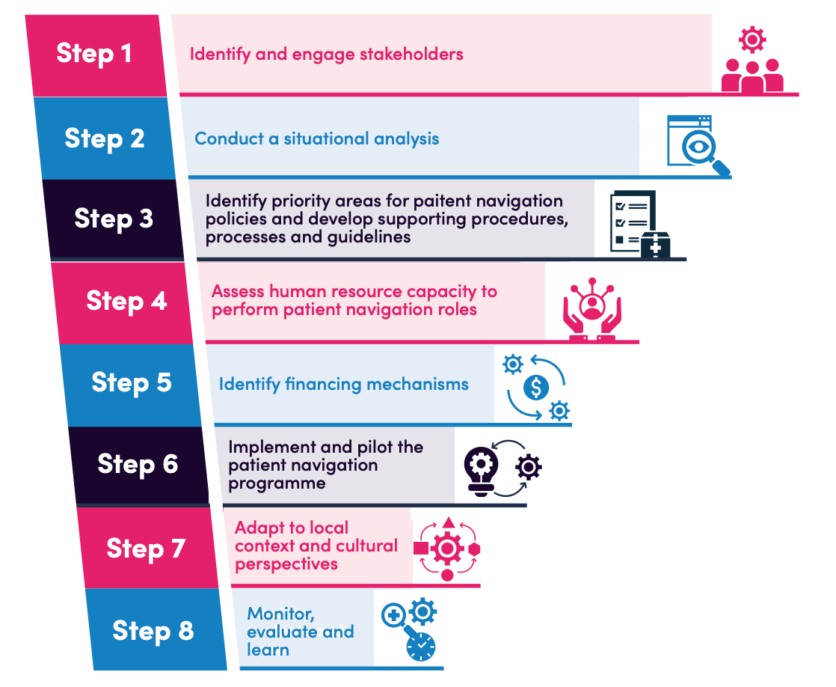
Formative Evaluation: World Health Organization Patient Navigation Evaluation Approach
Source: World Health Organization, 2024.
Notes:
Here is an example of a formative, process and outcomes evaluation. In 2024, the World Health Organization published a technical brief on patient navigation for early detection, diagnosis and treatment of breast cancer. Included in the brief was a framework for evaluation that starts with formative evaluation and ends with outcomes evaluation. This may be a useful approach for programs to adopt to optimize fit of their patient navigation program within their context.

Slide 12
Commission on Cancer Addressing Barriers to Care Standard
Conduct a community needs assessment at least once during the 3-year survey cycle
Address barriers to care through resources onsite or through the community
Evaluate the patient navigation process each year
Modify the patient navigation process to address newly identified barriers to care
Source: GW Cancer Center, 2021
Notes:
The evaluation of navigation programs through an assessment is required for most accreditation programs is directed by several different organizations, including
The National Comprehensive Cancer Network
the American Society for Radiation Oncology the National Cancer Institute The American College of Surgeons CoC Program
and the American College of Radiology
One of the most significant milestones in patient navigation is a requirement for institutions accredited by the American College of Surgeons’ Commission on Cancer, or CoC, to document a navigation process and conduct regular community health needs assessments to ensure that their navigation process aligns with patient needs. The CoC has made changes to the standards since first implementing them in 2012, with the most recent standard being 8.1: Addressing Barriers to Care.
The Commission on Cancer, accredits about 1,500 cancer programs across the country. If you work in a CoC-accredited program, you may be involved in this process. And even if you do not work directly for a CoC-accredited program, you may be involved in the community needs assessment if you work with patients at a CoC-accredited institution. Be sure to check annually on any changes to this standard from the CoC as standards change with evolving evidence and practice.

Slide 13
Formative Evaluation: Community Needs Assessment (CNA)
Cancer committee defines the scope of the needs assessment and must be involved in the design & evaluation
Encouraged to work with outreach & marketing at cancer centers as well as community-based organizations outside the facility
One system-wide barrier that will have the largest impact on patients is selected each year for improvement
A new system-wide barrier must be selected each year
Source: GW Cancer Center, 2021
Notes:
A Community Needs Assessment is a means of identifying and describing community health needs, like the patients you are helping in your organization or cancer care center. It serves as a mechanism to gain the necessary information to make informed choices of what your community needs to improve their health or experience. It can also help identify health disparities and barriers to care in an effort to address the gaps between what is and what should be.
Although the 2020 CoC standards do not specifically require conducting a community health needs assessment or establishing a patient navigation process, conducting a CNA can be a useful approach to identifying barriers to cancer care.

Slide 14
Road Map for Addressing Barriers to Care
GW Cancer Center developed a road map to guide CCC professionals and administrators in identifying and addressing barriers to accessing health and/or psychosocial cancer care for people with cancer
Although the 2020 Commission on Cancer (CoC) standards do not specifically require conducting a community needs assessment (CNA) or establishing a patient navigation process, road map includes guidance on conducting a CNA.
Useful approach to identifying barriers to cancer care
Source: GW Cancer Center, 2021
Notes:
An excellent resource for assessing and addressing barriers to care within your community is the GW Cancer Center’s Roadmap for Addressing Barriers to Care. This roadmap was developed to guide cancer care professionals and administrators in identifying both health and psychosocial barriers that patients may encounter when accessing care. It provides valuable guidance on conducting a Community Needs Assessment and implementing navigation processes. By utilizing this tool, you can better understand the strengths and gaps within your community, helping to improve the services provided at your cancer center.
The tool can be downloaded from our resource section of this training.

Slide 15
Conducting a Community Needs Assessment
Steps of community needs assessment:
Define the scope
Collect information
Review and analyze the data
Report on and share the data
Source: Heery et al., 2019
Notes:
There are four basic steps in conducting a community needs assessment.
1) Define the scope
2) Collect information
3) Review and analyze the data
4) Report on and share the data

Slide 16
Case Study: Needs Assessment
Scope
Data
Analyze
Report
Development of an advisory team
Identified all roles involved
Analyzed organizational resources and capacity
Which cold caps to be used
Cost of cold caps
Will the patient be responsible for payment?
Calculated patient volume
Determined the number of uninsured patients
Determined funds needed to offset cost for uninsured or low income patients
The patient demographic profiles for cultural and linguistically appropriate materials.
Effects of scalp cooling
Used a clear method to review all the data captured
The advisory team conducted multiple meetings to review data as it was captured
Reported on the efficacy/success rate of cold capping
Reported on patient adherence to cold capping
Clarified and reported on cold cap coordinator responsibilities
Identified reasons cold capping was successful or unsuccessful for patients
Reported on patient access outcomes to financial aid
Identified and reported on the implications for the nurse educator
Reported on family/caregiver involvement for best outcomes
Source: Heery et al., 2019
Notes:
We are going to review a case study in conducting a community needs assessment.
Patient feedback was received at a community-based breast cancer treatment center for a concern about chemotherapy induced hair loss. The patient requested a program to address this issue. The breast health team conducted a formative evaluation for starting a cold cap therapy program with a needs assessment.
Their step one was to determine the scope. This included the development of an advisory team of interest holders consisting of a Medical Oncologist, Advanced Practice Nurse, Oncology Certified Patient Navigator and a Nursing Administrator.
Then the advisory team identified roles that would involved to implement the program which included the psychosocial therapist, community fundraisers, scalp cooling device manufactures, and trained cold cappers.
The advisory team conducted an analysis of the organizational resources by reviewing staff role delineation and capacity, infrastructure needed such as electrical access, equipment needed, payment processes, assessing the space needed for post infusion cold capping stations, a time study of patient flow from infusion chair to the cold capping station, restroom access, and EMR charting ability.
The next step was for the advisory committee to gather the data. Some of the questions the team needed to answer were:
Which cold cap technology will be used?
How much does it cost to have access to cold cap technology?
Will the patient be responsible for payment?
How many patients receive infused chemotherapy who may need a cold cap?
How many patients are without insurance?
To offset costs, how much money needs to be fundraised to assist under or uninsured patients?
The team also explored the patient demographic profiles for cultural and linguistically appropriate materials. Finally they explored the effects of scalp cooling.
The third step was to analyze the data. The advisory team used a clear method to review all the data captured and conducted multiple meetings to review data as it was captured.
The final step was to report on the findings. The team reported on the efficacy and success rate of cold capping, patient adherence to cold capping, reasons cold capping was successful or unsuccessful for patients, patient access outcomes to financial aid, implications for the nurse educator, and involvement for best outcomes.
Because of the thorough assessment and process of this needs assessment, A cold cap program was developed with 100% access for all infused chemotherapy patients and a success rate of 84%–88% of patients maintaining more than 50% of their hair was achieved.

Slide 17
Data Sources for Community Needs Assessment
United States Cancer Statistics (USCS)
CDC/NCI State Cancer Profiles
Comprehensive Cancer Control Plans
NCI SEER
Healthy People 2030
CDC/NCI State Cancer Profiles
Your own program evaluation
Source: CDC, n.d.; CDC, n.d.; HHS, n.d., NCI, n.d.
Notes:
Data for your community needs assessment can come from a variety of sources. Here are a few:
The U.S. Cancer Statistics, or USCS, site combines the National Cancer Institute’s SEER data with the CDC’s National Program of Cancer Registries data.
The CDC/NCI State Cancer Profiles is an interactive map engine produced in collaboration between the National Cancer Institute and Centers for Disease Control and Prevention. It was developed with the idea to provide a geographic profile of cancer burden in the United States and reveal geographic disparities in cancer incidence, mortality, risk factors for cancer, and cancer screening, across different population subgroups. The target audiences are health planners, policy makers, and cancer information providers who need quick and easy access to cancer related data and maps to inform and prioritize investments in cancer control.
The National Comprehensive Cancer Control Program (NCCCP) requires all 50 states, the District of Columbia, 7 tribes and 8 U.S. territories to create comprehensive cancer control plans. Information about your state’s needs and specific goals of your state’s cancer control program are in the plans.
The National Cancer Institute provides the Surveillance, Epidemiology, and End Results (SEER) Program. You can find cancer statistics by type of cancer and demographics.You can also see historical trends and graphs for five-year rate change.
Healthy People 2030 has a list of key health indicators which are national goals and objectives for improving health, including indicators related to access to health care and cancer care. For example, one indicator is people who have health insurance.
You can also do your own evaluation and identify priorities based on findings from your assessment. We will talk more about this strategy next.

Slide 18
Determine Evaluation Metrics and Data Sources
Where can we find the information?
Electronic Health Records (EHR)
Cancer registry database
Tracking logs
Administrative data
Meeting summaries
Interview transcripts; notes
Survey results
Notes:
You will have to think about where you can find the information you need to answer your evaluation questions – some sources of data are listed here and include patient records, your cancer registry database, tracking logs, administrative data, meeting summaries, notes and survey results.

Slide 19
Source: AONN+ & ACS, 2020
Notes:
The Navigation Metrics toolkit developed by the Academy of Oncology Nurse & Patient Navigators can be a helpful toolkit for the evaluation process. AONN+ has identified 35 evidence-based navigation metrics that are relevant to cancer care, and demonstrate the value and sustainability of oncology navigation. This toolkit was developed to help support the integration of standardized metrics into normal business process. The toolkit provides guidance on how to select, implement, report, and utilize metrics in quality and performance improvement and also strategic decision-making.
The implications for navigation practices using quality navigation measures are that they are transformative, support the evaluation of professional practice and care delivery, define oncology navigation practice and outcomes, and are necessary for the sustainability of navigation programs.

Slide 20
Determine Evaluation Methods: Data Collection
How can we obtain the information?
Patient records abstraction
Surveys/questionnaires
Interviews
Review of tracking logs
Focus groups
Data Analysis: quantitative and/or qualitative
Notes:
It is important that oncology patient navigators understand that active participation in data collection, analytics, and reporting outcomes are not added responsibilities but are already a part of the professional role.
The method of collecting data is in important consideration. Will you get data from the medical record? Hand out surveys and then summarize the data? Keep a tracking log? Or Conduct a focus group?
Your evaluation might be quantitative – looking at numbers, like how many patients you gave gas cards to – or qualitative, which is reviewing perceptions and misperceptions, opinions, and words – for example, asking a patient what they thought of a support group. Qualitative data is used to look for themes in patient responses.

Slide 21
Process Evaluation
What was done?
How was the program implemented?
How well was the program implemented?
Was the program implemented as planned?
How satisfied are patients or health care team members with the program?
How can we demonstrate program implementation even before outcomes have been attained?
Notes:
Now that we have covered formative evaluation, we will move on to process evaluation which involves evaluating the program as it is being implemented. Process evaluation measures program fidelity, or whether it is working how you thought it would, by assessing which activities were implemented, and the quality, strengths and weaknesses of the implementation. Health care measures are often process measures, because it can be hard to measure patient outcomes.
Process evaluation asks:
What was done?
How was the program implemented?
How well was the program implemented?
Was the program implemented as planned?
How satisfied are patients or health care team members with the program?
How can we demonstrate program implementation even before outcomes have been attained?

Slide 22
Evaluation Metrics
Metrics Example | Measurement Task Examples
Barriers to Care | Measure the number and list the specific barriers to care identified by navigator each month
Time from diagnosis to treatment | Measure the number of business days from date pathology results were delivered to initial treatment
Health Economics | Measure the number of navigated patients readmitted to the hospital at 30, 60, 90 days
Psychosocial Support | Measure number of navigated patients referred to support network per month
Survivorship | Measure number of navigated patients referred to palliative care per month
Patient Advocacy | Measure number of navigated patients per month whose preferred learning style was discussed during intake
Professional Development | Measure percentage of new hires who have completed navigator core competencies training
Quality Improvement | Measure patient experience of patient satisfaction results per month using survey
Source: AONN+ & ACS, 2020
Notes:
Here are some possible metrics that could be tracked. Some of these can be tracked by accessing patient records. Others can be tracked by providing surveys to patients to ask about patient satisfaction or patient reported outcomes. All of these methods require more time than evaluating process measures. Keeping a tracking log and adding up columns and boxes for each patient does take time but is fairly straightforward, once you have a system and if you summarize your data at regular intervals.
Outcome measures require more time. You need time to look at the medical record, note the date of screening and the date of diagnosis and calculate the difference. You may be able to customize software to do this for you, but that will take up-front time and investment.
https://aonnonline.org/images/resources/navigation_tools/2020-AONN-Navigation-Metrics-Toolkit.pdf

Slide 23
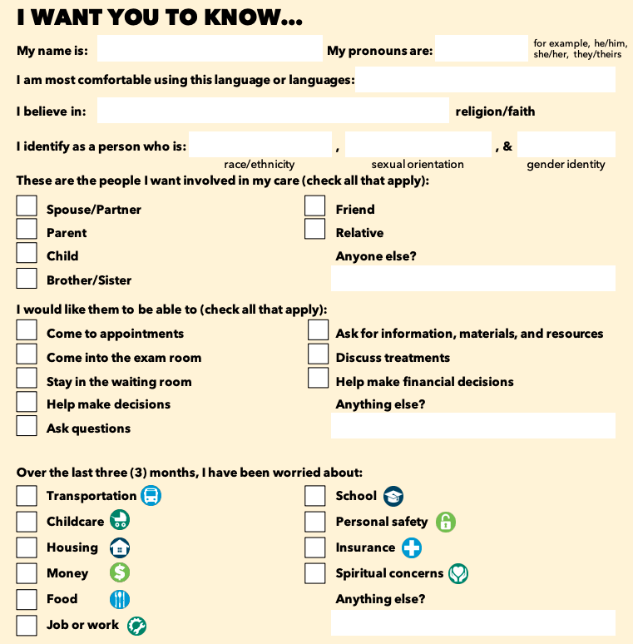
Sample Demographic Form
Available free of charge here.
Source: GW Cancer Center, 2021
Notes:
The GW Cancer Center “I want you to know” form is a helpful tool and this information tells you WHO you are serving but not WHAT you are doing for the patient. This can be important to funders. This form is available for you to use or adapt. You can access this in the Resources section of the training.
https://cancercontroltap.org/wp-content/uploads/2021/12/27%20-%20I%20Want%20You%20To%20Know%20Patient%20Card%205x7%20FINAL%20no%20logo%20508.pdf

Slide 24
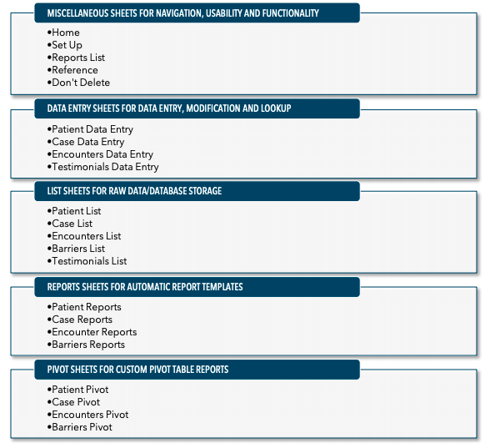
PN-BOT™ is available free of charge here.
Source: GW Cancer Center, 2021
Notes:
The Patient Navigation Barriers and Outcomes Tool or PN-BOT(TM), is freely available and includes worksheets and barriers list to track specific types of barriers – logistical, insurance-related, financial or employment. More specific logistical categories include transportation, housing, utilities, and dependent care, food and nutrition, clothing and immigration status. Specific insurance barriers include being uninsured, underinsured or having high deductibles or co-pays. Specific financial barriers might be a need for financial planning, low financial literacy or other non-medical financial needs. Employment barriers include being unemployed, needing job accommodations, not being able to work through treatment or having family members with employment difficulties.
This tool provides fields to track when you identified this was a barrier for the patient, the date it was resolved, the action you took to address or resolve the barriers and the time it took you to resolve the barrier. This could be minutes or hours.

Slide 25
Outcomes Evaluation
Outcome: The change(s) that your program will bring in your populations of focus or social condition (not the program itself).
Was our program effective?
How did the program impact the patient?
What evidence demonstrates that our administrators, funders, etc. should continue to support and fund the program?
Notes:
We have reviewed formative evaluation, process evaluation and now we will move on to outcomes evaluation. This evaluation step focuses on the changes that your program will bring about in your populations of focus or social condition. This evaluation is not focused on the program itself, but rather the outcomes or impacts to the people served.
This type of evaluation asks the questions:
is our program effective?
How did the program impact the patient?
And what evidence demonstrates that our administrators, funders and others should continue to support or fund the program?
For example, if you set up a program to reduce time to treatment, increase treatment adherence or increase the quality of life for your patients going through treatment, did you succeed in doing so? If you set up your program to keep patients within your system for a better patient experience and move revenue for your cancer center, did your program do this? If your institution set up a patient navigation program to ensure that it remained accredited, did you maintain your accreditation? While this is not a patient outcome, it is an important outcome for your administrators.

Slide 26
Navigation Outcome Measure
Patient Experience Survey for Cancer
FACT-C
PROMIS
Source: NIH, n.d.; Ward et al., 1999
Notes:
There are some validated measures you can use. Validated measures have been tested to make sure they measure what they are supposed to measure.
The National Cancer Institute spent several years developing a Patient Experience Survey for Cancer and provides guidance on how to use their survey. You can access these materials in the Resources section of the training. You can also make up your own survey with just a few questions to see how patients experienced their cancer care and how satisfied they were with navigation services.
For patient reported outcomes, the FACT-C is an easy way to measure physical well-being, social/family well-being, emotional well-being or functional well-being.
The National Institutes of Health also spent a great deal of time developing patient reported outcomes measures called PROMIS. These measures cover distress, cognition, fatigue, pain, physical function, sexual function, and emotional support. A link to the PROMIS web site is available in the Resources section of this training.
It can be helpful to access these tools, so you don’t have to start from scratch. Think about what is most important to your patients and your program leadership and measure those outcomes so that your evaluation is manageable.

Slide 27
Tracking Data
Keep your own records
Use technology
Track consistently and regularly
Ensure data accuracy
Notes:
Even if no one has directly asked you to participate in program evaluation, it is important that you track your activities for your own records. And, you never know when someone, such as a funder or an administrator, will want this information. It is much easier to track it as you go along than having to pull together the information at the last minute. In another lesson, we talked about HIPAA and the need to keep patient information secure. Tracking data on your computer is also typically more secure than keeping it in hard copy patient records.
Talk with your supervisor about what information to track and how to best track it. Then make sure you consistently track that information. It helps to set aside a particular time of the day or the week to enter in data. Daily is best, but if that is not possible it should be done in less than a week from the patient encounter. If more than a week goes by, it is likely that you will have trouble accurately remembering patient information.You may refer to the patient encounter in the EHR for patient data details. Accuracy is important for several reasons. First, as we discussed in another lesson, it can help you build trust with your coworkers. Second, the data can impact changes you make to the program, so you need to know that it is accurate to make those changes. And third, funding might be tied to your evaluation data. You may be violating the terms of the funding if your data is inaccurate, or you could risk that you will not be able to get funding in the future.

Slide 28
Quality/Process Improvement (Q/PI) Tools
Understanding the problem
Patient Flow/Process Map
Planning for change
Plan, Do, Study, Act (PDSA) Model
Notes:
Program evaluation is closely tied to quality and process improvement.
Many institutions have staff that focus on quality improvement. Even if your institution has quality improvement staff, it is still helpful to know about some tools you can use on your own.
Here are some tools that may be helpful.

Slide 29
Q/PI Process Mapping:
How many times is the patient passed from one person to another (hand-off)? | Where are delays, queues and waiting built into the process?
Where are the bottlenecks? | What are the longest delays?
What is the approximate time taken for each step (task time)? | What is the approximate time between each step (wait time)?
How many steps are there for the patient? | How many steps add no value for the patient?
Are there things that are done more than once? | Where are the problems for the patients?
Source: Agency for Healthcare Research and Quality, n.d.
Notes:
The first tool is a patient flow diagram or a process map. It’s pretty much what it sounds like – you map a patient’s experience across the continuum of care, whether that’s in your institution or across a network. Questions you might ask are:
How many times is the patient passed from one person to another?
Where are delays, queues and waiting built into the process?
Where are the bottlenecks?
What are the longest delays?
What is the approximate time taken for each step or task time?
What is the approximate time between each step or wait time?
How many steps are there for the patient?
How many steps add no value for the patient?
Are there things that are done more than once?
Where are the problems for the patients?

Slide 30
Q/PI Tools: Patient Flow
How long does it take for patients to get test results? What are the biggest barriers?
How long does it take for patients to start treatment? How many miss appointments and why? What administrative barriers do they face?
Screening
Treatment
Diagnosis
Post-Treatment
How long does it take to get to diagnosis? When do PN meet patients? What support or info do patients need at diagnosis?
Who helps transition the patient to survivorship? What informational needs do patients have? What resources are available?
Notes:
This is just one way of thinking through a patient flow diagram. What happens to the patient at each of these stages?
At screening, think about what happens to the patient – How long does it take for patients to get test results? What are the biggest barriers?
At diagnosis, How long does it take to get to diagnosis? When do patient navigators meet patients? What support or information do patients need at diagnosis?
During treatment, How long does it take for patients to start treatment? How many miss appointments and why? What administrative barriers do they face?
And once treatment is completed, Who helps transition the patient to survivorship? What informational needs to patients have? What resources are available?

Slide 31
Planning for Change: PDSA Cycle
What will be studied and how
Plan
Make changes based off findings
When and how were things done?
PDSA Model
Act
Do
Study
What does the data say?
Source: AONN+ & ACS, 2020
Notes:
The PDSA tool stands for Plan, Do, Study, and Act. Imagine that you looked at your flow diagram and found that you spend a lot of time helping patients prepare to talk with their doctors about treatment options. This is time consuming because you sit down with each patient, but you often times give them the same information. Maybe you decide to try something to streamline this process. Your idea is to create a patient binder that includes a lot of the information you give to each patient, but the binder would allow you to more efficiently provide the information to patients.
So you have planned a change, that’s the P. You want to start with a pilot, or a smaller version of your program, so you don’t throw all of your resources at a solution that may not work. So, in this example, you create the materials and give them to patients, that’s the D or Do. When you have data about your pilot, which might be a patient satisfaction survey or some informal interviews with the doctors and patients, you look at the results and figure out what you want to do. Do you want to expand the project so that all patients get the binder, alter it by changing some of the information or abandon it because it does not seem to be helping. For example, if patients tell you that something is missing from the binder, then you would decide in the Act phase to add the section to your binder. Then you could start over again with the new binder.

Slide 32
Checkpoint
True or False:
Coming up with a single statement that describes your role is better than tailoring your statements to match your audience.
Notes:
Let's pause for a checkpoint: true or false: coming up with a single statement that describes your role is better than tailoring your statements to match your audience.
This is false. Let's explore some different interest holders and how to make sure your message matches the interest holder and what they value.

Slide 33
Demonstrating Value to Interest Holders
Internal interest holders
External interest holders
Administration
Funders
Clinicians
Partners
Navigators
Patients
Source: Wilcox & Bruce, 2010
Notes:
Think about the different interest holders that you might want to know about what you do. For example, internal interest holders are part of your organization and could include administration, clinicians and other navigators. External interest holders are outside of your organization and could include funders, partners and patients.
Think about what these interest holders might find valuable and what differences there might be. For example, if you are telling a patient about what you do, you might say something like, “I help address barriers for you to make sure you get the care you need.” But if you were talking to a doctor, you might want to say something that shows how you specifically help the doctor. So maybe you would say something like, “I help take care of the barriers to help keep patients in treatment and so you can focus on their medical needs.”

Slide 34
Tips for Crafting an Elevator Pitch
Click here to watch a brief video from AONN on elevator pitches
Keep it short and simple
Should generate excitement
Be compelling
Include the value added to interest holder
Know your audience
Have an action item at the end
Practice!
Notes:
An elevator pitch is a term that originated from the need to have something short and simple to say to someone in an elevator or over a short period of time, like 15 seconds. You can use the concept to think about how you can talk about what you do. An elevator pitch should always be short and simple. It generates excitement and should be compelling.
People often think of who they are, rather than what they do. For example, instead of saying, “I am a patient navigator,” it is better to describe what that means, such as, “I help people with cancer stay in treatment so they have better outcomes.”
As we just talked about, think about your value to the particular interest holder. We’ll come back to this in a minute. To be able to do this, you need to know your audience and know what’s important to them. Also, it can help to have an action item at the end. If you are talking with a doctor, for example, you could say, “I would love to help you out, so please refer your patients to me.”
Lastly, it is important to practice your elevator pitch. You never know when you will need it.

Slide 35
Value to Interest Holders
Health Care System
Reduce no-shows/missed appointments Adherence to treatment Assist with non clinical issues (administrative, financial and practical) Free up their time to address clinical issues
Source: Pratt-Chapman et al., 2021
Notes:
Here are some example scenarios that you might encounter. Look at each one and think about how the interest holder and the context might impact what you say about your role as a navigator.
In Scenario 1 you might mention that in the last year, you've helped decrease the no-show rate by 15 percent.
In scenario 2 you might describe how you make sure patients know about important community resources that they may need.
In scenario 3 you might explain that you work closely with patients to make sure they are able to get to the care they need by helping with things like insurance and transportation.
In scenario 4, you might mention a patient story that shows how you helped address five barriers for one patient and then note that in the last year you navigated 312 patients who each had an average of four barriers.

Slide 36
Conclusion
In this lesson you learned to:
Describe the importance of program evaluation
Describe potential roles for the patient navigator in evaluating programs
Identify opportunities for quality improvement based on metrics
Identify and implement strategies for quality improvement
Describe value of patient navigation to different interest holders
Summarize the patient navigation role and responsibility to different interest holders
Notes:
This concludes the Program Evaluation and Quality Improvement lesson, part of the Oncology Patient Navigator Training: The Fundamentals course. In this lesson, you learned to:
Describe the importance of program evaluation
Describe potential roles for the patient navigator in evaluating programs
Identify opportunities for quality improvement based on metrics
Identify and implement strategies for quality improvement
Describe value of patient navigation to different interest holders
Summarize the patient navigation role and responsibility to different interest holders
Thank you for your participation in this lesson.

Slide 37
References
Academy of Oncology Nurse & Patient Navigators & American Cancer Society. (2020). Navigation Metrics Toolkit. https://aonnonline.org/images/resources/navigation_tools/2020-AONN-Navigation-Metrics-Toolkit.pdf
Agency for Healthcare Research and Quality. (2020). CAHPS Cancer Care Survey. https://www.ahrq.gov/cahps/surveys-guidance/cancer/index.html
Agency for Healthcare Research and Quality. (n.d.). Process mapping. https://digital.ahrq.gov/health-it-tools-and-resources/evaluation-resources/workflow-assessment-health-it-toolkit/all-workflow-tools/process-0
Centers for Disease Control and Prevention National Comprehensive Cancer Control Program. Comprehensive Cancer Control Plans. Retrieved November 11, 2024, from https://www.cdc.gov/comprehensive-cancer-control/about/programs.html
Centers for Disease Control and Prevention. (n.d.) National Program of Cancer Registries. Retrieved November 11, 2024 from https://www.cdc.gov/national-program-cancer-registries/index.html
Commission on Cancer. (2024). Optimal Resources for Cancer Care (2020 Standards). https://www.facs.org/quality-programs/cancer-programs/commission-on-cancer/standards-and-resources/2020/accept/
Dwyer, A. J., Staples, E. S., Harty, N. M., LeGrice, K. E., Pray, S. L. H., & Risendal, B. C. (2022). What makes for successful patient navigation implementation in cancer prevention and screening programs using an evaluation and sustainability framework. Cancer, 128 Suppl 13, 2636–2648. https://doi.org/10.1002/cncr.34058
Fertman, C. I., & Grim, M. (Eds.). (2022). Health promotion programs : from theory to practice (3rd ed., 77-78). Jossey-Bass. ISBN-13978-1119770886
GW Cancer Center. (2021). Implementing the Commission on Cancer standard 8.1 addressing barriers to care. https://cancercontroltap.org/wp-content/uploads/2021/09/30%20-%20CoC%20Standard%208.1%20Road%20Map%20FINAL%20508.pdf

Slide 38
References (Cont.)
GW Cancer Center. (2021, November 29). I Want You To Know. https://cancercontroltap.org/news/i-want-you-know/
GW Cancer Center. (2021, September 18). Patient Navigation Barriers and Outcomes Tool (PN-BOT). https://cancercontroltap.org/news/i-want-you-know/
Heery, M., Cohen, S., & Mena, Z. (2019). Scalp cooling: Implementing a cold cap program at a community breast health center. Clinical Journal of Oncology Nursing. 23(3), 237-241. https://doi.org/10.1188/19.CJON.237-241
Holtrop, J. S., Estabrooks, P. A., Gaglio, B., Harden, S. M., Kessler, R. S., King, D. K., Kwan, B. M., Ory, M. G., Rabin, B. A., Shelton, R. C., & Glasgow, R. E. (2021). Understanding and applying the RE-AIM framework: Clarifications and resources. Journal of Clinical and Translational Science, 5(1), e126. https://doi.org/10.1017/cts.2021.789
National Cancer Institute (n.d.) State Cancer Profiles. Retrieved November 11, 2024, from https://statecancerprofiles.cancer.gov/
National Institutes of Health. (n.d.). PROMIS. http://www.nihpromis.org/patients/measures?AspxAutoDetectCookieSupport=1
Newcomer, K. E., Hatry, H. P., & Wholey, J. S. (2015). Handbook of practical program evaluation: Planning and designing useful evaluations. (Newcomer, K. E., Harry, H. P., & Wholey, J. S., Eds.). 4th ed. Jossey‐Bass. https://doi.org/10.1002/9781119171386
Pratt-Chapman, M. L., Silber, R., Tang, J., & Le, P. T. D. (2021). Implementation factors for patient navigation program success: A qualitative study. Implementation Science Communications, 2(1), 141. https://doi.org/10.1186/s43058-021-00248-0
Ver Hoeve, E. S., Calhoun, E., Hernandez, M., High, E., Armin, J. S., Ali-Akbarian, L., Frithsen, M., Andrews, W., & Hamann, H. A. (2024). Evaluating implementation of a community-focused patient navigation intervention at an NCI-designated cancer center using RE-AIM. BMC Health Services Research, 24, 550. https://doi.org/10.1186/s12913-024-10919-y

Slide 39
References (Cont.)
Ward, W. L., Hahn, E. A., Mo, F., Hernandez, L., Tulsky, D. S., & Cella, D. (1999). Reliability and validity of the Functional Assessment of Cancer Therapy-Colorectal (FACT-C) quality of life instrument. Quality of Life Research: An International Journal of Quality of Life Aspects of Treatment, Care and Rehabilitation, 8(3), 181–195. https://doi.org/10.1023/a:1008821826499
Wilcox, B., & Bruce, S. D. (2010). Patient navigation: A "win‐win" for all involved. Oncology Nursing Forum, 37(1):21‐25. doi: 10.1188/10.ONF.21‐25
World Health Organization. (2024). Patient navigation for early detection, diagnosis and treatment of breast cancer: technical brief. https://iris.who.int/bitstream/handle/10665/379225/9789240100954-eng.pdf?sequence=1

Slide 40
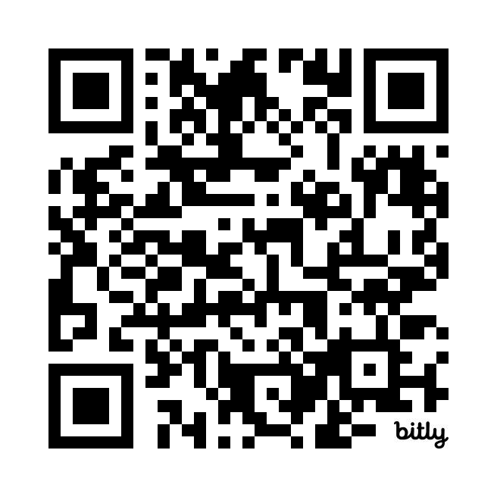
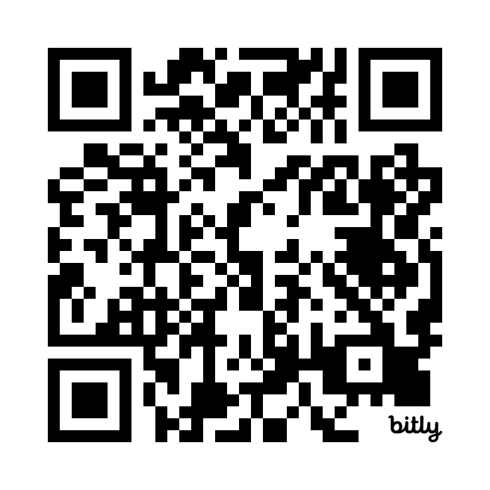
Thank you!
Sign up for the GW Cancer Center’s Patient Navigation and Survivorship E-Newsletter:
PNS Subscription
Sign up for the GW Cancer Center’s Cancer Control Technical Assistance E-Newsletter:
TAP Subscription

