Slide 1
U.S. Healthcare System, Payment and Financing
Oncology Patient Navigator Training: The Fundamentals
Notes:
Welcome to the lesson US Healthcare System, Payment and Financing, part of the Oncology Patient Navigator Training: The Fundamentals course. My name is PRESENTER NAME/TITLE/ORGANIZATION, and I will be your presenter for this lesson.

Slide 2
Acknowledgments
This work was supported by Cooperative Agreement #NU58DP007539-01 from the Centers for Disease Control and Prevention. Its contents are solely the responsibility of the authors and do not necessarily represent the official views of the Centers for Disease Control and Prevention.
We would like to thank the following people for their help with revising this training:
Katie Garfield, Center for Health Law and Policy Innovation, Harvard Law School
Zarek Mena, Patient Navigation Advisors
Jess Quiring, Patient Navigation Advisors
Reesa Sherin, Association of Cancer Care Centers
Notes:
We would like to acknowledge the Centers for Disease Control and Prevention for supporting this work.
We would also like to thank these professionals for their help with revising this training:
Katie Garfield, Center for Health Law and Policy Innovation, Harvard Law School
Zarek Mena, Patient Navigation Advisors
Jess Quiring, Patient Navigation Advisors
Reesa Sherin, Association of Cancer Care Centers

Slide 3
Learning Objectives
Compare hospital structures (public, non-profit, private)
Describe how cancer care may be structured and delivered
Compare inpatient and outpatient care delivery
Describe types of care and types of health professionals involved in different types of care
Describe how payment and health insurance works
Define key insurance terms
Describe public and private health insurance options, including patient eligibility
Notes:
After completing this lesson, you will be able to:
Compare hospital structures (public, non-profit, private)
Describe how cancer care may be structured and delivered
Compare inpatient and outpatient care delivery
Discuss types of care and types of health professionals involved in different types of care
Understand how health insurance works
Define key insurance terms
Describe public and private health insurance options, including patient eligibility

Slide 4
Hospital Systems
Public Hospitals
Non-profit hospitals
Private Hospitals
Notes:
Oncology patient navigators work in a variety of settings and need to understand differences between types of hospital systems. Let’s start with an overview.
A hospital system is a group of hospitals or facilities that work together to deliver services to their communities. Different types of hospital systems have different types of ownership and financial goals. Types of hospital systems include:
Public Hospitals
Public hospitals are funded and owned by local, state or federal governments and receive money from the government. Some public hospitals are associated with medical schools.
Non-profit Hospitals
Non-profit hospitals are often community hospitals and are sometimes associated with a religious denomination.
Private Hospitals
Private hospitals are owned by investors, to whom they are accountable.

Slide 5
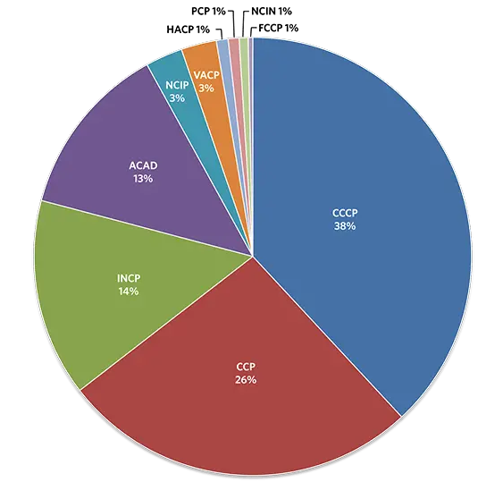
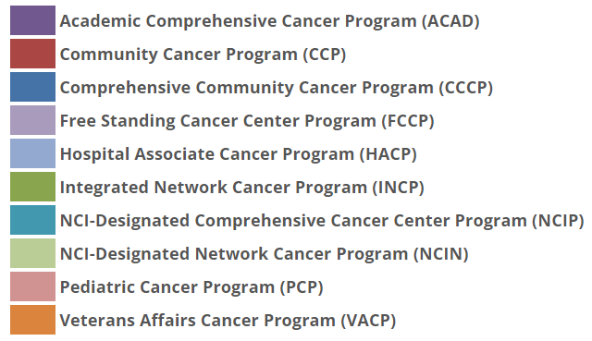
Cancer Care Delivery
Source: American College of Surgeons, n.d.
Notes:
Cancer care can be delivered in different settings, as illustrated in this chart by the American College of Surgeons. (https://www.facs.org/quality-programs/cancer-programs/commission-on-cancer/coc-accreditation/categories/)
An Academic Comprehensive Cancer Program (ACAD) facility provides postgraduate medical education in at least four program areas, including internal medicine and general surgery. The facility sees more than 500 newly diagnosed cancer cases each year.
A Community Cancer Program (CCP) sees more than 100 but fewer than 500 newly diagnosed cancer cases each year, while a Comprehensive Community Cancer Program (CCCP) sees 500 or more cases each year.
A Free Standing Cancer Center Program (FCCP) is a non-hospital-based program and offers at least one cancer-related treatment, with the full range of diagnostic and treatment services available by referral. There is no minimum caseload requirement for this category.
A Hospital Associate Cancer Program (HACP) accessions 100 or fewer newly diagnosed cancer cases each year and has a limited range of diagnostic and treatment services available on-site. Other services are available by referral.
In an Integrated Network Cancer Program (INCP), facilities belong to an owner organization and offer integrated and comprehensive cancer care services. The owner organization is overseen by a centralized governance structure/board and CEO.
An NCI-Designated Comprehensive Cancer Center Program (NCIP) secures a National Cancer Institute (NCI) peer-reviewed Cancer Center Support Grant and is designated a Comprehensive Cancer Center by the NCI. A full range of diagnostic and treatment services and staff physicians are available.
In an NCI-Designated Network Cancer Program (NCIN), facilities belong to an owner organization and offer integrated and comprehensive cancer care services. The owner organization is overseen by a centralized governance structure/board and CEO. Additionally, the facilities secure a National Cancer Institute (NCI) peer-reviewed Cancer Center Support Grant and are designated a Comprehensive Cancer Center Consortium by the NCI. To be included in the NCIN, all facilities must be included within the NCI grant.
A Pediatric Cancer Program (PCP) is a stand-alone facility that provides care to children and adolescents below the age of 18 (a center that cares only for teens and older is excluded). The pediatric facility or pediatric oncology program offers the full range of diagnostic and therapeutic services for pediatric patients. The pediatric facility is required to participate in cancer-related clinical research, including the enrollment of patients in cancer-related clinical trials. There is no minimum caseload requirement for this category.
A CoC Pediatric Specialty Accreditation (CoC-PS) is a pediatric oncology program within an existing CoC-accredited facility that provides care to children and adolescents below the age of 18 (a program that cares only for teens and older is excluded). The pediatric oncology program offers the full range of diagnostic and therapeutic services for pediatric patients separate from the adult services. The pediatric oncology program is required to participate in cancer-related clinical research, including the enrollment of patients in cancer-related clinical trials. There is no minimum caseload requirement for this category.
Finally, in a Veterans Affairs Cancer Program (VACP), the facility provides care to military veterans and offers the full range of diagnostic and treatment services either on-site or by referral, preferably to CoC-accredited cancer program(s). There is no minimum caseload requirement for this category.

Slide 6
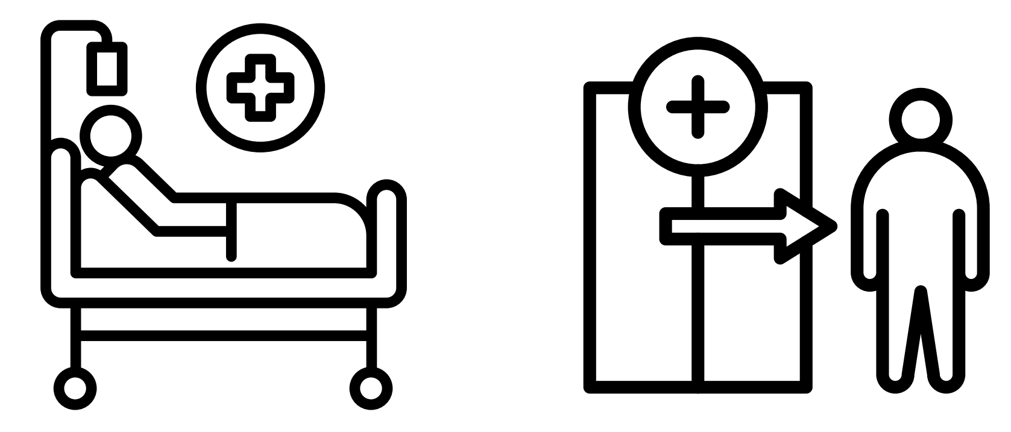
Inpatient and Outpatient Care Delivery
Notes:
A patient’s status is based on whether they are “inpatient” or “outpatient.” This will affect how much the patient will have to pay for hospital services such as X-rays, drugs, and lab tests, and may affect how insurers will cover the care they receive following their hospital stay.
A patient becomes an inpatient starting when they are formally admitted to a hospital with a doctor’s order. The last day of their inpatient stay is referred to as ‘Discharge Day’.
A patient is an outpatient if they’re getting emergency department services, observation services, outpatient surgery, lab tests, X-rays, or any other services at a hospital, clinic or associated facility, and the doctor has not written an order to admit them to a hospital as an inpatient. In these cases a patient is still an outpatient. As we mentioned previously, most adult cancer care is delivered in an outpatient setting.

Slide 7
Checkpoint: Types of Care
True or false? Emergency care must be provided to those who need it regardless of ability to pay.
Notes:
True or false? Emergency care must be provided to those who need it regardless of ability to pay.
The correct answer is true. Let's discuss more about this and other types of health care.

Slide 8
Types of Care
Primary Care
Specialty Care
Emergency
Care
Urgent Care
Primary care should be the first place patients go for non-urgent medical care
Care for a patient who has a health problem or illness that requires special knowledge in one medical area
Involves diagnosing and treating life-threatening illnesses or injuries that need immediate attention
Not life-threatening, but is care for an illness or injury that needs immediate attention
Notes:
There are different types of patient care. Select each type of care to see a description.
•Primary Care
Primary care should be the first place patients go for non-urgent medical care. Patients may get primary care in a doctor's office or in a community health center. One focus of primary care is to prevent disease through regular physical exams and health screenings. Another focus is to care for a patient's general health by diagnosing and treating a wide variety of conditions. If a patient has a health problem that requires special knowledge or skill, a primary care doctor will refer the patient to a specialist. Primary care doctors follow a patient's care while they see a specialist. Primary care doctors can also be called general practitioners, general internists, or family doctors. Other primary care clinicians include pediatricians, which are doctors for babies and children, physician assistants, and nurse practitioners. People with cancer may see oncology specialists or other specialists for general care, comorbidities, or issues related to their cancer care. These include Gynecologists, physical therapists, social workers, cardiologists, surgeons, and palliative care specialists.
•Specialty Care
Specialty care is care for a patient who has a health problem or illness that requires special knowledge in one medical area. Specialty care can be ongoing or preventive care around a specific system of the body. Specialists have knowledge or skills related to a specific disease or organ system. Specialists must complete special training and be certified or licensed in their area of specialty. They can be doctors, nurses or other health care team members.
•Emergency Care
Emergency care involves diagnosing and treating life-threatening illnesses or injuries that need immediate attention. Emergency care may take place in ambulances or other transportation vehicles, hospital emergency rooms or intensive care units. Emergency care is needed if a person has any of the following symptoms: difficulty breathing or speaking; traumatic injury; sudden face drooping; chest or upper abdominal pressure or pain; seizure; confusion; sudden or severe pain; uncontrolled bleeding; or severe or persistent vomiting or diarrhea.
A U.S. law called the Emergency Medical Treatment and Active Labor Act (EMTALA) states that hospitals and ambulance services must provide care to stabilize anyone who needs emergency care regardless of their ability to pay. Sometimes uninsured people go to the emergency room for care because they have no access to primary care. Hospitals must "write off" these unpaid medical bills as charity or business loss, which can increase the overall cost of care. As a result, some hospitals are closing emergency departments, even though there is a rising need for emergency care.
•Urgent Care
Urgent care is not life threatening, but is care for an illness or injury that needs immediate attention. Examples of urgent care needs are minor cuts or burns, stomach aches, sprains, ear or throat infections.

Slide 9
Types of Care
Long-term Care
Skilled Nursing Facility
Hospice Care
Mental Health Care
Long-term care is for someone who is not able to perform daily living activities
Can help when patients need help with a mental illness or emotional crisis
Focuses on care to manage symptoms rather than cure a disease toward the end of life
Can help when patients need help with a mental illness or emotional crisis
Notes:
Long-term Care
Long-term care is for someone who is not able to perform daily living activities due to an injury, disability, chronic condition or dementia. Long-term care is a combination of medical, nursing and social care. Long-term care may be provided in a person's home, a long-term care facility like a nursing home, or at an assisted living facility
Skilled Nursing Facility After a hospital stay, some patients need a longer period of care and rehabilitation that must be performed by licensed nurses. Care may be provided in a skilled nursing facility, where patients generally stay for less than a month.
Hospice Care
Hospice care focuses on care to manage symptoms rather than cure a disease toward the end of life. The philosophy of hospice care is give physical, emotional, spiritual or social care to support a patient and their family. Hospice care may be provided in a person's home or in a hospice care facility. Hospice care is end-of-life care and may be provided by health professionals or volunteers (typically under the direction of a medical professional) in a person's home or in a hospice care facility. This type of care may combine medical, psychological and spiritual care. Assistance may come from health professionals, End-of-Life Doulas, caregivers and volunteers.
Mental Health Care
Mental Health Care can help when patients need help with a mental illness or emotional crisis. Mental health treatment may include: medication, psychotherapy ("talk therapy") or both. Mental health care is important for people of all ages, and people with and without a serious physical illness like cancer.

Slide 10
Doctors
Primary Care Doctors
Specialists
Medical oncology
Radiation oncology
Surgical oncology
Gynecologic oncology
Hematology
Radiology
Notes:
Doctors or physicians are key members of the healthcare team. They have years of education and training. As we discussed, they may be primary care doctors or specialists. Primary care doctors focus on prevention and checkups and on diagnosing and treating some illnesses that don't require specialized attention, while specialists diagnose or treat specific short-term conditions or persistent or chronic diseases. Specialists, like oncologists are experts in diagnosing and treating cancer, identifying treatment options, discussing treatment benefits and side effects, overseeing treatment, and managing post-treatment care. These professions are board certified to specialize in cancer care and have additional training.
As mentioned earlier, cancer care specialties include medical oncology, radiation oncology, surgical oncology, gynecologic oncology, pathology, hematology, and radiology. Cancer specialists complete multi-year residencies in their speciality area. They also may pursue fellowships and additional training or certification in their fields.

Slide 11
Oncology Specialists
Radiology
Pathology
Radiation Oncology
Hematology/Oncology
Surgery
Notes:
Within oncology there are several types of specialties. Although some of these may sound similar, specialists in these fields provide very different services.
Radiology is the medical field of imaging. Doctors trained in this field are called radiologists. Radiologists provide diagnostic services for patients by taking images of the body. Interventional Oncology Radiologists specialize in the diagnosis and treatment of cancer and cancer-related ailments, however the entire field of Radiologists is not specific to cancer.
Pathology is the field focused on diagnosis. Doctors trained in this field are called pathologists. They look at body fluids like blood and urine as well as tissue samples to diagnose cancer.
Radiation oncology is a field focused on providing cancer treatment to patients using radiation. Doctors trained in this field are called radiation oncologists.
Hematology/oncology is the specialty that provides chemotherapy treatment to people diagnosed with cancer. Doctors who practice in this field are called medical oncologists or simply oncologists.
Surgery is another specialty that treats people diagnosed with cancer. Doctors who practice surgery are called surgeons.

Slide 12
Health Care Professionals
Genetic Counselor
Doctor
Advanced Practice Provider
Dietician
Nurse
Patient
Dosimetrist
Social Worker
Pharmacist
Psychosocial Support
Patient Navigator
Source: Tang & Ghali, 2021
Notes:
Cancer care is a team effort. Each health care professional is a member of the team with a special role. Some team members are doctors or technicians who help diagnose disease. Others are experts, such as dosimetrists, dieticians, and genetic counselors, who treat disease or care for patients' physical and emotional needs.
In this part of the lesson you will learn about different types of healthcare professionals, their jobs and their role on the health care team. You will also learn who the team members are for patients with cancer and different chronic diseases.

Slide 13
Advanced Practice Providers
Physician Assistants (PA)
Nurse Practitioners (NP)
Clinical Nurse Specialists (CNS)
Source: National Association of Clinical Nurse Specialists, 2022
Notes:
Another type of healthcare professional is an Advanced Practice Provider. Physician Assistants or PA’s, Nurse Practitioners or NPs, and Clinical Nurse Specialists, or CNSs, are licensed to provide health care services. These specialists complete comprehensive medical training but they do not complete an internship or residency like a doctor does. Like a medical doctor, PAs and NPs generally can perform physical exams, order tests, diagnose illnesses and prescribe medicine, assist in surgery, and provide preventive health care counseling. They provide patient education and symptom management. In oncology, advanced roles provide new consults, order chemotherapy, or perform invasive procedures. Education and experience determine scope of practice as well as state law, federal policy, and physician delegation.
PA’s are generally supervised by, and work in collaboration with, a doctor.
An NP’s scope of practice is determined by the state in which they practice.
Clinical nurse specialists are advanced practice registered nurses with advanced clinical expertise in a specialized area of nursing practice. These roles diagnose, prescribe, and treat patients and specialty populations across the continuum of care. The work of the CNS includes, but is not limited to, diagnosis and treatment of acute or chronic illness in an identified population with emphasis on specialist care for at-risk patients and/or populations. This role may often consult with other nurses and clinicians on complex patient cases or may provide clinical education for the nursing staff.

Slide 14
Nurses
Licensed Practical Nurse (LPN)
Registered Nurse (RN)
Advanced Practice Nurse (APRN)
Source: National Association of Clinical Nurse Specialists, 2022
Notes:
Nurses work closely with patients. Nurses’ jobs and duties depend on their education, area of specialty and work setting. Types of nurses include:
• Licensed Practical Nurses, or LPNs, who also may be called Licensed Vocational Nurses.
• Registered Nurses, or RNs, are also licensed by their state.
• Advanced Practice Nurses, or APRNs, are nurses who have more education and may have more experience than RN’s. Examples of advanced practice nurses are clinical nurse specialists, nurse anesthetists, nurse midwives and nurse practitioners.
Nurses who work in oncology focus on patient assessment, patient education, coordination of care, direct patient care, symptom management, and supportive care. In the ambulatory setting, oncology nurses function in nurse-run clinics that provide services such as long-term follow-up care to patients with cancer, pre-screening prior to chemotherapy administration, the administration of chemotherapy or immunotherapy, the management of fatigue, or general symptom management. As the field of cancer genetics has developed, so have roles for advanced practice nurses in the provision of cancer genetic counseling and risk assessment.
Each of these professions requires specialized training to be able to perform their functions.

Slide 15
Social Workers
Performs assessment, diagnosis, treatment, and prevention of mental illness, emotional, and other behavioral disturbances.
Source: National Association of Clinical Nurse Specialists, 2022
Notes:
Clinical social work is a specialty practice area of social work which focuses on the assessment, diagnosis, treatment, and prevention of mental illness, emotional, and other behavioral disturbances.

Slide 16
Psychosocial Support
Mental Health Professionals
Peer Support
Religion
Psychiatrist
Psychologist
Social Worker
Counselor
Marriage/Family Therapist
Licensed Clinical Counselor
Psychiatric disorders have been shown to affect at least 30–35% of people with cancer during all phases of their cancer journey.
Source: Caruso & Breitbart, 2020
Notes:
Special health care professionals are required for treating any mental health conditions a patient may experience. These mental health professionals include psychiatrists, counselors, psychologists, licensed clinical social workers, and other experts who treat disease or the physical, social, and emotional needs of people with cancer. The team members we have talked about so far provide physical support. There are many health care team members who provide emotional, social and spiritual support.
Mental Health Professionals help with the emotional aspect of living with a chronic disease.
Psychiatrists are medical doctors or MDs who diagnose and treat mental, emotional and behavioral disorders. This includes disorders of the brain, nervous system and drugs or chemical abuse. They can prescribe medications.
Psychologists deal with mental processes, especially during times of stress. They are not medical doctors, but have a Doctor of Psychology, or PsyD, or a doctor of philosophy degree, or PhD. Most psychologists do not prescribe medicine, but treat patients with counseling and psychotherapy, or "talk" therapy.
Social workers in a clinical or hospital setting help patients and families cope with emotional, physical and financial issues related to an illness. Depending on a patient's needs, a social worker may help coordinate services such as housing, transportation, financial assistance, meals, long-term care, or hospice care. Social workers may also refer patients to other mental health professionals for emotional or substance abuse support.
Marriage and Family Therapists address a variety of subjects, including childhood counseling, relationship counseling, and divorce counseling. Licensed Professional Clinical Counselors work with patients on their mental health needs in a range of areas, including mental or emotional disorders, disabilities, and personal trauma.
Religion or spirituality can be important for people coping with illness. Members of the clergy such as priests, ministers and rabbis provide patients with spiritual support. They may listen to patients, counsel them on religious or spiritual philosophy. They may also perform religious sacraments or rites such as special blessings, communion or last rights.

Slide 17
Pharmacists
Give medicines that are prescribed by a doctor
Talk about how to use medicines
Answer questions
Source: National Cancer Institute Dictionary of Terms, n.d.
Notes:
Pharmacists give patients medicines that are prescribed, or recommended in writing, by a doctor or other authorized health care professional. They tell patients how to use medicines and answer questions about side effects. Sometimes pharmacists help doctors choose which medicines to give patients and let doctors know if combinations of medicines may interact and harm patients. Oncology Pharmacists recommend, design, implement, monitor, and modify pharmacotherapeutic plans to optimize outcomes in patients with malignant diseases.

Slide 18
Dosimetrists
Member of the radiation oncology team
Determines the appropriate type of treatment and dosage of radiation
Designs a treatment plan for each patient
Source: American Association of Medical Dosimetrists, 2020
Notes:
Dosimetrists are members of the radiation oncology team. They work closely with radiation oncologists and other team members. They take into consideration factors such as tumor type, stage, and location to help decide on the best type of treatment and the radiation dosage, and to create patient treatment plans.

Slide 19
Dietitians
Registered Dietitian Nutritionists (RDN) are food and nutrition experts
May specialize in oncology nutrition
Provides medical nutrition therapy
Source: National Cancer Institute Dictionary of Terms, n.d.
Notes:
Registered Dietitian Nutritionists, or RDNs, are experts in food and nutrition. They may pursue speciality certification in areas like oncology nutrition. They provide medical nutrition therapy, which is a nutrition-based treatment for health conditions.

Slide 20
Genetic Counselors
Assesses patient risk for inheriting conditions or illnesses, including some types of cancer
Reviews genetic test results with patient and families
Supports patient decisions based on genetic test results
Source: National Cancer Institute Dictionary of Terms, n.d.
Notes:
Genetic counselors analyze a patient’s risk for inheriting conditions or illnesses, including some types of cancer. They review genetic test results with patients and their families or caregivers, and support them in making decisions based on the test results.

Slide 21
Technologists and Technicians
Look for bacteria or parasites, analyze chemicals, match blood for transfusions or test for drug levels in the blood to see how a patient is responding to treatment
Take x-rays, and perform CT (Computed Tomography) scans, MRIs (Magnetic Resonance Imaging) or mammography
Prepare prescription medications, perform customer service and perform administrative duties
Laboratory Technologists
Radiation Technologists
Pharmacy Technicians
Source: National Cancer Institute Dictionary of Terms, n.d.
Notes:
Technologists and technicians have a role in diagnosing or treating disease. They work in a variety of settings.
•Laboratory Technologists help clinicians diagnose and treat disease by analyzing body fluids and cells. They look for bacteria or parasites, analyze chemicals, match blood for transfusions, or test for drug levels in the blood to see how a patient is responding to treatment.
•Radiology Technologists, also called radiographers, help clinicians diagnose and treat disease by taking x-rays. For some procedures technologists make a solution that patients drink to help soft body tissues be seen. Radiology technologists can specialize in computed tomography (CT scans), Magnetic Resonance Imaging (MRI’s) or mammography.
•Pharmacy Technicians help pharmacists prepare prescription medications. They also provide customer service and perform administrative duties such as taking prescription requests, counting pills, labeling bottles and preparing insurance forms.

Slide 22
Therapists and Rehabilitation Specialists
Lymphedema Therapists
Treat lymphedema, which results in swelling and discomfort in the body
Occupational Therapists
Work with patients who have physical, mental or developmental needs or disabilities
Physical Therapists
Test a patient's strength and ability to move and create a treatment plan
Source: National Cancer Institute Dictionary of Terms, n.d.
Notes:
Therapists and rehabilitation specialists help people recover from physical changes caused by a medical condition, chronic disease or injury. Types of rehabilitation specialists include lymphedema therapists, occupational therapists, physical therapists, radiation therapists, respiratory therapists, and speech therapists.
•Lymphedema Therapists. Lymphedema is a condition that sometimes occurs after surgery or cancer treatment that causes fluid build-up in the body’s lymphatic system. This results in swelling and discomfort. Lymphedema therapists work with patients to reduce swelling and help improve patients’ quality of life.
•Occupational Therapists help patients perform tasks needed for everyday living or working. They work with patients who have physical, mental or developmental disabilities. They may visit patients in their home or workplace to find adaptive equipment or teach patients new ways to do things.
•Physical Therapists, or PTs, help patients when they have an injury, disability or medical condition that limits their ability to move or function. Physical therapists test a patient's strength and ability to move and create a treatment plan. The goal of treatment is to improve mobility, reduce pain, restore function or prevent further disability. PTs may treat patients who have had an amputation, stroke, injury or chronic disease.

Slide 23
Therapists and Rehabilitation Specialists
Radiation Therapists
Treat patients using machines that deliver radiation to shrink or destroy cancers
Respiratory Therapists
Treat and care for patients with breathing problems
Speech Therapists
Work with patients who have problems related to speech, communication or swallowing
Source: National Cancer Institute Dictionary of Terms, n.d.
Notes:
•Radiation Therapists operate machines that deliver radiation to treat patients by shrinking or destroying cancers
•Respiratory Therapists treat and care for patients with breathing problems.
•Speech Therapists are also called speech-language pathologists. They work with patients who have problems related to speech, communication or swallowing. Speech therapists tailor care plans to each patient's needs. If a patient has a problem speaking, the therapist may teach them to use communication devices, sign language or alternative ways to communicate. For problems swallowing, they may teach patients to strengthen muscles or new ways to swallow food and liquids without choking.

Slide 24
Social Needs Support
Health care teams increasingly screen for patients’ social needs
Patients who screen positive are connected to responsive resources
Resources may be within or outside of the healthcare system, including organizations that provide housing, nutritional or transportation support
Notes:
Health care teams increasingly screen for patient's social needs, such as food insecurity, housing instability, or lack of transportation to receive care. Teams then connect patients who screen positive to resources either within or outside of the healthcare system (e.g., housing, nutrition, or transportation organizations). While these organizations are not formal health care professionals, they are increasingly part of the network of care provided to patients with chronic illness.

Slide 25
Administrative and Support Staff
Clinic Care Coordinator
Medical Assistant
Patient Care Coordinator
Medical Records Specialists
Medical Billing Specialists
Scheduler
Notes:
Administrative and support staff coordinate and facilitate patient care. They schedule appointments, answer phones, greet patients, keep medical records, handle medical billing, fill out insurance forms, and arrange for laboratory or other diagnostic services. Some job titles of administrative or support staff include:
Clinic Care Coordinator
Administrative Medical Assistant
Patient Care Coordinator
Medical Records Specialist
Medical Billing Specialist
Scheduler

Slide 26
Financial Support Staff
Financial Patient Navigator
Financial Counselor
Prior Authorization Specialist
Notes:
Support staff also handle financial records. Some job titles of financial support staff include:
Financial Patient Navigator
Financial Counselor
Prior Authorization Specialist
GW offers a separate training on Financial Navigation that you can find in our Online Academy.

Slide 27
Volunteers
Notes:
Volunteers are a special support in cancer care. Volunteers work in both administrative and clinical areas and their functions can vary widely. Tasks can include: reception areas, gift shops, wig/bra fittings, filing, escorting patients, provide directions, file documents, offer rides, make calls, visit with patients, fundraise, health screening outreach, deliver documents, provide peer support, or assist with patient support programming.

Slide 28
A Simple Visit
When patients visit their clinician, the visit involves many more people than just the doctor.
Notes:
When patients visit their clinician, the visit involves many more people than just the doctor. Here's an example of health care professionals involved in a simple visit:
Members of the administrative staff schedule the appointment, find the medical record, make a reminder call, greet the person and verify insurance information.
A nurse or medical assistant record the patient's weight and vital signs, escort the person to an exam room and record the reason for the visit.
A patient navigator may help the patient write down questions to ask the doctor; a patient navigator identifies obstacle to coming to treatment appointments and helps the patient identify solutions to address these obstacles.
The treating clinician may be a doctor, physician assistant or nurse practitioner who examines and talks with the patient to develop a diagnosis and plan of care.
If a lab or radiology test is ordered, a technician does the test. Administrative staff may help ship out the sample, such as blood, skin, saliva, a lab will perform the analysis and write up the test results. The technician, nurse, or doctor will discuss the results with the patient. If treatment, such as medication is prescribed, a pharmacist fills the prescription.
Medical billing experts then bill the patient's insurance for the office visit and either the test or the medication.

Slide 29
Health Care Financing
Collection of $
From patient
From public health insurance (government)
Health care financing
Reimbursement to clinicians/hospitals
Private insurance companies
Government
Source: ISPOR, n.d.
Notes:
The financing of health care, or how it’s paid for, centers around two streams of money: the collection of money for health care, or money going in, and the reimbursement of health service providers for health care, or money going out. In the US, the responsibility for these two functions is shared by private insurance companies and the government, both of which are known as “payers.” So, the US can be thought of as a “multi-payer system.”
Healthcare is expensive. Even diagnosing and treating a short-term illness can cost thousands of dollars. Health insurance is a way to spread out the cost of healthcare among a group of people. The premiums we pay each month create a pool of money so when someone in the group is sick or injured, money from the pool pays for their healthcare. Some people pay in more than they ever use. Some of us get back more than we pay in.
Insurance is expensive because healthcare costs are high. With high healthcare costs, the pool of money needs to be big enough to cover costs when people get sick. The pool of money also needs to be big enough to cover those without health insurance or those who get healthcare at a reduced cost.

Slide 30
Insurance Terms
Copay
Co-insurance
Deductible
Premium
Source: Merriam-Webster, 2024
Notes:
Let’s go over some important insurance terms you will want to be familiar with:
Copayment or copay is an amount of money that a person with health insurance has to pay at the time of each visit to a doctor or when buying medicine. For example, a patient may have to pay a $25 copay for each visit to the primary care clinician, and $35 for each visit to a specialist.
Co-insurance is an agreement between the patient and the insurer to both take on risk as well as payment responsibility. For example, a patient may be responsible for paying 30% of a hospital stay and the insurance company pays 70%.
Deductible is the amount a person may owe for health care services that their health insurance or plan covers before their health insurance or plan begins to pay. So, if someone has a $1,000 deductible, that person will have to pay $1,000 from their own pocket before insurance will start covering services.
A premium is the amount that must be paid for by the patient for a health insurance plan. A patient and/or their employer usually pay it monthly, quarterly or yearly.
A list of common health insurance definitions can be found in the resources section of the learning management system.

Slide 31
Public Health Insurance
Medicare
Single-payer program administered by the government
Covers individuals aged 65 and over and some disabled individuals
Divided into four parts:
Medicare A: covers hospital services
Medicare B: covers physician services
Medicare C: Medicare Advantage
Medicare D: offers a prescription drug benefit
It is financed by:
Federal income taxes
A payroll tax (employers and employees)
Individual enrollee premiums (parts B and D)
Source: McInerney et al., 2017; PNTC, n.d.
Notes:
There are different types of health insurance. We will first describe Public Health Insurance.
Medicare is a federal program that covers individuals aged 65 and over, as well as some people with disabilities. Medicare is a single-payer program administered by the government; single-payer refers to the idea that there is only one entity (the government) performing the insurance function of reimbursement.
Medicare is divided into 4 parts.
Medicare Part A covers hospital services
Medicare Part B covers physician services
Medicare Part C refers to Medicare Advantage. These are health insurance plans offered by private companies that administer Medicare benefits.
Medicare Part D offers a prescription drug benefit.
Medicare is financed, or paid for, by federal income taxes, a payroll tax shared by employers and employees, and individual enrollee premiums for parts B and D.
There are gaps in Medicare coverage, including incomplete coverage for skilled nursing facilities, and no coverage for routine dental, hearing, or vision care. Because of this, many enrollees buy supplemental insurance.

Slide 32
Public Health Insurance
Medicare
Part D “Donut Hole”
Enrollee and Medicare Part D Coverage pays
Medicare Catastrophic Coverage pays
Enrollee pays 25% of drug costs
$0
$5,030
$8,000
Source: CMS, n.d.; CMS, n.d.
Notes:
You may have heard of the Medicare “Donut Hole,” which is the lack of coverage for Medicare Part D prescription drug costs after a patient and Medicare pay a certain amount. In 2024, a Medicare enrollee reaches the donut hole once the enrollee and the plan spend $5,030 in covered drugs. Then the enrollee is responsible for 25% of drug costs, until their out-of-pocket costs reach the catastrophic coverage threshold of $8,000. The donut hole will be eliminated in 2025 as a part of the Inflation Reduction Act. Beginning in 2025, an enrollee’s out-of-pocket costs for drugs will be capped at $2,000. This change will result in standard Part D coverage consisting of a three-phase benefit: a deductible phase, an initial coverage phase, and a catastrophic phase. There will be no initial coverage limit, and the initial coverage phase will extend to the maximum annual out of pocket threshold, at which point the catastrophic phase will begin.

Slide 33
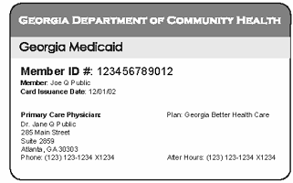
Public Health Insurance
Medicaid
By law must cover qualifying persons who are pregnant, children, elderly, disabled and parents/caretaker relatives
States administer the program; each state is different
Benefits of the plan include prescription drugs and are fairly comprehensive
Many clinicians do not accept Medicaid
The Affordable Care Act gives states the option to expand Medicaid coverage
It is financed jointly by the states and the government through taxes.
Source: KFF, 2024; PNTC, n.d.
Notes:
Medicaid is a program designed for people with a low income and for people with disabilities. By Federal law, states must cover qualifying people who are pregnant, children, elderly, disabled, and parents or caretaker relatives in mandatory or optional groups. Childless adults are not covered, and many individuals make too much money to qualify for Medicaid. The states and the District of Columbia are responsible for administering the Medicaid program, so there are effectively fifty-one different Medicaid programs in the country. It is important to note that because states manage their programs they also have the option of expanding eligibility if they so choose. For example, states can choose to increase income eligibility levels.
Medicaid is financed, or paid for, jointly by the states and federal government through taxes. The amount the government matches varies by state.
Medicaid offers a fairly comprehensive set of benefits, including prescription drugs. Despite this, many enrollees have difficulty finding clinicians that accept Medicaid for diverse reasons including low rates of reimbursement and administrative obstacles.
The Affordable Care Act gives states the option to expand Medicaid to cover childless adults with incomes up to 138% of the Federal Poverty Level. As of 2024, 41 states and the District of Columbia have adopted Medicaid expansion.

Slide 34
Medicaid in Tribes and Territories
Medicaid is available for American Indians and Alaska Natives and in U.S. territories
The Center for Medicare and Medicaid Services (CMS) collaborates with the Indian Health Service to provide access to Medicare and Medicaid
Program offerings and eligibility may vary in territories
Territories may use a local poverty level, rather than the federal poverty level, to determine eligibility
Source: CMS, 2024; Medicaid and CHIP Payment and Access Commission, 2021
Notes:
Medicaid is available for American Indians and Alaska Natives, as well as in the U.S. territories: American Samoa, Guam, Marshall Islands, Northern Marianas, Palau, and Puerto Rico.
The provision of Medicaid to American Indians and Alaska Natives is provided by the Center for Medicare and Medicaid Services, or CMS, in collaboration with the Indian Health Service.
Territories may use a local poverty level, rather than the federal poverty level, to determine Medicaid eligibility.

Slide 35
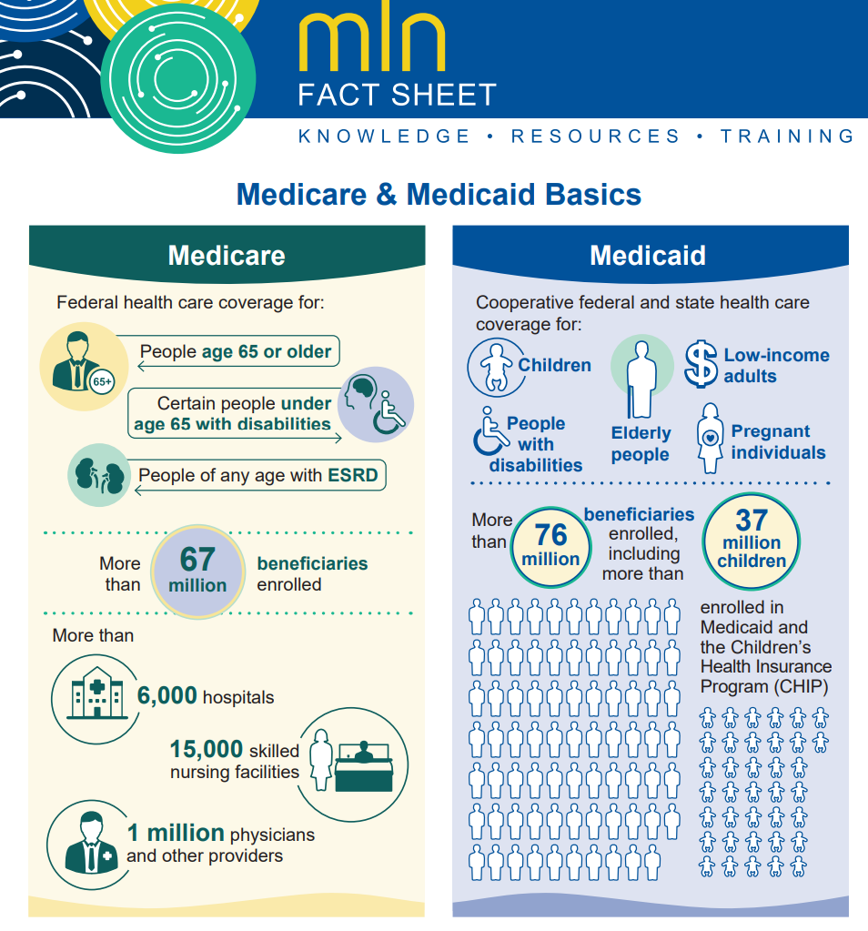
Medicare & Medicaid Basics
Source: Medicare Learning Network, 2024
Notes:
Refer to this fact sheet, which is included in the resources section of the LMS, for an infographic and more information on Medicare and Medicaid.

Slide 36
Medicare & Medicaid Basics
Source: National Infusion Center 2020
Notes:
Medicare and Medicaid can be complicated topics. Review this video which provides a high level overview of some of the things we just covered.
https://www.youtube.com/watch?v=KIh29MJOXhc

Slide 37
Federal Poverty Level (FPL)
Family size | 2023 income numbers | 2024 income numbers
For individuals | $14,580 | $15,060
For a family of 2 | $19,720 | $20,440
For a family of 3 | $24,860 | $25,820
For a family of 4 | $30,000 | $31,200
For a family of 5 | $35,140 | $36,580
For a family of 6 | $40,280 | $41,960
For a family of 7 | $45,420 | $47,340
For a family of 8 | $50,560 | $52,720
For a family of 9+ | Add $5,140 for each extra person | Add $5,380 for each extra person
Source: HealthCare.gov, 2024
Notes:
This graph displays the federal poverty level guidelines for all states and DC, with the exceptions of Alaska and Hawaii. The guidelines are based on individual or family income for 2023 and 2024. For example, according to the chart, the federal poverty level, or FPL, for a family of 4 in 2024 is $31,200. Eligibility for many public health insurance programs is calculated by determining a person’s federal poverty level. As a patient navigator you may want to become familiar with these poverty levels or have them readily accessible so you can better develop solutions for someone based on their income.
Since states do not all have the same eligibility levels, it is important to find the criteria for your state. Through the Affordable Care Act, states are encouraged to expand FPL eligibility, but not all states have chosen to do this. For example, people who are pregnant are eligible for Medicaid at 264% FPL in Connecticut, but they are eligible only at 154% FPL in Wyoming.
Be sure to research the Federal Poverty Level regularly as the definition changes every year.

Slide 38
Public Health Insurance
OTHER PUBLIC SYSTEMS
Children’s Health Insurance Program (CHIP)
Designed in 1997 to cover children whose families make too much money to qualify for Medicaid but make too little to purchase private health insurance.
Veterans Affairs
Health care is delivered in government-owned VA hospitals and clinics. The VA is funded by taxpayer dollars and generally offers extremely affordable (if not free) care to veterans.
Source: PNTC, n.d.
Notes:
Other health public systems include:
CHIP: The Children’s Health Insurance Program. This was designed in 1997 to cover children whose families make too much money to
qualify for Medicaid but make too little to purchase private health insurance. CHIP and Medicaid often share similar administrative and financing structures.
VA: The Veteran’s Administration is a federally administered program for veterans of the military. Health care is delivered in government-owned VA hospitals and clinics. The VA is funded by taxpayer dollars and generally offers extremely affordable (if not free) care to veterans.

Slide 39
Private Health Insurance
EMPLOYER-SPONSORED INSURANCE
Employers provide health insurance
Benefits and degree of cost-sharing varies considerably
Companies can be “self-Insured”
The company directly pays all health care costs for its employees and contracts a third party to administer the health plan.
Administered by private companies:
For Profit: Aetna, Cigna
Non-Profit: Blue Cross/Blue Shield
Financed by employers paying the majority of a premium and employees paying the remaining premium
Notes:
Private Health Insurance:
Many people get private insurance through their employers. When employers buy insurance for their employees, it is less expensive because the risk of high healthcare costs can be spread out among a large group of people.
Employer-sponsored insurance is the main way in which people in the U.S. receive health insurance, but more people who previously could not get approved for health insurance now have access to new marketplace policies due to the Affordable Care Act.
Benefits vary widely with the specific health insurance plan. Some plans cover prescription drugs, while others do not. The degree of cost-sharing (the amount the beneficiary pays) varies widely.
Employer-sponsored insurance plans are administered by private companies, both for-profit (such as Aetna or Cigna) and not-for-profit (such as Blue Cross/Blue Shield).
Some companies are “self-insured” – that is, they pay for all health care costs incurred by employees directly. In this case, the company contracts with a third party to administer the health insurance plan. Self-insured companies tend to be larger companies such as General Motors.
And lastly, employer-sponsored insurance is financed both through employers who usually pay the majority of the premium and employees who pay the remainder of the premium.

Slide 40
Private Health Plans
Health Maintenance Organization (HMO)
Preferred Provider Organization (PPO)
Point of Service (POS)
Fee for Service (FFS)
High Deductible Health Plan
Notes:
Private health insurance plans can vary. Generally, lower cost healthcare plans give people fewer choices in doctors and hospitals. Lower cost plans may also make it more difficult for people to see a specialist. Types of health plans include:
Health Maintenance Organization (HMO)
Preferred Provider Organization (PPO)
Point of Service (POS)
Fee for Service (FFS) or
High Deductible Health Plan
Let’s go into more detail on each type of plan.

Slide 41
Health Maintenance Organization (HMO)
Managed Care
Comprehensive services available
People can only see HMO doctors and hospitals
No or low deductible
Small copay
Must have a primary care clinician
Must get referral for specialty care
Cannot use out-of-network providers
Source: U.S. Office of Personnel Management n.d.
Notes:
HMO's use a "managed care" approach to healthcare. Managed care focuses on early preventive care and screening for diseases to keep costs down. HMO's are the strictest type of insurance plan because people can only see HMO doctors and hospitals. Patients pay either no deductible or a low deductible and may pay a small copay. In HMOs, people are required to have a primary care clinician and the primary care clinician must provide a referral for specialists.
Patients cannot use health care clinicians outside the HMO except for emergencies.

Slide 42
Preferred Provider Organization (PPO)
A “network” of providers agree to charge a certain amount for care
Patients can see other providers but will pay more
Copay and deductible are expected
Referrals are not required
Some networks have more providers than others
Source: U.S. Office of Personnel Management n.d.
Notes:
Like an HMO, Preferred Provider Organizations (PPO's) contract with a "network" of doctors and hospitals that agree to charge a certain amount. Someone in a PPO usually has a copay for doctor visits and a deductible. Referrals to specialists are not required in a PPO. Patients can see doctors outside the network, but they will pay more and may need to send medical bills to the insurance company for reimbursement.

Slide 43
Point of Service
Patient can see providers outside of network but will pay more
Copays and deductibles are low
Referral required to see a specialist
Source: U.S. Office of Personnel Management n.d.
Notes:
A Point of Service Plan (POS) is a combination between an HMO and a PPO. If someone uses a doctor inside the network, they pay less. Copays and deductibles in a POS are low if they stay in the network, but higher if they use doctors outside the network. POS plans require people to get a referral from their primary care physician to see a specialist.

Slide 44
Fee For Service
Refers to reimbursing a clinician for a specific service
Person can choose any doctor or hospital
Fewer services may be covered
May cost more
Source: U.S. Office of Personnel Management n.d.
Notes:
Fee for Service refers to reimbursing a clinician for a specific service. Most plans have been fee for service in the past, but this is changing. In a fee for service plan, the insurer will either pay the health care clinician directly or reimburse the patient for care. Fee for service may be linked to other plans like PPO plans or Medicaid. For non-PPO, non-Medicaid fee-for-service plans, costs may be higher for the person and not as many services may be covered.

Slide 45
High Deductible Health Plan
Lower premiums but higher deductibles
Patients can see any doctor or hospital
Insurance pays for coverage after high deductible is met
Source: U.S. Office of Personnel Management n.d.
Notes:
A High Deductible Health Plan (HDHP) has lower monthly premiums, but higher deductibles so people pay less each month but have to pay a higher deductible before insurance begins to cover costs. Some plans allow patients to see any doctor or visit any hospital, while others require people to use their networks, where they may pay less for services. Because of this flexibility, people with limited financial resources may choose this plan because they want to be covered in case they have an accident or a serious health problem.
These plans can be combined with a health savings account, or HSA, which can be helpful if people plan to pay a lot of money in a year for healthcare. An HSA is a special account that lets people save money on taxes to pay for healthcare expenses.

Slide 46
Healthcare and Incarceration
Correctional facilities are required to provide health services to people who are incarcerated, but provision of care varies widely across states and types of correctional facilities
Inmates are responsible for their copays and out of pocket costs
Incarcerated individuals are not eligible for coverage under the Affordable Care Act or Medicaid
Generally, incarcerated individuals may receive Medicare coverage for Part A (hospitalization) and Part B (physician services), as long as required premiums are paid
Source: Aziz et al., 2021;CMS.gov, 2024; CRS, 2024; Gates et al., 2014; HealthCare.gov, n.d.
Notes:
Correctional facilities are required to provide health services to people who are incarcerated. The provision of care varies widely, depending on the state and type of correctional facility. Some facilities have on-site infirmaries, for example, while others hire or contract with medical providers for care.
People who are incarcerated are responsible for the cost of their care. While the out-of-pocket expenses may be slightly lower, neither the Affordable Care Act nor Medicaid provides coverage for incarcerated individuals, although both options are available after release.
Generally, people who are incarcerated may receive Medicare coverage for Part A (hospitalization) and Part B (physician services), as long as required premiums are paid.

Slide 47
The Patient Protection and Affordable Care Act
Commonly called the ACA or “Obamacare”
Signed into law on March 23, 2010
More coverage including free cancer screening
Health coverage more affordable and accessible
Easier to understand
Source: American Cancer Society, 2023
Notes:
Many new protections for patients and their families are part of the Patient Protection and Affordable Care Act commonly known as the Affordable Care Act, the ACA or Obamacare. The law was signed by President Barack Obama on March 23, 2010, and it helps provide more coverage that is more affordable, more accessible and easier to understand.
We will go through some of these provisions in a moment, but the ACA is a large, complex law with many provisions that can affect people with cancer. More information is available in the resource section of the learning management system.

Slide 48
The Patient Protection and Affordable Care Act
Requires all health plans sold in new health insurance marketplaces to cover essential benefits
Makes proven cancer screenings and other preventive care available at no cost
Medicare coverage of a yearly check-up
Closes the “Donut Hole” in Medicare Part D
Provides Coverage for clinical trials
Source: CMS, 2024; Healthcare.gov, n.d.
Notes:
The law provides more coverage that people with and surviving cancer, and their families can receive by:
Requiring all health plans sold in new health insurance marketplaces to cover essential benefits that include cancer screening, treatment, and follow-up care
Making proven cancer screenings and other preventive care available at no cost to people in new plans, in Medicare, or who are newly eligible for Medicaid as part of the Medicaid expansion population - this provision was threatened in 2023 but as of June of 2024, the law continued to protect coverage of US Preventive Task Force screening recommendations with an A or B rating
Making sure that Medicare covers a yearly check-up to discuss disease prevention and ways to stay healthy
Closing the hole in Medicare Part D that forced seniors to pay high costs for prescription drugs
Making coverage available for patients who participate in clinical trials

Slide 49
The Patient Protection and Affordable Care Act
Removing $ limits on care and benefits
Ending higher charges for people who are ill
Limiting the amount of out-of-pocket costs and deductibles
Helping people and families with low to moderate incomes buy health insurance
Source: American Cancer Society, 2023
Notes:
The new law makes health coverage more affordable by:
Removing dollar limits on care and benefits. Insurance companies can no longer limit the amount they will pay for a patient’s care over a year or over that person’s lifetime.
Ending higher charges for people who are ill. Health plans can no longer charge sick people more for coverage than healthy people.
Limiting the amount patients must pay in out-of-pocket costs and deductibles and
Helping people and families with low to moderate incomes buy health insurance

Slide 50
The Patient Protection and Affordable Care Act
Covering children to stay on their parent’s insurance until the age of 26
Ending rescissions (when the insurance company cancels a policy without the patient agreeing)
Creating health insurance marketplaces
Giving states the option to cover more low-income, uninsured people through Medicaid
Source: Sullivan et al., 2024
Notes:
The new law makes health coverage more easily accessible by:
Covering children to stay on their parent’s insurance until the age of 26. Insurance companies can no longer deny coverage to children with pre-existing conditions such as cancer or diabetes. No one will be denied coverage because of their medical history.
Ending rescissions. Insurance plans can no longer rescind, or stop, coverage because a patient gets sick.
Creating health insurance marketplaces run by the state or the federal government. Online marketplaces will let people shop for insurance and compare health plans by quality and price and
Giving states the option to cover more low-income, uninsured people through Medicaid

Slide 51
The Patient Protection and Affordable Care Act
Making more information available
Grouping health plans based on level of coverage
Giving patients new rights to appeal claims that are denied by their insurer
Source: American Cancer Society, 2023
Notes:
The law will make health insurance easier to understand for many people by:
Making more information available. Insurance companies are required to give consumers more information than before about their plans.
Grouping health plans based on level of coverage. Plans offered in the health insurance marketplaces will be labeled as platinum, gold, silver, or bronze based on the level of coverage they offer. and
Giving patients new rights to appeal claims that are denied by their insurer.

Slide 52
Health Marketplaces (Exchanges)
A
B
C
Source: Healthcare.gov, n.d.
Notes:
One of the key components of the Affordable Care Act is the creation of Health Marketplaces or Exchanges. Every state must have Marketplace plans for those individuals who may not be covered by an employers plan or who prefer to get coverage on their own. The Insurance Marketplace or “exchange” is described on healthcare.gov as a place where people without health coverage enroll in a high-quality plan online, by phone, or with a paper application.
A. Exchanges are set up in every state and are either run by the state or the federal government
B. They can only sell qualified health plans
C. They must provide 10 essential health benefits - we will talk about these in a moment
Marketplace plans can be Bronze, Silver, Gold, Platinum or Catastrophic, which are based on costs and services covered. The deductibles and cost sharing are different for each plan. Marketplace plans might be PPO, POS or HMO plans. They may also be EPO, or Exclusive Provider Organization plans – this means it is a managed care plan where services are covered only if you use doctors, specialists, or hospitals in the plan’s network (except in an emergency).
To qualify for health coverage through the Marketplace, you:
Must live in the United States
Must be a U.S. citizen or national, or be a lawfully present non-citizen in the United States
Can not be currently incarcerated
It is important to note that if someone has Medicare, they are not eligible to use the Marketplace to buy a health or dental plan.
The exchanges or Marketplace plans are all available at Healthcare.gov.

Slide 53
Ten Essential Health Benefits
1. Ambulatory services | 6. Prescription drugs
2. Emergency services | 7. Rehabilitative and habilitative services and devices
3. Hospitalization | 8. Laboratory services
4. Maternity and newborn care | 9. Preventive and wellness services and chronic disease management
5. Mental health and substance use disorder services, including behavioral health treatment | 10. Pediatric services, including oral and vision care
Source: Healthcare.gov, n.d.
Notes:
Another key component of the Affordable Care Act is that all individual and small employer health plans must include these 10 essential health benefits. These include:
Ambulatory Services
Emergency Services
Hospitalization
Maternity and newborn care
Mental Health, substance use and behavioral health treatment and services
Prescription Drugs
Rehabilitative and habilitative services and devices
Laboratory services
Preventive and wellness services and chronic disease management and
Pediatric services, including oral and vision care
Plans will vary in how they define and package these 10 essential benefits. You may need to familiarize yourself with available plans in your state’s market place.

Slide 54
Conclusion
In this lesson you learned to:
Compare hospital structures (public, non-profit, private)
Describe how cancer care may be structured and delivered
Compare inpatient and outpatient care delivery
Discuss types of care and types of health professionals involved in different types of care
Understand how health insurance works
Define key insurance terms
Describe public and private health insurance options, including patient eligibility
Notes:
This concludes the lesson on US Healthcare System, Payment and Financing, part of the Oncology Patient Navigation Training: The Fundamentals course.
In this lesson you learned to:
Compare hospital structures (public, non-profit, private)
Describe how cancer care may be structured and delivered
Compare inpatient and outpatient care delivery
Discuss types of care and types of health professionals involved in different types of care
Understand how health insurance works
Define key insurance terms
Describe public and private health insurance options, including patient eligibility
We encourage you to check out the additional resources available for this lesson located below this video, and in the resources section of the learning management system.
Thank you for your dedication to learning and improving the lives of those affected by cancer.

Slide 55
References
American Association of Medical Dosimetrists. (2020). https://www.medicaldosimetry.org/about/medical-dosimetrist/
American Cancer Society. (2023, September 30). The Affordable Care Act: How it helps people with cancer and their families. https://www.cancer.org/cancer/financial-insurance-matters/health-insurance-laws/the-health-care-law.html
American College of Surgeons. (n.d.). About Cancer Program Categories. https://www.facs.org/quality-programs/cancer-programs/commission-on-cancer/coc-accreditation/categories/
Aziz, H., Ackah, R.L., Whitson, A., Oppong, B., Obeng-Gyasi, S., Sims, C., and Pawlik, T. M. (2021). Cancer care in the incarcerated population: Barriers to quality care and opportunities for improvement. JAMA Surgery 156(10), 964–973. doi:10.1001/jamasurg.2021.3754
Caruso, R., & Breitbart, W. (2020). Mental health care in oncology. Contemporary perspective on the psychosocial burden of cancer and evidence-based interventions. Epidemiology and psychiatric sciences, 29, e86. https://doi.org/10.1017/S2045796019000866
Centers for Medicare & Medicaid Services. (2023). 88 C.F.R. 78818. https://www.federalregister.gov/documents/2023/11/16/2023-24184/medicare-and-medicaid-programs-cy-2024-payment-policies-under-the-physician-fee-schedule-and-other
Centers for Medicare & Medicaid Services. (2024). American Indian/Alaska Native. https://www.cms.gov/training-education/partner-outreach-resources/american-indian-alaska-native
Centers for Medicare & Medicaid Services. (2024). Background: The Affordable Care Act’s new rules on preventive care. https://www.cms.gov/cciio/resources/fact-sheets-and-faqs/preventive-care-background
Centers for Medicare & Medicaid Services. (n.d.). Catastrophic coverage. https://www.medicare.gov/drug-coverage-part-d/costs-for-medicare-drug-coverage/catastrophic-coverage
Centers for Medicare & Medicaid Services. (n.d.). Costs in the coverage gap. https://www.medicare.gov/drug-coverage-part-d/costs-for-medicare-drug-coverage/costs-in-the-coverage-gap

Slide 56
References
Centers for Medicare & Medicaid Services. (2012). Emergency Medical Treatment & Labor Act (EMTALA). https://www.cms.gov/Regulations‐and‐ Guidance/Legislation/EMTALA/index.html?redirect=/EMTALA/
Centers for Medicare & Medicaid Services. (n.d.). Incarcerated Medicare beneficiaries. https://www.cms.gov/training-education/look-up-topics/special-populations/incarcerated-medicare-beneficiaries#:~:text=A%20beneficiary's%20entitlement%20to%20Medicare,beneficiary%20while%20they're%20incarcerated
Centers for Medicare & Medicaid Services. (n.d.). The Affordable Care Act: Increasing transparency, protecting consumers. https://www.medicare.gov/drug-coverage-part-d/costs-for-medicare-drug-coverage/catastrophic-coverage
Congressional Research Service. (2024, July 24). Medicaid and incarcerated individuals. https://crsreports.congress.gov/product/pdf/if/if11830
Cubanski, J., & Neuman, T. (2023, April 20). Changes to Medicare Part D in 2024 and 2025 under the Inflation Reduction Act and how enrollees will benefit. KFF. Retrieved September 12, 2024 from https://www.kff.org/medicare/issue-brief/changes-to-medicare-part-d-in-2024-and-2025-under-the-inflation-reduction-act-and-how-enrollees-will-benefit/
Gates, A., Artiga, S., and Rudowitz, R. (2014, September 5). Health coverage and care for the adult criminal justice-involved population. KFF. https://www.kff.org/uninsured/issue-brief/health-coverage-and-care-for-the-adult-criminal-justice-involved-population/
Giroir, B. P. (2020, April 20). When to seek emergency care. DHHS Office of Minority Health. https://minorityhealth.hhs.gov/news/when-seek-emergency-care
Healthcare.gov. (n.d.). A quick guide to the Health Insurance Marketplace®. https://www.healthcare.gov/quick-guide/eligibility/
Healthcare.gov. (2024). Federal poverty level (FPL). https://www.healthcare.gov/glossary/federal-poverty-level-fpl/
Healthcare.gov. (n.d.). Glossary. https://www.healthcare.gov/glossary/

Slide 57
References
Healthcare.gov. (n.d.). Health benefits & coverage. https://www.healthcare.gov/coverage/what-marketplace-plans-cover/
ISPOR. (n.d.). US Healthcare System Overview-Background. https://www.ispor.org/heor-resources/more-heor-resources/us-healthcare-system-overview/us-healthcare-system-overview-background-page-1
HealthCare.gov. (n.d.). Health coverage for incarcerated people. https://www.healthcare.gov/incarcerated-people/
KFF. (2024, May 8). Status of state Medicaid expansion decisions: Interactive map. https://www.kff.org/affordable-care-act/issue-brief/status-of-state-medicaid-expansion-decisions-interactive-map/
Medicaid and CHIP Payment and Access Commission. (2021, February). Medicaid and CHIP in the territories. https://www.macpac.gov/wp-content/uploads/2019/07/Medicaid-and-CHIP-in-the-Territories.pdf
McInerney, M., Rutledge, M. S., & King, S. E. (2022). How much does health spending eat away at retirement income? Center for Retirement Research at Boston College. https://crr.bc.edu/wp-content/uploads/2022/07/IB_22-12.pdf
Medicare Learning Network. (2024). Medicare & Medicaid basics. Center for Medicare & Medicaid Services. https://www.cms.gov/Outreach-and-Education/Medicare-Learning-Network-MLN/MLNProducts/Downloads/ProgramBasics.pdf
Merriam‐Webster Online Dictionary. (2024). http://www.merriam‐ webster.com/
National Cancer Institute. (n.d.). Dictionary of Terms. https://www.cancer.gov/publications/dictionaries/cancer-terms/def/nutritionist
National Cancer Institute. (n.d.). Dictionary of Terms. https://www.cancer.gov/publications/dictionaries/cancer-terms/def/genetic-counselor
National Infusion Center. (2020). https://www.youtube.com/watch?v=KIh29MJOXhc

Slide 58
References
Patient Navigator Training Collaborative. (n.d). http://patientnavigatortraining.org/
Patient Navigator Training Collaborative. (n.d.). http://patientnavigatortraining.org/
Simone, J. (2002). Understanding cancer centers. Journal of Clinical Oncology, 20(23):4503‐4507. doi: 10.1200/JCO.2002.07.574
Sullivan, J., Orris, A., & Lukens, G. (2024). Entering their second decade, Affordable Care Act coverage expansions have helped millions, provide the basis for further progress. Center on Budget and Policy Priorities. https://www.cbpp.org/research/health/entering-their-second-decade-affordable-care-act-coverage-expansions-have-helped#:~:text=The%20Affordable%20Care%20Act%20(ACA,to%20138%20percent%20of%20the
U.S. Office of Personnel Management. (n.d.). Healthcare plan information: Plan types. http://www.opm.gov/healthcare‐insurance/healthcare/plan‐information/plan‐types/
Weaver, A. J. (2005). Clergy as Health Care Providers. Southern Medical Journal, 98(12), 1237. Patient Navigator Training Collaborative. http://patientnavigatortraining.org/

Slide 59
Thank you!
Sign up for the GW Cancer Center’s Patient Navigation and Survivorship E-Newsletter:
PNS Subscription
Sign up for the GW Cancer Center’s Cancer Control Technical Assistance E-Newsletter:
TAP Subscription

