Slide 1
Patient Advocacy
Oncology Patient Navigator Training: The Fundamentals
Notes:
Welcome to Patient Advocacy, part of the Oncology Patient Navigator Training: The Fundamentals course. My name is PRESENTER NAME AND TITLE, and I will be your presenter for this lesson of the course.

Slide 2
Acknowledgments
This work was supported by Cooperative Agreement #NU58DP007539-01 from the Centers for Disease Control and Prevention. Its contents are solely the responsibility of the authors and do not necessarily represent the official views of the Centers for Disease Control and Prevention.
We would like to thank:
The GW Clinical Learning and Simulation Skills (CLASS) Center for providing space to film video simulations for this lesson. Patient navigator actors in the simulation videos: Thelma D. Jones and Falasha Culpepper
We would also like to thank the following for their assistance with content revision:
Monica Dean, Academy of Oncology Nurse & Patient Navigators
Jess Quiring, Patient Navigation Advisors
Zarek Mena, Patient Navigation Advisors
Reesa Sherin, Association of Cancer Care Centers
Notes:
Before we begin, we would like to acknowledge the Centers for Disease Control and Prevention for supporting this work. Its contents are solely the responsibility of the authors and do not necessarily represent the official views of the Centers for Disease Control and Prevention.
We would like to thank the GW Clinical Learning and Simulation Skills (CLASS) Center for providing space to film video simulations for this lesson. Additionally, we would like to thank Thelma D. Jones and Falasha Culpepper, the Patient Navigator actors in the simulation videos.
We would also like to thank the many professionals listed here for their assistance with content revision:
•Monica Dean, Academy of Oncology Nurse & Patient Navigators
•Jess Quiring, Patient Navigation Advisors
•Zarek Mena, Patient Navigation Advisors
•Reesa Sherin, Association of Cancer Care Centers

Slide 3
Learning Objectives
Describe the terms advocacy and self-advocacy Implement strategies for advocating for your patient Describe components of self-advocacy Assess patient capacity to advocate for themselves Support personal empowerment to help patients and caregivers advocate for themselves Identify strategies to support the patient's ability to advocate for themselves and communicate with the medical team Describe strategies for advocating for quality patient care and optimal patient systems
Notes:
After completing this lesson, you will be able to:
Describe the terms advocacy and self-advocacy
Implement strategies for advocating for your patient
Describe components of self-advocacy
Assess patient capacity to advocate for themselves
Support personal empowerment to help patients and caregivers advocate for themselves
Identify strategies to support the patient's ability to advocate for themselves and communicate with the medical team
Describe strategies for advocating for quality patient care and optimal patient systems

Slide 4
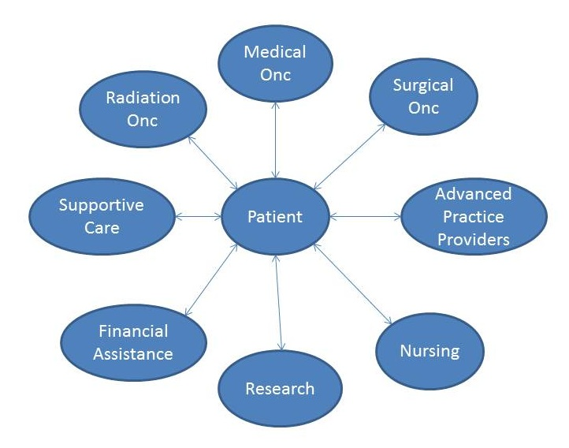
Patient-Provider Communication
Paternalism
Patient
Source: Vose, 2015
Notes:
Over the years, the dynamic between patients and healthcare professionals has shifted significantly—from a paternalistic approach, where professionals largely controlled the conversation, to a patient-centered model that prioritizes the patient’s voice. In the patient-centered model, patients are encouraged to express their wants, needs, and preferences.
To achieve optimal health outcomes and enhance patient satisfaction, it is important for patients to advocate for themselves. Patient navigators play an important role in this process by providing essential information and boosting patient confidence, enabling them to make informed decisions. Patient navigators support patient empowerment by helping patients take an active role in their care. Navigators can share information and provide easy-to-use, accessible tools that enhance patient knowledge and the patient’s ability to communicate effectively with their healthcare team, allowing them to ask questions and express their wants and needs. While patient navigators may sometimes need to take direct action on behalf of patients, it is equally important for patients to develop the skills to manage their own care. This preparation is invaluable for situations where patients do not have immediate access to a navigator, empowering them to take control of their healthcare and share their knowledge with others.

Slide 5
Definition: Advocacy
noun
ad·​vo·​ca·​cy ˈad-və-kə-sē
the act or process of supporting a cause or proposal
Source: Merriam-Webster Online, n.d.
Notes:
Before we dive into patient advocacy, what does the term ‘advocacy’ mean? Advocacy can be defined as:
“the act or process of supporting a cause or proposal.”

Slide 6
Definition: Patient Advocate
“A person who helps guide a patient through the healthcare system. This includes help going through the screening, diagnosis, treatment, and follow-up of a medical condition, such as cancer. A patient advocate helps patients communicate with their health care providers so they get the information they need to make decisions about their health care. Patient advocates may also help patients set up appointments for doctor visits and medical tests and get financial, legal, and social support. They may also work with insurance companies, employers, case managers, lawyers, and others who may have an effect on a patient’s health care needs. Also called patient navigator.”
Source: NCI Dictionary of Cancer Terms. n.d.
Notes:
The National Cancer Institute’s definition of a patient advocate is a person who helps guide a patient through the healthcare system. This includes help going through the screening, diagnosis, treatment, and follow-up of a medical condition, such as cancer. A patient advocate is someone that helps patients communicate with their health care professionals so they get the information they need to make decisions about their health care. Patient advocates may also help patients set up appointments for doctor visits and medical tests and connect patient to financial, legal, and social support. They may also work with insurance companies, employers, case managers, attorneys, and others who may have an impact on a patient’s health care needs. This person can also be called a patient navigator.

Slide 7
Strategies for Advocating For Your Patient
Assess patient abilities, strengths and needs
Determine when to advocate
Build strong partnerships with providers while working toward system improvement to support patient-centered care
Provide patients with the best evidence-based care that includes treatment options, decision-making tools, culturally and health literacy appropriate educational materials, and full disclosure of cost, side effects, and impact on quality of life
Display confidence and assertiveness
Source: Bellomo, 2016
Notes:
The first step in advocating for your patient is understanding your patient's wants and needs, which means knowing the patient and their medical background. Assessing the patient for their own individual abilities, strengths and needs will help you understand what is unique about them and what kind of support would be most helpful to them. Sometimes, it is easy enough to ask if they need help with a problem, if they want you to call the doctor or if they want you to talk to their family. Other times, you may need to determine what is in your patient's best interests. It's important not to confuse what you want with what your patient wants. As an advocate you can help patients and their families come to agreement on decisions that need to be made. You may also need to help find legal assistance for patients and their families.
Remember, advocate for your patient’s wishes, not yours or the family's. The second strategy for advocating on behalf of your patient is determining when to advocate. It may be difficult to know when to advocate for your patient or when to speak up. You should speak if the patient is unable or unwilling to speak for themselves, but you know they lack clarity about an aspect of care or they have a strong value or preference that is not being considered. Sometimes that means asking another colleague for help advocating for the patient, such as a social worker or nurse.
Another strategy of patient advocacy is building a network of partnerships with providers and community resources, so that you have resources to refer patients to when a need arises.
Lastly, advocates must be assertive. This means standing your ground and making your patients’ needs known. However, assertiveness is not the same as aggression. You still need to keep the mindset of negotiating, remaining calm and thinking about the patient's needs first and foremost.

Slide 8
Advocating on Behalf of a Patient
Letting a doctor know
Working with internal departments
Speaking up at a team meeting
Helping a patient access services
Writing appeal letters
Calling utilities company
Notes:
Here are several examples of how you might advocate on behalf of a patient:
Letting a doctor know about a conversation with the patient where the patient expressed a concern.
Working with internal departments, like the billing department, to help reduce costs to the patient.
Speaking up at a team meeting if you feel a patient’s preferences aren’t being factored in, such as how they deliver information to the patient.
Helping a patient access services, for example, calling the radiation oncology department to try to get them to see a patient if a patient has difficulty getting an appointment.
Writing appeal letters to insurance companies for different drugs or for disabilities. Or,
Calling utilities companies to seek assistance, for example, if a patient can’t pay a bill
These are just a few examples of situations that might require you to advocate. There are many other ways you can advocate on behalf of patients.

Slide 9
Advocating on Behalf of a Patient
Click here to watch the video
Source: GW Cancer Center, 2021.
Notes:
Let’s observe how Thelma advocates on behalf of a patient whose cultural needs may impact her care.
Video Transcript:
Navigator: Dr. Wood, can I talk to you about a new patient on your schedule today- Adira Bachman? She’s coming in at 1:30.
Doctor: Ah, sure. Do you know her?
N: Actually, we haven’t met but I have spoken with her over the phone. She was just diagnosed last week and today will be her first consult. She’s Jewish, and is Orthodox, so we discussed some cultural things that might impact her care and her priorities for treatment.
D: Okay, like what?
N: Actually, are you sure this is a good time?
D: Yeah, yeah it’s a good time.
N: Oh, okay. Well, some of the concerns are, if someone needs to touch her - take her temperature or other vitals, do a blood draw or give any type of exam, for example - it needs to be a woman. Orthodox Jews do not touch members of the opposite gender, not even to shake hands.
D: Wow, I didn’t even know that. Something I didn’t know.
N: And another point, she’s married, so she will probably wear a wig, or maybe a scarf, to cover her hair. But, Adira doesn’t have children, and having and raising children is extremely important to her and her family. So, I know she and her husband are very concerned about fertility, and that’s something she would like to discuss right away.
D: Okay that’s no problem, I will be happy to discuss that with them. I will bring that up with her for sure.
N: Okay, thank you. So, a few other things, she and I have also talked about resources and supportive services. Adira feels very strongly about using support from her community.
D: Okay.
N: Also, I will be working to find different resources and services available that she will feel comfortable with. I think she’ll need a lot of support during her treatment.
D: Okay, we have resources here that are available, psychologists and social workers that she can use here, that are readily available for use.
N: Thank you, I appreciate your reminding me of that, however, she has asked that her rabbi be informed about her treatment process and the ways her community can help her and her family. So, if she is willing, I know of another Orthodox Jewish woman who was treated here and who would be a good person to speak with. So, Adira would like to meet someone from her background who’s been through a similar experience. She does not know anyone who has survived cancer and so that is definitely has caused a lot of fear.
D: Okay, well, I think then that’s probably a really good idea. I think that’s a good idea.
N: Back on your point about the psychologist and social workers, just as a reminder so at least for now, she wants to speak with someone from her community, who has a shared background. So, I’ll call our other patient today and see if she would be interested in speaking with Adira.
D: Okay, great, if you can set that up, that would be wonderful.
N: Okay, thank you. So, and just finally, I’ve set aside some time to meet with her later today so we can continue to discuss her preferences and other needs. And then, I will let you know if there are other considerations as important to her care.
D: Okay, okay, thank you so much.
What did you observe during that interaction?
Thelma was polite, concise, and deferential when speaking with the doctor. Rather than directing the doctor’s work, she aimed to enhance it by providing important information about the patient’s cultural preferences that the doctor wasn’t aware of. Initially, the doctor seemed rushed and distracted, but as Thelma shared valuable insights about the patient’s cultural and religious beliefs, the doctor became more engaged and receptive. You can see the doctor’s posture and attitude shift as she realizes the significance of what Thelma is saying and how it could impact the patient’s care and perspective on treatment.
It's important to note that Thelma had not previously worked with a patient who had these specific cultural needs. However, she made sure that she took thorough notes during her phone conversation with the patient and referenced these notes during her discussion with the doctor to accurately convey the information.

Slide 10
System Advocacy
Speak up at tumor boards
Talk with doctors about common issues you notice
Convene a meeting
Join a state cancer coalition
Join local, regional and national cancer advocacy organizations
Call state or national representatives
Notes:
As a patient navigator, you will be in a unique role to see system issues for patients. You will know if there are certain barriers many patients face, and it is your role to advocate on behalf of patients in general in addition to advocating on behalf of individual patients. Some examples of system advocacy include:
Speaking up at tumor boards about issues that many patients are facing, such as problems getting tests preauthorized
Talking with doctors about issues you see, for example, tell them if a drug company was delayed in processing assistance applications, so they can follow up; or, tell them about patients who are eligible for clinical trials who are not being asked to join.
Convening a meeting with key stakeholders about an issue you’ve noticed.
Joining a state cancer coalition
Joining a local, regional or national advocacy organization to let them know what challenges patients are facing. For example, an organization might benefit from knowing that their eligibility criteria for services is too restrictive for your neediest patients. Or,
Calling state or national representatives.

Slide 11
Definition: Self-Advocacy
“Patient behaviors to get their preferences, needs, and values met in the face of a challenge.”
Source:Thomas et al, 2021
Notes:
We covered advocating for others, let’s learn about self-advocacy. Self-advocacy refers to behaviors to overcome challenges in getting preferences, needs, and values met in the face of a challenge. Remember that self-advocacy is more than confidence in abilities, self-management, or completing the tasks necessary to manage one’s care. Self-advocates stand up for their needs; and patient navigators equip patients with the skills and confidence to do so. Self-advocacy is a process of internalizing skills and resources to act in a way that supports survivors’ needs and goals.
Personality traits, skills, and lived experiences can all affect a person’s confidence and capacity to self-advocate. These traits may change during an individual’s cancer experience so it is important for everyone involved in the patient’s care to notice changes in a patient’s ability to self-advocate.
In this section, we will explore best practices on how to assess your patient’s ability to self advocate, barriers to self-advocacy, and the basic elements of self-advocacy.

Slide 12
Engagement Behavior Framework
Find Good Health Care
Communicate With Your Doctors
Participate in Your Treatment
Promote Your Health
Organize Your Health Care
Get Preventive Health Care
Pay for Your Health Care
Plan For Your End-of-Life Care
Make Good Treatment Decisions
Seek Knowledge About Your Health
Source: GW Cancer Center, n.d.
Notes:
This is the Engagement Behavior Framework. This framework provides an overview of ways that patients can self-advocate to support their health and benefit from their care.
These actions are:
Find Good Health Care
Communicate With Your Doctors
Participate in Your Treatment
Promote Your Health
Organize Your Health Care
Get Preventive Health Care
Pay for Your Health Care
Plan For Your End-of-Life Care
Make Good Treatment Decisions
Seek Knowledge About Your Health
As a patient navigator, you will be in a position to help patients with the activities so they can be more engaged in their care and more effectively advocate for themselves.

Slide 13
Outcomes of Self-Advocacy
Improved self-concept
Increased control over one’s own care
Strengthened sense of autonomy
Improved symptom management
Improved adherence
Increased satisfaction with care
Improved quality of life
Decreased health care use
Source: Hagan & Donovan. 2013
Notes:
Self-advocacy has many positive benefits. Outcomes can include improved self-concept, control and sense of autonomy. Other outcomes of self-advocacy may include improved symptom management, adherence, satisfaction with care and quality of life along with decreased healthcare use.

Slide 14
Learning About the Patient
Main Issues
Barriers and Problems
Solutions
Strengths and Weaknesses
Personal History
Personal Goals
Culture
Beliefs
Support System
Source: PNTC
Notes:
The best way to help support patient empowerment is by learning about the patient first. Each patient has different needs, priorities and strengths. Patient navigators should also ask questions to understand the patient’s culture and beliefs and how those relate to their medical and personal preferences. By identifying patient strengths and supports and asking about challenges, a navigator is well positioned to help patients understand and use their strengths and existing support system as much as possible to address challenges they may experience. This information allows a patient navigator to help the patient find solutions and create achievable personal goals. Using a strengths-based approach, navigators can supplement the patient’s personal strengths and social supports with additional resources to reduce barriers to care.

Slide 15
Assessing a Patient’s Ability to Self-Advocate
Does the patient accept cancer as part of their life? Do they feel empowered?
Is the patient assertive and engaged in shared decision-making?
Does the patient use available resources?
Does the patient have personal characteristics to help them advocate?
Does the patient have the skills needed to advocate?
Does the patient have access to support?
Notes:
Not all patients will be able to advocate for themselves, so it’s important to assess each patient’s ability and willingness to do so using the criteria we discussed. Consider the following questions:
Does the patient accept cancer as part of their life? Do they feel empowered?
Is the patient assertive and engaged in shared decision-making?
Does the patient utilize available resources?
Does the patient possess personal characteristics that support self-advocacy?
Does the patient have the necessary skills?
Does the patient have access to support?
As you interact with the patient and evaluate these factors, think about the best ways to support them. For example, if the patient could benefit from improved problem-solving skills, how can you assist them? How can you help the patient identify and utilize available resources and support?
Remember, patients may struggle to ask for help, influenced by their cultural background, linguistic abilities, or physical abilities, such as hearing. Take special care to ensure the patient truly understands what you are asking and isn’t simply agreeing to avoid embarrassment.

Slide 16
Supporting Patient Empowerment
Knowledge
Providing information and resources
Discussing options
Helping with decision-making
Attitudes
Encouraging assertiveness
Skills
Ability to self-care
Ability to cope
Ability to actively communicate
Sources: PNTC; National Coalition for Cancer Survivorship, n.d.
Notes:
It’s not uncommon for patients to need help with self-advocacy. They often don’t know what they don’t know. Navigators empower patients to activate themselves in their own care by sharing information and easy to use and accessible tools that bolster their knowledge and ability to communicate with their health team to ask questions and express their wants and needs. This gives patients greater confidence, increased understanding of medical system and the ability for them to meet their own needs. It also prepares patients for times and situations when they do not have access to a patient navigator, empowering them to manage their own care, and sharing knowledge with them that they can share with others.

Slide 17
Basic Elements of Self-Advocacy
Informed Decision-Making
Effective Communication
Connected Strength
Source: Hagan & Donovan, 2013
Notes:
There are three essential elements patients need to be able to advocate for themselves: informed decision-making, effective communication, and a strong support network. Let’s explore each one.

Slide 18
Informed Decision-Making
Accessing health information
Recognizing opportunities to make decisions
Weighing risks and benefits of various options
Making decisions based on priorities
Source: Hagan & Donovan, 2013
Notes:
The first element is informed decision-making. This involves several key behaviors:
Accessing reliable health information
Identifying opportunities to make decisions
Weighing the risks and benefits of different options
Making decisions based on personal priorities
An important step in self-advocacy is finding and utilizing accurate health information. When patients gain knowledge about their cancer, treatment options, management strategies, and the healthcare system, they better understand their situation and how to navigate it. With this knowledge, they can recognize important decision points in their care and carefully consider the risks and benefits of each option.

Slide 19
Effective Communication
Asking questions
Sharing opinions and preferences
Discussing personal experiences
Openly communicating concerns
Source: Hagan and Donovan, 2013
Notes:
The second basic element of self-advocacy is effective communication with healthcare professionals. This involves key behaviors such as:
Asking questions
Sharing opinions and preferences
Discussing personal experiences
Openly communicating concerns
Patients may find it challenging to communicate with their doctors due to time constraints or subtle interpersonal cues, which can limit opportunities to discuss important topics. Effective communication fosters a shared understanding between patients and healthcare professionals, creating an environment where concerns and challenges can be openly addressed. This may require patients to explicitly state their needs or respectfully decline recommendations that do not align with their preferences or values. Patient navigators can follow up with patients to make sure their concerns are addressed. Additionally, navigators can help patients prepare for appointments by helping them write down questions they want to discuss.

Slide 20
Connected Strength
Seeking support from others
Providing support to others
Sharing their experience of cancer with others
Raising awareness about cancer
Source: Hagan and Donovan. 2013
Notes:
While the first two dimensions of self-advocacy focus on the individual's role within the healthcare setting, the third dimension emphasizes gaining strength through connection with others.
Key behaviors include:
Seeking support from others
Providing support to others
Sharing their experience with cancer
Raising awareness about cancer
Openly asking for support and specific types of help is a sign of strong self-advocacy. People who are used to being caregivers may need to rely partially or fully on others in a way they never have before. It can be challenging to balance giving and receiving support. Patient navigators can help normalize the need for support and the frustration some patients may feel in not being able to do as much on their own as they are used to. Patient navigators can offer community resources that supplement the patient’s own social support network of family and friends.
Connected strength also manifests in those who self-advocate by supporting others with cancer, perhaps sharing their own cancer journey as a way to connect and uplift others.

Slide 21
Strategies to Support the Patient's Ability to Advocate
Patient navigators can help patients to:
Seek information
Engage providers
Talk to family and caregivers
Organize preferences and priorities
Use resources
Notes:
To support self-advocacy, patient navigators can assist individuals in:
Seeking information
Engaging with healthcare providers
Communicating with family and caregivers
Organizing their preferences and priorities
Utilizing available resources

Slide 22
Self-Advocacy Tools to Support Patients
Checklist of questions to ask providers
Checklist of items and documents to take to appointments
List of local resources, such as support groups or financial and legal counsel
Information packets
Source: PNTC
Notes:
There are several other ways navigators can support the patient empowerment to advocate for themselves.
For example, you can sit with your patient and discuss and write down questions they may want to ask their providers. Patients may not know the right questions to ask—so you can make some suggestions of questions to prompt their thoughts. This way, patients can make sure that all of their concerns are addressed when they meet their providers without feeling overwhelmed. Preparing questions ahead of time and discussing them with you will also increase their confidence in asking those questions.
Similarly, making a checklist of things patients may want to take to their appointments may be helpful. Things on the list may include anything from bus passes to insurance information and documents to voice recorders.
It may also be helpful to have a list of local resources such as support groups and financial and legal counselors on hand. Information packets with information on their illness and other sources of information will help patients make informed decisions.
Providing patients with informational packets is also an easy way for patients to share their situation and gain understanding with their family and caregivers.

Slide 23
Helping Patients Contact Organizations
Prioritize
Pace yourself
Get comfortable
Write things down
Be organized
Source: PNTC
Notes:
Patients share the responsibility of finding and using resources and may need to directly contact organizations as well. You can help them by giving them information about the organization and process so that they are prepared for the call. For example, you can tell them the menu tree options that they will need to press, or let them know that they will be expected to report their contact information, cancer diagnosis, and current treatment.
Patients sometimes have difficulty making calls because they are fatigued and overwhelmed from their illness or treatment side effects. You can encourage them to prioritize their calls to make the most important or urgent ones first. The patient does not have to make all their phone calls or web searches in one sitting. They can strategize by setting aside a time for making calls when they know that they will have the most energy. Before making calls, the patient can make sure that they are in a comfortable spot and have their glasses or magnifying glass at hand. The patient should take notes and write down information so that they do not forget it, including the date, name of the person that he or she spoke with and the information received. This information should be kept together in an easy to access place such as a spiral notebook so that it does not get lost later on.

Slide 24
Helping Patients with Limited English Proficiency
Find language-concordant services when possible
Work with interpreter services if available
Enlist family members, friends and neighbors to make calls in English and provide other support
Practice asking for a person who speaks the language of the patient
Identify agencies that the patient can visit in person
Source: PNTC
Notes:
When your patient’s primary language is not English, it is best to connect them with services in their preferred language whenever possible. Many government-funded services are accessible in multiple languages because of anti-discrimination laws and national standards. You should look beyond your list of usual organizations to find local community organizations that serve specific populations. These organizations often have the strongest linguistic and cultural capacity, and may offer services relevant to your patient. For example, there may be senior centers, churches, or social agencies that host cancer support groups in other languages.
Some non-profit organizations that serve mostly English-speakers may also have bilingual capacity. Provide your patient with the contact information and instructions that most directly and clearly connect them with the staff person or resource appropriate to their language. You do not want your patient to get lost in a phone menu tree or become discouraged because they see a lot of English text and do not know how to navigate to the bilingual portion of a website. For example, if your patient is Spanish-speaking, provide them with the direct extension of the Spanish-speaking staff, and provide the URL to the Spanish version of the website.
There may be language access services available where you work. Familiarize yourself with your location’s protocols for use of interpreter services as well as how to request these services. When working with interpreters, be sure to allow extra time for the communication, be clear with your word choices, pause after every couple of sentences so that the interpreter can repeat what you said, and refrain from trying to summarize information.
Bilingual patient family members and friends should NOT be asked to interpret medical information. Professional certified medical interpreters are necessary to make sure that medical information is accurately and neutrally conveyed to the patient. However, the patient’s bilingual family members and friends may be willing and able to put their language skills to use in other ways, for example by accompanying the patient to social service agencies or by helping the patient fill out assistance application forms.
If you are a bilingual navigator, you have the advantage of being able to directly walk the patient through services and applications which can make the processes simpler. However, you may need to spend more time assisting patients with limited English proficiency, especially if they do not have bilingual people who can support them in their social network.
Again, if you have not been trained in medical interpretation, you should not interpret medical information to patients. If medical interpreters are not available, hospitals and clinics can use language lines, to make sure the patient receives medical information and instructions in their native language.
Navigators can also:
Help patients identify family members, friends and neighbors who can help them make calls in English
Practice with the patient to ask for a person who speaks their language, and
Identify agencies that the patient can visit in person

Slide 25
Video
Click here to watch the video
Source: GW Cancer Center, 2021.
Notes:
Take a moment to observe this video where Patient Navigator, Falasha, talks with a patient who has low health literacy and feels embarrassed to ask questions in front of a physician and the rest of the medical team.
Video transcription:
Patient: By the way, I wanted to ask you about something. So, when my cousin was going through this, he was taking some drug… dox-something?
Navigator: Doxorubicin?
P: Yeah that’s it! Shouldn’t I be taking that? I mean, you know I, we, have the same type of cancer and the doctor said it was really important that he take that. So, should I be doing that?
N: Yeah, that’s a really good question. Did you think about asking Dr. Chang during your appointment today?
P: Well, no. I don’t want her to think that I think know better or something. Yeah, I know she’s the doctor, so… you know.
N: Yeah, but she’s here to answer any questions. We want you to be completely comfortable. So, if you have any questions about your treatment or treatment options, she would be glad to answer them.
P: I just don’t feel comfortable asking her. I am sure she knows best anyway.
N: I rest assure, we want everyone to feel comfortable and I just saw her go into her office. Let’s me grab her and we can all sit and talk.
P: Well, if you don’t think she would mind…
N: Not at all.
P: Okay, thank you.

Slide 26
Supporting Patients
Draw from knowledge of medical terms
Remain empathic, encouraging, positive and reassuring
Focus on working with the patient
Gently confront the patient when necessary
Encourage the patient to speak up and ask questions and to make sure she understands all of the treatment options
Notes:
Did you notice that when the patient first sat down with Falasha she did not seem empowered or in control of care? She was reluctant to ask questions or “challenge” perceived authority because she do not feel as powerful as the doctor. The Patient wants to know more about her treatment, but not at the risk of potentially alienating her medical team.
What did Falasha do to help?
She starts by relying on her familiarity with medical terms to understand the patient is describing a medication
She is empathic, encouraging, positive and reassuring and she is focused on working with the patient
Falasha is able to gently confront the patient to challenge defeatist thinking and help the patient feel more empowered. And,
She encourages the patient to speak up and ask questions and to make sure she understands all of the treatment options.

Slide 27
Maintain Communication with the Patient
Do not ever promise or guarantee anything that you cannot definitely provide yourself
Always keep your word and follow through
Be open and honest with the patient about realistic outcomes
Keep the patient updated
Notes:
While helping patients get resources, it is important to use open and clear communication with them. Services or resources may require applications from third parties. Be sure that the patient understands that applying does not necessarily mean that they will definitely get the service. Even if the outside organization usually provides a certain service, don’t ever promise anything that you cannot personally deliver on because you run the risk of being wrong and breaking their trust. If you do agree to directly provide the patient with a resource, be sure to keep your word and follow through. If something has changed to prevent you from doing so, be open and honest with the patient. When requesting outside resources that are not guaranteed, make sure that the patient’s expectations are realistic and that they understand all possible outcomes. This information can help patients make informed decisions about which resources they would like to try before taking any action, and allows the patient to be prepared for all possible outcome scenarios. Keep patients updated – this allows them to be informed partners with you in deciding how to proceed, maintains trust, and keeps them from worrying.

Slide 28
Self-Advocacy Tools to Support Patients
The National Coalition for Cancer Survivorship
Cancer Survival Toolbox
Self-Advocacy: A Cancer Survivor’s Handbook
www.CancerAdvocacy.org
Notes:
The Cancer Survival Toolbox, created by the National Coalition for Cancer Survivorship, is a free, self-learning audio program to help people develop skills to better meet and understand the challenges of cancer. It includes basic self-advocacy skills and other special topics, and the program can be used at any point in the cancer continuum. Program 6 “Standing up for your Rights” is a great complement to this lesson. You can access the Toolbox from the website listed on the slide and on Apple Podcasts.
The National Coalition for Cancer Survivorship also has a Cancer Survivor’s Handbook, which is a booklet that helps patients advocate for themselves. It provides training steps and tools.
The organization’s website is on this screen and will be listed in the resources section of the learning management system.

Slide 29
Conclusion
Describe the terms advocacy and self-advocacy
Implement strategies for advocating for your patient
Describe components of self-advocacy
Assess patient capacity to advocate for her or himself
Support personal empowerment to help patients and caregivers advocate for themselves
Identify strategies to support the patient's ability to advocate for him or herself and communicate with the medical team
Describe strategies for advocating for quality patient care and optimal patient systems
Notes:
You have reached the end of the Patient Advocacy lesson, part of the Oncology Patient Navigator Training: The Fundamentals. During this lesson, you learned to:
Define the terms advocacy and self-advocacy
Implement strategies for advocating effectively on behalf of your patients
Describe the key components of self-advocacy
Assess a patient's ability to advocate for themselves
Support personal empowerment to help patients and caregivers take an active role in their care
Identify strategies to enhance a patient's ability to advocate for themselves and communicate effectively with the medical team
Describe strategies for advocating for quality patient care and optimal patient systems
Thank you for your participation in this lesson. Your commitment to learning these skills is essential in providing the best possible support and care for those you serve.

Slide 30
References
Bellomo. C., (2016). Patient Advocacy/Patient Empowerment. Journal of Oncology Navigation & Survivorship. September 2016 Vol 7, No 8mber 2016 Vol 7, No 8. https://www.jons-online.com/issues/2016/september-2016-vol-7-no-8/1485-patient-advocacypatient-empowerment
GW Cancer Center (n.d.). Prepared Patient. https://preparedpatient.org/engagement-behavior-framework/
Hagan, T., & Donovan, H. (2013). Self‐advocacy and cancer: A concept analysis. Journal of Advanced Nursing, 69(10):2348–2359. doi: 10.1111/jan.12084.
Merriam‐Webster Online Dictionary. (2024). http://www.merriam‐webster.com
National Cancer Institute. (n.d.). Dictionary of cancer terms. http://www.cancer.gov/dictionary.
National Coalition for Cancer Survivorship. (n.d.). Cancer survival toolbox©. http://www.canceradvocacy.org/resources/cancer‐survival‐toolbox/
Patient Navigator Training Collaborative. (n.d.). http://patientnavigatortraining.org/
Thomas, T. H., Donovan, H. S., Rosenzweig, M. Q., Bender, C. M., & Schenker, Y. (2021). A Conceptual Framework of Self-advocacy in Women With Cancer. ANS. Advances in nursing science, 44(1), E1–E13. https://doi.org/10.1097/ANS.0000000000000342
Vose, J. (2015). Collective Wisdom: Patient-Centered Care and Research. ASCO Connection Blog. https://connection.asco.org/blogs/collective-wisdom-patient-centered-care-and-research

Slide 31
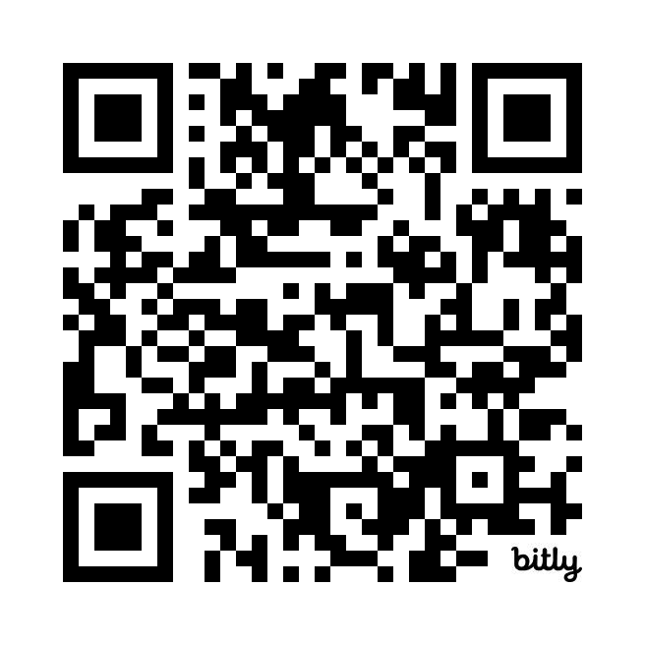
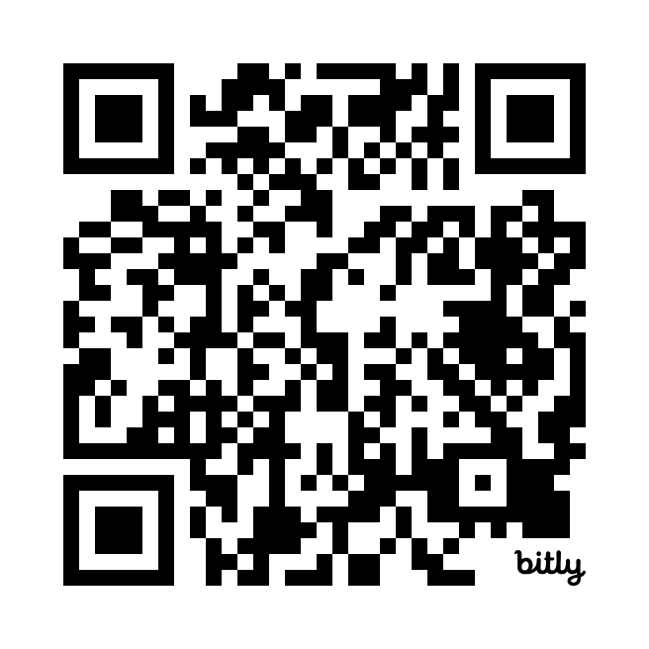
Thank you!
Sign up for the GW Cancer Center’s Patient Navigation and Survivorship E-Newsletter:
PNS Subscription
Sign up for the GW Cancer Center’s Cancer Control Technical Assistance E-Newsletter:
TAP Subscription

