Slide 1
This content may be used or adapted for noncommercial, educational purposes only. Please use the following citation:
George Washington University Cancer Center TAP. (2023). Management of Osteoporosis in Survivors of Adult Cancers with Nonmetastatic Disease [PowerPoint Slides]. GWU Cancer Center TAP. https://cme.smhs.gwu.edu/gw-cancer-center-/content/management-osteoporosis-survivors-adult-cancers-nonmetastatic-disease-0
This content was adapted from the GW Cancer Center the Oncology Patient Navigation Training: The Fundamentals (PI: Pratt-Chapman) developed and maintained by CDC cooperative agreements #NU38DP004972, #5NU58DP006461 and #NU58DP007539. The content added, changed, or adapted by our organization do not necessarily represent the views of the GW Cancer Center or the CDC.
If you have any questions about the following material or would like permission to use this material, please contact cancercontrol@gwu.edu

Slide 2
Osteoporosis Management in Adult Survivors of Nonmetastatic Cancer
Charles L. Shapiro, MD
Professor, Medicine, Hematology and Medical Oncology
Mount Sinai Hospital
Notes:
Hello and welcome to this module on osteoporosis management in adult survivors of nonmetastatic cancer. My name is Charles Shapiro and I am a Professor of Medicine, Hematology and Medical Oncology at Mount Sinai Hospital.

Slide 3
Disclosure
This American Society of Clinical Oncology (ASCO) Guideline summary was prepared by GW Cancer Center. Any summaries or commentary appearing herein were not prepared or reviewed by American Society of Clinical Oncology, Inc. (ASCO) or the editors of Journal of Clinical Oncology® (JCO). The ideas and opinions expressed herein do not necessarily reflect those of ASCO, the editors of JCO, or GW Cancer Center. The mention of any company, product, service, or therapy does not constitute an endorsement by ASCO. It is the responsibility of the treating physician or other health care provider, relying on independent experience and knowledge of the patient, to determine drug dosages and the best treatment for the patient. ASCO, the editors of JCO, and GW Cancer Center assume no responsibility for any injury or damage to persons or property arising out of or related to any use of these materials or any errors or omissions. This material has been reviewed by the speaker and deemed to be appropriate for continuing education.
Notes:
Please note our disclosures. This content was created by a review of ASCO guidelines and was not prepared by ASCO or JCO. Learners should always seek out the latest information and guidelines before making clinical care decisions.

Slide 4
Learning Objectives
Identify the associations between cancer, cancer treatment, and osteoporosis
Describe the management of osteoporosis in adult survivors of nonmetastatic cancer
Describe the role of the Primary Care Clinician (PCC) in the management of osteoporosis in adult survivors of nonmetastatic cancer
Notes:
After this module, you will be able to:
Identify the associations between cancer, cancer treatment, and osteoporosis
Describe the management of osteoporosis in adult survivors of nonmetastatic cancer
Describe the role of the Primary Care Clinician (PCC) in the management of osteoporosis in adult survivors of nonmetastatic cancer

Slide 5
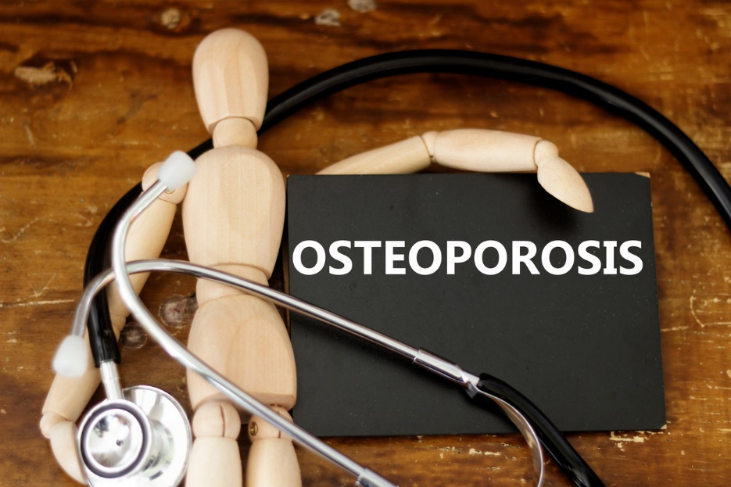
What is Osteoporosis?
The peak bone mass achieved by age 30 minus ongoing losses due to age and menopause
T-score of -2.5 or less in femoral neck, total hip, or lumbar spine
Photo from iStock library authorized by subscription
Mayo Clinic, n.d.; Shapiro et al, 2019
Notes:
Osteoporosis can be thought of as an equation, where you take the peak bone mass achieved by age 30 and subtract the ongoing losses due to age and menopause.
Osteoporosis is assessed by x-rays measuring how many grams of calcium and other essential minerals are present in the bones. A good indication if someone has osteoporosis is T-score, which usually is -2.5 or less in femoral neck, total hip, or lumbar spine areas.

Slide 6
Who Is Susceptible to Osteoporosis?
At least 40% of postmenopausal women and 15-30% of men will experience a fragility fracture
Lifestyle factors, including cigarette smoking and excessive alcohol consumption affect bone loss
Photo from iStock library authorized by subscription
Cauley, 2011; Salari et al, 2021; Shapiro et al, 2019
Notes:
In the general population, at least 40% of postmenopausal women and 15-30% of men will experience a fragility fracture in their lifetime. Worldwide it has been estimated that more than 200 million people are suffering from osteoporosis.
Risk factors for osteoporosis can be either modifiable or nonmodifiable. For example, modifiable risk factors are low body weight, tobacco and alcohol consumption, calcium deficiency, and long-term use of glucocorticoid (medication that is commonly used to reduce inflammation). Being older, non-Hispanic white or Asian female, having genetic predisposition are non-modifiable risk factors.

Slide 7
Cancer Survivors in the United States
In 2019, there were approximately 17 million cancer survivors in the US
It is projected that the number will increase to 22 million by 2023
Photo from iStock library authorized by subscription
NCI, 2019
Notes:
The number of cancer survivors has been exponentially growing not only in the US, but worldwide as well. In 2019, there were approximately 17 million cancer survivors in the US, which represents 5.0% of the population. It has been projected that there will be approximately 22 million survivors by 2030.
The largest groups of cancer survivors are:
Women with early-stage breast cancer
Men with nonmetastatic prostate cancer

Slide 8
Osteoporosis and Cancer
Patients with nonmetastatic cancer may experience challenges in skeletal integrity due to the disease and disease treatment
Photo from iStock library authorized by subscription
Shapiro et al, 2019
Notes:
Patients with nonmetastatic cancer may experience challenges in skeletal integrity as a result of the disease or the disease treatment.
Nonmetastatic cancer increases susceptibility to osteoporosis due to the local and systemic inflammation associated with the disease which can promote bone loss. Treatments are also associated with more rapid and severe bone loss. The rate of bone loss may be more than seven-fold higher than the rate associated with normal aging.

Slide 9
American Society of Clinical Oncology Recommendations
Identify Patients at Increased Risk
Screen Patients at Increased Risk
Identify Effective Interventions and Treatments
Shapiro et al, 2019
Notes:
The American Society of Clinical Oncology (ASCO) has published three recommendations for osteoporosis management in adult patients with nonmetastatic cancer.

Slide 10
American Society of Clinical Oncology (ASCO) Recommendations
Identify Patients at Increased Risk
Screen Patients at Increased Risk
Identify Effective Interventions and Treatments
Notes:
We will start with identifying patients at increased risk for osteoporosis.

Slide 11
Risk Factors
Impaired mobility
Postmenopausal status
Hypogonadism
Excessive alcohol consumption
Current cigarette smoking
Parental history of hip fracture
History of nontraumatic fracture in adulthood
Increased risk for falls
Advanced Age
Low body weight
Long-term exposure to glucocorticoids
Lewiecki, 2021; Salari et al, 2021; Shapiro et al, 2019
Notes:
As I have mentioned earlier, there are modifiable and nonmodifiable risk factors. This figure presents the most common risk factors.
Few studies have looked at cancer patients specifically, so these factors were identified based on risk in the general population.
Advancing age, defined as age 65 years or older in women and 70 years or older in men, has been reported to be the most critical determinant of fracture than bone mass
Increasing alcohol intake to greater than 10 servings per week was also a statistically significant risk factor, as were current smoking and history of chronic glucocorticoid use
Body weight less than 58 kg (127 lbs), low body mass index (20kg/m2) and loss off 5% of weight can also increase clinical risk, as well as history of a prior fracture in adulthood

Slide 12
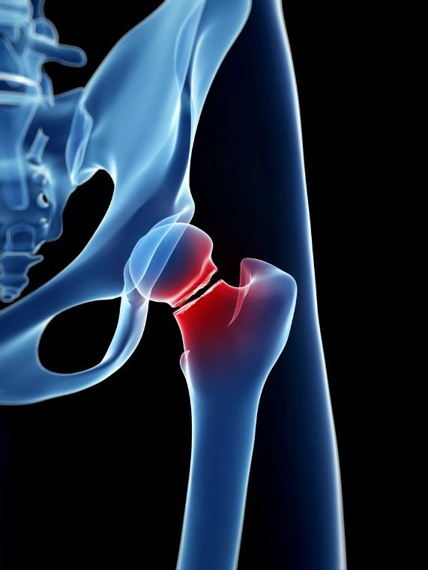
Risks from Treatment
Aromatase inhibitors (AIs) - increase the risk of fractures
Antiandrogen therapy (ADT) - accelerate and disrupt the bone turnover process
Radiation therapy can affect the bone in the treatment field
Photo from iStock library authorized by subscription
Shapiro et al, 2019
Notes:
Anticancer therapies may increase the risk of osteoporotic fracture in either the short- or long-term. This slide presents some notable therapies that providers should be aware of when assessing a patient’s baseline fracture risk.
Aromatase inhibitors may increase the risk of fracture in postmenopausal women with estrogen receptor positive early breast cancer. Antiandrogen therapy in men with prostate cancer can accelerate and disrupt the bone turnover process and men on this therapy have increased bone loss and fracture risk. Radiation therapy can affect the bone within the treatment field, and also indirectly effect bone through vascular changes.

Slide 13
Risk from Disease Manifestation
Physical, metabolic, and psychosocial changes in patients with cancer, can lead to bone atrophy
Cancer cachexia (“wasting”)
Cancer-related fatigue
Photo from Canva library authorized by subscription
Dhanapal et al, 2011; Shapiro et al, 2019
Notes:
Physical, metabolic, and psychosocial changes in patients with cancer, such as malnourishment due to nausea, weight loss, and cancer-related fatigue, can similarly lead to bone atrophy. Nutritional deterioration can occur at any point in the timeline of cancer diagnosis, treatment, or management. Two cancer-related conditions to be aware of are:
Cancer cachexia (”wasting”) which leads to diminished muscle strength and bone mass. Cachexia can be characterized by weight loss, anorexia, asthenia, and anemia
Cancer-related fatigue which may reduce physical activity, can contribute to mechanical unloading, sarcopenia (a skeletal muscle disorder), and bone loss

Slide 14
Quantifying Risk Estimates
Fracture Risk Assessment Tool (FRAX) assists in quantifying risk estimates in patients
Assessment tools not yet validated in cancer patients
Photo from Canva library authorized by subscription
Shapiro et al, 2019
Notes:
Clinicians may use risk assessment tools, such as the Fracture Risk Assessment Tool, known as “FRAX”, to quantify fracture risk estimates in patients. These calculators take into account risk factors, including age, sex, race, medical history, smoking and alcohol use, and family history. FRAX does not capture all risk factors though, and clinicians should consider additional evaluation if there is suspicion of rarer conditions, like high-risk medication use, causes of secondary osteoporosis, or collagen metabolism disorders that are not captured by FRAX.
It is important to note, that these assessment tools are used for the general population and have not been validated in cancer patients.

Slide 15
American Society of Clinical Oncology Recommendations
Identify Patients at Increased Risk
Screen Patients at Increased Risk
Identify Effective Interventions and Treatments
Notes:
Next, we will discuss screening patients at increased risk for osteoporosis.

Slide 16
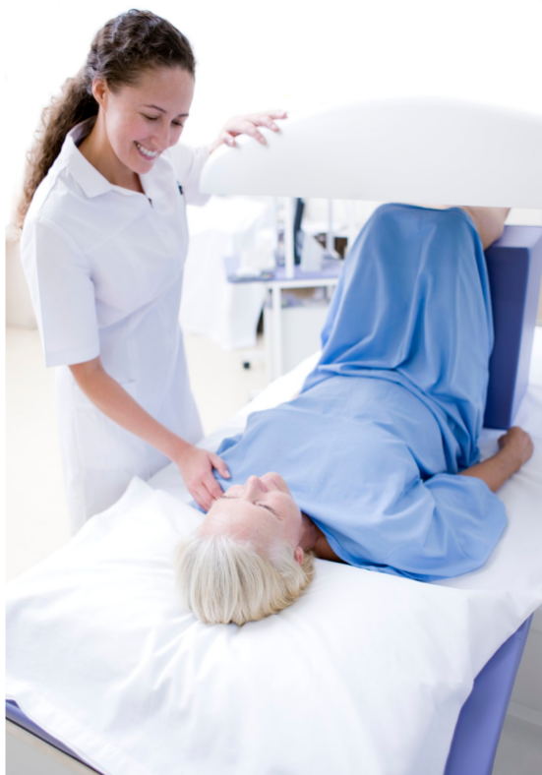
Bone Mineral Density Testing
Bone mineral density (BMD) testing with central/axial dual x-ray absorptiometry (DXA)
Photo from Canva library authorized by subscription
Shapiro et al, 2019
Notes:
Patients with nonmetastatic cancer with one or more risk factors for osteoporosis fractures, such as the ones we previously discussed, should be offered bone mineral density testing using central/axial DXA. Central/axial DXA is considered the gold standard measure, but if DXA is not feasible or accessible, alternative BMD testing methods, such as quantitative ultrasound or calcaneal DXA, should be offered.

Slide 17
Bone Mineral Density Testing (Cont.)
BMD testing should be offered every 2 years to patients with nonmetastatic cancer who:
Are prescribed a drug that causes bone loss or
Have a baseline BMD near threshold of treatment
Illustrations from iStock library authorized by subscription
Shapiro et al, 2019
Notes:
Bone mineral testing should be offered every 2 years to patients with nonmetastatic cancer who are prescribed a drug that causes bone loss or who have a baseline bone mineral density near the threshold of treatment.
Testing may be offered more frequently if medically necessary, but generally should not be conducted more than annually.

Slide 18
American Society of Clinical Oncology Recommendations
Identify Patients at Increased Risk
Screen Patients at Increased Risk
Identify Effective Interventions and Treatments
Notes:
We will now discuss the final group of recommendations: identifying effective interventions and treatments

Slide 19
Nonpharmacologic Interventions
Dietary Intake
(Calcium: 1000-1200 mg/d; vitamin D: at least 800-1000 IU/d)
Calcium and Vitamin D Supplements
(if dietary intake is insufficient)
Combination of Exercise Types
(Balance, flexibility/stretching, endurance. resistance/progressive strengthening)
Medical Rehab
(Offer to patients with impairments that affect gait or balance)
Smoking Cessation
Limit Alcohol Consumption
Shapiro et al, 2019
Notes:
These are some nonpharmacologic interventions identified to limit bone loss, based on the interventions used in noncancer populations. We’ll talk about a few of these.
If daily intakes of calcium and vitamin D are below the suggested levels, patients should be encouraged to consume diet high in vitamin D and calcium in addition to taking supplements to attain these levels
Combination of exercise types reduces the risk of fractures caused by falls. Exercises should be tailored to the needs of the abilities of the patient. Examples of such physical activities are balance, flexibility/stretching, endurance, resistance, and progressive strengthening exercises
Patients with impairments that affect their gait and balance should be offered medical rehabilitation
Smoking and alcohol consumption are risk factors for osteoporosis, so patients should aim to reduce or eliminate these behaviors

Slide 20
Nonpharmacologic Interventions – Cancer Populations
Dosing suggestions in noncancer populations may not be adequate in oncology settings
Checking levels of vitamin D is strongly recommended
Photo from Canva library authorized by subscription
Shapiro et al, 2019
Notes:
Checking levels of 25-OH(hydroxy) vitamin D is strongly recommended before initiation of Aromatase Inhibitors (AI), Androgen Deprivation Therapy (ADT), or any cancer therapy associated with bone loss, or when DXA( Dual energy x-ray absorptiometry) results indicate osteopenia or osteoporosis. The dosing suggestions in noncancer populations may not be adequate in cancer settings, due to the accelerated bone loss associated with cancer and cancer treatment.

Slide 21
Pharmacologic Interventions
Bone-modifying agents (BMAs) may be offered to reduce fracture risk
Hormonal therapies are generally avoided in patients with hormonal-responsive cancers
Photo from iStock library authorized by subscription
Shapiro et al, 2019
Notes:
In certain patients, bone-modifying agents (BMAs) may be appropriate to reduce fracture risk.
BMAs include:
Oral bisphosphonates
Intravenous bisphosphonates
Subcutaneous denosumab
For patients without hormonally responsive cancers, hormonal therapy may be offered with other BMAs, when appropriate. However, the hormonal therapies are generally avoided in patients with hormonal-responsive cancers.

Slide 22
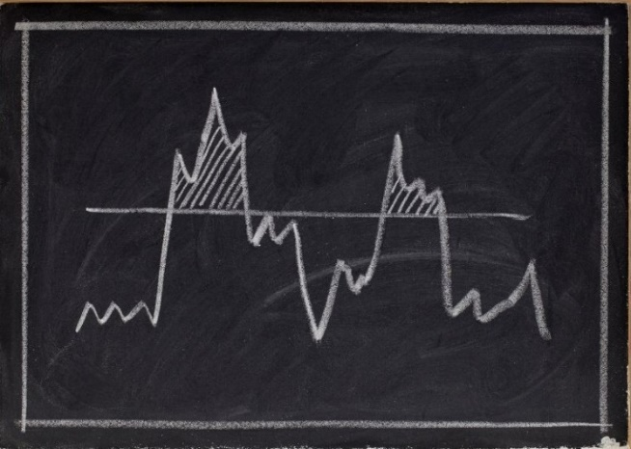
Candidates for BMAs
If a T-score and/or risk assessment exceed the threshold for fracture, candidates may include:
Premenopausal women on GnRH therapy, AIs, CIOF or prior oophorectomy
Men who previously or currently receive ADT
Patients with history of current bone marrow transplantation or more than 3-6 months of glucocorticoid use
Illustration from Canva library authorized by subscription
Shapiro et al, 2019
Notes:
If T-score and/or risk assessment exceed the threshold for fracture, candidates for BMAs may include:
Premenopausal women with GnRH (Gonadotropin-releasing hormone) therapy causing ovarian suppression
Premenopausal women with CIOF (Chemotherapy induced ovarian failure) or prior to oophorectomy
Postmenopausal women on Aromatase Inhibitors (AIs)
Men who previously or currently receive ADT
Patients with history or current bone marrow transplantation
Patients with more than 3-6 months of glucocorticoid use
Treatment at higher bone density or T-score may be appropriate due to rapid short-term bone loss associated with these conditions.t

Slide 23
Conclusion
Bone loss may occur without symptoms
Effects of cancer treatment can increase fracture risk during and after treatment
Providers should:
Integrate monitoring and management of bone health into the overall survival plan for adult patients with nonmetastatic cancer
Emphasize communication and shared decision-making across members of the care team
Adapt screening and treatment based on patient-specific risk factors
Photo from iStock library authorized by subscription
Notes:
Some key takeaways for providers:
Bone loss may occur without symptoms and the effects of cancer treatment may increase the risk of fracture during and after cancer treatment
Providers should monitor and manage bone health as part of the overall survival plan for adult patients with nonmetastatic cancer, emphasize shared decision-making and communication with the patient and other members of the care team, and adapt screening and treatment based on patient-specific risk factors, including the ones discussed in this presentation.

Slide 24
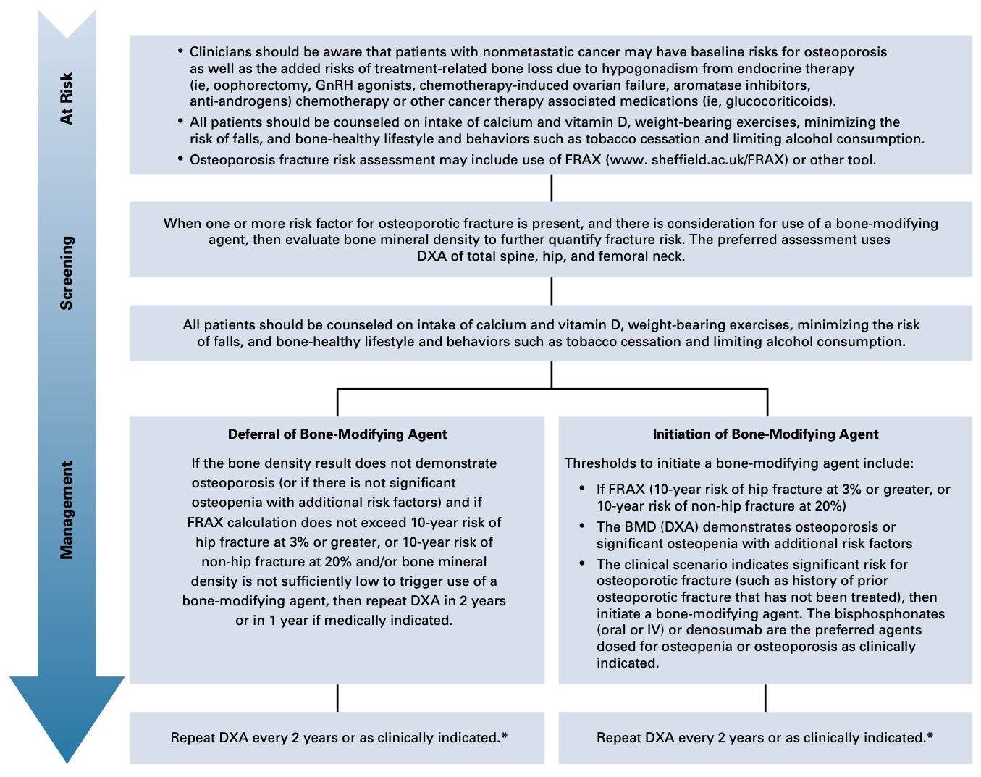
Summary Flow Chart
Shapiro et al. (2019)
Notes:
Finally, this flow chart was created by the ASCO guidelines team and provides an overview of everything we’ve discussed today.

Slide 25
Acknowledgments
This training was supported by Cooperative Agreement #NU58DP006461-04 from the Centers for Disease Control and Prevention (CDC).
The views expressed in written workshop materials or publications and by speakers and moderators do not necessarily reflect the official policies of the Department of Health and Human Services, nor does the mention of trade names, commercial practices, or organizations imply endorsement by the U.S. Government.
Notes:
This work was supported by cooperative agreements from the CDC. Its contents are solely the responsibility of the authors and do not necessarily represent the official views of the CDC. No industry funding was used to support this work.

Slide 26
References
Cauley J. A. (2011). Defining ethnic and racial differences in osteoporosis and fragility fractures. Clinical orthopaedics and related research, 469(7), 1891–1899. https://doi.org/10.1007/s11999-011-1863-5
Dhanapal, R., Saraswathi, T., & Govind, R. N. (2011). Cancer cachexia. Journal of oral and maxillofacial pathology, 15(3), 257–260. https://doi.org/10.4103/0973-029X.86670
Lewiecki EM. Osteoporosis: Clinical Evaluation. (2021). In: Feingold KR, Anawalt B, Boyce A, et al., editors. Endotext. South Dartmouth (MA): MDText.com, Inc.
Mayo Clinic. (n.d.). Bone Density Test. Retrieved from: https://www.mayoclinic.org/tests-procedures/bone-density-test/about/pac-20385273#:~:text=A%20bone%20density%20test%20determines,into%20a%20segment%20of%20bone.
National Cancer Institute. Office of Cancer Survivorship. (2019). Statistics and Graphs. Retrieved from: https://cancercontrol.cancer.gov/ocs/statistics.
Salari, N., Ghasemi, H., Mohammadi, L. et al. (2021). The global prevalence of osteoporosis in the world: a comprehensive systematic review and meta-analysis. Journal of Orthopaedic Surgery and Research, 16(609). https://doi.org/10.1186/s13018-021-02772-0
Shapiro, C.L., Poznak, C.V., Lacchetti, C., Kirshner, J., Eastell, R., Gagel, R.,…Neuner, J. (2019). Management of Osteoporosis in Survivors of Adult Cancers With Nonmetastatic Disease: ASCO Clinical Practice Guideline. Journal of Clinical Oncology, 37(31), 2916-2946. doi:10.1200/jco.19.01696
Notes:
Here are the references used to develop this presentation

Slide 27
Thank you!
<<<Charles L. Shapiro, MD>>
<<<Charles.Shapiro@mssm.edu>>>
Follow us on Twitter:
@GWCancer
www.gwcancercenter.org
Sign-up for the GW Cancer Center’s Patient Navigation and Survivorship E-Newsletter: bit.ly/PNSurvEnews
Sign-up for the GW Cancer Center’s Cancer Control Technical Assistance E-Newsletter: bit.ly/TAPenews
Notes:
Thank you for participating in this module. You can contact me via my email address and connect with the GW Cancer Center using the links on this slide.

