Slide 1
This content may be used or adapted for noncommercial, educational purposes only. Please use the following citation:
George Washington University Cancer Center TAP. (2020). Communication Training for Comprehensive Cancer Control (CCC) Professionals 101: Media Planning & Media Relations [PowerPoint Slides]. GWU Cancer Center TAP. https://cme.smhs.gwu.edu/gw-cancer-center-/content/communication-training-comprehensive-cancer-control-ccc-professionals-101-media-planning-and
This content was adapted from the GW Cancer Center the Oncology Patient Navigation Training: The Fundamentals (PI: Pratt-Chapman) developed and maintained by CDC cooperative agreements #NU38DP004972, #5NU58DP006461 and #NU58DP007539. The content added, changed, or adapted by our organization do not necessarily represent the views of the GW Cancer Center or the CDC.
If you have any questions about the following material or would like permission to use this material, please contact cancercontrol@gwu.edu

Slide 2
Media Planning and Media Relations
Communication Training for Comprehensive Cancer Control Professionals 101
Lesson 1: Health Communication, Social Marketing and Media Advocacy
Notes:
Welcome to the Communication Training for Comprehensive Cancer Control Professionals 101, Media Planning and Media Relations. To use your time most effectively, we split the training into two: the first is this training on Media Planning and Media Relations, for participants purely interested in understanding the requirements for creating a media plan and developing media relations to fulfill their CDC deliverable. The second is on Making Communication Campaigns Evidence-Based for participants who have time to learn more in-depth the process of organizing a communications campaign.
This lesson is on health communication, social marketing and media advocacy.

Slide 3
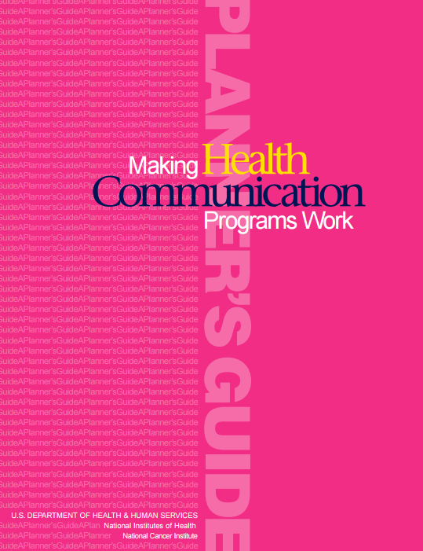
Acknowledgments
This work was supported by Cooperative Agreement #1U38DP004972-02 from the Centers for Disease Control and Prevention. Its contents are solely the responsibility of the authors and do not necessarily represent the official views of the Centers for Disease Control and Prevention.
We would like to thank Monique Turner, Ph.D., Associate Professor, Department of Prevention and Community Health, Milken Institute School of Public Health, the George Washington University.
The competencies in this training are based on
content from the National Cancer Institute’s
publication “Making Health Communication
Programs Work.”
Notes:
We would like to acknowledge the Centers for Disease Control and Prevention for supporting this work. We would also like to thank Dr. Monique Turner, Associate Professor at the Department of Prevention and Community Health at the Milken Institute School of Public Health of the George Washington University for her contributions to content development and review. The competencies in this training are based on content from the National Cancer Institute’s publication “Making Health Communication Programs Work” also known as “The Pink Book.”

Slide 4
Competency
Demonstrate knowledge of the differences between health communication, social marketing and media advocacy
Notes:
This lesson will address the following competency:
Demonstrate knowledge of the differences between health communication, social marketing and media advocacy.

Slide 5
Learning Objectives
Define communication and health communication
Explain the differences between commercial marketing, social marketing and media advocacy
Describe the role of communication in chronic disease and cancer prevention and control
Notes:
After completing this lesson, you will be able to:
Define communication, marketing and health communication
Explain the differences between health communication, social marketing and media advocacy and
Describe the role of communication in chronic disease and cancer prevention and control

Slide 6
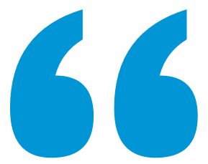
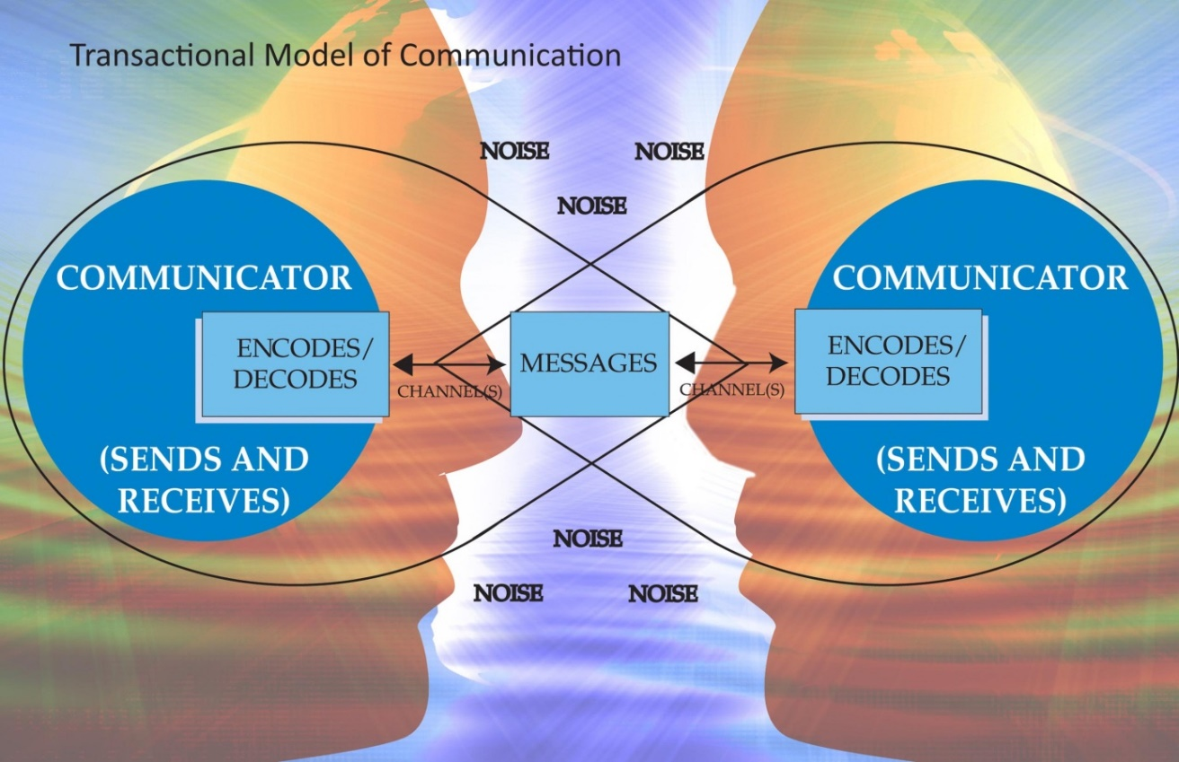
Communication
Collaborative and ongoing message exchange between individuals, or an individual and a group of individuals, with the goal of understanding each other”
National Communication Association. N.d.
Notes:
The study of communication as a formal discipline is more than 100 years old. Communication scholars and practitioners examine the ways in which people use messages to generate meanings. Meaning differs depending on the context, culture, channel employed, and even the media used.
Communication is also transactional. The transactional model of communication reveals the “collaborative and ongoing message exchange between individuals, or an individual and a group of individuals, with the goal of understanding each other.” This model clearly tells us what communication IS NOT. That is, communication is not the simple transfer of one message from a sender to a receiver. You probably understand, having communicated with thousands of people in your life, that communication can be between multiple people who are both sending verbal and nonverbal messages, in a context that is full of mental, and sometimes actual, noise. Noise is defined as any physical distraction such as traffic, psychological distraction such as anger or physiological distraction such as hunger.

Slide 7
Communication
Thoughts
Communication Channel
Applying Meaning
Words and Gestures
Translate message
Convey new message
Interpret message
National Communication Association. N.d.
Notes:
Therefore, a communicator might start out with a thought. They must then translate the message, which means putting thoughts into words and gestures, then convey a new message through some channel, such as speaking, email or text message, to the other communicators; who then interpret that message, or take the words and applying meaning to them.
It is also important to realize that the message that was communicated will probably encounter some “noise,” which could prevent the message from being received or fully understood as the sender intended.

Slide 8
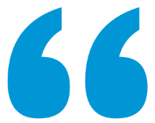
Health Communication
The study and use of communication strategies to inform and influence individual and community decisions that enhance health”
Inform and influence
Audience may be:
Individuals
Groups
Organizations
Communities
Societies
One of many tools to trigger change
National Cancer Institute. 2004.
Notes:
Now that you understand what communication is, we can define health communication. People have defined health communication in various ways. Both the Centers for Disease Control and Prevention and the National Cancer Institute define health communication as “The study and use of communication strategies to inform and influence individual and community decisions that enhance health.” People can communicate to convey all kinds of meanings—from interpersonal communication to organizational communication and even political communication. But, when people are communicating with the intent of talking about health, we define this as health communication.
There are three vital aspects of the definition of health communication that should be pointed out:
One is that the definition discusses the purpose of health communication as “to inform and to influence.” Certainly, there are times when health communicators merely want their audience to become more educated on the health issue. Perhaps we want people to understand the risks of a product, such as prescription medication or we may want people to be educated about the relationship between nutrition and colorectal cancer. Other times, health communicators want to influence or persuade their audience, such as when we try to convince women to get pap smears or to be more physically active each day.
The second aspect of the definition of health communication is the audience, which may be an individual, such as when a provider meets with her patient; a group, such as when a social media campaign attempts to influence teenagers about the consequences of smoking; or organizations, such as when media advocacy is used to aim messages on healthier school lunches at school boards; communities, such as when informational brochures on physical activity are distributed at faith-based organizations, or societies as a whole, such as when a mass-mediated public service announcement is used to raise awareness about lung cancer risk factors.
The third aspect is that communication is one of many tools that can be used to trigger change; therefore we need to understand what health communication can and cannot do to communicate effectively.

Slide 9
Health Communication
Communication alone can…
Increase the intended audience’s knowledge and awareness of a health issue, problem or solution
Communication + other strategies can…
Cause sustained change in which an individual adopts and maintains a new health behavior or an organization adopts and maintains a new policy direction
Communication cannot…
Compensate for inadequate health care or access to health care services
Influence perceptions, beliefs and attitudes that may change social norms
Prompt action
Demonstrate or illustrate healthy skills
Reinforce knowledge, attitudes or behavior
Show the benefit of behavior change
Advocate a position on a health issue or policy
Increase demand or support for health services
Refute myths and misconceptions
Strengthen organizational relationships
Overcome barriers/systematic problems, such as insufficient access to care
Produce sustained change in complex health behaviors without the support of a larger program for change, including components addressing health care services, technology and changes in regulations and policy
Be equally effective in addressing all issues or relaying all messages because the topic or suggested behavior change may be complex, because the intended audience may have preconceptions about the topic or message sender or because the topic may be controversial
National Cancer Institute. 2004.
Notes:
Let’s look at what health communication can accomplish. According to the National Cancer Institute, Communication alone can:
Increase the intended audience’s knowledge and awareness of a health issue, problem, or solution
Influence perceptions, beliefs, and attitudes that may change social norms
Prompt action
Demonstrate or illustrate healthy skill
Reinforce knowledge, attitudes, or behavior
Show the benefit of behavior change
Advocate a position on a health issue or policy
Increase demand or support for health services
Refute myths and misconceptions and
Strengthen organizational relationships
Communication, when combined with other strategies, can:
Cause sustained change in which an individual adopts and maintains a new health behavior or when an organization adopts and maintains a new policy direction and can
Overcome barriers/systematic problems, such as insufficient access to care
Communication cannot:
Compensate for inadequate health care or access to health care services
Produce sustained change in complex health behaviors without the support of a larger program for change, including components addressing health care services, technology, and changes in regulations and policy
Be equally effective in addressing all issues or relaying all messages because the topic or suggested behavior change may be complex, because the intended audience may have preconceptions about the topic or message sender, or because the topic may be controversial

Slide 10
Case Study
Notes:
So how can comprehensive cancer control professionals use health communication to meet their goals and objectives? We now know that health communication is the use of information to improve health. Let’s look at a case study using the transactional model to demonstrate how health communicators translate and convey thoughts so that the intended audience translates the message and applies meaning.

Slide 11
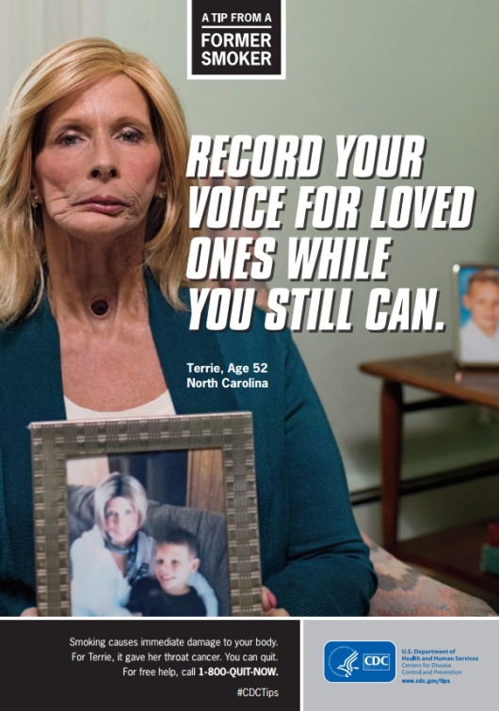
Health Communication
Health Communication
We need to lower the number of smokers!
Terri’s story in print ad
I should quit smoking
Smoking has severe health consequences
Translate message
Convey new message
Interpret message
Centers for Disease Control and Prevention. 2015; National Cancer Institute. 2004.
Notes:
The objective for this CDC Tips from Former Smokers campaign is to lower the number of smokers in the US. Health communicators translated the thought “we need to lower the number of smokers” into words, and conveyed the message in a print ad featuring Terri, a former smoker, giving a startling tip about how to deal with the consequences of smoking: “record your voice for loved ones while you still can.” The goal of this campaign is for the audience to receive and interpret the message in order to motivate them to quit smoking.
We will address the types of appeals that are appropriate for different audiences in lesson 3.

Slide 12
Social Marketing
Longer-term marketing campaign that uses the elements of commercial marketing to influence behaviors”
4 P’s of Marketing
Product
Represents the desired behavior you are asking your audience to perform, and the associated benefits, tangible objects and/or services that support behavior change
Price
Place
Where the audience will perform the desired behavior, where they will access the program products and services, or where they are thinking about your health topic
Promotion
Communication messages, materials, channels, and activities that will effectively reach your audience
The cost (financial, emotional, psychological, or time-related) of overcoming the barriers the audience faces in making the desired behavior change
Centers for Disease Control and Prevention. 2011.
Notes:
Health communication is an entire field or discipline that helps us to understand the best ways to use communication to inform or influence audiences. That communication can come in various forms: doctor to patient, nutritionist to client, public service announcements or PSAs, family communication, support groups, or even social marketing. Oftentimes, when health communicators are attempting to influence large groups of people, they are using social marketing. Social marketing is a longer-term marketing campaign that uses the elements of commercial marketing to influence behaviors. Social marketing is a type of mass communication strategy that practitioners often use to impact behavior change in target audiences. Social marketers use the theories, strategies, and practices of commercial marketers in order to affect social, or in our case public health, behaviors. Commercial marketers think about the 4 P’s of marketing: Product, price, place and promotion.
Product represents the desired behavior you are asking your audience to perform, and the associated benefits, tangible objects, and/or services that support behavior change. For example, a commercial product may be a laptop and a social product may be the act of wearing sunscreen.
Price is the cost, whether it be financial, emotional, psychological, or time-related, of overcoming the barriers the audience faces in making the desired behavior change. For example, the price for a laptop may be $2000 and the price of wearing sunscreen may be the $5 for the sunscreen and the discomfort and nuisance of wearing and reapplying sunscreen.
Place is where the audience will perform the desired behavior: where they will access the program products and services, or where they are thinking about your health topic. For example, the place for commercial marketers to sell laptops may be at the mall, while the place for social marketers to promote the use of sunscreen may be at local leisure centers with outdoor pools.
Promotion stands for communication messages, materials, channels, and activities that will effectively reach your audience. For example, commercial marketers may promote laptops on TV ads and billboards, while social marketers may promote the use of sunscreen using posters and sunscreen samples.

Slide 13
Case Study
Notes:
So how can comprehensive cancer control professionals apply the 4 P’s of commercial marketing to social marketing? Let’s look at a case study to compare the two.

Slide 14
Social Marketing
Product
Commercial Marketing
Social Marketing
A luxurious and high quality car
Eating 7-9 servings of fruits and vegetables today
Notes:
Let’s say you’re a commercial marketer looking to promote a high-end car. Your product is a luxurious and high quality car. On the other hand, if you’re a social marketer, you’re looking to influence behavior, such as healthy eating. Remember, a product represents the desired behavior you are asking your audience to perform, and the associated benefits, tangible objects, and/or services that support behavior change. Therefore, your product is the act of consuming 7 to 9 servings of fruits and vegetables each day.

Slide 15
Social Marketing
Price
Commercial Marketing
Social Marketing
$65,000
$15/week
Effort of integrating products into meals
Notes:
Now, let’s look at Price. For a commercial marketer, the price of your product is $65,000. If you’re a social marketer, the price of the change in behavior will be $15 a week and the effort it takes to figure out how to work fruits and vegetables into every meal.

Slide 16
Social Marketing
Place
Commercial Marketing
Social Marketing
Car dealership
Healthy cooking workshops for women at risk for breast cancer in local high schools
Notes:
Now, onto Place. For a commercial marketer, the place where you would sell your product is at the car dealership. If you’re a social marketer, the place where you would promote the behavior change may be workshops for women at risk for breast cancer, held at local high schools twice per year. The workshops may teach women how to cook vegetables and integrate fruits in new and fun ways.

Slide 17
Social Marketing
Promotion
Commercial Marketing
Social Marketing
Car dealership
Brochures promoting workshop
Flash drive with recipes
Notes:
Lastly, let’s look at Promotion. For a commercial marketer, promotion of the car may be through paid TV advertising or billboards. If you’re a social marketer, you might promote healthy eating behaviors using brochures to be placed at clinics to promote cooking workshops. After the workshop, you may send participants home with innovative materials such as recipes so they can continue to practice what they learned during the workshop.

Slide 18
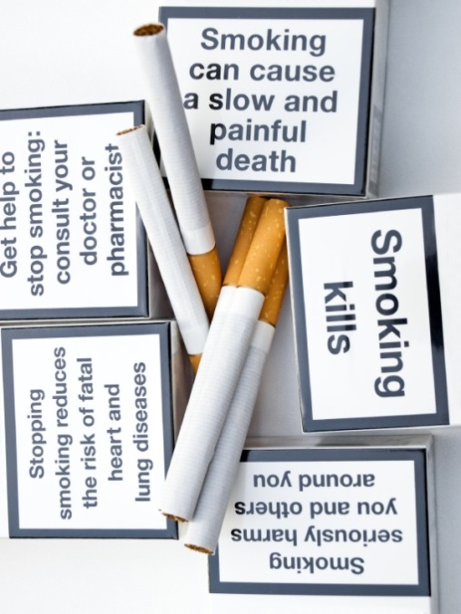
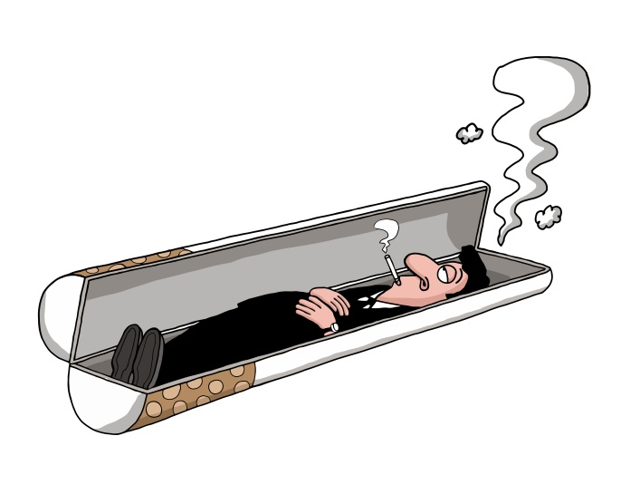
Media Advocacy
Media advocacy is the strategic use of mass media and community advocacy to advance environmental change or a public policy initiative”
Centers for Disease Control and Prevention. 2003; Brownell KD, et al. 2010.
Notes:
There are times when we may want to use communication to change the way a public health issue is thought about, or framed, in society at large. This is where media advocacy comes into play. The CDC defines media advocacy as the strategic use of mass media and community advocacy to advance environmental change or a public policy initiative.
For example, there was a time when lung cancer was only discussed from an “individual responsibility” frame, which poses that people solely are responsible for their cancer because they made poor choices. Many public health experts found this to be objectionable. Are individuals the only ones at fault? Perhaps we should also shed light on tobacco industry practices, the power of tobacco advertising, the addictive and dangerous nature of the substance, and even the power of pricing strategies, such as providing coupons and lowering prices.
Public health communication experts use media advocacy to get these kinds of stories into the news and other media such as TV shows or movies to reshape how Americans think about tobacco, the tobacco industry and lung cancer, as well as other tobacco-related diseases. This is a way of using strategic communication for the purposes of policy change.
When society at large begins looking at public health issues differently, such as thinking: “Maybe tobacco addiction isn’t all on the individuals’ shoulders; maybe tobacco advertising is unethical,” public opinion begins to support policy change. Media advocacy has been critical in affecting tobacco regulations and is now being used to affect other public health causes such as food and nutrition regulations, the amount of allowable sodium in foods, and to support a healthier climate for all.
[Emperor of All Maladies Episode Three: Finding the Achilles Heel clip 43:30-46:50]
In this clip from the third episode of the PBS documentary “Emperor of All Maladies,” you will see how the John Banzhaf and the American Cancer Society used media advocacy in the late 1960s and early 1970s to change the public discourse and perception on smoking. To view the complete three-part documentary visit www.cancerfilms.org

Slide 19
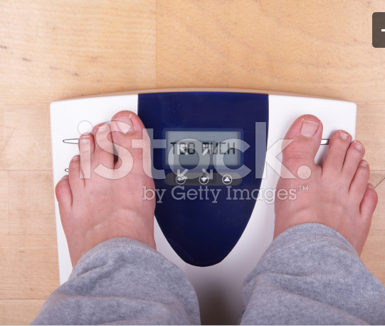
Media Advocacy
Individual Responsibility Frame
Shared Responsibility Frame
Dorfman and Wallack. 2007; Huang, et al. 2015.
Notes:
A more recent example of media advocacy includes the call to reframe public dialogue about obesity. In the early 2000s, researchers at the Berkeley Media Studies Group called for applying lessons learned from tobacco advocacy successes to the United States’ growing problem of overweight and obesity. They explained that the framing of weight issues as purely an individual responsibility limited intervention options and made success unlikely. Adding social, environmental, economic and political context to the discussion broadens potential strategies for intervention. They explained that quote “The public discussion of obesity prevention needs to shift toward accepting that a variety of environmental influences are creating a much worse public health problem than was recognized just a few years ago. That shift is necessary in order for the public and policy makers to accept that changes in the environment are an appropriate response to the issue,” end quote.
For example, a story or commentary about obesity could discuss how people are obese because they eat too much or don’t exercise enough. This is an individual frame for the cause of obesity. An individual responsibility frame would be suggesting that if people just ate fewer calories or exercised more then obesity would not be a problem. On the other hand, a shared frame might be that communities lack safe outdoor places for people to exercise, which leads to obesity. The problem is framed as caused by the community rather than an individual’s failing. A shared responsibility frame then might be that the community needs to work with police to create safe outdoor places for exercise. By using a shared responsibility frame, public health practitioners can help change public opinion about obesity and focus on a wider variety of interventions to address obesity.
Think for a moment about where we are now with initiatives focused on menu labeling, healthy corner stores and vending machines, healthier school lunches, shared use agreements for public facilities, revitalization of public parks, complete streets and bike lanes, and more. These activities are the result of making progress through media advocacy to move the discussion of obesity upstream to the root causes. However in 2015, an article published in Lancet by US-based researchers further emphasized that additional progress is needed in mobilizing the public to quote “enact obesity-prevention policies and to mitigate reaction against their implementation,” end quote. They explain that strategies to accomplish this include quote “refinement and streamlining of public information, identification of effective obesity frames for each population, strengthening of media advocacy, building of citizen protest and engagement, and development of a receptive political environment with change agents embedded across organizations and sectors” end quote.
Add references: http://www.bmsg.org/pdfs/Dorfman%20&%20Wallack%20JNEB.pdf; http://www.ncbi.nlm.nih.gov/pubmed/25703113

Slide 20
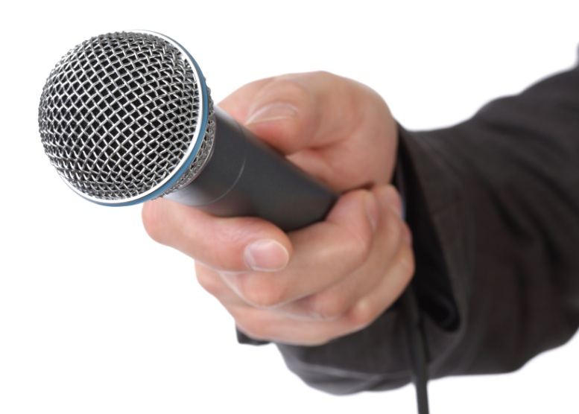
Check Point
Communication campaign promoting biking to work and the using bike lanes in your county
A. Social Marketing Campaign
B. Media Advocacy Campaign
Notes:
Check point: Let’s say your communication goal is to promote biking to work and the use of bike lanes in your county. Would this be A. a social marketing campaign, or B. a media advocacy campaign?
The answer is A. social marketing campaign. You are using your communication campaign to influence your county population’s behavior, which is to bike to work instead of driving. An example of a media advocacy campaign would be using social media and writing op-eds in newspapers to influence public opinion and change legislation to increase the number of bike lanes in your county.

Slide 21
Conclusion
Define communication, marketing and health communication
Explain the differences between health communication, social marketing and media advocacy
Describe the role of communication in chronic disease and cancer prevention and control
Notes:
In this lesson, you learned to:
Define communication, marketing and health communication
Explain the differences between health communication, social marketing and media advocacy
Describe the role of communication in chronic disease and cancer prevention and control

Slide 22
Resources
Centers for Disease Control and Prevention’s Gateway to Health Communication & Social Marketing Practice
Healthy People 2020’s Health Communication and Health Information Technology Goals and Objectives
Lee and Kotler’s Social Marketing: Changing Behaviors for Good Quick Reference Guide
Notes:
Here are some further readings and resources you can access on the topic of health communication and social marketing. These and other resources are included in the Media Planning and Media Relations Guide in the learning management system.

Slide 23
This concludes the lesson. Please exit and return to the learning management system.
EXIT
Notes:
This concludes the lesson. Please exit and return to the learning management system.

Slide 24
Media Planning and Media Relations
Communication Training for Comprehensive Cancer Control Professionals 101
Lesson 2: Health and Media Literacy in Public Health Communication
Notes:
Welcome to lesson 2: Health and media literacy in public health communication.

Slide 25
Acknowledgments
This work was supported by Cooperative Agreement #1U38DP004972-02 from the Centers for Disease Control and Prevention. Its contents are solely the responsibility of the authors and do not necessarily represent the official views of the Centers for Disease Control and Prevention.
We would like to thank Monique Turner, Ph.D., Associate Professor, Department of Prevention and Community Health, Milken Institute School of Public Health, the George Washington University.
The competencies in this training are based on
content from the National Cancer Institute’s
publication “Making Health Communication
Programs Work.”
Notes:
We would like to acknowledge the Centers for Disease Control and Prevention for supporting this work. We would also like to thank Dr. Monique Turner, Associate Professor at the Department of Prevention and Community Health at the Milken Institute School of Public Health of the George Washington University for her contributions to content development and review. The competencies in this training are based on content from the National Cancer Institute’s publication “Making Health Communication Programs Work” also known as “The Pink Book.”

Slide 26
Competency
Explain how health literacy and media literacy apply to public health communication
Notes:
This lesson will address the following competency:
Explain how health literacy and media literacy apply to public health communication

Slide 27
Learning Objectives
Explain the importance of health literacy and culturally appropriate messaging for communication strategies
Explain the importance of media literacy for communication strategies
Notes:
After completing this lesson, you will be able to:
Explain the importance of health literacy and culturally appropriate messaging for communication strategies
Explain the importance of media literacy for communication strategies

Slide 28
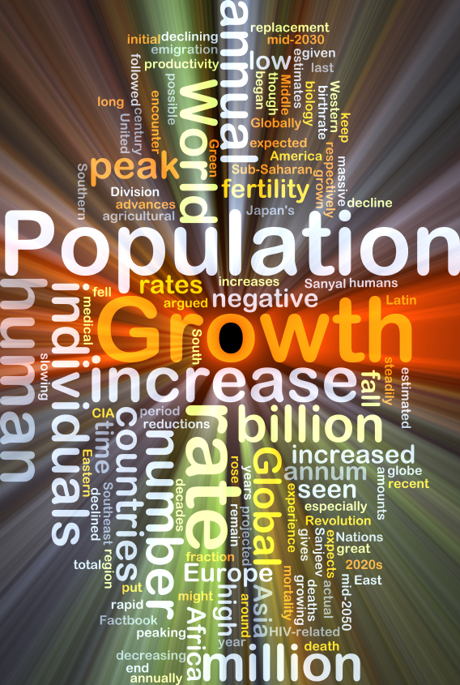
Audience
Demographics
Education
Household income
Race/ethnicity
Biological sex
Notes:
One of the most important considerations any health communicator makes, regardless of what type of communication she or he is using, relates to the audience. Health communication professionals must understand their audience in depth. It goes without saying that we need to understand our audience demographically. Demographics are the statistics that describe a population, usually, education level, household income, race/ethnicity, biological sex and so on. But, there are other characteristics that are vital to really understanding an audience—here, we will talk about two such characteristics: health literacy and media literacy.

Slide 29
Defining Health Literacy
the degree to which individuals have the capacity to obtain, process and understand basic health information and services needed to make appropriate health decisions”
77 million people
What if our audience can not make sense of what we are saying?
What if they can’t use the information to make good decisions?”
Institute of Medicine. 2004; National Network of Libraries of Medicine. 2013; U.S. Department of Health & Human Services. 2008.
Notes:
[The Institute of Medicine defines health literacy as "the degree to which individuals have the capacity to obtain, process, and understand basic health information and services needed to make appropriate health decisions." This definition conveys the importance of the issue: What does it matter if we work on creating effective health messages if our audience cannot access the materials? What if our audience cannot make sense of what we are saying? What if they cannot use the information to make good decisions?
Oftentimes, the health communication materials that we develop are too complicated for the intended audience. Think about the leaflets that come with prescription medications, information on the risks of cancer treatments, or informed consent forms for clinical trials. They may be too complicated and technical for many people. The 2003 National Assessment of Adult Literacy conducted by the US Department of Education found that only 12% of U.S. adults had proficient health literacy. This means that more than a third of U.S. adults, about 77 million people, would have difficulty with common health tasks, such as following directions on a prescription drug label or adhering to a childhood immunization schedule using a standard chart. It is important to note that in particular older adults, recent immigrants, and many minority populations struggle with health literacy.
Additional citation: America's Health Literacy: Why We Need Accessible Health Information. An Issue Brief From the U.S. Department of Health and Human Services. 2008.

Slide 30
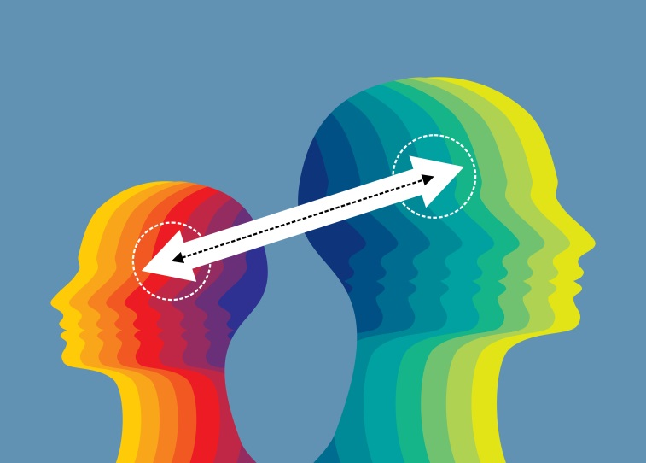
Health Literacy
Depends on individual and systemic factors:
Communication skills of health professionals
Knowledge of “lay” people and professionals about health topics
Culture
Demands of the message
Demands of the situation or context
National Communication Association. N.d.
Notes:
Health literacy is dependent on both individual and systemic factors:
Communication skills of health professionals: If professionals present the health information in a confusing way or make it too complicated and technical, it can affect others’ ability to comprehend or make use of that information
Knowledge of lay people and professionals about health topics: if the knowledge of lay people or professionals is poor from the start (e.g., not understanding a new regimen or recommendation), that will affect his or her ability to communicate it clearly
Culture: Culture also affects health literacy. If one’s culture deems it inappropriate to ask about certain topics (e.g., sexual reproductive issues), he or she will not be able to obtain the information needed
Demands of the message: If the message is overly demanding, cognitively or emotionally, then receivers may not be able to process that information
Demands of the situation/context: Sometimes, the demands of the situation or context affect health literacy. Health contexts are unusual compared to other contexts because of an underlying stress or fear factor. Healthcare contexts may also involve unique conditions such as physical or mental impairment due to illness. On top of that, health situations are often new, unfamiliar, and intimidating, all of which can limit a person’s ability to process information

Slide 31
Health Literacy
Audience
Messaging
Notes:
As health communicators, we have to think about health literacy on two distinct levels: First, we have to consider the health literacy of our audience and second, we have to consider the literacy level of our messaging. We need the message we are delivering to match the level of the audience.

Slide 32
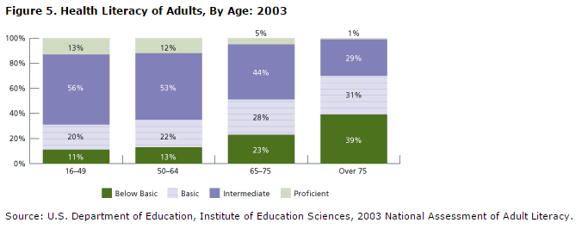
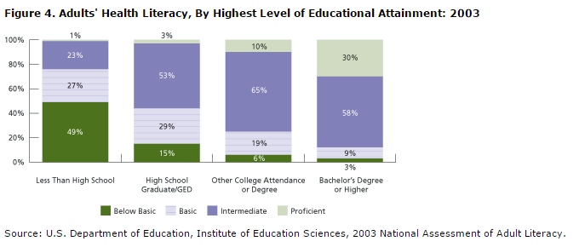
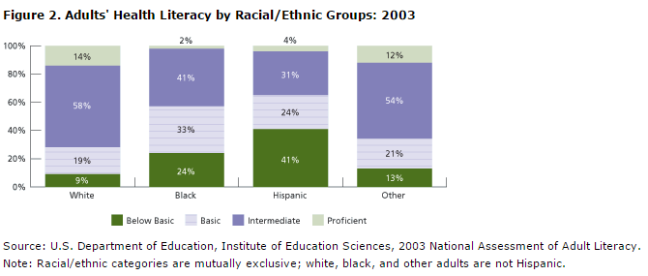
Health Literacy
Audience
Notes:
In order to create messaging that will be effective for your audience, you may want to conduct preliminary research to better understand some of the statistical data on health literacy for your potential audience. In part 102 of this communication training, we will highlight some of the topics and resources for you consider when conducting this research.
Here are some examples of survey results from the 2003 National Assessment of Adult Literacy conducted by the US Department of Education we mentioned previously. These examples demonstrate health literacy by age, education level and race or ethnic background.
[Figures will appear in Captivate as mentioned]
The first example is Figure two: this figure highlights adults’ health literacy by racial and ethic groups and that all racial and ethnic groups contain adults who were at the below basic or basic levels of health literacy. Blacks, Hispanics and other ethnic groups have a higher percentage of adults in these categories.
Figure four highlights adult’s health literacy by highest level of Education and the variation that exists. “More than 49 percent of adults with less than a high school degree are at below basic or basic levels.” As you can see from the figure the higher the education the more health literate but 44 percent of high school graduates and 12 percent of college graduates still remain at a below basic or basic level.
Lastly Figure five highlights health literacy of Adults by Age. Survey results demonstrate that age had relatively little relationship to health literacy for those under the age of 65 but adults 65 or older were more likely to have below basic and basic health literacy levels. More than two-thirds of adults 75 and older had below basic or basic health literacy levels.

Slide 33
Health Literacy
Messaging
Notes:
Clearly, we want to develop messages that people can access, understand and use. So, we want to develop messages that are clear, simple and take into consideration information you know about your audience. Further exploration of how to develop these messages will be covered in the following lessons on media planning, strategic principles and producing media-friendly materials.

Slide 34
Messaging
Culture
Messages that are translated properly into the correct language.
Messages that consider the cultural meaning of a group
Cultural expert
Community based-approach
Notes:
One consideration communication professionals have to think about in developing effective messages is culture. Usually, when people think of developing “culturally sensitive messages,” what they really mean is messages that are translated properly into the correct language.
Obviously, translating messages is a must; but, this alone does not make a message culturally sensitive.
What health communicators mean by “culturally sensitive messages” is messages that take the cultural meaning of a group into account. What metaphors work with the cultural group? What might offend them? What are traditional gender roles that might impact the communication? What do they want to be called (e.g., “Black” or “African American”)? What is appropriate (or inappropriate) to talk about in public? What emotions are effective (like fear) or inappropriate to express (like anger for some groups)?
Health communicators that really want to develop culturally sensitive messages should bring a cultural expert onto the team. Alternatively, they could use a community-based approach and work with the community from the beginning to develop messages.

Slide 35
Messaging
Demands of the message
Use “Plain Language”
Research has shown that 100,000 new cases of cancer can be prevented if every adult reduced their BMI by 1%
Keep a healthy weight to lower your chance of getting cancer
National Cancer Institute. 2012; Plain Language.gov. n.d.
Notes:
Another consideration communication professionals have to think about in developing effective messages is how difficult it is to understand. As the communicator you want to make sure that your message is in plain language which means your audience can understand it the first time they read or hear it. Some common techniques to assure that your communication materials are in plain language include:
Logical organization of information with the reader in mind
The use of “you” and other pronouns
Using Active voice to engage your audience in doing an action
Using short sentences
Including common, everyday words
And easy-to-read design features, such as plenty of white space on the page
For example: We could change this passive, complicated sentence “Research has shown that 100,000 new cases of cancer can be prevented if every adult reduced their BMI by 1%” to read “Keep a healthy weight to lower your chance of getting cancer” which is an active, personal, brief and easy to understand sentence.
This technique of using plain language is important to use to communicate with most audiences. Whether you are creating a flyer for cancer survivors, a billboard to encourage healthy eating or a Tweets advertising tobacco Quitlines, make your message simple, direct and easy to understand.
NCI reference: http://www.cancer.gov/about-cancer/causes-prevention/risk/obesity/obesity-fact-sheet

Slide 36
Messaging
Demands of the situation and context
Be aware of noise
Noise is any physical, psychological or physiological distraction or interference
Plain Language.gov. n.d.
Notes:
Another consideration communication professionals have to think about in developing effective messages is how the recipient’s situation or context may impact his or her ability to process the message. Noise, as explained in lesson one is a prime example of physical, psychological or physiological factors that could interfere with communication. For example, if a doctor delivers bad news to a patient, such as a cancer diagnosis, the patient’s ability to listen and process further information may be hindered because the patient may be overwhelmed and still trying to process the diagnosis. In this example, the patient might not hear or understand information about prognosis, treatment options, or support services. The communication could be improved by the doctor using plain language, providing simple written documentation and recommendations, and possibly by including a patient navigator or other support person in the conversation. If your comprehensive cancer control program is providing information to patients, those who are delivering messages should also consider these recommendations to reduce noise.

Slide 37
Media Literacy
the ability to access, analyze, evaluate and communicate in a variety of forms”
National Association for Media Literacy Education. 2015.
Notes:
Another type of literacy health communicators need to understand is “media literacy.” Media literacy is “the ability to access, analyze, evaluate and communicate media in a variety of forms.” The term “media literacy” is often used interchangeably with other terms related to media and media technologies. Media literacy is important as it allows an audience member to deconstruct the message into smaller parts and identify the motive for and meaning of the message. For the health communicator, understanding the audience’s media literacy helps creates messages that are easily deconstructed and better understood.

Slide 38
Defining Media Literacy
Media refers to all electronic or digital means and print or artistic visuals used to transmit messages.
Literacy is the ability to encode and decode symbols and to synthesize and analyze messages.
Media literacy the ability to access, analyze, evaluate and communicate media in a variety of forms.”
National Association for Media Literacy Education. 2015.
Notes:
So what is media? What is literacy? How does each concept apply to media literacy? The National Association for Media Literacy Education offers the following definitions for each:
•“Media: refers to all electronic or digital means and print or artistic visuals used to transmit messages. For example, media can be in print such as newspapers and magazines, broadcast like TV and radio and Twitter, Facebook, Podcasts, blogs and webpages represent digital or social types of media.
•Literacy: is the ability to encode and decode symbols and to synthesize and analyze messages. Examples include the ability to read, write and do basic math, which is also called numeracy. You want to make sure the recipient of your information can identify the purpose of your message, organize it and understand it clearly.
• Media literacy as defined before is the “the ability to access, analyze, evaluate and communicate media in a variety of forms” which includes the ability to encode and decode symbols transmitted via media. An example includes the ability to decipher what a commercial advertisement for a pharmaceutical drug is trying to sell. Media literacy should be assessed within your audience in order for you to understand how your audience is able to interpret messages through various communication channels and make informed decisions about any issue they face including health.

Slide 39
Media Literacy and Technology
Search Google or type URL
Notes:
As media platforms have become more technologically complex, the demand on audiences to keep up with evolving technology has also increased.
On a basic level, audiences have to understand how to get the information they need. For example, if an elderly woman wanted to find out on the Internet whether or not she should receive a mammogram, she would:
Need to have access to a computer with Internet connection
Need to know how to conduct a search and what search terms to use
Need to know how to discern the reliability of a Wikipedia page versus information on the National Cancer Institute’s web page
If she learned that she did need a mammogram based on that information, she would need to be able to act on it, finding an in-network provider or one who accepts her health insurance, if she is insured, and then make an appointment.
In other words, people need to use multi-media to obtain information; but not everyone has access to media such as computers or knows how to conduct searches or interpret search results.

Slide 40
Case Study
Notes:
Let’s look at a case study to further demonstrate the importance for health communicators to assess the target audience’s media literacy levels.

Slide 41
Case Study
If we were interested in communicating breast cancer screening recommendations to low-income elderly women, we might realize after conducting some research that Web-based media may not be the best way to reach that intended audience, because they tend to have less access to Web-based media.
On the other hand, if we were interested in communicating the benefits of wearing sun screen to urban youths, we may decide that Web-based or mobile campaigns may be the best way to reach them, because they have access to and widely use Internet-connected devices.
Notes:
For example, if we were interested in communicating breast cancer screening recommendations to the low-income elderly women, we might realize after conducting some research that Web-based media may not be the best way to reach that intended audience, because they tend to less access to Web-based media. On the other hand, if we were interested in communicating the benefits of wearing sun screen to urban youths, we may decide that Web-based or mobile campaigns may be the best way to reach them, because they have access to and widely use Internet-connected devices.

Slide 42
Conclusion
Explain the importance of health literacy and culturally appropriate messaging for communication strategies
Explain the importance of media literacy for communication strategies
Notes:
In this lesson, you learned to:
Explain the importance of health literacy and culturally appropriate messaging for communication strategies
Explain the importance of media literacy for communication strategies

Slide 43
Resources
Agency for Healthcare Research and Quality’s Health Literacy Measurement Tools
Centers for Disease Control and Prevention’s Health Literacy Trainings and Website
U.S. Department of Health and Human Services’ Health Literacy Online Guide
Notes:
Here are some further readings and resources on health and media literacy. These and other resources are included in the Media Planning and Media Relations Guide in the learning management system.

Slide 44
This concludes the lesson. Please exit and return to the learning management system.
EXIT
Notes:
This concludes the lesson. Please exit and return to the learning management system.

Slide 45
Media Planning and Media Relations
Communication Training for Comprehensive Cancer Control Professionals 101
Lesson 3: Media Planning & Strategic Principles in Public Health Communication
Notes:
Welcome to lesson 3: Media Planning & Strategic Principles in Public Health Communication.

Slide 46
Acknowledgments
This work was supported by Cooperative Agreement #1U38DP004972-02 from the Centers for Disease Control and Prevention. Its contents are solely the responsibility of the authors and do not necessarily represent the official views of the Centers for Disease Control and Prevention.
We would like to thank Monique Turner, Ph.D., Associate Professor, Department of Prevention and Community Health, Milken Institute School of Public Health, the George Washington University.
The competencies in this training are based on
content from the National Cancer Institute’s
publication “Making Health Communication
Programs Work.”
Notes:
We would like to acknowledge the Centers for Disease Control and Prevention for supporting this work. We would also like to thank Dr. Monique Turner, Associate Professor at the Department of Prevention and Community Health at the Milken Institute School of Public Health of the George Washington University for her contributions to content development and review. The competencies in this training are based on content from the National Cancer Institute’s publication “Making Health Communication Programs Work” also known as “The Pink Book.”

Slide 47
Competency
Apply strategic principles to public health communication and marketing to complete a media plan
Notes:
This lesson will address the following competency:
Apply strategic principles to public health communication and marketing to complete a media plan.

Slide 48
Learning Objectives
Explain the importance of strategic planning
Explain the differences between communication plans and media plans
Identify and assess a health issue or problem
Identify theories of communication to guide media plan development
Write health, behavioral and communication objectives for a media plan
Identify intended or “target” audiences
Identify media channels and activities best suited to reach intended audiences
Notes:
After completing this lesson, you will be able to:
Explain the importance of strategic planning
Explain the differences between communication plans and media plans
Identify and assess a health issue or problem
Identify theories of communication to guide media plan development
Write health, behavioral and communication objectives for a media plan
Identify intended or target audiences
Identify media channels and activities best suited to reach intended audiences
You may wish to follow along throughout this lesson with the Media Plan Template, a fillable Word document that you can use to develop a media plan for your comprehensive cancer control work. This template is located in the resources section of the learning management system and can also be found in Appendix A of the Media Planning and Medial Relations Guide. The appendix also includes a completed version of the template to give you an idea of what the final product can look like.

Slide 49
Strategic Planning
Understand the health issue you are addressing
Determine appropriate roles for health communication
Identify the approaches necessary to bring about or support the desired changes
Establish a logical program development process
Create a communication program that supports clearly defined objectives
Set priorities
Assign responsibilities
Assess progress
Avert disasters”
Planning and Strategy Development
Developing and pretesting concepts, messages and materials
Implementing the program
Assessing effectiveness and making refinements
Health Communication Program Cycle
National Cancer Institute. 2004.
Notes:
Strategic planning is imperative in developing any communication program. The first stage of the health communication cycle, planning and developing a strategy for your program ensures that you work more efficiently in building a successful communication program. According to the National Cancer Institute, planning your communication strategies will help ensure that you:
Understand the health issue you are addressing
Determine appropriate roles for health communication
Identify the approaches necessary to bring about or support the desired changes
Establish a logical program development process
Create a communication program that supports clearly defined objectives
Set priorities
Assign responsibilities
Assess progress
Avert disasters
A lack of planning means that the program might not work. Often planning is sacrificed because teams are in a hurry to get their communication campaign up and running right away. But, when we do not take a step back and take the time to carefully plan—the entire program may fall apart. So, it is always worthwhile to engage in thoughtful and careful planning.

Slide 50
Strategic Planning
What is the overall goal that we aim to achieve by implementing a communication program?
How do we aim to achieve that goal using specific strategies and tactics?
What resources do we need to develop those strategies and tactics?
What are our short, intermediate and long term objectives?
Notes:
Planning allows you to answer the following questions:
What is the overall goal that we aim to achieve by implementing a communication program?
How do we aim to achieve that goal using strategies and tactics?
What resources do we need to develop those strategies and tactics
What are our short, intermediate and long term objectives?

Slide 51
Types of Plans
Communication Plan
Media Plan
Notes:
There are two types of plans in public health communication, communication plans and media plans. We will walk you through each one.

Slide 52
Communication Plan
Public relations
Advertising
Education entertainment
Individual and group instruction
Paid, earned and social media
Owned media
Mass Media Promotions
Public Service Announcements
Paid Messages
Entertainment and news programs
Entertainment industry support
Interventions to counsel and educate
Advertising
Editorial influence
Grassroots media
Fully-owned media
Partially-owned media
Centers for Disease Control and Prevention. 2014; National Cancer Institute. 2004; Myers. N.d.
Notes:
A communication plan provides the outline for your message delivery. According to the CDC, a communication plan “generally contains a wide range of strategies that could include the following:
Public relations- Public relations includes all mass media promotions about a health issue or problem. Examples of mass media include radio, network and cable TV, magazines, direct mail, billboards, transit cards and newspapers.
Advertising- Advertising refers to public service or paid messages about a service or product as a form of endorsement or public education
Education entertainment- In education entertainment, the health promotion message is included in entertainment and news programs. This also includes efforts to remove conflicting messages about the health issue in entertainment and news programs. For example, a smoking cessation program may include providing information on how to quit smoking on a local news program. The campaign may be compromised if advertisements for e-cigarettes are shown on the same TV station, so you may seek support to remove those ads. Education entertainment can also include support for a particular health message by the entertainment industry.
Individual and group instruction- Individual instruction and group instruction are interventions to counsel and provide education to improve skills and encourage behavior change.
Paid, earned and social media- Paid media refers to forms of advertising that were purchased. Earned media is free media, often achieved by editorial influence, in which media outlets already have an awareness of a product, service or brand. Social media includes grassroots media, especially on the internet. Grassroots media, also called grassroots marketing, targets influential small groups or individuals to deliver a message, with the hopes of reaching a larger audience.
Owned media- Owned media are media channels that you own or have control over. Fully-owned media could be your website. Examples of partially-owned media are Facebook fan pages or Twitter profiles. According to the CDC, “Owned media creates brand portability,” or the capability of your message to be accessed on more than one device, such as on a computer or a smart phone.
Source for grassroots marketing: Cynthia Myers. Chron. Definition of Grassroots Marketing. http://smallbusiness.chron.com/definition-grassroots-marketing-23210.html

Slide 53
PESO Model
Letters to the editor Editorials Stories from journalists
Posts on others’… Twitter Facebook Instagram YouTube LinkedIn Google+
PAID Media
SOCIAL / SHARED Media
Polls on Twitter
Posters/banner
Paid TV/radio spots
OWNED Media
Posts on your… Twitter Facebook Instagram YouTube LinkedIn Google+
Website Webinars Videos and podcasts Success stories Expert-generated content
Dietrich. 2014; Iliff. 2014.
Notes:
The paid, earned, social/shared and owned media model, or PESO model adapted from Dietrich shown here provides examples of different types of each media form. Examples of paid media includes polls on Twitter, posters and banners and paid TV or radio spots. Earned media could include letters to the editor in a publication, editorials and stories from journalists. Social or shared media can include posts on Twitter, Facebook, Instagram, YouTube, LinkedIn and Google plus profiles owned by others. Examples of owned media are websites, webinars, videos and podcasts, success stories and expert-generated content.

Slide 54
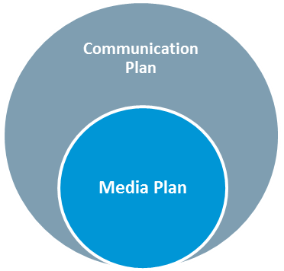
Media Plan
Focuses on strategies to create awareness
Includes print, broadcast and social media
Identifies goals, target audiences, objectives, strategies, tactics, activities and outcome measures”
Sections include:
Background and Justification
Health, Behavioral and Communication Objectives
Audiences
Media Plan Tactics and Timeline
Evaluation
Centers for Disease Control and Prevention. 2014.
Notes:
A media plan is a component of the larger communication plan. The media plan addresses efforts on paid, earned and shared social media, while the communication plan addresses efforts on paid, earned, shared and owned media. According to the CDC, the media plan “focuses on and describes strategies using media to reach, engage, inform and create awareness; Includes print which can be newspapers or magazines, broadcast such as TV or radio, and social media like Twitter and Facebook; and identifies goals, target audiences, objectives, strategies, tactics, activities and outcome measures for evaluation purposes.
You might want to follow along in the Media Plan Template from this point forward. The first section of the media plan is the Background and Justification, where the health problem is identified. It is in this section that you would present information from your state’s comprehensive cancer control plan. Section 2 lists your health, behavioral and communication strategies. The third section defines the audience intended to receive your message. The fourth section of your media plan, the media plan tactics and timeline section, will identify your key message, the media channels you will use, activities, timeline, budget, responsible staff and outcome measures. Last, but certainly not least, the fifth section is a highly recommended evaluation section that will identify ways you will track and evaluate the effectiveness of your campaign.
The Media Plan Template provided is a good outline for either a communication plan or a media plan; it is the tactics and channels you choose that determine whether it is simply a media plan or a broader communication plan. Some state comprehensive cancer control programs develop a 5-year communication and media plan to go along with their state cancer control plan. Other states choose to develop a 1-year, very actionable communication or media plan and update it with more regularity. Programs should work with their CDC project officer for further clarification on reporting requirements and expectations. For your convenience, an example of a completed media plan can be found in Appendix A of the Media Planning and Media Relations Guide in the resources section of the learning management system.

Slide 55
Health Issues and Problems
1. Background and Justification | 2. Health, Behavioral and Communication Objectives | 3. Audiences | 4. Media Plan Tactics and Timeline | 5. Evaluation
Morbidity
Mortality
Severity of outcomes
Populations affected
Prevalence rates among sub-groups
Risk and protective factors
See Media Plan Template pages 3-4
Centers for Disease Control and Prevention. 2014.
Notes:
As you complete the Background and Justification section of your media plan, you will want to assess your particular health issue or problem. The more we understand about an issue or health problem, the better we can develop a media plan. You will want to begin by referring back to your state’s Comprehensive Cancer Control Plan and its high-level goal(s).
Collect data on morbidity, mortality, severity of outcomes, populations affected and prevalence rates among sub-groups, risk and protective factors and more. For example, lets say you wanted to decrease breast cancer incidence rates in your community. You would want to review your state’s Comprehensive Cancer Control Plan to see what goals have been set for addressing breast cancer, and what information is available about the populations and subgroups most at risk for breast cancer in your community, including any rates such as morbidity, mortality, prevalence, etc. You would then conduct a literature review to find out more information about the populations you’ve identified as being impacted by breast cancer.
As you complete your assessment of the health issue or problem you wish to address, you will find that information about your target audience will emerge. This information will be relevant to help you complete sections one and two of your media plan, but will be the main focus of section 3.
Once you have a better understanding of your health problem, you will be able to create a media plan that’s well focused to address the issues. More information about conducting an assessment of health issues and problems will be provided in Module 102: Making Health Communication Campaigns Evidence-Based.

Slide 56
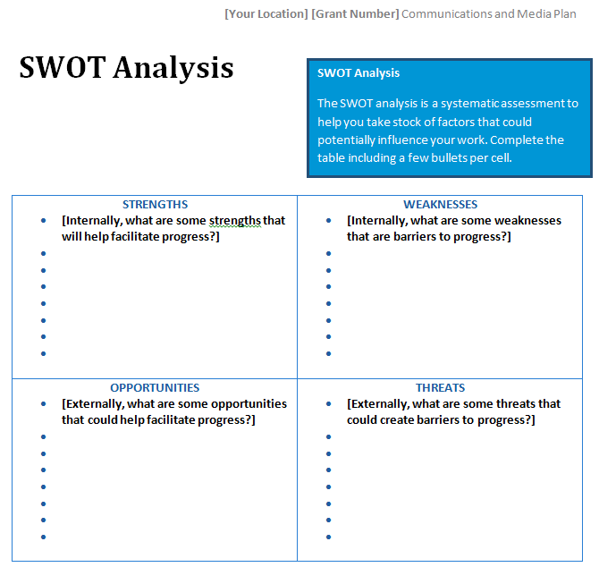
Health Issues and Problems
1. Background and Justification | 2. Health, Behavioral and Communication Objectives | 3. Audiences | 4. Media Plan Tactics and Timeline | 5. Evaluation
See Media Plan Template page 4
Centers for Disease Control and Prevention. 2014.
Notes:
A systematic analysis of strengths, weaknesses, opportunities, and threats can help you take stock of factors that could potentially influence your communication work. The media plan template includes a table on page 4 that can help you think through the following questions:
What are some internal strengths that will help facilitate progress on the health issue of interest? For example, do you have a leader with really strong connections with local reporters?
What are some internal weaknesses that may be barriers to progress? For example, do you lack a charismatic spokesperson who can speak publicly about your priority health issue?
What are some external opportunities that could help facilitate progress? For example, is there a new national focus in the news media or a recent Hollywood film that touches on the topic? Can you capitalize on the conversation to advance your media plan activities?
What are some external, uncontrollable threats that could hinder progress? For example, is there a cultural resistance to discussing the issue that will make it difficult to carry out your planned media tactics?

Slide 57
Theories of Communication
1. Background and Justification | 2. Health, Behavioral and Communication Objectives | 3. Audiences | 4. Media Plan Tactics and Timeline | 5. Evaluation
Diffusion of Innovations
Flow of information about a new product or practice
Elaboration Likelihood Model
Interaction between the message, motivation and ability in the processing of information
Extended Parallel Process Model
Perception of threat and efficacy and how they influence behavior change
Health Belief Model
Influenced by perceived susceptibility, seriousness, benefits, costs and social norms
Integrative Behavioral Model
Media effects depend on the behavior of the population and the relative importance of the determinants.
Social Cognitive Theory
How internal and external factors influence thought and behavior
Transtheoretical Model
Stages of readiness that predict behavior change
Notes:
The second section of the media plan identifies the objectives for your communication strategy. Before you can begin to craft objectives, you need to know what theory of communication you will use to develop your message, as the theory is what should drive the objectives. In order to increase the chance of success, it is vital that your communication program is informed by communication or behavior change theory.
Health campaigns and social marketing are not, in and of themselves, theories. But, health campaigners and social marketers use theory very early in the planning process to aid development. Typically, when we assess the health problem and identify the target audience, key themes will emerge from our data collection for section 1. When we study the intersection of the problem and the audience we should ask ourselves, “Why does this audience have this problem?” and find the answers in the published literature. There are numerous theories that communication experts use to guide their programs or campaigns. However, there needs to be good, thoughtful and evidence-based reasons for the theory we choose.
Let’s review the following communication theories and how you can apply them to your health communication campaign.
Some common theories include
The Diffusion of Innovations which explains the flow of information about a new product or practice
The Elaboration Likelihood Model which details the interaction between the message, motivation and ability in the processing of information
The Extended Parallel Process Model which includes perception of threat and efficacy and how they influence behavior change
The Health Belief Model which posits that health behaviors are influenced by perceived susceptibility, seriousness, benefits, costs and social norms
The Integrative Behavioral Model which explains that media effects depend on the behavior of the population and the relative importance of the determinants.
Social Cognitive Theory which describes how internal and external factors influence thought and behavior, and
The Transtheoertical or the stages of change model, which is based on stages of readiness that predict behavior change
These are just a few theories that you may wish to become familiar with as you craft your communication or media plan. This is not a comprehensive list of all theories related to health behavior and health communication, so you may wish to explore other theories that might be more applicable to the health issue or problem you wish to address in your communication campaign. More resources on theories of communication can be found in the media planning and media relations guide in the learning management system and theory will be discussed in much more detail in Module 2: Making Health Communication Programs Evidence-Based.

Slide 58
Health, Behavioral and Communication Objectives
1. Background and Justification | 2. Health, Behavioral and Communication Objectives | 3. Audiences | 4. Media Plan Tactics and Timeline | 5. Evaluation
Health Objectives
Health outcomes
Behavioral Objectives
Changes in actions
Communication Objectives
Changes in awareness, knowledge, perceptions, beliefs and confidence/efficacy
See Media Plan Template page 5
Notes:
Now that you’ve selected a theory to guide your planning process, you can begin to craft your health, behavioral and communication objectives.
Health objectives are the goals for changes in the audiences’ health status, also known as health outcomes. This could include reducing cancer and chronic disease in the population of interest and should align with the state’s cancer plan. Health objectives should correspond to your state Comprehensive Cancer Control Plan goals.
Behavioral objectives are goals for changes in your audiences’ behaviors. Behaviors can be actions we want people to engage in or actions we want them to stop. Behaviors might include getting screened or tested, increasing physical activity, eating vegetables, talking to one’s doctor, or quitting smoking. Here, our belief is that if people engage in these behaviors for long enough, then it will improve their health. Behavioral objectives should align and contribute to meeting your health objectives.
Communication objectives outline the changes in awareness, knowledge, perceptions, beliefs, attitudes and confidence/self-efficacy related to risk factors, diseases or behaviors that can be expected to result from a communication campaign or education activities. The belief is that if we can create changes in knowledge, attitudes, beliefs, perceptions, efficacy, norms and emotions, we can begin to change behaviors of the audience. Communication objectives should align and contribute to meeting your behavioral objectives, but are generally not expected to lead to large behavioral changes without being part of a larger multi-faceted intervention or initiative.

Slide 59
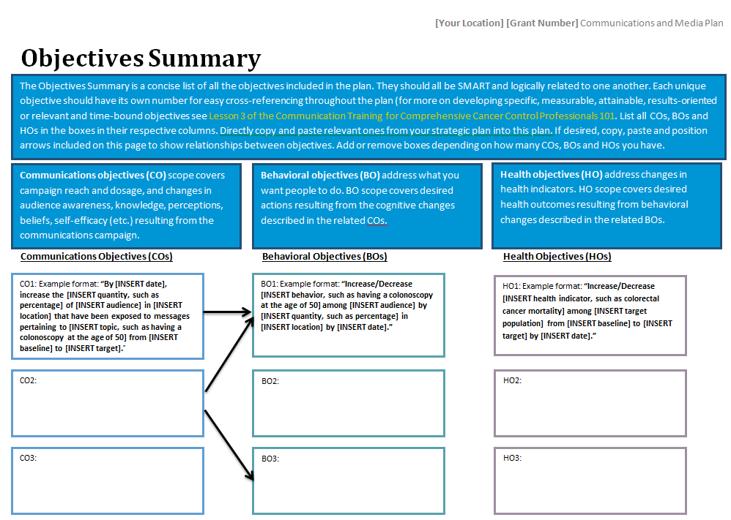
S.M.A.R.T. Objectives
Notes:
If you are following along in the Media Plan Template, we are now moving on to page 5.

Slide 60
S.M.A.R.T. Objectives
1. Background and Justification | 2. Health, Behavioral and Communication Objectives | 3. Audiences | 4. Media Plan Tactics and Timeline | 5. Evaluation
Specific – straightforward, clear, focuses your efforts
Measurable – to gauge your progress, stay on track
Achievable – feasible, easy to implement
Realistic – consider staff, financial and time resources
Time-bound – have a timeframe and target date
Notes:
As you write your objectives, you want to make sure that they are SMART. SMART objectives are objectives that are:
Specific – so you need to be clear on what you want to happen
Measureable – objectives should be results-oriented and you need to be able to measure some indicator of success to know if you are on track
Achievable (or sometimes this is called attainable) – If an objective isn’t actionable, easy to implement and feasible for your organization then it may be difficult to make progress no matter how wonderful the objective is
Realistic – when setting objectives, you must consider the resources needed to take action such as staff needs, cost and time
Time-bound – the objective should be established with a time target so you know when to check in on your progress. And time can be expressed either in time passed, such as 8 weeks or 6 months, or as a specific point in time, such as a date.
Another factor to consider is whether your objective is relevant to your state cancer plan, organization’s mission and funder’s priorities.
More information and resources for developing good goals and smart objectives are available in the media planning & media relations guide in the learning management system.

Slide 61
Check Point
Which of the following is a S.M.A.R.T. communication objective?
A. Increase clinicians’ knowledge of HPV vaccines and the appropriate timeline for administering them.
B. By the end of the programmatic year, increase by 20% state primary care clinicians’ knowledge of the fact that HPV vaccinations should be offered with the Meningococcal vaccine.
Notes:
Let’s check your understanding of writing SMART objectives. Which of the following is a S.M.A.R.T. communication objective?
Increase clinicians’ knowledge of HPV vaccines and the appropriate timeline for administering them, or
By the end of the programmatic year, increase by 20% state primary care clinicians’ knowledge of the fact that HPV vaccinations should be coadministered with the Meningococcal vaccine
Both examples focus on communication, because they focus on knowledge. The correct answer is choice B. Choice A is not a S.M.A.R.T. Objective because it is not specific, measurable or time-bound.
The objective in choice B is S.M.A.R.T. because it specifically indicates what kind of clinicians (primary care or gynecologic, etc.) and where the clinicians are (local, regional or state, etc.), what they will be educated about, by when they will be educated and by how much their knowledge will increase.

Slide 62
Check Point
Which of the following is a S.M.A.R.T. behavioral objective?
A. Increase provider recommendations of the HPV vaccine.
B. By the end of the programmatic year, reduce missed opportunities for providers to recommend the HPV vaccine to 11-17 year old girls by 10% in Texas.
Notes:
Here is another one:
Which of the following is a S.M.A.R.T. objective?
Increase provider recommendations of the HPV vaccine.
By the end of the programmatic year, reduce missed opportunities for providers to recommend the HPV vaccine to 11-17 year old girls by 10% in Texas. by 10%
Let’s assume that the communication objective highlighted on the previous slide was met. This is a behavioral outcome that might extend from that communication objective. Again, the correct answer is B, because it tells you how much (10%), by when, for what audience and where.

Slide 63
Check Point
Which of the following is a S.M.A.R.T. behavioral objective?
A. Reduce HPV incidence among young women in Texas by 2% within 4 years.
B. Reduce cervical cancer.
Notes:
Finally, let’s look at a health objective.
Again, let’s assume that our communication objective was achieved, increasing knowledge by 20% for Texan primary care providers regarding the coadministration of the HPV vaccine with the Meningococcal vaccine. And let’s assume our behavioral objective was met, so 10% of formerly missed opportunities to recommend the vaccine were avoided. What could our SMART health objective be?
Reduce HPV incidence among young women in Texas by 2% within 4 years.
Reduce cervical cancer.
While our hope is eventually to reduce cervical cancer, choice A provides a SMART objective – one that is specific and achievable and can be measured with in a specific period of time.

Slide 64
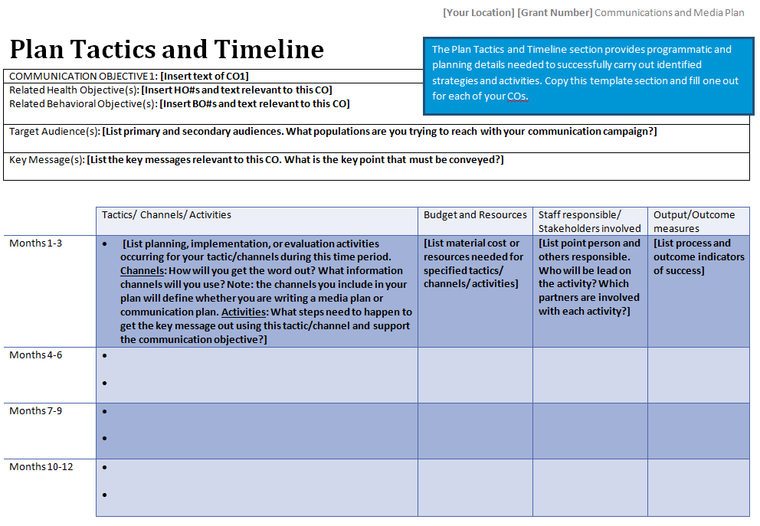
Intended Audiences
Notes:
As we move to the next section of the media plan, we will begin to identify target audiences.
The secret to effective communication comes from knowing your audience and this section of the media plan helps you to think through this process.

Slide 65
Intended Audiences
1. Background and Justification | 2. Health, Behavioral and Communication Objectives | 3. Audiences | 4. Media Plan Tactics and Timeline | 5. Evaluation
Driven by population needs as evidenced by data
Answers the questions:
See Media Plan Template pages 6-7
Why do they have this health problem?
How severely do they experience the health problem?
What is their knowledge level of the health problem?
Do they know they experience the health problem (i.e., do they perceive they are vulnerable)?
Are there cultural or personality-based traits that perpetuate this health problem (e.g., fatalism, machismo, groupthink, low health literacy)?
Notes:
Selection of the target audience should be driven by population needs as evidenced by data. Perhaps there is data that reveals that African American and Black populations in your region have disproportionately high rates of deaths from breast cancer. This may prompt you to refine your audience from women in general to African American and Black women.
Using primary data, such as data from your own research through focus groups or town hall meetings, or secondary data (like that collected from conducting a literature review, health communicators must be able to answer questions about their target audience such as: [appears as said]
Why does this population have this health problem?
How severely do they experience the health problem?
What is their knowledge level of the health problem?
Do they know or perceive that they are vulnerable to the health problem?
Are there cultural or personality-based traits that perpetuate this health problem? Examples include fatalism, machismo, groupthink, and low health literacy.
Understanding these kinds of audience characteristics will help you develop goals and objectives that are realistic for, and tailored to, your audience.
We will further explore how to identify and assess your target audience in Module 102: Making Health Communication Campaigns Evidence-Based.

Slide 66
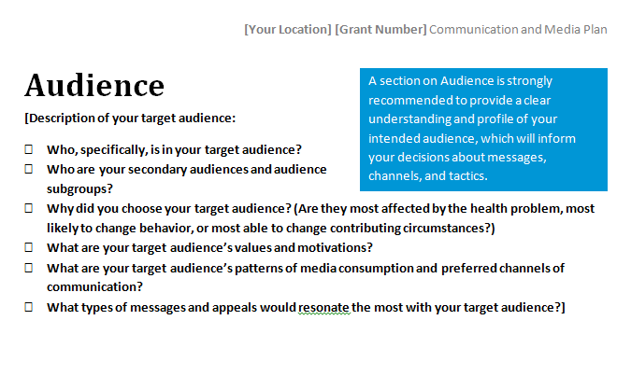
Media Channels
United Nations Development Fund for Women. 2003.
Notes:
Now that you know what your objectives are and you have narrowed down the audience you intend to reach, it is time to decide what activities you’ll carry out and in what timeline. The Plan Tactics and Timeline section of the media plan provides programmatic and planning details needed to successfully carry out identified strategies and activities. You should complete one table like this for each of your communication objectives

Slide 67
Media Channels
United Nations Development Fund for Women. 2003.
Notes:
An understanding of the intended audience will help the planning team with development of key messages and selection of appropriate channels that will reach and have the biggest impact. For example, research shows that intense and sensational messages are very effective for people who score high on a trait called “sensation seeking,” but, those same messages are ineffective for people scoring low on that trait. Other research show that messages that appeal to guilt are very effective for middle aged women (especially moms), but, causes negative effects in teenagers. As you can see, researching your audience and intimately knowing them is crucial to developing messages that resonate with the audience, seem authentic and inspire them to change. This is another benefit of involving audience members or community members in your formative research and planning process.

Slide 68
Media Channels
1. Background and Justification | 2. Health, Behavioral and Communication Objectives | 3. Audiences | 4. Media Plan Tactics and Timeline | 5. Evaluation
CHANNEL | ADVANTAGES | DISADVANTAGES
Display Print Media: Posters, billboards | Popular Visual Longevity | Limited space for information Language and literacy (audience must be able to read and understand the language
Print Media for Reading: Newsletters, pamphlets, brochures and booklets | Control of message Ability to communicate a more detailed/complicated story | Language and literacy Labor and time-intensive to produce Easily outdated
Mass Media: Newspapers and magazines | Large readership Powerful Permanent Ability to explain issues in depth | Language and literacy May only reach a those who have access (e.g., urban audiences) Expensive to produce
Mass Media: Radio | Large listenership Accessible (especially at grassroots level) Can be participatory and elicit immediate response (i.e., call-in programs) | Message may be transient Can send mixed messages (i.e., station may promote different messages) Expensive to produce
Mass Media: TV | Potential to reach large audiences Dramatic and emotive Can be participatory and elicit immediate response (i.e., call-in programs) | Require production skills Message may be transient Can send mixed messages (i.e., station may promote different messages) Expensive to produce
See Media Plan Template pages 6-7
United Nations Development Fund for Women. 2003.
Notes:
This table provides an overview of the advantages and disadvantages of various media channels. Media channels should be chosen after considering your target audience’s media habits. For example, if you are trying to reach teens with messaging about the consequences of indoor tanning, using electronic media and social media may be your best option. In particular, Facebook may be a good communication channel, as 94% of teen social media users have a Facebook profile and use it as their primary social media platform.
Your audience’s media habits should then be balanced with your communication team’s staff, financial and technological capacity. There are advantages and disadvantages to each media channel, whether it is newspapers, magazines, blogs, newsletters, TV, radio or social media, just to name a few.
Take some time to review the table and press the continue button when you are ready to move forward. Please note that this information can be found in the resource guide in the learning management system.
More information on media channels will be provided in in Module 102: Making Health Communication Campaigns Evidence-Based.
Once you complete the table in the template, you can use the information you gathered about your audience and further explain your planned activities and chosen tactics in narrative form below. Congratulations, at this point, you should have a solid draft of your comprehensive cancer control media plan!

Slide 69
Media Channels
1. Background and Justification | 2. Health, Behavioral and Communication Objectives | 3. Audiences | 4. Media Plan Tactics and Timeline
CHANNEL | ADVANTAGES | DISADVANTAGES
Electronic Media: Websites | Global reach Efficient Interactive Cost-effective | Language, literacy and media literacy Labor and time-intensive to maintain No rules
Electronic Media: Video and slide shows | Participatory Entertaining Conveys reality | Skill and labor-intensive Need equipment Expensive to produce
Social Media: Facebook | Large user base Longevity Easily accessible and versatile content (photos, videos, text) Engagement and interaction with audience Cost-effective Targeted or paid advertisement available | Somewhat time-intensive to produce Long-term strategy needed Competition for users’ attention Difficulty working with the newsfeed algorithm
Social Media: Twitter | Large user base Longevity Easily accessible and versatile content (photos, videos, text) High engagement and interaction with audience Cost-effective Possible to target messages for different audiences | Time-intensive to produce Long-term strategy needed Competition for users’ attention
Social Media: LinkedIn | Professional in nature Targeted messages for audiences with similar interests | Closed network Time-intensive to grow network
United Nations Development Fund for Women. 2003.

Slide 70
Letters to the Editor
1. Background and Justification | 2. Health, Behavioral and Communication Objectives | 3. Audiences | 4. Media Plan Tactics and Timeline
A written way of talking to a newspaper, magazine, or other regularly printed publication.”
What is it?
Take a position for or against an issue or inform, or both
Convince readers by using emotions or facts, or emotions and facts combined
Short and tight, rarely longer than 300 words
See Letter to the Editor Template pages 50-51
Community Tool Box. 2015.
Notes:
A media activity popular with comprehensive cancer control programs and coalitions is writing letters to the editor. Letters to the editor is a type of earned print media that is a low-cost and low-effort way to engage readers to advance your cancer control agenda. A template and sample of a letter to the editor is included in the appendix of the Media Planning and Media Relations Guide.
According to Community Toolbox, a letter to the editor is: A written way of talking to a newspaper, magazine, or other regularly printed publication. Letters to the editor are generally found in the first section of the newspaper, or towards the beginning of a magazine, or in the editorial page. They can take a position for or against an issue, or simply inform, or both. They can convince readers by using emotions or facts, or emotions and facts combined. Letters to the editor are usually short and tight, rarely longer than 300 words.

Slide 71
Letters to the Editor
1. Background and Justification | 2. Health, Behavioral and Communication Objectives | 3. Audiences | 4. Media Plan Tactics and Timeline
Why use it?
You think that an issue is so important that you have to speak out
Part of your group’s strategy is to persuade others to take a specific action
Suggest an idea to others
Influence public opinion
Educate the general public on a specific matter
Influence policy-makers or elected officials directly or indirectly
Publicize the work of your group and attract volunteers or program participants
You are angry about something, and want others to know it
Community Tool Box. 2015.
Notes:
So, why should you write a letter to the editor? There are some reasons why you may choose to write a letter to the editor specific to your program goals, but here are some general ones from Community Toolbox.
You may be angry about something, and want others to know it
You may think that an issue is so important that you have to speak out
Or part of your group’s strategy may be to persuade others to take a specific action
Or, you may want to:
Suggest an idea to others
Influence public opinion
Educate the general public on a specific matter
Influence policy-makers or elected officials directly or indirectly
And publicize the work of your group and attract volunteers or program participants.

Slide 72
Letters to the Editor
1. Background and Justification | 2. Health, Behavioral and Communication Objectives | 3. Audiences | 4. Media Plan Tactics and Timeli
How do I use it?
Open the letter with a simple salutation
Keep your letter under 300 words
Refer to a recent event in your community or to a recent article
Explain why the issue is important in the first paragraph
Give evidence for any praise or criticism
State your opinion about what should be done
Sign the letter
Include your contact information
Community Tool Box. 2015.
Notes:
Letters to the editor have a general outline and flow. Here are some guidelines on how to write an effective letter to the editor from the Community Tool Box:
Open the letter with a simple salutation
Don’t worry if you don’t know the editor’s name. A simple “To the Editor of the Daily Sun,” or just “To the Editor:” is sufficient. If you have the editor’s name, however, you should use it to increase the possibilities of your letter being read.
Keep your letter under 300 words
Again, editors have limited space for printing letters, and some papers have stated policies regarding length. You may want to check the editorial page of the newspaper or magazine you are writing to for more guidance. Generally, shorter letters have a better chance of being published.
Refer to a recent event in your community or to a recent article
Make a connection and make it relevant.
Explain why the issue is important in the first paragraph
Make sure your most important points are stated in the first paragraph. Editors may need to cut parts of your letter and they usually do so from the bottom up.
Give evidence for any praise or criticism
If you are writing a letter discussing a part or pending action, be clear in showing why this will have good or bad results… Use local statistics and personal stories to better illustrate your point
State your opinion about what should be done
You can write a letter just to “vent,” or to support or criticize a certain action or policy, but you may also have suggestions about what could be done to improve the situation. If so, be sure to add these as well. Be specific. And the more good reasons you can give to back up your suggestions, the better.
Sign the letter
Be sure to write you fill name (and title, if relevant) and to include your address, phone number, and e-mail address… It adds credibility, especially if it’s relevant to the topic being discussed
Include your contact information
Editors may want to contact you, so include your phone number and email address
Following these guidelines will give you a better chance of having your opinion published. Doing some homework on newspapers and magazines that are most respected in the health topic or based in your city or town prior to writing and sending the letter will further increase your chances of publication. We will cover more on these tactics and building and maintaining relationships with journalists in the following lesson, Lesson 4.

Slide 73
Evaluating Media Activities
1. Background and Justification | 2. Health, Behavioral and Communication Objectives | 3. Audiences | 4. Media Plan Tactics and Timeline | 5. Evaluation
Process evaluation
assess program operations, namely the who, what, when and how many of program activities and program outputs were met”
Paid Media
Measures of audience or exposure
Target Rating Point (TRA) = GRA x percentage of specific target audience
Earned Media
Number of letters to the editor, blog entries published
Social/Shared Media
Number of clicks on posts you shared
Number of radio and TV interviews
Number of your posts shared by others
Number of followers
Gross Rating Point (GRA) or “impressions” = reach x frequency
Circulation numbers
National Cancer Institute. 2004; Centers for Disease Control and Prevention. 2009; Centers for Disease Control and Prevention. 2014.
Notes:
Looking back at the National Cancer Institute’s Health Communication Program Cycle, we can see that tracking and evaluating your campaign is helpful to not only assess how effective your campaign was, but also to inform ways the campaign can be improved in the future. For the purposes of completing your media plan, planning and tracking process evaluation at a minimum is key.
According to CDC, process evaluation assesses program operations, namely the who, what, when and how many of program activities and program outputs were met. For example, when evaluating paid media, you can look at measures of audience or exposure, such as Gross or Target Rating Points. Gross rating points, or more commonly known as impressions, is a measure of reach, calculated as the number of people you reach times frequency, the number of times people have been exposed to the media. Target rating point takes the number of impressions and multiplies that by the percentage of those viewers who actually represent your target audience. For example, if you ran a radio spot on Pap smears, your target audience would be women of a certain age. If you want to calculate how effective the campaign was in reaching women in your target age range, you would look at TRP. But, you may have also reached men, who happened to be listening to the radio. Those numbers will be captured as a GRP.
When looking at evaluating earned media, you might track the number of letters to the editor or blog entries published, number of radio and TV interviews you and your organization members conducted, and also look at circulation numbers for reach, or impressions.
When looking at social or shared media, you might track the number of times your social media posts were shared by others; the number of times someone clicked on your posts; and the number of people who are following your account.
By tracking and analyzing these data, you can adjust your campaign in the future. For example, if you find that you are not reaching the right people by using one media channel, you may regroup and explore other channels that would be more effective.
More in-depth information on process evaluation and other evaluation measures such as outcome evaluation and impact evaluation will be provided in Module 102: Making Health Communication Campaigns Evidence-Based.
Source http://www.cdc.gov/healthyyouth/evaluation/pdf/brief4.pdf

Slide 74
Evaluating Media Activities
1. Background and Justification | 2. Health, Behavioral and Communication Objectives | 3. Audiences | 4. Media Plan Tactics and Timeline | 5. Evaluation
Planning and Strategy Development
Developing and pretesting concepts, messages and materials
Implementing the program
Assessing effectiveness and making refinements
Health Communication Program Cycle
National Cancer Institute. 2004; Centers for Disease Control and Prevention. 2009; Centers for Disease Control and Prevention. 2014.
Notes:
Looking back at the National Cancer Institute’s Health Communication Program Cycle, we can see that tracking and evaluating your campaign is helpful to not only assess how effective your campaign was, but also to inform ways the campaign can be improved in the future. For the purposes of completing your media plan, planning and tracking process evaluation is key.
According to CDC, process evaluation assess program operations, namely the who, what, when and how many of program activities and program outputs were met. For example, when evaluating paid media, you can look at measures of audience or exposure, such as Gross or Target Rating Points. Gross rating points, or more commonly known as impressions, calculates reach, the number of people you reach times frequency, the number of times people have viewed the media. Target rating point takes the GRA and multiplies that by the percentage of those viewers who are actually your target audiences. For example, if you ran a radio spot on Pap smears, your target audience would be women. If you want to calculate how effective the campaign was in reaching women, you would look at TRA. But, you may have also reached men, who happened to be listening to the radio. Those numbers will be captured as a GRA.
When looking at evaluating earned media, you can track the number of letters to the editor or blog entries, number of radio and TV interviews you and your organization members conducted, and also look at circulation numbers or reach or impressions.
When looking at social or shared media, you can track the number of times your social media posts were shared by others; the number of times someone clicked on your posts; and the number of people who are following your account.
By tracking and analyzing these data, your campaign can adjust your campaign in the future. For example, if you find that you are not reaching the right people by using one media channel, you may regroup and explore other channels that would be more effective.
More in-depth information on process evaluation and other evaluation measures such as outcome evaluation and impact evaluation will be provided in Module 102: Making Health Communication Campaigns Evidence-Based.
Source http://www.cdc.gov/healthyyouth/evaluation/pdf/brief4.pdf

Slide 75
Resources
Atkin and Rice’s Theory and Principles of Public Communications Campaigns
Centers for Disease Control and Prevention’s Develop SMART Objectives
Glanz and Bishop’s The Role of Behavioral Science Theory in Development and Implementation of Public Health Interventions
Notes:
Here are some further readings and resources you can access on the topic of media planning and strategic principles in public health communication. These and other resources are included in the Media Planning and Media Relations Guide in the learning management system.

Slide 76
Conclusion
Explain the importance of strategic planning
Explain the differences between communication plans and media plans
Identify and assess a health issue or problem
Identify theories of communication to guide media plan development
Write health, behavioral and communications objectives for a media plan
Identify target audiences
Identify media channels and activities best suited to reach intended audiences
Notes:
In this lesson, you learned to:
Explain the importance of strategic planning
Explain the differences between communication plans and media plans
Identify and assess a health issue or problem
Identify theories of communication to guide media plan development
Write health, behavioral and communications objectives for a media plan
Identify target audiences
Identify media channels and activities best suited to reach intended audiences

Slide 77
This concludes the lesson. Please exit and return to the learning management system.
EXIT
Notes:
This concludes the lesson.

Slide 78
Media Planning and Media Relations
Communication Training for Comprehensive Cancer Control Professionals 101
Lesson 4: Building Relationships with Journalists and Producing Media-Friendly Materials
Notes:
Welcome to lesson 4: Building Relationships with Journalists and Producing Media-Friendly Materials.

Slide 79
Acknowledgments
This work was supported by Cooperative Agreement #1U38DP004972-02 from the Centers for Disease Control and Prevention. Its contents are solely the responsibility of the authors and do not necessarily represent the official views of the Centers for Disease Control and Prevention.
We would like to thank Monique Turner, Ph.D., Associate Professor, Department of Prevention and Community Health, Milken Institute School of Public Health, the George Washington University, and Naomi Englar, Communications and Dissemination Coordinator, Prevention Research Center at Tulane University School of Public Health and Tropical Medicine for sharing her experience as a former journalist.
The competencies in this training are based on
content from the National Cancer Institute’s
publication “Making Health Communication
Programs Work.”
Notes:
We would like to acknowledge the Centers for Disease Control and Prevention for supporting this work. We would also like to thank Dr. Monique Turner, Associate Professor at the Department of Prevention and Community Health at the Milken Institute School of Public Health of the George Washington University for her contributions to content development and review, and Naomi Englar, Communication and Dissemination Coordinator, at the Prevention Research Center and Center of Excellence in Maternal and Child Health at Tulane University School of Public Health and Tropical Medicine. The competencies in this training are based on content from the National Cancer Institute’s publication “Making Health Communication Programs Work” also known as “The Pink Book.”

Slide 80
Competency
Recognize the needs of and build relationships with journalists by producing media-friendly materials
Notes:
This lesson will address the following competency: Recognize the needs of and build relationships with journalists by producing media-friendly materials.

Slide 81
Learning Objectives
Describe the needs of journalists
Identify strategies for reaching out to journalists
Identify strategies for building and maintaining relationships with journalists
Create an online newsroom
Produce a press release
Notes:
After completing this lesson, you will be able to:
Describe the needs of journalists
Identify strategies for reaching out to journalists
Identify strategies for building and maintaining relationships with journalists
Create an online newsroom and
Produce a press release

Slide 82
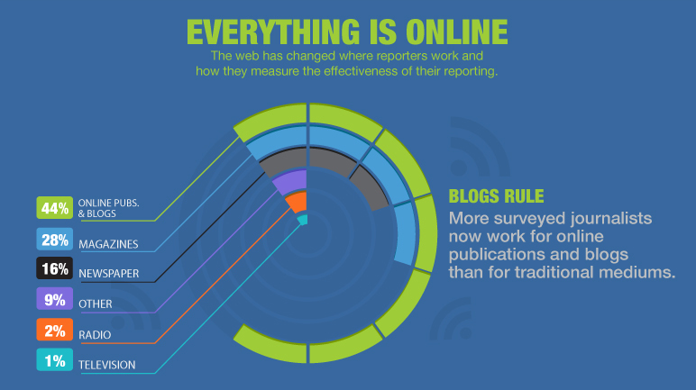
Journalists’ Preferences
Business Wire. 2014.
Notes:
Journalists are busy people. They are often being asked to write time-sensitive stories for publications on top of writing blog posts and maintaining social media accounts. The down side of this is that health communicators must compete to grab the media’s attention. This can also be an opportunity for health communicators, as journalists need to gather large bodies of informative and entertaining stories. So, health communicators must recognize the demands placed on journalists and cater to their needs. To do this, we must understand what makes them tick: where and what they look for and what makes their jobs easier.
Business Wire surveyed more than 300 North American-based journalists on their preferences for finding and receiving information. The results reveal that more journalists work for online publications and blogs than traditional media such as magazines, newspapers, radio and TV, and the primary metrics of their success are now digital. In the next six slides we’ll take a closer look at what other journalists’ preferences the Business Wire survey uncovered.

Slide 83
Journalists’ Preferences
What is your preferred method for receiving breaking news from an organization?
Business Wire. 2014.
Notes:
Journalists’ preferred methods of receiving breaking news is by email alerts, followed by press releases, telephone and social media.

Slide 84
Journalists’ Preferences
Where do you look when researching an organization?
Business Wire. 2014.
Notes:
Journalists’ do not like receiving a story pitch via social media, but they use social media as one of the top four sources for editorial research after searching google, looking at organizations’ websites and online newsrooms.

Slide 85
Journalists’ Preferences
Which social media network do you use primarily for work-related research and activities?
Business Wire. 2014.
Notes:
Of the social media platforms to conduct editorial research, journalists use Twitter, followed by LinkedIn and Facebook, so if your organization has social media accounts, it’s important to maintain them with relevant and timely information about your organization and activities.
Let’s now hear from Naomi Englar about how she and the Prevention Research Center at Tulane University School of Public Health and Tropical Medicine use social media to reach journalists and disseminate information. Before joining Tulane, Naomi worked as a local government reporter in Louisiana. Having a background in journalism, she is intimately aware of journalists’ needs and preferences, and now uses that knowledge to her advantage as the Communications and Dissemination Coordinator at Tulane.
Naomi: Social media can be an excellent platform for quickly disseminating your messages and doing so in a way that is personal and approachable so that you’re creating dialogue with a wide range of people, such as individuals, academics, funders, celebrities and elected officials. The Prevention and Research Center at Tulane University hasn’t used social media for research recruitment or research purposes. Instead, we’ve used it as a means to translate research and project outcomes of our center to the general public and decision makers and to lift up the work of our partners working on similar topics connecting our environment to our health. I have also found that Twitter has been a reliable way to pitch stories to journalists, and I have also been approached by journalists via Twitter.
One disadvantage of social media is that you have limited space to convey your message or your content. For example, a Tweet post cannot be longer than 140 characters. If you post about a new study you published in a scientific journal – and even if you link to the article – chances are most people won’t click on that link. So it’s important that you are accurate and can concisely describe the major importance of the article. I know for many researchers and academics being so definitive in statements can be intimidating. But it can be done.

Slide 86
Journalists’ Preferences
When did you last use (viewed, referenced, sourced or gathered) information from a press release to put a news item together?
Business Wire. 2014.
Notes:
Press releases are crucial to promoting your organization’s work or your health communication campaign. Nearly 90% of journalists drafted a story using a press release in the past week.

Slide 87
Journalists’ Preferences
Which type of multimedia elements do you prefer be offered along with a press release?
Business Wire. 2014.
Notes:
54% of journalists are more likely to review a press release that includes multimedia than one that does not, so be sure to include something to catch their attention. Preferred multimedia include photographs, graphics, infographics and video.

Slide 88
Journalists’ Preferences
Which type of information would you like to see in an online newsroom?
Business Wire. 2014; PR Fuel. 2015.
Notes:
In an online newsroom, which is a web page specifically dedicated for the media, where they can get more information on your organization to help build their story, journalists want to see press releases, breaking news items, phone number and email information for media contacts, fact sheets, and high-resolution images. They also like access to press kits, which are information packets about your organization, health issue and communication campaign, as well as executive biographies, history or timeline of your organization, and a listing of upcoming events.
Now that you know how journalists like to be approached and what materials they expect when approached, you can strategize ways to build and maintain relationships with them.
Once you have identified the target audience, key messages and appropriate media channels for your communication campaign, as you learned to do in lessons 1, 2 and 3, you may feel like you’re ready to reach out to journalists. But not so fast! Before making initial contact with an editor or reporter, you need to prepare the Online Newsroom that includes the press kit and background materials that reporters need and expect.

Slide 89
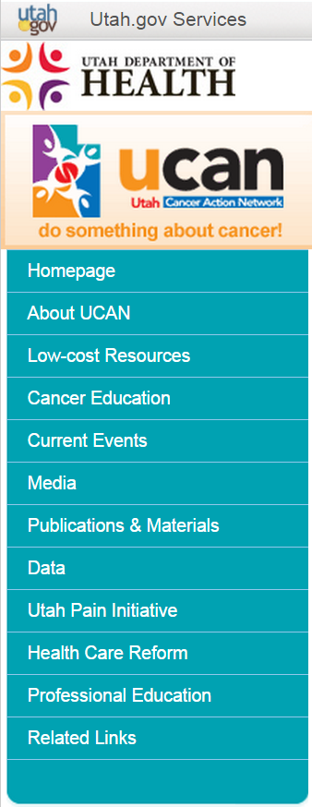
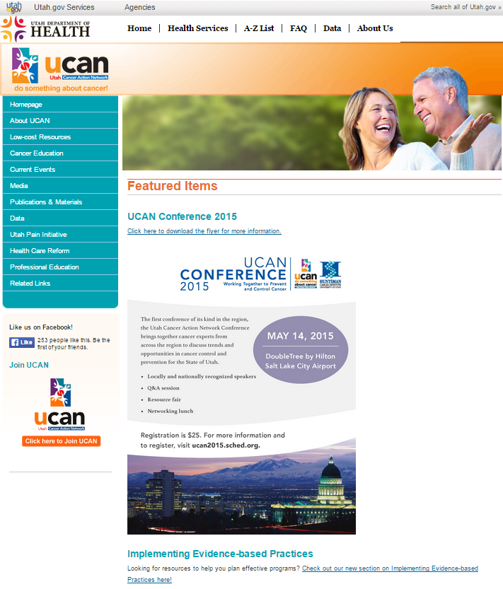
Online Newsroom
Business Wire. 2014; Communications Consortium Media Center. 2014; Utah Cancer Action Network. 2015.
Notes:
As Business Wire’s report has shown, 92% of journalists conduct editorial research on organization websites and 77% on online newsrooms, so it is crucial to create a media-friendly website that:
Have a button leading to the online newsroom on your homepage like the Utah Cancer Action Network’s website. [Zoom into Media button and highlight] It should be as prominent as other main buttons so journalists can find it easily. Reporters should be one click away from critical contact information and other relevant sections such as a press kit, frequently asked questions, news stories, press releases, free photos and video clips.
It’s also good to have a website that is mobile-optimized, which means that the website looks good on various-sized screens, from mobile phones to tablets. This is also known as responsive design. Many journalists are on the go as they respond to breaking news and many report live from conferences, events or campaign launches. Also, some search engines such as Google prioritize mobile-optimized websites over those that do not when displaying search results, which means journalists may have trouble finding your Website if it is not mobile-optimized. This may be a difficult task for comprehensive cancer control organizations to do on their own. However, the next time you are revamping your website, consider making it mobile-friendly. Some programs and coalitions may partner with universities or their state health departments, which may have responsive design capabilities that you can adapt.

Slide 90
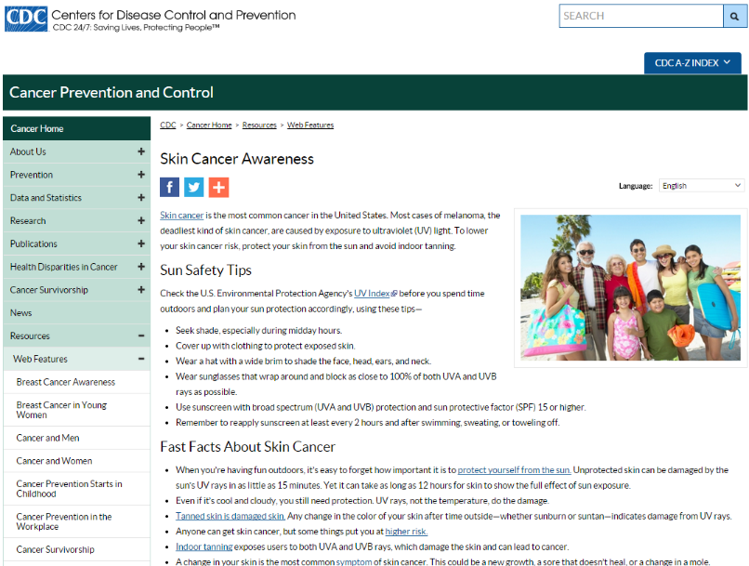
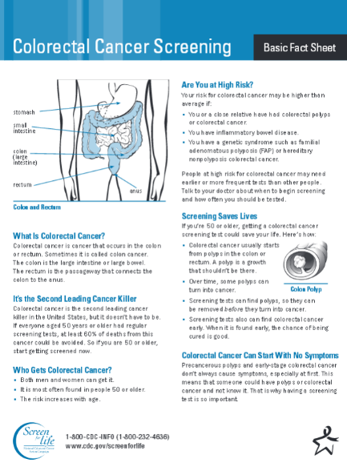
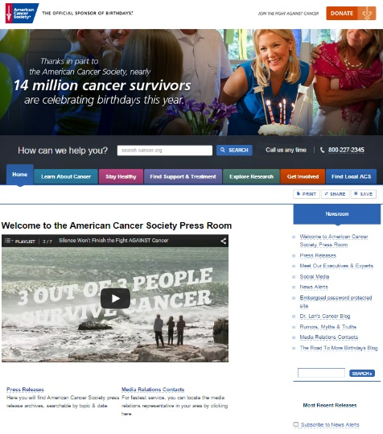
Online Newsroom
Contact information
Boilerplate for your organization
Executive biographies
High-resolution image gallery
Infographics
Social share buttons
Factsheets
American Cancer Society, 2015; Centers for Disease Control and Prevention. 2015; Livestrong Foundation. 2015; NASDAW OMS Corporate Solutions. 2014.
Notes:
Your online newsroom should include phone numbers in addition to email addresses of your organization’s communications director, media relations team or spokesperson. American Cancer Society’s online newsroom displays press contacts clearly on their website. Journalists become frustrated when only an email address is listed or they are forced to complete a contact form! Remember, they are busy people and are often on a deadline. Make it as easy as possible for journalists. Do not make them have to work hard to contact you.
Your online newsroom should also include a boilerplate for your organization. Livestrong Foundation has an exemplar boilerplate available on their website. If you have an “about” page or section on your website, make sure it is concise! Reporters browse this section of your website so they can write something like: “Livestrong Foundation, an organization created in 1997 that fights to improve the lives of people affected by cancer now…” Also, be sure to include a brief organizational history or timeline to establish your credibility.
Journalists also look for executive biographies in online newsrooms, such as this one from CDC. Include biographies of organization executives and experts as well as video clips, speeches and interviews, so producers can determine whether your experts would have a good on-air presence. Add high-resolution photos and links to articles, books and white papers they have written to help draw searches to your experts.
Also include a high-resolution image gallery in your online newsroom, as seen in CDC’s newsroom. We know that a picture tells a thousand words and images can leave an impression on your target audience. Not only that, journalists also value images, as articles with images are highly shared and prioritized in search results. Again, if you can provide them with a gallery of images, it makes it easier for journalists to write about your campaign.
Infographics are a great way to visually and creatively communicate often stale statistical information or health recommendations to your target audience, such as this one on cervical cancer prevention from CDC. Allowing journalists to reuse your infographics works similarly to the image gallery you provide them in that they help gain traction among readers. There are now online tools that will allow you to create infographics fairly quickly. Please refer to the Media Planning and Media Relations Guide in the learning management system for more information.
Factsheets, such as this one from CDC’s Screen for Life campaign, present useful information and data about the health behavior you are promoting or health issue you are highlighting. Include them in your online newsroom so journalists can use the information and data you provide in their own work or to educate themselves before reporting on it.
Finally, be sure to include social media share buttons in your online newsroom and organization website in general, as you can see the CDC has done. in the age of social media, it’s important to make sharing easy across all your content.

Slide 91
Relationships with Journalists
Most of us decide to pitch journalists right before a product launch or announcement, shooting out a press release and hoping to score great articles. This is the worst thing you can do. Don't expect to pitch someone who doesn’t know you or your product, in the hopes that [the journalist] will understand the story and details just right — all in a few days. Instead, build a strong relationship that benefits both of you — it's the only way you can ensure great news coverage of your product launch.”
Dragilev D. 2012.
Notes:
Now that you have your online newsroom ready, it’s time to reach out to journalists. But, quoting Dmitry Dragilev, a marketing lead at a design company: “Most of us decide to pitch journalists right before a product launch or announcement, shooting out a press release and hoping to score great articles. This is the worst thing you can do. Don't expect to pitch someone who doesn’t know you or your product, in the hopes that [the journalist] will understand the story and details just right — all in a few days. Instead, build a strong relationship that benefits both of you — it's the only way you can ensure great news coverage of your product launch.”

Slide 92
Relationships with Journalists
What are the most important media channels for my campaign?
What reporter is the most respected or read in my health topic?
Who is based in my city or town?
Which reporters are focused on long-term, feature stories versus breaking news?
Schwartz M. 2013.
Notes:
So where can health communicators start to build relationships with journalists? The first step is to conduct an environmental scan to answer:
What are the most important media channels for my campaign? Look for media companies and organizations that work for media channels of preference.
Also ask yourself: what reporter is the most respected or read in my health topic? There is plenty of information on reporters online. Look for their information on company websites. You may even be able to find reporters’ blogs and Twitter accounts to assess their interests and the kinds of topics they have covered in the past.
Also ask yourself: Who is based in my city or town? Considering where you want to have the most impact and how widely you want your campaign to be covered, whether it be locally, regionally, statewide or nationwide, will increase the chances of choosing a reporter that will be interested in covering your story.
Finally, ask yourself: Which reporters are focused on long-term, feature stories versus breaking news? In other words, do you have research you want to announce or do you want a story written about the severity of childhood obesity in your region? Depending on the type of coverage you want, your choice of reporters may differ.

Slide 93
Relationships with Journalists
Cold calling
Asking staff and partners
Networking at similar organizations’ media events
Twitter at-mentions
LinkedIn messages
Fox Z. 2013; National Cancer Institute. 2015; Working R. 2013.
Notes:
Once you have a wish list of top reporters with whom you want to build a relationship, the next step is figuring out how to approach them. One option is cold calling. This is the traditional method of reaching journalists, by calling them without previous encounters. However, this method is often awkward and rarely successful.
Another option is asking your staff and partners to connect you to journalists they may know. Ask your staff and partners if they have media contacts or know media figures such as owners of newspapers and broadcast stations. Outside your organization, talk with partners such as people you know at media outlets, public relations/advertising firms, and on the public relations staff of business firms; members of professional associations, such as chapters of the Public Relations Society of America; and public relations or marketing programs at local universities.
You can also network at media events of organizations that are similar to yours. Attending others’ media events and talking directly to reporters and passing out business cards is a way to get to know journalists and for them to get to know you. This will increase your chances for your story to get covered and for a lasting professional relationship.
Another way to initiate contact with journalists is by Tweeting at them. Creating and maintaining a Twitter profile, whether it be your organizations’ or your own, and at-mentioning the journalist, or using the journalist’s handle with the @ symbol, is becoming one of the most reliable ways of reaching journalists. However, make sure the journalist you want to contact is frequently engaged with Twitter and be mindful of your first approach, as they receive a lot of pitches on Twitter. Be sure to link to your organization’s website or online newsroom, so they have a reason to respond. An even better approach is to build a relationship through personal or funny interactions on Twitter leading up to your pitch.
LinkedIn is another social media channel through which you can contact journalists. It’s a professional network and your message will go directly to their inbox. Note here that Facebook is not a recommended approach because Facebook tends to be a social network platform reserved for personal use, not for professional use.
Let’s now hear from Naomi Englar about how she and the Prevention Research Center at Tulane University School of Public Health and Tropical Medicine reach out to journalists.
Naomi: When I was a reporter I generally didn’t like cold calls to my desk. If I was at my desk it was because I was writing a story (and the deadline was always looming) or I was desperately trying to reach sources. Now that I’m on the public relations/communications side, I generally don’t reach out to media unless I will for sure have someone lined up to talk to them or the topic is one we have direct information about. I have reached out to reporters – and had them reach out to me – over Twitter. But overall, I have found that going through the Tulane University public relations office is one of the best elements of a solid pitch. Our public relations office has longtime relationships with the media and the media expects to receive press releases from them. For example. a journalist I don’t know may overlook my email but not if it’s from an established organization like Tulane. Another element to a solid pitch is tying the story to other windows of opportunity, such as something currently happening in the community. For example, we had a project called the KidsWalk Coalition and as part of its mission we audited the safety or “walkability” of streets and sidewalks around New Orleans public schools. When we were getting ready to release an update to the first round of audit results, our initial plan was to publish it in December 2013. After some staffing changes, however, the report ended up not getting done till the summer and it was released right before school started. That timing ended up being ideal for media outlets looking for “back-to-school” stories.

Slide 94
Relationships with Journalists
Develop a plan for periodic media coverage
Identify and train media spokespeople
Track media coverage
Capitalize breaking news
Capitalize on national and global health observances
Capitalize on windows of opportunity
National Cancer Institute. 2015.
Notes:
Now that you’ve initiated contact with journalists, you want to continue to build and maintain relationships with them. According to the National Cancer Institute, to get continuing coverage of your program, you must develop an ongoing relationship with the media. The following steps can help ensure continuing media coverage: develop a plan for periodic media coverage, identify and train media spokespeople, track media coverage, capitalize breaking news, capitalize national and global health observances, and capitalize on windows of opportunity. Let’s look at each of these more closely.

Slide 95
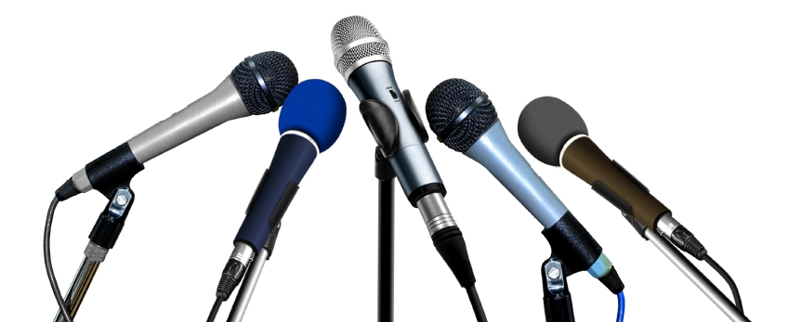
Relationships with Journalists
Develop a plan for periodic media coverage
Program objectives
Media contact
Promotional activities
Messages
National Cancer Institute. 2015.
Notes:
The first is to develop a plan for periodic media coverage of your program and make your program newsworthy: Your plan should include your program’s objectives; the messages you want to communicate to the media, including why your program or message deserves coverage, any promotional activities you plan to sponsor; and schedule a media contact, such as when it will occur and who will initiate it.

Slide 96
Relationships with Journalists
Identify and train media spokespeople
Talking points
Savvy spokespeople
National Cancer Institute. 2015.
Notes:
The second step is to identify and train media spokespeople: It is a good idea to select no more than three spokespeople. Be sure that all of them are providing the same information about your program by giving them written talking points and receive media training. The media usually prefer spokespersons with authority in your organization. The person who regularly handles media relations may not have that status. Some spokespersons will be savvy about working with the media and need only a briefing on your program. Others may need training on how to give interviews, respond to media queries during crisis or “bad news” situation, or how to be effective on TV or radio.
Let’s now hear from Naomi Englar about how she and the Prevention Research Center at Tulane University School of Public Health and Tropical Medicine prepare to talk to journalists.
Naomi: Journalists are looking to cultivate sources, people they can trust to be knowledgeable on a variety of issues and dependable to answer their phone or email. So be willing to have conversations with reporters – not just about your latest study or campaign or breakthrough, but about your field of work as a whole. I know this is intimidating for health professionals who focus on one aspect of a field. But remember that you are experts on the entire field and you have a much better understanding of the evidence base than the average person.

Slide 97
Relationships with Journalists
Track media coverage
Quantity
Prominence
Slant
Accuracy of content
Type of story
National Cancer Institute. 2015.
Notes:
The third step is to track media coverage: This includes coverage of issues generated by your media relations efforts as well as coverage that occurs independently. Monitoring all types of coverage can provide important process evaluation data. It will enable you to identify and take steps to correct misstatements and errors, determine the impact of your media activities and whether changes are needed, identify other media representatives that are interested in your issue, and find out whether your organization is being overlooked. Media coverage can be measured in terms of quantity, such as how much space a story gets and how often stories are published; prominence, such as whether it appears on a front page or not; slant, or whether the coverage is positive or negative; accuracy of content; and type of story, such as whether the story is an editorial or hard news.

Slide 98
Relationships with Journalists
Offer expert opinion
Capitalize breaking news
National Cancer Institute. 2015.
Notes:
The fourth is capitalizing on breaking news. When something happens that is related to your program, call news outlets and offer them an expert opinion. If a negative event occurs, take the opportunity to explain how the changes advocated by your organization could help prevent similar problems in the future. For example, when the story about traces of poisonous substances in Chilean grapes received widespread coverage, tobacco control activists used the event to point out that larger amounts of those same substances are found in a single cigarette.
Let’s now hear from Naomi Englar about what she and the Prevention Research Center at Tulane University School of Public Health and Tropical Medicine do if they are approached by journalists about a difficult or divisive topic.
Naomi: In terms of building relationships with journalists, it’s OK to set boundaries with them. If you aren’t available or don’t feel comfortable to respond to a request for comment, you can tell them that. But always try to refer them to someone who may be a good resource. If you interview with a journalist, you can ask them to send you the direct quotes they plan to use for you – but I suggest you ask for this sparingly. Do not ignore a journalist or wait to respond to their call or email until the next day. This is not good for relationship building. Reporters work under deadlines, and for most, this is not something they can control. Any response is appreciated, and you’ll be remembered in the future as someone who was courteous and helpful.

Slide 99
Relationships with Journalists
Highlight organization’s work
Highlight organization and its mission
Capitalize on national and global health observances
National Cancer Institute. 2015.
Notes:
Similarly, the fifth step is capitalizing on national and global health observances. There are countless awareness days, weeks and months throughout the year that are designed to raise awareness of diseases and healthy behaviors and fundraise for research into the cause, prevention, diagnosis, treatment, survivorship and cure. Perhaps the most ubiquitous awareness month is Breast Cancer Awareness Month in October with the symbol of the pink ribbon. Others include Melanoma/Skin Cancer Awareness Month in May, World Cancer Day on February 4th and Colorectal Cancer Awareness Month in March, to name a few. Health issues receive significant media coverage during these months, which is a great opportunity to highlight your organization’s work pertaining to that topic.

Slide 100
Relationships with Journalists
Showcase organization’s work
Capitalize on windows of opportunity
National Cancer Institute. 2015.
Notes:
Lastly, capitalize on windows of opportunity. When the Surgeon General releases a report or when state or federal governments pass health-related legislation, coverage surrounding pertinent health issues increases, which is another opportunity for your organization to showcase your work.
Let’s now hear from Naomi Englar about how she and the Prevention Research Center at Tulane University School of Public Health and Tropical Medicine capitalize on windows of opportunity for health communication.
Naomi: In New Orleans, a barrier we experience in pitching health related stories to journalists is that our area of public health is often overlooked for more timely stories of crime, government spending, community revitalization/economic development and local arts and culture. So a way we overcome this barrier is by integrating our messages about how our environment and surroundings influence our health into these other issues and topics.
For example, New Orleans and Louisiana have high pedestrian and bicycle fatality rates. At the same time, we know that streets and sidewalks – when built safely and used properly – can encourage communities to be more active outdoors. So we often partner with transportation planners and engineers to work on street safety to lift up the message that safe streets have far-reaching benefits for the community. And I’ve found that bike and pedestrian groups want to align themselves with public health professionals because we have a unique perspective and set of skills. Specifically in New Orleans, we recently saw a child hit and killed while trying to cross the street to his school bus. This was a catalyst that unified local advocates, schools and city government to address school transportation safety – and they wanted data and research to inform what actions to take.
In another example, media often frame nutrition and healthy eating stories as focusing on the individual or family and how to create personal behavior change, such as through personal tips or programming available in the community. The Prevention and Research Center at Tulane University is looking at the impact of systems or societal level changes on diet. We work on food access – a very wonky term – that describes the connection between our diets and the foods available around us. We have found that partnering with the local food movement and food justice advocates to be advantageous because our goals for equitable food systems align quite well.

Slide 101
Press Releases
A brief written summary or update, alerting the local media about your group’s news and activities…”
Uses of press releases
Announce an event, schedule, study, campaign, workshop or election of new leaders
Tell people why you think this development is news
Show your perspective on the development
Increase the visibility of your leaders
Remind people of what your group does and how active in the community you are
Allow you to highlight or summarize a report
Community Tool Box. N.d.
Notes:
Now that you have the media’s attention, a press release will come in handy to announce your communications campaign or anything else you want the public know about. According to the Community Tool Box, a press release is a brief written summary or update, alerting the local media about your group’s news and activities.
Press releases are useful to:
Announce an event, schedule, study, campaign, workshop or election of new leaders
Tell people why you think this development is news
Show your perspective on the development
Increase the visibility of your leaders
Remind people of what your group does and how active in the community you are and
Allow you to highlight or summarize a report

Slide 102
Press Releases
A brief written summary or update, alerting the local media about your group’s news and activities…”
Press releases are:
Created either to preview an upcoming event or to inform the public about something that has already occurred
Press releases are not:
Always a high priority for media producers to cover
Written by professional journalists
Written in a clear, concise manner that easily and quickly conveys its message to the reader
Written with the most current and pertinent information in the first two paragraphs
Subject to editing for content and space or time requirements, depending on the media
Community Tool Box. N.d.
Notes:
Press releases are created either to preview an upcoming event or to inform the public about something that has already occurred; Written in a clear, concise manner that easily and quickly conveys its message to the reader; Written with the most current and pertinent information in the first two paragraphs; And subject to editing for content and space or time requirements, depending on the media.
Unlike a news story, press releases are not always a high priority for media producers to cover and are not written by professional journalists.

Slide 103
Press Releases
Made to read like a news article and start with a lead
Clear headline and lead
Emphasize what makes your press release important
Importance to the community
Who did it
Why it happened
Where it happened
How it happened
Why people should care
Attention grabbing
Be provocative
Eye opening aspect
Strong emphasis on key points
What happened
Community Tool Box. N.d.
Notes:
Now that you know when it’s appropriate to use press releases, you can start preparing them. According to the Community Tool Box, press releases should be:
Made to read like a news article. Study news articles in your local paper. The headline of your press release and the lead should be as clear as possible. They need to hook the reader quickly or the release will be skimmed over and forgotten. News articles will also have the five Ws and the H in their beginning paragraph: what happened, who did it, why it happened, where it happened, when it happened and how it happened. This is called the lead. It should catch your readers’ attention, and immediately tell them what your campaign is all about in a clear and concise manner.
Press releases should emphasize what makes your press release important. What in your release is going to grab people’s attention? Why is it important to the community? Why should they care? Emphasize one or two of the five Ws and the H. For instance, if the mayor is going to speak on the issue at your event, it would be a good idea to emphasize the “who.” If your event is the first charity fundraiser at the new recreation center, the “where” should be emphasized.
Press releases should also be as provocative as possible. Most media, especially in large cities, receive a lot of press releases every week, so you want to make yours stand out. Find an eye-opening aspect to your release, or at least make sure your points are strongly emphasized. For example, perhaps pro-life and pro-choice activist groups are working together on teen pregnancy prevention, or real estate groups and housing activists are working together on a housing initiative. In both these cases, the organizations involved might use their unusual situations to create press releases the media would snap up.

Slide 104
Press Releases
Look professional
Letterhead and formatting
No typos
Short, easily readable sentences and paragraphs
Additional materials
Personalize
Community Tool Box. N.d.
Notes:
Your press release should look professional. Credibility is very important in an editor’s decision to read or pass over your release. Letterhead and formatting should look professional, and there should be no typos! The release should also have short, easily readable sentences and paragraphs, as news articles do.
Also, consider sending other materials with your release. If you already have contact with a reporter or editor, you may want to send a short cover letter reminding him or her of your previous conversation. Maybe you know this reporter has a personal interest in your issue. The key is to try and personalize the release so it gets the reporter’s or editor’s attention.

Slide 105
Press Releases
Formatting a press release
Dateline
Single spacing
Short
Summary of key points
Full quotes
Community Tool Box. N.d.
Notes:
In terms of formatting your press release the Community Tool Box recommends that you
Include a dateline like you would see in many newspaper articles.
Double spacing your press release is probably not necessary as most editing these days is done on computer, as long as your release is easy to read. Short paragraphs with a space between each and slightly wider than normal margins are helpful.
Your release should be relatively short: two or three pages, maximum. Keeping the release to one page does not necessarily improve readability, which is what you’re aiming for. Subheadings are also useful to grab the reader’s attention.
If you are including attachments to your press release, consider adding a summary of the key points can help the reporter write an article, if the paper decides that would be more appropriate than a press release for the story you have to tell.
Also, several full quotes should be included. Try to make the quotes sound like they were spoken, not written. For example, saying “The critical finding of the report is that many banks…” is not as effective as “This report shows that our banks are ignoring the needs of…” Quotes should come from subject matter experts from your organization or a recognizable public figure.

Slide 106
Case Study
Notes:
Let’s look at the Utah Department of Health Cancer Control Program’s press release on Melanoma from 2014 as a case study.

Slide 107
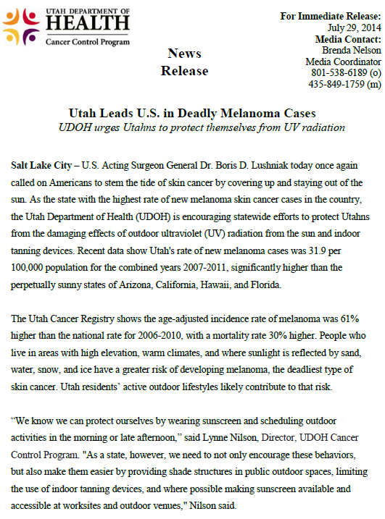
Press Release
Made to read like a news article and start with a lead
Clear headline and lead
Who did it
Why it happened
Where it happened
How it happened
What happened
Utah Department of Health Cancer Control Program. 2014.
Notes:
Let’s follow the checklist. Does the press release have a clear headline and lead? The headline reads: “Utah leads US in deadly Melanoma cases: UDOH urges Utahns to protect themselves from UV radiation. It’s bolded and centered at the top of the document. Check.
Does it have the 5 Ws and H? The what happened is the US Acting Surgeon General calling on Americans to stem the tide of skin cancer by covering up and staying out of the sun. Check. The who did it is, again, the US Acting Surgeon General. Check. The why it happened is the recent data that show Utah’s rate of new melanoma cases, which is significantly higher than the sunny states of Arizona, California, Hawaii and Florida. Check. The where and how it happened is obvious: Utah. Check.

Slide 108
Press Release
Emphasize what makes your press release important
Attention grabbing
Importance to the community
Why people should care
Utah Department of Health Cancer Control Program. 2014.
Notes:
Does the press release emphasize what makes it important? In other words, is it attention grabbing, conveying the importance of sun safety with the community and why people should care? The fact that this press release cites the US Surgeon General and the stark numbers of new melanoma cases in Utah compared to other sunny states conveys a sense of urgency of the matter. Check.

Slide 109
Press Release
Be provocative
Eye opening aspect
Strong emphasis on key points
Utah Department of Health Cancer Control Program. 2014.
Notes:
Is the press provocative, meaning does it have an eye opening aspect and place strong emphasis on key points? Again, the press release provides attention-grabbing data to back up its claims and places strong emphasis on UV protection. Check.

Slide 110
Press Release
Look professional
Letterhead and formatting
No typos
Short, easily readable sentences and paragraphs
Utah Department of Health Cancer Control Program. 2014.
Notes:
Does the press release look professional, meaning that is has a letterhead and appropriate formatting with no typos and short, easily readable sentences and paragraphs? Check.

Slide 111
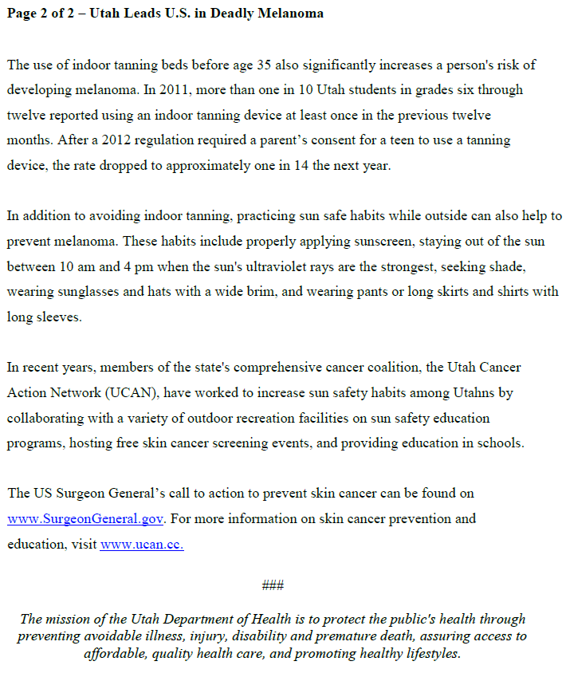
Press Release
Additional materials
Personalize
Utah Department of Health Cancer Control Program. 2014.
Notes:
Does the press release have attachments? Again, the Utah Department of Health may also have included personalized notes depending on who they were sending the press release to. In addition, the press release included a second page of additional information with links to the references US Surgeon General’s report and to the Utah Cancer Action Network’s website. Check.

Slide 112
Press Release
Formatting a press release
Dateline
Single spacing
Short
Attachment
Full quotes
Utah Department of Health Cancer Control Program. 2014.
Notes:
Lastly, let’s look at the press release’s formatting. Does it have a dateline? Check. Is it spaced so it’s easy to read? Check. It is short? Yes. It’s only one page long with an additional page for more information. Again, there may have been an attachment, but the press release also includes an additional page of more information. Check. And does it include full quotes? Yes, the press release quotes the Director of the Cancer Control Program. Check.

Slide 113
Resources
Creative Bloq’s 10 Free Tools for Creating Infographics
National Association of City and County Health Officials’ Public Health Communications Toolkit Media
Forbes’ article: What Journalists Really Think of Your Press Release
Notes:
Here are some further readings and resources you can access on the topic of health communication and social marketing. These and other resources are included in the Media Planning and Media Relations Guide in the learning management system.

Slide 114
Conclusion
Describe the needs of journalists
Identify strategies for reaching out to journalists
Identify strategies for building and maintaining relationships with journalists
Create an online newsroom
Produce a press release
Notes:
In this lesson, you learned to:
Describe the needs of journalists
Identify strategies for reaching out to journalists
Identify strategies for building and maintaining relationships with journalists
Create an online newsroom and
Produce a press release

Slide 115
This concludes the lesson. Please exit and return to the learning management system.
EXIT
Notes:
This concludes the lesson.

