Slide 1
This content may be used or adapted for noncommercial, educational purposes only. Please use the following citation:
George Washington University Cancer Center TAP. (2020). Communication Training for Comprehensive Cancer Control (CCC) Professionals 102: Making Communication Campaigns Evidence-Based [PowerPoint Slides]. GWU Cancer Center TAP. https://cme.smhs.gwu.edu/gw-cancer-center-/content/communication-training-comprehensive-cancer-control-professionals-102-making-communication#group-tabs-node-course-default1
This content was adapted from the GW Cancer Center the Oncology Patient Navigation Training: The Fundamentals (PI: Pratt-Chapman) developed and maintained by CDC cooperative agreements #NU38DP004972, #5NU58DP006461 and #NU58DP007539. The content added, changed, or adapted by our organization do not necessarily represent the views of the GW Cancer Center or the CDC.
If you have any questions about the following material or would like permission to use this material, please contact cancercontrol@gwu.edu

Slide 2
Making Communication Campaigns Evidence-Based
Communication Training for Comprehensive Cancer Control Professionals 102
Introduction: Using a Communication/Media Plan to Launch a Campaign
Notes:
Welcome to the Communication Training for Comprehensive Cancer Control Professionals 102, Making Communication Campaigns Evidence-Based. This is part two of the two-part communication training to walk you through the process of taking an evidence-based approach to planning, implementing and evaluating a health communication campaign. It is designed for professionals who have completed the Communication Training for Comprehensive Cancer Control Professionals 101: Media Planning and Media Relations and/or for those who already have a CDC-approved media or communication plan. This introduction will summarize what was outlined in Lesson 3 of Communication Training 101.
My name is Allison Harvey, and I am Senior Manager for Health Care Professional Education at the Institute for Patient-Centered Initiatives and Health Equity at the GW Cancer Center. I will be guiding you through this training. Welcome to the Introduction: Using a Communication or Media Plan to Launch a Campaign. This lesson will take approximately 25 minutes to complete. Before you get started, I recommend you download the Guide to Making Communication Campaigns Evidence-Based and follow along throughout the training. When the blue button appears on your screen, click it when you are ready to advance the lesson.

Slide 3
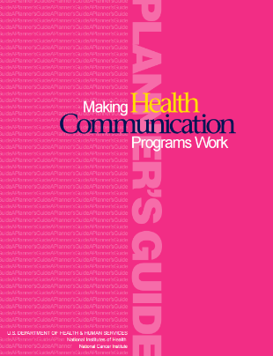
Acknowledgments
This work was supported by Cooperative Agreement #1U38DP004972-03 from the Centers for Disease Control and Prevention. Its contents are solely the responsibility of the authors and do not necessarily represent the official views of the Centers for Disease Control and Prevention.
Special thanks to:
Monique Turner, PhD, Milken Institute School of Public Health
Jerry Franz, Milken Institute School of Public Health
Julia Thorsness, Alaska Department of Health and Social Services
Keylee Wright, MA, Indiana State Department of Health
The content and competencies in this training are based on content from the National Cancer Institute’s publication “Making Health Communication Programs Work” and the Seven Areas of Responsibility for Health Education Specialists, 2015. The training was also influenced by the work of the Cancer Prevention and Control Research Network (CPCRN) and its “Putting Public Health Evidence into Action” training curriculum.
Notes:
We would like to acknowledge the Centers for Disease Control and Prevention for supporting this work. We would also like to thank Dr. Monique Turner, Associate Professor, and Jerry Franz, Adjunct Instructor, at the Department of Prevention and Community Health at the Milken Institute School of Public Health of the George Washington University for their contributions to content development and review.
We would also like to thank Julia Thorsness, Program Coordinator, Comprehensive Cancer Control, Alaska Department of Health and Social Services and Keylee Wright, Director, Cancer Control Section, Indiana State Department of Health for their thoughtful feedback on the initial draft.
The competencies in this training are based on content from the National Cancer Institute’s publication “Making Health Communication Programs Work”, also known as “The Pink Book”, and the Seven Areas of Responsibility for Health Education Specialists, 2015.
This training was also influenced by the work of the Cancer Prevention and Control Research Network (CPCRN) and its “Putting Public Health Evidence into Action” training curriculum.

Slide 4
Competencies
Demonstrate knowledge of the differences between health communication, social marketing and media advocacy
Apply strategic principles to public health communication and marketing to complete a media plan
Notes:
This introductory lesson will address the following competencies:
Demonstrate knowledge of the differences between health communication, social marketing and media advocacy;
and apply strategic principles to public health communication and marketing to complete a media plan.

Slide 5
Learning Objectives
Describe the role of communication campaigns in chronic disease and cancer prevention and control
Define a communication/media plan and
Explain the Centers for Disease Control and Prevention(CDC) requirements for a media plan
Notes:
After completing this lesson, you will be able to:
Describe the role of communication campaigns in chronic disease and cancer prevention and control
Define a communication and/or media plan and
Explain the Centers for Disease Control and Prevention (CDC) requirements for a media plan

Slide 6
Health Communication
The study and use of communication strategies to inform and influence individual and community decisions that enhance health.”
Inform and influence
Audience may be:
Individuals
Groups
Organizations
Communities
Societies
One of many tools to trigger change
Helps us understand the best ways to use theories and insights to inform or influence
National Cancer Institute (NCI), 2004.
Notes:
People have defined health communication in various ways. Both the Centers for Disease Control and Prevention (CDC) and the National Cancer Institute (NCI) define health communication as “The study and use of communication strategies to inform and influence individual and community decisions that enhance health.” Communication is an important tool in Comprehensive Cancer Control. It can influence your constituents’ health behaviors to decrease their risk of cancer and improve cancer outcomes in your state, region or community.
There are some key points to note on the definition of communication:
One is that the definition discusses the purpose of health communication as “to inform and to influence.” Certainly, there are times when health communicators merely want their audience to become more educated on the health issue. Perhaps we want people to understand the risks of a product, such as prescription medication or we may want people to be educated about the relationship between nutrition and colorectal cancer. Other times, health communicators want to influence or persuade their audience, such as when we try to convince women to get Pap smears or to be more physically active each day.
A second aspect of the definition of health communication is the audience, which may be an individual, such as when a provider meets with her patient; a group, such as when a social media campaign attempts to influence teenagers about the consequences of smoking; organizations, such as when media advocacy is used to aim messages on healthier school lunches at school boards; communities, such as when informational brochures on physical activity are distributed at faith-based organizations, or societies as a whole, such as when a mass-mediated public service announcement is used to raise awareness about lung cancer risk factors.
A third aspect to consider is that communication is one of many tools that can be used to trigger change; therefore we need to understand what health communication can and cannot do in order to communicate effectively. You may wish to review what communication can and cannot do from Communication Training 101. Communication alone cannot be expected to produce sustained change in complex health behaviors without the support of a larger program for change, including components addressing health care services, technology and changes in regulations and policy. Often, comprehensive cancer control programs do not have the resources to implement large scale communication campaigns; rather, communication is typically a component of a multi-faceted initiative.
A fourth aspect is that health communication is an entire field or academic discipline that helps us to understand the best ways to use communication theory and insights to inform or influence audiences. Communication can come in various forms: doctor to patient, nutritionist to client, public service announcements, family communication, support groups or even social marketing.

Slide 7
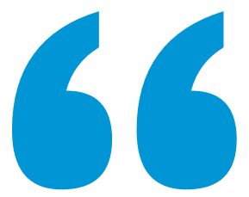
Social Marketing
Social Marketing
Longer-term marketing campaign that uses the elements of commercial marketing to influence behaviors.”
4 P’s of Marketing
Product
Price
Place
Promotion
Centers for Disease Control and Prevention (CDC), 2011.
Notes:
Oftentimes, when health communicators are attempting to influence large groups of people, they are using social marketing. Social marketing is a longer-term marketing campaign that uses the elements of commercial marketing to influence behaviors. Social marketing is a type of mass communication strategy that practitioners often use to impact behavior change in intended audiences and secondary audiences. Social marketers use the theories, strategies and practices of commercial marketers in order to affect social, or in our case public health, behaviors. Commercial marketers think about the 4 P’s of marketing: product, price, place and promotion. The 4 P’s of marketing can be reviewed in Communication Training 101.

Slide 8
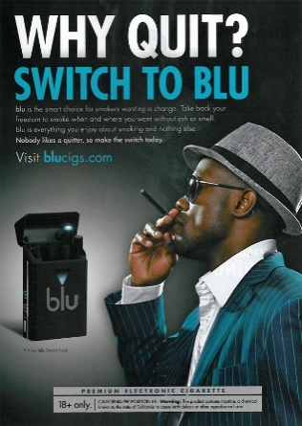
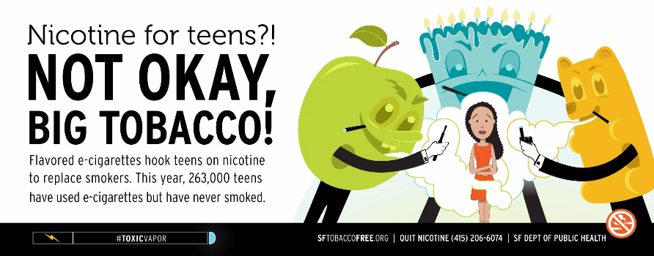
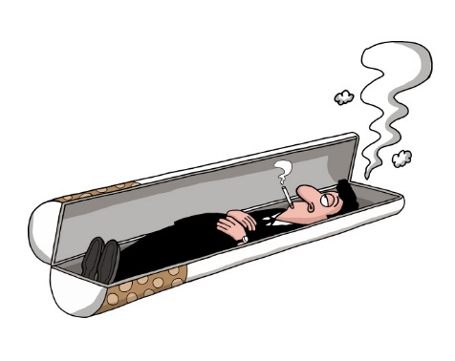
Media Advocacy
Media Advocacy
Media advocacy is the strategic use of mass media and community advocacy to advance environmental change or a public policy initiative.”
Brownell, Kersh, & Ludwig, 2010; U.S. Department of Health and Human Services, 1989.
Notes:
Sometimes, the goal of health communication is to change the way an issue is thought about or framed in society. This is where media advocacy can be useful. Media advocacy is the strategic use of mass media to advance a social or public policy initiative or environmental change. (U.S. Department of Health and Human Services, 1989).
For example, there was a time when lung cancer was only discussed from an “individual responsibility” frame, which argues that people are solely responsible for their cancer because of poor behavior choices (Brownell, Kersh, & Ludwig, 2010). Many public health experts found this to be objectionable. Are individuals the only ones at fault? Perhaps we should also shed light on tobacco industry practices: the power of tobacco advertising, the addictive and dangerous nature of the substance and even the power of pricing strategies, such as providing coupons and lowering prices.
Public health communication experts use media advocacy to get these kinds of stories into the news and other media, such as TV shows or movies, to reshape how Americans think about tobacco, the tobacco industry and lung cancer, as well as other tobacco-related diseases. This is a way of using strategic communication for the purposes of policy change.
When society at large begins looking at public health issues differently, such as thinking: “Maybe tobacco addiction isn’t all on the individuals’ shoulders; maybe tobacco advertising is unethical,” public opinion begins to support policy change. Media advocacy has been critical in affecting tobacco regulations and is now being used to affect other public health causes, such as food and nutrition regulations, to make the healthy choice the easy choice.
LGBT ad: https://trinketsandtrash.org/detail.php?item_number=213662
Menthol ad: http://img2.timeinc.net/health/images/slides/benson-menthol-400x400.jpg
E-cig ad: http://sites.psu.edu/cdcrclblog/wp-content/uploads/sites/15223/2014/10/E-Cigarette-Ad.jpg
Camel Bold Coupon ad: http://www.medicaldaily.com/camel-crush-cigarette-ads-entice-teenagers-says-campaign-tobacco-free-kids-246381
SF Media Advocacy poster: http://sanfranciscotobaccofreeproject.org/curbit-campaign-ads/

Slide 9
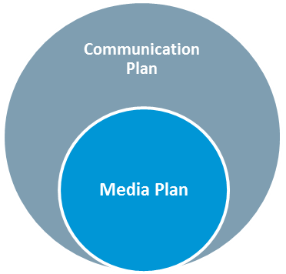
Media Plan
Focuses on strategies to create awareness
Includes print, broadcast and social media
Identifies goals, target audiences, objectives, strategies, tactics, activities and outcome measures.”
Planning and Strategy Development
Developing and pretesting concepts, messages and materials
Implementing the program
Assessing effectiveness and making refinements
Health Communication Program Cycle
Sections include:
Background and Justification
Health, Behavioral and Communication Objectives
Audiences
Media Plan Tactics and Timeline
Evaluation
CDC, 2014.
Notes:
Planning and strategy development is the first step in the National Cancer Institute’s Health Communication Program Cycle. We will follow the steps in the cycle throughout this training.
The CDC requires all National Comprehensive Cancer Control Programs to submit a media or communication plan. A media plan is part of a communication plan. If your program has a communication plan that includes a media plan, you have satisfied that deliverable. According to the CDC, the media plan “focuses on and describes strategies using media to reach, engage, inform and create awareness; includes print, which can be newspapers or magazines, broadcast, such as TV or radio, and social media, like Twitter and Facebook; and identifies goals, target audiences, objectives, strategies, tactics, activities and outcome measures for evaluation purposes. Simply put, the media plan addresses efforts on paid, earned and shared social media, while the communication plan addresses efforts on paid, earned, shared and owned media. To review the four different media types and common examples, see Communication Training 101.
Significant planning, time and thought go into creating a media plan. The first section of the media plan is the Background and Justification, where the health problem is identified. It is in this section that you would present information from your state’s comprehensive cancer control plan. Section 2 lists your health, behavioral and communication strategies. The third section defines the audience intended to receive your message. The fourth section of your media plan, the Media Plan Tactics and Timeline section, will identify your key message, the media channels you will use, activities, timeline, budget, responsible staff and outcome measures. Last, but certainly not least, the fifth section is a highly recommended Evaluation section that will identify ways you will track and evaluate the effectiveness of your campaign. Considering each section of the media plan and populating the sections with data, evidence- and theory-based S.M.A.R.T. objectives and activities that align with the objectives will not only fulfill media plan obligations to the CDC, but also serve as a crucial foundation when it comes to implementing and evaluating a health communication campaign.

Slide 10
Health Issues and Problems
1. Background and Justification | 2. Health, Behavioral and Communication Objectives | 3. Audiences | 4. Media Plan Tactics and Timeline | 5. Evaluation
Morbidity
Mortality
Severity of outcomes
Populations affected
Prevalence rates among sub-groups
Risk and protective factors
CDC, 2014.
Notes:
The first section of the media plan is the Background and Justification. It is an opportunity to describe the current status of cancer control in your state, region or community. As you complete the Background and Justification section of your media plan, you will want to assess the particular health issue or problem. The more you understand about an issue or health problem, the better you can develop a media plan. Here, it is important to refer back to your state’s Comprehensive Cancer Control Plan and its high-level goal or goals. This may include morbidity, mortality, severity of outcomes, populations affected and prevalence rates among sub-groups, risk and protective factors, and more. For example, let’s say you wanted to decrease breast cancer incidence rates in your community. You would want to review your state’s Comprehensive Cancer Control Plan to see what goals have been set for addressing breast cancer, and what information is available about the populations and subgroups most at risk for breast cancer in your community, including any rates such as morbidity, mortality, prevalence, etc. You might then conduct a literature review to find out more information about the populations you’ve identified as being impacted by breast cancer.
As you complete your assessment of the health issue or problem you wish to address, you will find that information about your target audience will emerge. This information will be relevant to help you complete sections 1 and 2 of your media plan, but will be the main focus of section 3.
Once you have a better understanding of your health problem, you will be able to create a media plan that’s well focused to address the issues. See Communication Training 101 for a media plan template.

Slide 11
Health Issues and Problems
1. Background and Justification | 2. Health, Behavioral and Communication Objectives | 3. Audiences | 4. Media Plan Tactics and Timeline | 5. Evaluation
Internal Strengths
(e.g., connections with local reporters)
Internal Weaknesses
(e.g., lack charismatic spokesperson)
External Opportunities
(e.g., national spotlight on health issue)
External Threats
(e.g., political climate or cultural resistance)
See Media Plan Template page 4
CDC, 2014.
Notes:
The CDC encourages that the Background and Justification section also include a “SWOT analysis, environmental scan and/or literature reviews as needed.”
A systematic analysis of strengths, weaknesses, opportunities and threats (or SWOT) can help you take stock of factors that could potentially influence your communication work. The media plan template includes a table on page 4 that can help you think through the following questions:
What are some internal strengths that will help facilitate progress on the health issue of interest? For example, do you have a leader with really strong connections with local reporters?
What are some internal weaknesses that may be barriers to progress? For example, do you lack a charismatic spokesperson who can speak publicly about your priority health issue?
What are some external opportunities that could help facilitate progress? For example, is there a new national focus in the news media or a recent Hollywood film that touches on the topic? Can you capitalize on the conversation to advance your media plan activities?
What are some external, uncontrollable threats that could hinder progress? For example, is there cultural resistance to discussing the issue that will make it difficult to carry out your planned media tactics?

Slide 12
Health, Behavioral and Communication Objectives
1. Background and Justification | 2. Health, Behavioral and Communication Objectives | 3. Audiences | 4. Media Plan Tactics and Timeline | 5. Evaluation
Health Objectives
Health outcomes
Behavioral Objectives
Changes in actions
Communication Objectives
Changes in awareness, knowledge, perceptions, beliefs and confidence/efficacy
NCI, 2004.
Notes:
After carefully identifying and assessing the health issue or problem, you can move on to writing objectives. Think about what communication can achieve. What can you expect to change because of your communication program? Keep in mind that communication is only one of many tools for promoting or improving health and “changes in health care services, technology, regulations, and policy are often necessary to completely address a health problem” (National Cancer Institute, 2004, p. 3).
Health objectives are the goals for changes in the audiences’ health status, also known as health outcomes. This could include reducing cancer and chronic disease in the population of interest and should align with your state’s Comprehensive Cancer Control Plan.
Health objectives should correspond to your state cancer plan’s goals and objectives.
Behavioral objectives are goals for changes in your audiences’ behaviors. Behaviors can be actions we want people to engage in or actions we want them to stop. Behaviors might include getting screened or tested, increasing physical activity, eating vegetables, talking to one’s doctor or quitting smoking. Here, our belief is that if people engage in these behaviors for long enough, then it will improve their health. Behavioral objectives should align with and contribute to meeting your health objectives.
Communication objectives outline the changes in awareness, knowledge, perceptions, beliefs, attitudes and confidence/self-efficacy related to risk factors, diseases or behaviors that can be expected to result from a communication campaign or education activities. The belief is that if we can create changes in knowledge, attitudes, beliefs, perceptions, efficacy, norms and emotions, we can begin to change behaviors of the audience. Communication objectives should align with and contribute to meeting your behavioral objectives, but are generally not expected to lead to large behavioral changes without being part of a larger multi-faceted intervention or initiative.
All your objectives should be S.M.A.R.T – specific, measurable, achievable, realistic and time-bound. To review SMART objectives, see Communication Training 101. Another factor to consider is whether your objectives are relevant to your state cancer plan, organization’s mission and funder’s priorities.

Slide 13
Intended Audiences
1. Background and Justification | 2. Health, Behavioral and Communication Objectives | 3. Audiences | 4. Media Plan Tactics and Timeline | 5. Evaluation
Driven by population needs as evidenced by data
Answers the questions:
Why do they have this health problem?
How severely do they experience the health problem?
What is their knowledge level of the health problem?
Do they know they experience the health problem?
Are there cultural or personality-based traits that perpetuate this health problem?
Notes:
The secret to effective communication comes from knowing your audience, and this section of the media plan helps you to think through this process.
Selection of the target audience should be driven by population needs as evidenced by data. Perhaps there is data that reveals that African American or black populations in your region have disproportionately high rates of death from breast cancer. This may prompt you to refine your audience from women in general to African American or black women.
Using primary data, such as data from your own research through focus groups or town hall meetings, or secondary data (like that collected from conducting a literature review), health communicators must be able to answer questions about their target audience such as:
Why does this population have this health problem?
How severely do they experience the health problem?
What is their knowledge level of the health problem?
Do they know or perceive that they are vulnerable to the health problem?
Are there cultural or personality-based traits that perpetuate this health problem? Examples include fatalism, machismo, groupthink and low health literacy.
Understanding these kinds of audience characteristics will help you develop goals and objectives that are realistic for, and tailored to, your audience. Aligning your media plan with your state cancer plan and conducting basic research to inform your plan will help you when it comes to executing the plan and evaluating specific communication campaigns. Communication Training 101 provides information on choosing media channels, and Lesson 3 of this training will go into more depth on how to develop key messages, tactics and choose channels for specific intended audiences.

Slide 14
Evaluating Media Activities
1. Background and Justification | 2. Health, Behavioral and Communication Objectives | 3. Audiences | 4. Media Plan Tactics and Timeline | 5. Evaluation
Planning and Strategy Development
Developing and pretesting concepts, messages and materials
Implementing the program
Assessing effectiveness and making refinements
Health Communication Program Cycle
NCI, 2004; CDC, 2009; CDC, 2014.
Notes:
According to the National Cancer Institute’s Health Communication Program Cycle, we can see that tracking and evaluating your campaign is helpful to not only assess how effective your campaign was, but also to inform ways the campaign can be improved in the future. For the purposes of your media plan, planning and tracking process evaluation at a minimum is key.

Slide 15
Evaluating Media Activities
1. Background and Justification | 2. Health, Behavioral and Communication Objectives | 3. Audiences | 4. Media Plan Tactics and Timeline | 5. Evaluation
assess program operations, namely the who, what, when and how many of program activities and program outputs were met”
Paid Media
Measures of audience or exposure
Target Rating Point (TRP) = GRP x percentage of specific target audience
Earned Media
Number of letters to the editor, blog entries published
Social/Shared Media
Number of clicks on posts you shared
Number of radio and TV interviews
Number of your posts shared by others
Number of followers
Gross Rating Point (GRP) or “impressions” = reach x frequency
Circulation numbers
NCI, 2004; CDC, 2009; CDC, 2014.
Notes:
According to the CDC, process evaluation assesses program operations, namely the who, what, when and how many of program activities and program outputs were met.
For example, when evaluating paid media, you can look at measures of audience or exposure, such as Gross or Target Rating Points. Gross Rating Points, or more commonly known as impressions, is a measure of reach, calculated as the number of people you reach times frequency, the number of times people have been exposed to the media. Target Rating Points takes the number of impressions and multiplies that by the percentage of those viewers who actually represent your target audience. For example, if you ran a radio spot on Pap smears, your target audience would be women of a certain age. If you want to calculate how effective the campaign was in reaching women in your target age range, you would look at TRP. But, you may have also reached men, who happened to be listening to the radio. Those numbers will be captured as GRP.
When looking at evaluating earned media, you might track the number of letters to the editor or blog entries published, number of radio and TV interviews you and your organization members conducted, and also look at circulation numbers for reach, or impressions. When looking at social or shared media, you might track the number of times your social media posts were shared by others, the number of times someone clicked on your posts, and the number of people who are following your account.
By tracking and analyzing these data, you can adjust your campaign in the future. For example, if you find that you are not reaching the right people by using one media channel, you may regroup and explore other channels that would be more effective.
In addition to process outputs, measuring outcomes, satisfaction and impact is important and will be discussed in depth in Lesson 4 of this training.

Slide 16
Resources
Media Planning and Media Relations Guide from Communication Training for Comprehensive Cancer Control Professionals 101
CDCynergy Lite: Social Marketing Made Simple. A guide for creating effective social marketing plans
Johns Hopkins Bloomberg School of Public Health/Center for Communication Programs’ A Field Guide to Designing a Health Communication Strategy
National Cancer Institute’s Making Health Communication Programs Work
Notes:
Here are some further readings and resources you can access on the topic of using a communication or media plan to launch a campaign. These and other resources are included in the Guide to Making Communication Campaigns Evidence-Based in the learning management system.

Slide 17
Conclusion
Describe the role of communication campaigns in chronic disease and cancer prevention and control
Define a communication/media plan
Explain Centers for Disease Control and Prevention(CDC) requirements for a media plan
Notes:
In this lesson, you learned to:
Describe the role of communication campaigns in chronic disease and cancer prevention and control
Define a communication/media plan and
Explain Centers for Disease Control and Prevention(CDC) requirements for a media plan
This introductory lesson was a review of the Communication Training 101. The subsequent lessons of this training will cover in depth the following topics:
Overview of EVIDENCE-BASED HEALTH COMMUNICATION CAMPAIGNS, including defining evidence, how to collect it and how to use theory to inform your campaign
Conducting community assessments and developing campaign roadmaps as part of the COMMUNICATION CAMPAIGN BACKGROUND AND JUSTIFICATION
Development of COMMUNICATION CAMPAIGN MESSAGES, TACTICS AND CHANNELS FOR INTENDED AUDIENCES, including audience research and pre-testing of materials
Planning for campaign evaluation, including identification of metrics of success and selection of evaluation methods, and
Campaign implementation, including developing an implementation plan and timeline

Slide 18
This concludes the lesson.
Please exit and return to the learning management system.
EXIT
Notes:
This concludes the lesson.

Slide 19
Making Communication Campaigns Evidence-Based
Communication Training for Comprehensive Cancer Control Professionals 102
Lesson 1: Evidence-Based Health Communication Campaigns
Notes:
Welcome to Lesson 1: Evidence-Based Health Communication Campaigns.

Slide 20
Acknowledgments
This work was supported by Cooperative Agreement #1U38DP004972-03 from the Centers for Disease Control and Prevention. Its contents are solely the responsibility of the authors and do not necessarily represent the official views of the Centers for Disease Control and Prevention.
Special thanks to:
Monique Turner, PhD, Milken Institute School of Public Health
Jerry Franz, Milken Institute School of Public Health
Julia Thorsness, Alaska Department of Health and Social Services
Keylee Wright, MA, Indiana State Department of Health
The content and competencies in this training are based on content from the National Cancer Institute’s publication “Making Health
Communication Programs Work” and the Seven Areas of Responsibility for Health Education Specialists, 2015. The training was also influenced by the work of the Cancer Prevention and Control Research Network (CPCRN) and its “Putting Public Health Evidence into Action” training curriculum.
Notes:
We would like to acknowledge the Centers for Disease Control and Prevention for supporting this work. We would also like to thank Dr. Monique Turner, Associate Professor, and Jerry Franz, Adjunct Instructor, at the Department of Prevention and Community Health at the Milken Institute School of Public Health of the George Washington University for their contributions to content development and review. We would also like to thank Julia Thorsness, Program Coordinator, Comprehensive Cancer Control, Alaska Department of Health and Social Services and Keylee Wright, MA, Director, Cancer Control Section, Indiana State Department of Health for their thoughtful feedback on the initial draft. The competencies in this training are based on content from the National Cancer Institute’s publication “Making Health Communication Programs Work” also known as “The Pink Book” and the Seven Areas of Responsibility for Health Education Specialists, 2015. This training was also influenced by the work of the Cancer Prevention and Control Research Network (CPCRN) and its “Putting Public Health Evidence into Action” training curriculum.

Slide 21
Competencies
Access and assess existing evidence to plan a communication campaign
Apply theories and/or models of implementation
Notes:
This lesson will address the following competencies:
Access and assess existing evidence to plan a communication campaign, and
Apply theories and/or models of implementation

Slide 22
Learning Objectives
Define “evidence” and its role in public health
Explain the importance of evidence-based approaches in communication campaigns
Describe methods to collect evidence
Describe behavioral and communication theories to inform evidence-based communication campaigns
Notes:
After completing this lesson, you will be able to:
Define “evidence” and its role in public health,
explain the importance of evidence-based approaches in communication campaigns,
describe methods to collect evidence, and
describe behavioral and communication theories to inform evidence-based communication campaigns.

Slide 23
Evidence
The available body of facts or information indicating whether a belief is true or valid”
Media/marketing data
Public health surveillance data
Qualitative data from community members or other stakeholders
Personal experiences
Systematic reviews of multiple intervention evaluations
Program evaluation
Policy analysis
Jewell & Abate, 2001; Chambers & Kerner, 2007.
Notes:
Evidence can be used to establish proof or to confirm the existence of a particular phenomenon. Evidence is best defined as the “available body of facts or information indicating whether a belief is true or valid.” By establishing evidence, health care delivery and public health programs can enhance their potential for achieving desired outcomes by building on what others have done. Evidence adds credibility to your work and can be used to guide decision making about public health practice.
Some forms of evidence in public health include: Media/marketing data, public health surveillance data, qualitative data from community members or other stakeholders, personal experiences, systematic reviews of multiple intervention evaluations, program evaluation and policy analysis.

Slide 24
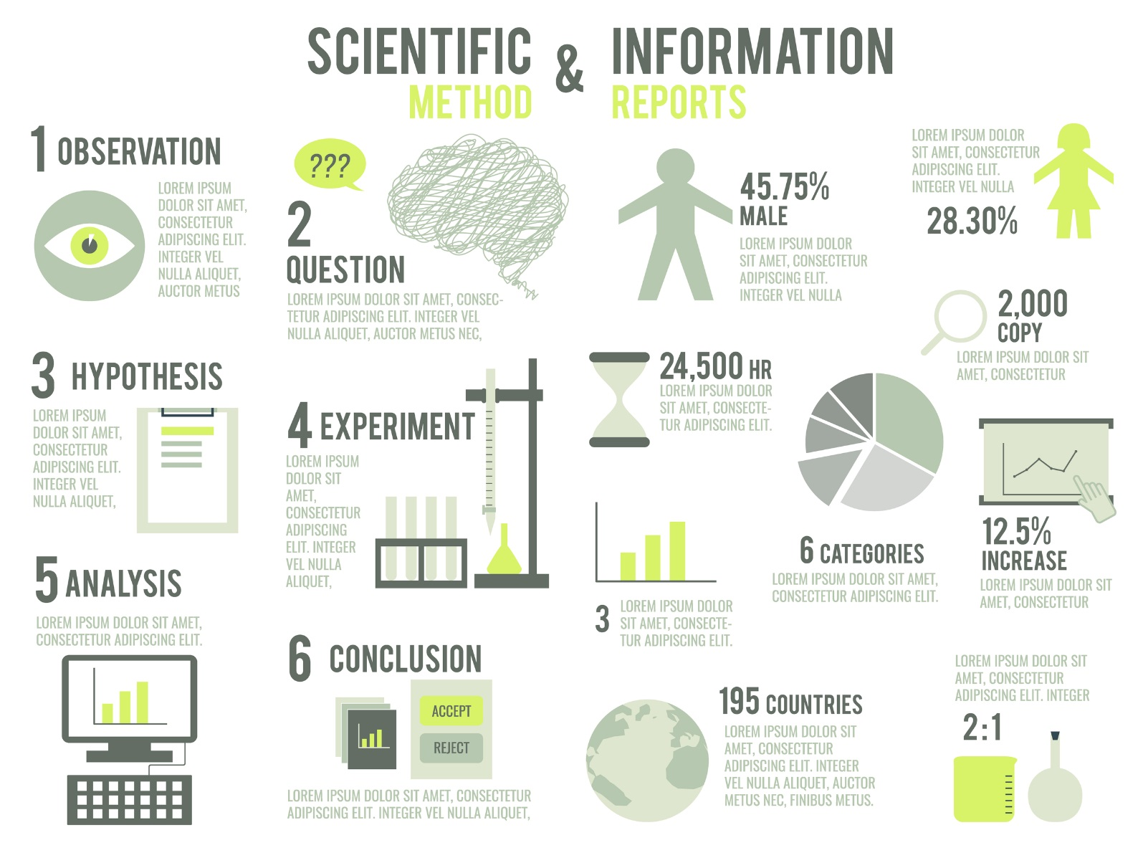
Evidence-Based Public Health
process of integrating science-based interventions with community preferences to improve the health of populations.”
Kohatsu, Robinson, & Toner, 2004.
Notes:
Evidence-based public health is defined as the “process of integrating science-based interventions with community preferences to improve the health of populations.”
Making use of evidence-based public health in health communication campaigns is imperative to achieving sustainable, population-level health outcomes.

Slide 25
Evidence-Based Public Health
Objective
Subjective
Systematic reviews of multiple intervention evaluations
Public health surveillance data
Policy Analysis
Program evaluation
Qualitative data from community members or other stakeholders
Media/marketing data
Word-of-mouth
Personal experience
Cancer Prevention and Control Research Network, 2014.
Notes:
Decisions regarding public health policies, programs and practice should be informed by the best available evidence. Evidence used to make decisions can either be subjective evidence, derived from direct experience with smaller populations in variable conditions, or objective evidence, derived under highly controlled conditions that may not exist in reality, but are essential for measuring cause and effect.
All evidence is not created equal. Each source of public health evidence should be weighed differently. We make no judgements about what type of evidence is better than another; practice-based evidence related to feasibility or cultural appropriateness is just as important as research-based evidence of intervention effectiveness when planning a campaign or program.

Slide 26
Evidence-Based Public Health
Evidence-based programs
Program produces the expected positive results
Evidence-based policies
Public policy
Rely on appropriate and effective packaging of evidence aimed at specific policy elements that are likely to effectively impact public health
Evidence-based strategies
Recommended actions
No precise implementation details
Results can be attributed to the program itself
Evaluation is peer-reviewed by experts in the field
Program is “endorsed” by a federal agency or respected research organization and included in their list of effective programs
Informed by the best available quantitative and qualitative evidence
Organizational policy
Evidence of effectiveness from multiple studies
Cooney, Huser, Small, & O’Connor, 2007;
Brownson, Chriqui, & Stamatakis, 2009; Brownson et al., 2009; U.S. Food and Drug Administration, 2015.
Notes:
The Cancer Prevention and Control Research Network (CPCRN) defines three main categories of evidence-based approaches (EBAs) that can be used to promote public health: evidence-based programs, evidence-based policies and evidence-based strategies.
Evidence-based programs, also called evidence based interventions are judged to be evidence-based if “(a) evaluation research shows that the program produces the expected positive results; (b) the results can be attributed to the program itself, rather than to other extraneous factors or events; (c) the evaluation is peer-reviewed by experts in the field; and (d) the program is “endorsed” by a federal agency or respected research organization and included in their list of effective programs.” Programs are typically available with detailed implementation instructions and programmatic materials. An example is the Body & Soul program designed to increase fruit and vegetable consumption among African Americans through education in faith-based group settings.
Evidence-based policies include public and organizational policies that are informed by, “the best available quantitative and qualitative evidence...in order to improve public health outcomes.” Evidence-based policies rely on appropriate and effective packaging of evidence aimed at specific policy elements that are likely to effectively impact public health. All levels of policy can affect public health, including public policy and organizational policy. An example of public policy is the Family Smoking Prevention and Tobacco Control Act (Tobacco Control Act), which gives the Food and Drug Administration (FDA) “broad authority to regulate the manufacture, distribution, and marketing of tobacco products to help all Americans…live longer, healthier lives.” Organizational policies include smoke-free workplace initiatives to decrease the dangers of smoking in the workplace.
Evidence-based strategies are recommended actions based on evidence of effectiveness from multiple studies. Strategies are not prescriptive and therefore do not include precise implementation details. An example of evidence-based strategy is provider reminder and recall systems to promote cancer screenings. If you select an evidence-based strategy, you will need to build in time and expertise to develop the intervention materials and protocols (discussed in more detail in Lesson 2).
Selecting an evidence-based approach and adapting it for your context requires adherence to a strategic decision making process incorporating a) evidence from the best available research; b) resources, such as practitioner expertise; and c) the attributes of the community or population’s values, preferences and characteristics. When searching for an evidence-based solution to an identified health problem, you will likely encounter intervention programs, policies and strategies with varying types and amounts of evidence behind them.

Slide 27
Evidence-Based Public Health
CATEGORY | HOW THE EVIDENCE IS ESTABLISHED | CONSIDERATIONS FOR THE LEVEL OF SCIENTIFIC EVIDENCE | DATA SOURCE EXAMPLES
Evidence-based | Peer review via systematic or narrative review | - Based on study design and execution - Has external validity - Identifies potential benefits or harms - Illustrates costs and cost-effectiveness | - The Community Guide - Cochrane Reviews - Narrative reviews based on published literature
Effective | Peer review | -Based on study design and execution -External validity -Potential benefits or harms -Costs and cost-effectiveness | -Articles in the scientific literature -Research-tested intervention programs -Technical reports with peer review
Promising | Written program evaluation without formal peer review | - Offers summative evidence of effectiveness - Includes formative evaluation data - Is theory-based, plausible, potentially high-reach, low-cost, replicable | -State or federal government reports (without peer review) -Conference presentations
Emerging | Ongoing work, practice-based summaries, or evaluation works in progress | - Includes formative evaluation data - Has face validity - Is theory-based, plausible, potentially high-reaching, low-cost, replicable | - Evaluability assessments - Pilot studies - NIH RePORT (formerly CRISP database) - Projects funded by health foundations
Most Rigorous
Least Rigorous
Brownson et al., 2009.
Notes:
In the cancer control field, you have likely heard terms like “promising practice” and “effective intervention” lumped in with discussions of evidence-based practice. While often used interchangeably, there are true differences between these terms. This chart shows a typology for classifying evidence-based approaches by level of scientific rigor and highlights some of the considerations that contribute to an approach being truly evidence-based. Here we also provide some common sources for evidence-based approaches that you might wish to explore when developing your campaign.

Slide 28
Evidence in Communication Campaigns
Making decisions using the best available peer-reviewed evidence (both quantitative and qualitative research)
Using data and information systems systematically
Applying program planning frameworks (that often have a foundation in behavioral science theory)
Engaging the community in assessment and decision making
Conducting sound evaluation
Disseminating what is learned to key stakeholders and decision-makers”
Brownson et al., 2009.
Notes:
As with health behavior change interventions, communication campaign strategies should be rooted in evidence. An evidence-based approach ensures systematic use of existing data and tools, and should be used in developing, monitoring and measuring health communication campaigns. Using evidence for public health communication campaigns is important for: Making decisions using the best available peer-reviewed evidence (both quantitative and qualitative research), using data and information systems systematically, applying program planning frameworks (that often have a foundation in behavioral science theory), engaging the community in assessment and decision making, conducting sound evaluation and disseminating what is learned to key stakeholders and decision-makers.

Slide 29
Evidence in Communication Campaigns
Community
Geography
Context
Ethnicity
Race
History
Cultural behaviors
Cultural beliefs
Demographics
Escoffery et al., 2015.
Notes:
The emphasis on experimental evidence should not override practice-based evidence. Each community, whether defined by geography, race or ethnicity, or some other demographic, has its own context, history and cultural behaviors and beliefs that will likely require you to adapt an evidence-based approach to fit your situation. For this reason, it is important to consider different types of evidence to get the most comprehensive understanding of how the health issue impacts a specific group and what techniques would be most effective in eliciting change. Success of the communication campaign will depend on local feasibility, acceptability and fit with context, each can all be assessed through integrating evidence, expertise and prior experience.

Slide 30
Collecting Evidence
Primary Data
Qualitative Data
(e.g., unstructured or semi-structured interviews, focus groups or small group discussions, public meetings or forums, direct observation of communities or groups of people)
Quantitative Data
(e.g., structured interviews, surveys)
Secondary Data
Government databases
(e.g., Demographics from the US Census Bureau such as American FactFinder or State and County QuickFacts, Vital statistics from State and Local Health Departments, academic literature review)
Behavioral Risk Factors and Psychographic (i.e. knowledge, attitudes, beliefs, etc.)
(e.g., Behavioral Risk Factor Surveillance System, National Health Interview Survey, academic literature review)
Media Use Habits
(e.g., computer and internet access and use: U.S. Census Bureau; internet usage: PEW Research Center - Internet, Science & Technology; Media circulation: PEW Research Center – Journalism & Media)
Notes:
Evidence for a communication campaign may be located in various places. Evidence can be data that you collect (primary data) or data that have been collected and published (secondary data). These data can be used to inform planning, implementation, evaluation and grant writing. The advantage of using primary data is that the data can be collected using methods that are specific to subject matter and audience of the communication campaign. For example, if you wanted to determine whether women 50 years and older who received mammograms from your clinic were comfortable accessing health information using social media platforms, you could conduct a focus group or brief survey at intake to collect primary data on that audience. This would be evidence that could determine whether using social media platforms to promote mammography screenings to women of this age group had the potential to be successful. Primary data can be collected using qualitative and quantitative methods. Qualitative data sources include unstructured or semi-structured interviews, focus groups or small group discussions, public meetings or forums and direct observation of communities or groups of people. Quantitative data might come from structured interviews or surveys.
Examples of sources used to obtain secondary data include government databases such as the US Census Bureau for demographic data or media use habits such as computer access and use or the Behavioral Risk Factor Surveillance System for behavioral risk factors and psychographic data including information about knowledge, attitudes and beliefs. Examples of non-governmental sources used to obtain secondary data include academic literature reviews, or other databases such as the PEW Research Center for internet usage information or media circulation.
The combination of primary data, secondary data and knowledge from past experience will facilitate planning of the communication campaign.

Slide 31
Standards of Effectiveness
Consider the following standards when applying scientific criteria to establish strong evidence for effectiveness:
Significant confidence in the results or evaluations with at least one matched comparison
Programs with community support should be subject to experimental evaluations
Evidence of effectiveness in real-world environments, reasonable cost, and manuals or other materials available to guide implementation with a high level of fidelity
National Research Council and Institute of Medicine, 2009.
Notes:
Earlier, we defined different types of evidence and introduced the concept of emerging, promising, effective and truly evidence-based approaches. To determine if something is evidence-based, established scientific criteria must be applied. The National Academy of Sciences recommends considering the following standards when applying scientific criteria to establish strong evidence for effectiveness:
“Evidence for efficacy or effectiveness of prevention and promotion programs should be based on designs that provide significant confidence in the results. The highest level of confidence is provided by multiple, well-conducted randomized experimental trials, and their combined inferences should be used in most cases. Single trials that randomize individuals, places (e.g. schools), or time (e.g., wait-list or times-series designs), can all contribute to this type of strong evidence for examining intervention impact
When evaluations with such experimental designs are not available, evidence for efficacy or effectiveness cannot be considered definitive, even if based on the next strongest designs, including those with at least one matched comparison. Designs that have no control group (e.g., pre-post comparisons) are even weaker
Programs that have widespread community support as meeting community needs should be subject to experimental evaluations before being considered evidence-based
Priority should be given to programs with evidence of effectiveness in real-world environments, reasonable cost, and manuals or other materials available to guide implementation with a high level of fidelity.”
It is likely that you are not the first public health professional to want to address the health issue you have chosen for your communication campaign. Before attempting to develop a campaign from scratch, take some time to see what has been done before you and either adopt or adapt an evidence-based approach for your context. See the Guide to Making Communication Campaigns Evidence-Based for a list of reliable resources for locating evidence-based programs, policies, and strategies.

Slide 32
Behavioral & Communication Theories
A theory is a set of interrelated concepts, definitions and propositions that explains or predicts events or situations by specifying relations among variables.”
Behavioral theories and models help explain behavior, as well as suggest how to develop more effective ways to influence and change behavior.”
Communication theories and models explain how a sender, message and channel can be used to effectively communicate an idea.”
Glanz, n.d.
Notes:
An evidence-based communication campaign should be driven by behavioral change or communication theory. Selecting the appropriate theory requires familiarity with the health issue and defined health and behavioral objectives. These should be outlined in the communication plan, and are discussed in Lessons 1 and 2 of Communication Training 101. Your communications campaign may be only one component of a larger public health intervention. The over-arching intervention should be theory-based and this theory may help inform the communication campaign.
A theory is a set of interrelated concepts, definitions and propositions that explains or predicts events or situations by specifying relations among variables. Behavioral theories and models help explain behavior, as well as suggest how to develop more effective ways to influence and change behavior.”
Communication theories and models explain how a sender, message and channel can be used to effectively communicate an idea. The theory you choose will be used to guide you in creating your communication campaign roadmap to explain how you expect your campaign activities to lead to the desired change in behavior and health. The theory will help you refine your communication objectives, plan activities to accomplish them and determine what you can measure for evaluation of your campaign.

Slide 33
Theories of Change
Social Ecological Model
Societal
Community
Relationships
Individual
Jackson et al., 2007.
Notes:
Generally speaking, public health seeks to improve overall quality of life through implementation of programs, policies and strategies that improve health. As you will likely see when you begin to collect data on factors related to the behaviors and health outcome of interest, health is influenced by many factors at multiple levels including individual, organizational and societal, as depicted in the social ecological model of health. Interventions that target change at multiple levels and multiple determinants of health tend to be most successful at achieving sustainable change. The multi-level determinants of health and their relationship to quality of life and the development of the campaign will be discussed further in Lesson 2.
Your public health communication campaign may aim to intervene at multiple levels. For example, the campaign may try to affect change simultaneously at the individual, environmental and policy levels for maximum impact. Your choice of theory to guide the campaign will be related to the levels at which you wish to intervene and the factors that you believe (based on evidence) to be determinants of the health outcome. If a single theory does not seem to align well with your background research and objectives, it is okay to combine concepts from more than one theory into a theory of change for your program as long as you can justify your decision.

Slide 34
Theories of Change
What is the level, or levels, at which the campaign will intervene?
Individual
What constructs are you hoping to impact?
Knowledge
Interpersonal
Organizational
Community
Awareness
Skills
Behavior
Social influence
Systems
Environmental
Notes:
Before choosing a theory, consider:
What is the level, or levels, at which the campaign will intervene? Is it individual, interpersonal, organizational or community level?
What constructs, or key concepts, are you hoping to impact? Is it knowledge, awareness, skills, behavior, social influence, systems or environmental change?
With the answers to these questions, you can identify a theory that matches what you hope to accomplish.
Now let’s look at three theories of communicating information.

Slide 35
Diffusion of Innovations
Innovation Development
Adoption
Continued Adoption
Later Adoption
Dissemination
Rejection
Discontinuance
Continued Rejection
Adoption
Relative advantage
Compatibility
Complexity
Trialability
Observability
Implementation
Maintenance
Sustainability
Institutionalization
Rogers, 1983; Glanz, Rimer, & Viswanath, 2008.
Notes:
The Diffusion of Innovations model focuses on how information about a new, idea, product or social practice flows within the social environment (for example, neighborhoods and networks) through certain communication channels over time. This model helps to identify what is necessary to encourage widespread dissemination of new health innovations. The stages of this model include innovation development, dissemination, adoption, implementation, maintenance, sustainability and institutionalization. At the innovations stage, there are some key characteristics of innovations to consider that can affect the distribution of your product or practice. According to Glanz et al., these include:
“Relative advantage- Is the innovation better than what was there before?
Compatibility- Does the innovation fit with the intended audience?
Complexity- Is the innovation easy to use?
Trialability- Can the innovation be tried before making a decision to adopt?
Observability- Are the results of the innovation visible and easily measurable?”
At the adoption phase, your target audience will decide to either adopt or reject your new product or practice. There is the possibility that individuals will delay making a decision or change their decision later in the process.
An example of an evidence-based campaign that has used the Diffusion of Innovations model is the Pool Cool Skin Cancer Prevention Program. Based across the United States and Okinawa, Japan, this program includes interventions to address skin cancer prevention measures at community pools through the dissemination of toolkits, training DVDs and the Internet. Staff at community pools received training, sun safety lessons and interactive activities were provided in communities, and other interventions such as an increase in signage and promoting sun-safe environments were also included. The program’s evaluation assessed how the diffusion of information increased awareness of skin cancer prevention measures among youth and parents within communities.

Slide 36
Elaboration Likelihood Model
Message
Information Processing
Motivation
Change in Attitude
Cacioppo, 1986; Glanz et al., 2008.
Notes:
According to Glanz and others, the Elaboration Likelihood Model explains how messages are processed and how they are able to influence motivation and change in attitude. This model suggests that direct persuasive media messages can be processed and result in lasting behavior change when compared to more indirect, low motivation messages.
Let’s consider an example of how the Elaboration Likelihood Model could be applied to a public health campaign. Let’s say that you’ve found that many cancer survivors in your state are experiencing heart problems, so you want to increase their cardiovascular screening rates. After conducting your assessment of this health issue, you discover that this high rate is most prevalent in individuals who were treated with doxorubicin for breast, ovarian, bladder, lung, thyroid or stomach cancer or for lymphoma. When talking to some of these survivors, you find that they think that heart disease is a normal part of aging, and are not motivated to be screened as they feel there is not much that can be done to change their situation. A media campaign that provided information on the importance of heart disease screenings would likely not be enough to motivate your target audience to change their behavior and seek screening. Therefore, to address the needs of this group, you would tailor your campaign to persuade this subgroup that heart disease is NOT a normal part of aging and cancer survivors should ask their doctor if certain chemotherapy drugs or radiation put them at greater risk for heart disease and get screened early.

Slide 37
Extended Parallel Process Model
Rational Considerations and Emotional Response
Motivations
Behavior
Perceived Self-Efficacy
 | High | Low
High | Feel that they have the ability to change their behavior Feel that they are at risk Most likely to engage in healthy behavior | Do not feel as if they have the ability to change their behavior Feel that they are at risk
Low | Recognize that they have the ability to change their behavior Do not feel that they are at risk | Do not feel that they have the ability to change their behavior Do not feel that they are at risk Least likely to engage in healthy behavior
Perceived Threat
Glanz et al., 2008; Witte, 1994.
Notes:
The Extended Parallel Process Model describes the influence of the combination of rational considerations (self-efficacy) and emotional response (fear of a health threat) on motivations and behavior. This model relies on the idea that how much an individual feels they are at risk for a condition (perceived threat) and how much they feel they are able to change their behavior on their own (perceived self-efficacy) predicts whether they will engage in a healthy behavior. According to this model, individuals who feel that they are at risk for a health issue and feel capable of changing their behavior are most likely to engage in the healthy behavior. Individuals who feel that they are not able to change their behavior and are not at risk for a health issue are least likely to adopt a healthy behavior. Some individuals may fall somewhere in between this continuum, and may feel that they can not change their behavior but feel that they are at risk for the health issue, or feel that they have the ability to change their behavior but they are not at risk for the health issue.
Let’s say you wanted to create a health communication plan to discourage teenage girls from sun tanning. If after assessing your target audience, you found that these individuals did not think that their indoor tanning habits put them at risk and felt that they were expected by peers and society to convey a certain, tan image and thus did not feel they could change their behavior, you would assume under the Extended Parallel Process Model that your target audience would be least likely to stop tanning. Your campaign would need to address both the risks of indoor tanning as well as provide teenage girls with resources on how to increase their self-efficacy.

Slide 38
Communication Theories
Diffusion of Innovations
Elaboration Likelihood Model
Extended Parallel Process Model
Notes:
The diffusion of innovations, elaboration likelihood model and extended parallel process model were three theories about communicating information. Now let’s look at four common social and behavioral change theories.

Slide 39
Up Next: Social and Behavioral Change Theories
Health Belief Model
Integrative Behavioral Model
Social Cognitive Theory
Transtheoretical Model
Notes:
Now let’s look at four common social and behavioral change theories.

Slide 40
Health Belief Model
Perceived susceptibility
Perceived severity
Perceived benefits
Perceived barriers
Cues to action
Self-efficacy
Glanz et al., 2008; Hochbaum, Kegels, & Rosenstock, 1952; Lee & Kotler, 2011.
Notes:
The Health Belief Model attempts to predict health behaviors by focusing on how target audiences are influenced by perceived personal susceptibility and severity of a health issue as well as benefits, costs and norms. Constructs, or key concepts, of the Health Belief Model include:
Perceived susceptibility: An individual’s belief that they are at risk for a disease or condition
Perceived severity: An individual’s belief of how much the disease or condition can impact their well-being
Perceived benefits: How much the individual believes that there will be positive outcomes from adopting healthy behaviors
Perceived barriers: Obstacles that an individual sees as hindrances to behavior change
Cues to action: A message or event that prompts behavior change
Self-efficacy: One’s perception that they are capable of changing their own behavior to bring about desired outcomes
These constructs can be impacted by modifying factors such as age, gender, ethnicity, personality, socioeconomics and knowledge.
Let’s consider an example of how the health belief model could be applied to a campaign. Let’s say you wanted to encourage physical activity among middle aged men in your community. You decide to create a social media campaign on Facebook, since a recent PEW report showed that 66% of men use Facebook compared to much lower statistics for other social media platforms. To encourage your target audience to increase their exercise, you schedule Facebook posts over time that provide information on how not exercising puts individuals at risk for diseases that could greatly impact their well-being to increase perceived susceptibility and severity. You could provide information on the benefits of adopting an exercise routine, such as improving mood and energy to increase perceived benefits. If your target audience felt that barriers to exercising included lack of time and cost, you’d include posts about quick exercises that could be done at home or the office without needing equipment or a gym membership. To prompt behavior change, your cues to action could be to promote an exercise challenge day on Facebook and periodically update a leaderboard. To increase self-efficacy, you could share inspirational messages and images to help motivate your target audience and provide practical suggestions to improve their sense of ability to succeed.

Slide 41
Integrative Behavioral Model
Intentions
(primary predictor of behavior)
Susceptibility
Self-efficacy
Targeted media messages
Norms and Beliefs
Intention to Change
Attitudes
Glanz et al., 2008; Fishbein & Ajzen, 2010.
Notes:
The Integrative Behavioral Model also known as the Integrative Model of Behavioral Prediction proposes that intentions are the primary predictor of behavior. Media messages based on this model are created for different target audiences, depending on the population and the determinants (susceptibility, self-efficacy, norms and beliefs, intention to change, and attitudes) that are most likely to influence their intentions to change behavior.
The key construct of the Integrative Behavioral Model is the intention to change. Without intention to do so, an individual is unlikely to carry out a behavior. Intention to change is informed by the other factors: susceptibility, norms and beliefs, attitudes and self-efficacy. This model can be useful to design health messages that are responsive to your audience’s needs. For example, if you are designing a campaign to promote eating five servings of fruits and vegetables every day, you may start by researching which factors are most influential in positively impacting intention to change. Perhaps your audience isn’t confident that they can cook meals that incorporate five servings of fruits and vegetables a day. In this case, you may design your messaging to direct your audience to recipes or to the frozen vegetable aisle at grocery stores. Or perhaps you find that it’s not the norm in certain cultures to eat as much as five serving of fruits and vegetables a day. This may prompt you to design messages that normalize healthy eating and making it fun. In this way, the integrative behavior model allows you to pinpoint factors that influence intention to change.

Slide 42
Check Point
Nisreen wants to create a communication campaign to encourage breast cancer screening among Arab women in New York City. When she assessed her target audience, she found that many barriers to health services access facing her target population include not understanding the causes of cancer, language and economic barriers, discrimination, cultural embarrassment as well as having fatalistic views about cancer.
Which theoretical framework should she use to launch a successful communication campaign?
Health Belief Model – Correct. Through your campaign you want to address the audience’s perception about screening and offer ways to increase self-efficacy so the Health Belief Model is the best framework to help you do this.
Diffusion of Innovations – Incorrect. Diffusion of Innovations focuses on how information flows through certain channels over time rather than focusing on perceived barriers and self-efficacy.
Notes:
Let’s pause here for a brief knowledge check question before continuing with the remainder of the lesson.

Slide 43
Social Cognitive Theory
Costs
Benefits
Benefits
Self-efficacy
Costs
Financial costs
Cervical cancer prevention
Child care
Financial costs saved
Time off work
Insurance
Productive life
Lack of transportation
More time with family
Fear of pain
Peace of mind
Crothers, Hughes, & Morine, 2008; Lee & Kotler, 2011; Glanz et al., 2008.
Notes:
Social Cognitive Theory emphasizes that behavioral, personal and environmental factors interact to determine motivation and behavior. The theory explains that the likelihood of adopting a behavior is influenced by self-efficacy and perceptions that benefits outweigh the costs.
For example, if you are targeting women ages 21-65 to get pap smears every 3 years to prevent cervical cancer, as the US Preventive Services Task Force recommends, your campaign will need to show how the benefits outweigh the costs. For example, costs may include financial costs, cost of child care while mothers go to the clinic, time off work needed to go to the clinic, lack of insurance, lack of transportation to the clinic and fear of pain from the pap smear procedure. On the other hand, benefits may include prevention of death or disability, financial costs saved from preventing costs associated with cervical cancer treatment and cancer impacts, potentially more time to enjoy time with family, and peace of mind from being cancer free. Knowing these costs and benefits can inform your health communication campaign: Will you focus on reducing perceived costs by busting myths and providing more information and increasing your audience’s self-efficacy? Or will you focus on increasing perceived benefits by highlighting and reminding your audience of the benefits of cervical cancer screening? Or both? In Lesson 3 we’ll discuss in depth choosing key messages and tactics; you’ll learn that research shows that a message highlighting the risks of NOT screening is most effective in increasing screening behaviors.
[Source for USPSTF recommendations: http://www.uspreventiveservicestaskforce.org/Page/Topic/recommendation-summary/cervical-cancer-screening]

Slide 44
Transtheoretical Model
Termination
Precontemplation
Contemplation
Preparation
Action
Maintenance
Prochaska, Redding, & Evers, 2008; Prochaska & Di Clemente, 1982; Glanz & Bishop, 2010.
Notes:
The Transtheoretical Model, also called Stages of Change, emphasizes the notion of readiness to change where people are at different stages of readiness to adopt healthy behaviors. The theory has been useful in explaining and predicting behaviors such as smoking, physical activity and eating habits. The stages include:
Precontemptation: The individual will likely not make any changes in the next 6 months, either because they have little or no knowledge of the consequences of their behaviors or they are unmotivated to make a change.
Contemplation: Individuals in this stage have some awareness of their need to adopt healthy behaviors and wish to make a change within the next 6 months.
Preparation: The individual in this stage likely has a plan in place to take action, or has already made some move towards the intended behavior.
Action: People in the action stage have actually made a change in their behavior in the last six months.
Maintenance: Less likely to return to prior behaviors, people in this stage are working to continue a behavior change they’ve already put in place.
Termination: People in this stage have made a habit of their new behavior, and feel complete self-efficacy in continuing to live their new lifestyle
By assessing where your audience is in the stages of change, you can tailor your campaign messaging. For example, if you are planning a smoking cessation campaign and your target audience is mostly in the precontemplation stage where they have little to no idea that smoking causes lung cancer or they simply are not motivated to change, your campaign may focus on educating your audience to make the connection between smoking and lung cancer or appealing to specific motivations of your target audience that might help them contemplate change. If you find most of your target audience is in the preparation stage where they are getting ready to quit smoking, your campaign may focus on educating your audience about quitlines, tobacco cessation groups or where they can receive nicotine replacement therapy. If your audience is in the maintenance stage where they are sure they have given up smoking, your campaign may focus on raising awareness of neighborhood support groups so they do not relapse. In this way, assessing your audience’s readiness to change will shape your campaign to influence your audience most effectively.

Slide 45
Resources
Brownson, R.C., Baker, E.A., Leet, T.L., Gillespie, K.N., & True, W.R. (2010). Evidence-Based Public Health (2nd ed.) New York, NY: Oxford University Press.
Cancer Prevention and Control Research Network’s Putting Public Health Evidence in Action Training Materials
Center for Training and Research Translation (Center TRT)
Notes:
Here are some further readings and resources you can access on the topic of Evidence-Based Health Communication Campaigns. These and other resources are included in the Guide to Making Communication Campaigns Evidence-Based in the learning management system.

Slide 46
Conclusion
Define “evidence” and its role in public health
Explain the importance of evidence-based approaches in communication campaigns
Describe methods to collect evidence
Describe behavioral and communication theories to inform evidence-based communication campaigns
Notes:
In this lesson, you learned to:
Define “evidence” and its role in public health,
explain the importance of evidence-based approaches in communication campaigns,
describe methods to collect evidence, and
describe behavioral and communication theories to inform evidence-based communication campaigns.

Slide 47
This concludes the lesson.
Please exit and return to the learning management system.
EXIT
Notes:
This concludes the lesson.

Slide 48
Making Communication Campaigns Evidence-Based
Communication Training for Comprehensive Cancer Control Professionals 102
Lesson 2: Communication Campaign Background and Justification
Notes:
Welcome to lesson 2: Communication Campaign Background and Justification.

Slide 49
Acknowledgments
This work was supported by Cooperative Agreement #1U38DP004972-03 from the Centers for Disease Control and Prevention. Its contents are solely the responsibility of the authors and do not necessarily represent the official views of the Centers for Disease Control and Prevention.
Special thanks to:
Monique Turner, PhD, Milken Institute School of Public Health
Jerry Franz, Milken Institute School of Public Health
Julia Thorsness, Alaska Department of Health and Social Services
Keylee Wright, MA, Indiana State Department of Health
The content and competencies in this training are based on content from the National Cancer Institute’s publication “Making Health
Communication Programs Work” and the Seven Areas of Responsibility for Health Education Specialists, 2015. The training was also influenced by the work of the Cancer Prevention and Control Research Network (CPCRN) and its “Putting Public Health Evidence into Action” training curriculum.
Notes:
We would like to acknowledge the Centers for Disease Control and Prevention for supporting this work. We would also like to thank Dr. Monique Turner, Associate Professor, and Jerry Franz, Adjunct Instructor, at the Department of Prevention and Community Health at the Milken Institute School of Public Health of the George Washington University for their contributions to content development and review. We would also like to thank Julia Thorsness, Program Coordinator, Comprehensive Cancer Control, Alaska Department of Health and Social Services and Keylee Wright, MA, Director, Cancer Control Section, Indiana State Department of Health for their thoughtful feedback on the initial draft. The competencies in this training are based on content from the National Cancer Institute’s publication “Making Health Communication Programs Work” also known as “The Pink Book” and the Seven Areas of Responsibility for Health Education Specialists, 2015. This training was also influenced by the work of the Cancer Prevention and Control Research Network (CPCRN) and its “Putting Public Health Evidence into Action” training curriculum.

Slide 50
Competencies
Access existing information and data related to health
Collect primary data to determine needs
Analyze relationships among behavioral, environmental and other factors that influence health
Notes:
This lesson will address the following competencies:
Access existing information and data related to health
Collect primary data to determine needs, and
Analyze relationships among behavioral, environmental and other factors that influence health

Slide 51
Learning Objectives
Conduct a systematic community assessment to define the health issue and intended audience for a communication campaign
Develop a communication campaign roadmap
Notes:
After completing this lesson, you will be able to:
Conduct a systematic community assessment to define the health issue and intended audience for a communication campaign and
Develop a communication campaign roadmap

Slide 52
Systematic Community Assessment
Phase 1
Assess Quality of Life and Community Assets
Phase 2
Assess Health Issue
Phase 3
Assess Behavioral and Environmental Risk Factors
Phase 4
Assess Determinants of Behavior
Brownson et al., 2009; Green & Kreuter, 2005.
Notes:
In the communication and marketing field, a situation analysis is a necessary first step to planning a campaign. The process involves assessing and articulating the problem you wish to solve including factors that contribute to the problem and what others have done in the past or are currently doing to address it; then you develop a plan to solve the problem. Similarly, in public health program planning, the PRECEDE-PROCEED Model provides a framework for systematically planning, implementing and evaluating a program (Green & Kreuter, 2005). To learn more about PRECEDE-PROCEED or other common program planning frameworks like the National Association of County and City Health Officials (NACCHO) Mobilizing for Action through Planning and Partnerships (MAPP), visit the Community Tool Box. A link is provided in the resources section of the Guide to Making Health Communication Campaigns Evidence-Based.
In this lesson, we will adapt the PRECEDE-PROCEED model to describe how to conduct a community assessment for planning a communication campaign. Note that you may not need to start from scratch; review your state cancer control plan and community health needs assessment reports completed by local tax-exempt hospitals. Together, the cancer plan and community health needs assessment may meet the informational needs of your communication campaign.
Community assessment should be a participatory process that involves stakeholders from the outset of planning. Health is influenced and shaped by the community, and health is part of a larger context for individuals and communities. An understanding of the multi-level social determinants of health is prerequisite to conducting a systematic community assessment.

Slide 53
Multi-Level Determinants of Health
HEALTH
Personal
Social
Economic
Environmental
Individual Characteristics
Education
Personal Lifestyle
Culture
Living Environment
Policies
Working Environment
Access to Health Services
Office of Disease Prevention and Health Promotion, 2014.
Notes:
Health is impacted by a variety of factors at multiple levels. Determinants of health are the personal, social, economic and environmental factors that influence health status. General examples include individual characteristics, personal lifestyle, education, culture, living and working environments, access to health services and various policies among other factors. To achieve optimal impact, public health communication campaigns should aim to contribute to change at more than one of these levels to enable and reinforce change.

Slide 54
Multilevel Influences on Health and Health Care
National Health Policy Environment
State Health Policy Environment
Family
Individual Patient
Local Community Environment
Organization and/or Practice Setting
Provider/Team
Improved Quality of Cancer Care
Talpin et al., 2012.
Improved Cancer-Related Health Outcomes
Notes:
Health-related quality of life is a broad concept encompassing a person’s perception about his or her physical and mental health, and it is influenced by determinants at multiple levels. This figure provides a cancer-specific example of multi-level influences on health and healthcare. The figure does not identify specific solutions, but rather potential points of intervention. By understanding the determinants of health that impact the health-related quality of life issue you are interested in, you can create a communication campaign that intervenes at the level(s) that best address the issue. [If it is feasible and makes sense, fade in each level of the diagram as spoken and include corresponding iStock images]
At the individual patient level, biological factors, socio-demographics, insurance coverage, risk status, comorbidities, knowledge, attitudes and beliefs, decision making preferences, and psychological reaction and coping all influence cancer outcomes.
At the family and social supports level, family dynamics and friends and social network support can influence health outcomes and quality of life.
At the health care provider and team level, provider knowledge and communication skills, perceived barriers, norms, cultural competency, staff mix and turnover, role definition and teamwork can impact cancer care delivery and outcomes.
At the organization or practice level, leadership, organizational structure and policies, delivery system design, clinical decision support, clinical information systems and patient education and navigation can impact care and outcomes.
At the local community environmental level, community resources such as medical care offerings, population socioeconomic status, lay support networks and private cancer organizations; local hospital and cancer services such as the market structure, level of competition, their party payors, pay for performance incentives, managed care penetration, percent nonprofit, specialty mix and local professional norms can all influence care delivery and outcome.
At the state health policy level, Medicaid reimbursement, hospital performance data policies, state cancer plans and programs, regulations on clinical trials and activities of state-wide advocacy groups can all impact care delivery.
Finally, at the national health policy level, Medicare reimbursement, federal healthcare reform, national cancer initiatives, accreditations and professional standards can all impact care delivery and outcomes.

Slide 55
Multilevel Influences on Health and Health Care
A comprehensive multi-level intervention, with a communication component, has the potential to reinforce the desired health outcomes and facilitate sustainable systems-level change
Policy
Notes:
Communication alone is not likely to produce sustained behavior or health changes. A comprehensive multi-level intervention, with a communication component, has the potential to reinforce the desired health outcomes and facilitate sustainable systems-level change. For example, social media and radio messages about the benefits of sunscreen alone might not increase sunscreen use but introducing national policy change around sunscreen labeling can facilitate better understanding of appropriate sunscreen usage at the individual level. Policies can be implemented at various levels including national, state and local. Even an organizational policy can enhance a program’s effectiveness. For example, a rule requiring all people who swim at a local recreation center to apply sunscreen with SPF 30 before visiting the pool.

Slide 56
Community Assessment
Assess Quality of Life and Community Assets
Assess Health Issue
Assess Behavioral and Environmental Risk Factors
Assess Determinants of Behavior
Cancer Prevention and Control Research Network, 2014
Notes:
Existing evidence and expertise should be used to inform development and implementation of the evidence-based communication campaign, including defining the health issue and the intended audience. The four phases of the community assessment guide you through defining the health issue and related determinants and identifying an intended audience for your communication campaign. By working through each of these phases, you will gather the information needed to complete a campaign roadmap to outline what you plan to do and how you expect it to lead to the desired outcomes and overall impact.

Slide 57
Literature Review
Assess Quality of Life and Community Assets
Assess Health Issue
Assess Behavioral and Environmental Risk Factors
Assess Determinants of Behavior
A systematic, explicit and reproducible method for identifying, evaluating and synthesizing the existing body of completed and recorded work produced by researchers, scholars and practitioners”
Articulate Question
Identify Search Terms
Conduct Search
Identify Database
Screen Results
Read Literature
Synthesize Findings
Fink, 2005
Notes:
The first phase of a community assessment is assessing the quality of life of your community. Concerns about health-related quality of life in your community may be inspired by topics discussed at local coalition meetings, health issues highlighted by the department of health, state cancer plans or news reports. You can gather additional information through a review of academic literature. Taking real-time knowledge and events and researching them further by conducting a literature review and then mapping community assets and resources will increase your campaign’s ability to respond to health issues.
A scientific literature review is a “systematic, explicit and reproducible method for identifying, evaluating and synthesizing the existing body of completed and recorded work produced by researchers, scholars and practitioners.” Literature review is useful at all phases of community assessment.
There are seven key steps to follow when conducting a literature review to provide a pragmatic approach for investigating and evaluating existing research: 1. Articulate your question, 2. Identify where to find information, 3. Identify search terms, 4. Conduct the search, 5. Screen the results, 6. Read the literature and 7. Synthesize the findings. More details about each step can be found in the Guide to Making Communication Campaigns Evidence-Based.

Slide 58
Asset Mapping
Assess Quality of Life and Community Assets
Assess Health Issue
Assess Behavioral and Environmental Risk Factors
Assess Determinants of Behavior
An assessment of a community or neighborhood’s capacities and assets.”
Individual
Skills, knowledge of community residents
Organizational
Faith-based organizations
Public, Private & Physical
Private and non-private organizations (i.e. hospitals, social services agencies)
Local business owners
Home based enterprises
Personal income
Citizen associations
Associations of businesses
Cultural organizations
Communication organizations
Public institutions and services (i.e. public schools, police, fire department)
Physical resources (i.e. vacant land, housing, commercial structure)
Kretzman & McKnight, 1993.
Notes:
When assessing deficits in quality of life as the first phase in systematic community assessment, it is also important to look at what positive assets and resources the community has. Asset mapping is “an assessment of a community or neighborhood’s capacities and assets.”
Primary assets include individual and organizational assets that are readily available in the neighborhood or community. Examples of individual assets include skills, knowledge of community residents, local business owners, home based enterprises and personal income. Organizational assets include faith-based organizations, citizen associations, associations of businesses, cultural organizations and communication organizations, such as community newsletters.
Secondary assets include public and private institutions as well physical assets that are located within the community but controlled by outsiders. Examples of institutions include, private and non-private organizations such as hospitals and social service agencies; public institutions and services such as public schools, police and fire departments; and physical resources such as vacant land, housing and commercial structure.
Community asset mapping can improve the process of selecting, adapting and evaluating communication campaigns. Mapping assets helps prioritize health problems in the intended audience, characterize the intended audience’s health goals and priorities and identify existing community assets including factors at multiple levels that could support the achievement of desired outcomes. Asset-based strategies are more likely to produce long-term sustainable outcomes.

Slide 59
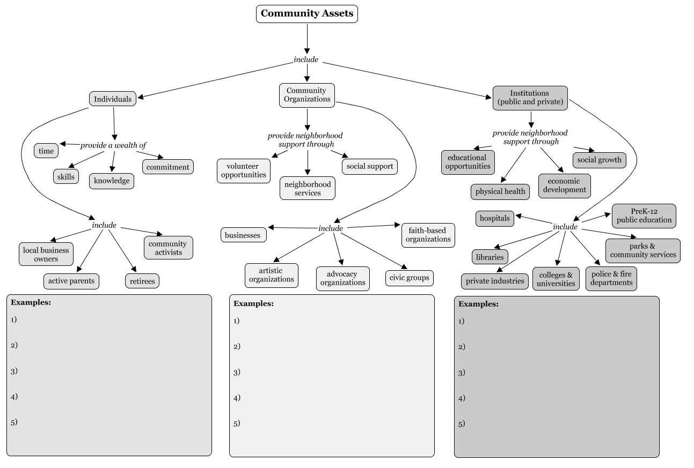
Asset Mapping
Merten, Barr, Monroe-Ossi, King, Griner, & Vosoughi, 2014.
Notes:
Depending on your communication campaign objectives, the assets that you outline may vary. It is, however, recommended that you try to create as comprehensive asset map as possible. This figure illustrates a method for organizing the components of your asset map. A comprehensive asset map can help you better understand the ecological context and could give insight to new collaborations, or new mediums through which to promote this particular campaign and your future work in the community. For more on how to map community assets, visit the Community Tool Box.

Slide 60
Check Point
True or False?
Asset-based strategies do not help to produce long-term sustainable outcomes.
True – Incorrect.
False – Asset mapping is an important part of the assessment process and can help produce long-term sustainable outcomes.
Notes:
Let’s pause here for a brief knowledge check question before continuing with the remainder of the lesson.

Slide 61
Assessing the Health Problem
Assess Quality of Life and Community Assets
Assess Health Issue
Assess Behavioral and Environmental Risk Factors
Assess Determinants of Behavior
Summary Indicators | Healthy People 2020 Target | US | State | Source
Female breast cancer death rate | 20.7% | 20.8% (2013) | 19.6% (2013) | US: NVSS-M FL: NVSS-M
Prostate cancer death rate | 21.8% | 19.2% (2013) | 17.3% (2013) | US: NVSS-M FL: NVSS-M
Adults meeting aerobic physical activity and muscle-strengthening federal guidelines (age adjusted, ≥18 years) | 20.1% | 20.8% (2013) | 19.9% (2013) | US: NHIS FL: NHIS
Adolescents in grades 9 through 12 meeting aerobic physical activity federal guidelines | 31.6% | 27.1% (2013) | 25.3% (2013) | US: YRBSS FL: YRBSS
Notes:
Now that you have a better understanding of the quality of life concerns and assets in your community of focus, it is time to dig into the data on the specific health issue you plan to address. Terms like data mining are common among marketing strategists. The term is somewhat of a misnomer because it implies a heavy focus on finding data. However, the important part of data mining is the knowledge and insights that are extracted from the data. The way that the data are presented can improve your ability to derive insights from your assessment of the prevalence, incidence, morbidity and mortality related to the specific health issue being addressed. In conducting this assessment, it may be helpful to access databases that have information on incidence, prevalence and other population health statistics. For a list of helpful databases, see the Guide to Making Communication Campaigns Evidence-Based.
You probably already have some background information and health objectives in your communication or media plan. This is an opportunity to expand or update the data, as necessary, and refine your S.M.A.R.T. health objective.
Compiling statistics based on your literature review and your communication campaign objectives can be time consuming but is necessary to set you up to evaluate your efforts. This table illustrates one way to visualize data in a format that compares state statistics to national data, and then to benchmarks like those outlined in Healthy People 2020. Green numbers indicate where the state is performing better than the U.S. average and the Healthy People 2020 target, if available. Comparing statistics can guide you in defining specific, measurable and realistic S.M.A.R.T. objectives for your campaign.

Slide 62
Assessing Behavioral and Environmental Risk Factors
Assess Quality of Life and Community Assets
Assess Health Issue
Assess Behavioral and Environmental Risk Factors
Assess Determinants of Behavior
Environment
Genetics
Behavior
Determinants of Health
Health Services
Social Factors
Policies
Office of Disease Prevention and Health Promotion, 2014
Notes:
Health status can be thought of as a combination of several factors: genetics, environment, behavior, social factors, health services and policies, commonly referred to as determinants of health. You cannot change genetics with a communication campaign, but it is important to remember that it does play a role in health status. In continuing the systematic community assessment to define the health problem and identify an intended audience or priority population you have already assessed quality of life, community assets and the health issue. Now, you look to identify major behavioral and environmental risk factors that contribute to the health issue.
Information on risk factors may be included in your communication plan or state cancer plan already. Further literature review and dialogue with community members can help elucidate any lesser known contributing factors.

Slide 63
Assessing Determinants of Behavior
Assess Quality of Life and Community Assets
Assess Health Issue
Assess Behavioral and Environmental Risk Factors
Assess Determinants of Behavior
Decision Matrix
Behavior
Predisposing Factors
Enabling Factors
Reinforcing Factors
 | More Important | Less Important
More Changeable | High priority for program focus | Low priority for program focus, except to demonstrate a “quick win” for political purposes
Less Changeable | Priority for innovative program but evaluation is crucial | Not a priority
Green et al., 2005
Notes:
After outlining the behavioral and environmental risk factors for the health issue that is reducing quality of life in your community, you now need to determine what factors predispose, enable or reinforce the risky behaviors. Typical things to consider here are psychosocial factors such as knowledge, attitudes, beliefs, self-efficacy, social norms, intentions as well as skills, access, cultural factors, language, neighborhood or school environment, etc. Don’t forget to consider the multiple levels of the social ecological model we looked at in Lesson 1. You likely already are aware of some of these factors but a thorough literature review will give you a full picture of the various potential factors you could intervene on to make progress toward change.
One thing to consider in selecting determinants to focus your campaign on is how important it is and how changeable. If a behavior or determinant of that behavior is very important in influencing health, and can be easily changed, it should absolutely be a focus of your campaign. For behaviors or determinants that are important but difficult to change, it might be a focus but you’ll need to plan an innovative approach and evaluate outcomes often to see if you are making an impact. If a behavior or determinant is less important but easily changed, it might be an initial focus of your campaign to show a quick win and garner additional political support for your program. Finally, if a behavior or determinant is neither important nor changeable, you should not waste limited resources focusing on it.
Once you have identified the determinants you wish to focus on, then you can start to look for an evidence-based approach to address the determinants. Lesson 1 included some suggestions for where and how to identify various evidence-based approaches and Lesson 3 will discuss adapting an evidence-based approach to your context. In selecting an approach, assessing its fit with your organization’s resources, policies and abilities as well as fit with the community’s needs and preferences will be important. Development of key partnerships and involvement of community assets identified in the community assessment can help offset any gaps in capacity within your organization.

Slide 64
Case Study
Notes:
Let’s look at a case study. Imagine your state cancer plan has this objective: “To reduce new cervical cancer cases in [state] by vaccinating against human papillomavirus (HPV) infections.”

Slide 65
Case Study
To reduce new cervical cancer cases in state by vaccinating against human papillomavirus (HPV) infections.
Assess Quality of Life and Community Assets
Assess Health Issue
Assess Behavioral and Environmental Risk Factors
Assess Determinants of Behavior
Conduct a literature review and learn how cervical cancer impacts quality of life indicators
Create a document that illustrates organizations and services relevant to adolescent and women’s health and wellbeing
Review state cancer profile and Healthy People 2020 targets
Update health objective with a more recent baseline and realistic target for change
Through literature review you learn there are several known risk factors for cervical cancer
Identify two strongest, best documented, and most changeable determinants of cervical cancer
Set behavioral objective
Identify several factors that influence whether or not an adolescent gets vaccinated against HPV
Based on information set a communication objective focuses on providers
Notes:
Let’s walk through each of the phases of a community assessment.
Phase 1: Assess Quality of Life and Community Assets
You know that cervical cancer incidence rates are higher in your state than the national average and that pockets of the population experience disparities. You conduct a literature review and learn further how cervical cancer impacts various quality of life indicators including physical and economic wellbeing. At the state level it is difficult to do a true community asset map, but you create a document that illustrates non-profits, clinical organizations and public services that are relevant to adolescent and women’s health and wellbeing.
Phase 2: Assess the Health Issue
After reviewing the latest state cancer profile and Healthy People 2020 targets, you are able to update your health objective with a more recent baseline and realistic target for change: To reduce new cervical cancer cases in [state] from approximately 8.0 to 7.2 per 100,000 population by 2020.
Phase 3: Assess Behavioral and Environmental Risk Factors
Through literature review you learn that there are several known risk factors for cervical cancer including age, race/ethnicity, family history, cigarette smoking, and reproductive behaviors, among others. Long-term use of oral contraceptives, number of full-term pregnancies, and young age at first full-term pregnancy have all been shown to increase a woman’s risk of cervical cancer. The two strongest, best documented, and most changeable determinants of cervical cancer are failure to follow screening guidelines and persistent infection with HPV subtype 16 or 18.
Risk factors for HPV infection include age, particular races/ethnicities and poverty level as well as sexual behaviors including young age at sexual debut, number of lifetime sex partners, and number of sex partners within the past year.
Failure to vaccinate against HPV infection is a primary risk factor for cervical cancer, so you set your behavioral objective to the following: Increase the coverage level of 3 doses of HPV vaccine for girls aged 13 to 15 years from 16.6% to 50% by 2018.
Phase 4: Assess Determinants of Behavior
Again through literature review you learn that several factors influence whether or not an adolescent gets vaccinated against HPV including, lack of strong provider recommendation, low parental vaccine acceptability (awareness and knowledge about HPV, cervical cancer, and vaccine safety + perceived susceptibility of child to HPV infection + belief that the vaccine will condone or encourage risky sexual behavior in vaccinated daughters) and lack of access to vaccination (health insurance status, socioeconomic status, language, literacy). Based on this information, one of your communication objectives is: Increase the number of providers giving a strong recommendation for HPV vaccination at adolescent visits for girls 11-12 years old from 64.4% to 80% by 2016.

Slide 66
Campaign Roadmap
What quality of life or public health problem did you uncover and what can a communication campaign do to lead to positive change?
What are some behavioral and environmental risk factors for the health problem?
What awareness, knowledge or attitudes do you want to change through the communication efforts?
Gay & Lesbian Alliance Against Defamation (GLAAD) & the Movement Advancement Project (MAP), 2008.
Notes:
Now that the systematic community assessment has been completed, it is time to put the campaign plan into a format that will illustrate how the campaign will achieve its desired impact. This is your campaign roadmap, also referred to as a logic model.
It may help to think through these questions:
What quality of life or public health problem did you uncover and what can a communication campaign do to lead to positive change?
Looking back at the community assessment, what are some behavioral and environmental risk factors for the health problem?
What awareness, knowledge or attitudes do you want to change through the communication efforts?

Slide 67
Campaign Roadmap
IF
THEN
Inputs
Outputs
Outcomes – Impact
Activities
Participation
Short
Medium
Long
IF
THEN
University of Wisconsin, 2008.
Notes:
With your health problem and campaign objectives defined, and a priority population identified, you can now lay out your communication campaign roadmap. A campaign roadmap, often called a logic model in public health, is a diagram that illustrates what your campaign hopes to achieve and how you expect that change to happen. Defining your campaign goal and outlining the objectives of the campaign will help you identify what activities need to take place to lead to the desired outcomes and what resources, or inputs, you need to carry out the activities. This process can be thought of as backwards planning; you first determine what you want to change and then you plan how you think you can make that happen, and finally what you need to implement your plan. Think of the roadmap as a series of “IF, THEN” statements. For example, If the inputs or resources are used to implement the campaign, then the following activities can occur. If the outputs occur as planned, then the desired outputs can be achieved.

Slide 68
Campaign Roadmap
Identify the products, short-term, intermediate and long-term outcomes for your program
Link outcomes to each other and to program activities using the identified logic/theory/model for your program (illustrate cause and effect)
Incorporate findings from research and demonstration projects
Select indicators to measure outcomes depending on the stage of your program’s development
Illustrate why the program is important as well as its fundamental purpose
Depict what intermediate outcomes/products must occur before long-term outcomes will be evident
Make mid-course adjustments and improvements in your program
Become a common reference point for staff, stakeholders, constituents and funding agency
Centers for Disease Control, N.d.
Notes:
A roadmap or logic model is useful in communicating to stakeholders the objectives of your campaign and how they will be achieved as well as in focusing the evaluation by making assumptions and expectations for your communication campaign explicit. By outlining the program inputs and showing how they are linked to the desired outcomes to impact health, the roadmap can illustrate the theory behind your evidence-based campaign. Roadmaps can be used to:
Identify the products, short-term, intermediate and long-term outcomes for your program
Link outcomes to each other and to program activities using the identified logic/theory/model for your program (illustrate cause and effect)
Incorporate findings from research and demonstration projects
Select indicators to measure outcomes depending on the stage of your program’s development
Illustrate why the program is important as well as its fundamental purpose
Depict what intermediate outcomes/products must occur before long-term outcomes will be evident
Make mid-course adjustments and improvements in your program
Become a common reference point for staff, stakeholders, constituents and funding agency

Slide 69
Case Study
Notes:
Let’s return to our case study about cervical cancer and HPV.

Slide 70
Case Study
Health-Related Quality of Life Issue | Cervical cancer causes premature death in women, disrupting economic and family stability |  | Campaign Goal, Overall Impact Goal | To reduce new cervical cancer cases in [state], thus improving quality of life for women and their families.
Specific Health Problem | State cervical cancer rates are above the national average and fall short of Healthy People 2020 goals |  | Health Objective | To reduce new cervical cancer cases in [state] from approximately 8.0 to 7.2 per 100,000 population by 2020.
Behavioral and Environmental Risk Factors | Parents are failing to vaccinate their children during the recommended 11-12 year range |  | Behavioral Objective | Increase the coverage level of 3 doses of HPV vaccine for girls aged 13 to 15 years from 16.6% to 50% by 2018.
Determinants of Health | A strong provider recommendation is the strongest predictor of a parent’s decision to vaccinate a child |  | Communication objective | Increase the number of providers giving a strong recommendation for HPV vaccination at adolescent visits for girls 11-12 years old from 64.4% to 80% by 2016.
Notes:
In the case study, we found that the health-related quality of life issue was that cervical cancer causes premature death in women, disrupting economic and family stability. The campaign goal, then, could be to reduce new cervical cancer cases in [state], thus improving quality of life for women and their families.
The specific health problem is that state cervical cancer rates that are above the national average and fall short of Healthy People 2020 goals. The health objective, then, could be to reduce new cervical cancer cases in [state] from approximately 8.0 to 7.2 per 100,000 population by 2020.
The behavioral and environmental risk factors include parents failing to vaccinate their children during the recommended 11-12 year range. The behavioral objective, then, could be to increase the coverage level of 3 doses of HPV vaccine for girls aged 13 to 15 years from 16.6% to 50% by 2018.
The assessment of determinants of health found that a strong provider recommendation is the strongest predictor of a parent’s decision to vaccinate a child. The communication objective, then, could be to increase the number of providers giving a strong recommendation for HPV vaccination at adolescent visits for girls 11-12 years old from 64.4% to 80% by 2016.

Slide 71
Campaign Roadmap
Roadmap can be simple or complex
Roadmap must communicate theory of your program by showing the link between the identified resources, activities, products/outputs, outcomes and impact
Roadmap can be a space to include assumptions or external factors that might affect the campaign
Centers for Disease Control, N.d.
Notes:
There is no single standard for what a roadmap should look like. It can be simple or complex depending on the stakeholder audience and complexity of your campaign. However, regardless of how you choose to display the information, it must communicate the theory of your program by showing the link between the identified resources, activities, products/outputs, outcomes and impact. Further, the roadmap can be a space to include assumptions or external factors that might affect the campaign.

Slide 72
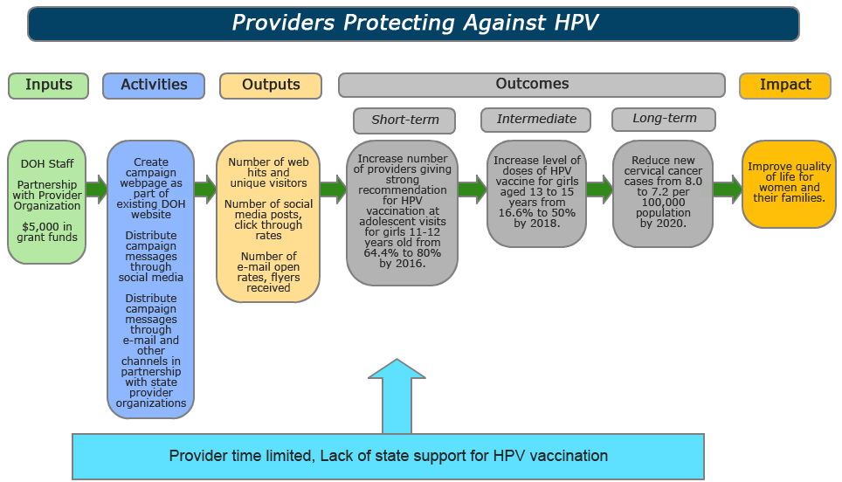
Campaign Roadmap
Centers for Disease Control, N.d.
Notes:
Let’s look at each section of this sample campaign roadmap that matches our cervical cancer and HPV case study. Start with the audience and campaign goal. Ask yourself: Who are you trying to reach and what is our ultimate goal? If you try to reach everyone, you will reach no one. The activities and outputs in your roadmap must always tie back to your audience. An effective campaign roadmap usually includes some indication of the overall campaign goal, including who the intended audience is as well as the name of the campaign.
Let’s look at the campaign impact. What was the ultimate goal of your campaign in improving health-related quality of life? A comprehensive campaign roadmap will also note the desired impact of the campaign. Impacts are seen after the long-term outcomes and refer to even broader-level change compared to long-term outcomes. Impact is the overall campaign goal and relates back to the original quality of life issue you aimed to address. Often, the impact is very long-term societal, economic, civic or environmental change. This can be difficult to measure and harder to attribute to your campaign alone, but a well laid out roadmap can illustrate how you campaign may have contributed to the desired impact.
Now let’s look at the campaign outcomes. Ask Yourself: What changes will your campaign bring about? Outcomes or results can be short-term, intermediate and long-term. These are the measurable and specific changes observed as a result of the campaign. The outcomes should list targets in the roadmap. Short-term outcomes are usually related to the participants or the campaign audience and are achieved within one to three years. When creating a health communication campaign, these are related to the communication objectives to change knowledge, skills attitudes, etc. The intermediate and long-term outcomes are expected to be achieved later, sometimes as long as two to six years after the campaign has been launched. Intermediate outcomes are related to change objectives in behaviors, policies or practices and long-term outcomes are related to the campaign’s health objectives.
Now let’s look at the campaign outputs. Ask Yourself: What, and how many, tangible products will be created? Outputs are the tangible accomplishments resulting from the activities and typically link the activities with the campaign’s audience(s) or short-term outcomes. Outputs can be thought of in terms of your campaign’s “reach.”
Now let’s look at the campaign activities
Ask Yourself: What are the main functions that the program will do or provide?
Activities are the actual events or interventions that will occur, using the defined inputs, in implementing the campaign. Activities include processes, events and actions.
Now let’s look at the campaign inputs. Ask Yourself: What resources will be needed to carry out the planned activities? Inputs typically include things like time, human resources such as staff or volunteers, collaborations with organizational or community partners, community assets, financial resources such as grant funding or in-kind donations and physical resources like space, brochures, raw materials or other supplies. Your planned activities should be feasible with the resources you have available and this section of the roadmap should capture everything you need to accomplish your program objectives.
An additional section that is included in many campaign roadmaps is an assessment of external factors and assumptions. The context or conditions under which you are implementing your campaign can significantly influence the process or outcomes of the campaign. Being aware of potential factors that could detract from or augment the effectiveness of your campaign is imperative. Note these external factors that can negatively or positively influence program success and sustainability in your roadmap during campaign planning. For example, the socioeconomic status of your audience, current political climate or other factors from the community assessment that you cannot control. Assumptions are other factors that must be taken into consideration when assessing the campaign’s success. While the rest of the roadmap communicates specific processes by which outcomes will be achieved, the underlying assumptions of the intervention can play a substantial role in affecting these outcomes. For example, you might make certain assumptions about the level of participation or reach you will achieve with your campaign.

Slide 73
Resources
Community Tool Box: Models for Promoting Community Health and Development
Local Tax-Exempt Hospitals’ Community Health Needs Assessment Reports
Notes:
Here are some further readings and resources you can access on the topic of Communication Campaign Background and Justification.
These and other resources are included in the Guide to Making Communication Campaigns Evidence-Based in the learning management system.

Slide 74
Conclusion
Conduct a systematic community assessment to define the health issue and intended audience for a communication campaign
Develop a communication campaign roadmap
Notes:
In this lesson, you learned to:
Conduct a systematic community assessment to define the health issue and intended audience for a communication campaign
Develop a communication campaign roadmap

Slide 75
This concludes the lesson.
Please exit and return to the learning management system.
EXIT
Notes:
This concludes the lesson.

Slide 76
Making Communication Campaigns Evidence-Based
Communication Training for Comprehensive Cancer Control Professionals 102
Lesson 3: Communication Campaign Messages, Tactics and Channels for Intended Audiences
Notes:
Welcome to lesson 3: Communication Campaign Messages, Tactics and Channels for Intended Audiences.

Slide 77
Acknowledgments
This work was supported by Cooperative Agreement #1U38DP004972-03 from the Centers for Disease Control and Prevention. Its contents are solely the responsibility of the authors and do not necessarily represent the official views of the Centers for Disease Control and Prevention.
Special thanks to:
Monique Turner, PhD, Milken Institute School of Public Health
Jerry Franz, Milken Institute School of Public Health
Julia Thorsness, Alaska Department of Health and Social Services
Keylee Wright, MA, Indiana State Department of Health
The content and competencies in this training are based on content from the National Cancer Institute’s publication “Making Health Communication Programs Work” and the Seven Areas of Responsibility for Health Education Specialists, 2015. The training was also influenced by the work of the Cancer Prevention and Control Research Network (CPCRN) and its “Putting Public Health Evidence into Action” training curriculum.
Notes:
We would like to acknowledge the Centers for Disease Control and Prevention for supporting this work. We would also like to thank Dr. Monique Turner, Associate Professor, and Jerry Franz, Adjunct Instructor, at the Department of Prevention and Community Health at the Milken Institute School of Public Health of the George Washington University for their contributions to content development and review. We would also like to thank Julia Thorsness, Program Coordinator, Comprehensive Cancer Control, Alaska Department of Health and Social Services and Keylee Wright, MA, Director, Cancer Control Section, Indiana State Department of Health for their thoughtful feedback on the initial draft. The competencies in this training are based on content from the National Cancer Institute’s publication “Making Health Communication Programs Work” also known as “The Pink Book” and the Seven Areas of Responsibility for Health Education Specialists, 2015. This training was also influenced by the work of the Cancer Prevention and Control Research Network (CPCRN) and its “Putting Public Health Evidence into Action” training curriculum.

Slide 78
Competencies
Select or design strategies/interventions
Develop a plan for the delivery of health education/promotion
Address factors that influence implementation of health education/promotion
Identify, develop and deliver messages using a variety of communication strategies, methods and techniques
Notes:
This lesson will address the following competencies:
Select or design strategies/interventions
Develop a plan for the delivery of health education/promotion
Address factors that influence implementation of health education/promotion and
Identify, develop and deliver messages using a variety of communication strategies, methods and techniques

Slide 79
Learning Objectives
Describe strategies to identify audience characteristics and habit
Create key messages and take-home messages
Identify best-practices for specific communication channels to reach intended audience
Describe ways to adapt an evidence-based intervention to intended audience
Identify methods to pretest campaign messaging and materials
Notes:
After completing this lesson, you will be able to:
Describe strategies to identify audience characteristics and habit,
Create key messages and take-home messages,
Identify best-practices for specific communication channels to reach intended audience,
Describe ways to adapt an evidence-based intervention to intended audience, and
Identify methods to pretest campaign messaging and materials.

Slide 80
Audience
National Cancer Institute, 2004.
Notes:
Campaigns should focus on one, at most two, intended audiences. Although we suspect the campaign will reach more people than those you are targeting, it is recommended that you distinguish and focus on one segment of the population, also known as the primary audience, to affect change. Secondary audiences are “those with influence” on the primary intended audience. For example, your campaign may primarily be designed to encourage colorectal cancer screening among African American men 50-75 years old, a secondary audience would likely be the spouses or domestic partners of those men.

Slide 81
Audience Segmentation
The process of defining subgroups of a population according to common characteristics”
Can “help you develop messages, materials and activities that are relevant to the intended audience’s current behavior and specific needs, preferences, beliefs, cultural attitudes [and] knowledge” as well as media use and habits
National Cancer Institute, 2004.
Notes:
Audience segmentation is the process of “defining subgroups of a population according to common characteristics” and can “help you develop messages, materials and activities that are relevant to the intended audience’s current behavior and specific needs, preferences, beliefs, cultural attitudes [and] knowledge” as well as media use and habits. There is no such thing as a “general public” in the public health marketing context: one approach will not engage all people. How each group of people interprets and views the health issue varies, and therefore how each group engages with your communication campaign’s messages will vary.

Slide 82
Audience Segmentation
Identify a spectrum of potential audiences defined by commonalities (e.g. attitudes, behaviors or how they would relate to program components)
Understand the beliefs, attitudes and behaviors of those audiences related to lifestyle issues (e.g. weight control, nutrition and physical activity)
Select one or more intended audiences based on variety of perspectives, such as degree of health risk, likelihood to respond to a program strategy and short- versus intermediate or long-term goals
Tailor behavior change programs or create calls to action most salient to interests and concerns of intended audiences
Identify appropriate communication channels (e.g. social media advertisements, public service announcements and billboards) for promotion and dissemination of program strategies
Centers for Disease Control and Prevention, 2015.
Notes:
Audience segmentation allows the campaign planner to:
identify a spectrum of potential audiences defined by commonalities (such as attitudes, behaviors or how they would relate to program components);
understand the beliefs, attitudes and behaviors of those audiences related to lifestyle issues (such as weight control, nutrition and physical activity);
select one or more intended audiences based on variety of perspectives, such as degree of health risk, likelihood to respond to a program strategy and short- versus intermediate or long-term goals;
tailor behavior change programs or create calls to action most salient to interests and concerns of intended audiences; and
identify appropriate communication channels (such as social media advertisements, public service announcements and billboards) for promotion and dissemination of program strategies.

Slide 83
Audience Segmentation
Determine which audience segments have the biggest needs
Consider if this audience is persuadable
Decide which segment of the audience has the most influence and impact
Ask if it is realistic to reach this intended audience
Notes:
To understand your intended audience’s attitudes and behaviors related to the specific health outcomes your campaign hopes to influence, employ the literature review and data analysis skills you learned about in Lessons 2. If there is no literature or data available on the population that you are working with, it is best to employ the techniques described in Lesson 2 and conduct formative research and community assessments to better characterize your intended audience. It may be helpful to consider the feasibility of your S.M.A.R.T. objectives during this formative research: remember that the “M” in SMART represents “measurable,” so start to consider what you want to and are able to measure to demonstrate the effects of your campaign. For more on SMART objectives, refer to “Lesson 3: Media Planning and Strategic Principles in Public Health Communication” in Communication Training 101.
The following are four methods to use when narrowing down your intended audience:
Determine which audience segments have the biggest needs,
Consider if this audience is persuadable,
Decide which segment of the audience has the most influence and impact, and
Ask if it is realistic to reach this intended audience

Slide 84
Key Messages
What is the key message you want to convey to your audience?
What do you want your audience to take away from your campaign?
“If-then” statements
Two to three key messages
Notes:
Having identified and gained a better understanding of your intended audience, you can make effective decisions about the kinds of messages you want to employ in your communication campaign. What is the key message you want to convey to your audience? What do you want your audience to take away from your campaign? This is your key message, also known as a take-home message. You probably want to narrow your campaign to 2-3 key messages to keep your campaign materials focused. One tip to help you articulate your key message is to think about what promises you are making in your campaign. Let’s see how to do this through if-then statements.

Slide 85
Key Messages
If you are age 60 or older and get colorectal cancer screening, then you can reduce your risk of dying from colorectal cancer by up to 70%
Screening can reduce your risk of dying from colorectal cancer by up to 70%. There are several screening options available. Talk to your doctor about getting screened.
Most health insurance plans cover colorectal cancer screening that can save your life. Call your doctor today.
National Cancer Institute, 2015.
Notes:
Once you have your campaign promise solidified, you can start to adapt them to fit your primary and secondary intended audiences to create campaign messages. Let’s look at an example of an “if-then” key promise and campaign messages that could be developed from it. “If you are age 60 or older and get colorectal cancer screening, then you can reduce your risk of dying from colorectal cancer by up to 70%.” Campaign messages that could be developed from this if-then key promise might include the following: “Screening can reduce your risk of dying from colorectal cancer by up to 70%. There are several screening options available. Talk to your doctor about getting screened,” “Most health insurance plans cover colorectal cancer screening that can save your life. Call your doctor today.”
Next, we will cover several different ways to frame messages and present evidence.

Slide 86
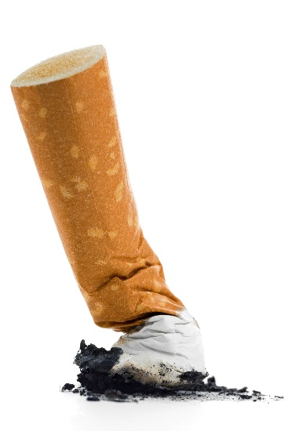
Social Norms Marketing Messages
Perception of norm
Behavior
Shepherd, Meteyer, Bruzios, Pol, & Charpentier, 2016; Baer, Stacy, & Larimer, 2015; Pederson & LaBrie, 2008.
Notes:
Messages in “Social Norms Marketing” focus on stating the actual commonality of any given health behavior. The hope is that by using this messaging approach, the audience will adjust their perception of the norm and ultimately, adjust their likelihood of engaging in the behavior.
Social Norms Marketing came about because studies consistently found that when people over-perceive certain risky behaviors, they are more likely to engage in that behavior as well. In other words, there is a positive correlation between perception and behavior. For example, public health issues such as smoking perpetuate among social groups because the prevalence of that behavior is over-perceived: About 15 years ago, surveys among college students indicated a perception that “everyone smokes.” However, data revealed that far fewer college students smoked than they perceived. This normative misperception was also pervasive for alcohol consumption behaviors, with college and high school students believing that more of their peers were consuming alcohol than they actually were. In such instances, norm messaging may be employed to reset the intended audience’s perceived norm.

Slide 87
Framing the Message
Loss Frame Messaging
Emphasizes behavior risk
Gain Frame Messaging
Emphasizes behavior benefits
Rothman, Bartels, Wlaschin, & Salovey, 2006.
Notes:
In planning, you should consider how the messages should be framed or presented to manage how your audience reacts. There are two types of framing in public health communication: loss frame and gain frame. Loss frame emphasizes the risk of a behavior. For example, a loss frame anti-smoking campaign will emphasize the dangers and consequences of smoking. A gain frame anti-smoking campaign will emphasize the benefits of quitting.
In their article “The Strategic Use of Gain- and Loss-Framed Messages to Promote Healthy Behavior: How Theory Can Inform Practice”: Alexander Rothman and colleagues explain: “It is important to note that gain-framed statements can refer to both good things that will happen and the bad things that will not happen, whereas loss-framed statements can refer to bad things that will happen and good things that will not happen.”

Slide 88
Framing the Message
Gain Frame Messaging
Protect yourself
from the sun and you
will help yourself
stay healthy.
Loss Frame Messaging
Expose yourself to
the sun and you will
risk becoming sick.
Detweiler, Bedell, Salovey, Pronin, & Rothman, 1999.
Notes:
Here’s an example of sun protection behavior messages. A 1999 study compared 2 gain framed messages and 2 loss framed messages and found that participants who read either of the 2 gain-framed brochures, compared with those who read either of the 2 loss-framed brochures, were significantly more likely to request sunscreen, intend to repeatedly apply sunscreen while at the beach, and intend to use sunscreen with a sun protection factor of 15 or higher.
Reference: Health Psychol. 1999 Mar;18(2):189-96.
Message framing and sunscreen use: gain-framed messages motivate beach-goers.
Detweiler JB¹, Bedell BT, Salovey P, Pronin E, Rothman AJ.

Slide 89
Framing the Message
Screening Loss Framed Message
Screening Gain Framed Message
Health Promotion Loss Framed Message
Emphasizes behavior risk
Emphasizes risk of noncompliance
Emphasizes benefits of compliance
“By not getting the HPV vaccine, you may make it more likely for you to develop genital warts and/or cervical cancer”
“When a woman gets regular mammograms, she is doing her best to detect breast cancer early. And, detecting breast cancer early can save her life”
“When a woman does not get regular mammograms, she is not doing her best to detect breast cancer early. And, failing to detect breast cancer early can cost her life.”
Health Promotion Gain Framed Message
Emphasizes behavior benefits
“By getting the HPV vaccine, you may make it less likely for you to develop genital warts and/or cervical cancer”
O’Keefe & Jensen, 2007; Nan, 2012; Schneider et al., 2001.
Notes:
Numerous studies have examined the effects of different messages on health promotion and disease detection behaviors. Generally speaking, most research suggests gain-framed appeals are more effective promoting behaviors that prevent diseases, such as exercise or sunscreen use, whereas loss-framed appeals are more effective when targeting behaviors that detect diseases, such as cancer screening.
Now let’s take a look at some examples of disease detection and health promotion messages stated in loss and gain frame. A screening message in loss framing, emphasizes the risk of noncompliance with the desired screening behavior. For example, a pamphlet might say, “When a woman does not get regular mammograms, she is not doing her best to detect breast cancer early. And, failing to detect breast cancer early can cost her life.”
On the other hand, the less-effective gain framed screening message emphasizes the benefits of compliance and might read, “When a woman gets regular mammograms, she is doing her best to detect breast cancer early. And, detecting breast cancer early can save her life.”
For promoting prevention behaviors other than screening, gain-framed messages that emphasize the benefits of the health promotion behavior are often most effective. For example a radio ad might say, “By getting the HPV vaccine, you may make it less likely for you to develop genital warts and/or cervical cancer.”
Less-effective loss-framed prevention messages emphasize the behavior’s risk such as in this example: “By not getting the HPV vaccine, you may make it more likely for you to develop genital warts and/or cervical cancer.”
However, the existing body of literature also highlights the importance of pre-testing messages with the intended audience because several studies show no true difference in effectiveness between message frames for certain behaviors or audiences, and others show only a small statistically significant difference.
For example, one meta-analytic review of 53 studies conducted by Daniel O’Keefe and Jakob Jensen found that in messages aimed at encouraging disease detection behaviors, loss-framed appeals (emphasizing the disadvantages of noncompliance with the communicator's recommendation) are only slightly more persuasive than gain-framed appeals (emphasizing the advantages of compliance). They explain, “Loss-framed appeals showed a small statistically significant advantage for messages advocating breast cancer detection behaviors, but not for any other kind of detection behavior (such as skin cancer, other cancers, dental problems, or miscellaneous other diseases) nor for all other kinds of detection behaviors combined. Thus, in advocacy of disease detection behaviors, using loss-framed rather than gain-framed appeals is unlikely to substantially improve persuasiveness.”
References: J Health Commun. 2007 Oct-Nov;12(7):623-44.
The relative persuasiveness of gain-framed and loss-framed messages for encouraging disease prevention behaviors: a meta-analytic review.
O'Keefe DJ¹, Jensen JD.
HPV Vax sample message from: Health Commun. 2012;27(1):10-8. doi: 10.1080/10410236.2011.567447. Epub 2011 Jun 14.
Communicating to young adults about HPV vaccination: consideration of message framing, motivation, and gender.
Nan X¹.
Mammography sample message from: Health Psychol. 2001 Jul;20(4):256-66.
The effects of message framing and ethnic targeting on mammography use among low-income women.
Schneider TR¹, Salovey P, Apanovitch AM, Pizarro J, McCarthy D, Zullo J, Rothman AJ.

Slide 90
Check Point
Which of the following is an example of Gain Frame messaging?
If you smoke, you are 15 to 30 times more likely to get lung cancer or die from lung cancer.
Incorrect. This is an example of loss frame messaging and emphasizes the behavior risk.
Quitting smoking can reduce your risk of developing lung cancer.
Correct. This is a gain frame message that emphasizes the benefits of a behavior.
Exposure to radon is the second leading cause of lung cancer and increases your risk of developing the disease.
Incorrect. This is an example of loss frame messaging and emphasizes the behavior risk.
7,300 people who have never smoked die from lung cancer each year due to exposure to secondhand smoke.
Incorrect. This is an example of loss frame messaging and emphasizes the behavior risk.
What are the risk factors for lung cancer? 2016.
Notes:
Let’s pause here for a brief knowledge check question before continuing with the remainder of the lesson.
Citation:
What are the risk factors for lung cancer? (2016, July 20). Centers for Disease Control and Prevention. Retrieved from http://www.cdc.gov/cancer/lung/basic_info/risk_factors.htm

Slide 91
Presentation of Evidence
How many of these root causes of a health issue should we bring up when we communicate about a public health issue?
Psychosocial Factors
Epidemiological Factors
Educational Factors
Ecological Factors
Administrative Factors
Political Factors
Notes:
As outlined in Lesson 1, making your communication campaign evidence-based is of utmost importance for its effectiveness, scalability and sustainability. When presenting evidence to your intended audience, it is important not to forget the reasons people engage in the risky behavior you are trying to change or aren’t engaging in preventive behaviors you are trying to promote. For example, think to yourself:
Why do people start smoking?
Why do people continue to smoke?
Why do some teenagers use tanning beds?
Why do people eat fast foods?
Why do some people avoid colorectal cancer exams?
Some of the answers you may have considered could include psychosocial, epidemiological, educational, ecological, administrative and political factors you identified in your community assessment in Lesson 2, such as peer pressure, stress, financial costs, lack of access to services, convenience or perceived embarrassment. This begs the question: How many of these root causes of a health issue should we bring up when we communicate about a public health issue?

Slide 92
Presentation of Evidence
One-sided message
Presents one side of an issue and ignores other opposing viewpoints
Can be persuasive for audiences whose attitudes are already in the desired direction
Two-sided message
Presents both sides of an issue and refutes the side that has little or no evidence or is dangerous
More effective, especially with audiences who are skeptical or need convincing
Arora & Arora, 2006; Erlinde, Cauberghe, & DePelsmacker, 2013; Hale, Mongeau, & Thomas, 1991; Allen, 1991; O’Keefe, 1993.
Notes:
A one-sided message is a message that only presents one side of an issue and ignores other opposing viewpoints. A two-sided message, also known as a two-sided refutational message, presents both sides of an issue and refutes the side that has little or no evidence or is dangerous.
Two-sided messages have been found to be more effective, especially with audiences who are skeptical or need convincing. Such audiences find two-sided messages more thoroughly researched, fair, honest and transparent. Perhaps more importantly, two-sided messages prompt the audience to think more critically about an issue. Skeptics also tend to find one sided messages unconvincing. However, for audiences whose attitudes are already in the desired direction, for example, if they are already anti-smoking, one-sided messages are persuasive. In this case, a one-sided message reminds the audience of what they believe in and aids the maintenance of those attitudes.

Slide 93
Emotional Appeals
Fear
Guilt
Hope
Humor
Shame
Lang & Yegiyan, 2008; Witte & Allen, 2000; Crawford & Okigbo, 2014; Bleakley , et al., 2015; Turner, 2011.
Notes:
Content analysis of public health communication materials shows that most of them contain neutrally phrased facts. However, people are most motivated to change their behavior when they experience emotion with regard to a health issue. Thus, campaigns may be more effective when they use emotional appeals. This is not to say we should abandon communicating facts and figures, but we also need to compel people to care about the health information. Research on the effects of emotional appeals has garnered the attention of practitioners and scholars alike in recent years. Often, people want to know what emotional appeals work best; but, the better question is: what emotional appeal is most effective with your particular audience, in this particular context? Most emotional appeals (except for shame) can work, as long as they are used at the correct time, with the correct audience, for the correct reasons. Overall, humanizing your campaign, whether it be humanizing your messages or the way you present it will be most effective. Let’s look at the best practices for five types of emotional appeals: fear, guilt, hope, humor and shame.

Slide 94
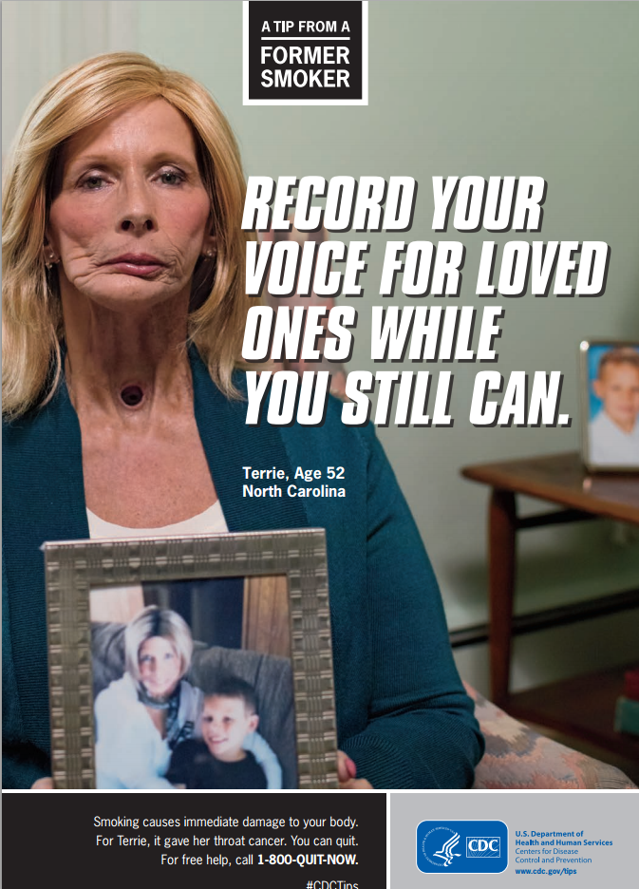
Fear Messaging
National Cancer Institute, 2014.
Notes:
Fear messages focus in on relevant threat(s) to the intended audience. The focus is on the severity of the threat and susceptibility of the audience to the threat. This kind of messaging is appropriate for most audiences as long as the concerns intended are real concerns for the audience but should probably be avoided with children. Fear messaging is most effective for changing risk perceptions, attitudes and intentions.

Slide 95
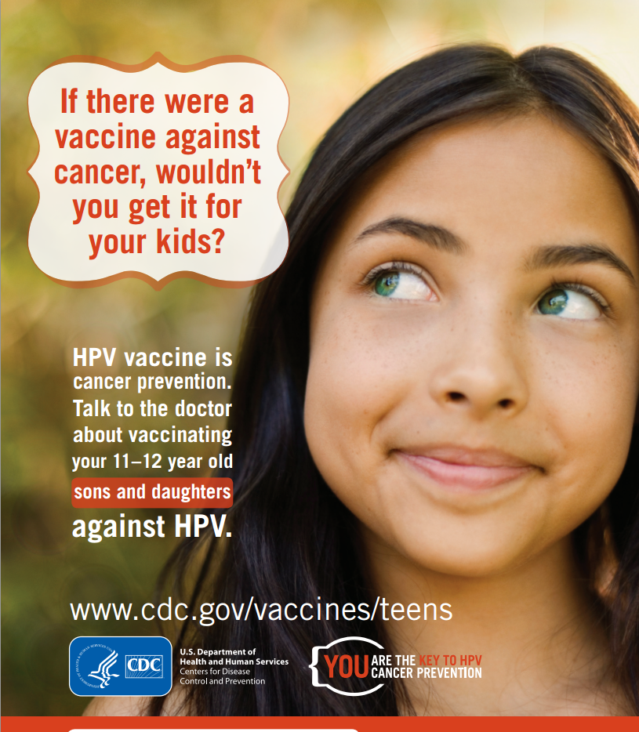
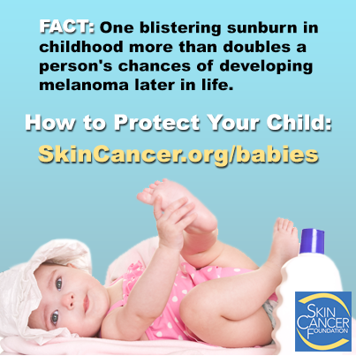
Guilt Messaging
National Cancer Institute, 2014.
Notes:
Guilt messages emphasize how the audience would feel if they engaged in a behavior that was below “their moral code” or that hurt relevant others. This kind of messaging is most effective with adults, and may be more effective with female audiences. It should be avoided with adolescents. Guilt messaging is most effective for changing risk perceptions, attitudes and intentions.

Slide 96
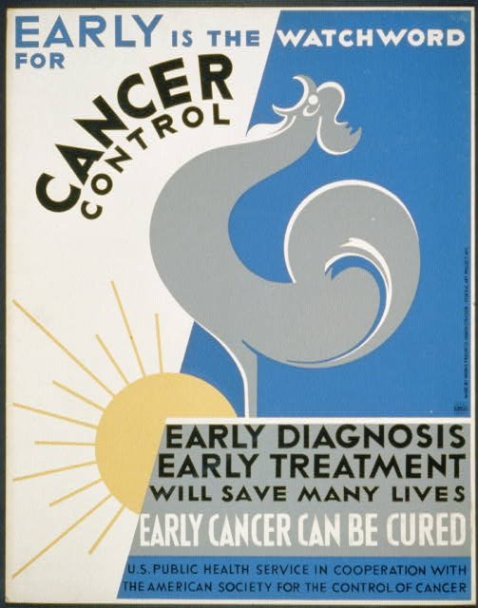
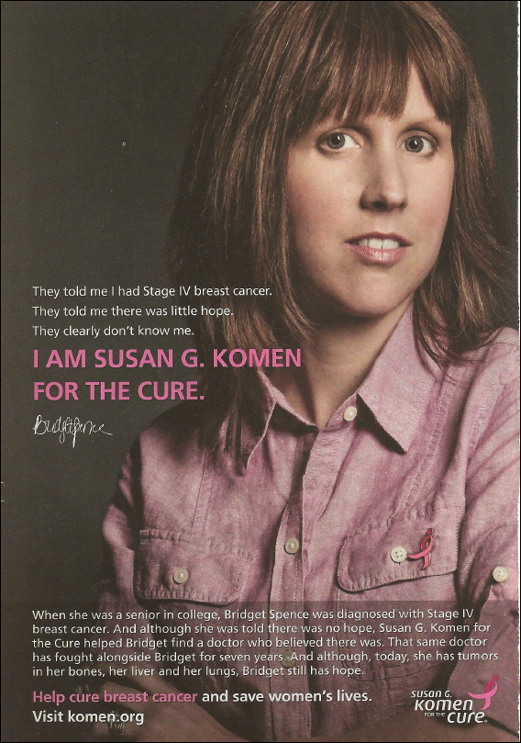
Hope Messaging
National Cancer Institute, 2014.
Notes:
Hope messages focus on uncertainty of consequences and emphasize the behaviors that can be conducted to diminish the uncertainty. This kind of messaging can work well with any audience, and works especially well with older adolescents and adults. Hope emotional messaging is most effective for causing changes in cognitions, emotions, message recall and attitudes.

Slide 97
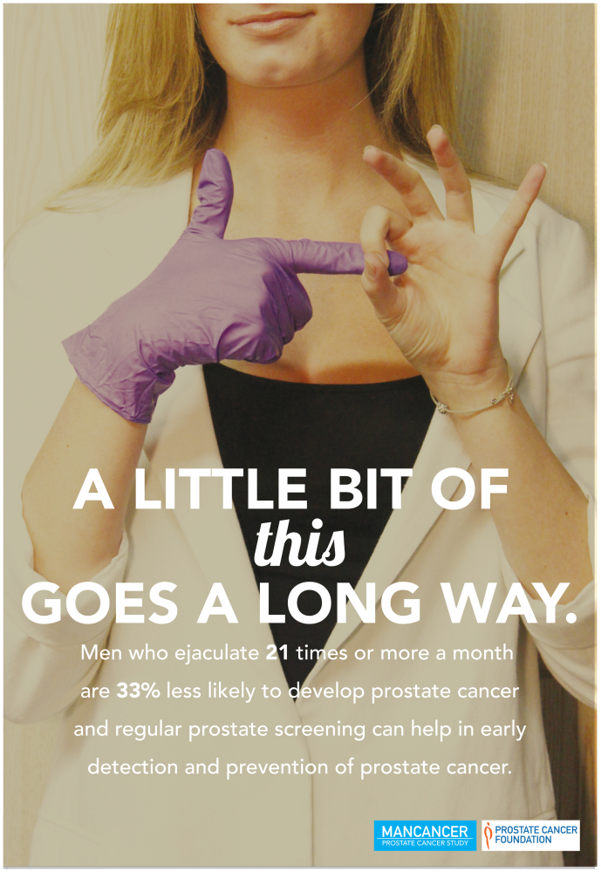
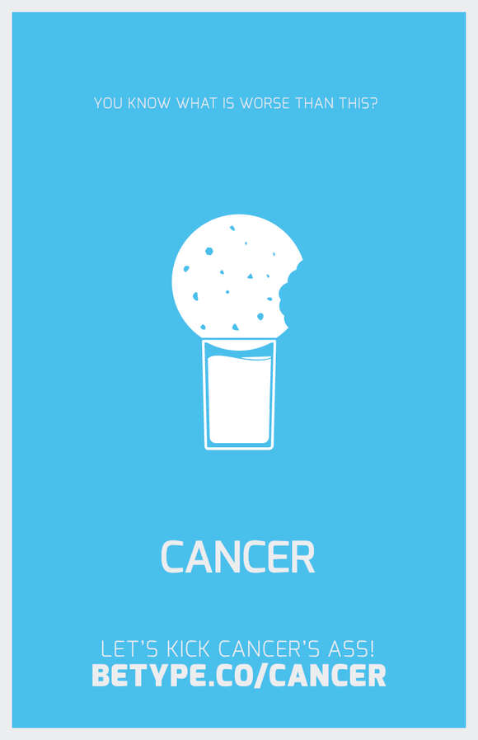
Humor Messaging
National Cancer Institute, 2014.
Notes:
Humor use a positive and humorous tone to grab attention to an issue. This kind of messaging is most effective with any audience - as long as they find the message humorous. The messages are most effective if the humor is related to the topic. Humor messaging is most effective for causing attention to the topic and message, but does not necessarily lead to attitude or intention changes.

Slide 98
Shame Messaging
National Cancer Institute, 2014.
Notes:
Shame messages focus on the intended audience’s personal characteristics that they should be ashamed of. This kind of messaging should be avoided at all costs with all audiences. Shame messaging causes feelings of shame, anger, and perceptions of being manipulated.

Slide 99
Communication Channels
Use the channel your intended audience uses
Distinguish channels your audience uses for personal vs. health information
Use an appropriate message tactic for the channel you use
Use multiple channels
Have a website for more in-depth health information and resources
Notes:
Now that you have a better understanding of your intended audience and message strategy, you can determine which media channels to use for your campaign. Let’s take a look at some general best practices to consider when developing your messaging for specific channels.
First, use the channel your intended audience uses: There are several databases that tell us who is using what channel, which can be reviewed in Lesson 1. For example, does your audience use smart phones? Do they read tabloid magazines? Where do they go to seek health information?
Second, distinguish channels your audience uses for personal reasons versus to receive health information. For example, an audience may prefer to learn about colorectal cancer screening recommendations on Twitter but not on Facebook, as many people regard Facebook as a more private space for friends and family only. Similarly, as we learned in Communication Training 101, journalists prefer that stories be pitched to them via Twitter or LinkedIn, but not Facebook.
Third, make sure you use a message tactic that is appropriate for the channel. For example, does your intended audience want a scary, negative message in their Facebook feed? Do people want graphic images of a stoma in TV ads? We must pilot test these assumptions and ensure that the kind of messaging we employ is appropriate for the channel used. Pilot testing messages will be addressed in more detail shortly.
Fourth, use multiple channels whenever it is appropriate or possible to maximize resources and widen the reach of your campaign.
Finally, have a dynamic, interesting and user-friendly website for your intended audience to navigate to for more in-depth health information and resources. For example, you may use posters to place around local community clinics to capture patients’ attention about survivorship services and direct them to a website with more information about specific support groups and resources.

Slide 100
Best Practices for Media Channels
Display Print Media: Posters, billboards
Appropriate for visual (graphics and images) and emotional appeals. Attention-grabbing. Not appropriate for deep, lengthy or complex messages
Print Media for Reading: Pamphlets, brochures and booklets
Communicate more difficult or complex facts that must be thought about carefully. Effective for targeting audiences that already support your cause
Mass Print Media: Newspapers and magazines
Best used when the objective is political or policy change. May be best for media advocacy efforts
Mass Audiovisual Media: Radio, TV
Electronic Media: Websites
Suitable for grabbing and maintaining attention to messages with novel, interesting and emotionally evocative messages that are dynamic
Used to communicate simple and complex messages, provide stories and facts, archive past and present campaign materials, present reports on effectiveness of the program, provide contact information for campaign staff and more
Turner, 2011.
Notes:
Let’s look at some of the best practices for specific channels to keep in mind.
Display print media such as posters and billboards are appropriate for emotional and/or visual appeals like graphics and images. They tend to be effective at grabbing attention. They are not appropriate for deep, lengthy or complex messages.
Print media for reading such as pamphlets, brochures and booklets are appropriate for communicating more difficult or complex facts that must be thought about carefully. These media channels may be effective for targeting audiences that already support your cause.
Mass print media such as newspapers and magazines are best to use when the objective is political, such as a policy change. These forms of mass media may be best for use with media advocacy efforts.
Mass audiovisual media such as radio and television are suitable for grabbing and maintaining attention to messages with novel, interesting and emotionally evocative messages that are dynamic.
Electronic media such as websites should be included in all campaigns. A short and memorable website URL should be provided on all corresponding campaign materials. The website can be used to communicate simple and complex messages, provide stories and facts, archive past and present campaign materials, present reports on effectiveness of the program, provide contact information for campaign staff and more.
You may wish to review the overview of advantages and disadvantages for distinct channels that was provided in Communication training 101.

Slide 101
Adapting an Evidence-Based Intervention
Evidence-based approaches
Goals and objectives
Determinants of focus
Delivery method
Characteristics of population
Organizational and community context (resources, capacity)
Notes:
As outlined in Lesson 1, ideally all health communication campaigns should be evidence-based, drawn from existing best practices and literature and be theoretically driven. By now, you know how to research best-practices and existing literature and use theory to shape your work; but how should you select and adapt other successful campaigns for your context?
The Cancer Prevention and Control Research Network provides resources for evaluating and adapting evidence-based approaches. In choosing a best fit approach, they recommend referring back to the community assessment and considering approaches that align with your goals and objectives, particularly with the determinants you selected to focus on, with the delivery method you hope to employ, with the characteristics of your priority population and with your organization and community context, including the resources and capacity you have to implement the approach.

Slide 102
Adapting an Evidence-Based Intervention
Select communication campaign with similar objectives and desired outcomes
Adapt program to your campaign’s objectives, target audience, and available resources
Pretest messages within the target audience
Notes:
Assess the various successful communication campaigns and choose one with similar objectives and outcomes as you are trying to achieve. You can start by conducting a literature review or looking at databases of successful campaigns such as Community Preventive Services Task Force’s The Community Guide. The model campaign you select will likely have a different intended audience from yours. Think through whether the tactics and channels used in the campaign are appropriate for your intended audience.
Once you select a program to implement, you will likely have to adapt by adding, deleting or substituting program elements. This is a delicate balance of achieving a good fit for your community and organizational capacity and reaching a level of implementation, or fidelity, that maintains the program’s effectiveness. In deciding where to make adaptations, identify the core elements of the program that most likely make it effective and should probably not be changed. These might be content related or methods of delivery. A general rule of thumb is to avoid unnecessary changes in an evidence-based approach to maintain likelihood of the impact you hope for. Common adaptations you might consider include updating statistics and guidelines for your population, changing recruitment or engagement strategies, or customizing program materials so that they resonate with your audience. For example, you might change pictures, wording, names of characters, etc.
In making decisions about adaptation, you may want to conduct a quick qualitative study with members of your intended audience to assess their opinions and reactions to the campaign you chose before adapting it. Does your intended audience find anything particularly frustrating, unrealistic, offensive or angering, or do the materials and messages resonate well and motivate the desired action? Do the individuals in the existing campaign look like the people in your community? You might need to adapt your campaign messages for a Latino or South Asian audience, for example. Make sure your intended audience can relate to the characters in the campaign. Do members of your audience understand the messages? You may need to adapt the messages so that they are culturally sensitive and relevant. By understanding the phrases (and even incorporating slang), myths and misconceptions, history and context of your audience, you can adapt the messaging so that it will resonate with and be understood by them. Use this knowledge to adapt the campaign for your community, then be sure to pretest new messages with a small group of audience members.

Slide 103
Pretesting and Pilot Testing
Refine messages and materials
Determine barriers and facilitators to implementation
Assess quality of program implementation
Assess likelihood of campaign success
Notes:
It might be tempting to develop new or adopt existing messages and immediately distribute them to your intended audience. Before you do, it is critical to pretest campaign materials with members of the audience to help refine the messaging and materials. Depending on your budget, a pilot test could also be very useful. A pilot test is a small dry run of your campaign to determine barriers and facilitators to implementing the program protocol, and assess the quality of program implementation and likelihood of success.

Slide 104
Pretesting and Pilot Testing
Pretesting
Determine which messages should be used
Determine which messages resonate with which segments of audience
Pilot Testing
Assess whether the message was received by the intended audience as planned
Examine whether the message advances campaign objectives and goals
Understand which messages might offend the audience
Watkins, 2015; Jeudin et al., 2013.
Notes:
There are several objectives of conducting this testing before launching the full scale campaign:
First, if you developed several versions of campaign messages, pretesting can help determine which of the messages should be used. Second, if you have several intended audience segments, this pretest can help determine which messages resonate with which segments.
Third, a pretest can also help understand which, if any, messages offend people, also known as the boomerang effect. This is when a message that was intended to move the audience’s attitudes and behaviors in a positive direction actually makes the audience less positive about the behavior due to poor message delivery. For example, a recent study assessed the effects of graphic and emotional messages on an anti-vaccine audience to persuade them to vaccinate their children. Results showed that audience became even more anti-vaccine. Therefore, pretesting messages is crucial to assess whether the message leads to negative reactions, including anger, frustration or shame.
Pilot testing can assess whether the message was received by the intended audience as you planned. As introduced in Communication Training 101, the transactional model of communication shows that once health messages are conveyed through some channel to the audience, the audience must then interpret the message amidst noise, which could prevent the message from being received or fully understood as the sender intended. For example, if you developed a campaign promoting pap smears with humor appeal, it would be important to assess whether your audience indeed found the campaign funny.
Pilot testing can also examine whether the message advances your objectives and goals. By testing messages with a sample of the intended audience and subsequently measuring attitudes, beliefs, knowledge, intentions and behaviors, you can gain insight as to whether your campaign is likely to work.

Slide 105
Pre and Pilot Testing Methods
Assessment of reading level
Focus groups
Surveys
In-depth interviews
Gatekeeper interviews
Center-location intercept interviews
Social media polling
Notes:
Many different methods can be used in pretesting or pilot testing, and there are benefits and challenges with each method. You will need to decide how rigorous you want the results to be and the level of resources you want to put into this portion of campaign development. Testing may include assessing the reading level of your campaign messages, convening focus groups, distributing surveys, conducting interviews (including in-depth, gatekeeper and center-location intercept interviews) or social media polling. More details on each of these methods are discussed in Lesson 3 in your Communication 102 Guidebook.

Slide 106
Case Study
Notes:
Let’s look at how communication strategies can be used to promote colorectal cancer screening to Alaskans. The following case study is inspired by “The Cancer I Can Prevent” campaign by the Alaska Native Tribal Health Consortium and the Alaska Colorectal Cancer Partnership.
We would like to thank Dr. Diana Redwood, Senior Epidemiologist from the Alaska Native Epidemiology Center of the Alaska Native Tribal Health Consortium, for her contribution to this case study.

Slide 107
Case Study
Behavioral objective: increase colorectal cancer screening rates among Alaskans from 57% in 2012 to 80% by 2020
Audience segmentation:
Determine which audience segments have the biggest needs
Consider if this audience is persuadable
Decide which segment of the audience has the most influence and impact
Ask if it is realistic to reach this intended audience
Colorectal Cancer Facts and Figures, 2014; Kelly JJ, Schade TL, Starkey BM, White S, Ashokkumar R, & Lanier AP, 2014; Colorectal Cancer Screening, 2008; Colorectal Cancer Control Program, 2016; Redwood D, Provost E, Asay E, Ferguson J, & Muller J., 2013.
Notes:
Let’s say your program’s behavioral objective is to increase colorectal cancer screening rates among Alaskans from 57% to 80% by 2020 (ACS).
Now, let’s look at the four methods to use when narrowing down your intended audience for your program’s communication campaign.
First, determine which audience segments have the biggest needs. According to the Alaska Native Tumor Registry, colorectal cancer is the leading cause of new cancer diagnosis and the second leading cause of cancer deaths among Alaska Native people. So much so, that although the United States Preventive Services Task Force recommends adults between 50 and 75 years of age get screened for colorectal cancer, the Alaska Native Medical Center recommends Alaska Native people to begin screening at 40, due to their increased risk. Further, first-degree relatives of those diagnosed with colorectal cancer are known to be at increased risk. So, the intended audience can be segmented to Alaska Native and non-Alaska Natives with a family history of colorectal cancer between the ages of 40 and 75. Check.
2. Second, consider if this audience is persuadable. Research findings from previous communication interventions in Alaska have shown increased knowledge levels and intention to screen, so we can assume that our intended audience is, indeed, persuadable. Check.
3. Third, decide which segment of the audience has the most influence and impact. Again, the audience of interest is Alaska Native men and women and Alaskans with a family history of colorectal cancer between ages 40 and 75. Check.
4. Finally, ask if it is realistic to reach this intended audience. Again, research findings from previous communication interventions have shown increased knowledge levels and intention to screen, so we can assume that our intended audience is reachable. Check.
Now that you have defined the audience, you can move onto identifying key messages.
In order of reference:
Colorectal Cancer Facts and Figures. (2014). American Cancer Society. Retrieved from http://www.cancer.org/acs/groups/content/documents/document/acspc-042280.pdf
Kelly JJ, Schade TL, Starkey BM, White S, Ashokkumar R, Lanier AP. Cancer in Alaska Natives: forty-year report 1969–2008. (2012). Anchorage (AK): Alaska Native Tumor Registry, Alaska Native Epidemiology Center, Alaska Native Tribal Health Consortium. Retrieved from http://anthctoday.org/epicenter/assets/cancerReport/cancer40year_report.pdf
Colorectal Cancer Screening (2008). U.S Preventative Services Task Force. Retrieved from http://www.uspreventiveservicestaskforce.org/Page/Document/UpdateSummaryFinal/colorectal-cancer-screening
Colorectal Cancer Control Program. (2016). Alaska Native Tribal Health Consortium. Retrieved from http://anthctoday.org/epicenter/colon/
Redwood D, Provost E, Asay E, Ferguson J, & Muller J. (2013). Giant inflatable colon and community knowledge, intention, and social support for colorectal cancer screening. Preventing Chronic Disease, 10, DOI http://dx.doi.org/10.5888/pcd10.120192

Slide 108
Case Study
Key Messages:
If you get screened at the appropriate age, then you can reduce your risk of dying from colorectal cancer
Screening can find small growths that can be taken out before turning into cancer. Alaska native people should get screened starting at age 40. Talk to your doctor today.
You should get screened if you have a family member who has had colorectal cancer. Call your doctor today.
Notes:
What is the key message you want to convey to your audience? What do you want your audience to take away from your campaign? Let’s outline an if-then statement: “If you get screened at the appropriate age, then you can reduce your risk of dying from colorectal cancer.”
From this key promise, you can create campaign messages such as: “Screening can find small growths that can be taken out before turning into cancer. Alaska Native people should get screened starting at age 40. Talk to your doctor today.” or “You should get screened if you have a family member who has had colorectal cancer. Call your doctor today.”

Slide 109
Case Study
Fear
Guilt
Hope
Humor
Shame
Key Messages:
Colorectal cancer can be prevented.
Alaska Natives should be screened to find small growths early.
If you get screened at the appropriate age, then you can reduce your risk of dying from colorectal cancer
Screening can find small growths that can be taken out before turning into cancer. Alaska native people should get screened starting at age 40. Talk to your doctor today.
You should get screened if you have a family member who has had colorectal cancer. Call your doctor today.
Screening can save your life. Get screened if you have a family member who has had colorectal cancer.
Notes:
As you learned in this lesson, loss-framed appeals are more effective when targeting behaviors that detect diseases such as cancer screening. However, after pretesting the loss-framed messages with elders, Alaska Native people and other community members eligible for colorectal cancer screening, you find that your intended audience prefers more humor and light-heartedness in cancer prevention messaging.
With this important feedback, you can adjust your messages using hope as an emotional appeal: “Colorectal cancer can be prevented. Alaska Natives should be screened to find small growths early,” or “Screening can save your life. Get screened if you have a family member who has had colorectal cancer.”

Slide 110
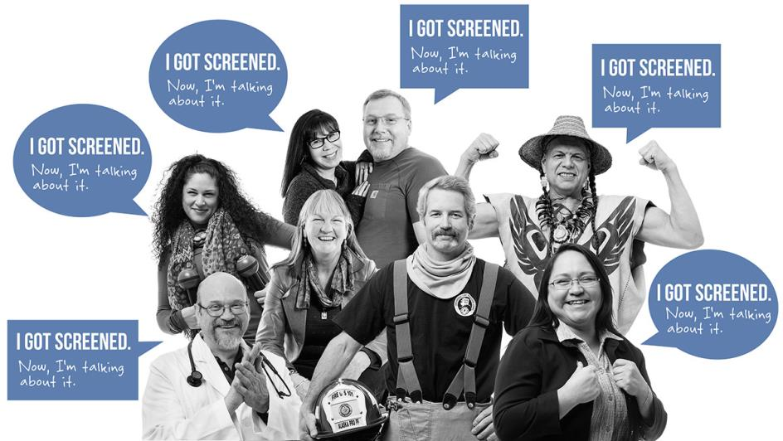
Case Study
Alaska Colon Health, 2014.
Notes:
Now, you can start thinking about communication channels. Let’s say you determine from conducting a literature review and key informant interviews that the campaign message will most effectively be disseminated using small media, such as pamphlets, that providers, businesses and community leaders can customize and distribute.
Let’s take a look at what the Alaska Native Tribal Health Consortium and Alaska Colorectal Cancer Partnership created for their colorectal cancer screening communication campaign called “The Cancer I Can Prevent.”

Slide 111
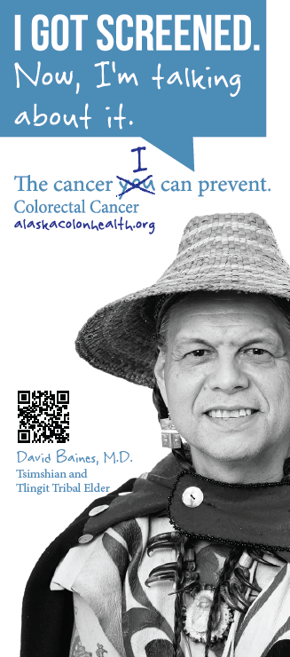
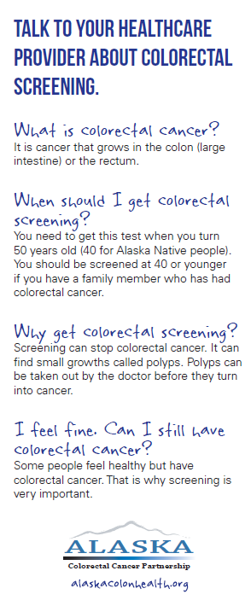
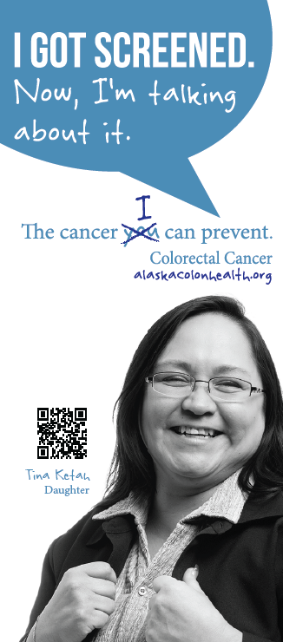
Case Study
Alaska Colon Health, 2014; Oregon Health Authority, n.d.
Notes:
“The Cancer I Can Prevent” campaign was adapted from the Oregon Health Authority Public Health Division’s “The Cancer You Can Prevent” campaign. The Oregon Health Authority had conducted focus groups of urban and rural; African American; American Indian; Alaska Native and Latino communities to test campaign messages, materials and images.
The Alaska Native Tribal Health Consortium and Alaska Colorectal Cancer Partnership built their campaign on what the Oregon Health Authority learned, and partnered with other tribal colorectal cancer control program grantees and cancer education staff to create small media, such as this pamphlet, for patients and providers, businesses and community leaders to distribute.
For example, the Oregon Health Authority found that Alaska Natives are more likely to get screened if it is recommended by someone they know and trust. The Alaska Native Tribal Health Consortium and Alaska Colorectal Cancer Partnership leveraged this finding and featured real Alaskans and Alaska Native people who have already been screened with a campaign message that uses hope as an emotional appeal: “I got screened. Now, I’m talking about it. The cancer I can prevent. Colorectal cancer.”
The pamphlet features familiar-looking faces, such as a tribal elder and daughter of a colorectal cancer survivor.
The back of the pamphlet includes gain-frame messaging: “You need to get this test when you turn 50 years old (40 for Alaska Native People). You should be screened at 40 or younger if you have a family member who has had colorectal cancer,” and “screening can stop colorectal cancer,” which is appropriate given the feedback received during pretesting for more positive messaging.
The pamphlet also prominently features the Alaska Colon Health dot org website for more in-depth health information and resources.
Oregon Health Authority. Colorectal Cancer Screening Focus Groups. Funded by Centers for Disease Control and Prevention Cooperative Agreement #2U58DP002065.

Slide 112
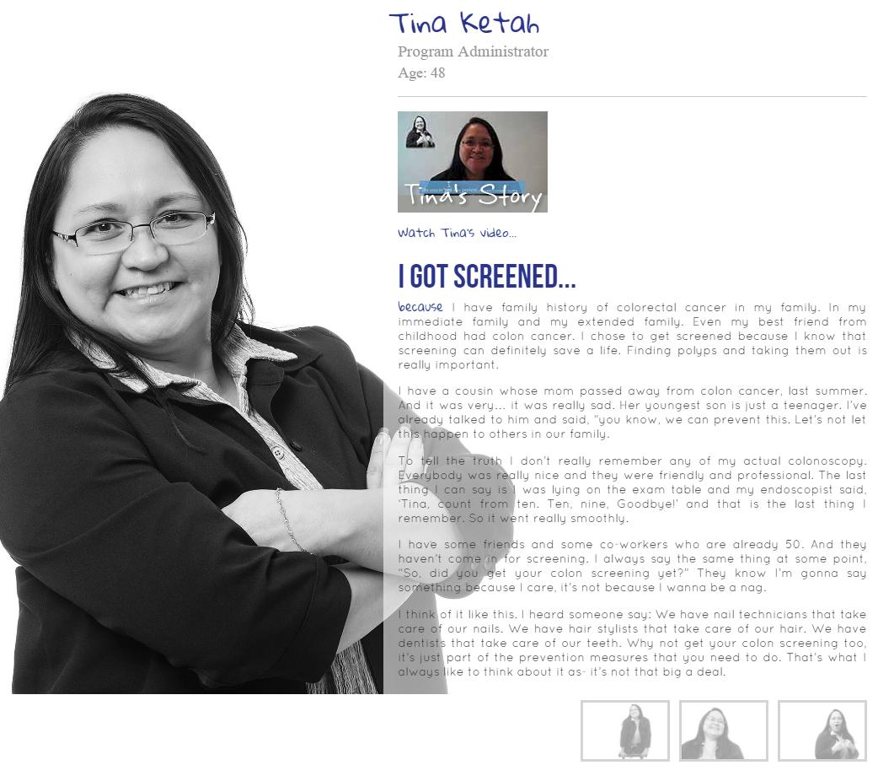
Case Study
I got screened because I have family history of colorectal cancer in my family. In my immediate family and my extended family… I chose to get screened because I know that screening can definitely save a life…
Alaska Colon Health, 2014.
Notes:
The Alaska Native Tribal Health Consortium and Alaska Colorectal Cancer Partnership also uses the website, AlaskaColonHealth.org to feature testimonials from members of the intended audience, such as Tina, who is a first-degree relative of a cancer survivor. Tina, pictured here on the website, says: “I got screened because I have family history of colorectal cancer in my family. In my immediate family and my extended family… I chose to get screened because I know that screening can definitely save a life…” Tina goes on to recount her easy experience with getting a colonoscopy and encourages others to do the same.

Slide 113
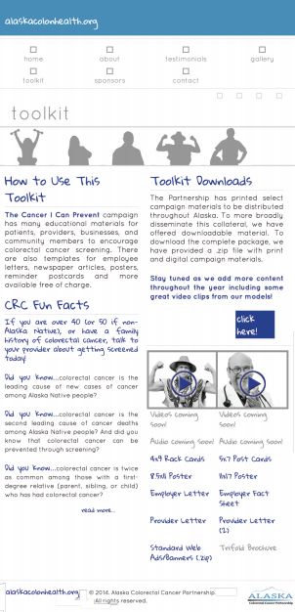
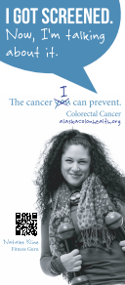
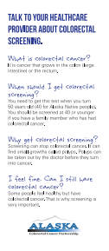
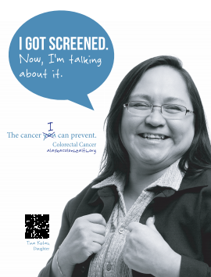
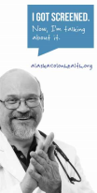
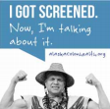
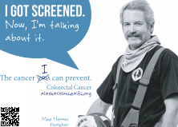
Case Study
Website
4”x9” pamphlets
8.5”x11” poster
Web ads
5”x7” postcard
Alaska Colon Health, 2014.
Notes:
The Alaska Native Tribal Health Consortium and Alaska Colorectal Cancer Partnership also created similarly-branded posters, reminder postcards and web ads all with a cohesive look. All of these materials are available on the website, where gatekeepers to the intended audience such as clinicians and community leaders can go to download and customize the materials.
The Alaska Native Tribal Health Consortium and Alaska Colorectal Cancer Partnership asked champions of colorectal cancer screening to give presentations to the gatekeepers to encourage them to use the campaign materials available on the website. They also posted these materials and testimonials on Facebook, conducted television and radio interviews, ran a statewide public service announcement on TV and submitted newspaper and newsletter articles. The testimonials will also be adapted for use on the radio, as many in rural and remote parts of Alaska often listen to the radio.

Slide 114
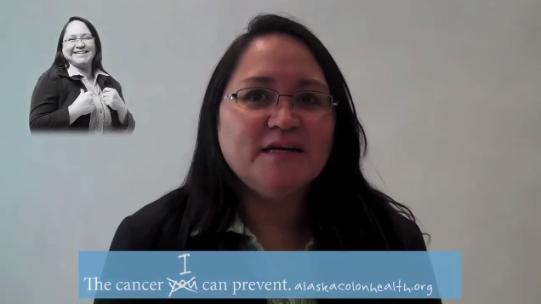
Case Study
Alaska Colon Health, 2014.
Notes:
The Cancer I Can Prevent campaign also won Prevent Cancer Foundation’s 2014 National “Screening Saves Lives” Challenge and received a $7,500 grant, which was used to produce testimonials to further advance the campaign. The videos are available on the Alaskacolonhealth.org website and YouTube.
Here is a public service announcement that aired on TV in Alaska, featuring the testimonials of Alaskans that have already received colorectal cancer screening. Hit the play button on your screen to view the 30 second PSA.

Slide 115
Resources
Centers for Disease Control and Prevention (CDC) Division of Community Health’s Making Healthy Living Easier Community Health Media Center
CDC’s Everyday Words for Public Health Communication
CDC’s Executive Summary of Findings: Testing Core Community Health Messages with the Public
Notes:
Here are some further readings and resources you can access on the topic of Communication Campaign Messages, Tactics and Channels for Intended Audiences. These and other resources are included in the Guide to Making Communication Campaigns Evidence-Based in the learning management system.

Slide 116
Conclusion
Describe strategies to identify audience characteristics and habit
Create key messages and take-home messages
Identify best-practices for specific communication channels to reach intended audience
Describe ways to adapt an evidence-based intervention to intended audience
Identify methods to pretest campaign messaging and materials
Notes:
In this lesson, you learned to:
Describe strategies to identify audience characteristics and habit,
Create key messages and take-home messages,
Identify best-practices for specific communication channels to reach intended audience,
Describe ways to adapt an evidence-based intervention to intended audience, and
Identify methods to pretest campaign messaging and materials.

Slide 117
This concludes the lesson.
Please exit and return to the learning management system.
EXIT
Notes:
This concludes the lesson.

Slide 118
Making Communication Campaigns Evidence-Based
Communication Training for Comprehensive Cancer Control Professionals 102
Lesson 4: Planning for Evaluation
Notes:
Welcome to lesson 4: Planning for Evaluation.

Slide 119
Acknowledgments
This work was supported by Cooperative Agreement #1U38DP004972-03 from the Centers for Disease Control and Prevention. Its contents are solely the responsibility of the authors and do not necessarily represent the official views of the Centers for Disease Control and Prevention.
Special thanks to:
Monique Turner, PhD, Milken Institute School of Public Health
Jerry Franz, Milken Institute School of Public Health
Julia Thorsness, Alaska Department of Health and Social Services
Keylee Wright, MA, Indiana State Department of Health
The content and competencies in this training are based on content from the National Cancer Institute’s publication “Making Health
Communication Programs Work” and the Seven Areas of Responsibility for Health Education Specialists, 2015. The training was also influenced by the work of the Cancer Prevention and Control Research Network (CPCRN) and its “Putting Public Health Evidence into Action” training curriculum.
Notes:
We would like to acknowledge the Centers for Disease Control and Prevention for supporting this work. We would also like to thank Dr. Monique Turner, Associate Professor, and Jerry Franz, Adjunct Instructor, at the Department of Prevention and Community Health at the Milken Institute School of Public Health of the George Washington University for their contributions to content development and review. We would also like to thank Julia Thorsness, Program Coordinator, Comprehensive Cancer Control, Alaska Department of Health and Social Services and Keylee Wright, MA, Director, Cancer Control Section, Indiana State Department of Health for their thoughtful feedback on the initial draft. The competencies in this training are based on content from the National Cancer Institute’s publication “Making Health Communication Programs Work”, also known as “The Pink Book”, and the Seven Areas of Responsibility for Health Education Specialists, 2015. This training was also influenced by the work of the Cancer Prevention and Control Research Network (CPCRN) and its “Putting Public Health Evidence into Action” training curriculum.

Slide 120
Competency
Develop an evaluation plan for health education/promotion
Notes:
This lesson will address the following competency:
Develop an evaluation plan for health education/promotion.

Slide 121
Learning Objectives
Explain the importance of evaluation in communication campaigns
Identify metrics for campaign objectives
Select appropriate methods of evaluation for a communication campaign
Notes:
After completing this lesson, you will be able to:
Explain the importance of evaluation in communication campaigns,
Identify metrics for campaign objectives, and
Select appropriate methods of evaluation for a communication campaign.

Slide 122
Evaluation
The systematic collection of information about the activities, characteristics and outcomes of programs to make judgments about the program, improve program effectiveness and/or inform decisions about future program development”
Patton, 1997
Notes:
National Comprehensive Cancer Control Programs are required to evaluate their programs and are encouraged to conduct process and outcome evaluation for their efforts at minimum. Program evaluation is “the systematic collection of information about the activities, characteristics and outcomes of programs to make judgments about the program, improve program effectiveness and/or inform decisions about future program development.” Evaluation should occur simultaneously with your campaign implementation and after the campaign ends; thus, you need to plan for evaluation early. You should already have a basic evaluation strategy in your communication or media plan, but here we explain some concepts and methods in greater detail.

Slide 123
Types of Evaluation
Process Evaluation
Satisfaction Evaluation
Impact Evaluation
“Are you actually doing the things you planned to do?”
How did people feel about your campaign? Were they satisfied?
“Is the intervention having the desired effect on the intended audience?”
Outcome Evaluation
“Is the intervention leading to the desired long-term impact envisioned?”
Patton, 1997; Community Tool Box, n.d.
Notes:
There are four basic types of evaluation: process, satisfaction, outcome and impact evaluation, and each tells you something different about your campaign.
Process evaluation answers the question: “are you actually doing the things you planned to do?” It is important to assess whether your communication campaign has been implemented as intended, and why or why not. It involves monitoring progress toward program goals, identifying problems and seeking technical assistance before significant resources are used and identifying areas for program improvement and allowing for scalability and replication. For a communication campaign that is part of a larger program effort, process evaluation is likely where you will focus your efforts and limited resources. If you developed a clear campaign roadmap, process evaluation findings will allow you to predict future changes in behaviors and health.
Satisfaction evaluation, related to process evaluation, can be used to assess how people felt about your campaign after the fact, whether they were satisfied with the quality and quantity of the campaign and what elements of the campaign they found helpful or not. It is a good way to collect suggestions for future improvements.
Outcome evaluation answers the question: “is the intervention having the desired effect on the intended audience?” Has your audience’s attitude changed? Have they adopted healthy behaviors? Outcome evaluation is important to show the effectiveness of your communication campaign, which is vital for justifying the program to management and funders, providing evidence of and celebrating successes with stakeholders and advocating for additional resources.
Impact evaluation answers the question: “is the intervention leading to the desired long-term impact envisioned?” Assessing impact is often not used for health communication activities, because communication campaigns alone cannot create sustained changes in complex health behavior and quality of life indicators without the support of a larger program for change, including policy, systems and environmental changes. Further, full impact may not be apparent for years or decades. Some data takes years to be published, and benefits of behavior change will take time to translate into changes in health status or quality of life. You can make certain assumptions about impact based on short-, intermediate- or long-term outcomes, based on your campaign roadmap. For example, you may assume that if individuals called to receive a free radon test kit, they received it, used it and reduced their risk of lung cancer. Just be sure to make such assumptions clear in your evaluation report.

Slide 124
Identify Metrics for Objectives
What are the communication objectives? How can these changes be measured?
How do you expect change to occur? What measurable intermediate outcomes are likely to take place before the behavior change can occur?
How long will the program last? What kinds of changes can we expect in that time period?
Which outcome evaluation methods can capture the scope of the change that is likely to occur?
Which aspects of the outcome evaluation plan best fit with your organization’s priorities?
National Colorectal Cancer Roundtable, 2012
Notes:
The campaign roadmap and S.M.A.R.T. objectives lay the foundation for evaluation metrics. In developing your campaign objectives, you should have set targets for the outcomes and had baseline data or a desired magnitude of change in mind.
Depending on the time and resources you have at your disposal, your program will need to identify the most important evaluation questions you want to ask. Refer back to your campaign roadmap to decide what process and outcome measures to prioritize. Ask yourself: “which outcomes will be most useful in understanding program success and guiding improvements? Which outcomes are most important to the participants? Which outcomes are most important to other stakeholders, including funders?”
Consider the following questions to help you focus the evaluation: “What are the communication objectives? What should the members of the intended audience think, feel or do as a result of the health communication plan in contrast to what they thought, felt or did before? How can these changes be measured?
How do you expect change to occur? Will it be slow or rapid? What measurable intermediate outcomes (i.e., steps toward the desired behavior) are likely to take place before the behavior change can occur?
How long will the program last? What kinds of changes can we expect in that time period (e.g., attitudinal, awareness, behavior, policy changes)? Sometimes, programs will not be in place long enough for objectives to be met when outcomes are measured (e.g., outcomes measured yearly over a 5-year program). To help ensure that you identify important indicators of change, decide which changes could reasonably occur from year to year.
Which outcome evaluation methods can capture the scope of the change that is likely to occur? Many outcome evaluations are relatively crude, which means that a large percentage of the intended audience (sometimes an unrealistically large percentage) must make a change before it can be measured. If this is the case, the evaluation is said to “lack statistical power.” For example, a public survey of 1,000 people has a margin of error of about 3 percent. In other words, if 50 percent of survey respondents said they engage in a particular behavior, in all likelihood somewhere between 47 and 53 percent of the population represented by the respondents actually engages in the behavior. Therefore, you can conclude that a statistically significant change has occurred only if there is a change of 5 or more percentage points. It may be unreasonable to expect such a large change, and budgetary constraints may force you to measure outcomes by surveying the general population when your intended audience is only a small proportion of the population.
Finally, which aspects of the outcome evaluation plan best fit with your organization’s priorities? Only rarely does a communication program have adequate resources to evaluate all activities. You may have to illustrate your program’s contribution to organizational priorities to ensure continued funding. If this is the case, it may be wise to evaluate those aspects most likely to contribute to the organization’s mission (assuming that those are also the ones most likely to result in measurable changes).”

Slide 125
Process Evaluation
Assess the extent to which the communication program was implemented as planned
Monitor progress toward the stated objectives, and adjust program if necessary
Interpret results of outcome evaluation
Determine if observed changes were result of program
Notes:
The purpose of process evaluation is to assess the extent to which the communication program was implemented as planned.
Process evaluation is also useful for monitoring progress toward the stated objectives so that adjustments to the program materials or delivery may be made if necessary.
Process evaluation can also help with interpreting results of outcome evaluation, and help determine if observed changes were the result of the program.

Slide 126
Process Evaluation
Documents and assesses implementation; quantifies what was done; when, where and how it was done; and who was reached…It can help you identify any implementation concerns, determine if the program is communicating the right messages about the health topic or determine if participants understand the information they receive ”
National Cancer Institute (NCI), 2004
Notes:
In practice, process evaluation “documents and assesses implementation; quantifies what was done; when, where and how it was done; and who was reached…It can help you identify any implementation concerns, determine if the program is communicating the right messages about the health topic or determine if participants understand the information they receive.” Looking at the campaign roadmap, process evaluation measures inputs, activities and outputs.
Examples of process metrics could include:
- Quantitative or qualitative feedback from program staff regarding the planning resources (financial, staff, material) and timeline of the campaign to inform future improvements
- Number of attendees at campaign kick-off event
- Documentation of engagement with campaign partners, such as number of local businesses who sign on in support
- Number of posters, brochures, ads, etc. distributed
- Number of people in intended audience exposed to the campaign
- Number of hits to campaign website, downloads, video views, etc.
- Number of media impressions – media outlets represented at kick-off, stories generated about campaign activities, free or paid ad spots, etc.
- Number of social media followers, post shares, likes, re-tweets, etc.
With process evaluation data, you should be able to effectively explain how your program operates and what reach it has had, whether the audience understood the messages, if funding was sufficient to meet your objectives and how effective your partnerships were. Your process evaluation will be helpful in making improvements to the program and in helping others who may wish to replicate your work.

Slide 127
Satisfaction Evaluation
Assesses how people felt about your campaign, including satisfaction about the level of exposure to the messages and how they reacted to the various elements of the campaign”
NCI, 2004.
Notes:
Satisfaction evaluation, related to process evaluation, is typically conducted after the conclusion of the campaign. It assesses how people felt about your campaign, including satisfaction about the level of exposure to the messages and how they reacted to the various elements of your campaign—such as a particular program, a brochure or a specific educational session. Even a simple satisfaction evaluation with a small sample of audience members can be a good way to collect suggestions for campaign improvements.
Examples of satisfaction evaluation questions might include:
- What did you like most about the program/brochure/educational session?
- What did you like least about the program/brochure/educational session?
- How did the program meet your needs?
- What, if anything, did you learn from the program?
- How, if at all, did the program affect your willingness to engage in the desired behavior, such as screening?
- The information provided by the program was useful (rate from 1, strongly agree and 5, strongly disagree)
- The information provided by the program was easy to understand (rate from 1, strongly agree and 5, strongly disagree)
- What, if anything, would you change about the program?

Slide 128
Outcome Evaluation
Short-term Outcomes
Awareness
Knowledge
Perceptions
Beliefs
Intentions
Intermediate Outcomes
Behavior
Notes:
Outcome evaluation primarily measures the short-term and intermediate outcomes of the communication campaign. Short-term outcomes are likely communication outcomes, which are changes in awareness, knowledge, perceptions, beliefs and confidence (also known as self-efficacy) or intentions that result from your communication campaign. For example, an outcome evaluation by way of a public survey conducted before and after a print poster campaign around workplaces might find that knowledge of the key message, that a person should eat five or more servings of fruits and vegetables each day to maintain a healthy weight and reduce the risk of cancer, increased by 27 percentage points.
Intermediate outcomes are likely changes in your audience’s behaviors that can be expected as a result of your communication campaign. Metrics for outcomes should be stated in your campaign objectives. For example, an outcome evaluation conducted after the publication of the letter to the editor might find that 20 percent more of those who saw the letter signed the petition urging state legislators to increase funding to build safer and complete streets than those who did not see the letter.

Slide 129
Impact Evaluation
Long-term Outcomes
Health
Notes:
Now we understand that outcome evaluation looks at the short-term and intermediate outcomes. The impact evaluation measures the longer-term outcomes of the communication campaign, and the larger initiative within which the communication campaign is operating. Long-term outcomes are likely health outcomes, which are changes in the audience’s health status and quality of life as a result of your communication campaign. Measuring impact is often impossible for communication campaigns, as changes in health outcomes take time to manifest on a population-level and it is hard for communication strategies alone to produce sustained behavioral and health changes.
An example of an impact evaluation conducted a year after a social media campaign during Melanoma and Skin Cancer Awareness Month might find that reported sun burns reduced by 8% during the period the campaign ran.

Slide 130
Check Point
Match the four types of evaluation with the applicable metrics.
Satisfaction Evaluation | Percentage of people who like the campaign Percentage of people who found campaign useful
Impact Evaluation | Change in health (often impossible for communication campaigns to measure)
Process Evaluation | Number of media impressions Number of hits to a campaign Number of posters distributed
Outcome Evaluation | Changes in knowledge, awareness, beliefs and behavior
Notes:
Let’s pause here for a brief knowledge check question before continuing with the remainder of the lesson.

Slide 131
Evaluation Methods
Method | Purpose | Advantages | Disadvantages
Surveys or questionnaires | Collecting information from respondents without direct contact. Paper versions of a survey may be handed out or mailed. You might also ask people to complete surveys electronically via email or the Internet | Good for outcome evaluation Most anonymity: therefore, least bias toward socially acceptable responses Cost per respondent varies with response rate: the higher the response rate, the lower the cost per respondent Less selection bias than with telephone interviews | Least control over quality of data Dependent on respondent’s reading level Mailed instruments have lowest response rate Surveys using mailed instruments take the most time to complete because such instruments require time in the mail and time for respondent to complete
Focus groups | Conducting group interviews with a small group of participants or other informants at the same time | Good for outcome evaluation as you can ask people to explain how the program affected them Can identify a lot of issues and effects Can give staff better understanding of the program from participants’ own words Can be done relatively quickly (1-2 hours per focus group) | Requires a good facilitator Takes time to analyze and interpret the discussion May require extra resources for facilitator’s time and participant incentives
“Tips for Conducting Program Evaluation”, 2006; Centers for Disease Control and Prevention, 2012; Asian Pacific Partnership for Empowerment, Advocacy and Leadership, 2009.

Slide 132
Case Study
Notes:
Let’s look at how evaluation can be used to measure the impact of a communication campaign. The following case study is inspired by the Communication Campaign conducted by the New Orleans Department of Health after the passing of the New Orleans Smoke-Free Ordinance.
We would like to thank Mary Martin Fein with the Louisiana Public Health Institute and Mara O’Brien Hahn with the New Orleans Health Department for their contributions to this case study.

Slide 133
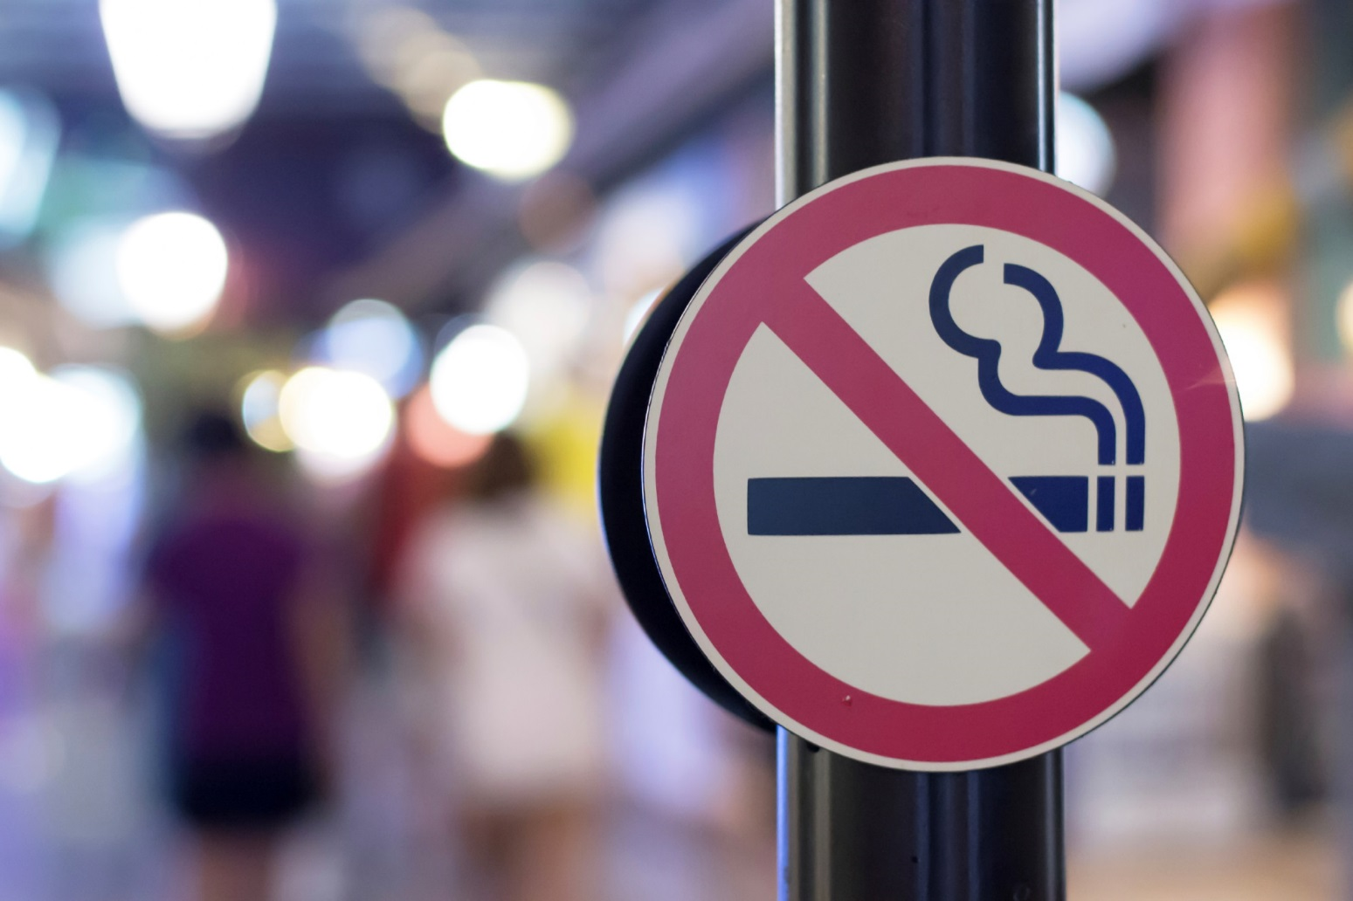
Case Study
Smoke-Free Ordinance, 2016; Fein & Schachter, 2015; Smoke-Free New Orleans, 2016.
Notes:
On January 2015, the New Orleans City Council unanimously passed a comprehensive smoke-free ordinance. This law places additional restrictions on the already existing Louisiana Smokefree Air Act, expanding smoking and vaping restrictions in many locations across the city. It went into effect on April 22, 2015.
After the ordinance was passed, the New Orleans Health Department developed and conducted a communication campaign to educate the target audience, which was New Orleans residents and affected business owners. This education campaign was launched on April 22nd and continued for three months. During this time, the ordinance was not enforced, but rather education was provided to the public and business owners found violating the ordinance.
Reference(s):
Fein, M. M. and Schachter, J. (2015, October 22). After six months, 78 percent of New Orleans voters approve of smoke-free law. Retrieved from https://smokefreenola.org/2015/10/22/after-six-months-78-percent-of-new-orleans-voters-approve-of-smoke-free-law/
Smoke-Free Ordinance. (2016). New Orleans Health Department. Retrieved from http://www.nola.gov/smokefree/
Smoke-Free New Orleans. (2016). Healthier for All. Retrieved from http://www.healthierairforall.org/successes/detail/smoke-free-new-orleans

Slide 134
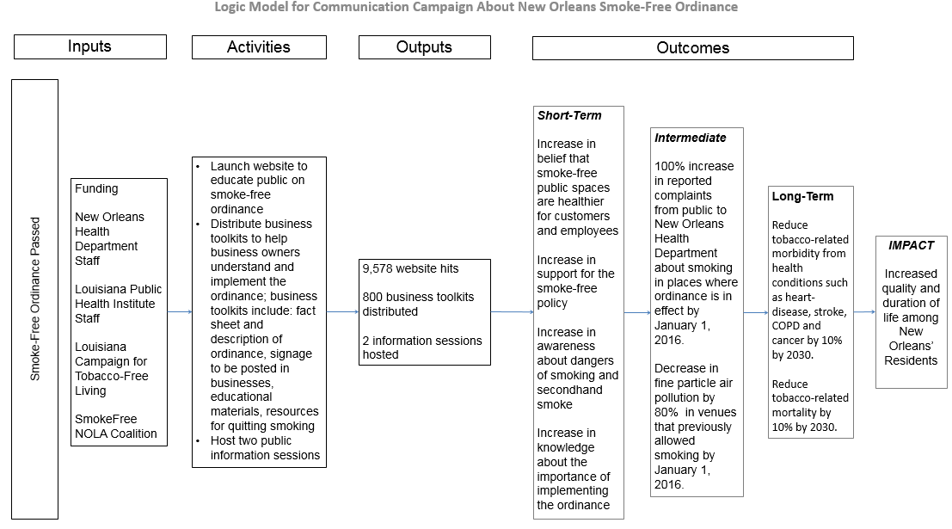
Case Study
Notes:
Here is the campaign roadmap (or logic model) that shows inputs, activities, outputs and outcomes. Remember a communication campaign is typically not conducted in isolation. Together with policy enforcement and other multilevel programs and strategies, these activities aim to reduce tobacco related morbidity and mortality and improve overall quality of life.

Slide 135
Case Study
Process evaluation measures
Number of website hits
Number of business toolkits distributed
Number of public information sessions hosted
Smoke-Free Ordinance, 2016.
Notes:
Now let’s look at the methods of evaluation used to assess the impact of the campaign.
A process evaluation was conducted to assess if the communication campaign was implemented as planned. The process evaluation measured:
Number of website hits
Number of business toolkits distributed
Number of public information sessions hosted
The campaign either met or exceeded their goals originally set forth in the outputs portion of their campaign roadmap.
Images from:
http://www.nola.gov/smokefree/

Slide 136
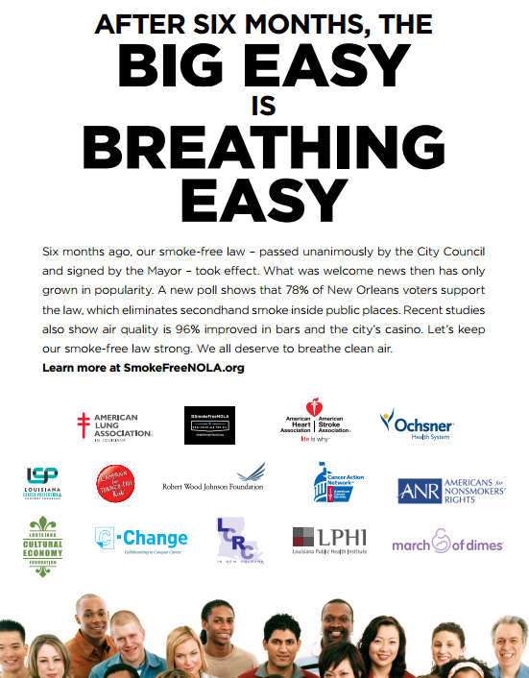
Case Study
“It has been really nice to go out and enjoy bars and casinos without breathing cigarette smoke or smelling like cigarette smoke.”
“Smoke free bars and casinos are healthier for customers and employees.”
Smoke-Free Ordinance, 2016; Fein & Schachter, 2015.
Notes:
In order to evaluate if the short-term impact of their campaign was achieved, the city’s partners in the smoke-free ordinance efforts, the Louisiana Campaign for Tobacco-Free Living (TFL) and the SmokeFree NOLA Coalition, worked with Public Opinion Strategies, an opinion research firm, to conduct a citywide survey among 500 registered New Orleans voters. The survey was conducted by cell phone and landline, using Public Opinion Strategies staff to conduct the interviews. Some examples of questions that were asked on the survey include:
Would you say you favor or oppose the law? Do you strongly or somewhat favor or oppose the law?
Would you say that you are personally more supportive of the law than you were before it went into effect or less supportive of the law?
In general, do you feel that exposure to second-hand smoke is a serious health hazard, moderate health hazard, minor health hazard, or not a health hazard at all? And,
How important is it to you to have a smoke-free environment inside all workplaces, including restaurants, bars and casinos?
Findings from the survey were compared to baseline data and found that support for the law increased from 66 percent to 78 percent. Eighty-nine percent agreed that smoke-free bars and casinos, “are healthier for customers and employees,” and 85 percent stated that, “it has been really nice to go out and enjoy bars and casinos without breathing cigarette smoke or smelling like cigarette smoke.” In addition, 88 percent felt that secondhand smoke exposure is a health hazard and 80 percent believe the rights of employees and customers to breathe clean air in casinos, restaurants and bars is more important than the right of smokers to smoke.
These findings confirm the short-term outcomes of increases of knowledge, attitudes and beliefs of the campaign were met.

Slide 137
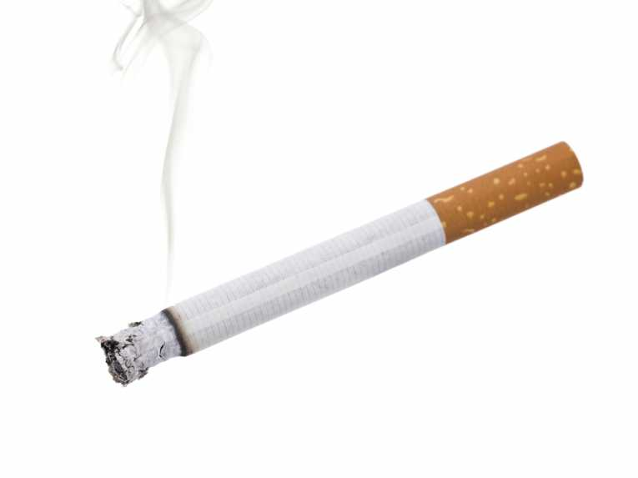
Case Study
Complaints
Certified Letters
On-site visits
Fine Particle Air Pollution
Smoke-Free Ordinance, 2016; Fein & Schachter, 2015.
Notes:
This brings us to measuring the intermediate outcomes of the campaign. To do this, the Louisiana Campaign for Tobacco-Free Living and the SmokeFree NOLA Coalition partnered with the Roswell Park Cancer Institute in Buffalo, New York, to conduct a study on the air quality of 13 bars and 1 casino, before the ordinance went into effect and after the campaign. The Louisiana Campaign for Tobacco-Free Living and the SmokeFree NOLA Coalition provided this data to the New Orleans Health Department and the public. The study found that compared to baseline data, the level of fine particle air pollution fell by 96 percent in spaces that previously allowed smoking. Moreover, there was a 99 percent reduction in fine particle air pollution in the casino.
In addition, during the first year of implementation, the New Orleans Health Department received complaints regarding 25 businesses during the education period and 24 businesses during the enforcement period about smoking in venues where it is prohibited. The city responded by sending 52 certified letters and conducting on-site visits at 7 businesses.
These findings confirm that the intermediate outcomes, which focused on behavior, were met.

Slide 138
Case Study
Outcomes
Impact
Long-Term
Reduce tobacco-related morbidity from health conditions such as heart-disease, stroke, COPD and cancer by 10% by 2030
Reduce tobacco-related mortality by 10% by 2030
Increased quality and duration of life
Short-Term
Intermediate
Smoke-Free Ordinance, 2016.
Notes:
The long-term outcomes of the campaign are to:
Reduce tobacco-related morbidity from health conditions such as heart-disease, stroke, COPD and cancer by 10% by 2030, and
Reduce tobacco-related mortality by 10% by 2030
The campaign will measure the long-term outcomes through sources such as BRFSS and the state cancer registry.
Finally, the overall impact of the campaign is increased quality and duration of life for all New Orleans residents, which as previously discussed in the lesson, is more difficult for a communication campaign to measure.

Slide 139
Resources
Center for Disease Control and Prevention’s (CDC) Gateway to Health Communication & Social Marketing Practice: Research & Evaluation
National Colorectal Cancer Roundtable’s (NCCRT) Evaluation Tooklit: How to evaluate activities to increase awareness and use of colorectal cancer screening
Robert Wood Johnson Foundation’s A Practical Guide for Engaging Stakeholders in Developing Evaluation Questions
Notes:
Here are some further readings and resources you can access on the topic of Planning for Evaluation. These and other resources are included in the Guide to Making Communication Campaigns Evidence-Based found in the learning management system.

Slide 140
Conclusion
Explain the importance of evaluation in communication campaigns
Identify metrics for campaign objectives
Select appropriate methods of evaluation for a communication campaign
Notes:
In this lesson, you learned to:
Explain the importance of evaluation in communication campaigns,
Identify metrics for campaign objectives, and
Select appropriate methods of evaluation for a communication campaign.

Slide 141
This concludes the lesson.
Please exit and return to the learning management system.
EXIT
Notes:
This concludes the lesson.

Slide 142
Making Communication Campaigns Evidence-Based
Communication Training for Comprehensive Cancer Control Professionals 102
Lesson 5: Communication Campaign Implementation
Notes:
Welcome to lesson 5: Communication Campaign Implementation.

Slide 143
Acknowledgments
This work was supported by Cooperative Agreement #1U38DP004972-03 from the Centers for Disease Control and Prevention. Its contents are solely the responsibility of the authors and do not necessarily represent the official views of the Centers for Disease Control and Prevention.
Special thanks to:
Monique Turner, PhD, Milken Institute School of Public Health
Jerry Franz, Milken Institute School of Public Health
Julia Thorsness, Alaska Department of Health and Social Services
Keylee Wright, MA, Indiana State Department of Health
The content and competencies in this training are based on content from the National Cancer Institute’s publication “Making Health Communication Programs Work” and the Seven Areas of Responsibility for Health Education Specialists, 2015. The training was also influenced by the work of the Cancer Prevention and Control Research Network (CPCRN) and its “Putting Public Health Evidence into Action” training curriculum.
Notes:
We would like to acknowledge the Centers for Disease Control and Prevention for supporting this work. We would also like to thank Dr. Monique Turner, Associate Professor, and Jerry Franz, Adjunct Instructor, at the Department of Prevention and Community Health at the Milken Institute School of Public Health of the George Washington University for their contributions to content development and review. We would also like to thank Julia Thorsness, Program Coordinator, Comprehensive Cancer Control, Alaska Department of Health and Social Services and Keylee Wright, MA, Director, Cancer Control Section, Indiana State Department of Health for their thoughtful feedback on the initial draft. The competencies in this training are based on content from the National Cancer Institute’s publication “Making Health Communication Programs Work” also known as “The Pink Book” and the Seven Areas of Responsibility for Health Education Specialists, 2015. This training was also influenced by the work of the Cancer Prevention and Control Research Network (CPCRN) and its “Putting Public Health Evidence into Action” training curriculum.

Slide 144
Competency
Implement health education/promotion plan
Monitor implementation of health education/promotion
Notes:
This lesson will address the following competency:
Implement health education/promotion plan and
Monitor implementation of health education/promotion

Slide 145
Learning Objectives
Create a communication campaign implementation plan
Launch a campaign
Notes:
After completing this lesson, you will be able to: Create a communication campaign implementation plan and launch a campaign

Slide 146
Implementation
Implementation
Who?
What?
When?
How much?
Notes:
At this point in the process, you have developed a plan to guide your campaign and you have identified the expected outcomes you want to evaluate; now it is time to implement your plan.
The implementation phase includes finalizing the “who, what, when and how much” of your communication campaign. We recognize that many organizations may have a dedicated communication staff or media team to handle many aspects of implementation. However, even if you are not responsible for all the details, it’s important to know what is involved so you can properly plan and create a realistic timeline. When planning for implementation, allow time for internal reviews and thoroughly assess your organization and staff capacity throughout the planning process and your campaign.

Slide 147
Partners
Do you need creative design of concepts and materials?
Who is able to do media placement?
What partners can assist with community mobilization?
Who will oversee and implement any training activities?
What organizations can do advocacy?
Who will provide service delivery?
Who will oversee monitoring and evaluation?
Johns Hopkins Center for Communication Programs, 2015.
Notes:
The first step in implementation planning is to determine what partners will be involved in your campaign. This can include local community organizations, health departments, non-profits, governmental organizations, coalitions or other leaders. Having a list of needs and roles for your campaign will help you identify partners who can provide support throughout the implementation process:
Do you need creative design of concepts and materials?
Who is able to do media placement?
What partners can assist with community mobilization
Who will oversee and implement any training activities?
What organizations can do advocacy?
Who will provide service delivery? and
Who will oversee monitoring and evaluation?
Remember that cultivating relationships and gaining buy-in from collaborators may take months, so start reaching out early during your campaign planning.

Slide 148
Activities
Planning and formative research
Development of messages and materials
Planning for evaluation
Implementation
Evaluation
Franz, 2015.
Notes:
After you have established partnerships and determined partner roles and skills, the next step is to determine what activities need to be implemented. You should have a general sense of what needs to be done based on your campaign roadmap—use that as a guide when outlining what activities need to happen. Account for any intermediate steps as well. For example, if “print materials” is an activity, you may need to include “(1) obtain content approvals (2) submit purchase orders (3) work with print vendor on formatting and file requirements and (4) shipping and receiving” as intermediate steps.
Think about your activities in five phases:
Planning and formative research
Development of messages and materials
Planning for evaluation
Implementation, and
Evaluation
When creating your list of activities, make sure you consider sequence of events as well as who will be responsible for each activity based on the list of partners you identified.
A sample of common implementation activities for a communication campaign is provided in the Guide to Making Communication Campaigns Evidence-Based. Note that not all of these activities will apply to your campaign; it is meant to be used as a general overview and adapted for your particular circumstances. The more detailed your list of activities, the more realistic your timeline will be when you develop it.

Slide 149
Timeline
Work backwards from a big milestone (e.g., launch date or material distribution)
Review and update throughout campaign
Consider how each activity is linked
Allow as much time as possible
Be aware of other events and news going on at the same time
Johns Hopkins Center for Communication Programs, 2015.
Notes:
When creating your timeline, think first in terms of big milestones. It may be useful, for example, to work backwards from your launch date if you are having a media event (more on media events at the end of this lesson), or start from when you’ll first distribute materials for pilot testing as part of a phased rollout. It is also important to remember that your timeline is a living, flexible document. It will need to be reviewed and updated throughout your campaign and can be used to monitor whether or not your implementation is on schedule.
Think about when each activity will be implemented and how each activity is linked. If your efforts are tied to a service, like increasing screening, be sure to consider capacity of service providers in your timeline. Likewise, if your campaign includes provider training as a component, be sure that the activity happens first so capacity is in place before your campaign launches.
The most important rule for creating timelines is to allow as much time as possible—especially if you are working with a large group of partners or within a large organization—approvals and red tape frequently take longer than expected. Also take into account the calendar year. For example, it is much more difficult and expensive to get advertising in the fall as it is the start of the holiday advertising season. If you are running your campaign in the fall, make sure you reserve advertising space during the spring before, if possible. Perhaps your timeline also needs to take into account your grant year or funder requirements—many organizations require money to be spent down well in advance of the end of the grant or fiscal year; be sure to take this into account as you plan your timeline.
If you are considering a kick-off or launch event to start your campaign, think about other media activities that may be happening at the same time. Here in the Washington, DC area, for example, a visit by a foreign dignitary or international leader can often dominate the press—the more you know about what is going on in the news, both locally and nationally, the more prepared you can be to launch at the right time and ensure the best possible coverage of your event. Consider holding your event around an awareness month or health observance, as many media may be more likely to write about your campaign if it has a natural news hook with other events.

Slide 150
Budget
Secure timeline and list of activities
Leverage partnerships
Estimate budget
Leverage free and low-cost resources
Notes:
Once you have a timeline and list of activities, you can begin to estimate your budget. The Guide to Making Health Communication Campaigns Evidence-Based provides a list of activities and possible costs to plan for throughout the campaign. Finalize the budget once your work plan is complete.
Organizations are often forced to implement health communication campaigns with little or no budget. Leveraging partnerships and free or low-cost resources can expand your capacity and reach without additional cost. Some channels, such as Twitter or Facebook, are free and can expand your potential reach. Outreach to high-influence bloggers, message boards and social networks can also be an effective and low-cost way to advertise, in addition to posting social marketing advertisements on state Department of Health webpages. More information on channels, including cost, is available in Communication Training 101.
The CDC also offers sample creative elements like posters, graphics, television spots, radio spots and outdoor advertising at free or low cost from their Community Health Media Center or Media Campaign Resource Center (for tobacco counter-advertising). Make it Your Own (MIYO) also offers health communication campaigns that are customizable to your target audience. Finally, the National Public Health Information Coalition (NPHIC) has a searchable repository of campaigns on a variety of topics and budgets.

Slide 151
Finalizing Implementation Plan
Implementation
Campaign activities (What)
Who is responsible (Who)
Timeline (When)
Budget (How much)
Notes:
At this point in the implementation process, you should be able to put together the pieces of your plan into a single document that includes all campaign activities (what), who is responsible, the timeline (when), and budget (how much) for each piece of the communication campaign. A sample implementation plan is provided in the Guide to Making Health Communication Campaigns Evidence-Based.

Slide 152
Check Point
True or False. During the implementation phase, partners can help in promotion efforts to help keep campaign cost down.
True – Partners can include local community organizations, coalitions and other leaders. Remember getting campaign buy-in can take time so start reaching out to people early!
B. False – Incorrect.
Notes:
Let’s pause here for a brief knowledge check question before continuing with the remainder of the lesson.

Slide 153
Launch Event
Builds excitement around campaign
Generates earned media
Notes:
Many campaign implementation plans include a launch event (also called a press event, kick-off event or media event). Launch events are a great way to build excitement around your campaign and generate earned media. Reach out to the press early to generate interest in your event and consider any activities to generate more interest in your event, like placing an op-ed, editorial or letter-to-the-editor beforehand.
Generally schedule press events for Tuesdays, Wednesdays or Thursdays (journalists are generally catching up from weekend developments on Mondays, and Friday coverage often goes unnoticed). It is best to schedule your event for mid-morning, no early than 10 a.m., since journalists often don’t have their assignments until that part of the day. Determine who will represent you with the media (your organization and your issue; patients or people otherwise affected help personalize your news and your campaign). Be flexible with speakers, as many individuals in positions of leadership may not know until the last minute whether they will be able to attend. Always have a back-up plan! You may wish to review concepts covered in Lesson 4 of Communication Training 101 for more on Building Relationships with Journalists and Producing Media-Ready Materials.

Slide 154
Event Promotion
Let journalists know about events ASAP, up to 2-3 weeks in advance
Send formal media advisory 3-4 days in advance to reporters
Follow media advisory up with a phone call to reporters
Send press release day of event
Hold event in a convenient and central location
Use visuals at the event
Consider creating a media kit
Notes:
As you learned in Communication Training 101, building relationships with reporters should start long before your launch event. Assuming you have established relationships with journalists, it’s best to let them know about the timing of your event as early as possible, ideally up to two to three weeks beforehand. Send a formal media advisory to reporters at least three to four days in advance of your event with relevant location and details. A media advisory is a short one-page document that lets reporters know about an upcoming news event. Media advisories should be followed up with a phone call. It’s important to emphasize here that the media advisory ideally shouldn’t be the first contact you have with a journalist. If you have been building relationships with journalists as part of your media strategy, you’ll be able to informally reach out to them as soon as you have established the date of your event.
The day of the event, disseminate a press release that announces your news and provides more details about your campaign. Press releases should lead with the most important information first, and should be written in a newsy style. Many journalists rely on press releases when writing their stories. More information on writing press releases is available in Communication Training 101.
Hold the launch event in a location that is convenient, central and meaningful. Reporters are often covering multiple stories in any given day, so thinking about details like parking, space and proximity to downtown will ensure that your event receives optimal attendance. The location should also be meaningful and connected to your campaign. If you are promoting a screening program, for example, consider holding the launch event at one of the neighborhood clinics, and invite members of the community to participate. Always have a back-up location in the event of changing circumstances, such as weather.
When planning your launch event, remember that visuals are important. Members of the press will often shoot supplemental “b-roll” footage for their piece, so include posters, demonstration items, graphs or any other creative visuals to emphasize your message. Don’t forget to reserve any necessary audiovisual equipment in advance, including a mult-box that allows media to plug in their equipment, lighting, microphones, stages, podiums and chairs. Consider creating a media kit that includes information on your press event, media advisory, fact sheets and anything else that will help attendees understand your issue and cover your campaign. Be sure to follow-up with media personnel who attended and those who didn’t, and track coverage after the event. Have designated individuals who are available to give follow-up interviews after the event and make sure the media knows how to contact them for additional stories in the future.

Slide 155
Post-Launch
Monitor your campaign
Re-print, re-stock, maintain partner engagement
Collect process evaluation data
Make changes as needed
Notes:
After your campaign is launched, the work is ongoing! Continue monitoring your campaign to make sure you’re reaching your target population. If you are running paid ads, make sure they are airing at times that make sense. For example, if you are directing people to call a hotline, but TV ads are airing at night when the hotline is closed, re-assess and run the ads at a more appropriate time.
This is also when you start collecting any process evaluation data. You may make necessary modifications to materials, re-print and re-stock collateral materials, continue to engage existing partners and possibly add new community partners. Developing a structured timeline will help your campaign coordinator keep things moving. One strategy to consider is staggering your messages to keep your campaign fresh and engaging. It may make sense to “pulse” your messages depending on the time of year and your audience. For example, if you are doing a quit smoking campaign, it may make sense to do a big push of advertising or roll out new messaging around New Year’s Day, since many smokers may be thinking about quitting around that time, and then again during national awareness events.

Slide 156
Case Study
The Heart Truth® Campaign, from the National Heart, Lung and Blood Institute (NHLBI)
The Heart Truth, 2016.
Notes:
Let’s look at The Heart Truth Campaign, from the National Heart, Lung and Blood Institute (NHLBI), as an example of launching, promoting and monitoring a campaign.

Slide 157
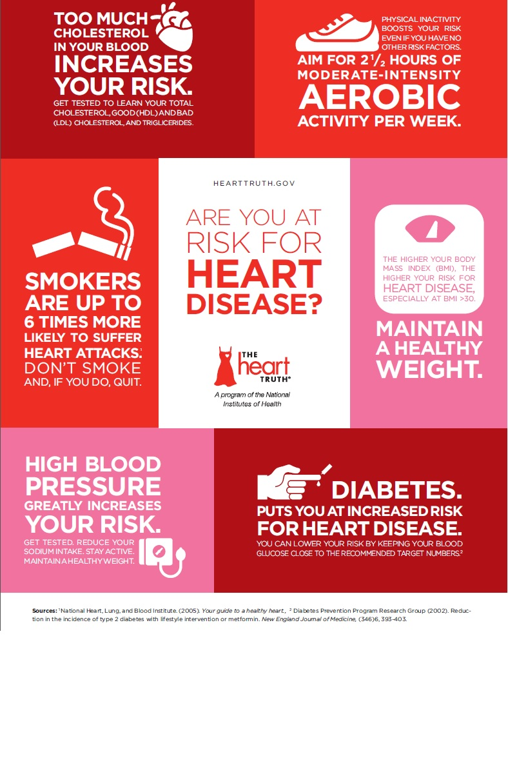
Case Study
American Heart Association found only 34 percent of women recognized heart disease as the leading cause of death among women
Long et al., 2008.
Notes:
The Heart Truth Campaign was developed to address a problem identified in a study conducted by the American Heart Association in 2000, which found only 34 percent of women recognized heart disease as the leading cause of death among women.
In 2001, the NHLBI awarded a multi-million dollar contract to Ogilvy Public Relations to develop and launch a campaign to address the problem.

Slide 158
Case Study
Activity
Key Messages
Planning and formative research
Heart disease is the #1 killer of women.
Having risk factors, such as high blood pressure and high cholesterol, can lead to heart disease, disability, or death.
Talk to your doctors about heart disease risk factors and action you can take to prevent or control heart disease.
Elements identified were:
Heart disease is the #1 killer of women
Put a face on heart disease
Show consequences of heart disease
Give a sense of hope
Provide clear call to action and sense of urgency
Long et al., 2008; The Heart Truth, 2016.
Notes:
In 2002, after planning, formative research and testing, the following elements were identified that needed to be included in the campaign:
• Prominently state that heart disease is the #1 killer of women
• Put a face on heart disease so women could better identify with the idea that it could happen to them
• Show the consequences of heart disease
• Give a sense of hope that women can lower their risk
• Provide a clear call to action and a sense of urgency
These elements informed the key messages of the campaign, which are:
• Heart disease is the #1 killer of women.
• Having risk factors, such as high blood pressure and high cholesterol, can lead to heart disease, disability, or death.
• Talk to your doctors about heart disease risk factors and action you can take to prevent or control heart disease.

Slide 159
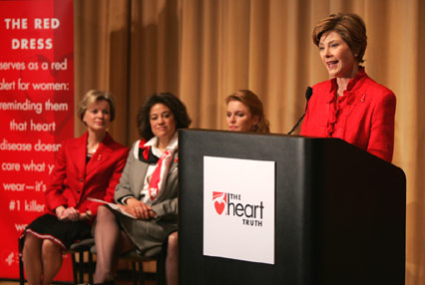
Case Study
Long et al., 2008.
Notes:
To generate initial buzz, the campaign launched with a print PSA in September 2002 with the Red Dress as a campaign symbol.
Campaign leaders then approached fashion designers and developed a partnership to have the cause featured as part of the 2003 New York Fashion Week. In addition to an exhibit at Fashion Week, a jewelry designer also created a Red Dress pin. Fashion Week and the pin drew further attention to the issue of women and heart disease. First Lady Laura Bush was also engaged as a campaign ambassador. On Valentine’s Day of 2003, Mrs. Bush appeared on three network morning shows wearing a red dress pin and talked about the problem of heart disease among women.

Slide 160
Case Study
To alert the media about the press conference, campaign advisors:
First reached out to media contacts informally via phone about the upcoming event
Sent an official media advisory four days before the press conference and followed-up with a phone call and
Sent a press release on the day of the press conference
USA Weekend Magazine, 2008.
Notes:
After the morning show appearances, Mrs. Bush and the head of the NHLBI, Dr. Elizabeth Nabel, held an additional press conference to discuss the campaign further. To alert the media about the press conference, campaign advisors:
• First reached out to media contacts informally via phone about the upcoming event
• Sent an official media advisory four days before the press conference and followed-up with a phone call and
• Sent a press release on the day of the press conference
Laura Bush’s campaign from the heart. USA Weekend. http://www.famousfix.com/topic/usa-weekend-magazine-united-states-3-february-2008. February 3, 2008. Accessed on August 16, 2016.

Slide 161
Case Study
In planning for the press conference, campaign leaders made sure to:
Reach out and secure press conference participation from women who had been affected by heart disease
Create a timeline and checklist for day of event logistics
Rent a mult box (to allow media to plug in their equipment) and
Create a media kit to distribute at the press conference and after
Notes:
In planning for the press conference, campaign leaders also made sure to:
• Reach out and secure press conference participation from women who had been affected by heart disease
• Create a timeline and checklist for day of event logistics
• Rent a mult box (to allow media to plug in their equipment) and
• Create a media kit to distribute at the press conference and after

Slide 162
Case Study
Long et al., 2008.
Notes:
As the campaign evolved, key partners continued to be added to help deliver campaign messages. Partners included: corporations such as Johnson & Johnson and Coco-Cola and organizations such as the American Heart Association, WomenHeart and the Office of Women’s Health.

Slide 163
Case Study
Long et al., 2008; The Heart Truth, 2016.
Notes:
In 2004, campaign leaders partnered with the American Heart Association, other non-profits and the media to create the first National Wear Red Day to raise awareness about women and heart disease. The first observance was February 2, 2004, which was also when the first Red Dress Collection fashion show was held at New York Fashion Week.

Slide 164
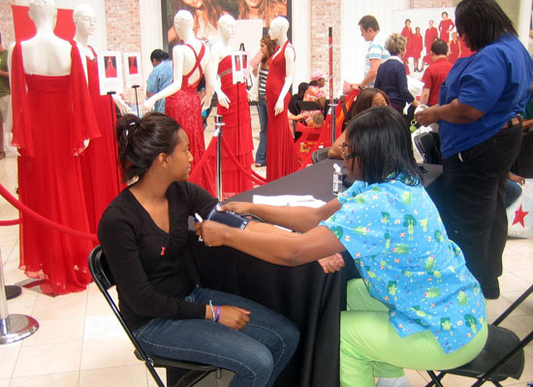
Case Study
The Heart Truth, 2016.
Notes:
After the first observance of National Wear Red Day, local communities began implementing their own tailored activities during the month of February to tie into the national campaign and leverage national media coverage, which expanded the campaign’s reach and impact.
The Heart Truth campaign continues today and has been successful in increasing awareness about the impact of heart disease.
--
References:
The Heart Truth. National Heart, Lung, and Blood Institute website. http://www.nhlbi.nih.gov/health/educational/hearttruth/materials/index.htm. Updated on June 2016. Accessed August 2016.
Also: http://www.ncbi.nlm.nih.gov/pmc/articles/PMC2574437/
Long, T., Taubenheim, A., Wayman, J., Temple, S., & Ruoff, B. (2008). “The Heart Truth:” using the power of branding and social marketing to increase awareness of heart disease in women. Social Marketing Quarterly, 14(3), 3-29. doi: 10.1080/15245000802279334

Slide 165
Resources
Make it Your Own (MIYO) – Adaptable evidence-based interventions with images, messages, designs
National Public Health Information Coalition’s health promotion resource library
Notes:
Here are some further readings and resources you can access on the topic of Communication Campaign Implementation. These and other resources are included in the Guide to Making Communication Campaigns Evidence-Based found in the learning management system.

Slide 166
Conclusion
Create a communication campaign implementation plan
Launch a campaign
Notes:
In this lesson, you learned to: Create a communication campaign implementation plan and launch a campaign

Slide 167
This concludes the lesson. Please exit and return to the learning management system.
EXIT
Notes:
This concludes the lesson.

