Slide 1

This content may be used or adapted for noncommercial, educational purposes only. Please use the following citation:
George Washington University Cancer Center TAP. (2022). Financial Navigation Lesson [PowerPoint Slides]. GWU Cancer Center TAP. https://cme.smhs.gwu.edu/gw-cancer-center-/group/gw-cancer-center
This content was adapted from the GW Cancer Center the Oncology Patient Navigation Training: The Fundamentals (PI: Pratt-Chapman) developed and maintained by CDC cooperative agreements #NU38DP004972, #5NU58DP006461 and #NU58DP007539. The content added, changed, or adapted by our organization do not necessarily represent the views of the GW Cancer Center or the CDC.
If you have any questions about the following material or would like permission to use this material, please contact cancercontrol@gwu.edu

Slide 2
Financial Navigation
Clara N. Lambert, CPH, BBA, OPN-CG
Director of Financial Navigation
TailorMed
Notes:
Welcome to the training on Financial Navigation.
My name is Clara Lambert, and I am a Director of Financial Navigation at TailorMed.

Slide 3
Disclosure
No disclosures
Notes:
I have no disclosures.

Slide 4
Learning Objectives
Define financial toxicity and its impact on patient wellness
Describe components of financial navigation
Identify resources to meet patient financial challenges
Access sample evaluation tools to show value of financial navigation in practice
Notes:
In this lesson, you will learn how to:
Define financial toxicity and its impact on patient wellness
Describe components of financial navigation
Identify resources to meet patient financial challenges
Access sample evaluation tools to show value of financial navigation in practice

Slide 5
Financial Toxicity Definition
The consequence of a health diagnosis impacting the material, psychological, and behavioral status of a patient, including
  Financial distress
  Bankruptcy
  Poorer quality of life
  Treatment non-adherence
Iragorri et al., 2021; Watabayashi et al., 2020
Notes:
In the past few years, a new term has emerged to describe the financial burden experienced by the patients, called financial toxicity. Financial toxicity is a consequence of healthcare needs impacting patient's material, psychological, and behavioral status, including financial distress, bankruptcy, and treatment non-adherence. Financial toxicity affects patients’ well-being and quality of life due to challenges in affording essential life expenses, including treatment, medication, food, transportation, dependent care, clothing, education, and other expenses. People diagnosed with cancer are at a high risk for financial toxicity given the high costs of cancer care. According to a 2021 study, on average, cancer patients spent 42% and caregivers 16% of their annual income on out-of-pocket expenses. Spending almost half of a person’s income on health care expenses can cause severe stress. Financial toxicity is usually caused by out-of-pocket costs that the patient is not able to cover and may consist of copayments, deductibles, and coinsurance.

Slide 6

Path of Financial Distress & Toxicity
Uninsured Underinsured
Lack of Income Loss of Income
Financial
Distress
Financial
Toxicity
Illustration from iStock library authorized by subscription
Notes:
When financial distress causes patients to take actions that affect their treatment, it is considered financial toxicity.
The terms financial distress and financial toxicity can often be confused. Financial distress describes the inability to pay for the care and may involve borrowing money and declaring bankruptcy.
Financial toxicity refers to the patient’s decisions related to the financial distress. This can include cost of care, as well as other financial problems: such as a decrease in income or not having health insurance, therefore experiencing financial problems, This puts a patient at a higher risk of facing bankruptcy and debt.

Slide 7
Financial Toxicity and Cancer
Elements that put individuals at higher risk of financial toxicity
Cancer diagnosis and chronic disease
Advanced stage or recurrent cancer
Multiple cancers
Prior cancer diagnosis
Adjuvant and antineoplastic therapies
Living far away from a cancer treatment site
Lower household income
Loss of income
No insurance and insurance type
High risk of financial toxicity is associated with particular lived experiences due to structural inequities
Carrera et al., 2018; NCI, 2019;
Yap et al., 2020; Zafar et al., 2013; Zahnd et al., 2019
Notes:
Several studies have shown that cancer patients experience much higher levels of financial toxicity than other patients. Cancer patients may also feel more anxiety about their cancer treatment and the costs of care than about the possibility of death.
Elements that put individuals at higher risk of financial toxicity include:
Cancer diagnosis and chronic disease
Advanced stage or recurrent cancer
Multiple cancers
Prior cancer diagnosis
Adjuvant and antineoplastic therapies
Living far away from cancer treatment site
Lower household income
Loss of income
No insurance and insurance type
Because of structural bias, being female, being younger and non-white, having widowed partnership status, lower education level, and living in a rural setting are all associated with greater financial toxicity. This is because there are structural biases such as unequal opportunities, unequal pay, hiring bias, and/ or disparities in accessing care closer to home which results in higher transportation costs for people with these lived experiences. For all of these reasons, people with these backgrounds may have fewer financial resources.
Such patients may delay or discontinue treatment because they may feel they cannot pay for treatment or paying for care will result in financial devastation for their loved ones.

Slide 8
Factors Affecting Financial Toxicity
Household Income
Credit Score
Savings
Supplemental Insurance
Protective Factors
Increased Household income Use of supplemental insurance Credit score
Risk Factors
Reduction/ Cessation of work Increased out-of-pocket expenses
Offodile et al., 2020
Notes:
A 2020 study asked more than 570 breast cancer patients to fill out a COmprehensive Score for Financial Toxicity (COST) survey that measured financial toxicity. Lower scores represented greater treatment induced distress. The researchers found that lower scores were commonly associated with lower rates of supplemental insurance usage, lower household income, low education levels and credit scores.
Protective factors, or factors that reduced one’s risk of financial toxicity, included:
Increased household income, which allowed patients to get supplemental insurance
Increased credit scores
Risk factors for financial toxicity:
Reduction and cessation of work
Increased out of pocket expenses
Individuals who experienced high financial toxicity sometimes limited their food and/ or clothing purchases and limited leisure expenses.

Slide 9
Financial Distress: Psychosocial Impact
Depressed mood most of the day, nearly every day or observed by others
Markedly diminished interest or pleasure in activities most of the day, nearly every day
Unable to stop or control worry, nearly every day
Recurrent thoughts of death, recurrent suicidal ideation
Significant changes in weight, appetite, sleep, concentration
Significant distress or impairment in social, occupational, or other important areas of functioning
ACCC Financial Advocacy Network, 2019
Notes:
Mental health affects patients’ treatment adherence as well as quality of life and health outcomes.
The psychosocial impact of financial distress on the patient can be recognized by the following:
Depressed mood most of the day, nearly every day (e.g., patient feels sad, empty, hopeless) or observed by others (e.g., appears tearful)
Markedly diminished interest or pleasure in all, or almost all, activities most of the day, nearly every day
Not being able to stop or control worry, nearly every day
Recurrent thoughts of death (not just fear of dying), recurrent suicidal ideation
Significant changes in weight, appetite, sleep, concentration
Significant distress or impairment in social, occupational, or other important areas of functioning

Slide 10
Financial Navigation Services
Financial Navigation
Access to billing department
Benefits review & prior authorization
Patient’s clinical needs
Optimize coverage & patient assistance programs
ACCC Financial Advocacy Network, 2019; Sherman, 2019
Notes:
It is essential to include financial navigation services for people affected by cancer to reduce financial toxicity and improve patient health outcomes.
This illustration demonstrates how basic financial navigation services work. Essentially, financial navigation becomes a hub that links and addresses other components of comprehensive cancer care.
Benefits review & prior authorization: It is important to review the insurance benefits together with the patient and make sure that the patient understands the insurance coverage
Patient’s clinical needs: The Financial Navigator should work together with a clinical team that can suggest different treatment options which would put the patient at lower risk of financial toxicity
Optimize coverage & patient assistance programs: The Financial Navigator should optimize coverage and assist patients with providing referrals or resources
Access to billing department: Finally, Financial Navigators should have good communication skills and continuously communicate with the billing department
It is important to note that Financial Navigators should have the financial literacy to understand the complexities of this service and explain to the patient some of the financial terms. Such a job requires individuals to have strong interpersonal skills to be able to communicate effectively and be detail-oriented, so each patient’s needs would be meticulously tracked.

Slide 11
Main Components of Financial Navigation
Stay updated about patient assistance programs and resources
Intervene in reducing financial toxicity by proactively assisting patients and optimizing health insurance benefits
Explain insurance coverage and assistance options
Use effective communication strategies with patients and caregivers on the cost of care, patient assistance support, and additional resources
Manage, track, and report all financial navigation and patient access service interventions
Ensure providers and cancer program staff are aware of policy requirements from payers for coverage of services
Discuss affordable treatment plans with the cancer care team
Notes:
These are the main components that make financial navigation an effective strategy.
Keep yourself updated about available patient assistance programs and other resources
Intervene in reducing financial toxicity by proactively assisting patients and optimizing health insurance benefits
Explain insurance coverage and provide assistance options (drug replacement, copay and etc.)
Use effective communication strategies with patients and their caregivers focusing on issues of cost of care, patient assistance support, and additional resources (patients, caregivers, team at your facility)
Manage, track, and report on all financial navigation and patient access services
Ensure that providers and cancer program staff are aware of ongoing policy requirements from payers for coverage of services (especially when there are new treatments and there is no information about the coverage)
Discuss more affordable treatment plans with the cancer care team if possible (determining with a clinical team if there are different options that are less financially toxic to the patient)
Let’s dive deeper in each of these elements.

Slide 12
Stay Updated and Intervene
Notes:
First, stay updated and intervene early.

Slide 13
Keep Yourself Updated
Keep yourself updated about available patient assistance programs or other resources
  American Cancer Society Local Resources
  Cancer Can’t
  Donate Drugs
  Charitable Pharmacy Group
  Good Rx
  Needy Meds
  Prescription Drug Assistance Network
Notes:
To provide efficient financial navigation to the patient, it is essential to keep yourself updated about available patient assistance programs and other resources. Applications and processes for such programs continuously change; new programs are being offered; in addition, deadlines can vary from one program to another. Therefore, always make sure you use the most recent information to assist your patient. For example, you can sign up for the newsletters of various foundations to learn about when they open new funds or programs.
These are examples of patient assistance programs and other resources:
American Cancer Society Local Resources and Cancer Can’t - transportation, lodging, education, and emotional support
Donate Drugs and Charitable Pharmacy Group – option to donate unused drugs, so patients in need of such medications would be able to have access to them
Good Rx – free tool to compare medication prices at different pharmacies
Needy Meds - connects patients to programs that help them afford their medications and other healthcare costs
Prescription Drug Assistance Network - finds and/ or manages a program for medications

Slide 14
Patient Assistance Programs
External assistance programs
  Manufacturer (pharmaceutical) copay assistance
  Foundation assistance
  Free drug programs
Living expense funds
Internal assistance programs
  Charity programs
  Payment plans
Notes:
Patient assistance programs can be external or internal.
External assistance programs are outside of patient’s health system
1. Manufacturer copay assistance: Copay cards for people with commercial insurance (patients are not eligible if they have government insurance). Pharmaceutical companies assist with out-of-pocket drug costs. This assistance is specific to drugs offered by a particular drug company
2. Foundation assistance: Copay assistance for people who have government insurance. Provided by disease foundations supported by donations to assist patients with specific diseases treatment
3. Free drug programs: When someone doesn’t have insurance, or their treatment is not covered
Internal assistance programs (within the hospital/ health system)
1. Charity programs
2. Payment plans: If someone is not eligible for a charity program, they might be eligible for payment plans
Other types of assistance include living expense funds: Different organizations have funds available for the patient to pay rent, mortgage, utility bills, or get groceries.
Always use an external assistance program before using internal. In this way, you may be able to make the funds last longer.

Slide 15
Patient Assistance Programs
Elements to consider to help you determine what type of assistance could be provided to the patient
  Insurance type (or no insurance)
  Out-of-pocket
  Level of coverage (underinsured)
Where to find Patient Assistance Programs (PAP)
  Association of Community Cancer Centers (ACCC) Patient Assistance and Reimbursement Guide
  Pharmaceutical drug company websites
  The Cancer Financial Assistance Coalition
  Needymeds.org
  Rxassist.org
ACCC Financial Advocacy Network, 2019
Notes:
To determine what type of assistance could be provided to the patient, it is important to determine the following:
If the patient has insurance and what type it is (government or commercial)
Has the patient met their out-of-pocket (OOP) costs for the year?
Is the patient underinsured?
Where to find Patient Assistance Programs (PAP):
Association of Community Cancer Centers (ACCC) Patient Assistance and Reimbursement Guide (free – you can find patient assistance programs by drug name)
Pharmaceutical drug company websites (either specific drug websites or patient assistance websites)
The Cancer Financial Assistance Coalition – provides education about available resources and advocates for patients who need financial assistance due to cancer treatment and care. The website does a good comprehensive look up that is zip code specific
Needymeds.org – helps find financial assistance for certain drugs
Rxassist.org – database of patient assistance programs, tools, and articles

Slide 16
Patient Assistance Programs
Manufacturer Copay Cards
Come directly from the manufacturer
Funding available by medication/ treatment
Cover only cost of medication
Federally insured patients not eligible
Approval can last for a full calendar year
Some manufacturers sets income guidelines
Foundations
Funding primarily available by diagnosis
Cover only treatment copays
Will not provide assistance if uninsured or insurance has denied coverage
Reapply every year
Most provide assistance for individuals at 500% FPL, some 400% FPL
Manufacturer Free Drug
For uninsured or underinsured patients
If foundation is available, free drug will be denied
Manufacturers pay if drug is off-label or denied by insurance
Appeal with peer to peer must occur first (sometimes multiple)
Every manufacturer sets their income guidelines
Charity Care & Local Social Service Organizations
Check with cancer center to see if they provide financial assistance
Check with pharmacy to inquire about any assistance
Check with Oncology Social Worker/ Patient Navigator about local organizations that provide non-medical financial/ in-kind assistance
Notes:
Let’s review different patient assistance programs.
Manufacturer Copay Cards
Copay cards come directly from the manufacturer
Funding is available by medication/ treatment
Cover only cost of medication
Approval can last for a full year from the date of approval or to the end of a calendar year (some automatically get renewed; some require you to renew)
Federally insured (Medicaid, Medicare, Tricare) patients are not eligible for copay cards
Some manufacturers set their income guidelines, but some of them don’t have any income eligibility guidelines
Foundations
Funding is primarily available by diagnosis
Foundations only cover treatment copays. Do not usually cover administration fees, labs, doctor’s visits, testing, etc.
If you are uninsured or insurance has denied overage, foundation will not provide assistance
Must reapply every year
Most provide assistance for individuals at 500% FPL or below, some 400% FPL, but may differ
Manufacturer Free Drug
Intended for patients with no insurance or who are underinsured
If foundation funding is available, the free drug will be denied
Manufacturers will pay if the drug is off label (not intended for diagnosis) or denied by insurance. However, appeal with peer to peer must occur first. Some manufacturers require multiple appeals
Every manufacturer sets their income guidelines
Charity Care & Local Social Service Organizations
Check with your cancer center to see if they provide financial assistance
Check with your pharmacy to inquire about any assistance available to you
Check with your Oncology Social Worker/ Patient Navigator about local organizations that provide nonmedical financial/ in-kind assistance (i.e., Catholic Charities, Cancer Lifeline, Salvation Army)
If someone qualifies for manufacturer copay cards, these should be used rather than applying to the foundations. Save the foundations for people who cannot qualify for the manufacturer copay assistance.

Slide 17

Insurance Optimization
  Medicaid applications
  Disability applications
  Extra help applications
  Continuation of Health Coverage (COBRA)
  Affordable Care Act (ACA) enrollment
  Medicare open enrollment
  Medicare Advantage enrollment
  Medigap enrollment
Illustration from iStock library authorized by subscription
Notes:
The following examples can ensure insurance optimization:
Medicaid applications
Disability applications (e.g., short-term and long-term disability available through the employer or other disability applications for patients who no longer can work)
Extra help applications (through social security, if your patient qualifies and has Medicare, this assistance can provide patients with up to $5,000 savings per year)
COBRA (insurance for someone who has stopped working)
ACA enrollment
Medicare open enrollment
Medicare Advantage enrollment
Medigap enrollment (when someone turns 65, they are automatically enrolled in Medigap)

Slide 18
Hospital Charity Programs
If patients receive a hospital bill and are unable to pay it, they might be eligible for a hospital charity program or discounted payment program
Charity care: Discounted or free medically necessary hospital services for underinsured patients or those individuals who do not have insurance
ACCC Financial Advocacy Network, 2019
Notes:
If patients receive a hospital bill and are unable to pay it, they might be eligible for a hospital charity program or discounted payment program
Charity care: Discounted or free medically necessary hospital services for underinsured patients or those individuals who do not have insurance
Please note that hospital charity programs vary widely and are not always available. Many foundations and copay cards have retroactive periods. We should always enroll retroactively before enrolling in hospital charity.

Slide 19
Other Programs
Colorectal CareLine
DONNA CareLine
Notes:
Other patient assistance programs to consider:
Colorectal CareLine – financial assistance to colorectal cancer patients who need help with financial burden, such as getting more information on insurance navigation and other services
DONNA CareLine – financial and healthcare access assistance for breast cancer patients

Slide 20
Financial Assistance Foundations
The Assistance Fund
CancerCare
HealthWell Foundation
Leukemia and Lymphoma Society
Patient Access Network Foundation
Patient Advocate Foundation
Notes:
Financial assistance foundations:
The Assistance Fund – a charitable organization that assists patients with high medical costs, such as copayments, coinsurance, deductibles, and other expenses
CancerCare – service that offers financial copay assistance, education, and emotional support
HealthWell Foundation – non-profit that assist underinsured patients with prescription copays, premiums, deductibles and coinsurance, pediatric treatment costs, and travel expenses
Leukemia and Lymphoma Society – offers patient financial assistance programs for blood cancers
Patient Access Network Foundation – assistance with out-of-pocket expenses and drug costs for underinsured patients suffering from life-threatening, chronic, and rare diseases
Patient Advocate Foundation – provides financial assistance and copay relief funds and offers scholarships and case management

Slide 21
Copay Cards and Drug Discount Cards
Copay cards: Offered by drug companies to reduce or eliminate the out-of-pocket amount that needs to be paid for a prescription drug
Discount cards: Assist in lowering the cost of a prescription
ACCC Financial Advocacy Network, 2019
Notes:
Prescription drug programs:
Drug companies offer copay cards to reduce or eliminate the out-of-pocket amount needed for a prescription drug. Not all pharmacies accept such cards.
Discount cards: Assist in lowering the cost of a prescription. Such programs work through participating pharmacies that agree to lower the drug prices. Discount cards can be used if a patient decides to purchase drugs that are not covered by their insurance, or the deductible has not been met. Usually, there are no restrictions to using such cards.

Slide 22
Eligibility for Foundation Assistance
Type of disease
Drug
Insurance
Federal Poverty Level (FPL)
Residency
ACCC Financial Advocacy Network, 2019
Notes:
In order to consider patient’s eligibility for foundation assistance, you need to keep in mind the following:
Many foundations are disease-specific and medication-specific
Has the out-of-pocket been met? Many foundations can assist with that; however, people who do not have insurance do not qualify for such assistance
Many foundations base their eligibility on the federal poverty level, or FPL
Foundations require patients to be US residents, not necessarily citizens
These applications are complex and require a lot of documentation. Each patient assistance program application differs and changes frequently. Some of the applications need to be faxed; others can be applied for online. Create a spreadsheet that could assist you in tracking the process and progress of such applications for each patient.
Note that the federal poverty level changes from year to year. The annual update of HHS Poverty Guidelines can be found each January from the Federal Register at federalregister.gov.

Slide 23
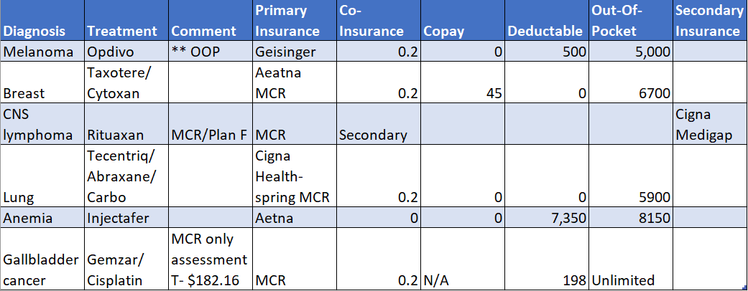
Prepare for Patient
Understand coverage
Identify patient assistance program
Execute a plan to approach the patient
  Assess for Medicaid
  Copay Cards
  Foundations
  Compassionate Care
Santiago, n.d.
Notes:
As we saw from the previous slides, patients can be eligible for different assistance programs. Therefore, keeping track of patients and programs can ensure optimal and comprehensive care.
This is an example spreadsheet created by a navigator that allows the navigator to see all details that necessary about each patient: The diagnosis, what type of treatment is being offered, what kind of insurance (if any) this patient has, do they have co-insurance, how big is the copay, the deductible, out-of-pocket expenses. Such information will be beneficial in helping the Financial Navigator to identify patient assistance programs and have a plan to access Medicaid, copay cards, determine if any foundations could assist the patient, or they could use compassionate care.
Tracking such elements can:
Ensure all infusion patients are accounted for
Assign Financial Navigators to a daily schedule
Easy to identify:
- Who requires assistance
- Population of Medicaid, Medicare, commercial insurance patients

Slide 24
Screening for Financial Distress
Grade | Description
1 | Lifestyle modification (deferral of large purchases or reduced spending on vacation and leisure activities) because of medical expenditure
 | Use of charity grants/ fundraising/copayment program mechanisms to meet costs of care
2 | Temporary loss of employment resulting from medical treatment
 | Need to sell stocks/ investments for medical expenditure
 | Use of savings accounts, disability income, or retirement funds for medical expenditure
3 | Need to mortgage/ refinance home to pay medical bills
 | Permanent loss of job as a result of medical treatment
 | Current debts > household income
 | Inability to pay for necessities such as food or utilities
4 | Need to sell home to pay for medical bills
 | Declaration of bankruptcy because of medical treatment
 | Need to stop treatment because of financial burden
 | Consideration of suicide because of financial burden of care
COmprehensive Score for Financial Toxicity (COST)
Personal Finance Well-Being (PFW) Scale
Financial Toxicity Grading/ Scoring System
Psychosocial assessment tools
De Souza et al., 2017; Khera, 2014; NCCN, 2020; Pfeef.org, n.d.
Notes:
Screening for financial toxicity is essential because it may improve patient outcomes and quality of life by assisting patients with financial issues from early on. Therefore, it is advisable to screen for financial toxicity before and during the treatment.
COmprehensive Score for Financial Toxicity (COST) is a reliable tool to assess the risk of financial toxicity caused by the high cost of treatment. The scale has been shown to be reliable and has demonstrated high internal consistency. It presents the patient with 12 statements and asks them to rate those statements on a five-point Likert scale (from not at all, a little bit, somewhat to quite a bit, and very much).
Another measure that can assess financial toxicity is the Personal Finance Well-Being Scale©. This tool can assess financial health and treatment outcomes to reduce financial distress and improve financial well-being.
Financial toxicity can be graded as: mild (grade 1), moderate (grade 2), severe (grade 3), life-threatening or disabling (grade 4), or fatal (grade 5). The chart above describes what would qualify for each grade. For example, mild financial toxicity might result in a deferral of non-essential purchases or vacation spending while disabling financial toxicity might mean needing to sell one’s home or declare bankruptcy to pay for treatment. Please note that this scale has not yet been validated.
Besides screening patients for financial distress, some providers use psychosocial assessment tools before and throughout the treatment process, such as National Comprehensive Cancer Network (NCCN) Distress thermometer that measures patients’ distress on a scale from 0 to 10.

Slide 25
Be Proactive
Intervene in reducing financial toxicity by proactively assisting patients and optimizing health insurance benefits
  Insurance coverage review
  Open enrollment
  Cancer insurance checklist
Notes:
A cancer diagnosis can be a very stressful experience for a patient. Patients do not always know that they need help; therefore, the Financial Navigator or Patient Navigator assisting with financial navigation should reach out to patients first, rather than being contacted by the patient.
It is important to look into insurance coverage when meeting with the patient for the first time.
Does the patient have insurance?
If not, talk about open enrollment. What plan could benefit the patient the most, and when can they enroll.
Remember that there are open and special enrollments if the patient qualifies. While reviewing insurance benefits, the Financial Navigator needs also to consider the time of the year (whether it is the beginning or the end of the insurance coverage year which typically matches the calendar year), which may impact the out-of-pocket cost/ deductible.
The cancer insurance checklist is available at no-cost online and offers side-by-side insurance plan comparisons. The checklist lists different treatments and how they will to be covered with a particular plan.

Slide 26
Explain Insurance and
Coverage Types
Notes:
Another component of financial navigation is explaining insurance and coverage types.

Slide 27
Important Terms That Require Explanation
Explain insurance coverage and provide assistance options
  Insurance terminology
  Copays
KFF, 2021
Notes:
Research has shown that cancer survivors with low health literacy were more likely to report financial hardship and make financial sacrifices than patients with higher health literacy.
Therefore, it is crucial to make sure the patients understand insurance terminology, such as deductible, out-of-pocket payments, copays, etc. Unfortunately, according to the literature, 7 out of 10 Medicare enrollees reported insurance as confusing and challenging to understand.
It is also essential to see what the patient deductible is, how much has been met so far, and when to renew the benefits.
The opening conversation should be about making sure that the patient understands insurance terminology and the key terms, so you can identify where the patients are at and start talking about assistance.
Most commonly used insurance terms can be found on the GW Cancer Center Financial Toxicity tip sheet, Oncology Patient Navigator guide, or Oncology Patient Navigator Training: The Fundamentals (in Module 3: The Basics of Health Care → Lesson 6: U.S. Health Care Payment and Financing).

Slide 28
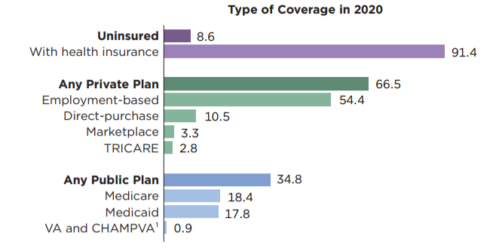
Health Insurance Types
According to US Census 2020 data, 91% of the US population has some type of health coverage
Illustration from US Census Bureau
US Census Bureau, 2021
Notes:
According to US Census 2020 data, 91% of the US population has some type of health coverage. The majority are covered by a private plan, such as employer-based insurance. In terms of public plans, most individuals have Medicare, Medicaid or both.

Slide 29
Private Health Insurance Types
Health Maintenance Organization (HMO)
Preferred Provider Organization (PPO)
Point of Service (POS)
Exclusive Provider Organization (EPO)
US Census Bureau, 2021
Notes:
Just a brief reminder about different types of private health insurance
HMO: Coverage is limited to providers who work/ are contracted for the HMO. Usually, no out-of-network charges are allowed, only with a few exceptions
PPO: This plan provides cheaper services from the in-network providers, and no referrals are needed to see any doctor. Patients can use providers that are out-of-network. However, such service will be more costly
POS: A health plan that provides cheaper services for the providers that belong to the plan’s network. This plan requires a primary doctor referral to see a specialist
EPO: A managed health care plan that covers only the providers and services in the plan’s network

Slide 30
Public Health Insurance Types
Medicaid
Medicare
  - Qualified Medicare Beneficiary Program
  - Specified Low-Income Medicare Beneficiary Program
  - Qualifying Individual Program
  - Qualified Disabled and Working Individuals Program
Medicare.gov, n.d.; Medicare Interactive, n.d.
Notes:
Medicaid: State and federal programs for individuals with a very low income. It may cover older individuals, people with disabilities, children, pregnant women, or parents/ caretakers of children. Each state defines its eligibility guidelines. Medicaid expansion has been left to the states, and some of them opted for expansion.
Medicare: Federal program for individuals who are 65+ or under 65 and have disabilities (no matter the income). Medicare has three different types that cover specific services: Part A mainly covers inpatient hospital stays, hospice, and nursing facility care; Part B covers outpatient care, doctors’ visits, medical supplies, and prevention; Part D covers prescription drugs.
Medicare provides some financial assistance to individuals to pay premiums. There are four main Medicare Savings Programs:
Qualified Medicare Beneficiary Program – assists with Part A and B premiums, deductibles, coinsurance, and copayments
Specified Low-Income Medicare Beneficiary Program – helps patients to pay Part B premiums
Qualifying Individual Program – provides financial assistance to pay Part B premiums for individuals who have Part A and receive low income
Qualified Disabled and Working Individuals Program – help patients to pay for Part A premiums
You can use the website provided on this slide to determine if your patient’s eligible for any of these programs.

Slide 31
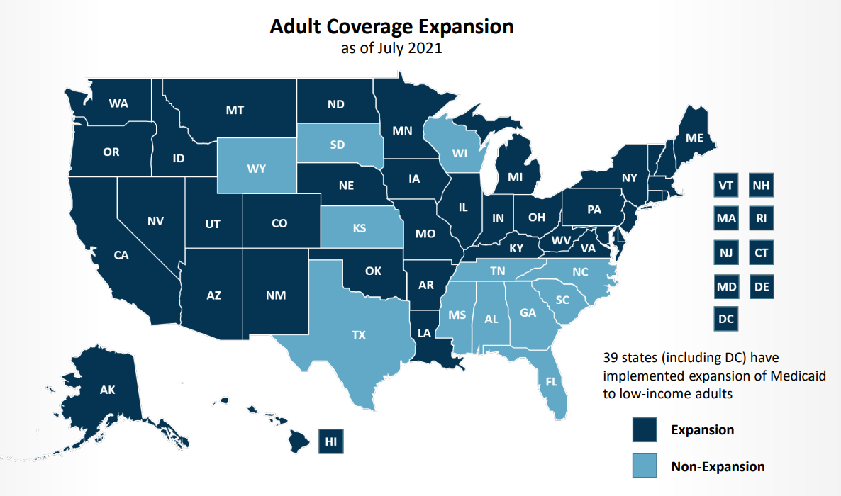
Public Health Insurance Types
The latest list of expansion states can be found on the Medicaid website
Illustration from Medicaid.gov
Medicaid, 2021
Notes:
This website represents the states that have expanded Medicaid adult coverage as of July 2021. Medicaid expansion remains the same as of July 2022. – let’s remove this sentence?

Slide 32
Loss of Insurance: Enrollment Opportunities
Spouse
Consolidated Omnibus Budget Reconciliation Act (COBRA)
HealthWell Foundation
The Affordable Care Act
Notes:
In case a patient or anyone in the household loses insurance, they may qualify for a Special Enrollment Period. Depending on the type of Special Enrollment, a patient may have 60 days prior or 60 after an event to enroll in such a plan.
Enrollment through a spouse
COBRA - continuation coverage by patient’s former employer, same enrollment period
The HealthWell Foundation is a non-profit dedicated to assisting patients in filling the gap when insurance is insufficient. Assistance includes copays, premiums, deductibles, and out-of-pocket expenses
The Affordable Care Act, also known as "Obamacare,“ assists patients to access affordable health insurance through a health insurance marketplace where Americans can purchase federally regulated and subsidized health insurance during open enrollment. To qualify, individuals must sign up during Open Enrollment. However, they could also be eligible for Obamacare if they had a qualifying life event such as changing jobs, getting married/ divorced

Slide 33
Effective Communication Strategies to Support Financial Navigation
Notes:
One of the most important component of financial navigation is effective communication strategies to support financial navigation.

Slide 34
Clear Communication
It is important to have clear communication with patients and caregivers on the cost of care, patient assistance support, and additional resources
Notes:
It is important to have clear communication with patients and caregivers on cost of care, patient assistance support, and additional resources.

Slide 35
Health Insurance Literacy
Multiple studies have shown that patients are not familiar with the health insurance terms
“Premium” and “deductible” are most familiar terms
Terms “out-of-pocket maximum” and “co-insurance” were are less familiar
Only 52% of study participants knew the majority of insurance terms
Health Care Dive, 2017; KFF, 2014
Notes:
In 2017, United Health Care surveyed more than 1,000 individuals and found that most participants were familiar with terms like “health plan premium” and “health plan deductible.” Still, less than half of the participants knew other terms, such as “out-of-pocket maximum” and “co-insurance.”
Kaiser Family Foundation (KFF) asked more than a thousand people to answer online survey questions about insurance terms knowledge in 2014. Only half of the sample answered seven questions out of ten correctly, which indicates that most people do not know enough to understand their health care coverage.

Slide 36
Health Literacy
Individuals more likely to have low health literacy
Older than 65
Limited education
Lower Socioeconomic Status (SES)
Chronic conditions
Non-native English speakers
Hickey et al., 2018; Van der Heide et al., 2013
Notes:
It is essential to assess patients’ literacy levels.
Insurance terms can be complex and challenging to be comprehended. People that are more likely to have lower health literacy are people:
Older than 65 (health literacy decreases with age)
With limited education (pre-primary or primary education level)
Lower socioeconomic status (SES) (earning less than $15,000 annually)
Chronic conditions
Non-native English speakers
Limited patient health literacy levels may affect patients from sharing information about their health. It might also make them less likely to complete complex forms that have questions or terms they don’t understand, particularly when some mathematical concepts are included, such as probabilities.

Slide 37
Building Trust in Patient-Financial Navigator Relationship
Active listening
Open-ended questions
Teach-back method
Visual aids
Educational materials
Interpreters
ACCC Financial Advocacy Network, 2019: AHRQ, n.d.; New Brunswick Association for Community Living, n.d.; NCI, 2021
Notes:
So how does one communicate effectively with patients who have different health literacy levels?
A key component is building trust with the patient
Actively listen to patients (listen and respond to feelings, reflect, and note both verbal and non-verbal cues), use empathy, show respect to the patient and other members of the team
Ask open-ended questions, use reflective listening and summarize what the patient has told you
Financial Navigators need to make sure they take time to explain complex insurance terms. One way to do that is by using the teach-back method. First, ask patients to repeat back what you described, then clarify some steps that the patient didn’t understand, and then again ask the patient to repeat the same information
Visual aids may assist in making complex terms easily understood, such as pictures, diagrams (see example in the resource section)
Use educational materials. They can be presented in waiting areas as educational videos or flyers
Use interpreters for individuals who don’t speak English or for whom English is a second language. Visuals can be helpful to native English speakers, too!

Slide 38
Effective Communication with Patients
Cancer patients have special communication needs
Check to ensure patient understanding of insurance benefits to support patients’ empowerment
NCI, 2021
Notes:
Good communication is important in many settings; however, cancer patients have special communication needs. Patients feel more satisfied when they have a sense of control.
Proactive communication with the patients explaining their insurance benefits and making sure that this is well understood may support patients’ empowerment and help them feel less worried about the financial situation.

Slide 39
Continuous Communication
Retain continuous communication with patients and their caregivers
  Cost of care
  Patient assistance
  Additional resources
Notes:
Keep continuous communication with patients and their caregivers, particularly focus on:
Cost of care
Patient assistance programs
Additional resources
The Financial Navigator helps the patient determine the payment plan for the treatment after investigating the patient’s income and overall budget.

Slide 40
Patients: Think Like an Advocate
Know your insurance plan and coverage
Deductibles
Maximum out-of-pocket
Copays
Know the benefits available through your employer
Family and Medical Leave Act
Short- and Long-Term Disability
Critical Illness Insurance
Ask your physician and care team questions
Notes:
Think like an advocate for your patients and mentor them to be advocates for themselves.
A great way to support patients’ empowerment is by increasing their knowledge about insurance plans, coverage, and benefits offered through their employer. Encourage patients to ask their cancer care team questions.

Slide 41
Financial Navigation Management, Tracking, and Reporting
Notes:
Next component of the financial navigation is its’ management, tracking, and reporting.

Slide 42

Manage, Track, and Report
Manage, track, and report on all financial navigation and patient access services
  Patient outreach
  Patient assistance programs
  Daily tracker
Illustration from iStock library authorized by subscription
Notes:
As we saw from the previous slides, there are a lot of patient assistance programs and other resources out there.
It is helpful to have a system in place that allows you to track each patient, manage their care, and create reports. Specifically, focus on tracking patient outreach efforts, patient assistance programs, and using a daily tracker for patients. You can use patient navigator software programs, or you can create a spreadsheet that would meet your needs based on various patient criteria.
The Financial Navigator is a relatively new position, and lack of standardization may lead to confusion and poor patient health outcomes. By incorporating accurate tracking into their position, Financial Navigators can demonstrate the value of their work and job security.
The tracking might be done using well-known software, such as Microsoft Office, or specific cancer care programs, such as:
TailorMed, AssistPoint, or Atlas Health

Slide 43
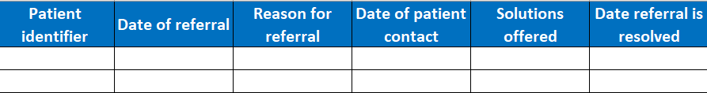
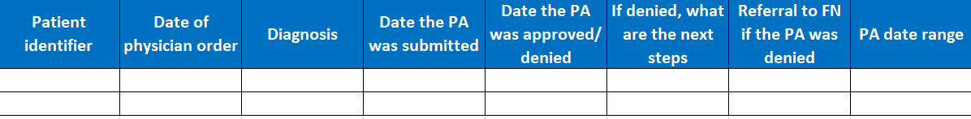
Patient Referral & Prior Authorization (PA) Process Tracking
ACCC Financial Advocacy Network, 2019
Notes:
ACCC suggests tracking the following elements in financial navigation for cancer patients:
How frequently patients are referred to the Financial Navigators (date/ reason/ solutions offered and when the issue was solved). This helps to identify the need for this position.
Prior authorization (PA) process – when the provider's order was entered/ when was the PA form submitted/ when it was denied or accepted/ why)

Slide 44
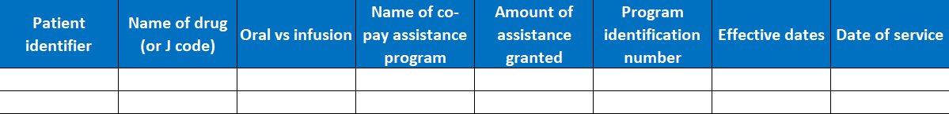
Copay Assistance & Patient Assistance Programs and Drug Replacement Tracking
ACCC Financial Advocacy Network, 2019
Notes:
More suggestions on how to track patient assistance programs:
Copay assistance programs – the name of the drug/ oral vs. infusion type/ the name of Patient Assistance Program and amount of assistance provided/ effective dates/ dates of service
Patient assistance programs and drug replacement programs – the name of the drug/ dose/ date when the drug was requested and received/ date of service/ name of the program/ savings for the patient/ billing adjustments requested
Keeping records of patient assistance programs is essential:
Easy to track and follow-up on:
Payments
Pending claims
Identify issues:
Delays from patient assistance program
Coding issues

Slide 45
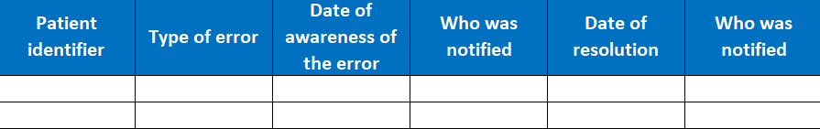
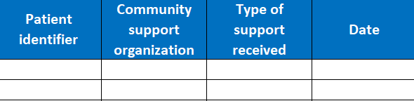
Billing Errors & Community Support Tracking
Possible error types
Duplicate billing
Unbundling
Insufficient information
Incorrect coding
ACCC Financial Advocacy Network, 2019
Notes:
Financial Navigators may also be the go to person for a patient who is having a difficult time with their bills. There are times that there are billing error that need to be resolved.
Billing errors – how often they occur/ type/ when they were noticed/ solved
Some examples of billing errors are:
Duplicate Billing – which is exactly what it sounds like – billing twice for the same service
Unbundling – to explain this, we need to start with what bundling is – bundling is putting together codes for procedures that are normally billed together. A billing error could be separating those codes and billing them separately – this is what is called unbundling.
Insufficient information – is not sending enough information to the insurance company for payment. This can include information about previous procedures and treatments, and information about an authorization that was obtained
Coding is very important to medical billing, so billing with an incorrect code can get a bill rejected
Community support organizations – there might be several such organizations that can provide the support within various communities. Tracking is essential: Document the type of support, like transportation, or financial assistance, this information will be a help to your organization Community Benefit Reports, even if they do not provide direct revenue to the facility

Slide 46
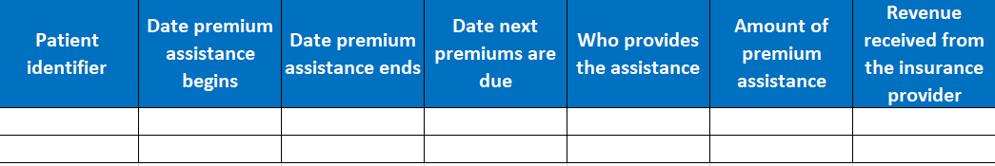
Other Tools
Premium Assistance Tracking
ACCC Financial Advocacy Network, 2019
Notes:
Premium assistance tracking – important to track when it begins and when it ends/ who provides the assistance and amount of it

Slide 47
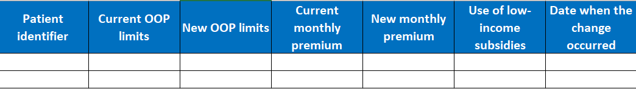
Other Tools
Insurance Optimization
ACCC Financial Advocacy Network, 2019
Notes:
Insurance optimization – track the original out-of-pocket (OOP) limits and what potential new OOP would be, also note current premiums and the new premiums, among other details

Slide 48
Track, Measure, and Report Value
Tracking | Measuring | Reporting Value
Total # of applications submitted | Number of applications submitted | Volume of assistance programs
Total # of patients | Number of new patients who met a financial navigator | Volume of new patients being seen
Total # of charity care apps submitted | Number of applications submitted | Assistance provided when no other patient assistance available
Total # of claims paid | The number of claims billed to the copay/ foundation program after the insurance paid | Dollar amount that was applied to the patient’s balance
Total # of patients: Free drug approved | Number of patients enrolled into a free/ drug replacement program | The dollar amount of the drug credit received that did not need to be written off against the infusion center
Santiago, n.d.
Notes:
This table provides a summary of different types of tracking, what they measure, and reporting value.
Total Number of Applications Submitted:– this is measuring the number of applications submitted. This is important information, both the volume and when looking at the time from meeting with the patient to approval, it can be used in a business case to support your financial navigation program
It is also important to track the number of new patients – this can be measured by financial navigator, and reports volume and productivity of individuals and a team
Charity care will not be fully alleviated with a financial navigation program, so it is important to continue tracking this number by measuring the number of applications submitted.
The dollar amount of the claims paid is an important number to show the value of copay assistance. This is measured when the claims are paid by the copay program.
Patient on free drug show the cost avoidance of the free drug program. Both the number of patients on free drugs, the number of free drugs the patient is on, and the cost avoided by both the facility and the patient can be measured here.

Slide 49
Benefits of the Financial Navigator Daily Tracker
Allows fair distribution of work among team
Shows the need for the position
Enables supervisor to complete quality checks
Notes:
Finally, the daily trackers are beneficial for the Financial Navigators:
To distribute workload among the cancer care team
To show the value of the Financial Navigator position
To make it easier for the supervisor to do quality checks

Slide 50
Staff Awareness
Notes:
Do not forget to include all staff in financial navigation.

Slide 51
Staff Awareness
Discuss more affordable treatment plans with the cancer care team if possible
Ensure that providers and cancer program staff are aware of ongoing policy requirements from payers for coverage of services
  Family Reach
  The Lung Cancer Foundation of America
Notes:
One of the most important keys of a successful financial navigation model is to improve cost transparency and have a conversation about cost at the time of surgical decision-making.
If clinicians are trying to find out more about financial assistance for their patients, they can contact the following organizations:
Family reach – nonprofit that aims to reduce the financial barriers accompanying a cancer diagnosis. They work with patients and healthcare professionals at more than 400 top-tier hospitals and cancer centers, striving to reach more families before they hit critical financial breaking points
The Lung Cancer Foundation of America – information about the risks and symptoms of lung cancer, the latest research discoveries, and advocacy through lung cancer research funding

Slide 52
Financial Navigation Strategies
Notes:
Final key component is financial navigation strategies.

Slide 53
Financial Navigation Programs
Financial navigation can provide concrete assistance in navigating the treatment costs and reducing patient’s anxiety about the financial burden of the cancer care expenses
Financial navigation programs should be provided in an acceptable and accessible method along the cancer care continuum
Shankaran et al., 2018
Notes:
In 2018, a pilot study was conducted to assess the feasibility and impact of a financial navigation program designed to inform patients about treatment costs, assist them with the management of out-of-pocket expenses, and provide them with financial counseling. Eligible patients received financial education and monthly financial coaching. At baseline, 37% and 47% of patients experienced financial burden and anxiety, respectively. Post-enrollment results from 15 patients who could be assessed over the course of the study period showed a self-reported decrease in anxiety level in 5 patients. Self-reported survey findings indicated that 83% of the participants reported high satisfaction with the financial navigation program. The authors concluded that financial navigation can help navigating the treatment costs and may reduce patients’ anxiety about the financial burden of cancer care expenses.
Financial navigation programs should be provided in an acceptable and accessible method along the cancer care continuum.

Slide 54
Individuals Who Benefit from Financial Navigation the Most
Uninsured or underinsured
Patients with advanced-stage disease or on high-cost oral medications
Consolidated Omnibus Budget Reconciliation Act (COBRA) recipients
Affordable Care Act (ACA) enrollees
Patients with Medicare A/ B or who are new to Medicare
Notes:
As mentioned earlier, financial toxicity may cause anxiety to patients who already endure physical, emotional, and financial difficulties once they are diagnosed with cancer.
Individuals who benefit from financial navigation the most:
Uninsured or underinsured
Patients with advanced-stage disease or on high-cost oral medications
Consolidated Omnibus Budget Reconciliation Act (COBRA) recipients
Affordable Care Act enrollees
Patients with Medicare A/ B only or who are new to Medicare

Slide 55
Mitigation Strategies
Leverage financial toxicity screening tools
Embed Financial Navigators in outpatient centers
De-implement services that add costs without proven beneficial outcomes
Change care plan to reduce out of pocket costs
Notes:
A few studies have reported various interventions for mitigating financial toxicity:
Leverage financial toxicity screening tools – to help identify people at risk
Embed Financial Navigators in outpatient centers to offer resources for financial assistance to patients at risk of financial toxicity
De-implement services that add costs without proven beneficial outcomes
Change the care plan to reduce out of pocket costs – this requires physician consultation. Be sure quality of care is not sacrificed in the process

Slide 56
Internal Connections
Patient Access
When a patient has insurance
concerns
Benefit investigations
Price estimates
Hospital Financial Counselor
Medicaid application
Charity assistance
Payment plans
Cancer Center Financial Counselor
Manufacturer copay programs
Foundation copay assistance
Pharmacy
Manufacturer patient assistance programs
Manufacturer replacement programs
Social Work
Disability applications
Low-income subsidies
Living expenses
Billing
When a patient has billing concerns
Billing copay assistance programs
Notes:
This is a list of possible internal stakeholders that could help you create an effective financial navigation program. If you don’t have all these positions where you work, advocate for their importance and potential cost savings for the patient and the institution.

Slide 57
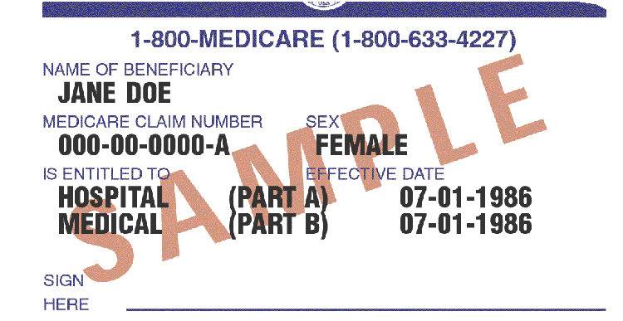


External Connections
Medicare Enrollment/ Medigap Enrollment
Senior services
A trusted insurance agent
ACA Enrollment
In-person navigators
A trusted insurance agent
Local & Community Resources
Nonprofit organizations
Notes:
This is a list of possible external stakeholders that could assist in creating financial navigation program. Please consider Medicare, Medigap, and ACA enrollments, in addition to using local and community resources.

Slide 58






National Organizations
www.nccn.org/
www.accc-cancer.org/
http://cpan.communityoncology.org/
www.asco.org/
Notes:
These are some examples of national organizations that can assist with developing financial navigation in your cancer care team.

Slide 59
Your Cancer Team Members Are Here to Help
You are not on your own!
Financial Counselors/ Financial Advocates/
Financial Navigators
Patient Navigators/ Patient Advocates
Social Workers
Notes:
Remember, you are not on your own! Your cancer team members are here to help. Working together can:
Align and unite for a common goal
Eliminate fear of job elimination
Create clear processes

Slide 60
Resources
Guidelines:
ACCC Financial Advocacy Services Guidelines
ACCC Financial Advocacy Toolkit
ACCC Patient Assistance and Reimbursement Guide
Financial Advocacy and Navigation Trainings:
ACCC Financial Advocacy Bootcamp (Members only)
NaVectis Financial Navigation Training Program
Local SHIP Federal Grant Program
Notes:
Social Workers, Nurse Navigators, and Patient Navigators already do some financial navigation. In order to standardize the financial navigation, ACCC created financial advocacy service guidelines, toolkit, and patient assistance and reimbursement guide.
In addition, for those interested in enrolling in financial advocacy and financial navigation trainings, this is a list of possible courses that could be helpful, such as ACCC Financial Advocacy Bootcamp (for ACCC members only), NaVectis Financial Navigation Training program, and local SHIP federal grant program.

Slide 61

Other Resources
Oncology Roundtable
Network with colleagues
Notes:
Other resources for successful financial navigation.

Slide 62
Case Study
Notes:
The following case study is intended to support learning and practice using training materials to assist patients.

Slide 63

Case Study
Illustration from iStock library authorized by subscription
1. Explain insurance coverage and help enroll in manufacturer copay assistance program
2. Facilitate copay billing – communicate with billing team to ensure copay program is billed
Keep in communication with patient
Patient alerts you that her husband has been laid off and they will be losing their insurance coverage!

Slide 64
Case Study
COBRA for family
  Premium is $1,700
  Premium Assistance is available, but only for patient
  Family is concerned about how they will pay with reduction in income
Illustration from iStock library authorized by subscription
COBRA for patient
  You CAN get COBRA for just the patient EVEN if they were not the Policy Holder
  Rest of the family can enroll in ACA and benefit from Premium Subsidies (maybe even cost sharing)

Slide 65
Acknowledgments
This webinar was supported by Cooperative Agreement #NU58DP006461-03 from the Centers for Disease Control and Prevention (CDC).
The views expressed do not necessarily reflect the official policies of the Department of Health and Human Services, nor does the mention of trade names, commercial practices, or organizations imply endorsement by the U.S. Government.

Slide 66
References
Agency for Healthcare Research and Quality. (n.d.). Health Literacy Universal Precautions Toolkit, 2nd Edition. https://www.ahrq.gov/health-literacy/improve/precautions/tool5.html.
American Cancer Society. (2021). Understanding Financial and Legal Matters. https://www.cancer.org/treatment/finding-and-paying-for-treatment/understanding-financial-and-legal-matters.html.
Association of Community Cancer Centers (ACCC) Financial Advocacy Network. (2019). Financial Advocacy Boot Camp Level I. https://www.accc-cancer.org/home/learn/financial-advocacy/boot-camp.
CancerandCareers.org. (2021). https://www.cancerandcareers.org/en.
Carrera, P. M., Kantarjian, H. M., & Blinder, V. S. (2018). The financial burden and distress of patients with cancer: Understanding and stepping-up action on the financial toxicity of cancer treatment. CA: A Cancer Journal for Clinicians, 68(2), 153-165. doi:10.3322/caac.21443.
De Souza, J. A., Yap, B. J., Wroblewski, K., Blinder, V., Araújo, F. S., Hlubocky, F. J., . . . Cella, D. (2017). Measuring financial toxicity as a clinically relevant patient-reported outcome: The validation of the COmprehensive Score for financial Toxicity (COST). Cancer, 123(3), 476-484. doi:10.1002/cncr.30369.
HealthCare.gov. (n.d.). Enroll in or Change 2021 Plans — Only With a Special Enrollment Period. The White House. https://www.healthcare.gov/coverage-outside-open-enrollment/special-enrollment-period/.
HealthCare.gov. (n.d.). COBRA Coverage and the Marketplace. The White House. https://www.healthcare.gov/unemployed/cobra-coverage/#:~:text=When%20you%20lose%20job%2Dbased,coverage%20by%20your%20former%20employer.&text=Losing%20job%2Dbased%20coverage%20qualifies,the%20annual%20Open%20Enrollment%20Period.
HealthCare.gov. (n.d.). Health Insurance Plan & Network Types: HMOs, PPOs, and More. https://www.healthcare.gov/choose-a-plan/plan-types/.
HealthCareDive.com. (2017). UnitedHealth Survey: Most Americans Don’t Understand Basic Health Plan Terms. https://www.healthcaredive.com/news/unitedhealth-survey-most-americans-dont-understand-basic-health-plan-term/506895/.
Hickey, K. T., Masterson Creber, R. M., Reading, M., Sciacca, R. R., Riga, T. C., Frulla, A. P., & Casida, J. M. (2018). Low health literacy: Implications for managing cardiac patients in practice. The Nurse Practitioner, 43(8), 49-55. doi:10.1097/01.NPR.0000541468.54290.49.
Iragorri, N., de Oliveira, C., Fitzgerald, N., & Essue, B. (2021). The out-of-pocket cost burden of cancer care-a systematic literature review. Current Oncology, 28(2), 1216-1248. doi:10.3390/curroncol28020117.

Slide 67
References
KFF. (2021). 7 in 10 Medicare Beneficiaries Report That They Did Not Compare Their Coverage Options During a Recent Open Enrollment Period. https://www.kff.org/medicare/press-release/7-in-10-medicare-beneficiaries-report-that-they-did-not-compare-their-coverage-options-during-a-recent-open-enrollment-period.
KFF. (2014). Assessing Americans' Familiarity With Health Insurance Terms and Concepts. https://www.kff.org/health-reform/poll-finding/assessing-americans-familiarity-with-health-insurance-terms-and-concepts/.
Khera, N. (2014). Reporting and grading financial toxicity. Journal of Clinical Oncology, 32(29), 3337-3338. doi:10.1200/JCO.2014.57.8740.
Medicaid.gov. (2021). Adult Coverage Expansion as of July 2021. https://www.medicaid.gov/medicaid/program-information/downloads/medicaid-expansion-state-map-10-2021.pdf.
Medicare.gov. (n.d.). What’s Medicare? https://www.medicare.gov/what-medicare-covers/your-medicare-coverage-choices/whats-medicare.
MedicareAdvantage.org. (2020, September 1). Most Medicare Beneficiaries Don't Understand Their Coverage. TZ Insurance Solutions LLC. https://www.medicareadvantage.com/original-medicare/medicare-literacy-survey.
Medicare Interactive.org. (n.d.). Differences between Medicare and Medicaid. https://www.medicareinteractive.org/get-answers/medicare-basics/medicare-coverage-overview/differences-between-medicare-and-medicaid#:~:text=Medicare%20is%20a%20federal%20program,have%20a% 20very%20low%20income.&text=They%20will%20work%20together%20to,coverage%20and%20lower%20your%20costs.
National Cancer Institute. (2019, September 20). Financial Toxicity (Financial Distress) and Cancer Treatment (PDQ®)–Patient Version. https://www.cancer.gov/about-cancer/managing-care/track-care-costs/financial-toxicity-pdq#_247.
NCCN. (2020). Distress During Cancer Care. https://www.nccn.org/patients/guidelines/content/PDF/distress-patient.pdf.
New Brunswick Association for Community Living. (n.d.). Tips for Being an Effective Advocate. Community Living NB. https://nbacl.nb.ca/module-pages/tips-for-being-an-effective-advocate/.
National Cancer Institute. (2021). Communication in Cancer Care (PDQ®)–Patient Version. https://www.cancer.gov/about-cancer/coping/adjusting-to-cancer/communication-pdq.
Obamacare-Plans.com. (2021). Get 2021 Health Coverage. https://www.obamacare-plans.com/?_ci=5679953&_ai=&_ap=&_d=c;CQ0-3n1teJDpzIT3DJe2Z3Of47CyGNrRs9eC15gBCfPDtQY7d5NXcJ2ORW5WIpumYociogbNYqUol7g7c8m5io_YJRkQGA&gclid=Cj0KCQiAzZL-BRDnARIsAPCJs71FhJMwtJBKdK61G2Z13khdfdbLPsRwu3DhYmfYiuZLEOg6-UazhzAaApmTEALw_wcB.

Slide 68
References
Offodile, A. C., Asaad, M., Boukovalas, S., Bailey, C., Lin, Y. L., Teshome, M., ... & Butler, C. (2020). Financial toxicity following surgical treatment for breast cancer: a cross-sectional pilot study. Annals of Surgical Oncology, 1-12.
Pfeef.org. (n.d.). Using the Personal Finance Well-Being Scale©. https://pfeef.org/wp-content/uploads/2016/09/Using-PFW-Scale-051606.pdf.
Santiago, A. (n.d.). We need a Financial Navigator! AONN+ 11th Annual Navigation and Survivorship Conference.
Shankaran, V., Leahy, T., Steelquist, J., Watabayashi, K., Linden, H., Ramsey, S., ... & Overstreet, K. (2018). Pilot feasibility study of an oncology financial navigation program. Journal of oncology practice, 14(2), e122-e129.
Sherman, D. (2019). Growing and Sustaining a Robust Financial Navigation Program. The NaVectis Group. https://www.accc-cancer.org/docs/Documents/meetings/orm-2019/growing-sustaining-financial-navigation-Sherman.
United States Census Bureau. (2021). Percentage of People by Type of Insurance Coverage and Change from 2018 to 2020. https://www.census.gov/content/dam/Census/library/visualizations/2021/demo/p60-274/figure1.pdf.
van der Heide, I., Wang, J., Droomers, M., Spreeuwenberg, P., Rademakers, J., & Uiters, E. (2013). The relationship between health, education, and health literacy: results from the Dutch Adult Literacy and Life Skills Survey. Journal of health communication, 18 Suppl 1(Suppl 1), 172–184. https://doi.org/10.1080/10810730.2013.825668.
Watabayashi, K., Steelquist, J., Overstreet, K. A., Leahy, A., Bradshaw, E., Gallagher, K. D., ... & Shankaran, V. (2020). A pilot study of a comprehensive financial navigation program in patients with cancer and caregivers. Journal of the National Comprehensive Cancer Network, 18(10), 1366-1373.
Yap SL, Wong SS, Chew KS, Kueh JS, Siew KL. Assessing the Relationship between Socio-demographic, Clinical Profile and Financial Toxicity: Evidence from Cancer Survivors in Sarawak. Asian Pac J Cancer Prev. 2020;21(10):3077-3083. Published 2020 Oct 1. doi:10.31557/APJCP.2020.21.10.3077.
Zafar, S. Y., & Abernethy, A. P. (2013). Financial toxicity, Part I: a new name for a growing problem. Oncology (Williston Park), 27(2), 80-81, 149.
Zahnd, W. E., Davis, M. M., Rotter, J. S., Vanderpool, R. C., Perry, C. K., Shannon, J., ... & Eberth, J. M. (2019). Rural-urban differences in financial burden among cancer survivors: an analysis of a nationally representative survey. Supportive Care in Cancer, 27(12), 4779-4786.

Slide 69

Thank you!
Clara Lambert, CPH, BBA, OPN-CG
Follow us on Twitter: @GWCancer
www.gwcancercenter.org
Sign-up for the GW Cancer Center’s Patient Navigation
and Survivorship E-Newsletter: bit.ly/PNSurvEnews
Sign-up for the GW Cancer Center’s Cancer Control
Technical Assistance E-Newsletter: bit.ly/TAPenews
Notes:
Thank you for participating in this module.

