Slide 1

This content may be used or adapted for noncommercial, educational purposes only. Please use the following citation:
George Washington University Cancer Center TAP. (2022). Implementation Science Base Camp [PowerPoint Slides]. GWU Cancer Center TAP. https://cme.smhs.gwu.edu/gw-cancer-center-/content/implementation-science-base-camp
This content was adapted from the GW Cancer Center the Oncology Patient Navigation Training: The Fundamentals (PI: Pratt-Chapman) developed and maintained by CDC cooperative agreements #NU38DP004972, #5NU58DP006461 and #NU58DP007539. The content added, changed, or adapted by our organization do not necessarily represent the views of the GW Cancer Center or the CDC.
If you have any questions about the following material or would like permission to use this material, please contact cancercontrol@gwu.edu

Slide 2
Introduction to Cancer Control Implementation Science Base Camp
Notes:
Hello, Welcome to the Cancer Control Implementation Science Base Camp from the GW Cancer Center. I'm Kelly Wells Sitting the Executive Director of the Iowa Cancer Consortium.

Slide 3
Disclosure
This session was supported by Cooperative Agreement #NU58DP006461-03 from the Centers for Disease Control and Prevention (CDC). The views expressed in written workshop materials or publications and by speakers and moderators do not necessarily reflect the official policies of the Department of Health and Human Services, nor does the mention of trade names, commercial practices, or organizations imply endorsement by the U.S. Government.
Notes:
This session was supported by a cooperative agreement from the Centers for Disease Control and Prevention.
The views expressed in written workshop materials or publications and by speakers and moderators do not necessarily reflect the official policies of the Department of Health and Human Services.
Nor does the mention of trade names commercial practices or organizations imply endorsement by the US Government.

Slide 4

Welcome
Let’s work together to learn how to optimize cancer screening interventions to reduce health disparities!
From this training, you will:
  Learn a lot about implementation science
  Be prepared to bring this back to your unique context
Notes:
We are excited to share this new training program with you. The training is called Cancer Control Implementation Science Base Camp, because it aims to provide you with all of the supplies and tools, you need to pack your bag and head up the mountain of implementation.
We know, putting evidence based interventions into practice can be challenging like climbing a mountain.
But with the right tools, you and your partners can learn how to optimize cancer screening interventions to reduce health disparities. From this training, you will learn a lot about implementation science and be prepared to bring this back to your unique context.
From this training, you will:
Learn a lot about implementation science
Be prepared to bring this back to your unique context

Slide 5
Purpose
Increase cancer control practitioners’ knowledge of and capacity for implementing and optimizing cancer screening evidence-based interventions (EBIs) that fit within their unique context
Provide the knowledge, tools, and hands-on experience for learners to conduct implementation science in their settings
Notes:
The purpose of the base camp is to increase comprehensive cancer control practitioners knowledge of, and capacity for implementing and optimizing cancer screening EBI's or evidence based interventions.
That fit with each of their contexts, for the purposes of this training we consider a cancer control practitioner to be any of the following: comprehensive cancer control program directors, national breast and cervical cancer early detection program project level staff,
National colorectal cancer control program project level staff, coalition members and leaders, clinicians, executive leadership, and researchers and evaluators.
We also want to provide knowledge, tools and experience for you to use implementation science approaches to optimize cancer control in your own settings.

Slide 6

Session Agenda
  Intro to Cancer Control Implementation Science Base Camp
Notes:
This quick sessions agenda includes an introduction to the foundation of implementation science in order to help you navigate the base camp.

Slide 7

Learning Objectives
Define basic implementation science terms
Establish a high-level understanding of how implementation science can be used to improve cancer screening
Describe how to implement evidence-based interventions through a health equity lens
Notes:
The 3 main learning objectives of this session are listed here.
We will begin to describe how to implement EBIs through a health equity lens in this session by incorporating equity elements into SMARTIE objective development – a spin on the commonly used SMART objective. You will also notice this theme of health equity throughout the entire Base Camp training. An important part of climbing a mountain is preparing for everyone to make it up together—you can use this vision to guide your equity work where everyone has the tools to achieve their goals.
Likely you have already begun this process and are not starting from scratch. Take your time to really integrate this new material into your current initiatives.

Slide 8
Implementation Science
Implementation science is the study of ________ to promote the adoption and integration of _________________, interventions, and policies into routine ___________and ________________ settings to improve our impact on _________________________ (2019)
Methods
Word Key:
Health Care
Evidence-based Practices
Evidence-based Practices
Health Care
Population Health
Public Health
Methods
Population Health
Public Health
National Cancer Institute, 2019
University of Washington, n.d.
Notes:
Let's see if you can help us fill in the blank here with words from the right to help define what implementation science is. We'll move through this fairly quickly, so please feel free to pause your recording to take time to fill in the blanks.
Implementation science is the study of...
Methods to promote the adoption and integration of...
Evidence based practices, interventions, and policies into routine...
Health care and...
Public Health settings to improve our impact on.
Population health.

Slide 9
Implementation is Transdisciplinary
Anthropology and Sociology
Economics and Finance
Public Health Epidemiology and Statistics
Policy Analysis
Psychology
Organization Studies
Health Promotion
Implementation Science
Kislov et al., 2019
Schackman, 2010
Birken et al., 2017
Bauer et al., 2015
Notes:
There are quite a number of disciplines that together inform the field of implementation science. Some of them are listed here.

Slide 10

Maybe you have been thinking about the challenges to achieving your goals…
“I want to get more people screened for colorectal cancer, but I want to provide options for screening that are equitable, accessible, and acceptable by a certain population in my region”
Notes:
Do you remember the animation where you may have first learned about Base Camp?
Like Talia, maybe you have been thinking about the challenges to achieving your goals.
Like her, maybe you have been deeply considering how to provide interventions that are intentionally designed with equity at the center.
Although this training is focused on improving cancer screening, the ideas in implementation science can be used for many other areas across the cancer continuum such as risk reduction, treatment, survivorship, and palliative care.

Slide 11
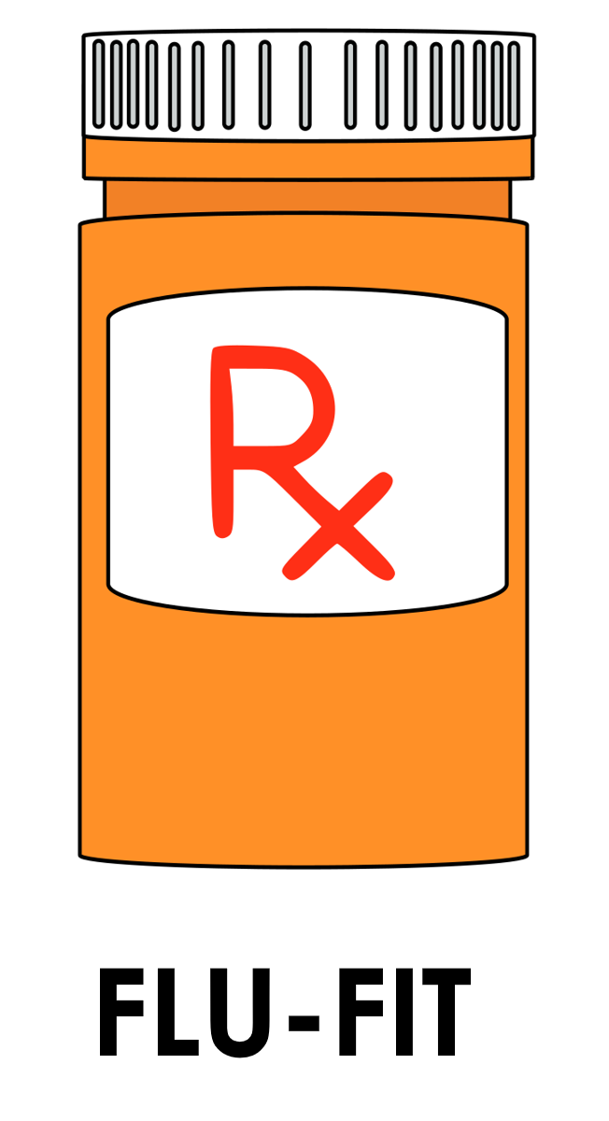
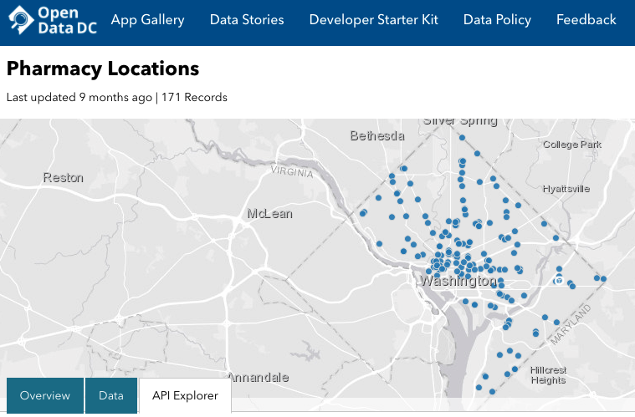
Case Study
Notes:
You will notice this FLU-FIT Pharmacy Logo in the top right of the slide. We want you to be able to use this Base Camp training immediately in your work, so anytime you see this image think “applied case study”.
In the companion material you will find an extended write up of a fictional case study that is woven throughout the Base Camp to illustrate all of the different elements of implementation science. This case study focuses on two areas of Washington DC with high colorectal cancer disparities; in fact, the neighborhoods in the wards we focus on have less than 50% of their population screened for colorectal cancer and documented racial disparities. Preliminary contextual assessment demonstrates that the Federally Qualified Health Center serving the area does not have the capacity to take on new screening interventions due to COVID-19, causing a backlog of work.
Engagement events are uncovering that many pharmacies in the neighborhood are currently taking on the majority of flu shots given because these settings are more accessible than other healthcare sites. This is resulting in more equitable distribution of the vaccine.
What would you do to implement this innovation?
You learn how implementation strategies such as train-the trainer and the use of local champions can enhance the intervention’s effectiveness.

Slide 12
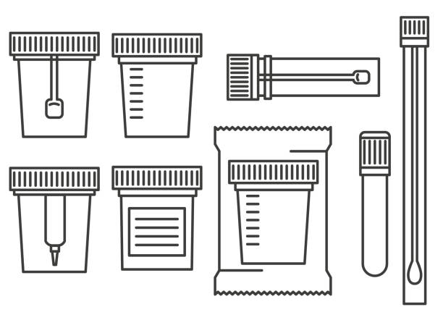

Case Study
Notes:
An implementation team considers these context factors and identifies the FLU-FIT intervention as an evidence-based intervention that just might fit well for the community.
This hypothetical case study walks through an innovative intervention that partners with community-based pharmacies to distribute FLU-FIT kits as a way to increase the accessibility and acceptability of colorectal cancer screening. In the first year of the program, some pharmacies have been successful in introducing FLU-FIT and have preliminary data, but there is no coordinated effort to centralize training and implementation planning.
A clinical champion from the team searches an EBI library to find a bundled package for new FLU-FIT programs. This helps them decide what are the necessary, or core components, of the intervention.
The stakeholder group also uncovers that the pharmacists in the local system respond best to changes that are introduced by their peers who are considered natural leaders in the profession. The team decides to design a strategy to make this program work, by building a train-the-trainer model with local champions becoming the backbone of the intervention.

Slide 13
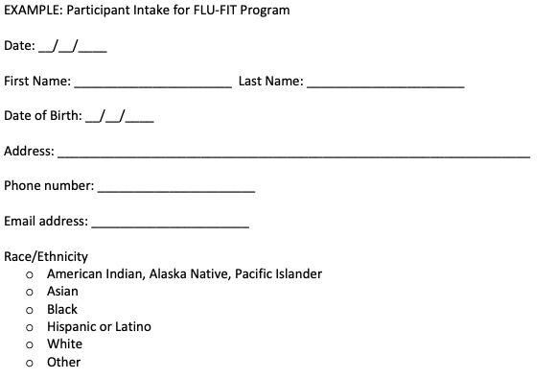
Case Study
Notes:
Initial feasibility evaluation data show that patients find the intervention acceptable and it takes minimal extra time for the technicians to implement.
The team does realize they will need to implement some new strategies to share data between providers and pharmacies to increase the reach and adoption of the program in the future to help institutionalize the change.
The team decides to perform a sustainability assessment and discovers that there are some factors showing the program is sustainable, although there are some indicators that demonstrate a need for planning for extended sustainability into the future.
Follow along with the case study throughout this whole training to see implementation in action.

Slide 14
Base Camp Can Help With:
Implementing cancer screenings projects
Implementing projects across the cancer continuum
Notes:
This training is designed to help coalitions implement cancer screening better by:
Engaging stakeholders in developing a focused objective
Planning interventions that best fit your unique location
Designing an implementation blueprint to guide your process
Proactively planning for sustainability
Although this training is focused on improving cancer screening, the ideas in implementation science can be used for many other areas across the cancer continuum such as risk reduction, treatment, survivorship, and palliative care.

Slide 15

Why Are You Learning This?
Practitioners become increasingly important as research moves from effectiveness to implementation on the knowledge pipeline
You are the key to bridging the gap!
Proctor et al., 2013
University of Washington, n.d.
Notes:
There is a significant gap between what we know works and what we actually do in practice. The key to bridging this is you—practitioners! Researchers can only take you so far. Next you will see a visual of this process as a pipeline.

Slide 16
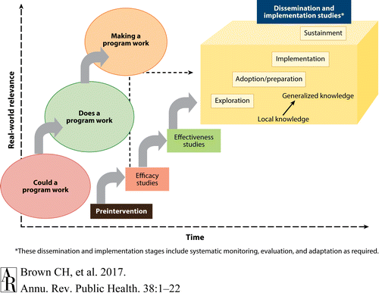
Knowledge Pipeline
Meissner et al., 2013
Bauer et al., 2015
Beidas et al., 2018
Brown, C.H., 2017
Singal et al., 2014
Notes:
Hi I am Heather Brandt and I served as the Co-Associate Director of Outreach, St. Jude Children's Research Hospital & Comprehensive Cancer Center. I will pick up here with the knowledge pipeline.
You can see in this figure as time goes on real world relevance increases.
First is answering the questions ”if a program could work” and “does it work”, which are the major questions in efficacy and effectiveness research.
Efficacy: Efficacy can be defined as the performance of an intervention under ideal and controlled circumstances
Effectiveness: Effectiveness refers to its performance under ‘real-world' conditions
HOW to make a program work is the focus of this training.

Slide 17
What Do We Do?
Help you elevate your unique context and integrate evidence by putting your needs at the center
Start
Ask:
Could a program work?
Does a program work?
Once we know it works, what happens next is up to you!
Notes:
Another way to think about this is shown in this diagram.
Much research is done to establish the efficacy and effectiveness of an intervention.
This is done by asking: could/does a program work?
But once we know it works, what happens next is up to you in terms of making a program work. This is the “HOW” of making a program work.
This Base Camp will help you unpack how to incorporate your unique context into the planning of how to make an intervention work.

Slide 18

Making a Program Work
Facilitate change by:
  Preparing individuals and systems for change if they are not ready
  Adapting the intervention without changing its effectiveness
  Adjusting the environment to integrate the intervention
Notes:
The real world is complicated and sometimes it might feel like you are trying to fit puzzle pieces together that just don’t go together!
Implementation Science has an impressive toolkit to help you see the big picture and facilitate change by:
Preparing those involved for change if they are not ready
Adapting the intervention without changing its effectiveness
Adjusting the environment to integrate the intervention

Slide 19
Case: Designing a SMARTIE Objective
Specific
Measurable
Achievable
Realistic
Timely
Inclusive
Equitable
SMARTIE Objective: Increase colorectal cancer screening among Black residents in Ward 7 of Washington D.C. from 48% to 63% in one year by conducting a train the trainer program with 10 pharmacists across 5 pharmacies and including partnerships with 5 community leaders to overcome institutional racism causing colorectal cancer disparities
Notes:
In your companion guide the first box of the logic model is a space for reflection on your SMARTIE objective that can include a health equity component.
Health equity occurs when every person has the opportunity to attain their full health potential and no one is disadvantaged from achieving this potential because of social position or other socially determined circumstances. In terms of the Base Camp model—you can think of it as working to get everyone up the mountain.
Health equity is a great foundation to start in the planning process required to make a program work well. If not addressed early on in the process, it is at risk of becoming an afterthought. This can lead to community members not fully buying into your intervention at best, and mistrusting change at worse. If you can integrate health equity approaches into your objectives, your team will be held accountable for the outcomes of your process.
You see here a SMARTIE objective example that demonstrates all the elements of the acronym.
SMARTIE Objective: Increase colorectal cancer screening among Black residents in Ward 7 of Washington D.C. from 48% to 63% in one year by conducting a train the trainer program with 10 pharmacists across 5 pharmacies and including partnerships with 5 community leaders to overcome institutional racism causing colorectal cancer disparities

Slide 20
Base Camp Basics
Context
Adaptation
Sustainability
Evidence-Based Interventions
Implementation Strategies
Implementation Outcomes
Beidas et al., 2018
Lewis et al., 2020
University of Washington, n.d.
Notes:
The training is built around the following skill bundles.

Slide 21

Base Camp Basics
Context
Adaptation
Sustainability
Evidence-Based Interventions
Implementation Strategies
Implementation Outcomes
Beidas et al., 2018
Lewis et al., 2020
University of Washington, n.d.
Notes:
Context: The unique factors in a setting that influence the outcomes of implementing an EBI.

Slide 22
Context Matters
Every setting contains unique elements that can help or hinder changes in becoming integrated consistently
Consolidated Framework for Implementation Research (CFIR) will be used to assess context
Bauer and Kirchner, 2020
Notes:
Every setting contains unique elements that can help or hinder changes in becoming integrated consistently.
We will use a popular framework here to assess context. The logo on the top right refers to the Consolidated Framework for Implementation Research or CFIR. Anytime you see this image, you can bet we are referring to context!

Slide 23
Context Considerations
Intervention characteristics
Inner setting
Outer setting
Individuals involved in implementation
    Population(s) of Focus
Process of implementation
CFIR Research Team-Center for Clinical Management Research, 2021
Notes:
This framework examines 5 domains commonly accepted to influence the quality of implementation.
Intervention characteristics
Inner setting at the site where intervention is happening
Outer setting, which examines forces external to the setting where the intervention is happening
Individuals involved in implementation, including if there is a population of focus which could be tied with health equity goals
Lastly, factors related to the process of implementation

Slide 24
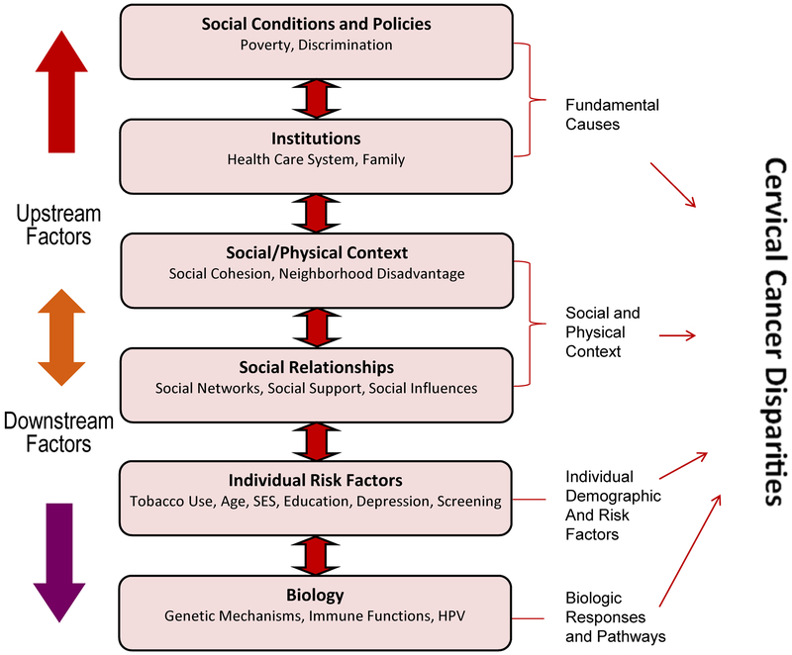
Multilevel Problems
Paskett et al., 2020
Notes:
Taking context seriously into consideration requires us to examine the multiple levels of the problem. For example, this model came out of a collaborative project on cervical cancer disparities in Ohio and Kentucky. We see the upstream factors such as social conditions that affect these disparities, as well more individual level downstream factors such as risk factors and biology.

Slide 25
Multilevel Solutions
Executives
Cancer Coalition representatives
Comprehensive Cancer Control program directors
Clinical providers and public health professionals
Community members and patients
An implementation plan should incorporate multiple levels of your context
Notes:
An implementation plan should incorporate multiple levels of your context. That is why we designed this training for teams taking on implementation challenges together.

Slide 26
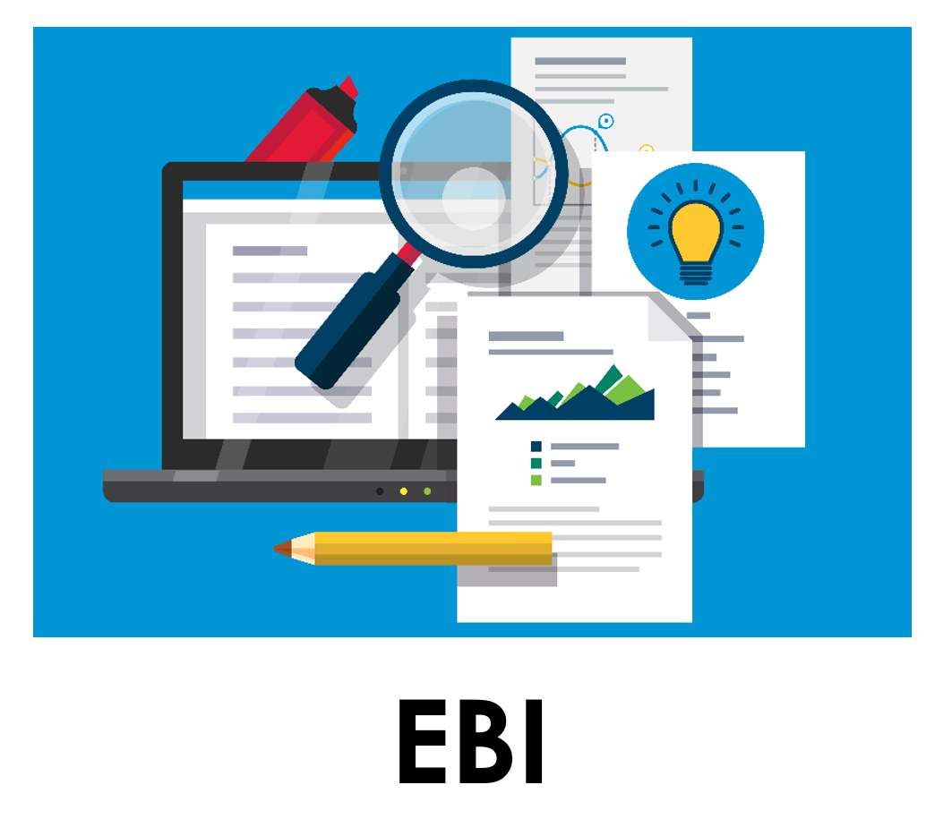
Base Camp Basics
Context
Adaptation
Sustainability
Evidence-Based Interventions
Implementation Strategies
Implementation Outcomes
Beidas et al., 2018
Lewis et al., 2020
University of Washington, n.d.
Notes:
Evidence-based Interventions (EBIs): These are the ”what” of implementation science and can take many different forms.

Slide 27
The ABCs of EBIs
Evidence-Based Interventions:
Health-focused intervention, practice, program, or guideline with evidence demonstrating the ability of the intervention to change a health-related behavior or outcome
Beidas et al., 2018
Lewis et al., 2020
University of Washington, n.d.
Notes:
An EBI is a health-focused intervention, practice, program, or guideline with evidence demonstrating the ability of the intervention to change a health-related behavior or outcome.
These are often included in resources such as the Community Guide or the Evidence-Based Cancer Control Programs database from the National Cancer Institute.
You will notice this image on the top right when we are referring to specific evidence-based interventions.

Slide 28

Base Camp Basics
Context
Adaptation
Sustainability
Evidence-Based Interventions
Implementation Strategies
Implementation Outcomes
Beidas et al., 2018
Lewis et al., 2020
University of Washington, n.d.
Notes:
Adaptations: Everyone knows cookie-cutter interventions and one size fits all approaches just won’t work for the diversity of populations we need to support in our comprehensive cancer control work.

Slide 29
What is Adaptation?
The degree to which an EBI is changed or modified by a user during adoption and implementation to suit the needs
of the setting or to improve the fit to local conditions
Beidas et al., 2018
Lewis et al., 2020
University of Washington, n.d.
Notes:
That is why we include skills related to the adaptation. This is the degree to which an evidence-based intervention is changed or modified by a user during adoption and implementation to suit the needs of the setting or to improve the fit to local conditions.
That is why we chose the chameleon for the image to refer to anytime we are talking about adaptation. Like a chameleon, your intervention will change to fit into its contextual setting.

Slide 30
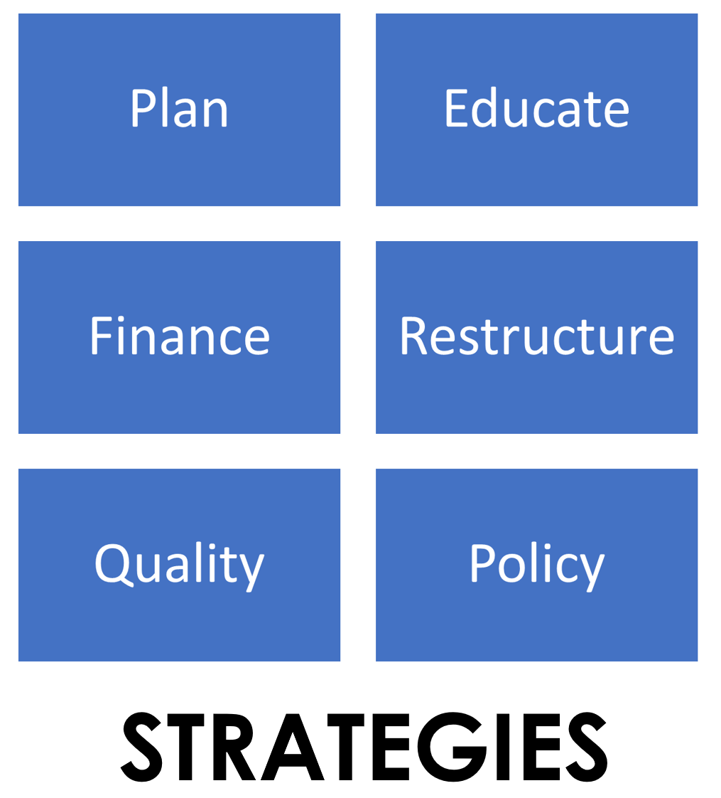
Base Camp Basics
Context
Adaptation
Sustainability
Evidence-Based Interventions
Implementation Strategies
Implementation Outcomes
Beidas et al., 2018
Lewis et al., 2020
University of Washington, n.d.
Notes:
Implementation strategies: Methods or techniques used to operationalize the adoption, implementation, and sustainability of a clinical program or practice.

Slide 31
Implementation Strategies
  Planning
  Educating
  Restructuring
  Quality Management
  Financial & Policy Changes
Notes:
These can include strategies related to planning, educating, restricting, quality management, as well as financial and policy changes in the inner and outer settings where the intervention is occurring.
You will notice this blue grid made of these categories of strategies anytime we are referring to specific documented strategies known to help implement EBIs.

Slide 32
Facilitating Implementation
Brings together context, strategies, and evaluation
Implementing Cancer Screening Interventions:
Stories From the Field
Notes:
Facilitating implementation is where the rubber meets the road. We will highlight several screening case studies that exemplify this process during this session of the Base Camp. Stories from the field will bring together strategies and evaluation with real world stories of implementation from a range of different contexts.

Slide 33
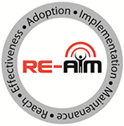
Base Camp Basics
Context
Adaptation
Sustainability
Evidence-Based Interventions
Implementation Strategies
Implementation Outcomes
Beidas et al., 2018
Lewis et al., 2020
University of Washington, n.d.
Notes:
Implementation outcomes are the effects of deliberate and purposive actions to implement new treatments, practices, and services. These outcomes often serve as indicators of implementation success. We often can’t achieve health outcomes without first achieving these markers of quality.

Slide 34

Implementation Outcomes
RE-AIM Framework
  Reach
  Effectiveness
  Adoption
  Implementation
  Maintenance
Notes:
To organize the process of evaluating implementation outcomes—we will introduce another framework called RE-AIM. Each letter of RE-AIM represents an implementation outcome of interest. When you see the logo for RE-AIM shown here in the top right, you will know that we are referring to the evaluation process.

Slide 35

Base Camp Basics
Context
Adaptation
Sustainability
Evidence-Based Interventions
Implementation Strategies
Implementation Outcomes
Beidas et al., 2018
Lewis et al., 2020
University of Washington, n.d.
Notes:
Sustainability is defined as the extent to which an evidence-based intervention can deliver its programming and its intended benefits over an extended period of time after external support is ended.

Slide 36
Sustainability Elements
Environmental Support
Funding Stability
Partnerships
Organizational Capacity
Evaluation
Adaptation
Strategic Planning
Communication
Notes:
When you see the recycle logo, you will know we are talking about the long-term maintenance of an intervention.
Here are some of the elements we will explore related to sustaining an intervention after initial adoption.

Slide 37
Tools and Supplemental Resources
Cancer Prevention and Control Research Network
The Center for Implementation
Center for Participatory Research: Engage for Equity Toolkit
Comprehensive Cancer Control National Partnership Health Equity Tip Sheet
Dissemination and Implementation Resource Guide and Glossary
Freakonomics Postcast: Policymaking Is Not a Science (Yet)
Implementation Science: An Introductory Workshop for Researchers, Clinicians, Policy Makers and Community Members
The Journal of Public Health Management and Practice Implementation Science Podcast with Randy Schwartz and Justin Moore
National Cancer Institute Cancer Facts and Figures 2021
National Cancer Institute Dispatches from Implementation Science at NCI
National Cancer Institute Implementation Science: Context & Equity in Cancer Research Webinar
Notes:
Finally, here are tools, resources, and references to help continue your work in Implementation Science

Slide 38
Tools and Supplemental Resources
National Cancer Institute Implementation Science Practice Tools
National Cancer Institute Implementation Science Webinars Series
National Cancer Institute Newsletter: Opportunities to Advance Health Equity through Implementation Science
National Cancer Institute Orientation to the Science of Dissemination and Implementation Training
National Cancer Institute Training Institute for Dissemination and Implementation Research in Cancer (TIDIRC) Facilitated Course
National Implementation Research Network
State Implementation and Scaling-Up of Evidence-Based Practices
University of California San Francisco Implementation Science Mini Course
The Veterans Affairs Quality Enhancement Research Initiative (QUERI) Program

Slide 39
References
Bauer, M. S., Damschroder, L., Hagedorn, H., Smith, J., & Kilbourne, A. (2015). An introduction to implementation
science for the non-specialist. BMC Psychology, 3(1):32. doi: 10.1186/s40359-015-0089-9
Bauer, M.S. & Kirchner, J., (2020). Implementation science: What is it and why should I care? Psychiatry Research,
283:112376. doi: 10.1016/j.psychres.2019.04.025
Beidas, R., Lewis, C., & Powell. B. (2018). Orientation to dissemination and implementation research in health:
Resource guide. https://cancercontrol.cancer.gov/sites/default/files/2020-05/Orientation-to-DI-Research-in-Health-
Resource-Guide.pdf
Birken, S. A., Powell, B. J., Shea, C. M. Haines, E. R., Kirk, M. A., Leeman, J., Rohweder, C., Damschroder L.,&
Presseau, J. (2017). Criteria for selecting implementation science theories and frameworks: Results from an
international survey. Implementation Science 12(124). https://doi.org/10.1186/s13012-017-0656-y
Brown, C. H., Curran G., Palinkas, L., Aarons, G. A., Wells, K. B., Jones, L., Collins, L. M., Duan, N., Mittman, B.,
Wallace, A., Tabak, R., Ducharme, L., Chambers, D., Neta, G., Wiley, T., Landsverk, J., Cheung, K., & Cruden, G.
(2017). An overview of research and evaluation designs for dissemination and implementation.
Annual Review of Public Health, 38:1, 1-22.
CFIR Research Team-Center for Clinical Management Research. (n.d.). Consolidated framework for implementation
research. https://cfirguide.org
Kislov, R., Pope, C., Martin, G.P., & Wilson, P. (2019). Harnessing the power of theorising in implementation
science. Implementation Science, 14(103). https://doi.org/10.1186/s13012-019-0957-4
Lewis, C. C., Boyd, M. R., Walsh-Bailey, C., Lyon, R., Beidas, R., Mittman, B., Aarons, G., Weiner, B., & Chambers, D.
(2020). A systematic review of empirical studies examining mechanisms of implementation in health.
Implementation Science, 15(21). https://doi.org/10.1186/s13012-020-00983-3

Slide 40
References
Meissner, H. I., Glasgow, R. E., Vinson, C. A., Chambers, D., Brownson, R., Green, L., Ammerman, A., Weiner, B.,
Mittman, B. (2013). The U.S. training institute for dissemination and implementation research in health.
Implementation Science, 8(12). https://doi.org/10.1186/1748-5908-8-12.
National Cancer Institute. (2019). Implementation science at a glance: A guide for cancer control practitioners. https://cancercontrol.cancer.gov/sites/default/files/2020-07/NCI-ISaaG-Workbook.pdf
Paskett, E. D., Pennell, M. L., Ruffin, M. T., Weghorst, C. M., Lu, B., Hade, E. M., Peng, J., Bernardo, B. M., &
Wewers, M. E. (2020). A Multi-level Model to Understand Cervical Cancer Disparities in Appalachia. Cancer
prevention research (Philadelphia, Pa.), 13(3), 223–228.
Proctor, E. K., Powell, B. J. & McMillen, J. C. (2013). Implementation strategies: Recommendations for specifying and
reporting. Implementation Science, 8(139). https://doi.org/10.1186/1748-5908-8-139
Schackman, B. R. (2010). Implementation science for the prevention and treatment of HIV/AIDS. Journal of Acquired
Immune Deficiency Syndromes, 55 Suppl 1(Suppl 1):S27-31. doi: 10.1097/QAI.0b013e3181f9c1da
Singal, A. G., Higgins, P. D., & Waljee, A. K. (2014). A primer on effectiveness and efficacy trials. Clinical and
Translational Gastroenterology, 5(1), e45. doi: 10.1038/ctg.2013.13
University of Washington (n.d). What is implementation science?
https://impsciuw.org/implementation-science/learn/implementation-science-overview/.

Slide 41
Acknowledgments
PI:
Mandi L. Pratt-Chapman PhD
Staff:
Sarah Adler
Joseph Astorino
Leila Habib
Sarah Kerch
Workgroup Members:
Shauntay Davis-Patterson
Caleb Levell
Notes:
Thank you to all those listed here who helped in developing this training.

Slide 42
Assess the Context
Notes:
Welcome to session two of Base Camp.
I am Shauntay Davis Patterson, the program director of the comprehensive cancer control program at the California Department of Public Health.

Slide 43
Disclosure
This session was supported by Cooperative Agreement #NU58DP006461-03 from the Centers for Disease Control and Prevention (CDC). The views expressed in written workshop materials or publications and by speakers and moderators do not necessarily reflect the official policies of the Department of Health and Human Services, nor does the mention of trade names, commercial practices, or organizations imply endorsement by the U.S. Government.
Notes:
This session was supported by a Cooperative Agreement from the Centers for Disease Control and Prevention (CDC). The views expressed in written workshop materials or publications and by speakers and moderators do not necessarily reflect the official policies of the Department of Health and Human Services, nor does the mention of trade names, commercial practices, or organizations imply endorsement by the U.S. Government.

Slide 44
Learning Objectives
Explain the key elements of assessing context
Develop a plan to assess context
Notes:
You will use what you learn in this session to prioritize the needs of your stakeholders so there is a clear shared understanding about the problem your intervention will be addressing. More specifically, you should be able to explain the key elements of assessing context and develop a plan to assess context after this session.

Slide 45
Session Agenda
  Introduce how context is related to focusing on a problem
  Explore a tool for assessing context
  Prepare to analyze fit of EBI
Notes:
Here is the plan for the session so you can see the road ahead.
First, we will introduce how context is related to focusing on a problem. Then we will explore a tool for assessing context. Next, we will prepare to analyze the fit of an evidence-based Intervention.

Slide 46
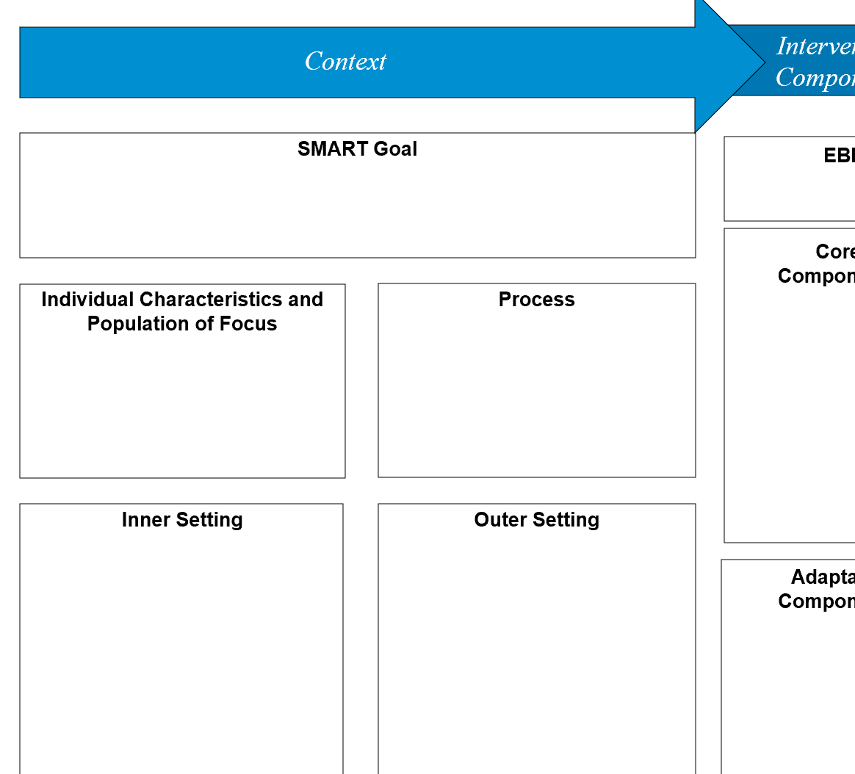
Implementation Blueprint
Notes:
We will be working on the context section of the implementation blueprint.

Slide 47
Why Define the Problem Early?
Allows you to build a team matching the level of the problem
How you define the problem is connected to your implementation goal:
  Behavioral change goals (Attitudes about screening)
  Structural change goals (Accessibility of screening)
Notes:
Getting specific early in the process allows you to build a team matching the level of the problem.
How you define the problem should be connected to your implementation goal. One level you might include in your plan includes the individual level, where you address behavioral change goals. A barrier you might work on at this level is changing attitudes about colorectal cancer screening. Another level you might work on is the systems level, where you address structural change goals. Maybe you decide to work on the access or financial barriers to screening at this level.
Will you aim for behavioral change or structural change goals? Or both?
Are there stakeholders that are missing from your team that you need to invite in after this Base Camp based on your definition of the problem?

Slide 48
Categorizing Behavioral and Structural Change
Behavioral Change:
Example Bank:
Insurance Claims
Patients have no family history; they think they aren’t at risk and don’t have to be screened.
Availability of transportation to screening sites
Patients are concerned about the cost
Patients think the test is difficult or painful, and they may be embarrassed to discuss colorectal cancer screening with their doctor
Patients think screening is only for those who have symptoms
Patients have no family history; they think they aren’t at risk and don’t have to be screened.
Patients think the test is difficult or painful, and they may be embarrassed to discuss colorectal cancer screening with their doctor
Patients are concerned about the cost
Patients think screening is only for those who have symptoms
Structural Change:
Insurance Claims
Availability of transportation to screening sites
Notes:
Here we will play a game to drive home the point that it is important to understand the level of a barrier so that you can address it accordingly. We will start on the right with each barrier from the example bank and you can take a moment to determine if it is a behavioral change level barrier, or a structural change level barrier. Let’s start with insurance claims. Insurance claims are a structural change barrier.
Next, patients have no family history they think they aren't at risk and don't have to be screened.
Where does that go? That's a... behavioral change. Availability of transportation to screening sites..
That's a structural change. Patients are concerned about the cost.
That's a behavioral change. Patients think the test is difficult or painful and they may be embarrassed to discuss colorectal cancer screening with their doctor. That's a behavioral change.
Patients think screening is only for those who have symptoms, that's also a behavioral change.

Slide 49
Multiple Levels & Context
Counseling and Education
Population
Impact
Effort Needed
Clinical Interventions
Long-Lasting Protective
Interventions
Changing the Context to make
Individuals’ Default Decisions Healthy
Socioeconomic Factors
Frieden, 2010
Notes:
Another way of thinking about behavioral and structural change is the health impact pyramid. We can see here the base is socio-economic factors. These and other factors near the bottom of the pyramid have high population impact.
As you move up the pyramid, increasing individual effort is needed, similar to behavioral change interventions. Ideally you are working on many of these levels together in multi-level interventions.

Slide 50

Identify the Problem
Create a specific problem statement
  Specify level of the problem
Quantify the issue so measuring improvements is possible
Do research with community stakeholders
  Existing data on problem in larger context
  Collect new data at your site/community
Jacobs et al., 2014
Notes:
The first step in mapping context is to get specific about the problem. Try to draft a statement that clearly lays out the scope of the problem you will work on. Your stakeholders should all be in agreement about the levels of the problem you will address with your intervention.
If possible, quantifying the issue will help you measure any improvements that come from your intervention.
Your team can also perform research with community stakeholders to uncover existing data on the problem, or collect new data to help understand the problem more clearly.
See an example of a problem statement the companion materials for the FLU-FIT case study.

Slide 51
Understand the System
System: Complex whole with interacting parts
What elements of the system are critical to the implementation of your cancer screening objective?
  Federally Qualified Health Center serving Ward 7 is too overwhelmed to introduce new screening program at this time
  Pharmacies are currently offering flu shots
  Most pharmacies do not have baseline data on screening rates of their customers
Ramsey et al., 2016
Notes:
A problem like cancer screening is complex and requires a systems perspective to really make wide impactful change.
Let’s back up and determine what a system really is. A system is a complex whole with interacting parts.
Work with your team early on to narrow down the elements of the system that are critical to your goals.
This can be overwhelming without specific goals in mind, as well as a framework to keep your assessment organized.
From the Case Study, we can see stakeholders learned that the health center in their location is too overwhelmed to introduce a new screening program.
They also observed an increase in flu shot acceptability at pharmacies.
By using systems thinking, they identified an opportunity to expand screening through pharmacies
However, no baseline data is currently available in pharmacy health records, so this will be a challenge going forward

Slide 52
Ward 7 & Population of Focus
Colorectal Cancer Screening Rate in Ward 7: 48%
Black: 91.7% of the population
Families Below Poverty: 23.3% of the population
Colorectal Cancer Screening Rate at each pharmacy location in Ward 7: Unknown at this time
Notes:
Zooming down on the population of focus, we can see some demographic data about Ward 7 from our hypothetical case study as well.
Of concern is the 48% screening rate in the Ward. With almost 92% of the area being Black, and 23% of the families living below the poverty rate, this raises a lot of issues from an equity standpoint.
Remember we want to include a health equity approach EARLY on, because a fundamental premise of our work is that there is no quality without equity.

Slide 53

Methods for Contextual Mapping
Community input
  Needs assessment tools: listening sessions, surveys, mapping, photovoice, etc.
Engaged implementation research: involve stakeholders in the implementation process​
Formative evaluation: evaluate context to inform intervention, evaluate process of intervention
Fernandez et al.. 2018
Vanderpool et al., 2016
Community Toolbox Chapter 3, n.d.
Notes:
Community input via a needs assessment can help you map your context.
Needs assessment tools such as listening sessions, surveys, mapping, photovoice, etc. can help with this. Some of these tools are available at the Community Toolbox link located in the supplemental resources.
Two ways to include stakeholders in this context mapping as part of your intervention are included here:
Engaged implementation research: which is involving stakeholders in the implementation process and
Formative evaluation: evaluate context to inform intervention, evaluate process of intervention

Slide 54

Stakeholder Engagement
Develop and maintain trusting, equitable relationships
Build a shared understanding
Encourage dialogue and new ideas
Achieve buy-in for both the evidence and the use of implementation science to put evidence in practice
Notes:
Doing context assessments is a chance to engage many different stakeholders quickly, early on in the intervention process.
To engage stakeholders authentically, trusting and equitable relationships need to be developed.
The earlier you can build a shared understanding the better in the long term.
Getting as many ideas on the table from as many points of view means the most creative solutions will be liberated.
Authentic stakeholder relationships built between researchers and practitioners will also mean higher trust and buy in for the evidence base at the foundation of your
intervention including the use of an implementation science approach.

Slide 55
Goals of Contextualization
Ensure match between EBI and values, needs, skills, and resources
  Consider stakeholders delivering interventions and patients/populations benefiting
Reflect on root causes to allow barriers and assets to be identified
Design tailored strategies for implementation
Horner et al., 2014
Hamilton et al., 2007
Notes:
Socrates is famous for saying “Know thyself”. This could be changed to “Know thy context” in implementation.
You really are aiming to ensure a match between the intervention and the needs and resources of the setting you are working with.
Consider the stakeholders who will be delivering and benefitting from the interventions you are working on.
Spending significant time reflecting on the root causes of your problem will help barriers and assets to be identified-meaning you can
Tailor specific strategies to make implementation better.

Slide 56

Session Agenda
  Introduce how context is related to focusing on a problem
  Explore a tool for assessing context
  Prepare to analyze fit of EBI
Notes:
Hello everyone, my name is Caleb Levell, and I am the Strategic Director of National Partnerships and Roundtables at the American Cancer Society.
Next, we will explore a tool for assessing context.

Slide 57
How Do I Achieve These Goals?
Use the Consolidated Framework for Implementation Research (CFIR) to help:
  Ensure match between EBI and context
  Diagnose barriers
  Design implementation strategies
Notes:
The use of the Consolidated Framework for Implementation Research (or CFIR) will help:
-Ensure a match between your intervention, or EBI and the context you are working in
-Diagnose barriers to implementation and
-Design implementation strategies to overcome those barriers

Slide 58
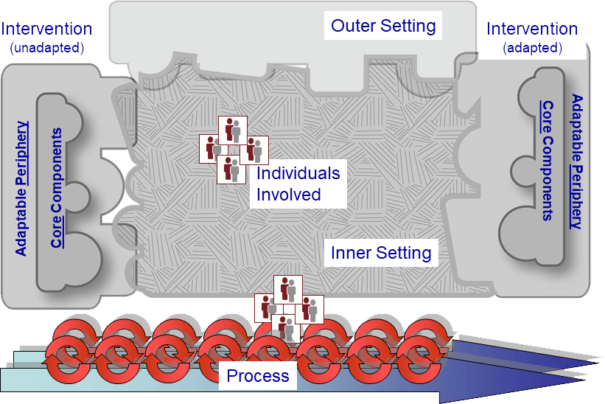
Case Example: CFIR
CFIR Research Team-Center for Clinical Management Research, 2021
Notes:
This is one of many frameworks to help map context. The CFIR is visually demonstrated here and we will walk through each of the domains in this session.

Slide 59
Diagnostic Analysis
Barriers: Elements of your context that may impede implementation of your chosen EBI
Facilitators: Elements of your context that may support implementation of your chosen EBI
Notes:
One use of your context map is a diagnosis of the problem in your unique setting.
Barriers are elements of your context that may impede implementation and are marked with a downward pointing arrow.
Facilitators, also called assets, are elements of your context that may support implementation and are marked with an upward pointing arrow.
Approaching this process with a health equity lens will allow you to identify barriers/facilitators connected to health disparities when mapping your context.

Slide 60
Case Example: CFIR
Determinants
Intervention characteristics
Inner setting
Outer setting
Individuals involved in implementation
  Population(s) of Focus
Process of implementation
CFIR Research Team-Center for Clinical Management Research, 2021
Notes:
We will now walk through the Consolidated Framework.
Follow along with the blue star. First, we will look at characteristics of the intervention itself.

Slide 61
Intervention Characteristics
Key aspects of the EBI itself that influences implementation outcomes
Examples:
  Complexity
  Relative advantage
  Evidence strength and quality
CFIR Research Team-Center for Clinical Management Research, 2021
Notes:
One important first step is looking closely at the key aspects of the EBI itself. For example:
Complexity: how difficult do people perceive a new intervention to be? This taps into how long the change will take, the scope of change required, radicalness or disruptiveness of the innovation, and the number of steps required to implement.
Relative Advantage: This is the stakeholders’ perception of the advantage of implementing the intervention versus an alternative solution.
Evidence Strength and Quality: This is the stakeholders’ perceptions of the quality and strength of evidence supporting the belief that the intervention will actually have the desired results.
Working with EBIs in detail will be addressed in the next session in a lot more detail, but it is worth noting that part of mapping context is determining what your setting is implementing in detail.

Slide 62
Getting Specific about EBIs
What exactly are you implementing?
Example: Colorectal Cancer Screening Intervention
  Program: Screening awareness program
  Product: FLU-FIT kits
  Policy: Paid time off for screening
  Practice: Coordinate transportation to screening
Notes:
You should work hard to get specific about what exactly is being implemented.
This level of detail helps you determine implementation strategies that will enhance health outcomes.
Maybe you know you are working on a colorectal cancer screening intervention generally, but that can can mean an educational program, a new product, a policy change, or a practice such as coordinating transportation.
In our case study we will focus on the implementation of FLU-FIT Screening kits.

Slide 63
Case Example: CFIR
Determinants
Intervention characteristics
Inner setting
Outer setting
Individuals involved in implementation
  Population(s) of Focus
Process of implementation
CFIR Research Team-Center for Clinical Management Research, 2021
Notes:
Next, we will explore how to map the inner setting as part of your context map.

Slide 64

Inner Setting
Examples:
  Organizational structure
  Internal network & communications
  Power structures
  Implementation culture & climate
  Readiness
CFIR Research Team-Center for Clinical Management Research, 2021
Notes:
The inner setting refers to context factors within the organization where an EBI is being implemented.
For example:
Organizational structure: The hierarchy, age, maturity, and size of an organization are important to understand when implementing new interventions.
Internal networks and communications: The nature and quality of webs of social networks and formal and informal communications within an organization.
The bottom three highlighted in blue as we are going to explore then in more detail.

Slide 65

Understand Power Structures
Resistance to change is normal!
Stems from fear:
    "My work routine is going to change"
    "My relationships to colleagues will change"
    "Our patients/clients will be affected"
Gesme & Wiseman, 2010
Notes:
Understanding power structures helps build empathy with resistance to change, which is normal in hierarchies.
This resistance stems from fear that work, relationships, or patient health will change negatively.
These fears can be addressed and lessened by not changing everything at once.
Develop a cycle of work that can be undone if not successful for example.
Spread and scale successful results as you move into sustainability planning.

Slide 66

Relationships Matter
Empathy
Active Listening
Growth-Oriented Relationships
People are experts in their own systems
Listen for concerns that can help adapt the plan
Model humility, transparency, and accountability
Notes:
Growth-oriented relationships can fuel implementation support
Be empathetic
Active listening can get at the “why” of resistance
People are experts in their own systems
Listen for concerns that can help adapt the plan
Model humility, transparency, and accountability

Slide 67
Implementation Climate
The extent to which employees collectively perceive that the adoption and implementation of an innovation is expected, rewarded, and supported by the organization
How important is the intervention to the organization?
Ramsey et al., 2016
Notes:
Implementation climate is the extent to which employees as a group think that the adoption and implementation of an innovation is expected, rewarded, and supported by the organization.
Things like tension for change, relative priority, learning climate, and clear goals with feedback all affect implementation climate.
Maybe you can map out through discussions with folks at the organization their capacity for change in past projects.

Slide 68

Case Study
Implementation Climate – Pharmacists:
  Can be stressed by quickly changing too many things
  Need peer training for new programs
  Feel supported and rewarded for innovation
Notes:
In this case, how might the implementation climate affect the FLU-FIT intervention?
How would feeling stressed impact implementation of FLU-FIT?
How might training affect the level of stress people are feeling?
How would feeling rewarded impact implementation of FLU-FIT?

Slide 69
R=MC²
Readiness results from interplay between three components:
  Motivation
    Recent coverage of FLU-FIT and billing system changes at pharmacies
    Interest in community prevention and equity
  General Capacity
    Recent turnover in pharmacy staff
  Innovation-Specific Capacity
    Pharmacy is ramping up flu vaccine program
Wandersman Center, n.d.
Livet et al., 2020
Walker et al., 2020
Notes:
It is worth considering whether the organization is READY for this type of undertaking.
Readiness comes down to: Are you and your organization willing and able to change?
Implementation of change often includes collective change and multilevel systems redesign.
There are many tools for assessing readiness already developed such as the online decision support tool available in your supplemental resource list.
A fun equation to think about readiness is R=MC squared.
Readiness for change equals=
Motivation
General Capacity
Innovation-Specific Capacity
Some examples from the FLU-FIT case study. Motivation: The incentive of recent coverage of FLU-FIT and billing change systems creates a readiness for change. There is also a reported interest in community prevention and health equity concerns.
The general capacity for change might be weakened by recent turnover in staff.
Innovation specific capacity may be increased due to increases in FLU vaccines which are paired with FIT kits in the intervention’s product.

Slide 70
Case Example: CFIR
Determinants
Intervention characteristics
Inner setting
Outer setting
Individuals involved in implementation
  Population(s) of Focus
Process of implementation
CFIR Research Team-Center for Clinical Management Research, 2021
Notes:
Next, we will examine the outer setting elements to be mapped as part of a context assessment.

Slide 71

Outer setting
Social influences outside of the organization affecting implementation outcomes
Examples:
  Patient needs and resources
  External partnerships
  External policies and incentives
  Peer pressure
CFIR Research Team-Center for Clinical Management Research, 2021
Notes:
Outer setting refers to social influences outside of the organization affecting implementation outcomes
Some examples include:
Patient needs and resources: The extent to which patient needs, as well as barriers and facilitators to meet those needs, are accurately known and prioritized by the organization.
External partnerships: The degree to which an organization is connected with other external organizations.
External policies and incentives: Strategies to spread interventions, including policy and regulations (governmental or other central entity), external mandates, recommendations and guidelines, pay-for-performance, collaboratives, and public or benchmark reporting.
Peer pressure: competitive pressure to implement an intervention; typically because key peer or competing organizations have already implemented or are in a bid for a competitive edge

Slide 72
Case: Colorectal Cancer Screening
Outer Setting – Patient Needs and Resources
“And I hate to say it, but I do [delay the FIT test] … I may delay a FIT test for six months or so until they’re financially able to do it.”
– Staff H
Zoellner et al., 2020
Notes:
An example of patient needs in a community as an outer setting influence from a case study:
“And I hate to say it, but I do [delay FIT test]. I’ve done that a couple of times because like if they’re in between jobs, it’s hard. I mean this is a poverty area here. I have some patients a lot of patients who don’t have any income coming in... I may delay a FIT test for six months or so until they’re financially able to do it.”
We can see here this outer setting (outside of the organization’s control) element is acting as a barrier to full implementation.

Slide 73

Case: Lung Cancer Screening
Outer Setting – External Policies
“I think really the key was when Medicare said they would start paying for it [lung cancer screening].”
– Screening Facility Director
Allen et al., 2020
Notes:
External policies can also influence what happens with implementation. For example from a case study on lung cancer screening:
“I think really the key was when Medicare said they would start paying for it. At that point, it really became something that people could take advantage of. I think that’s really when we started being able to get substantial referrals.”
This is an example of a facilitator for implementation.

Slide 74
Case Example: CFIR
Determinants
Intervention characteristics
Inner setting
Outer setting
Individuals involved in implementation
  Population(s) of Focus
Process of implementation
CFIR Research Team-Center for Clinical Management Research, 2021
Notes:
Next, we will look at the Individuals involved in implementation and populations of focus.

Slide 75

Individuals
The actions and behavior of individuals ripples outward and affects networks and organizations in settings
Examples:
  Individual stage of change
  Knowledge & beliefs about EBI
  Belief in ability to succeed
CFIR Research Team-Center for Clinical Management Research, 2021
Notes:
We shouldn’t gloss over the power of individuals in creating change. The actions and behavior of individuals ripples outward and affects networks and organizations.
Some examples include:
Individual stage of change: Identifying the phase of change an individual is in, as he or she progresses toward skilled, enthusiastic, and sustained use of the intervention.
Knowledge and beliefs about the EBI: Individual attitudes toward and value placed on the intervention as well as familiarity with facts, truths, and principles related to the intervention.
Individual belief in their own capabilities to execute courses of action to achieve implementation goals and succeed.

Slide 76


Populations of Focus
Equity Reflection:
  Are there subpopulations of interest in your context you want to focus on?
  Is there historical segregation, discrimination, or implicit bias?
  Are there specific health disparities that you want to address?
Comprehensive Cancer Control National Partnership, 2021
Notes:
Another important aspect of individuals in the context is determining your population of focus. Starting with reflecting on equity concerns is a good place to start. For example:
Are there subpopulations in your context you want to focus on?
Is there a history of segregation, discrimination or implicit bias that needs addressed?
Are there specific health disparities you want to include in your goals?

Slide 77
Case Example: CFIR
Determinants
Intervention characteristics
Inner setting
Outer setting
Individuals involved in implementation
  Population(s) of Focus
Process of implementation
CFIR Research Team-Center for Clinical Management Research, 2021
Notes:
Finally, we will look at the setting’s process for implementing changes in evidence-based practices.

Slide 78
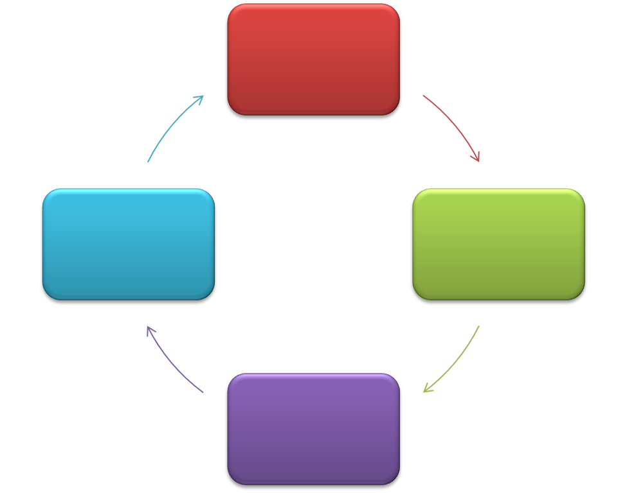
Process
Organization’s methods of carrying out change performed
in repeated and incremental steps, refined over time,
and necessary for implementation success
Examples:
  Planning
  Engaging
  Executing
  Reflecting and Evaluating
CFIR Research Team-Center for Clinical Management Research, 2021
Notes:
Mapping an organization’s processes for change management can help plan for successful implementation.
Process includes the methods of carrying out change performed in repeated and incremental steps, refined over time. and necessary for implementation success
We will match each of these step in the change process with its definition as part of a game.

Slide 79
Match the word to its definition
Words:
Planning
Engaging
Executing
Reflecting and Evaluating
Definitions:
Attracting and involving appropriate individuals in the implementation and use of the intervention through a combined strategy of social marketing, education, role modeling, training, and other similar activities
Quantitative and qualitative feedback about the progress and quality of implementation accompanied with regular personal and team debriefing about progress and experience
Carrying out or accomplishing the implementation according to plan
The degree to which a scheme or method of behavior and tasks for implementing an intervention are developed in advance and the quality of those schemes or methods
Notes:
Let’s match the word on the left to the definition on the right.
First, planning: The degree to which a scheme or method of behavior and tasks for implementing an intervention are developed in advance and the quality of those schemes or methods.
Engaging: Attracting and involving appropriate individuals in the implementation and use of the intervention through a combined strategy of social marketing, education, role modeling, training, and other similar activities.
Executing: Carrying out or accomplishing the implementation according to plan.
Reflecting and Evaluating: Quantitative and qualitative feedback about the progress and quality of implementation accompanied with regular personal and team debriefing about progress and experience.

Slide 80
Case Example: Lung Cancer Screening
Process – Planning
“We took a lot of time on the front end to plan the process steps and the flow. And we tweaked it as we’ve gone along, but we didn’t go live until we got all our ducks in a row.”
– Imaging Manager
Allen et al., 2020
Notes:
We can see some examples of a facilitator for implementation from a real case study of lung cancer screening program that had a well-defined planning process within a Federally Qualified Health Center setting.
“We took a lot of time on the front end to plan the process steps and the flow. And we tweaked it as we’ve gone along, but we didn’t go live until we got all our ducks in a row.”

Slide 81
Case Example: Lung Cancer Screening
Process – Planning
“I think that may have been one part that was left out of the training, because I think a lot of the staff felt like … are we trained? So how do we really do it? How could it look?”
– Primary Care Physician
Allen et al., 2020
Notes:
Another example shows how lack of planning can be a barrier to implementation. Once again this is similar program in a different FQHC that had less success implementing lung cancer screening.
“I think that may have been one part that was left out of the training, because I think a lot of the staff felt like … are we trained? So how do we really do it? How could it look?”

Slide 82
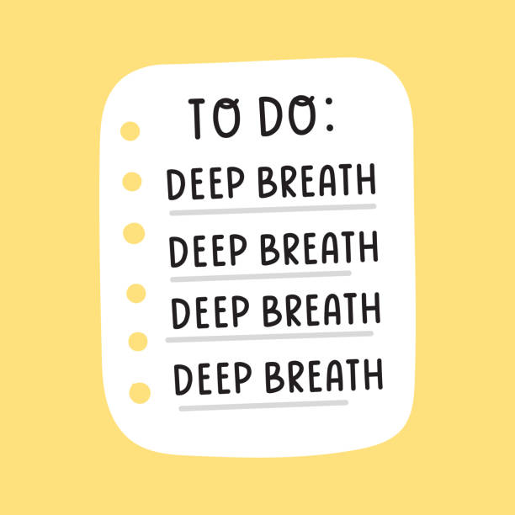

Notes:
At this point, you have assessed your context and you have may start to be overwhelmed by the amount of information you gathered.
A suggestion for moving forward is to slow down and begin to reflect on what all of this information means.

Slide 83
Session Agenda
  Introduce how context is related to focusing on a problem
  Explore a tool for assessing context
  Prepare to analyze fit of EBI
  Team Huddle: Mapping your context
Notes:
The next section will help you prepare to analyze the fit of the EBI to your setting.

Slide 84
Reminder: Goals of Contextualization
Ensure match between EBI and values, needs, skills, and resources
  Consider stakeholders delivering interventions and patients/populations of focus
Reflect on root causes to allow barriers and assets to be identified
Design tailored strategies for implementation
Horner et al., 2014
Hamilton et al., 2007
Notes:
Remember we are trying to ensure a match between the EBI you will implement and the needs, values, skills, and resources of your setting.
It is also a good idea to continually stay aware of context as you are implementing new interventions. Context is dynamic and elements of the system or culture will change and require flexibility.

Slide 85
Equity Reflection
How has our understanding of the problem evolved?
  What upstream causes are better understood?
  What assumptions are we taking for granted?
  What practice-based evidence has been uncovered?
  Do all stakeholders agree on the conclusions of the assessment that will guide the next steps?
Ward et al., 2012
Rohweder et al., 2017
Notes:
Some questions to reflect on how your understanding of the problem is evolving:
What upstream causes are better understood?
What assumptions are we taking for granted?
What practice-based evidence has been uncovered? Has talking to clinical or community health partners demonstrated a need for clarity or adjustment?
Do all stakeholders agree on the major findings of the assessment?

Slide 86
Support Stakeholders in Prioritizing Needs and Opportunities
Why?
  Prioritizing encourages a shared purpose
When?
  Prioritize after a contextual assessment in terms of which gaps/problems to focus on
Who?
  Involve multiple stakeholders with diverse agendas at many levels
How?
  Cyclical process narrowing goals based on readiness, power dynamics, data, context, and fit
  Use methods to gather feedback from multiple levels
Notes:
Often stakeholders may agree on the findings generally, but do not have the same feelings about the relative priority of the problems and solutions.
Often organizations are not clear on their priorities, or not all levels of the organization are aware or in consensus about the priorities. You may find yourself supporting stakeholders in prioritizing needs together in an engaged and transparent way as part of implementation. Maybe your context turned up behavioral and structural sources of the problem and stakeholders are not sure which to tackle with their intervention.
Why Prioritize?
Prioritizing encourages a shared purpose
When?
Prioritize after a contextual assessment in terms of which gaps/problems to focus on
Who?
Involve multiple stakeholders with diverse agendas at many levels
How?
Repeated process narrowing goals based on readiness, power dynamics, data, context, and fit
Use facilitation methods to gather feedback from multiple levels

Slide 87

Case Example
Inequities across neighborhoods in large urban areas
Colorectal cancer screening rates are 48% in Ward 7
Community input shows the need for a focus on more accessible EBIs for screening
                Implementing FLU-FIT program at a more accessible location such as a pharmacy could help
Notes:
Some takeaways from our hypothetical case study context map:
There are significant cancer inequities across neighborhoods in large urban areas
Colorectal cancer screening rates are 48% in Ward 7 of Washington, D.C.
Community input shows the need for a focus on more accessible EBIs for screening
This map shows implementing a FLU-FIT program at a more accessible location such as a pharmacy could help solve the problem, demonstrating a fit between the EBI and the context.

Slide 88

Partnerships for Accessible Sites
Reminder: Who is critical to the implementation of your cancer screening objective?
  Nurses/medical assistants
  Pharmacies
  Community health centers
  Seasonal flu clinics
    Drop-in clinics
    Primary Care visits
Notes:
Brainstorming partnerships at this point after a context assessment can really help you identify who else needs to be at the table.
Examples from our FLU-FIT example include:
Nurses/medical assistants
Pharmacies
Community health centers
Seasonal flu clinics
Drop-in clinics
Primary Care visits

Slide 89
Case: Colorectal Cancer Inequalities
System: Federally Qualified Health Center in Ward 7 is too overwhelmed to introduce FLU-FIT
Culture: Pharmacies are looking for new preventive services to offer customers
Climate: Pharmacists often need lead time with peer training for new programs; Change = Stress
Notes:
A higher-level map of context might summarize the situation like this:
System: FQHC: New program is not a good match right now due to other priorities, current capacity.
Culture: Pharmacies are looking for new preventive services to offer customers
Climate: Pharmacists often need lead time with peer training for new programs; Change = Stress

Slide 90
Tools and Supplemental Resources
Action for PSE Change: Steps 2-4
Ariadne Labs: Implementation Context Assessment Organization
Consolidated Framework for Implementation Research (CFIR) Tool
Community Toolbox: Chapter 3 Assessing Community Needs and Resources
Community Toolbox: Chapter 4 Collecting Information About the Problem
National Collaborating Centre for Methods and Tools: Selecting a Tool to Assess Organizational Readiness
Tools to Assess Readiness
Using CFIR-informed interviews to evaluate the implementation of a multilevel intervention
Wandersman Center
Washington University Institute of Clinical and Translational Sciences Dissemination & Implementation Barriers & Facilitators Measurement Toolkit
Notes:
All of these tools are located in the companion guide for your use in your projects.

Slide 91
References
Allen CG, Cotter MM, Smith RA, Watson L. Successes and challenges of implementing a lung cancer screening
program in federally qualified health centers: a qualitative analysis using the Consolidated Framework for
Implementation Research. Transl Behav Med. 2021;11(5):1088-1098. doi:10.1093/tbm/ibaa121
CFIR Research Team-Center for Clinical Management Research. (n.d.). Consolidated framework for implementation
research. https://cfirguide.org/.
Community Toolbox. (n.d.) “Chapter 3: Assessing Community Needs and Resources.” https://ctb.ku.edu/en/table-of-
contents/assessment/assessing-community-needs-and-resources
Comprehensive Cancer Control National Partnership. (2021). Health equity: Tip sheet. https://www.acs4ccc.org/wp-
content/uploads/2021/04/Cancer-Plan-Tip-Sheet_Health-Equity_FINAL.pdf.
Fernandez ME, Walker TJ, Weiner BJ, et al. Developing measures to assess constructs from the Inner Setting domain
of the Consolidated Framework for Implementation Research. Implement Sci. 2018;13(1):52. Published 2018 Mar 27.
doi:10.1186/s13012-018-0736-7
Frieden, T. R. (2010). A framework for public health action: The health impact pyramid. American Journal of Public
Health, 100(4):590-5. doi: 10.2105/AJPH.2009.185652.
Gesme, D., & Wiseman, M. (2010). How to implement change in practice. Journal of Oncology Practice, 6(5), 257-259.
doi: 10.1200/JOP.000089
Hamilton, S., McLaren, S. & Mulhall, A. (2007). Assessing organisational readiness for change: Use of diagnostic
analysis prior to the implementation of a multidisciplinary assessment for acute stroke care. Implementation
Science, 2(21). https://doi.org/10.1186/1748-5908-2-21
Holt, D. T., Helfrich, C. D., Hall, C. G., & Weiner, B. J. (2010). Are you ready? How health professionals can
comprehensively conceptualize readiness for change. Journal of General Internal Medicine, 25(Suppl 1), 50-55.
doi: 10.1007/s11606-009-1112-8
Horner, R., Blitz, C., & Ross, S. (2014). The importance of contextual fit when implementing evidence-based
Interventions. U.S. Department of Health & Human Services: Office of the Assistant Secreatry for Planning and
Evaluation. https://aspe.hhs.gov/report/importance-contextual-fit-when-implementing-evidence-based-
Interventions
Notes:
As well as references for your use as needed.

Slide 92
References
Jacobs, J. A., Duggan, K., Erwin, P., Smith, C., Borawski, E., Compton, J., D'Ambrosio, L., Frank, S. H., Frazier-
Kouassi, S., Hannon, P. A., Leeman, J., Mainor, A., & Brownson, R. C. (2014). Capacity building for evidence-
based decision making in local health departments: scaling up an effective training approach. Implementation
Science, 9(124). https://doi.org/10.1186/s13012-014-0124-x
Khan, S., Timmings, C., Moore, J. E. Marquez, C., Pyka, K., Gheihman, G., & Strauss, S. (2014). The
development of an online decision support tool for organizational readiness for change. Implementation
Science, 9(56).https://doi.org/10.1186/1748-5908-9-56
Liang, S., Kegler, M. C., Cotter, M., Emily, P., Beasley, D., Hermstad, A., Morton, R., Martinez, J., & Riehman,
K. (2016). Integrating evidence-based practicesfor increasing cancer screenings in safety net health
systems: A multiple case study using the Consolidated Framework for Implementation Research.
Implementation Science, 11(109). https://doi.org/10.1186/s13012-016-0477-4
Livet, M., Yannayon, M., Richard, C., Sorge, L., & Scanlon, P. (2020). Ready, set, go!: Exploring use of a
readiness process to implement pharmacy services. Implementation Science Communications,
1(52). https://doi.org/10.1186/s43058-020-00036-2
Ramsey, A., Lawrence, K., Prusaczyk, B., Baumann, A., Kryzer, E., & Proctor, E. (2016) Organizational
Measures. St. Louis, MO: Washington University. Eight toolkits related to Dissemination and
Implementation. Available from https://sites.wustl.edu/wudandi
Rohweder, C. L., Laping, J. L., Diehl, S. J., Moore, A. A., Isler, M. R., Scott, J. E., Enga, Z. K., Black, M. C.,
Dave, G., Corbie-Smith, G., & Melvin, C. L. (2016). Bridging research, practice, and policy: The "Evidence
Academy" conference model. Journal of Public Health Management and Practice, 22(2), 200–203.
doi: 10.1097/phh.0000000000000230

Slide 93
References
Vanderpool, R. C., Moore, S. C., Stradtman, L. R., Carman, A. L., Kurgat, H. L., & Fain, P. (2016). Adaptation of an
evidence-based intervention to improve preventive care practices in a federally qualified health center in
Appalachian Kentucky. Journal of Health Care for the Poor and Underserved, 27(4A), 46–52.
doi: 10.1353/hpu.2016.0185
Walker, T. J., Brandt, H. M., Wandersman, A. Scaccia, J., Lamont, A., Workman, L., Dias, E., Diamond, P. M., Craig,
D. W, & Fernandez, M. E. (2020). Development of a comprehensive measure of organizational readiness
(motivation × capacity) for implementation: A study protocol. Implementation Science Communications, 1(103).
https://doi.org/10.1186/s43058-020-00088-4
Wandersman Center. (n.d). “Readiness Building Center” https://www.wandersmancenter.org/defining-readiness.html
Ward, V., Smith, S., House, A., & Hamer, S. (2012). Exploring knowledge exchange: A useful framework for practice
and policy. Social Science & Medicine, 74(3):297-304. doi: 10.1016/j.socscmed.2011.09.021
Weiner, B. J. (2009). A theory of organizational readiness for change. Implementation Science, 4(67).
https://doi.org/10.1186/1748-5908-4-67
Zoellner J, Porter K, Thatcher E, Kennedy E, Werth JL Jr, Grossman B, Roatsey T, Hamilton H, Anderson R, Cohn W.
A Multilevel Approach to Understand the Context and Potential Solutions for Low Colorectal Cancer (CRC)
Screening Rates in Rural Appalachia Clinics. J Rural Health. 2021 Jun;37(3):585-601. doi: 10.1111/jrh.12522. Epub
2020 Oct 7. PMID: 33026682; PMCID: PMC8238123.

Slide 94
Acknowledgments
PI:
Mandi L. Pratt-Chapman PhD
Staff:
Sarah Adler
Joseph Astorino
Leila Habib
Sarah Kerch
Workgroup Members:
Shauntay Davis-Patterson
Caleb Levell
Notes:
Thank you to all those listed here who helped in developing this training.

Slide 95
How to Find Evidence-Based Interventions for Cancer Control
Notes:
Welcome to session 3 of the Base Camp.
I am Sarah Kerch, the Comprehensive Cancer Control Technical Assistance Manager for the George Washington University Cancer Center.
This session will focus on How to find Evidence-Based Initiatives for Cancer Control.

Slide 96
Disclosure
This session was supported by Cooperative Agreement #NU58DP006461-03 from the Centers for Disease Control and Prevention (CDC). The views expressed in written workshop materials or publications and by speakers and moderators do not necessarily reflect the official policies of the Department of Health and Human Services, nor does the mention of trade names, commercial practices, or organizations imply endorsement by the U.S. Government.
Notes:
This session was supported by a Cooperative Agreement from the Centers for Disease Control and Prevention (CDC). The views expressed in written workshop materials or publications and by speakers and moderators do not necessarily reflect the official policies of the Department of Health and Human Services, nor does the mention of trade names, commercial practices, or organizations imply endorsement by the U.S. Government.

Slide 97
Learning Objectives
Describe sources and examples of evidence-based interventions (EBIs)
Notes:
Our main learning objective is that learners should be able to describe sources and examples of evidence-based interventions (EBIs) after this quick session.

Slide 98
Session Agenda
  Introduce landscape of evidence
Notes:
Our plan for the session is to introduce the landscape of evidence.

Slide 99
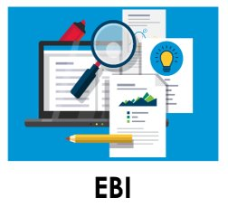
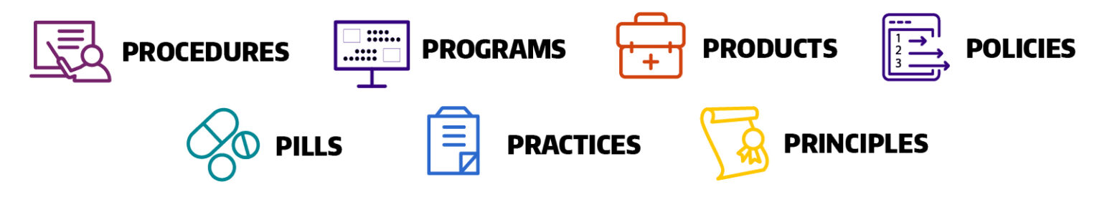
What are Evidence-Based Interventions (EBIs)?
Health-focused interventions with evidence demonstrating the ability to change a behavior or outcome
Jacobs et al., 2012
University of Washington, n.d.
Notes:
EBIs are health-focused interventions with evidence demonstrating the ability to change a behavior or outcome. These come in many different forms such as:
Procedures which are written documents depicting the necessary steps of a practice
Programs: Short-term interventions that create temporary improvements in the wake of challenges.
Products: A thing or object that is a result of productive actions
Policies: policy (little p) is a guiding principle used to set direction in an organization; Policy (big P) guides the rules we collectively choose to live by, as articulated in legislation and regulation. They inform our socially accepted morals and ethics.
Pills: Medicine itself.
Practices: An activity or process
Principles: A high level ideal or value guiding behavior internally

Slide 100
Match the EBI
Word Bank
Colorectal cancer early detection pilot program
Paid time off for screening
Coordinating transportation to colorectal cancer screening
FLU-FIT Kit
Product:
Policy:
Program:
Practice:
FLU-FIT Kit
Paid time off for screening
Colorectal cancer early detection pilot program
Coordinating transportation to colorectal cancer screening
Notes:
Now we are going to do a matching game. Match the blue words to the right EBI type. Let’s start with “colorectal cancer early detection pilot program”. Where do you think that would go?
Continue going down the word bank list.
Product: FLU-FIT Kit
Policy: Paid time off for screening
Program: Colorectal cancer early detection pilot program
Practice: Coordinating transportation to colorectal cancer screening

Slide 101

What Does Evidence Mean?
Systematic review: Summaries of evidence made up of multiple studies and recommendations
Guideline synthesis: Synthesis of systematic reviews of research-tested interventions used to help practitioners select interventions for implementation
Jacobs et al.,2012
Notes:
Hi everyone. My name is David Chambers, and I serve as the Deputy Director for Implementation Science within the Office of the Director in the Division of Cancer Control and Population Sciences at the National Cancer Institute.
Next we will examine what does evidence even mean?
Two examples of evidence are:
Systematic reviews: Summaries of evidence made up of multiple studies and recommendations
Guideline synthesis: Synthesis of systematic reviews of research-tested interventions used to help practitioners select interventions for implementation

Slide 102

Practice-Based Evidence
Lived experience matters!
  Practitioners know their patients, context, and needs best
Two-way flow of knowledge can inform implementation
  Rigorous quality improvement efforts
  Getting stakeholders involved in evaluation
  Co-creating with implementation scientists
Green, 2008
Notes:
Practitioners know their setting best therefore lived experience matters.
Practitioners know their patients, context and needs best.
Some ways that this knowledge can inform implementation research include:
-Rigorous quality improvement efforts
-Getting stakeholders involved in evaluation
-Co-creating with implementation scientists
You might ask yourself (or your team): who is critical to the implementation of your cancer screening objective that might have this type of knowledge?

Slide 103
Resources that Synthesize Evidence
The Campbell Corporation
https://www.campbellcollaboration.org
Cochrane Effective Practice and Organization of Care
https://epoc.cochrane.org/
Notes:
There are also many resources that synthesize evidence for you as practitioners. The Campbell Corporation and the Cochrane Group both are useful resources that have already done the work of synthesizing evidence for you.

Slide 104
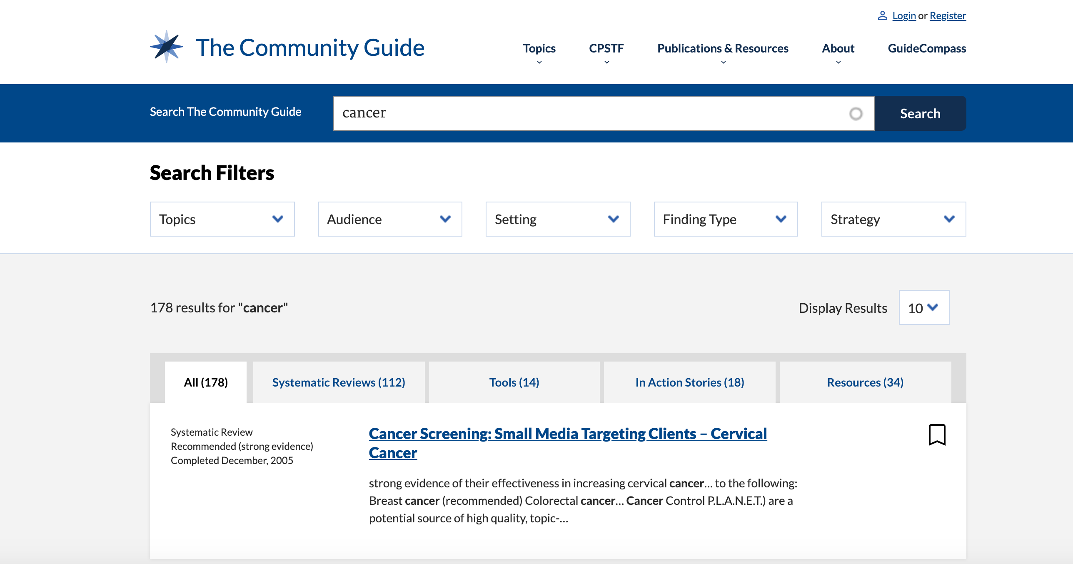
The Community Guide
The Community Guide, n.d.
Notes:
The Community Guide is developed by the Community Preventative Services Task Force and provides evidence-based findings and recommendations about community services, programs, and other interventions aimed at improving population health.

Slide 105
The Community Guide
The Community Guide, n.d.
Notes:
Some examples from the Community Guide include the systematic reviews that recommend interventions that engage community health workers to increase screening for breast, colorectal, and cervical cancer.

Slide 106

Guide to Clinical Preventive Services
Cancer Screening
    Breast
    Cervical
    Lung
    Colorectal
A.H.R.Q., n.d.
Notes:
The Guide to Clinical Preventive Services contains the U.S. Preventive Services Task Force (USPSTF) recommendations on the use of screening, counseling, and other preventive services that are typically delivered in primary care settings.

Slide 107
Evidence-Based Cancer Control Programs
National Cancer Institute, n.d.
Notes:
The Evidence-Based Cancer Control Programs (EBCCP) website is a searchable database that provides program planners and public health practitioners easy and immediate access to
programs tested in a research study
publication(s) of the study findings
program products or materials used with a particular study population in a specific setting
Given that the programs on this website are based on evidence-derived research studies, they may be particularly effective in serving the populations and communities in the settings in which they were originally tested.
Starred here are EBCCPs that focus on screening.
Each of these program areas contain detailed information about populations of focus and community type that the intervention was designed for and tested with. This should help with integrating a health equity approach when choosing an EBI.

Slide 108
Cancer Control Plans and EBIs
48% of cancer control planners used EBI resources in 2010
Planners request assistance to help them use EBIs more & adapt resources for their context
Funders are increasingly interested in supporting evidence-based projects
Hannon et al., 2010
Notes:
In terms of including EBIs in your work, such as Cancer Control plans:
48% of cancer control planners used EBI resources in 2010
Planners often request assistance to help them use EBIs more
Help is also requested to adapt resources for their context
Funders are increasingly interested in supporting evidence-based projects

Slide 109

Choosing an EBI
Selecting among many available interventions:
  How much evidence is available and what is the quality of evidence?
  How ready is your setting for change?
  How much buy-in is there from executive and clinical champions?
  What resources will you need to initiate and sustain this intervention?
Fernández et al., 2014
Notes:
Choosing an EBI is very important as you probably could tell by the last presentation on mapping context in order to ensure a match between the needs of your setting and the intervention. Some questions to help guide your decision include:
How much evidence is available and what is the quality of evidence?
How ready is your setting for change?
How much buy-in is there from executive and clinical champions?
What resources will you need to initiate and sustain this intervention?
Another thing to consider before making a final decisions is how much adaptation is going to be needed to ensure a good fit between your EBI and the setting?

Slide 110
Assess Contextual Fit
Ask:
  What EBIs might be valued in this context?
  Does the community/organization express a need for this EBI?
  Are all stakeholders in agreement about the degree of fit?
  Is the EBI addressing a high priority of your organization?
Notes:
A reminder from the last session-–you should reflect on fit by asking yourself (and stakeholders) these questions:
What EBIs might be valued in this context?
Does the community/organization express a need for this EBI
Are all stakeholders in agreement about the degree of fit?
Is the EBI addressing a high priority of your organization?

Slide 111
Tools and Supplemental Resources
The Community Guide
National Cancer Institute Evidence-Based Cancer Control Programs (EBCCP)
Steele, B. C., Rose., J. M., Chovnick, G., Townsend, J. S., Stockmyer, C. K., Fonseka, J., & Richardson, L. C. (2016). Use of evidence-based practices and resources among Comprehensive Cancer Control Programs. Journal of Public Health Management and Practice, 21(5). doi: 10.1097/PHH.0000000000000053.
University of Iowa Hospitals and Clinics: Evidence-Based Practices
US Preventive Services Task Force: The Clinical Guide to Preventive Services
Notes:
Tools listed here are all located in your companion guide.

Slide 112
References
Agency for Healthcare Research and Quality. (2014). Guide to clinical preventive services.
https://www.ahrq.gov/prevention/guidelines/guide/index.html
Fernández, M. E., Melvin, C. L., Leeman, J., Ribisl, K. M., Allen, J. D., Kegler, M. C., Bastani, R., Ory,
M. G., Risendal, B. C., Hannon, P. A., Kreuter, M. W., & Hebert, J. R. (2014). The cancer prevention and control
research network: An interactive systems approach to advancing cancer control implementation
research and practice. Cancer Epidemiology, Biomarkers & Prevention, 23(11), 2512–2521. doi:
10.1158/1055-9965.EPI-14-0097
Green, L. W. (2008). Making research relevant: If it is an evidence-based practice, where's the practice-based
evidence? Family Practice, 25 Suppl 1:i20-4. doi: 10.1093/fampra/cmn055. Epub 2008 Sep 15.
Hannon, P. A., Fernandez, M. E., Williams, R. S., Mullen, P. D., Escoffery, C., Kreuter, M. W., Pfeiffer, D., Kegler, M.
C., Reese, L., Mistry, R., & Bowen, D. J. (2010). Cancer control planners' perceptions and use of evidence
based programs. Journal of Public Health Management and Practice, 16(3), E1–E8.
doi: 10.1097/phh.0b013e3181b3a3b1
Jacobs, J. A., Jones, E., Gabella, B. A., Spring, B., & Brownson, R. C. (2012). Tools for implementing an evidence-
based approach in public health practice. Preventing Chronic Disease, 9, E116. doi: 10.5888/pcd9.110324
National Cancer Institute (n.d). Evidence-based cancer control programs (EBCCP).
https://ebccp.cancercontrol.cancer.gov/index.do
The Community Guide. (n.d.). Search the community guide. https://www.thecommunityguide.org/search/cancer
University of Washington (n.d). Study design.
https://impsciuw.org/implementation-science/research/designing-is-research/
Notes:
As well as all references.

Slide 113
Acknowledgments
PI:
Mandi L. Pratt-Chapman PhD
Staff:
Sarah Adler
Joseph Astorino
Leila Habib
Sarah Kerch
Workgroup Members:
Erin Hahn
Kelly Wells Sittig
Notes:
Thank you to all those listed here who helped in developing this training.

Slide 114
Using Evidence & Theories to Inform Adaptation
Notes:
Welcome to session 4 of Base Camp.
Hi everyone, I am Randy Schwartz. I am the President of Public Health Systems, Inc. and also bring much experience from state health department and voluntary health organizations.

Slide 115
Disclosure
This session was supported by Cooperative Agreement #NU58DP006461-03 from the Centers for Disease Control and Prevention (CDC). The views expressed in written workshop materials or publications and by speakers and moderators do not necessarily reflect the official policies of the Department of Health and Human Services, nor does the mention of trade names, commercial practices, or organizations imply endorsement by the U.S. Government.
Notes:
This session was supported by a Cooperative Agreement from the Centers for Disease Control and Prevention (CDC). The views expressed in written workshop materials or publications and by speakers and moderators do not necessarily reflect the official policies of the Department of Health and Human Services, nor does the mention of trade names, commercial practices, or organizations imply endorsement by the U.S. Government.

Slide 116
Learning Objectives
Identify key process components of adapting an EBI
Notes:
Our main learning objectives for this session include:
Identifying key process components involved in adapting an EBI

Slide 117
Session Agenda
  Introduce adaptation process
Notes:
Here is our map for the session:
We will introduce the adaptation process.

Slide 118


Evidence Meets Context
Adaptations are often needed to ensure that interventions are feasible and ‘fit’ the population of focus and setting…
Tu et al., 2014
Escoffrey et al., 2018
Notes:
Adaptations are often needed to ensure that interventions are feasible and ‘fit’ the population of focus and setting. This can be a vital step in planning for health equity in your intervention, where you can plan ahead to adapt for your population(s) of focus.
Adaptation is defined as the degree to which an evidence-based intervention is changed or modified by a user during adoption and implementation to suit the needs of the setting or to improve the fit to local conditions.
Fidelity, a related term, is the degree to which an intervention or program is implemented as intended by the developers and as prescribed in the original protocol.
Example: For example, say the cancer screening program you are working with is needing to be carried out in a new setting because of system changes such as a Federally Qualified Health Center being too overwhelmed at the moment. Maybe you want to carry out the FLU-FIT program at a workplace or at a pharmacy which is more accessible and a better fit for your context. What should you take into consideration before carrying out changes like this? This session will help you plan these changes in advance.

Slide 119
Situations to Look Out For:
Voltage Drop: When interventions are less effective in the real world outside the research setting
  Lack of champions who are willing to be trained in screening program
Drift: When changes to a program make it less effective (i.e. deletion of core components)
  Lack of attention to behavioral change framework in a smoking cessation program
Chambers et al., 2013
Notes:
Here we will introduce two more concepts that help explain why being intentional about adaptation is so important.
Voltage Drop occurs when interventions are less effective in real world practice than they are in a research setting, because research settings are sometimes better resourced with special conditions that a real world setting might not be able to replicate day to day.
An example could be a lack of champions who are willing to be trained in a screening program, and therefore the program is not as effective as in a clinical trial.
Drift on the other hand results from adapting an intervention in a way that changes the program’s effectiveness – such as deleting a core component of a program that makes it work
An example might be a lack of adherence to the behavioral change framework in a smoking cessation program
Maybe clinicians do not fully understand the theories underlying a cessation program and have changed the components so much that it is not producing effective outcomes

Slide 120
Steps in the Adaptation Process
Understand the “Why”: What theories support intervention?
Understand core components and risks of adapting these
Document adaptations and measure fidelity
    Implementation quality
Notes:
Some steps in the adaptation process:
Understand the “Why”: What theories support intervention?
Understand core components and risks of adapting these
Document adaptations and measure fidelity. This will help you understand the quality of implementation.

Slide 121
Steps in the Adaptation Process
Understand the “Why”: What theories support intervention?
Understand core components and risks of adapting these
Document adaptations and measure fidelity
    Implementation quality
Notes:
First—let’s look at why.

Slide 122


Understand the “Why”
Interventions are designed around models of behavioral change
  Target a barrier or cause of behavior
  Designed intentionally for multiple levels of change
Notes:
EBIs are grounded in theory, that is the foundation of why they work the way they do.
Interventions are designed around models of behavioral change
They may be carefully designed to target a barrier or cause of behavior
They may also sometimes be designed to target multiple levels of change
Maybe they act on a specific barrier or determinant of behavior, which causes the intervention to be effective.
Do we want to change that function? No

Slide 123

“Why do I need to know why?”
“Public health interventions grounded in health behavior theory often prove to be more effective than those lacking a theoretical base, because these theories conceptualize the mechanisms that underlie behavior change.”
ICEBeRG Group, 2006
Jacobs et al., 2012
Notes:
Why does this matter?
“Public health interventions grounded in health behavior theory often prove to be more effective than those lacking a theoretical base, because these theories conceptualize the mechanisms that underlie behavior change.”

Slide 124
Steps in the Adaptation Process
Understand the “Why”: What theories support intervention?
Understand core components and risks of adapting these
Document adaptations and measure fidelity
    Implementation quality
Notes:
Next, we will look at core and adaptable components of interventions.

Slide 125
Intervention Form and Function
Components:
Setting
Dose/Timeline
Behavioral model or theory
Target audience
Content
Cultural tailoring for population of focus
Function: Core Components
Form: Adaptable Components
Dose/Timeline
Behavioral Model or Theory
Content
Setting
Target Audience
Escoffery et al., 2018
Hartman et al., 2015
Movsisyan et al., 2019
Moore and Metz, 2020
Cultural tailoring for population of focus
Notes:
We do not want to change the function of the EBI as it is the core reason why the program works, or is effective. Changing the form, or the adaptable components of an EBI, does not change the function.
Let’s match what you think might be a core component or functional component of an intervention, versus what you think might be adaptable components.

Slide 126
Traffic Light Model
Minor changes
Program names
Updated statistics
Tailored content
Adding or modifying flexible components
Activities, sequence, audience, delivery format, delivery person
Changing core elements or theory/model
Deleting core components
Timeline
Dose
Balis et al., 2021
NCI, 2019
Notes:
As we just learned, making too many changes to an intervention can reduce its original effectiveness, or worse, introduce unintended and harmful outcomes.
Before making adaptations to the intervention, you should think about how the change to the original intervention can improve the fit to your community, setting, or target population, and at the same time, maintain fidelity to the core components of the original intervention.
Think of possible adaptations as you would a green, yellow, or red traffic light:
green light changes are usually OK to make;
yellow light changes should be approached with caution; and
Red light changes should be avoided when possible.

Slide 127
Steps in the Adaptation Process
Understand the “Why”: What theories support intervention?
Understand core components and risks of adapting these
Document adaptations and measure fidelity
    Implementation quality
Notes:
Last, we will introduce some tools for documenting adaptations and measuring fidelity.

Slide 128

Document Adaptations
Be Proactive:
  Make adaptations to promote acceptance
  Design implementation blueprint to allow for EBI adaptation in an intentional way
Kilbourne at al., 2020
Aarons et al., 2012
Notes:
Be intentional in the design of adaptations in your implementation blueprint
Make adaptations to promote end-user acceptance from the start.
Maybe you know will be working with a specific population of focus that will require minor changes and cultural tailoring of content and activities. It is better to include populations most affected by the planned intervention early and document changes and reasons for changes proactively

Slide 129
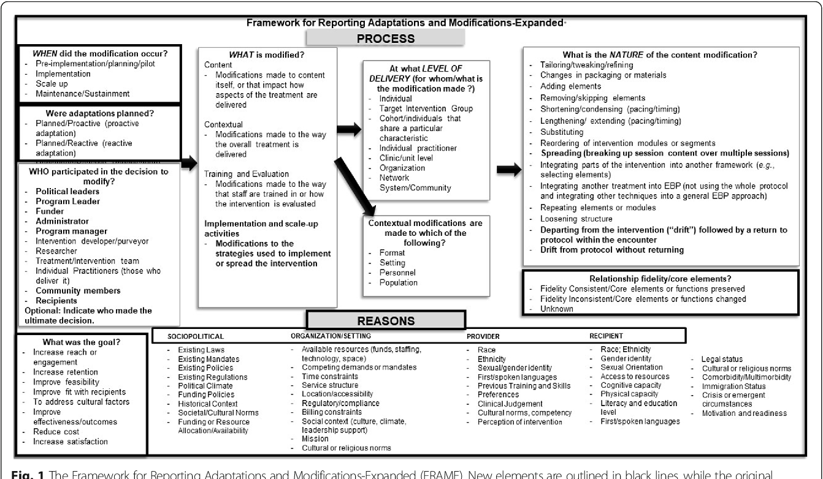
Framework for Reporting Adaptations and Modifications (FRAME)
Wiltsey et al., 2019
Notes:
One example of a framework for documenting adaptations is the FRAME. See here a picture of the template/tool available for your use in adapting interventions. This tool contains prompts to remind you to document when adaptations occurred, who decided to modify an intervention, as well as the nature of the changes made. This tool is also located in the supplemental resources.

Slide 130
Tools and Supplemental Resources
IM Adapt
Make It Your Own Tool
Model for Adaptation Design and Impact Guide
National Cancer Institute Guidelines for Choosing and Adapting Programs
National Cancer Institute Theory at a Glance: A Guide for Health Promotion Practice
Planning Health Promotion Programs: An Interventions Mapping Approach, 4th Edition
Notes:
Tools listed here are all located in your companion guide for your continued learning

Slide 131
Tools and Supplemental Resources
AcademyHealth Blog Post “Implementation Science: Embracing Adaptations to Complex Interventions for Better Outcomes”
Stirman, S. W., Baumann, A. A., & Miller, C. J. (2019). The FRAME: An expanded Framework for Reporting Adaptations and Modifications to Evidence-based interventions. Implementation Science, 14(1). https://doi.org/10.1186/s13012-019-0898-y

Slide 132
References
Aarons, G. A., Green, A. E., Palinkas, L. A., Self-Brown, S., Whitaker, D. J., Lutzker, J., Silovsky, J. F., Hecht, D., &
Chaffin, M. (2012). Dynamic adaptation process to implement an evidence-based child
maltreatment intervention. Implementation Science, 7(32). https://doi.org/10.1186/1748-5908-7-32
Balis, L. E., Kennedy, L. E., Houghtaling, B., & Harden, S. M. (2021). Red, yellow, and green light changes:
Adaptations to extension health promotion programs. Prevention Science. doi: 10.1007/s11121-021-01222-x
Chambers, D. A., Glasgow, R. E., & Stange, K. C. (2013). The dynamic sustainability framework: Addressing the
paradox of sustainment amid ongoing change. Implementation science, 8(117).
https://doi.org/10.1186/1748-5908-8-117
Escoffery C, Lebow-Skelley E, Haardoerfer R, et al. A systematic review of adaptations of evidence-based public health
interventions globally. Implement Sci. 2018;13(1):125. Published 2018 Sep 26. doi:10.1186/s13012-018-0815-9
Hartman, M. A., Stronks, K., Highfield, L. Cremer, S. W., Verhoeff, A. P., & Nierkens, V. (2015). Disseminating
evidence-based interventions to new populations: A systematic approach to consider the need
for adaptation. Implementation Science, 10(49). https://doi.org/10.1186/1748-5908-10-S1-A49
Jacobs, J. A., Jones, E., Gabella, B. A., Spring, B., & Brownson, R. C. (2012). Tools for implementing an evidence-
based approach in public health practice. Preventing Chronic Disease, 9, E116. doi: 10.5888/pcd9.110324
Kilbourne, A. M., Glasgow, R. E. & Chambers, D. A. (2020). What can implementation science do for you? Key
success stories from the field. Journal of General Internal Medicine, 35, 783–787. doi: 10.1007/s11606-020-06174-6
Moore, J. & Metz, A. (2020). Practicing implementation blog:
https://nirn.fpg.unc.edu/practicing-implementation/providing-implementation-support-program-
adaptations-covid-19-Environment.
Notes:
.

Slide 133
References
Moore, J. & Metz, A. (2020). Practicing implementation blog:
https://nirn.fpg.unc.edu/practicing-implementation/providing-implementation-support-program-
adaptations-covid-19-Environment.
Movsisyan, A., Arnold, L., Evans, R. Hallingberg, B., Moore, G., O’ Cathain, A., Pfadenhauer, L. M., Seegrott
J., Rehfuess, E. (2019). Adapting evidence-informed complex population health interventions for new contexts:
A systematic review of guidance. Implementation Science, 14(105).
https://doi.org/10.1186/s13012-019-0956-5
National Cancer Institute. (2019). Implementation science at a glance.
https://cancercontrol.cancer.gov/sites/default/files/2020-07/NCI-ISaaG-Workbook.pdf
The Improved Clinical Effectiveness through Behavioural Research Group (ICEBeRG). (2006). Designing theoretically-informed implementation interventions. Implementation Science,
1(4). https://doi.org/10.1186/1748-5908-1-4
Tu, S-P., Chun, A., Yasui, Y., Kuniyuki, A., Yip, M., Taylor, V., & Bastani, R. (2014). Adaptation of an
evidence-based intervention to promote colorectal cancer screening: A quasi-experimental
study. Implementation Science 9(85). https://doi.org/10.1186/1748-5908-9-85
Wiltsey Stirman, S., Baumann, A. A. & Miller, C. J. (2019). The FRAME: An Expanded Framework for
Reporting Adaptations and Modifications to Evidence-based interventions. Implementation Science,
14(58). https://doi.org/10.1186/s13012-019-0898-y

Slide 134
Acknowledgments
PI:
Mandi L. Pratt-Chapman PhD
Staff:
Sarah Adler
Joseph Astorino
Leila Habib
Sarah Kerch
Workgroup Members:
Christi Cahill
David Chambers
Tamara Robinson
Randy Schwartz
Notes:
Thank you to all those listed here who helped in developing this training.

Slide 135
Using Evidence & Theories to Inform Implementation Strategies
Notes:
Welcome to session 5 of Base Camp.
My name is Christi Cahill and I am the executive director for the Colorado Cancer Coalition.

Slide 136
Disclosure
This session was supported by Cooperative Agreement #NU58DP006461-03 from the Centers for Disease Control and Prevention (CDC). The views expressed in written workshop materials or publications and by speakers and moderators do not necessarily reflect the official policies of the Department of Health and Human Services, nor does the mention of trade names, commercial practices, or organizations imply endorsement by the U.S. Government.
Notes:
This session was supported by a Cooperative Agreement from the Centers for Disease Control and Prevention (CDC). The views expressed in written workshop materials or publications and by speakers and moderators do not necessarily reflect the official policies of the Department of Health and Human Services, nor does the mention of trade names, commercial practices, or organizations imply endorsement by the U.S. Government.

Slide 137
Learning Objectives
Proposing implementation strategies that fit the unique needs of specific interventions
Notes:
Our main learning objective for this session is :
Proposing implementation strategies that fit the unique needs of specific interventions

Slide 138
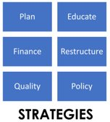
Session Agenda
  Introduce implementation strategies

Slide 139
Specifying Implementation Strategies
Implementation strategies are:
Approaches or techniques used to enhance the adoption, implementation, sustainment, and scale-up or spread of EBIs
Leeman et al., 2017
Notes:
Implementation strategies are:
Approaches or techniques used to enhance the adoption, implementation, sustainment, and scale-up (or spread) of EBIs

Slide 140

Case Study of Strategic Implementation
CDC, 2012
Notes:
We would now like to play a short video about an evidence-based program that uses some well-known implementation strategies. In the course companion material, you will also find a link to this Black Corals program video.
Video link: https://www.youtube.com/watch?v=bn4aATMCfiw

Slide 141

Game: Implementation Strategies
Which of the following do you think are implementation strategies from the video?
  Reminding providers with a red folder
  Addressing high mortality rate
  Engagement with coral bracelets
  Identifying evidence from the Community Guide
  Workshops
  Churches becoming interested in supporting program
Notes:
Which of the following do you think are implementation strategies from the video?
Let’s take a look at the next slide to review

Slide 142
Educational Meetings
Remind Clinicians
Local opinion leaders
Prepare patients
Notes:
Here you see a very important table (that is also located in your companion guide) identifying common implementation strategies. We pulled out some of the ones that were found in the Black Corals video.
Reminding providers to ask about screening-this is a great example of an implementation strategy.
Preparing patients to be active participants-another example.
Conducting educational meetings-a commonly used strategy.
Inform & involve local opinion leaders-our last example.
Some of the things from the video that are important, but NOT implementation strategies:
Addressing high mortality rate—this is a great goal for a program, but not really a strategy to implement an intervention.
Identifying evidence from the Community Guide—this is an important step in planning an intervention, but not actually a strategy for implementing.
Are you starting to see the distinction of implementation strategies within the general process of planning an EBI?

Slide 143
Use Evidence & Theories to Plan Implementation Strategies
Locate intervention-specific guidance
  Intervention & Implementation Guidelines
Apply behavioral change theories
Use implementation science research approaches
  Design tailored implementation strategies
  Use contextual evidence to select/design strategies
Skolarus et al., 2016
Notes:
There are many ways to plan your implementation strategies.
First, you can location intervention-specific guidance. This might be bundled with a pre-packaged intervention, which contains implementation guidelines.

Slide 144
Intervention Specific Guidance
Some EBIs come with implementation guides
  Examples: EBCCP downloadable implementation guides
      Delivery protocols
      Reminder card templates
      Scripts
      Factsheets
      Videos
Notes:
Some EBIs come with implementation guides.
Examples: Some Evidence-based cancer control programs come with downloadable implementation guides
These may contain protocols, templates, scripts, etc.

Slide 145
Use Evidence & Theories to Plan Implementation Strategies
Locate intervention-specific guidance
  Intervention & Implementation Guidelines
Apply behavioral change theories
Use implementation science research approaches
  Design tailored implementation strategies
  Use contextual evidence to select/design strategies
Skolarus et al., 2016
Notes:
Next, we will return to theory.

Slide 146
Behavioral Change Theories
Behavior-change techniques
Guide implementation process step by step
Helps to focus on implementation outcomes
“Public health interventions grounded in health behavior theory often prove to be more effective than those lacking a theoretical base, because these theories conceptualize the mechanisms that underlie behavior change.”
ICEBeRG Group, 2006
Jacobs et al., 2012
Notes:
Similar to theories lying underneath an EBI, implementation should also be guided by theories of behavioral change.
This might include behavior-change techniques that help:
Guide implementation process step by step, which:
Helps to focus on implementation outcomes
Remember from before, interventions grounded in health behavior are often more effective than those lacking a theoretical base.

Slide 147
Use Evidence & Theories to Plan Implementation Strategies
Locate intervention-specific guidance
  Intervention & Implementation Guidelines
Apply behavioral change theories
Use implementation science research approaches
  Design tailored implementation strategies
  Use contextual evidence to select/design strategies
Skolarus et al., 2016
Notes:
Last, we will introduce implementation science approaches to designing these strategies.

Slide 148

Implementation Science Approaches
Implementation science provides us with evidence completely focused on optimizing the implementation process
  Toolkits
  Journal articles
  Systematic reviews
Notes:
Implementation Science provides us with evidence completely focused on optimizing the implementation process.
These come in the form of:
-Toolkits
-Journal articles
-Systematic reviews

Slide 149
Implementation Approaches
Implementation Research Logic Modelling:
A structured way of developing a pathway between context and outcomes
Intervention Mapping:
A 6-step method for developing effective interventions by integrating evidence, context and theories
Looijmans-van den Akker et al., 2011
Notes:
There are many approaches to co-designing Implementation strategies collaboratively between researchers and stakeholders like yourselves.
We are using the first way (implementation logic modelling) during this training, but there is also a well-known method called intervention mapping that is linked in your supplemental tools list.

Slide 150
Educational Meetings
Remind Clinicians
Local opinion leaders
Prepare patients
Powell et al., 2012
Notes:
Here is a commonly used model (called the Expert Recommendations for Implementation Change) that categorizes strategies to optimize implementation.
The top row includes headings such as planning, educating, financing, restructuring, quality management, and policy-oriented actions you can take to implement an EBI. These are the “meat” of Implementation Science--the specific actions tested and enacted to bring change to both healthcare and public health organizations, as well across levels and sectors.
You will remember some of the strategies we highlighted from the video; now you can see where they fit in the model.
There is much research on each of these strategies available and more still coming out.
Implementation science can help broaden the range of health disparity studies by providing methods to test each of these different strategies and determine if and how they actually reduce disparities.
Incorporating social determinants of health in the development and testing of each of these implementation strategies may help drive population health goals for achieving equitable implementation of interventions.
For example, restructuring strategies based around adaptations to workflow in settings with disparities might improve health outcomes. Possibly attending to financial contexts that enact changes as to what is allowed to be covered by insurance may incentivize which EBIS are practiced.
You will find this table in detail (with a complete list of the strategies listed below each category) in Appendix E in the companion guide.

Slide 151
Tools and Supplemental Resources
Powell, B. J., Waltz, T. J., Chinman, M. J., Damschroder, L., Smith, J., Matthieu, M., Proctor, E., & Kirchner, J. (2015). A refined compilation of implementation strategies: Results from the Expert Recommendations for Implementing Change (ERIC) project. Implementation Science, 10(21). https://doi.org/10.1186/s13012-015-0209-1
Waltz, T. J., Powell, B. J., Fernandez, M. E., Abadie, B., & Damschroder, L. J. (2019). Choosing implementation strategies to address contextual barriers: Diversity in recommendations and future directions. Implementation Science, 14(42). https://doi.org/10.1186/s13012-019-0892-4
Washington University Institute of Clinical and Translational Sciences Implementation Strategies Toolkit
Notes:
Tools listed here are all located in your companion guide.

Slide 152
References
Centers for Disease Control and Prevention (CDC). (2012). Black corals cancer education [Video]. YouTube.
https://www.youtube.com/watch?v=bn4aATMCfiw.
Looijmans-van den Akker, I., Hulscher, M. E., Verheij, T. J., Riphagen-Dalhuisen, J., van Delden, J. J., & Hak, E.
(2011). How to develop a program to
increase influenza vaccine uptake among workers in health care settings? Implementation Science 6(47). doi:
10.1186/1748-5908-6-47
Leeman, J., Birken, S. A., Powell, B. J., Rohweder, C., & Shea, C. M. (2017). Beyond "implementation strategies":
Classifying the full range of strategies used in implementation science and practice. Implementation Science 12(1).
https://doi.org/10.1186/s13012-017-0657-x
Powell, B. J., McMillen, J. C., Proctor, E. K., Carpenter, C. R., Griffey, R. T., Bunger, A. C., Glass, J. E., &
York, J. L. (2012). A compilation of strategies for implementing clinical innovations in health and mental
health. Medical Care Research and Review, 69(2), 123–157. doi: 10.1177/1077558711430690
Skolarus, T. A., & Sales, A. E. (2016). Using implementation science to improve urologic oncology
care. Urologic Oncology, 34(9), 384–387. doi: 10.1016/j.urolonc.2016.05.022
The Improved Clinical Effectiveness through Behavioural Research Group (ICEBeRG). (2006). Designing
theoretically-informed implementation interventions. Implementation Science,
1(4). https://doi.org/10.1186/1748-5908-1-4
Notes:
As well as references

Slide 153
Acknowledgments
PI:
Mandi L. Pratt-Chapman PhD
Staff:
Sarah Adler
Joseph Astorino
Leila Habib
Sarah Kerch
Workgroup Members:
Christi Cahill
David Chambers
Tamara Robinson
Randy Schwartz
Notes:
Thank you to all those listed here who helped in developing this training.

Slide 154
Facilitating Implementation
Notes:
Welcome to an exciting session of Base Camp.

Slide 155
Disclosure
This session was supported by Cooperative Agreement #NU58DP006461-03 from the Centers for Disease Control and Prevention (CDC). The views expressed in written workshop materials or publications and by speakers and moderators do not necessarily reflect the official policies of the Department of Health and Human Services, nor does the mention of trade names, commercial practices, or organizations imply endorsement by the U.S. Government.
Notes:
Disclosures listed here.

Slide 156
Learning Objectives
Determine implementation strategies based on context
Identify needed adaptations to optimize success
Identify approaches to quality improvement
Notes:
Our 3 main learning objectives for this session are listed here and we aim to bring these to life with breakout group discussions and a panel of 3 case studies.
All panelists included today come from cancer screening projects
They are from diverse settings and contexts
They demonstrate a range of implementation strategies also represent various approaches to evaluation and quality improvement

Slide 157
Session Agenda
  Breakout groups
  Review case study narrative summaries and identify outstanding questions
  Panel of case study authors
Notes:
Here is the map for the session.
First, we will go into breakout groups.
You will be hosted by a subject matter expert in cancer screening, who will facilitate a discussion about the case studies you read about last night.
The goal is to have your team come up with some questions for the authors of the case studies you read, who will then present and answer questions for the last part of the session.

Slide 158
Session Agenda
  Breakout groups based on cancer type
  Review case study narrative summaries and identify outstanding questions
  Panel of case study authors
Notes:
Let’s break into teams now.

Slide 159
Breakout Group Instructions
You should have already read the narrative summaries about your case study last night or this morning
  Review the case your group is assigned (See Appendix C in Companion Guide)
  Develop questions for the panel that follow this session made up of the researchers from the case study narratives (See Pages 24 and 41 in Companion Guide)

Slide 160
Session Agenda
  Breakout groups based on cancer type
  Review case study narrative summaries and identify outstanding questions
  Panel of case study authors

Slide 161

Panel of Case Examples
Allen et al. 2020
Henderson et al. 2020
Zoellner et al. 2020
Notes:
Now we will introduce our panelists.
Names and Bios here:

Slide 162

Questions for Panelists
How did health equity factor into the goals of your project?
Which stakeholders were critical to achieving your intervention objectives?
How did you address resistance to change?
What did you need to adapt and how did you go about doing that?
How did your project complement ongoing quality improvement work at your site?
What has happened since the intervention began? How has the intervention been sustained?

Slide 163
Menu of Implementation Strategies
Plan Strategies
Finance Strategies
Restructure Strategies
Quality Management Strategies
Attend to Policy Context Strategies
Educate Strategies
Powell et al., 2012
Notes:
Just a quick reminder of the strategies discussed in the previous session on using evidence. These are essentially the nuts and bolts of facilitating implementation. Can you recognize any of these coming through from your conversations in breakout groups as well as from our panelists?

Slide 164
Tools and Supplemental Resources
Community Tool Box: Developing Strategic and Action Plans
National Implementation Research Network: Active Implementation Hub Module 4
Oregon Social Learning Center: Stages of Implementation Completion

Slide 165
References
Allen, C. G., Cotter, M. M., Smith, R. A., & Watson, L. (2020). Successes and challenges of
implementing a lung cancer screening program in federally qualified health centers: A qualitative
analysis using the Consolidated Framework for Implementation Research. Translational Behavioral
Medicine, 2020 Dec 8;ibaa121
Henderson, V., Tossas-Milligan, K., Martinez, E., Williams, B., Torres, P., Mannan, N., Green, L.,
Thompson, B.. Winn, R., & Watson, K. S. (2020). Implementation of an integrated framework for a
breast cancer screening and navigation program for women from underresourced communities.
Cancer, 126(Suppl 10), 2481-2493
Powell, B. J., McMillen, J. C., Proctor, E. K., Carpenter, C. R., Griffey, R. T., Bunger, A. C., Glass, J.
E., & York, J. L. (2012). A compilation of strategies for implementing clinical innovations in health
and mental health. Medical Care Research and Review, 69(2), 123-57
Zoellner, J., Porter, K., Thatcher, E., Kennedy, E., Werth, J. L. Jr., Grossman, B., Roatsey, T.,
Hamilton, H., Anderson, R., & Cohn, W. (2020). A multilevel approach to understand the context
and potential solutions for low colorectal cancer (CRC) screening rates in rural Appalachia clinics.
The Journal of Rural Health

Slide 166
Acknowledgments
PI:
Mandi L. Pratt-Chapman PhD
Staff:
Sarah Adler
Joseph Astorino
Leila Habib
Sarah Kerch
Workgroup Members:
Christi Cahill
David Chambers
Tamara Robinson
Randy Schwartz

Slide 167
Evaluation
Notes:
Greetings everyone. My name is Polly Hager, and I am the Cancer Prevention and Control Section Manager for the Michigan Department of Health and Human Services.
Welcome to the Evaluation session of the Base Camp.

Slide 168
Disclosure
This session was supported by Cooperative Agreement #NU58DP006461-03 from the Centers for Disease Control and Prevention (CDC). The views expressed in written workshop materials or publications and by speakers and moderators do not necessarily reflect the official policies of the Department of Health and Human Services, nor does the mention of trade names, commercial practices, or organizations imply endorsement by the U.S. Government.
Notes:
This session was supported by a Cooperative Agreement from the Centers for Disease Control and Prevention (CDC). The views expressed in written workshop materials or publications and by speakers and moderators do not necessarily reflect the official policies of the Department of Health and Human Services, nor does the mention of trade names, commercial practices, or organizations imply endorsement by the U.S. Government.

Slide 169
Learning Objectives
Describe a framework's use in evaluation
Explore and identify measurable outcomes of implementation quality
Notes:
Our main learning objectives are to describe a framework's use in evaluation and to explore and identify measurable outcomes of implementation quality.

Slide 170
Session Agenda
  Introduce RE-AIM evaluation framework
    Evaluation overview
    Examine each element of evaluation framework in detail
    Case examples
Notes:
Here is the map for the session.
First, we will introduce the RE-AIM framework for evaluation.

Slide 171
Implementation Logic Model
Notes:
Here is the section of the blueprint we will be working through.

Slide 172

Reminder: Practitioners to Involve in Evaluation Process
Comprehensive Cancer Control Program Director
National Breast and Cervical Cancer Early Detection Program project level staff
National Colorectal Cancer Control Program project level staff
Coalition member/leader
Clinician
Executive leadership
Researchers and evaluators
Anyone else critical to implementation of your objective
Notes:
Polly:
Listed here are the practitioners you can involve in evaluating your implementation.
Reminder: You can invite any other stakeholders critical to implementation to become involved in evaluation process.

Slide 173
Value of an Implementation Science Approach
Identify:
  WHEN something works: Context
  HOW something works: Strategies
  HOW something was changed: Adaptations
  IF something works: Outcomes
More likely to achieve cancer control SMARTIE objectives
Notes:
The value of implementation science approach is that it helps you map out when something works, how something works, and document any changes made as part of the adaptation process.
Now, one of the most important elements—if your intervention worked! Let’s look at outcomes.

Slide 174

Building Context Around Evaluation
Integrate with SMARTIE objectives
Choose metrics that make sense
More is not always better!
Work with existing quality improvement efforts
Run improvement cycles
Involve community and provider stakeholders
Rubin Means & Wagenaar, 2018
Rohweder et al., 2019
Notes:
To build a context around evaluation activities you can:
Integrate any evaluation work with SMARTIE objectives
Choose metrics that make sense
Remember that more is not always better!
Work with existing quality improvement efforts
Run improvement cycles
Involve community and provider stakeholders
Also:
You also don’t have to address every category of an evaluation framework. Think about where you are in your program – do you know it is effective already?
Are you mostly concerned with sustaining the intervention? If so, focus on evaluating maintenance.
Focus on the implementation outcomes most important to your evaluation questions. If you already know the innovation is acceptable, focus on cost or penetration for example.
You don’t want your eval to take more time than the intervention itself!

Slide 175
Session Agenda
  Introduce RE-AIM evaluation framework
    Evaluation overview
    Examine each dimension of evaluation framework in detail
    Case examples
Notes:
Next, we will examine each dimension of the RE-AIM framework in detail.

Slide 176
Framework: RE-AIM
Reach into the population
Effectiveness or efficacy of the intervention
Adoption by settings or staff
Implementation consistency and cost of delivery
Maintenance of intervention effects in individuals and settings over time
Holt et al., 2014
Notes:
A framework can help you decide which aspects of implementing an intervention are important to understanding so you can uncover why something worked or didn’t work. We will introduce RE-AIM here, a very common framework in public health.
R stands for Reach, reach into the population
E is for Effectiveness or efficacy of the intervention
A is for Adoption by settings or staff
I is for Implementation consistency and cost of delivery
And M is for Maintenance of intervention effects in individuals and settings over time

Slide 177




Case Example
EBI: FLU-Fecal Immunochemical Test (FLU-FIT)
Implementation Strategy: Train-the-Trainer for Pharmacists
SMARTIE Objective: Increase colorectal cancer screening among Black residents in Ward 7 of Washington D.C. from 48% to 63% in one year by conducting a train-the-trainer program with 10 pharmacists across 5 pharmacies and including partnerships with 5 community leaders to overcome institutional racism causing colorectal cancer disparities
Chatterjee et al., 2015
Notes:
For our case example:
The EBI is the: FLU-Fecal Immunochemical Test (FLU-FIT)
The Implementation Strategy is the: Train-the-Trainer for Pharmacists
And our SMARTIE Objective is: Increase colorectal cancer screening among Black residents in Ward 7 of Washington D.C. from 48% to 63% in one year by conducting a train the trainer program with 10 pharmacists across 5 pharmacies and including partnerships with 5 community leaders to overcome institutional racism causing colorectal cancer disparities

Slide 178
MATCH CRITERIA to the Objective
SMARTIE Criteria
Specific
Measurable
Achievable
Realistic
Timely
Inclusive
Equitable
Objective
To overcome institutional racism causing colorectal cancer disparities
Black residents in Ward 7 of Washington D.C.
from 48% to 63%
In one year
10 pharmacists across 5 pharmacies
Conducting a train-the-trainer program with 10 pharmacists
Including partnerships with 5 community leaders
Notes:
Let’s work through matching the SMARTIE criteria with the objective.

Slide 179
Case Example: FLU-FIT Intervention REACH
You are evaluating the FLU-FIT intervention.
How do you start?
Notes:
Each of the aspects of RE-AIM can be addressed using several relatively simple techniques I will speak about next.
These are just models of tracking tools used to teach – you might want to add more detail or less.

Slide 180
Kit and Intake Form
Notes:
Some elements of your evaluation to consider:
The kits themselves and the intake forms.

Slide 181
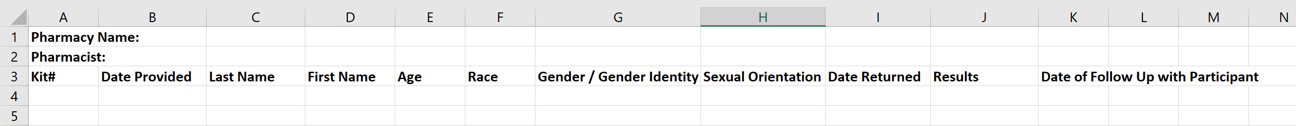
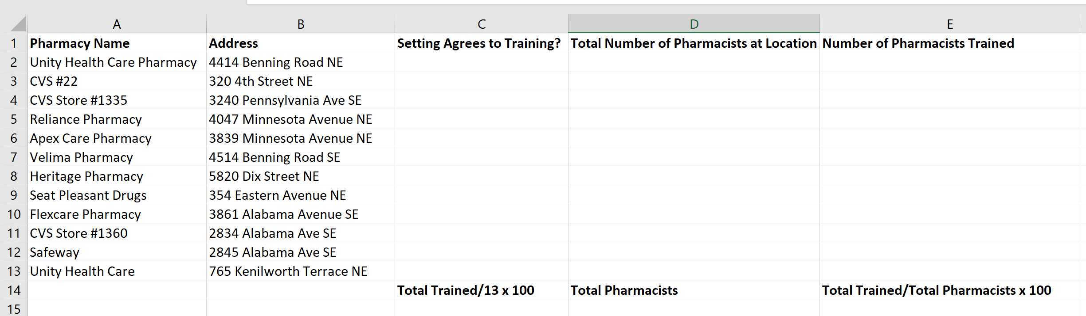
Tracking Logs for Pharmacy and Train- the-Trainer Program
Notes:
Also, Tracking Logs for evaluating the adoption of the program by pharmacists and the training program for pharmacists.

Slide 182
Ward 7 & Population of Focus
Black: 91.7% of the population
Families Below Poverty: 23.3% of the population
Colorectal Cancer Screening Rate in Ward 7: 48%
Colorectal Cancer Screening Rate at each pharmacy location in Ward 7: Unknown at this time
Notes:
Remember that early on, we spoke about the case study context being that the Federally Qualified Health Center was too overwhelmed to take on a new screening program at the moment. This choice of partnering with pharmacies came with one weakness being a lack of baseline screening rate data.

Slide 183
Health Equity Outcomes
Who was included as the Population(s) of Focus?
How did your project consider the history of the issue within the community?
How is the Population(s) of Focus:
    Affected?
    Engaged and included in the planning?
    Included in the dissemination of results?
Comprehensive Cancer Control National Partnership, 2021
Notes:
Remember to reflect on equity early on in the process.
How would you evaluate if your intervention moved the needle on health equity? You can ask yourself and your team:
Who was included as the Population(s) of Focus?
How did your project consider the history of the issue within the community?
How was the Population(s) of Focus: Affected?
Engaged in the planning?
Included in the dissemination of results?
You can also reflect on who wasn’t involved in this specific project but should be included now that we know what we know.

Slide 184
Health Equity Approach
How did the initiative:
  Remove unfair social, economic, or environmental disadvantages for certain groups?
  Increase access to resources or opportunities?
  Strengthen support systems?
  Reduce bias and discriminatory actions among providers?
  Increase skills and abilities?
Comprehensive Cancer Control National Partnership, 2021
Notes:
Also, some some more complex questions should be asked.
You can ask: how did the initiative:
Remove unfair social, economic, or environmental disadvantages for certain groups?
Increase access to resources or opportunities?
Strengthen support systems?
Reduce bias and discriminatory actions among providers?
Increase skills and abilities?
Transition between Polly and Gloria

Slide 185
Session Agenda
  Introduce RE-AIM evaluation framework
    Evaluation overview
    Examine each dimension of evaluation framework in detail
    Case examples
Notes:
Hi Everyone! My name is Gloria Coronado and I serve as the Distinguished Investigator of Health disparities at the Kaiser Permanente Center for Health Research.
What does RE-AIM stand for?
What do you think the R in RE-AIM stands for?

Slide 186
Evaluate Reach
Characteristics for eligibility in program
Characteristics of participants in program
Characteristics of participants vs. non-participants
Understanding why some people participate and others do not
National Cancer Institute, 2012
Notes:
Reach examines
Characteristics for eligibility in program/population of focus
Characteristics of participants in program: age, race, gender/gender identity, sexual orientation
Characteristics of participants compared to non-participants
Understanding why some people participate and others do not

Slide 187
Case Example: Eligibility Criteria
What are your eligibility criteria?
Notes:
A tracking log example is shown here. Based on your eligibility criteria, you might track race, gender/gender identity, and sexual orientation for example.

Slide 188
Case: Characteristics of People Returning Kits
Notes:
Here is an intake form or survey (paper or electronic) to collect demographic information
Reminder that we are still talking about the case example so remember these are examples and not specifically what you have to be doing in your projects!
For example, you may be interested in screening for social determinants of health and want to include questions related to housing instability, food insecurity, employment status, and transportation challenges.

Slide 189
Case: Subpopulation Reach
Year 1: Black individuals screened=501
Year 2: Black individuals screened=871
Notes:
Here is a Tracking log example:
Here you see year 1 with 501 Black individuals screened and year 2 at 871 showing an increase

Slide 190

Why do some people participate?
Why do some people return the kits & others do not?
Notes:
Focus Groups can uncover the reason why some return the kits and others do not.
Next slide--What do you think the E in RE-AIM stands for?

Slide 191
Evaluate Effectiveness
Percent of people screened by program compared to SMARTIE objective
Did your FLU-FIT program achieve your objective?
  How close did you get?
How confident can you be about the results?
Measure of quality and health outcomes
Who stayed involved and completed the program?
National Cancer Institute, 2012
Notes:
Effectiveness gauges:
Percent of people screened by program compared to SMARTIE objective
Did your FLU-FIT program achieve your objective?
How close did you get?
How confident can you be about the results?
Measure of service and patient outcomes
Who stayed involved and completed the program?

Slide 192
Case: Effectiveness & SMARTIE Objective Achievement
Year 1: 48%
Year 2: 60%
Notes:
Here is the area of the Tracking log where you can see effectiveness data:
One pharmacy was able to share data with an insurance company to gather the 48% baseline rate for returning CRC FLU-FIT Kits among their patients before the intervention (i.e. before there was a pharmacy partnership program).

Slide 193
Case: Did you reach your SMARTIE objective?
SMARTIE Objective: To increase colorectal cancer screening among Black residents in Ward 7 of Washington D.C. from 48% to 63% in one year by conducting a train-the-trainer for 10 pharmacists across 5 pharmacies
SMART Objective: 63%
Actual: 60%
Notes:
The percentage of people being screened have increased, but the project did not reach goal-it was very close though!
Next, we are going to focus on the second aspect of the objective, that of reaching 10 pharmacies.
What do you think the A in RE-AIM stands for?

Slide 194
Evaluate Adoption
Penetration: Percent of pharmacies approached that participate
Characteristics of participating vs. non-participating pharmacies
Percent of pharmacists invited that participate
Characteristics of participating vs. non-participating pharmacists
Why did some pharmacies (and pharmacists) not participate?
Pharmacies excluded
National Cancer Institute, 2012
Notes:
Adoption: is the decision to make full use of an innovation, intervention, or program as the best course of action available.
Some ways to think about this include:
Penetration: Percent of pharmacies approached that participate
Characteristics of participating vs. non-participating pharmacies
Percent of pharmacists invited that participate
Characteristics of participating vs. non-participating pharmacists
Why did some pharmacies (and pharmacists) not participate?
Pharmacies excluded for any reason

Slide 195
Inventory Pharmacies in Ward 7
Unity Health Care Pharmacy
CVS
Reliance Pharmacy
Apex Care Pharmacy
Velima Pharmacy
Heritage Pharmacy
Seat Pleasant Drugs
Flexcare Pharmacy
Notes:
A map is shown here of Ward 7 Pharmacies.

Slide 196
Case Example: Penetration
Percent of
pharmacies trained
Percent of
pharmacists trained
Notes:
You can see here the percent of pharmacies and pharmacists trained. This penetration metric can help us understand the degree of adoption of the program.
What do you think the I in RE-AIM stands for?

Slide 197
Case Example
EBI: FLU-Fecal Immunochemical Test (FLU-FIT)
Implementation Strategy: Train-the-Trainer for Pharmacists
SMARTIE Objective: Increase colorectal cancer screening among Black residents in Ward 7 of Washington D.C. from 48% to 63% in one year by conducting a train-the-trainer program with 10 pharmacists across 5 pharmacies.
Chatterjee et al., 2015
Notes:
Next, we will look at how to evaluate the implementation process itself, rather than the EBI.

Slide 198
Case: Implementation Strategy
Train-the-Trainer for Pharmacists about FLU-FIT
  Develop or identify highly visual, low literacy educational materials on FIT
  Conduct train-the-trainer
  Make training dynamic
  Conduct outreach visits
  Provide ongoing consultation
Notes:
For this example, our hypothetical implementation team chose to use strategies to educate pharmacists. Specifically, they used the concept of a Peer Training Program. The five tactics listed here were used in the implementation intervention approach.

Slide 199
Evaluate Implementation
How acceptable/appropriate is the FLU-FIT intervention for this population?
How feasible is the FLU-FIT intervention for pharmacists to deliver?
Fidelity: To what extent did pharmacists implement the protocol as instructed? How consistently is protocol followed?
What adaptations were made to the protocol? When and why were they made? By whom?
How much additional time did the program take compared to time typically needed to just vaccinate a patient? How much does that extra time cost to the pharmacy?
National Cancer Institute, 2012
Notes:
Some questions to ask about evaluating the implementation of the intervention:
How acceptable/appropriate is the FLU-FIT intervention for this population?
How feasible is the FLU-FIT intervention for pharmacists to deliver?
Fidelity: To what extent did pharmacists implement the protocol as instructed? How consistently is the protocol followed?
What adaptations were made to the protocol? When and why were they made? By whom?
How much additional time did the program take compared to time typically needed to vaccinate a patient? How much does that extra time cost to the pharmacy?

Slide 200
Case Example: Feasibility
Focus: Pharmacist’s experience of intervention
 | Completely Disagree | Disagree | Neither Agree nor Disagree | Agree | Completely Agree
The FLU-FIT program is user-friendly.
Our pharmacy is equipped to carry out the FLU-FIT program.
Our pharmacy is satisfied with FLU-FIT.
There are barriers to the adoption of the FLU-FIT program in our site.
1
2
3
4
5
1
2
3
4
5
1
2
3
4
5
1
2
3
4
5
Notes:
Here is an example of a way to measure feasibility. This survey could be given to pharmacists and asks them to confirm their level of agreement with some statements.
For example: Our pharmacy is equipped to carry out the FLU-FIT program.

Slide 201

Case: Fidelity & Feasibility
Understand the degree to which an intervention is implemented as intended
  Review checklist of core components with pharmacists shortly after training
  Focus group with trained pharmacists
    What adaptations were needed? Why? When? By whom?
    What were patient reactions to receiving the FIT kit?
    How much extra time did it take you on average?
    How consistently were you able to implement the checklist of core components?
Notes:
Understanding the degree to which an intervention is implemented as intended is important.
You could review a fidelity checklist with pharmacists shortly after the training
You could host a focus group with trained pharmacists. This might ask:
What adaptations were needed? Why? When? By whom?
What were patient reactions to receiving the FIT kit?
How much extra time did it take you on average?
How consistently were you able to implement the protocol?
What do you think the M in RE-AIM stands for?

Slide 202
Evaluate Maintenance: Patients
Baseline screening rates for pharmacy (if available)
% of FLU-FIT kits returned correctly
Patient satisfaction with ease of using and returning kits
Characteristics of participants vs. non-participants over the long-term
National Cancer Institute, 2012
Notes:
Maintenance is the next dimension of RE-AIM. It can help understand:
Baseline screening rates for pharmacy (if available)
% of FLU-FIT kits returned correctly
Patient satisfaction with ease of using and returning kits
Characteristics of participants vs. non-participants over the long-term
Remember you don’t have to track EVERYTHING. If you want data about who and to what extent pharmacists are continuing the intervention after the official program ends, ask pharmacists to continue their tracking log and to send you the log without patient names 6 months after the end of your intervention. This will tell you which pharmacies and pharmacists are still providing FIT kits and how often
Because this is a seasonal program, so you might also send a reminder the following year and assess maintenance based on response to repeat the program without your support

Slide 203
Acceptability & Feasibility - Part 1
Weiner et al., 2017
Notes:
Example of a validated measure: Weiner BJ, Lewis CC, Stanic C, et al.
Validated questions have been tested with a sample representative of the general population and have been shown to have consistent results when given repeatedly. They also are demonstrated to be accurate ways to actually measure what you are trying to measure.
If you want to add new questions based on your intervention, have other team members review them for clarity and relevance. More is not always better with a survey.

Slide 204
Acceptability & Feasibility - Part 2
Notes:
Use the same intake form to collect demographic information to measure acceptability and feasibility.

Slide 205
Evaluate Maintenance: Pharmacies
Did pharmacies and pharmacists continue to implement the FLU-FIT program in subsequent years?
How was program adapted long term?
Does program fit into organizational mission and workflow?
Use qualitative methods to understand setting level institutionalization
National Cancer Institue, 2012
Notes:
Some questions you can ask to understand the long-term maintenance of your intervention:
Did pharmacies and pharmacists continue to implement the FLU-FIT program in subsequent years?
How was the program adapted long term?
Does the program fit into the organizational mission and workflow?
Use qualitative methods to understand setting level institutionalization

Slide 206
Survey Pharmacy Leads
Does this program align with your pharmacy’s mission?
Has an administrative-level individual within pharmacy been actively involved in advocating for this program’s continuation?
Have permanent staff been assigned to implement this program?
What adaptations have been needed to integrate FLU-FIT into your workflows?
Goodman et al., 1993
Notes:
This was taken from a larger survey of level of institutionalization of change that available in the supplemental tools. While maintenance is similar to sustainability, it is not the same thing. Rather, it is a shorter-term measure of institutionalization, and can be seen as on the way towards long term sustainability.
Does this program align with your pharmacy’s mission?
Has an administrative-level individual within the pharmacy been actively involved in advocating for this program’s continuation?
Have permanent staff been assigned to implement this program?
What adaptations have been needed to integrate FLU-FIT into your workflows?

Slide 207
Insurance Companies
Community Pharmacies
Cancer Screening Status Data Sharing
Eligibility status for FLU-Fit Kits
Notes:
Not all pharmacies may not have baseline data to compare colorectal cancer screening rates before and after the intervention. If this is the case, you may determine whether you could build infrastructure to share data between insurance companies and pharmacies and help build capacity for quality improvement and evaluation in the future.
Having the pharmacy and insurance company share data could be a daunting and expensive undertaking, but there could be benefits for both the pharmacy and overall patient health.
Examples: Brings patients to the pharmacy and potentially allows them to bill for new services
Reduces the health system demand for GI specialists given the need to catch up from limited screening during COVID and the likelihood of reducing the age for CRC screening from 50 to 45 (adding 5 more years worth of patient population)

Slide 208
Using Evaluation Data & Results
Use data to measure whether you are achieving goals
Use results to inform which implementation strategies to use in future
Distribute results to stakeholders to improve future implementation
Metz et al., 2020
Notes:
Most important is how you use evaluation data once it is collected and analyzed. For example, you could:
Use data to regularly measure whether you are achieving goals
Use results to inform which implementation strategies to use in future
Distribute results to stakeholders to improve future implementation

Slide 209
Tools and Supplemental Resources
Grid-Enabled Measures Database
Proctor, E., Silmere, H., Raghavan, R., Hovmand, P., Aarons, G., Bunger, A., Griffey, R., & Hensley, M. (2011). Outcomes for implementation research: Conceptual distinctions, measurement challenges, and research agenda. Administration and Policy in Mental Health, 38(2), 65-67
Implementation Outcome Repository
RE-AIM Tool
Washington University Institute of Clinical and Translational Sciences Implementation Outcomes Toolkit
Notes:
Tools listed here are all located in your companion guide.

Slide 210
References
Chatterjee S., Chattopadhyay, A., & Levine, P. (2015). Between-ward disparities in colorectal cancer incidence and
screening in Washington DC. Journal of Epidemiology and Global Health, 5(4 Supplement 1), S1-S9.
doi: 10.1016/j.jegh.2015.08.001
Comprehensive Cancer Control National Partnership. (2021). Health equity tip sheet.
https://www.acs4ccc.org/wp-content/uploads/2021/04/Cancer-Plan-Tip-Sheet_Health-Equity_FINAL.pdf
Goodman, R. M., McLeroy, K. R., Steckler, A. B., & Hoyle, R. H. (1993). Development of level of institutionalization
scales for health promotion programs. Health Education Quarterly, 20(2):161-78
doi: 10.1177/109019819302000208
Holt, C. L., Tagai, E. K., Scheirer, M. A., Santos, S. L., Bowie, J., Haider, M., Slade, J., Wang, M., & Whitehead, T.
(2014). Translating evidence-based interventions for implementation: Experiences from Project HEAL in African
American churches. Implementation Science, 9(1). doi: 10.1186/1748-5908-9-66
Metz, A., Louison, L., Burke, K., Albers, B., & Ward, C. (2020). Implementation support practitioner profile: Guiding
principles and core competencies for implementation practice. Chapel Hill, NC: National Implementation Research
Network, University of North Carolina at Chapel Hill.
https://nirn.fpg.unc.edu/resources/implementation-support-practitioner-profile.
National Cancer Institute. (2012). http://re-aim.org/wp-content/uploads/2016/09/checklistdimensions.pdf
Rohweder, C., Wangen, M., Black, M., Dolinger, H., Wolf, M., O'Reilly, C., Brandt, H., & Leeman, J. (2019)
Understanding quality improvement collaboratives through an implementation science lens. Prevention
Medicine, 129S:105859. doi: 10.1016/j.ypmed.2019.105859
Rubin Means, A., & Wagenaar, B. (2018). An introduction quality improvement. The ImpSci UW Blog.
https://impsciuw.org/an-introduction-to-quality-improvement/
Notes:
As well as references.

Slide 211
References
Smith, J. D., Li, D. H. & Rafferty, M. R. (2020). The Implementation Research Logic Model: A method for planning,
executing, reporting, and synthesizing implementation projects. Implementation Science, 16(84).
https://doi.org/10.1186/s13012-020-01041-8
Weiner, B. J., Lewis, C. C., Stanick, C., Powell, B., Dorsey, C., Clary, A., Boynton, M., & Halko, H. (2017).
Psychometric assessment of three newly developed implementation outcome measures. Implementation Science,
12(108). https://doi.org/10.1186/s13012-017-0635-3

Slide 212
Acknowledgments
PI:
Mandi L. Pratt-Chapman PhD
Staff:
Sarah Adler
Joseph Astorino
Leila Habib
Sarah Kerch
Workgroup Members:
Heather Brandt
Polly Hager
Notes:
Thank you to all those listed here who helped in developing this training.

Slide 213
Planning for Sustainability
Notes:
Welcome to the last session of Base Camp.
My name is Tamara Robinson, and I am the program director for the Nebraska Cancer Coalition, also known as NC2.

Slide 214
Disclosure
This session is supported by Cooperative Agreement #NU58DP006461-03 from the Centers for Disease Control and Prevention (CDC). The views expressed in written workshop materials or publications and by speakers and moderators do not necessarily reflect the official policies of the Department of Health and Human Services, nor does the mention of trade names, commercial practices, or organizations imply endorsement by the U.S. Government.
Notes:
This session is supported by a Cooperative Agreement from the Centers for Disease Control and Prevention (CDC). The views expressed in written workshop materials or publications and by speakers and moderators do not necessarily reflect the official policies of the Department of Health and Human Services, nor does the mention of trade names, commercial practices, or organizations imply endorsement by the U.S. Government.

Slide 215
Learning Objectives
Identify elements critical for sustaining an intervention
Describe how to integrate a sustainability tool into cancer screening implementation planning
Notes:
Here are our main learning objectives for this session.
Identify elements critical for sustaining an intervention
Describe how to integrate a sustainability tool into cancer screening implementation planning

Slide 216
Session Agenda
  Introduce sustainability as extension of previous sessions
  Introduce sustainability elements from a tool using real CCC examples and hypothetical FLU-FIT case study examples
Notes:
And our map for the session:
Introduce sustainability as extension of previous sessions
Introduce sustainability elements from a tool using real CCC examples and hypothetical FLU-FIT case study examples

Slide 217
Sustainability
To what extent an evidence-based intervention can deliver its ___________ and its intended ________ over an ____________________ after _____________________ is ended
Programming
Benefits
Extended Period of Time
External Support
Word Box:
Programming
Extended period of time
External Support
Benefits
Rabin et al., 2008
Shelton et al., 2020
Notes:
Let’s fill in the blanks here to define sustainability. I will pause for each blank while you think about the correct word from the word bank.
Sustainability can be defined as: to what extent an evidence-based intervention can deliver its programming and its intended benefits over an extended period of time after external support is ended
EBIs can only succeed at the population health level if they are appropriate to the Populations of Focus, affordable across most settings, feasible for workflows that vary across settings, and are delivered consistently and equitably over time across diverse settings and populations

Slide 218

What are you sustaining?
Evidence-based interventions
  Example: FLU-FIT Intervention
Implementation strategies supporting those EBIs
  Examples:
    “Train the Trainer” education strategy
    Restructuring strategies
    Quality management strategies
    Policy strategies
Notes:
First, you should get clear about WHAT you are actually sustaining.
From our case example:
You want to sustain the Evidence-based intervention
Example: FLU-FIT Intervention
You also want to sustain the implementation strategies supporting those EBIs
Examples:
“Train the Trainer” education strategy
Restructuring strategies
Quality management strategies
Policy strategies

Slide 219

Comprehensive Cancer Control & Sustainability Planning
92% of CCC plans mention sustainability, but often without detailed action plans
Ory et al., 2015
Photo: @ryansnaadt
Notes:
In terms of Comp Cancer Control---92% of CCC plans mention sustainability, but often without detailed action plans
Sample details for more actionable plans: Can you determine--
Which agencies will take the lead in seeking funding? Which will be involved in carrying out the intervention and implementation?
How will funds be administered and managed?

Slide 220
Session Agenda
  Introduce sustainability as extension of previous sessions
  Introduce sustainability elements from a tool using real CCC examples and hypothetical FLU-FIT case study examples
Notes:
Next, we will introduce sustainability elements from a tool using real world and hypothetical case study examples.

Slide 221
Assess Elements that Influence Sustainability Outcomes in Your Context
Use an existing tool: Program Sustainability Assessment Tool (PSAT)
Calhoun et al., 2014
Notes:
The PSAT, or Program Sustainability Assessment tool, will allow you to assess your current capacity for sustainability, identifying specific strengths and weaknesses in regards to sustainability.
You can then use results to guide sustainability action planning for your program.
This tool has been designed for use with a wide variety of programs, both large and small, across different settings. Given this flexibility, it is important for you to think through how you are defining your program, organization, and community before starting the assessment.
Below are a few definitions of terms that are frequently used throughout the tool.
Program refers to the set of formal organized activities that you want to sustain over time. Such activities could occur at the local, state, national, or international level and in a variety of settings.
Organization encompasses all the parent organizations or agencies in which the program is housed. Depending on your program, the organization may refer to a national, state, or local department, a nonprofit organization, a hospital, etc.
Community refers to the stakeholders who may benefit from or who may guide the program. This could include local residents, organizational leaders, decision-makers, etc. Community does not refer to a specific town or neighborhood.

Slide 222

PSAT Elements
Next, we’re going to learn about the eight (8) PSAT elements
Notes:
Next we’re going to learn about the eight (8) PSAT Elements.

Slide 223

PSAT Elements
Environmental Support
Funding Stability
Partnerships
Organizational Capacity
Evaluation
Adaptation
Communication
Strategic Planning
Notes:
Hi everyone, My name is Mandi Pratt-Chapman, and I am the Associate Center Director in charge of Patient-Centered Initiatives and Health Equity for the George Washington University Cancer Center.

Slide 224
PSAT Elements
Environmental Support
Funding Stability
Partnerships
Organizational Capacity
Evaluation
Adaptation
Communication
Strategic Planning
Notes:
First, we will examine environmental support.

Slide 225


Environmental Support
Identify supportive clinical and community champions with:
  Decision-making ability
  Resources
Gain leadership support within organization
Proactively foster
  Community support
  Public policy and educating on policy
Notes:
For example – if we wanted to bolster environmental support ,we would want to work with stakeholders to:
Identify supportive clinical and community champions with:
Decision-making ability
Resources
We can also foster environmental support by gaining leadership support within organization
We can also proactively foster
Community support
We might also educate policymakers on supportive policies

Slide 226
Examples
Massachusetts:
  Developing and sustaining collaborations to reduce cancer-related health disparities and promote health equity
  Creating and sustaining a cancer policy and legislative agenda that supports projects across the cancer control continuum
  Creating and sustaining environments that support risk reduction
Ory et al., 2015
Notes:
A real world example is the Comp Cancer program in Massachusetts:
To bolster environmental supports, they
Developed and sustained collaborations to reduce cancer-related health disparities and promote health equity
Created a cancer policy and legislative agenda that supports projects across the cancer control continuum
Advocated for environments that support risk reduction

Slide 227

Case Study Example
Partnerships with pharmacy champions
  Invitation to comprehensive cancer control coalition meetings
  Increased engagement from pharmacy sector
Notes:
Let’s think about our case study… To build environmental supports, we would want to create or strengthen partnerships with pharmacy champions
Invitation to comprehensive cancer control coalition meetings – or if they are too busy in practice, consider ad hoc engagement to use their time most efficiently. This might mean direct community outreach to pharmacists.
Increased engagement from this sector

Slide 228
PSAT Elements
Environmental Support
Funding Stability
Partnerships
Organizational Capacity
Evaluation
Adaptation
Communication
Strategic Planning
Notes:
Next, we will look at funding stability.

Slide 229

Funding Stability
Create policies and systems that sustain ongoing funding
Diversify funding streams, including stable and flexible funding
Notes:
Create policies and systems that sustain ongoing funding
Diversify funding streams, including stable and flexible funding

Slide 230
Examples
Texas: Create policies that sustain ongoing funding
  Advocacy education for funding for risk reduction, monitoring, survivorship, and general operating to support quality data and delivery of risk reduction and care programs
Several state CCC organizations: Diversify funding
  Established their own or subsidiary 501(c)(3) organization for greater financial flexibility
    Georgia, Virginia, Arkansas, Maine, and Kentucky
Ory et al., 2015
Notes:
Example from:
Texas: Create policies that sustain ongoing funding
Advocacy education for funding for risk reduction, monitoring, survivorship, and infrastructure supporting quality data and delivery of risk reduction and care programs
Several state CCC organizations: Diversify funding
Established their own or subsidiary 501(c)(3) organization for greater financial flexibility
Georgia, Virginia, Arkansas, Maine, and Kentucky

Slide 231
PSAT Elements
Environmental Support
Funding Stability
Partnerships
Organizational Capacity
Evaluation
Adaptation
Communication
Strategic Planning
Notes:
Next is partnerships.

Slide 232

Partnerships
Identify community leaders who are passionate about your cancer screening goals and cultivate buy-in
Engage diverse organizations and groups in planning, implementation, and measuring success
Engage partners from multiple levels
Notes:
Identify community leaders who are passionate about your cancer screening goals and cultivate buy-in
Engage diverse organizations and groups in planning, implementation, and measuring success
Engage partners from multiple levels

Slide 233
Examples
Texas:
    Requires organizations seeking support letters to identify how their proposals address the plan goals and objectives; uses participatory planning
Nebraska:
The state partners with the coalition to develop the state cancer plan and help facilitate implementation through established community relationships
Ory et al., 2015
Notes:
Here are two real-world examples
Texas:
Cancer Alliance of Texas
Requires organizations seeking support letters to identify how their proposals address the plan goals and objectives and uses participatory planning
Nebraska:
The state partners with the coalition to development the state cancer plan and help facilitate implementation through established community relationships

Slide 234
PSAT Elements
Environmental Support
Funding Stability
Partnerships
Organizational Capacity
Evaluation
Adaptation
Communication
Strategic Planning
Notes:
Organizational capacity is next.

Slide 235
Organizational Capacity
Assess strengths and needs related to general operations
  Provide training & show its value to daily work
  Ensure adequate management and staffing
  Articulate your vision to external partners
Metz et al., 2020
Notes:
Assess strengths and needs related to organizational systems
Provide training to improve capacity and network; show its value to daily work
Ensure adequate management and staffing for ongoing implementation
Articulate your vision to external partners

Slide 236
Examples
South Carolina:
  Ensuring and setting aside resources: quality data, funds, and educated workforce
  Goals and objectives related to human resources, information services, and financial resources
Maryland: Training professionals, patients, and caregivers
District of Columbia: Budget breakdown for plan implementation includes $75,000 defined in budget for coalition member technical assistance and capacity building
Ory et al., 2015
Notes:
Examples:
South Carolina:
Ensuring and setting aside resources for quality data, funds, and educated work-force
Goals and strategies related to human resources, information services, and financial resources
Maryland: plan addresses training professionals, patients, and caregivers in several sections of the document
District of Columbia: budget breakdown for plan implementation, which includes a $75,000 specifically defined for coalition member technical assistance and capacity building

Slide 237
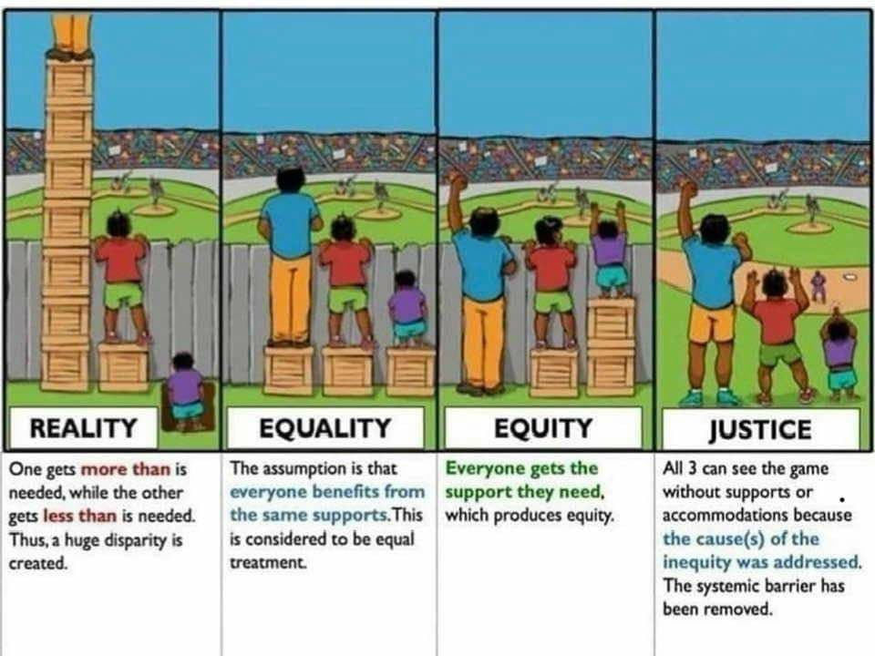
Case Study Example
Training pharmacy students about cancer screening goals
Inclusion of FLU-FIT program in pharmacy school curriculum
Culture of health developing at intervention sites; screening for social determinants at pharmacies in Ward 7
Image from: https://medium.com/@sandeepkumar_52041/equality-equity-and-justice-5f71ebe31245
Notes:
Some more hypothetical examples from the FLU-FIT case study:
Maybe the program leads to:
Training pharmacy students about cancer screening goals
Inclusion of FLU-FIT program in pharmacy school curriculum
Culture of health developing at intervention sites; screening for social determinants and cancer screening status at pharmacies in Ward 7 as a result of community leadership inclusion. This can be seen as an extension of equity coming from the momentum of equitable implementation. This leads to the path of justice, where systemic barriers are removed.

Slide 238
PSAT Elements
Environmental Support
Funding Stability
Partnerships
Organizational Capacity
Evaluation
Adaptation
Communication
Strategic Planning
Notes:
Next, we will examine Evaluation.

Slide 239


Evaluation
Inform planning with results from evaluation
  Repeat RE-AIM process for each cycle of improvement
  Develop organizational capacity to perform evaluation
  Set new goals in context of resources available in communities of interest
  Share evaluation results with
  external stakeholders
Notes:
You heard lots about RE-AIM in the last session.
The main goal of evaluation is to inform the next round of planning
You can repeat aspects of RE-AIM process for each cycle of improvement
You can also develop organizational capacity to perform evaluation
Work to set new goals with communities of interest to help with sustainability – so that interests are aligned
Make sure you share evaluation results with external stakeholders to increase buy-in and show feasibility
In this case, when showing value for stakeholders concerned most about sustainability, you may want to highlight effectiveness and maintenance.
Remember, you don’t have to evaluate all of these constructs all the time. Your activities should fit with the bigger picture of your context.

Slide 240
Examples
Increase the percentage of adults who receive colorectal cancer screening according to national guidelines
Texas
  Define SMART objectives based on review of initial and ongoing data, with consideration of factors such as available resources, barriers, and capacity for implementation of strategic actions
(BRFSS, 2016)
Adults, ages 50-75, who have fully met the USPSTF recommendation
60.1%
80%
2018 Baseline
2023 Target
CPRIT, 2018
Ory et al., 2015
Notes:
A real-world example: Texas included in their cancer plan SMART objectives based on a review of initial and ongoing data, with consideration of factors such as available resources, barriers, and capacity for implementation of strategic actions.
Here you see from the Texas plan the Baseline and Target percentages for colorectal cancer screening very clearly laid out. They had around a 60% baseline colorectal cancer screening rate and set a target of 80% by 2023.
So their evaluation was focused on the R of RE-AIM—a 20% increase in reach of CRC screening

Slide 241
Extending RE-AIM Framework to Enhance Sustainability
Who is/isn’t reached by the EBI at various points over long term?
Does the EBI continue to be effective at various points over time?
Which settings continue to deliver the EBI over time?
Are certain implementation strategies having sustained impact?
Shelton et al., 2020
Notes:
We need to be evaluating from the beginning to show value and to show the importance of maintaining and sustaining an initiative, but you can use RE-AIM to structure your description of sustainability.
Who is/isn’t reached by the EBI at various points over long term?
Does the EBI continue to be effective at various points over time?
Which settings continue to deliver the EBI over time?
Are certain implementation strategies having sustained impact?

Slide 242

PSAT Elements
Environmental Support
Funding Stability
Partnerships
Organizational Capacity
Evaluation
Adaptation
Communication
Strategic Planning
Notes:
Adaptation is another important element of sustainability.

Slide 243

Program Adaptation
Periodically:
  Review evidence and contextual changes
  Assess fit between context and EBI
Chambers et al., 2013
Notes:
“Real-world” contexts require adaptation, capacity building, responsiveness
Choose what you're sustaining; pay attention to what you are putting your effort towards sustaining
Periodically review the evidence base and compare it to what you are currently doing in practice.
Assess how well the EBIs that are institutionalized fit your changing context and adapt accordingly

Slide 244
Examples
Changes to the evidence base:
  Adapt to evolving guidelines by lengthening the interval for cervical cancer screening with pap smear from 1 to 3 years
Changes in the context:
  COVID-19 pandemic led to drive-by FLU-FIT programs and changing locations for program to other innovative sites
Changes in the fit between context and evidence:
  Telehealth environment no longer fits a screening program’s delivery of health promotion messages
Shelton et al., 2020
Wang et al., 2018
Notes:
You don't have to sustain everything at all times for all people.
For example, there may be changes to the evidence base. For example--
Adapt to evolving guidelines by lengthening the interval for cervical cancer screening with pap smear from 1 to 3 years
There may be changes in the context: COVID-19 Pandemic: Drive by FLU-FIT Programs and changing locations for program to other innovative sites
Lastly, there may be changes in the fit between context and evidence: Maybe the telehealth environment no longer fits a screening program’s delivery of health promotion messages

Slide 245
PSAT Elements
Environmental Support
Funding Stability
Partnerships
Organizational Capacity
Evaluation
Adaptation
Communication
Strategic Planning
Notes:
Communication is another key element of sustainability.

Slide 246

Communication
Communicate with the population of focus
Demonstrate and communicate needs and value to leadership and to the public
Market new initiatives to generate interest and awareness
Consider varied strategies and modes of communication
Notes:
Make sure to communicate with the population of focus
Demonstrate and communicate needs and value to leadership and to the public
Market new initiatives to generate interest and awareness
Consider varied strategies and modes of communication

Slide 247

Examples
Nebraska: Developed state-wide CRC screening messaging campaign for 2 years
Go to: FightBackNE.org
California: Participated in media efforts regarding policy education
  Educating about policy can help public, healthcare professionals, and policy makers garner support for funding
Ory et al., 2015
Notes:
Examples:
NE: Development of state-wide messaging campaigns – they are doing it a third year
California: Participated in media efforts regarding policy education encouraging increased cancer control funding
Educating about policy can help public, healthcare professionals, and policy makers garner support for funding

Slide 248

Case Study Example
Shared advertisements to recruit more pharmacies and customers to participate
Notes:
From our case study: A communication strategy would be to share advertisements to recruit more pharmacies and customers to participate

Slide 249
PSAT Elements
Environmental Support
Funding Stability
Partnerships
Organizational Capacity
Evaluation
Adaptation
Communication
Strategic Planning
Notes:
Last, we will examine the role of Strategic Planning as a sustainability element.

Slide 250
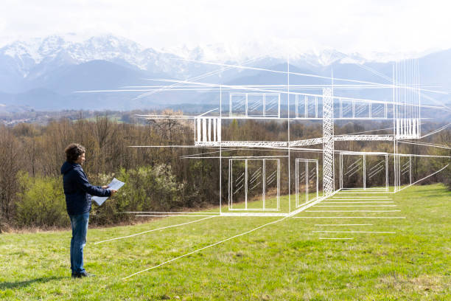
Strategic Planning
Identify and plan for future resource needs
Maintain clear roles and responsibilities
Create a long-term financial plan
Create a sustainability plan, considering the PSAT domains
Notes:
These four points help with strategic planning:
Identify and plan for future resource needs
Maintain clear roles and responsibilities
Create a long-term financial plan
Create a sustainability plan, considering the PSAT domains we just spoke about.

Slide 251
Example
Texas: Each partner’s organizational capacity for intervention maintenance taken into consideration when planning implementation
Ory et al., 2015
Notes:
For example:
Texas: Each partner’s organizational capacity for intervention maintenance is taken into consideration when planning implementation

Slide 252
Base Camp Basics
Context
Adaptation
Sustainability
Evidence-Based Interventions
Implementation Strategies
Implementation Outcomes
Beidas et al., 2018
Lewis et al., 2020
University of Washington, n.d.
Notes:
The past sessions of the training were built around the following skill bundles. We have made it back to the beginning with context, which is always changing and will continually needed assessed as an extension of your sustainability plan.

Slide 253

Base Camp Can Help With:
Implementing cancer screenings projects
Implementing projects across the cancer continuum
Notes:
Remember that although this training is focused on improving cancer screening, the ideas in implementation science can be used for many other areas across the cancer continuum such as risk reduction, treatment, survivorship, and palliative care.

Slide 254
Tools and Supplemental Resources
Center for Health Innovation and Implementation Science
Community Toolbox: Planning for Sustainability
Conceptualizing De-Implementation in Cancer Care Delivery
Program Sustainability Assessment Tool
Systems Grantmaking Resource Guide
Notes:
Tools listed here are all located in your companion guide.

Slide 255
References
Calhoun, A., Mainor, A., Moreland-Russell, S., Maier, R. C., Brossart, L., & Luke, D. A. (2014). Using the Program
Sustainability Assessment Tool to assess and plan for sustainability. Preventing Chronic Disease, 11, 130185.
http://dx.doi.org/10.5888/pcd11.130185
Cancer Prevention and Research Institute of Texas CIPRIT (2018). 2018 Texas cancer plan.
https://www.cprit.state.tx.us/media/1457/tcp2018_web_09192018.pdf.
Chambers, D. A., Glasgow, R. E., & Stange, K. C. (2013). The dynamic sustainability framework: Addressing the
paradox of sustainment amid ongoing change. Implementation Science, 8(117).
https://doi.org/10.1186/1748-5908-8-117
Metz, A., Louison, L., Burke, K., Albers, B., & Ward, C. (2020). Implementation support practitioner profile:
Guiding principles and core competencies for implementation practice. Chapel Hill, NC: National
Implementation Research Network, University of North Carolina at Chapel Hill.
https://nirn.fpg.unc.edu/resources/implementation-support-practitioner-profile
Ory, M. G., Sanner, B., Vollmer Dahlke, D., & Melvin, C. L. (2015). Promoting public health through state cancer
control plans: A review of capacity and sustainability. Frontiers in Public Health, 3, 40.
https://doi.org/10.3389/fpubh.2015.00040
Rabin, B. A., Brownson, R. C., Haire-Joshu, D., Kreuter, M. W., & Weaver, N. L. (2008). A glossary for dissemination
and implementation research in health. Journal of Public Health Management and Practice, 14(2):117-23.
doi: 10.1097/01.PHH.0000311888.06252.bb
Shelton, R. C., Chambers, D. A., & Glasgow, R. E. (2020). An extension of RE-AIM to enhance sustainability:
addressing dynamic context and promoting health equity over time. Frontiers in Public Health, 8(134).
doi: 10.3389/fpubh.2020.00134
Wang, V., Maciejewski, M., Helfrich, C., & Weiner, B. (2018). Working smarter not harder: Coupling implementation to
de-implementation. Healthcare, 6(2), 104-107. doi: 10.1016/j.hjdsi.2017.12.004
Notes:
As well as references.

Slide 256
Acknowledgments
PI:
Mandi L. Pratt-Chapman PhD
Staff:
Sarah Adler
Joseph Astorino
Leila Habib
Sarah Kerch
Workgroup Members:
Christi Cahill
David Chambers
Tamara Robinson
Randy Schwartz
Notes:
Thank you to all those listed here who helped in developing this training.

