Slide 1
This content may be used or adapted for noncommercial, educational purposes only. Please use the following citation:
George Washington University Cancer Center TAP. (2020). Action for Policy, Systems and Environmental (PSE) Change: A Training [PowerPoint Slides]. GWU Cancer Center TAP. https://cme.smhs.gwu.edu/gw-cancer-center-/content/action-policy-systems-and-environmental-pse-change-training
This content was adapted from the GW Cancer Center the Oncology Patient Navigation Training: The Fundamentals (PI: Pratt-Chapman) developed and maintained by CDC cooperative agreements #NU38DP004972, #5NU58DP006461 and #NU58DP007539. The content added, changed, or adapted by our organization do not necessarily represent the views of the GW Cancer Center or the CDC.
If you have any questions about the following material or would like permission to use this material, please contact cancercontrol@gwu.edu

Slide 2
Action for Policy, Systems and Environmental (PSE) Change: A Training
Overview
Notes:
Welcome to Action for Policy, Systems and Environmental (PSE) Change: A Training. This training also serves as a companion to Action4PSEchange.org. This lesson is an overview to Policy, Systems and Environmental change. This lesson will take approximately 20 minutes to complete. Throughout this training when the blue button appears on your screen, click it when you are ready to advance the lesson.

Slide 3
Acknowledgments
This work was supported by Cooperative Agreement #1U38DP004972-04 from the Centers for Disease Control and Prevention. Its contents are solely the responsibility of the authors and do not necessarily represent the official views of the Centers for Disease Control and Prevention.
We would also like to thank the American Cancer Society and the Comprehensive Cancer Control National Partnership for the use of their Policy, Systems and Environmental Change Resource Guide, upon which the seven steps of the PSE process are based.
Notes:
We would like to acknowledge the Centers for Disease Control and Prevention for supporting this work. We would also like to thank the American Cancer Society and the Comprehensive Cancer Control National Partnership for the use of their Policy, Systems and Environmental Change Resource Guide, upon which the seven steps of the PSE change process are based.

Slide 4
Competencies
Engage in advocacy for health and health education/promotion
Influence policy and/or systems change to promote health and health education
Notes:
The competencies in this training are based on the Seven Areas of Responsibility for Health Education Specialists, 2015. This lesson will address the following competencies:
Engage in advocacy for health and health education/promotion.
Influence policy and/or systems change to promote health and health education.

Slide 5
Learning Objectives
Describe the process of PSE change as an evidence-based approach to improve health
Distinguish between PSE change initiatives and conventional public health interventions
Notes:
After completing this lesson, you will be able to:
Describe the process of PSE change as an evidence-based approach to improve health.
Distinguish between PSE change initiatives and conventional public health interventions.

Slide 6
Introduction of PSE Change
In this lesson, we will:
Talk about the current state of the evidence base for PSE change
Define PSE change activities
Discuss how PSE change differs from other public health initiatives
Provide PSE change examples
List resources to refer to for additional information
“PSE change” - the purpose of a PSE initiative is to effect change at the policy, systems or environmental level
Notes:
You already may be familiar with the acronym “PSE,” which is short for policy, systems and environment. During this training, we will use the phrase “PSE change,” as the purpose of a PSE initiative is to effect change at the policy, systems or environmental level.
In this lesson, we will talk about PSE change as an evidence-based approach. We will define PSE change activities and discuss how they differ from other public health initiatives. Finally, we will provide examples and a list of resources to refer to for additional information.

Slide 7
What is PSE?
“Definite course of action… selected from among alternatives…to guide and determine present and future decisions”
P – Policy
S – Systems
E – Environment
“An organization forming a network… serving a common purpose”
“The circumstances, objects, or conditions by which one is surrounded”
Merriam-Webster.com, n.d.a.; Truss, 2013; Myerson, n.d.; Smith, 2013; Merriam-Webster.com, n.d.b.; Merriam-Webster.com, n.d.c.
Notes:
Before discussing PSE initiatives, let’s talk more about the P, the S, and the E.
“P” – Policy Merriam-Webster defines “policy” as “a definite course…of action selected from among alternatives…to guide and determine present and future decisions.”
Policies are usually written and regulate the actions of entities, including governments, corporations, small businesses, non-profit organizations and community associations. Accordingly, the word “policy” describes all of the following: laws, rules, regulations, ordinances and corporate or organizational policies.
You may have heard references to “Big P” and “little p” policies. Simply put, “Big P” Policy refers to laws, rules and regulations, generally at the federal, state, or even the local level. “Little p” policy more often refers to the policies of all other entities.
“S” – Systems In this context, “systems” is defined as “an organization forming a network… serving a common purpose.” The word “system” can describe the structure of a hospital, school, recreation department, or condominium association – numerous entities fit this description.
Because these entities most often are governed by policies, this is an example of PSE change overlap. For instance, a school system’s decision to eliminate the sale of sugar-sweetened beverages on its properties constitutes both a systems and a policy change.
“E” – Environment- Environment may be defined as “the circumstances, objects, or conditions by which one is surrounded.” Accordingly, a modification to the surrounding physical environment is an environmental change. The construction of bike or walking paths is an example of an environmental change.
As we saw with the school vending example, aspects of PSE change often overlap. Policy change typically prompts systems and/or environmental changes. For example, the policy that changed the vending machine contents in schools system-wide could also be considered an environmental change, with the replacement of unhealthy options with healthier choices changing the snacking environment.
Slide Citations
Policy. (n.d.). Merriam-Webster.com. Retrieved March 23, 2017, from https://www.merriam-webster.com/dictionary/policy
{Truss, M. Policy, Systems, and Environmental Change in Cancer Control}. Examples of policies include state laws imposing minimum requirements for physical education in schools or a corporate code that subsidizes employees’ gym memberships.
Meyerson, B. (n.d.). State Policy Issues in Cervical Cancer [Web presentation]. Retrieved from http://www.womeningovernment.org/sites/default/files/documents/events/Meyerson.pdf; Smith, C. (2013, July 19). Big P, little p, Policy. [Web log post] Safe Routes to School National Partnership Blog. Retrieved from http://www.saferoutespartnership.org/blog/big-p-little-p-policy
System. (n.d.). Merriam-Webster.com. Retrieved March 23, 2017, from https://www.merriam-webster.com/dictionary/system
Environment. (n.d.). Merriam-Webster.com. Retrieved March 23, 2017 from https://www.merriam-webster.com/dictionary/environment
{Truss, M. Policy, Systems, and Environmental Change in Cancer Control}

Slide 8
Evidence-Based Public Health and PSE
Evidence-based public health – “the conscientious, explicit, and judicious use of current best evidence in making decisions about the care of communities and populations in the domain of health protection, disease prevention, health maintenance and improvement”
In order to grow the PSE change evidence-base, it has been suggested that initiatives include:
Rigorous process and outcomes evaluation
Brownson et al., 2009; CDC, 2006; Honeycutt et al., 2015.
Notes:
Evidence-based public health has been defined as:
"the conscientious, explicit, and judicious use of current best evidence in making decisions about the care of communities and populations in the domain of health protection, disease prevention, health maintenance and improvement.” Dr. Ross Brownson is a national leader in the field of evidence-based public health, co-directs the CDC-funded Prevention Research Center in St. Louis and holds an appointment at Siteman Cancer Center. Brownson and his colleagues explain that the widespread adoption of evidence-based health strategies has been recommended in the literature in order to improve population health.
CDC and the Comprehensive Cancer Control National Partnership both have acknowledged the importance of a robust evidence base for PSE change initiatives. They also have noted, however, that the “hard evidence” for the effectiveness of PSE changes is “just beginning to emerge.”
In order to build the PSE change evidence base, it’s been suggested that all such initiatives include “rigorous process and outcome evaluations.”
We will talk about evaluation further in Lesson 7 of this training.
Slide Citation
Brownson, R., Fielding, J., & Maylahn, M. Evidence-based public health: a fundamental concept for public health practice
Centers for Disease Control and Prevention. Advancing the Nation’s Health: A Guide to Public Health Research Needs, 2006-2015; Comprehensive Cancer Control National Partnership, Policy, Systems, and Environmental Change Resource Guide
Evaluating Policy, Systems, and Environmental Change Interventions: Lessons Learned From CDC’s Prevention Research Centers. Prev Chronic Dis 2015;12:150281. DOI: http://dx.doi.org/10.5888/pcd12.150281

Slide 9
Theory and PSE Change
Community Mobilization frameworks
Collective action on a shared issue - Focus on community empowerment to improve own conditions
Examples: REACH & MATCH
Organizational Development
May inform approaches to systems change – Focus on system climate, culture and improvement process
CDC, 2016; Kindig Booske, Siemering, Henry & Remington, 2010; Kindig, Booske & Remington, 2010; Zahner, Oliver, Siemering, 2014.
Notes:
For those of you who might be academic theory buffs, there are clear connections between theory and the PSE change approach. If you think about the social ecological approach to public health, PSE efforts are focused at the outer levels, aiming to improve the health of individuals across a population. Often we think about health behavior change theories at the individual level, but community mobilization and organizational development frameworks may be helpful as you think about embarking on PSE change in your community. Since this is an introductory course, we don’t have time to go into theory in detail.
Community mobilization means collective action, often taking the form of a coalition. The focus is typically on empowering a community to improve its own conditions. A classic manual on community mobilization is called Organizing for Social Change and is linked at the end of the training.
Since 1999, CDC’s Racial and Ethnic Approaches to Community Health or REACH program has “used community-based, participatory approaches to identify, develop, and disseminate effective strategies for addressing health disparities.” REACH gives funds to state and local health departments, tribes, universities, and community-based organizations to build strong partnerships to guide and support implementing evidence-based strategies at community, societal, cultural, and environmental levels.
In the late 2000s CDC and the Robert Wood Johnson Foundation funded a project called Mobilizing Action Toward Community Health (MATCH) at the University of Wisconsin-Madison Population Health Institute. A foundational understanding of the program was that multisector partnerships and a focus on implementing evidence-based programs and policies targeting multiple determinants of population health would have the largest impact.
In 2014 the group published findings from a multiple case study analysis of partnerships and found that multisector partnerships were associated with policy, systems and environmental changes and improvements in community health indicators. They describe the coalition environment, factors that led to partnership initiation, coalition processes, structure and constraints and outcomes. These components will be covered in subsequent lessons.
Organizational Development theory may inform your approach to systems change. It focuses on assessing the system climate and culture and conducting a multi-step process of diagnosing the problem, developing an action plan for improvement, testing the improvement, and reassessing – this cycle is similar to the plan-do-study-act clinical quality improvement process.
As you embark on your PSE initiative, consider it as an opportunity to contribute to the cancer control PSE evidence base!
Citations
https://www.cdc.gov/chronicdisease/resources/publications/aag/reach.htm
Kindig DA, Booske BC, Siemering KQ, Henry BL, Remington PL. Observations and recommendations From the Mobilizing Action Toward Community Health (MATCH) Expert Meeting. Prev Chronic Dis 2010;7(6):A124.http://www.cdc.gov/pcd/issues/2010/nov/10_0132.htm.
Kindig DA, Booske BC, Remington PL. Mobilizing Action Toward Community Health (MATCH): metrics, incentives, and partnerships for population health. Prev Chronic Dis 2010;7(4):A68. http://www.cdc.gov/pcd/issues/2010/jul/10_0019.htm.
Zahner SJ¹, Oliver TR², Siemering KQ². The mobilizing action toward community health partnership study: multisector partnerships in US counties with improving health metrics. Prev Chronic Dis. 2014 Jan 9;10:E05. doi: 10.5888/pcd10.130103.

Slide 10
PSE Change: How is it Different?
Traditional Public Health Behavior Change Programs | PSE Change
Time limited touch point | Ongoing
Often results in only short-term behavior change | Produces longer-term behavior change over time
Traditionally individual level | Community/population level
May be done in isolation or not part of a larger plan | Part of an ongoing plan and engages multiple stakeholders
Short-term effort (typically 1-3 years) | Long-term
Less sustainable (usually funding-dependent) | Sustainable
Chart adapted from The Food Trust (2012)
Truss, 2013.
Notes:
Now, let’s look at how PSE change initiatives differ from other cancer control or public health programs you may be more familiar with. Public health aims to improve the health of populations; however, many public health interventions tend to focus on changing individual or interpersonal knowledge, attitudes and behaviors. For example, a health department might offer a tobacco cessation class to help individuals quit smoking, or a healthy eating class where people learn how to read nutrition labels in order to make healthier choices. Despite some great PSE public health achievements, the best developed theories and most common interventions are individual-level.
In general, the focus of PSE change interventions shifts from “individual behavior and direct services” to the “infrastructure to support healthy behavior.” Instead of teaching individuals the skills necessary to make healthier choices, PSE change initiatives alter the surrounding environment in ways that make it easier for people to make healthy choices.
For example, instead of encouraging an individual to enroll in a smoking cessation class, a PSE change would aim to implement policies that would raise tobacco excise taxes or prohibit smoking in public places.
Modifying the environment also allows comprehensive cancer control programs to support healthy choices at the population level, rather than at an individual level, which often results in the more efficient use of resources.
Take a moment to consider the difference between these concepts.
Truss, M. Policy, Systems, and Environmental Change in Cancer Control

Slide 11
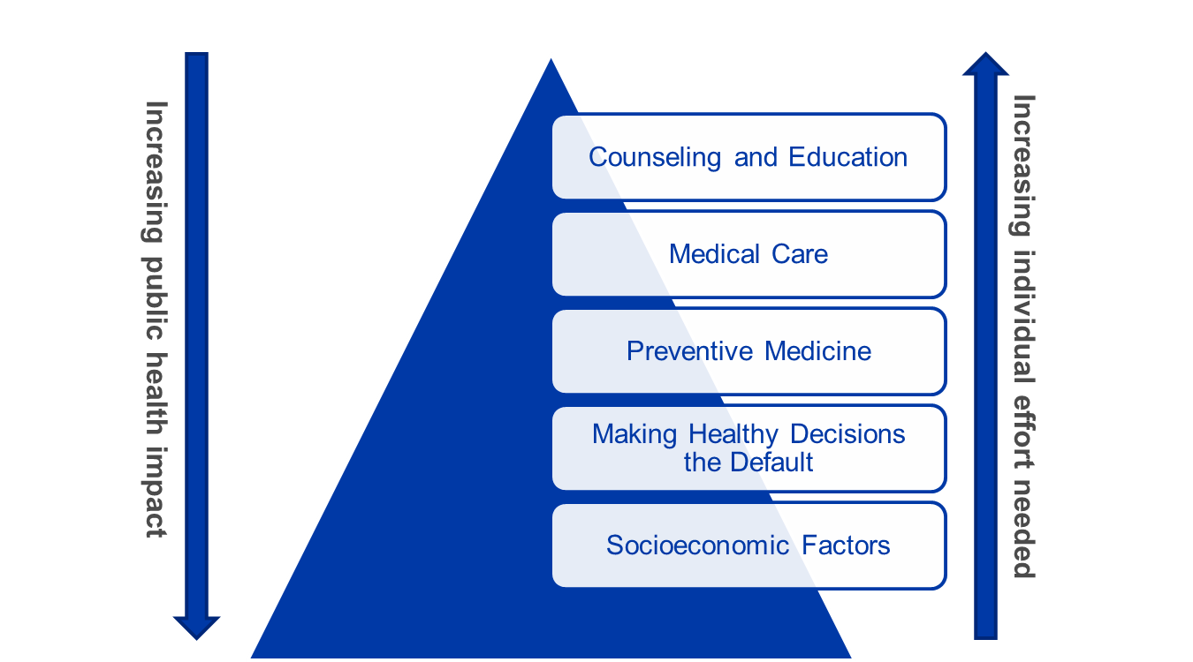
Health Impact Pyramid
CDC, n.d.; Frieden, 2010.
Notes:
To clarify the shift in focus represented by moving to a PSE change mindset, let’s look at the health impact pyramid, first explained by former CDC Director, Thomas R. Frieden. The pyramid illustrates the impact of five different types of public health and clinical interventions. Comprising the base of the pyramid are efforts that have the greatest possible impact on populations while requiring the least individual effort.
Interventions that address social determinants of health anchor the pyramid. These are followed by initiatives that “change the context for health” – that is, PSE changes. Following in ascending order are protective interventions that offer long-term benefits, direct clinical care, and patient counseling and education.
Because PSE changes are removed by three levels from efforts to educate individuals, they offer the potential for a significantly broader impact at the population level.
A common feature of each of these approaches is that the change makes it easier for individuals to make healthier choices.
Centers for Disease Control and Prevention. (n.d.) Public Health Series 101, Introduction to Public Health. Retrieved from https://www.cdc.gov/publichealth101/documents/introduction-to-public-health.pdf
Frieden, T. (2010) A framework for public health action: the health impact pyramid. Am J Public Health. 2010 Apr;100(4):590-5. doi: 10.2105/AJPH.2009.185652

Slide 12
Differences Between Policy, Systems and Environmental Changes
 | Policy | Systems | Environment
Definition | Changing laws, regulations, resolutions, ordinances or rules | Changing processes or rules of an organization, institution or system | Physically changing the environment
Settings | Legislature (national, state, local), government administrations, healthcare settings, schools, worksites, community organizations (faith-based, daycare, senior center) | Health care delivery and insurance systems, schools, worksites, communities, parks | Physical (stores, schools, worksites, parks, health clinics/offices), economic and social environments
Examples | Increasing tobacco taxes, implementing a school-entry vaccination policy, implementing a healthy meeting policy at work | Developing a community plan that accounts for health impact of projects, reviewing and revising organizational procedures to increase cancer screening rates among patient population | Constructing sidewalks to make roads pedestrian-friendly, designating a lactation room for nursing mothers at work
Overlap | Smoke-free policies (e.g., legislature, hospital grounds, college campus, worksite) Healthy vending machine policy for a school system Adding night or weekend health care provider or clinic hours Zoning restrictions or limitations on fast food establishments Farm-to-school healthy school lunch program
Truss, 2013.
Notes:
The following table highlights the differences between policy, systems and environmental changes.
Click on the table to explore the differences between policy, systems and environmental changes.
Truss, M. Policy, Systems, and Environmental Change in Cancer Control

Slide 13
Preview of PSE Steps
Engage
Scan
Assess
Review
Promote
Implement
Evaluate
Prior to beginning the PSE process, you will have identified, in the broadest sense, the cancer priority area in which you hope to effect PSE change
Action4PSEChange.org
Notes:
Prior to beginning the PSE process, you will have identified, in the broadest sense, the cancer priority area in which you hope to effect PSE change. This could come, for example, from routine reviews of cancer burden data or your general familiarity with the intended audience.
It should be noted, while this training follows a linear order, that’s not necessarily the case for PSE change. In practice, individuals can approach the steps in an order that makes sense, keeping in mind that they may overlap. You should revisit the steps regularly throughout the PSE change process to stay current with changing conditions. Over the course of your initiative, for example, new data may become available. Similarly, changes may occur in the composition of your task force, in government policies or in your level of funding.
In the subsequent lessons in this training, we will cover each step in the PSE change process. One lesson will be devoted to each of the following:
Step 1 – Engage PSE change initiatives involve a wide variety of people, agencies and organizations from all corners of the community, working toward a common goal. As with other public health initiatives, partnerships are vital to any PSE change process. They make it possible to divide the work so it can be completed more efficiently. Working with diverse partners also strengthens efforts by capitalizing on each member’s strengths and reaching each member’s constituencies.
Step 2 – Scan
An environmental scan can help determine what actions should be taken within the broad health issue you want to address. The environmental scan allows you to identify gaps, trends and factors affecting the political, social, economic and legal context to help you understand the drivers of PSE change.
Step 3 – Assess
After you have scanned the external environment surrounding the health issue you want to address, you now understand the drivers and challenges of your potential PSE change initiative. However, you need evidence to support your position and the development of SMART objectives. Assess and review available data to determine which specific aspect of the health issue can be potentially resolved or lessened through PSE change. Your state, tribe or territory cancer control plan is a great place to start.
Step 4 – Review
After you have scanned the environment and assessed available evidence to create SMART goals and objectives, review the feasibility of your proposed PSE change intervention to determine if your goals and objectives can be implemented.
Step 5 – Promote
Now that you have established your community partnerships, determined needs and prioritized potential solutions, identified data to inform your initiative and determined a feasible strategy, you are ready to communicate the need for your PSE change effort. Communicate to all stakeholders the need for PSE change prior to implementation to help lessen potential resistance.
Step 6 – Implement
Each step covered in this training is leading to the implementation of your PSE change intervention, which links directly with goals and objectives in your cancer control plan.
Step 7 – Evaluate
Evaluate the processes employed during the implementation of your PSE change intervention as well as the short-term, intermediate and long-term outcomes expected to result from the intervention. Evaluation can provide quantitative and qualitative data to demonstrate the change(s) that occurred.

Slide 14
Supplemental Modules
Educating Stakeholders
Case study of a PSE initiative walking through all 7 steps
Notes:
The training also contains a lesson on advocacy and educating stakeholders, as well as a full-length case study highlighting a real-world example of a PSE initiative that used all seven steps.

Slide 15
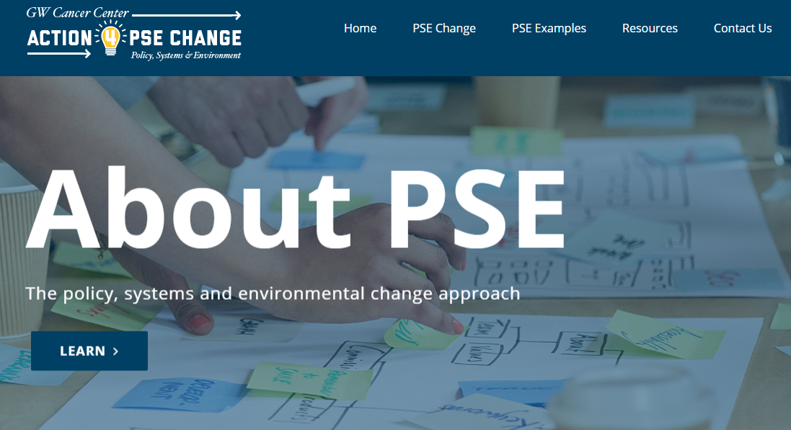
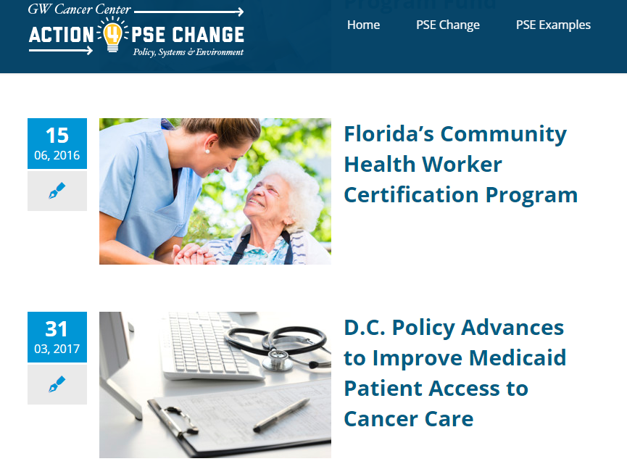
Cancer-Specific PSE Examples
Action4PSEChange.org
Notes:
As you have seen in this lesson, the potential for PSE change is broad-ranging. Throughout this training, we will interchangeably use the terms PSE change effort/initiative/intervention/or program, in order to represent the range of possibilities. Outside of this training, for additional cancer specific PSE change examples, please visit action4psechange.org.

Slide 16
Recap
Defined the P, S and E of the PSE change process and provided examples of each
Discussed the evidence base for PSE change and illustrated the difference between PSE change and traditional health programs
Introduced the seven steps of the PSE change process
Notes:
In this lesson, we defined the P, S, and E of the PSE change process and provided examples of each. We discussed the evidence base for PSE change and illustrated the difference between PSE change and traditional public health programs, and introduced the seven steps of the PSE change process that we will review in subsequent lessons.

Slide 17
Resources
Policy, Systems, and Environmental Change Resource Guide
Organizing for Social Change: Midwest Academy Manual for Activists
Organizational Development Theory
A Framework for Public Health Action – The Health Impact Pyramid
Evidence-Based Public Health: A Fundamental Concept for Public Health Practice
What is Policy, Systems and Environmental (PSE) Change?
Notes:
Here are some further readings and resources to access for more information about PSE change. These and other resources are included in the learning management system.

Slide 18
References
Action4PSEChange.org. (n.d.). Why is PSE Change Important? Retrieved from http://action4psechange.org/about-pse-change/
Brownson, R., Fielding, J., & Maylahn, M. (2009). Evidence-based Public Health: A Fundamental Concept for Public Health Practice. Annual Review of Public Health, 30, 175-201.
Centers for Disease Control and Prevention. (2016). Racial and Ethnic Approaches to Community Health (REACH). Retrieved from https://www.cdc.gov/chronicdisease/resources/publications/aag/reach.htm
Centers for Disease Control and Prevention. (2006). Advancing the Nation’s Health: A Guide to Public Health Research Needs, 2006-2015.
Centers for Disease Control and Prevention. (n.d.). Public Health Series 101: Introduction to Public Health. Retrieved from https://www.cdc.gov/publichealth101/documents/introduction-to-public-health.pdf
Frieden, T. (2010). A Framework for Public Health Action: The Health Impact Pyramid. American Journal Public Health, 100(4), 590-595.
Honeycutt, S., Leeman, J., McCarthy, W., Bastani, R., Carter-Edwards, L., Clark, H., & Garney, W. et al. (2015). Evaluating Policy, Systems, and Environmental Change Interventions: Lessons Learned from CDC’s Prevention Research Centers. doi: http://dx.doi.org/10.5888/pcd12.150281
Kindig, D., Booske, B., Siemering, K., Henry, B., & Remington, P. (2010). Observations and recommendations From the Mobilizing Action Toward Community Health (MATCH) Expert Meeting. Preventing Chronic Disease, 7(6), A124.
Kindig, D., Booske, B., & Remington P. (2010). Mobilizing Action Toward Community Health (MATCH): metrics, incentives, and partnerships for population health. Preventing Chronic Disease, 7(4), A68.
Notes:
Here is the full reference list of sources cited in this lesson.

Slide 19
References
Merriam-Webster.com. (n.d.a). Environment. Retrieved from https://www.merriam-webster.com/dictionary/environment
Merriam-Webster.com. (n.d.b). Policy. Retrieved from https://www.merriam-webster.com/dictionary/policy
Merriam-Webster.com. (n.d.c). System. Retrieved from https://www.merriam-webster.com/dictionary/system
Meyerson, B. (n.d.). State Policy Issues in Cervical Cancer. Retrieved from http://www.womeningovernment.org/sites/default/files/documents/events/Meyerson.pdf
Smith, C. (2013). Big P, Little P, Policy. Safe Routes to School National Partnership Blog. Retrieved from http://www.saferoutespartnership.org/blog/big-p-little-p-policy
Truss, M. (2013). Policy, Systems, and Environmental Change in Cancer Control. Retrieved from http://phpa.dhmh.maryland.gov/cancer/cancerplan/SiteAssets/SitePages/publications/PSE%20Presentation%20FINAL.pps
Zahner, S., Oliver, T., & Siemering, K. (2014). The mobilizing action toward community health partnership study: multisector partnerships in US counties with improving health metrics. Preventing Chronic Disease, 11, E05.

Slide 20
Conclusion
Describe the process of PSE change as an evidence-based approach to improve health
Distinguish between PSE change initiatives and conventional public health interventions
Notes:
Now that you have completed this lesson, you are able to:
Describe the process of PSE change as an evidence-based approach to improve health.
Distinguish between PSE change initiatives and conventional public health interventions.

Slide 21
This concludes the lesson.
Please exit and return to the learning management system.
EXIT
Notes:
This concludes the lesson. Please exit and return to the learning management system.

Slide 22
Action for Policy, Systems and Environmental (PSE) Change: A Training
Lesson 1: Engage
Build Partnerships and Engage the Community
Notes:
Welcome to Lesson 1: Engage -- Build Partnerships and Engage the Community. In this lesson, we will cover the first step in PSE change, which is Engage. We will discuss questions that need to be asked to help you effectively build partnerships to support your PSE change initiative. This lesson will take approximately 20 minutes to complete.

Slide 23
Acknowledgments
This work was supported by Cooperative Agreement #1U38DP004972-04 from the Centers for Disease Control and Prevention. Its contents are solely the responsibility of the authors and do not necessarily represent the official views of the Centers for Disease Control and Prevention.
We would also like to thank the American Cancer Society and the Comprehensive Cancer Control National Partnership for the use of their Policy, Systems and Environmental Change Resource Guide, upon which the seven steps of the PSE change process are based.
Notes:
We would like to acknowledge the Centers for Disease Control and Prevention for supporting this work. We would also like to thank the American Cancer Society and the Comprehensive Cancer Control National Partnership for the use of their Policy, Systems and Environmental Change Resource Guide, upon which the seven steps of the PSE change process are based.

Slide 24
Competency
Engage stakeholders in advocacy initiatives
Notes:
The competencies in this training are based on the Seven Areas of Responsibility for Health Education Specialists, 2015. This lesson will address the following competency:
Engage stakeholders in advocacy initiatives

Slide 25
Learning Objectives
Build various types of partnerships in order to achieve the goals and objectives of PSE change
Identify potential partners and determine if they are appropriate, meaningful and important to PSE change
Explain the importance of sustainability in PSE change interventions to stakeholders
Notes:
After completing this lesson, you will be able to:
Build various types of partnerships in order to achieve the goals and objectives of PSE change;
Identify potential partners and determine if they are appropriate, meaningful and important to PSE change; and
Explain the importance of sustainability in PSE interventions to stakeholders.

Slide 26
Why Are Partners Integral to PSE Change?
PSE change initiatives involve a wide variety of people, agencies and organizations from all corners of your community, working toward a common goal.
Notes:
PSE change initiatives involve a wide variety of people, agencies and organizations from all corners of your community, working toward a common goal.
As with other public health initiatives, partners make it possible to divide the work so it can be completed more efficiently. Working with diverse partners also strengthens your efforts by capitalizing on each member’s strengths and reaching each member’s constituencies.

Slide 27
Why Are Partners Integral to PSE Change?
The coalition is “comprised of a diverse, professional group of stakeholders from across the state.”
Utah Cancer Action Network, 2016.
Notes:
Utah’s comprehensive cancer control coalition, the Utah Cancer Action Network, demonstrates a broad membership of diverse partners poised to be successful with PSE change efforts. Coalition members come from a variety of groups and interest areas across the state. They include state and local governments and private and nonprofit organizations, such as Communidades Unidas, Eastern Utah Women’s Health and Habitat for Humanity of Utah County. The coalition also includes academic institutions, such as University of Utah College of Nursing and Utah State University, researchers, physicians, cancer survivors, caregivers, patients, and advocates.
Source:
Utah Cancer Action Network. (2016). 2016-2020 Utah Comprehensive Cancer Prevention and Control Plan. Retrieved from http://www.ucan.cc/wp-content/uploads/2015/12/State-Cancer-Plan-Revision-2.pdf

Slide 28
What Role Does the Comprehensive Cancer Control Coalition Play?
CCC coalitions are valuable assets in achieving PSE change.
Coalition Resources:
Create a PSE task force
Modify an existing policy committee to lead PSE change efforts
Notes:
One part of comprehensive cancer control is building coalitions to address cancer in the community. It is likely that you’re already engaged in a cancer coalition. Accordingly, one option in preparing to work toward PSE change is to call upon the coalition’s resources.
Many states, tribes and territories choose to effect PSE change by creating a task force. In this situation, the comprehensive cancer control coalition could create a new PSE change task force. Alternatively, the coalition could modify an existing policy committee to lead PSE change efforts.

Slide 29
Comprehensive Cancer Control (CCC) Coalition
http://bit.ly/PSECCNP
Notes:
For more information about forming a task force, see the Policy, Systems and Environmental Change Resource Guide prepared by the Comprehensive Cancer Control National Partnership.
Others may choose to develop a working group outside of the coalition. The group may be a permanent entity or it could dissolve upon the completion of the PSE change initiative. This is entirely dependent on the needs and resources of your particular state, tribe or territory. The group does not necessarily have to be permanent to ensure the sustainability of your effort.

Slide 30
Puerto Rico PSE Change Effort
Nutrition workgroup members
CCC Staff
Leadership from Puerto Rico’s Sports and Rec Dept.
Experts in physical activity
Legal advisors
Physical activity workgroup members
Goal:
Educate health professionals working as fitness specialists about cancer and other diseases.
M. Sánchez Aracil, personal communication, September 19, 2016.
Notes:
Let’s look at the group Puerto Rico assembled to support a recent PSE change effort. The goal was to educate health professionals working as fitness specialists about cancer and other chronic diseases. Puerto Rico brought together comprehensive cancer control staff, members of the nutrition and physical activity workgroup, leadership from Puerto Rico’s Sports and Recreation Department, experts in physical activity and legal advisors. The efforts of this tailor-made group resulted in a new chronic disease course in the continuing education curriculum for fitness specialists.
Source:
Sánchez Aracil, M. M., personal communication, September 19, 2016.

Slide 31
Have We Identified a Leader?
CCC Plans
Workgroup
Chair
Workgroup
Chair
Workgroup
Chair
Workgroup Leaders
Notes:
Another important question to ask is whether you have identified a leader (either an individual or committee or group) to hold the team accountable and moving forward. The existing structure of comprehensive cancer control plans can often help identify a leader for your task force or working group. Plans are often divided into work groups across the cancer continuum, each with its own chair. Based on the type of PSE change sought, these individuals can often serve as work group leaders who facilitate meetings and help hold members accountable.

Slide 32
Which Stakeholders Should Be Included?
What resources can each member bring to the table?
Who is interested?
Who has the expertise?
Notes:
Composition of the task force is critical to its success. Before beginning to recruit task force members, think about the following questions: Who is interested in working toward PSE change? Who has the expertise we need to achieve our goal? What resources can each member bring to the table?

Slide 33
Which Stakeholders Should Be Included?
Communications and media
Community and faith-based organizations
Health-related associations
Notes:
As with other collaborative efforts, you will need members who offer different experience and backgrounds. These might include communications and media, community and faith-based organizations and health-related associations.

Slide 34
Are There Any Unique Stakeholders Who Should be Included?
PSE change differs from traditional public health efforts
It occurs across sectors and on multiple levels
Think beyond traditional partners
Engage members uniquely suited to your PSE change initiative
Notes:
At the same time, remember that PSE change differs from traditional public health efforts: it occurs across multiple sectors and on multiple levels. Therefore, it is important to think beyond traditional partners when establishing a PSE change task force. Be sure to engage members uniquely suited to your PSE change initiative.

Slide 35
Are There Any Unique Stakeholders Who Should be Included?
Notes:
For example, if your goal is to eliminate the sale of sugar-sweetened beverages in local schools to combat childhood obesity...

Slide 36
Are There Any Unique Stakeholders Who Should be Included?
Task Force
Leaders of parent-teacher association
Teachers
Principals
School administrators
Students
Members of the school board
Notes:
Your task force might include leaders of the parent-teacher association, teachers, principals, school administrators, students and/or members of the school board.

Slide 37
Are There Any Unique Stakeholders Who Should be Included?
Notes:
Do you want to build a community walking trail to make it easier for community residents to be active?

Slide 38
Are There Any Unique Stakeholders Who Should be Included?
Task Force
Representatives from:
Parks, planning and transportation departments
Environmental Protection
Nature advocacy organizations
Notes:
Your task force might include representatives from parks, planning and transportation departments, environmental protection and/or nature advocacy organizations. You can probably think of other individuals or groups to include.

Slide 39
https://youtu.be/DMzxE4GBATE
Click on the play button above to watch the video.
American Cancer Society, n.d.
Notes:
Here's a brief clip from the American Cancer Society explaining the benefits of adopting the PSE approach. In it, Brianna Herndon, Indiana Government Relations Director for the American Cancer Society Cancer Action Network (ACS CAN), discusses the mix of experience and skills to consider when creating a task force.
To view the complete video from ACS, please visit their YouTube page.
Source:
American Cancer Society. (n.d.). Comprehensive Cancer Control Programs: Setting Up A PSE Task Force. Retrieved from https://www.youtube.com/watch?v=DMzxE4GBATE&feature=youtu.be (start: 6:26, end: 7:25)
<iframe width="560" height="315" src="https://www.youtube.com/embed/DMzxE4GBATE?start=386&end=447" frameborder="0" allowfullscreen></iframe>

Slide 40
Do Our Missions Align?
Diverse groups often have different cultures, interests, priorities and values.
Ensures all members have ownership of the process and accountability for the outcome.
Notes:
It’s also important to ask if your mission aligns with your partners’ to accomplish shared goals. While the diverse make-up of the task force is an asset to building support and carrying out the PSE change, it also presents a potential disadvantage. Diverse groups often have different cultures, interests, priorities and values. It’s up to you to find the common ground.
Presumably, the partners agree about the end result of the PSE change effort. Work backwards from this point of understanding. Ask the members to develop the task force’s mission statement. This ensures that all members have ownership of the process – and accountability for the outcome. Some coalitions have employed an external facilitator to assist members in arriving at the mission statement and creating their comprehensive cancer control plans.

Slide 41
https://youtu.be/DMzxE4GBATE
Click on the play button above to watch the video.
American Cancer Society, n.d.
Notes:
Let’s listen again as Brianna Herndon describes lessons she has learned in establishing task forces.
Source:
American Cancer Society. (n.d.). Comprehensive Cancer Control Programs: Setting Up A PSE Task Force. Retrieved from https://www.youtube.com/watch?v=DMzxE4GBATE&feature=youtu.be (start: 13:06, end: 14:27)
<iframe width="560" height="315" src="https://www.youtube.com/embed/DMzxE4GBATE?start=786&end=868" frameborder="0" allowfullscreen></iframe>

Slide 42
What Stakeholders Will Be Opposed?
Build strong support for the initiative
Notes:
Before launching your PSE change effort, the task force should build strong support for the initiative. Think about what stakeholders might be opposed to the change. Broad-based support will better position the task force to counter objections from critics.

Slide 43
What Stakeholders Will Be Opposed?
Alternative sources of revenue?
Lost profits?
What data support your position?
Notes:
Anticipate who might oppose your PSE change efforts. In the previously mentioned example, removing sugar-sweetened beverages from schools could result in lost profits for schools accustomed to receiving vending machine revenues. Can the task force identify alternative sources of revenue for the schools? What data support your position?
Preparing in advance will allow you to strategically respond when objections arise.

Slide 44
What Resources Are Needed?
Tangible
Volunteers
Intangible
Expertise in city planning, curriculum, evaluation, government relations (local or state), media or policy
Attend council meetings
Write letters to editor
Distribute leaflets
Notes:
Identify at the outset the resources—both tangible and intangible—necessary to achieve your PSE change goal. For example, you may need tangible resources, such as a large group of volunteers to help publicize your message by attending local council meetings, writing letters to the editor or distributing leaflets. Or you may need funding to proceed, if your effort is not supported by a grant or other award. (And even if an initiative currently has grant support, the task force should evaluate whether funding is still needed once the goal of the PSE change initiative is achieved.)
PSE efforts also require numerous intangible resources. Depending on your initiative, these may include expertise in city planning, curriculum, evaluation, government relations (local or state), media, or policy.
Look to the members of your task force. What services does each individual or organizational member provide? Consider how those services align with the needs of the PSE initiative and make the ask!

Slide 45
Why Should Others Care About PSE Change?
Notes:
As we discussed in the Overview, PSE change efforts improve health on a population level. To persuade others of the benefit of the change, find a way to personalize these results. We will talk more about messaging and communication in Lesson 5.

Slide 46
Why Should Others Care About PSE Change?
Louisiana 5th highest smoking rate in the United States
Louisiana CCC program, Geographic Health Equity Alliance, Louisiana Campaign for Tobacco-Free Living worked with the SmokeFree NOLA Coalition.
Action4PSEChange, 2016b.
Notes:
For example, Louisiana had the fifth highest smoking rate in the United States and was second to Nevada in the percentage of workers who worked in non-smoke-free workplaces. In response, the Louisiana Comprehensive Cancer Control Program and the Geographic Health Equity Alliance engaged with the Louisiana Campaign for Tobacco-Free Living and, ultimately, with the SmokeFree NOLA Coalition.
Sources:
Action4PSEChange. (2016b). New Orleans Smoke-Free Ordinance. Retrieved from http://action4psechange.org/new-orleans-smoke-free-ordinance/

Slide 47
Why Should Others Care About PSE Change?
“It has been really nice to go out and enjoy bars and casinos without breathing cigarette smoke or smelling like cigarette smoke.”
“Smoke free bars and casinos are healthier for customers and employees.”
Action4PSEChange, 2016b.
Notes:
The Coalition raised awareness among the community and stakeholders about the health impact of smoking, exposure to secondhand smoke and related health disparities. Among other activities, the Coalition used stories of casino employees, musicians and tourists to personalize the effects of secondhand smoke.
Sources:
Action4PSEChange. (2016b). New Orleans Smoke-Free Ordinance. Retrieved from http://action4psechange.org/new-orleans-smoke-free-ordinance/

Slide 48
Why Should Others Care About PSE Change?
Broad- Based Support
Health of Individual
Health of the Community
Tourism Trade
Action4PSEChange, 2016b.
Notes:
This strategy resonated with stakeholders on multiple levels, including the health of individuals, the health of the community and the strength of the important tourism trade in New Orleans. This multi-pronged approach resulted in broad-based support for the Coalition’s efforts and resulted in a comprehensive smoke-free ordinance that took effect in April of 2015.
Sources:
Action4PSEChange. (2016b). New Orleans Smoke-Free Ordinance. Retrieved from http://action4psechange.org/new-orleans-smoke-free-ordinance/

Slide 49
How Will We Sustain PSE Change?
How long will the grant last?
Do other mechanisms exist that could fund the PSE effort?
Notes:
As with other coalition initiatives, it’s important to think about sustainability at the outset. If your initiative is grant-based, how long will the grant last? Do other mechanisms exist that could fund the PSE effort?

Slide 50
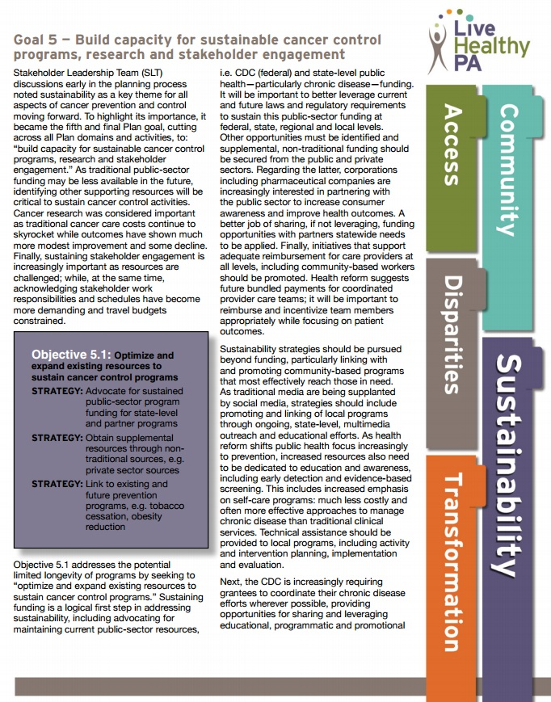
How Will We Sustain PSE Change?
Seeking private funding
Utilizing social media to promote local programs focused on prevention
Advocacy
Maintenance of existing resources through interagency collaboration
The Pennsylvania Cancer Control, Prevention and Research Advisory Board, 2013.
Notes:
It is important to include sustainability in your cancer control plan. The Pennsylvania cancer control plan included sustainability as its final objective and outlined sustainability strategies, including seeking private funding and utilizing social media, to promote local programs focused on prevention. In addition, the Pennsylvania plan outlines strategies beyond sustaining funds, such as advocacy and maintenance of existing resources through interagency collaboration.
Source:
The Pennsylvania Cancer Control, Prevention and Research Advisory Board. (2013). 2013-2018 Pennsylvania Cancer Control Plan. Retrieved from ftp://ftp.cdc.gov/pub/Publications/Cancer/ccc/pennsylvania_ccc_plan_2013_2018.pdf

Slide 51
How Will We Sustain PSE Change?
Department of Environmental Protection
Sports and Recreation Department
Local ordinance
Action4PSEChange, 2016b; The Pennsylvania Cancer Control, Prevention and Research Advisory Board, 2013; M. Sánchez Aracil, personal communication, September 19, 2016.
Notes:
In suggesting ways of addressing lung cancer, for example, the Pennsylvania cancer control plan suggests working with the state Department of Environmental Protection, the agency primarily responsible for the impact of lead and radon exposure. This approach aligns with the Centers for Disease Control and Prevention’s guidance that grantees coordinate efforts when possible, in order to share educational, programmatic and promotional resources.
As discussed earlier in this lesson, the Puerto Rico Comprehensive Cancer Control Program recently embarked on a PSE change effort designed to educate health professionals working as fitness specialists about cancer. The Program’s Nutrition and Physical Activity Workgroup joined with Puerto Rico’s Sports and Recreation Department to establish a free continuing education class for this group of professionals. The work of promoting the importance of the training, as well as securing course instructors was shared across agencies, allowing resources to be leveraged more efficiently.
Another successful collaboration occurred in New Orleans, where the Louisiana Comprehensive Cancer Control Program engaged with numerous other entities to educate stakeholders about the health impacts surrounding smoking. These efforts resulted in broad support for a smoke-free policy. Sustainability was ensured when a comprehensive smoke-free ordinance was signed into law.
Sources:
Action4PSEChange. (2016). New Orleans Smoke-Free Ordinance. Retrieved from http://action4psechange.org/new-orleans-smoke-free-ordinance/
The Pennsylvania Cancer Control, Prevention and Research Advisory Board. (2013). 2013-2018 Pennsylvania Cancer Control Plan. Retrieved from ftp://ftp.cdc.gov/pub/Publications/Cancer/ccc/pennsylvania_ccc_plan_2013_2018.pdf
Sánchez Aracil, M. M., personal communication, September 19, 2016.
iStock:
http://www.istockphoto.com/vector/lung-cancer-human-body-gm490025288-74994933?st=_p_lung%20cancer
http://www.istockphoto.com/vector/different-people-in-outdoors-physical-activity-gm516448638-89003591?st=_p_sport%20and%20recreation

Slide 52
How Will We Sustain PSE Change?
http://bit.ly/CTBSec2
Community Tool Box, n.d.
Notes:
Finally, evaluation of the partnership created to implement PSE change is another effective strategy that can sustain stakeholder engagement. We will talk more about evaluation in Lesson 7.
For more information on sustainability, visit the Community Toolbox.
Source:
Community Tool Box. (n.d.). Section 2. Strategies for Sustaining the Initiative. Retrieved from http://ctb.ku.edu/en/table-of-contents/sustain/long-term-sustainability/sustainability-strategies/main
Logo Image: http://ctb.ku.edu/en

Slide 53
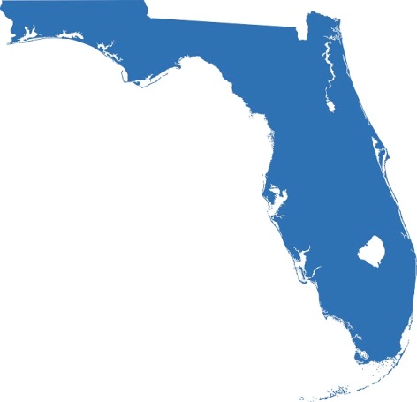
Florida PSE Effort
Promote Work of Community Health Workers (CHWs)
Florida Department of Health
CHW Certification & Training
Action4PSEAChange, 2016a.
Notes:
The state of Florida had great success with a PSE change effort by engaging a multi-disciplinary task force to promote the work of community health workers, or CHWs. Prior to this activity, many state agencies employed CHWs, but there had not been a robust effort to promote their work. To fill this gap, the Florida Department of Health established partnerships with community and health services entities statewide.
By engaging numerous agencies in the effort, promotion of CHWs became a multi-agency priority that also aligned with a goal of the Florida Cancer Plan. Stakeholders provided the group with numerous intangible resources, including expertise in networking, sustainability, curriculum, policy, research and practice. As part of the effort, task force members also gathered data in support of the effort, such as models, curricula and best practices.
As a result, Florida established a statewide CHW certification and training program. The PSE change task force became the Florida CHW Coalition, which now is an independent tax-exempt organization. You can read the complete Florida case study on the Action for PSE Change website.
Source:
Action4PSEChange. (2016a). Florida’s Community Health Worker Certification Program. Retrieved from http://action4psechange.org/floridas-community-health-worker-certification-program/
iStock:
http://www.istockphoto.com/vector/florida-map-gm530607083-54736204?st=_p_state%20of%20florida%20map

Slide 54
Recap
Form partnerships
Think outside the box
Identify common ground
Anticipate opposition
Match resources
Plan for sustainability
Notes:
Let’s summarize the concepts we’ve covered in this lesson that will help establish a solid foundation for your PSE change initiative. Form partnerships with a broad range of agencies, individuals and organizations. Think outside the box to identify those with the mix of experience, expertise and resources to support the effort. Identify common ground among the diverse members to further the effort. Anticipate opposition in advance. Match the resources needed to the individual talents of the task force members. Finally, plan for sustainability from the outset of your PSE change effort.

Slide 55
Resources
Coalitions Work™
Policy, Systems and Environmental Change Resource Guide
National Trails Training Partnership
Partnerships: Frameworks for Working Together
Notes:
Here are some further readings and resources you can access on the topic of Engagement. These and other resources are included in the learning management system.

Slide 56
Conclusion
Build various types of partnerships in order to achieve the goals and objectives of PSE change
Identify potential partners and determine if they are appropriate, meaningful and important to PSE change
Explain the importance of sustainability in PSE change interventions to stakeholders
Notes:
Now that you have completed this lesson, you are able to:
Build various types of partnerships in order to achieve the goals and objectives of PSE change;
Identify potential partners and determine if they are appropriate, meaningful and important to PSE change; and
Explain the importance of sustainability in PSE change interventions to stakeholders.

Slide 57
References
Action4PSEChange. (2017). Florida’s Community Health Worker Certification Program. Retrieved from http://action4psechange.org/floridas-community-health-worker-certification-program/
Action4PSEChange. (2016b). New Orleans Smoke-Free Ordinance. Retrieved from http://action4psechange.org/new-orleans-smoke-free-ordinance/
American Cancer Society. (n.d.). Comprehensive Cancer Control Programs: Setting Up A PSE Task Force. Retrieved from https://www.youtube.com/watch?v=DMzxE4GBATE&feature=youtu.be
Community Tool Box. (n.d.). Section 2. Strategies for Sustaining the Initiative. Retrieved from http://ctb.ku.edu/en/table-of-contents/sustain/long-term- sustainability/sustainability-strategies/main
The Pennsylvania Cancer Control, Prevention and Research Advisory Board. (2013). 2013-2018 Pennsylvania Cancer Control Plan. Retrieved from ftp://ftp.cdc.gov/pub/Publications/Cancer/ccc/pennsylvania_ccc_plan_2013_2018.pdf
Utah Cancer Action Network. (2016). 2016-2020 Utah Comprehensive Cancer Prevention and Control Plan. Retrieved from http://www.ucan.cc/wpcontent/uploads/2015/12/State-Cancer-Plan-Revision-2.pdf
Notes:
Here is the full reference list of sources cited in this lesson.

Slide 58
Action for Policy, Systems and Environmental (PSE) Change: A Training
Lesson 2: Scan
Perform Environmental Scans
Notes:
Welcome to Lesson 2, Scan: Perform Environmental Scans. In this lesson, we will cover the second step in PSE change, which is Scan. We will discuss questions that need to be asked to help you conduct an effective environmental scan. This lesson will take approximately 20 minutes to complete.

Slide 59
Acknowledgments
This work was supported by Cooperative Agreement #1U38DP004972-04 from the Centers for Disease Control and Prevention. Its contents are solely the responsibility of the authors and do not necessarily represent the official views of the Centers for Disease Control and Prevention.
We would also like to thank the American Cancer Society and the Comprehensive Cancer Control National Partnership for the use of their Policy, Systems and Environmental Change Resource Guide, upon which the seven steps of the PSE process are based.
Notes:
We would like to acknowledge the Centers for Disease Control and Prevention for supporting this work. We would also like to thank the American Cancer Society and the Comprehensive Cancer Control National Partnership for the use of their Policy, Systems and Environmental Change Resource Guide, upon which the seven steps of the PSE process are based.

Slide 60
Competency
Identify current and emerging issues requiring advocacy
Notes:
The competencies in this training are based on the Seven Areas of Responsibility for Health Education Specialists, 2015. This lesson will address the following competency: Identify current and emerging issues requiring advocacy.

Slide 61
Learning Objectives
Define the ultimate purpose, goal and level of your PSE change effort
Explain how an environmental scan can help determine the appropriate PSE change action to be taken
Determine if the environment is conducive to PSE change and explain the importance of this step to stakeholders
Notes:
After completing this lesson, you will be able to:
Define the ultimate purpose, goal and level of your PSE change effort;
Explain how an environmental scan can help determine the appropriate PSE change action to be taken; and
Determine if the environment is conducive to PSE change and explain the importance of this step to stakeholders.

Slide 62
Review of Previous Step
Engage
Notes:
In Lesson 1 of this training, we discussed the importance of building partnerships with a range of individuals and organizations, including those uniquely suited to your PSE change effort. We reviewed the role of comprehensive cancer control coalitions in PSE change. We emphasized the need to proactively anticipate opposing positions and to plan for sustainability of your effort.
In this lesson, we will discuss the role of an environmental scan in your PSE change efforts.

Slide 63
What is an Environmental Scan?
The systematic analysis and interpretation of gaps, trends and factors in the external environment that could play a role in your PSE change effort.
External factors:
Economic, political, social and legal context that allow you to identify opportunities and threats around your issue
Comprehensive Cancer Control National Partnership, n.d.; Morrison, 1992.
Notes:
Comprehensive cancer control professionals, by the nature of their jobs, are familiar with the health issues facing their communities. Accordingly, prior to beginning the PSE change process, you will have identified a general area of interest for your effort. An environmental scan provides information that will help determine the actions necessary for potential PSE change.
An environmental scan is the systematic analysis and interpretation of gaps, trends and factors in the external environment that could play a role in your PSE change effort. While the list can vary depending on your particular initiative, important external factors include the economic, political, social and legal context that allow you to identify opportunities and threats around your issue.
Sources:
Policy, Systems and Environmental Change Resource Guide, Comprehensive Cancer Control National Partnership (n.d.). Retrieved from http://bit.ly/PSECCNP;
Morrison, J. L. (1992). Environmental scanning. In M. A. Whitely, J. D. Porter, and R. H. Fenske (Eds.), A primer for new institutional researchers (pp. 86-99). Tallahassee, Florida: The Association for Institutional Research. Retrieved from http://horizon.unc.edu/courses/papers/enviroscan/.

Slide 64
Prepare to Scan
Identify gaps, trends and external factors affecting political, social and economic context in community
Determine which action should be taken and what that action should be
Scan
1st step in developing PSE agenda
Notes:
Conducting a scan of the environment surrounding the issue and the intended audience is also important because the scan will reveal conditions outside of your task force or coalition such as gaps, trends and external factors affecting the political, social and economic context in the community. The information gathered in your scan will inform your decision-making about what type of PSE change initiative should be taken.
An environmental scan is made up of different activities that draw upon different types of expertise. Since you have assembled a diverse task force whose members offer a variety of skills (as discussed in Lesson 1), you can capitalize on each member’s assets and experience to most efficiently conduct your scan and distribute the work. No single member of the task force or coalition should be tasked with the multiple demands of an environmental scan.
The scan is the first step in developing a PSE agenda (also known as a policy agenda), which will act as a roadmap for the overall PSE change efforts of your task force or policy working group. To develop a realistic PSE agenda, the Comprehensive Cancer Control National Partnership recommends that you scan broadly enough to identify existing state or local PSE change efforts and who is working on them, as well as initiatives that other groups or states have tried unsuccessfully to implement. To learn more about developing a PSE agenda, see Policy, Systems and Environmental Change Resource Guide available in the Learning Management System.
iStock:
http://www.istockphoto.com/photo/asian-businesswoman-leading-meeting-at-boardroom-table-gm504988008-83447201
iStock:
http://www.istockphoto.com/vector/road-with-pin-pointer-gm521504652-91378053?st=_p_roadmap

Slide 65
Conducting an Environmental Scan
Legal analysis
Economic factors
Political Landscape
Federal Leadership
State Leadership
Regional Leadership
Local Leadership
Social factors
Review grey literature, legislation, funding announcements and program websites
Collect additional information
Bradley, 2016.
Notes:
So how do you conduct an environmental scan? Think about the health issue you have selected in order to identify the full range of factors that could influence your work. To ensure that you discover as much relevant information as possible, take a wide view of the environment—economic, legal, political and social. While the local political landscape may not initially appear to be significant, you may, for example, find an unexpected champion on the city council.
Sources of information vary widely but should include the grey literature – that is, information not published by academic or commercial sources, including newsletters, conference proceedings, government reports and white papers. Other important sources are program websites, funding announcements, and legislation, as we will discuss in the following slides. You can also collect additional information you may need through key informant interviews, surveys, community meetings or other primary data collection methods if time and resources allow (which we will cover in more detail in lesson 3).
Source:
Bradley, P. (2016). Gray Literature 101: Introduction. Retrieved from http://libguides.health.unm.edu/graylit

Slide 66
Economic Landscape
What economic impact – positive or negative – could a PSE change effort have on community stakeholders?
Factors:
Labor market
Tourism
Unemployment
Grant making priorities
Notes:
As with any other program, economic factors can play a large role in PSE change initiatives. As part of your scan, review the economic context. What economic impact—positive or negative—could a PSE change effort have on community stakeholders? Consider factors such as the labor market, tourism and unemployment, as relevant in your community. Look also at the websites of potential funding organizations and funding announcements. This will help to determine the types of programs being funded and who is funding them.

Slide 67
Legal Landscape
Comprehensive legal analysis includes review of:
Enacted laws at federal, state and local levels
County and city ordinances, rules and regulations
Court cases
Can you identify trends in proposed or enacted legislation that might provide insight into the legislative process or challenges you may encounter?
Notes:
The legal landscape clearly is important if you contemplate any type of legislative activity, such as the implementation of a city-wide smoking ban. But laws also come into play in other areas. For example, think about how zoning ordinances or the policies of a parks department could affect the creation of bike paths.
A comprehensive scan of the legal landscape includes review of enacted laws at the federal, state and local levels— it also includes county and city ordinances, rules and regulations, as well as court cases. Can you identify trends in proposed or enacted legislation that might provide insight into the legislative process or challenges you may encounter?

Slide 68
Political Landscape
Federal leadership
State leadership
Regional leadership
Local leadership
Notes:
Taking stock of the political landscape can help you understand the relationships between stakeholders involved in the issue you want to address. Consider federal, state, regional and local leadership. The latter can include county or city councils, mayors or county executives or boards of education. Identify individuals who have championed issues similar to yours.

Slide 69
Social Landscape
Social determinants of health
Housing, education and income
How do demographics play a role in your priority health issue?
What are the attitudes and beliefs of decision-makers, stakeholders and your intended audience?
Who is already attempting PSE change efforts?
Notes:
Think about social determinants of health, such as housing, education and income and how demographics play a role in your selected health issue. What are the attitudes and beliefs of decision-makers, stakeholders and your intended audience?
Who is already attempting PSE change efforts? Identifying similar efforts at this point in the PSE change process may yield additional partners, as well as supporting or opposing stakeholders you could bring to the table as part of your effort.

Slide 70
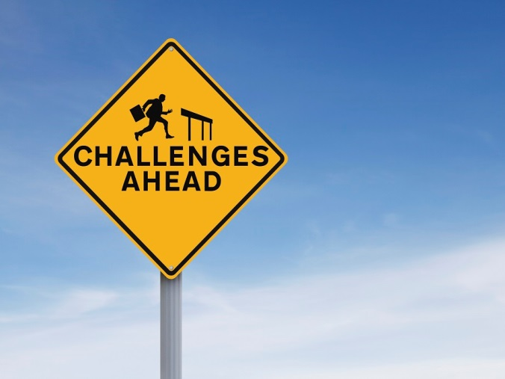
What Challenges are Posed?
Notes:
What challenges are posed by the economic and political environment? Along with highlighting factors supporting a PSE change, a comprehensive environmental scan also will reveal obstacles. Have neighborhood organizations blocked previous attempts to construct walking trails? Have employers been reluctant to participate in a work-based fitness program? Have efforts to enact related legislation failed? Learning about challenges early on will help you make decisions about the best path forward. Summarize your challenges.
iStock:
http://www.istockphoto.com/photo/challenges-ahead-gm478704571-36032472

Slide 71
Example: Kentucky
Enhance HPV vaccination uptake in pediatric care setting
State cancer registry and immunization information
Supplemental vaccination data
Literature review
Review of other states’ approaches
Key informant interviews
Media coverage
Wilburn, Vanderpool & Knight, 2016.
Notes:
In Kentucky, a number of cancer centers undertook a comprehensive environmental scan in support of a PSE change effort to enhance HPV vaccination in pediatric care settings. The Kentucky Cancer Consortium was engaged as a stakeholder in this process. Among other activities, the Consortium’s scan included state cancer registry and immunization information as well as supplemental vaccination data, a literature review, a review of other states’ approaches, key informant interviews and media coverage.
Source:
Wilburn A, Vanderpool R. C., & Knight J.R. (2016). Environmental Scanning as a Public Health Tool: Kentucky’s Human Papillomavirus Vaccination Project. Preventing Chronic Disease, 13:160165. DOI: http://dx.doi.org/10.5888/pcd13.160165
iStock:
http://www.istockphoto.com/vector/kentucky-map-gm475462430-65604257?st=_p_kentucky%20map

Slide 72
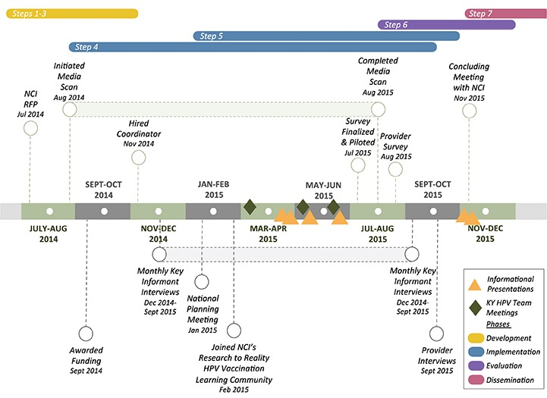
Wilburn, Vanderpool & Knight, 2016.
Notes:
Here is an illustration of the timeline that Kentucky used to conduct their environmental scan.
As you can see an environmental scan could take months. You may want to create a timeline so you can plan for the environmental scan and thoroughly review information related to the context of your potential PSE change effort!
We will talk more about PSE change timelines in Lesson 3.
Source:
Wilburn A, Vanderpool R. C., & Knight J.R. (2016). . Preventing Chronic Disease, 13:160165. DOI: http://dx.doi.org/10.5888/pcd13.160165

Slide 73
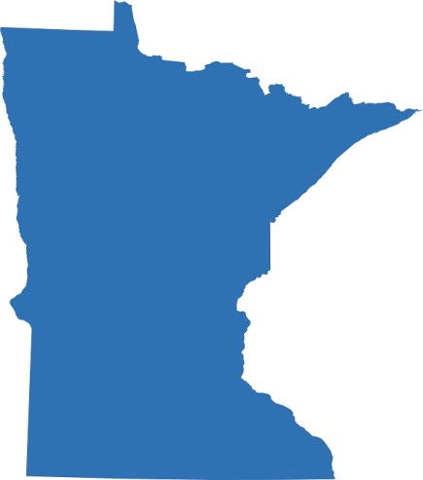
Example: Minnesota
Minnesota Department of Health Environmental Scan
Considered strategies of the Centers for Disease Control and Prevention and National Academy of Medicine
Reviewed influence in state of federal Healthy Hunger-Free Kids Act of 2010
Included data about obesity rates in the U.S and in MN, link between obesity and cancer risk and the association between high sugar consumption of sugar-sweetened beverages and obesity
Action4PSEChange, 2016.
Notes:
As we mentioned at the outset of this lesson, an environmental scan helps determine the specific type of PSE change that’s needed. This is illustrated by a recent PSE change initiative in Minnesota. The Department of Health’s environmental scan surrounding obesity considered strategies of the Centers for Disease Control and Prevention and the Institute of Medicine (now National Academy of Medicine). It reviewed the influence in the state of the federal Healthy Hunger-Free Kids Act of 2010, as well as existing policies related to healthier drink choices in hospitals.
Minnesota’s scan also included data about obesity rates in the United States and in Minnesota, the link between obesity and cancer risk, and the association between the high consumption of sugar-sweetened beverages and obesity. We address data in the following lesson, when we talk about Step 3 of the PSE change process--Assess.
It is important to note that there is not one right way to pursue PSE change. The activities associated with different steps may occur concurrently, or in a different order. This will depend on a range of factors, including the identified health issue, the length of time a task force or partnership has existed and its general knowledge of relevant issues, staff expertise and the availability of data.
The write-up of Minnesota’s environmental scan is included on the list of resources at the end of this lesson.
Sources:
Action4PSEChange. (2016). Minnesota Sugar-Sweetened Beverage Reduction Initiative. Retrieved from http://action4psechange.org/minnesota-sugar-sweetened-beverage-reduction-initiative/

Slide 74
Is the Environment Conducive to the PSE Change?
Has your scan identified an influential champion to endorse your efforts?
Do community members and key informants acknowledge a need for action?
Notes:
Remember to collect information about your intended audience in your scan. Consider public opinion – do community members and key informants acknowledge a need for action? Has your scan identified an influential champion to endorse your efforts?
Finally, based on the support and challenges you’ve identified, ask yourself: Is the environment conducive to PSE change? If the answer is yes, you are ready to move on to Step 3: Assess to identify your priority areas.
iStock:
http://www.istockphoto.com/photo/crowd-with-hands-on-their-shoulders-gm509863119-46037262

Slide 75
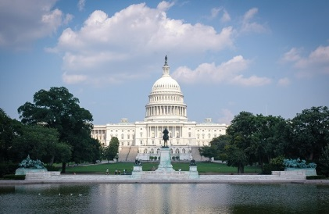
Example: Washington, DC
The GW Cancer Center
Scanned publicly available information on websites of Medicaid fee-for-service and managed care organizations
Reviewed DC-specific white papers on Medicaid challenges
Assessed political landscape
Determined stakeholders’ attitudes/beliefs about Medicaid access
Action4PSEChange, 2017.
Notes:
In Washington, D.C., The George Washington University Cancer Center, or GW Cancer Center, undertook an environmental scan as part of a PSE change effort to improve access to continuum of cancer care services for Medicaid beneficiaries. GW scanned information publicly available on the websites of Medicaid fee-for-service and managed care organizations and reviewed DC-specific white papers on Medicaid challenges. The local political landscape was assessed through meetings with leadership at the DC Department of Health Care Finance. The scan also determined that stakeholders’ attitudes and beliefs about Medicaid access to cancer care – an important part of the social landscape - varied widely. This discovery highlighted an early challenge, as awareness of the problem and agreement on the most significant barrier to care were critical to the success of this initiative. (We will review this case study in its entirety in Lesson 8.)
Source:
Action4PSEChange. (2017). D.C. Policy Advances to Improve Medicaid Patient Access to Cancer Care. Retrieved from http://action4psechange.org/d-c-policy-advances-to-improve-medicaid-patient-access-to-cancer-care/.
iStock:
http://www.istockphoto.com/photo/capitol-building-gm511742362-86799115
http://www.istockphoto.com/photo/medical-insurance-and-medicaid-and-stethoscope-gm637957272-114092753

Slide 76
What is your “ask”?
Goal
Serves the purpose
The “ask”
Purpose
Reason for why you want to create change
Determine level of PSE change: national, state, regional, local
Notes:
Now, with your general knowledge of the selected health issue, along with the specific information collected through the environmental scan, you can identify the goal of the potential PSE change effort that will serve your ultimate purpose. Think of the ultimate purpose as the reason why you want to create change, and the goal serves this purpose. For example, prior to conducting a scan, the Florida Department of Health was interested in establishing a collaborative mechanism for developing and promoting the work of community health workers, or CHW; this was Florida’s ultimate purpose. The information collected during their scan helped narrow the focus, and the CHW taskforce worked toward developing a statewide CHW certification program, which became their goal. In this way, the environmental scan focused efforts from the ultimate purpose of promoting CHWs to the goal of creating a new credentialing system--which can be thought of as the “ask.”
And as we’ve discussed, the scan should have also revealed the level of PSE change required. In Florida, the innovation occurred at the state level. In other cases, the desired change may occur at the local level – for example, when working toward enactment of a citywide smoking ban or the creation of bike paths. And in still others, PSE change may occur at the institutional level, such as within a school or hospital system.

Slide 77
Recap
Environmental scan:
Identifies gaps, trends and factors in the external environment that will impact your PSE change effort
Helps focus on the ultimate purpose, identify the “ask” and pinpoint the level of change
Determine readiness for PSE change
Notes:
Let’s summarize the concepts we’ve covered in this lesson regarding your environmental scan. The purpose of an environmental scan is to identify gaps, trends and factors in the external environment that will impact your PSE change effort. The scan will help you focus more clearly on how to achieve the ultimate purpose of the PSE change by identifying your “ask” and pinpointing the level – state, local or institutional – at which change needs to occur. You also will determine readiness for PSE change.

Slide 78
Resources
Communication Training for Comprehensive Cancer Control Professionals 102: Guide to Making Communication Campaigns Evidence-Based, Chapter 2 on Community Assessments
Environmental Scanning as a Public Health Tool: Kentucky’s Human Papillomavirus Project
Health in All Policies: A Guide for State and Local Governments
Maree Conway, Thinking Futures’ Environmental Scanning: What It Is and How to Do It
The Nonprofit Village’s Environmental Scans
Minnesota Department of Health Policy Brief: Sugar-Sweetened Beverages, Obesity, and Cancer: What is the problem and what can we do?
Notes:
Here are some further readings and resources you can access on the topic of environmental scans. These and other resources are included in the learning management system.

Slide 79
Conclusion
Define the ultimate purpose, goal and level of your PSE change effort
Explain how an environmental scan can help determine the appropriate PSE change action to be taken
Determine if the environment is conducive to PSE change and explain the importance of this step to stakeholders
Notes:
In this lesson, we have discussed conducting an environmental scan to identify the economic, political and social context in the external environment that will impact your PSE change efforts. You now should be able to:
Define the ultimate purpose, goal and level of your PSE change effort;
Explain how an environmental scan can help determine the appropriate PSE change action to be taken; and
Determine if the environment is conducive to PSE change and explain the importance of this step to stakeholders.

Slide 80
References
Action4PSEChange. (2016). Minnesota Sugar-Sweetened Beverage Reduction Initiative. Retrieved from http://action4psechange.org/minnesota-sugar-sweetened-beverage-reduction-initiative/
Action4PSEChange. (2017). D.C. Policy Advances to Improve Medicaid Patient Access to Cancer Care. Retrieved from http://action4psechange.org/d-c-policy-advances-to-improve-medicaid-patient-access-to-cancer-care/
Bradley, P. (2016). Gray Literature 101: Introduction. Retrieved from http://libguides.health.unm.edu/graylit
Comprehensive Cancer Control National Partnership. (n.d.). Policy, Systems and Environmental Change Resource Guide. Retrieved from http://bit.ly/PSECCNP
Morrison, J. L. (1992). Environmental scanning. A Primer for New Institutional Researchers, 86-99. Retrieved from http://horizon.unc.edu/courses/papers/enviroscan/
Wilburn A, Vanderpool R., & Knight J. (2016). Environmental Scanning as a Public Health Tool: Kentucky’s Human Papillomavirus Vaccination Project. Preventing Chronic Disease, 13:160165. DOI: http://dx.doi.org/10.5888/pcd13.160165
Notes:
Here is the full reference list of sources cited in this lesson.

Slide 81
Action for Policy, Systems and Environmental (PSE) Change: A Training
Lesson 3: Assess
Address Priority Areas
Notes:
Welcome to Lesson 3: Assess – Address Priority Areas. In this lesson, we will cover the third step in PSE change, which is Assess. We will discuss questions that need to be asked to help you effectively review and assess data to support your PSE change initiative. This lesson will take approximately 20 minutes to complete.

Slide 82
Acknowledgments
This work was supported by Cooperative Agreement #1U38DP004972-04 from the Centers for Disease Control and Prevention. Its contents are solely the responsibility of the authors and do not necessarily represent the official views of the Centers for Disease Control and Prevention.
We would also like to thank the American Cancer Society and the Comprehensive Cancer Control National Partnership for the use of their Policy, Systems and Environmental Change Resource Guide, upon which the seven steps of the PSE process are based.
Notes:
We would like to acknowledge the Centers for Disease Control and Prevention for supporting this work. We would also like to thank the American Cancer Society and the Comprehensive Cancer Control National Partnership for the use of their Policy, Systems and Environmental Change Resource Guide, upon which the seven steps of the PSE process are based.

Slide 83
Competency
Access existing information and data related to health
Notes:
The competencies in this training are based on the Seven Areas of Responsibility for Health Education Specialists, 2015. This lesson will address the following competency: Access existing information and data related to health.

Slide 84
Learning Objective
Review and evaluate available data to inform PSE change and explain the importance of this step to stakeholders
Notes:
After completing this lesson, you will be able to: Review and evaluate available data to inform PSE change and explain the importance of this step to stakeholders.

Slide 85
A Look Back at Previous Steps
Engage
Scan
Notes:
In Lesson 1 of this training, we discussed the importance of forming partnerships with a broad range of entities, including those uniquely suited to your PSE change effort. We emphasized the need to proactively anticipate opposition and to plan for sustainability from the outset.
Lesson 2 addressed the environmental scan of the external environment surrounding the broad health issue you wish to address. You now understand the drivers and challenges of your potential PSE change initiative.
It is vital, however, to have evidence to support your position. Accordingly, in this lesson, we will addresses the review and assessment of available data. Data often can be used as evidence to help you determine which aspect of the health issue can be potentially resolved or lessened through PSE change.

Slide 86
Why Are Data Necessary?
Provide a solid foundation for your PSE change effort
Help you allocate limited resources most effectively
Show you where the gaps are in existing evidence
Re-think your plan and consider other options
Find a way to collect missing information
Notes:
We begin by asking why are data necessary? As with other public health initiatives, data will provide you with a solid foundation for your PSE change effort. They will help you allocate limited resources most effectively. A thorough review of published research also will show you where the gaps are in the existing evidence.
Finding gaps in the evidence base could affect the PSE change process in one of two ways. You may re-think your plan and consider other options. Alternatively, you and your partners may respond by finding a way to collect the missing information.

Slide 87
What Data Do You Need to Support Your Position on the Issue?
Secondary Data
Data that have already been collected and published
E.g., Youth Risk Behavior Surveillance System (YRBSS) details high school student tobacco use
Primary Data
Data that you collect
E.g., tribal tobacco prevention program surveys parents to accurately characterize students’ tobacco use
Rudolph, Caplan, Ben-Moshe & Dillon, 2013.
Notes:
As part of your assessment, consider both secondary data (that already have been collected and published) and primary data (which you collect). For example, a well-known source of secondary data, the Youth Risk Behavior Surveillance System, or YRBSS, details tobacco use by high school students. However, the use of tobacco in tribes has unique characteristics, as in the distinction between traditional and commercial tobacco. Accordingly, a tribal tobacco prevention program might survey parents—a means of primary data collection—to accurately characterize students’ tobacco use.
As you move through this step, keep in mind the distinction between data and evidence, discussed in depth in Health in All Policies: A Guide for State and Local Governments. Data are a collection of facts, while evidence is information that illustrates the effectiveness of an initiative.
Source:
Rudolph, L., Caplan, J., Ben-Moshe, K., & Dillon, L. (2013). Health in All Policies: A Guide for State and Local Governments. Washington, DC and Oakland, CA: American Public Health Association and Public Health Institute. Retrieved from https://www.apha.org/~/media/files/pdf/factsheets/health_inall_policies_guide_169pages.ashx

Slide 88
What Data Do You Need to Support Your Position on the Issue?
Depends entirely on the type of PSE change envisioned
Florida’s Task Force
Gathered models, curricula and best practices information to promote work of Community Health Workers
Action4PSEChange, 2017b.
Notes:
What data do you need to support your position on the issue? While data from surveillance systems are standard sources for planning PSE change initiatives, the types of data needed depend entirely on the PSE change envisioned. Florida’s task force, for example, gathered program models, curricula and best practices information in furtherance of its initiative to promote the work of Community Health Workers.
Source:
Action4PSEChange. (2017). Florida’s Community Health Worker Certification Program. Retrieved from http://action4psechange.org/floridas-community-health-worker-certification-program/
iStock:
http://www.istockphoto.com/vector/florida-map-gm530607083-54736204?st=_p_florida

Slide 89
Where Can You Obtain Data to Support Your Position?
Your state’s Comprehensive Cancer Control plan
National surveillance systems
Behavioral Risk Factor Surveillance System (BRFSS)
National Health Interview Survey (NHIS)
National Cancer Institute
PubMed Central
Notes:
Sources routinely used by public health professionals can provide data for your PSE change efforts. Begin with your state’s Comprehensive Cancer Control plan to see what work already has been done in your area of interest and what data are available. National surveillance systems like the the Behavioral Risk Factor Surveillance System and National Health Interview Survey are rich sources of data. You can also visit National Cancer Institute websites to review cancer statistics and other data relevant to the issue you aim to address. Additionally, visit PubMed Central to look for open source articles and peer-reviewed literature relevant to your issue.

Slide 90
Are There Data that Support Positions in Opposition?
Are those data evidence-based, objective, reliable and valid?
Pay close attention to data that support an opposing view
Are they compelling?
Construct convincing arguments as to why your position is stronger
Notes:
During your assessment, pay close attention to data that might support an opposing view. Are those data evidence-based, objective, reliable and valid? Are they compelling? Before you encounter opposition to your plan, construct convincing arguments as to why your position is stronger. If you cannot, you might consider reassessing your approach and focusing on another aspect of the health issue that does have strong evidence behind it.
For an extensive list of resources, please visit the Action4PSE Change.org resources page.

Slide 91
What Issues Are Important?
Priority Area
Assess Data
Highlights the areas in which your initiative can have the most impact
Stakeholders and decision-makers more likely to endorse your PSE change initiative if it is well-supported with data
Notes:
What issue(s) are important and why? Will others find the issue(s) important and why? At this point, you have identified the cancer control priority area of interest and now are aware of the context in which your PSE change will take place. Assessing data will take you to the next step in the process, as it will highlight the areas in which your initiative can have the most impact. Stakeholders and decision-makers will be more likely to endorse your PSE change initiative if it is well-supported with data.

Slide 92
Is this Issue Specific to Your Community or State?
Broad View
Behavioral risk factor surveillance
Cancer surveillance
Data related to cost-benefit
Tobacco excise tax rates
Comprehensive Approach
State tribe or territory data
Regional and local data
Notes:
As you begin this process, take a broad view of the data available, encompassing points such as behavioral risk factor surveillance, cancer surveillance, data related to cost-benefit and tobacco excise tax rates, for example. Your initial review should include sources of state, tribe or territory data but must also include regional and local data if they are available. Each source provides information necessary for developing a complete picture of the issue, so aim for a comprehensive approach.

Slide 93
Is this Issue Specific to Your Community or State?
State Level Data
Low obesity rates
Local Level Data
Higher rates of obesity
Notes:
It’s also important to acknowledge that public health issues may have different impacts at the state and local levels. For example, when compared to others, a state may rank well for low obesity rates. Yet, an assessment reveals that rural communities in an otherwise well-ranked region have higher rates of obesity. This finding helps target the PSE change initiative and helps the task force begin to tailor its approach to address specific aspects of the issue faced by the intended audience.

Slide 94
Cast a wide net when conducting your data assessment
Cherokee Nation Comprehensive Cancer Control Program
Identified student tobacco use as priority area
As part of assessment
Obtained quantitative smoking rates data from YRBSS
Qualitative data came in the form of parents’ and community members’ observations of youth tobacco use
Information on disparate burden of tobacco use in American Indian communities came from published literature
Action4PSEChange, 2017a; Hopkins et al., 2010.
Notes:
Cast a wide net when conducting your data assessment—the more data that support your position, the better. For example, the Cherokee Nation Comprehensive Cancer Control Program identified student tobacco use as its priority area. As part of its assessment, the Program obtained quantitative smoking rates data from the YRBSS. Qualitative data came in the form of parents’ and community members’ observations of youth tobacco use. Information about the disparate burden of tobacco use in American Indian communities came from published literature such as the American Journal of Preventive Medicine.
Drawing upon the wide variety of data available will provide robust support for your position.
Source:
Action4PSEChange. (2017). Cherokee Nation Tobacco-Free Schools. Retrieved from http://action4psechange.org/cherokee-nation-tobacco-free-schools/
Hopkins, D., Razi, S., Leeks, K.D., Priya Kalra, G., Chattopadhyay, S.K., & Soler, R.E. (2010). Smokefree policies to reduce tobacco use: A systematic review. American Journal of Preventive Medicine, 38(2 Suppl), S275-289. doi: 10.1016/j.amepre.2009.10.029.
iStock:
http://www.istockphoto.com/photo/blank-antique-teal-blue-wooden-sign-with-fish-net-border-gm464700320-58684100?st=_p_net

Slide 95
Are Data/Evidence Available on Potential Costs and Benefits?
Estimate the strengths and weaknesses of your initiative against alternative types of action.
What is the cost of the proposed PSE Change?
Does your plan provide value while keeping costs in check?
Assess data and build evidence around potential PSE change.
First, look to comprehensive cancer control program for previous cost-benefit analyses.
If another cancer control program implemented a similar PSE change, they may share information about costs.
Notes:
Comprehensive Cancer Control programs operate in an environment of limited resources. For this reason, one of the first questions posed by stakeholders and decision-makers likely will surround the cost of the proposed PSE change. Be prepared to estimate the strengths and weaknesses of your initiative against alternative types of action. Does your plan provide value while keeping costs in check? For example, if you’re assessing data and building evidence around a potential PSE change initiative like a cancer screening program, first look to your comprehensive cancer control program for previous cost-benefit analyses. If another cancer control program has implemented a similar PSE change intervention, they may be able to share information about costs.
You can also look for published data regarding cost-benefit analysis of similar programs. If research provides evidence of improved health outcomes at a low cost and recommends extending such programs for similar audiences, this will certainly build your case.

Slide 96
Use “high quality data and research to assess the burden of cancer in their jurisdictions, set priorities, and develop program goals.”
When you summarize your data and evidence and build your case, explain how they are evidence-based, objective, relevant and valid.
Steele et al., 2015.
Notes:
Cancer Control programs routinely are encouraged by the National Comprehensive Cancer Control Program to use “high-quality data and research to assess the burden of cancer in their jurisdictions, set priorities, and develop program goals.”
This advice also applies to building a PSE change initiative. Stakeholders, community members and decision-makers are more likely to support a program that is based on solid evidence. So, when you summarize your data and evidence and build your case, explain how they are evidence-based, objective, relevant, and valid.
Source:
Steele, C. B., Rose, J. M., Townsend, J. S., Fonseka, J., Richardson, L. C., & Chovnick, G. (2015). Comprehensive Cancer Control Partners’ Use of and Attitudes About Evidence-Based Practices. Preventing Chronic Disease, 12, E113. http://doi.org/10.5888/pcd12.150095

Slide 97
Why is Research Vital for Decision-Making?
Limited resources available for public health initiatives
Conducting a thorough review and assessment of data is an investment of time that provides a strong foundation
Allows you to address priority areas in your PSE intervention
High likelihood of success!
Notes:
Decision-makers are well aware of the limited resources available for public health initiatives. In this environment, decision-makers are not likely to support a plan that doesn’t show promise.
Conducting a thorough review and assessment of data at the outset is an investment of time that will provide a strong foundation as you move forward. Each segment of data, taken together, builds your case and allows you to address priority areas through your PSE intervention which, when based on evidence, will have a high likelihood of success. If data are not available and you have the resources to conduct your own analysis, call on the partners in your task force or coalition who have this expertise.

Slide 98
What Would Happen if the Issue is Not Addressed?
Cherokee Nation
Smoke-Free Schools Initiative
American Indian/Alaska Native communities bear a disproportionate burden of disease and death from tobacco use.
Increased smoking rates would continue without an effort to reach school-age children before they started smoking
Action4PSEChange, 2017a; Mowery et al., 2015.
Notes:
Think through possible outcomes if your PSE change initiative fails. Information gathered during this process can reinforce the importance of your effort.
For example, in the previously mentioned Cherokee Nation smoke-free schools initiative, Cancer Program staff knew that American Indian and Alaska Native communities bear a disproportionate burden of disease and death from tobacco use.
Without an effort to reach school-age children before they started smoking, it was reasonable to conclude increased smoking rates would result in community members experiencing greater rates of tobacco-related illnesses and deaths.
Source:
Action4PSEChange. (2017). Cherokee Nation Tobacco-Free Schools. Retrieved from http://action4psechange.org/cherokee-nation-tobacco-free-schools/
Mowery, P. D., Dube, S. R., Thorne, S. L., Barrett, B. E., Homa, D. M., & Henderson, P. N. (2015). Disparities in Smoking-Related Mortality Among American Indians/Alaska Natives. American Journal of Preventive Medicine, 49(5):738-44. http://doi.org/10.1016/j.amepre.2015.05.002
iStock:
http://www.istockphoto.com/photo/try-fail-repeat-success-gm502917948-82216751?st=_p_fail

Slide 99
Conducted a comprehensive environmental scan that incorporates state, tribal, territorial and local data
Reviewed a range of data types and sources, including cost-benefit analysis
Considered data that can be used to support conflicting points of view and have formulated counter arguments
Your data are objective, relevant and valid
Notes:
The steps we have discussed in this lesson have been designed to help build a compelling case for your PSE change initiative. By this point in the process, you have conducted a comprehensive environmental scan that incorporates state, tribal, territorial and local data. You have reviewed a range of data types and sources, including cost-benefit analysis. You have considered data that can be used to support conflicting points of view and have formulated counter arguments. Your data are objective, relevant and valid. You laid the foundation for persuading decision-makers to support your objective. Now it’s time to use this evidence to develop SMART goals and objectives for your PSE change initiative.

Slide 100
SMART Objectives
Notes:
Your data can give you a starting point for identifying specific, measurable, attainable, relevant and time-bound – or SMART - goals and objectives.
iStock:
http://www.istockphoto.com/photo/set-goals-smart-gm576608218-99085843?st=_p_smart%20objectives

Slide 101
What Are Our SMART Objectives?
Specific
What is the particular PSE change we seek?
Measureable
Is there a calculable way to know that a change has occurred?
Will we be able to measure the change (or obtain the measurements from another source)?
Attainable
Do we have the necessary resources to make the change?
Have we considered limitations?
Relevant
Are the goals relevant to all stakeholders?
Time-Bound
What is the timeframe for accomplishing the change?
What is our objective?
What strategies will we use to achieve it?
Can we make the change in the desired timeframe?
Do they align with their missions?
What are the milestones?
Centers for Disease Control and Prevention, 2011.
Notes:
As with other public health efforts, PSE change objectives must be SMART. Ask the following questions about your initiative to be sure you’re on the right track. Test the rationale for each objective by asking if it will result in the desired outcome.
Specific: What is the particular PSE change we seek? What is our objective? What strategies we will use to achieve it?
Measurable: Is there a calculable way to know that a change has occurred? Will we be able to measure the change (or obtain the measurements from another source)?
Attainable: Do we have the necessary resources to make the change? Can we make the change in the determined timeframe? Have we considered limitations?
Relevant: Are the goals relevant to all stakeholders? Do they align with their missions?
Time-Bound: What is the timeframe for accomplishing the change? What are the milestones?
Source:
Centers for Disease Control and Prevention. (2011). Develop SMART Objectives. Retrieved from https://www.cdc.gov/phcommunities/resourcekit/evaluate/smart_objectives.html

Slide 102
SMART Objectives
Non-SMART Objective
SMART Objective
“Change school policy to add fresh fruits and vegetables to schools’ lunch menus.”
“Amend the existing school policy to specify the addition of at least one fresh fruit and one vegetable to the daily lunch menu in all public elementary schools by the end of the next programmatic year.”
The George Washington University Cancer Center, 2015.
Notes:
The following example illustrates the difference between a non-SMART objective and a SMART objective. Non-SMART objective: “Change school policy to add fresh fruits and vegetables to schools’ lunch menus.” This objective is not SMART because it is not specific, measurable or time-bound. It can be made SMART by specifically indicating: the amount of fresh fruits and vegetables to be added, the number and kinds of schools that will be targeted, and by when the change will occur, as follows: “Amend the existing school policy to specify the addition of at least one fresh fruit and one vegetable to the daily lunch menu in all public elementary schools by the end of the next programmatic year.”
Source:
The George Washington University Cancer Center. (2015). Media Planning and Media Relations Guide. In: Communication Training for Comprehensive Cancer Control Professionals 101. Retrieved from https://smhs.gwu.edu/cancercontroltap/sites/cancercontroltap/files/MediaPlanningMediaRelationsGuide_FINAL.pdf

Slide 103
Developing a Timeline
Define your overarching goal, then identify:
Short-term
Objectives
Intermediate
Objectives
Long-term
Objectives
Comprehensive Cancer Control National Partnership, n.d.
Notes:
Develop a realistic timeline (and milestones) for accomplishing your goals and identify short-term, intermediate and long-term objectives. This will help you create activities for implementation and will also allow you to create metrics for evaluation, which you will learn about in lessons 6 and 7.
Source:
Comprehensive Cancer Control National Partnership. (n.d.). Policy, Systems and Environmental Change Resource Guide. Retrieved from https://smhs.gwu.edu/cancercontroltap/sites/cancercontroltap/files/PSE_Resource_Guide_FINAL_05.15.15.pdf?src=CancerPolicyMap

Slide 104
Year One
Year Two
Step 7: Evaluate
Sept. 1 – Ongoing
Step 1: Engage
{Sept. 1 – Oct. 31}
Step 3: Assess
{Mar. 1 – May 30}
Step 5: Promote
{July 1 – Aug 31}
Process Evaluation
{Sept. 1 – Dec. 31}
Outcome Evaluation
Short-term: {Dec. 31}
Intermediate: {Apr 1}
Long-term: {ongoing}
Step 2: Scan
{Nov. 1 – Apr. 30}
Step 4: Review
{June 1 – July 31}
Step 6: Implement
{Sept. 1 – Dec. 31}
Notes:
This figure is a simple timeline illustrating the PSE change process, from establishment of a partnership through evaluation of an intervention. Keep in mind that this is only one example. Your timeline could vary significantly, depending on the type of PSE change you pursue.
For each step, fill in the short-term, intermediate and long-term objectives, as we have discussed, and create milestones. Because PSE change steps often occur concurrently, the timeframes for different steps may overlap. Remember that it’s important to revisit steps as necessary, to add new partners, engage new stakeholders or assess newly available evidence.

Slide 105
Keep your goal in mind and ensure your efforts are designed to achieve it
Once successful, you will be ready to shift toward sustaining progress
Notes:
As you now know, assessing data helps you pinpoint the goal of your PSE change efforts. As you work through the PSE change process, periodically remind yourself of that goal and ensure that your efforts are designed to achieve it.
You will be able to measure your success in the evaluation step, which you will learn about in lesson 7. When your efforts prove successful, you will be ready to shift your efforts toward sustaining your progress.
Now let’s take a closer look at the Cherokee Nation initiative we previously discussed.

Slide 106
Cherokee Nation Comprehensive Cancer Control Program
Priority area = increased student tobacco use
Secondary Data Sources
Youth Risk Behavior Surveillance System (YRBSS)
Published literature
Online self-assessment and planning tool
Primary Data Sources
Interviews with parents
Community observations
Action4PSEChange, 2017a.
Notes:
The Cherokee Nation Comprehensive Cancer Control Program identified increased student tobacco use as its priority area. The Program’s data assessment encompassed secondary sources such as the YRBSS survey and published literature to obtain student smoking rates and studies regarding the burden of second-hand smoke on American Indian and Alaska Native communities. They used an online self-assessment and planning tool from the CDC to evaluate and improve school-based tobacco-use prevention and policies. These data were supplemented with primary data that resulted from interviews with parents and community observations of student tobacco use.
Source:
Action4PSEChange. (2017). Cherokee Nation Tobacco-Free Schools. Retrieved from http://action4psechange.org/cherokee-nation-tobacco-free-schools/
iStock:
http://www.istockphoto.com/photo/harvested-tobacco-leaves-stack-gm595746146-102132547

Slide 107
Cherokee Nation Comprehensive Cancer Control Program
Tobacco-Free Schools Initiative
Partnered with Cherokee County Community Health Coalition and established a PSE task force
Communicated problem to decision makers
Principals and superintendents in public schools
SMART Objective: By September 2012, facilitate the implementation of 24/7 tobacco-free policies in six schools within the Cherokee Nation Tribal Jurisdictional Service Area
Action4PSEChange, 2017a.
Notes:
The Cherokee Nation Comprehensive Cancer Control Program had been a partner of the Cherokee County Community Health Coalition even before beginning work on the Tobacco-Free Schools initiative. The Coalition was a ready source of partners for the PSE task force that was formed as a result of the assessment. Using the data collected, task force members were able to communicate the problem to decision-makers – that is, principals and school superintendents – in public schools.
In keeping with the PSE change process, the Program also established SMART objectives, including: By September 2012, facilitate the implementation of 24/7 tobacco-free policies in 6 schools within the Cherokee Nation Tribal Jurisdictional Service Area. As a result of this successful PSE change initiative, all 6 schools have established tobacco-free policies.
Source:
Action4PSEChange. (2017). Cherokee Nation Tobacco-Free Schools. Retrieved from http://action4psechange.org/cherokee-nation-tobacco-free-schools/

Slide 108
Recap
Emphasized the importance of reviewing and assessing data
Discussed how to best use data to build a strong foundation for PSE change initiative
Discussed how data can provide a starting point for creating SMART goals and objectives
Notes:
Let’s recap the concepts we’ve covered in this lesson. We emphasized the importance of reviewing and assessing data to support your PSE change initiative. We discussed how to best use data to build a strong foundation for PSE change. And we talked about how data can provide a starting point for creating SMART goals and objectives.

Slide 109
Resources
CDC’s Behavioral Risk Factor Surveillance System (BRFSS)
Community Health Assessment and Group Evaluation (CHANGE:) Building a Foundation Knowledge to Prioritize Community Needs – An Action Guide
County Health Rankings & Roadmaps
National Cancer Institute’s Surveillance, Epidemiology, and End Results (SEER) program
PubMed Central®
Notes:
Here are some further readings and resources you can access on the topic of assessing data. These and other resources are included in the learning management system.

Slide 110
Conclusion
Review and evaluate available data to inform PSE change and explain the importance of this step to stakeholders
Notes:
In this lesson, you learned to: Review and evaluate available data to inform PSE change and explain the importance of this step to stakeholders.

Slide 111
References
Action4PSEChange. (2017a). Cherokee Nation Tobacco-Free Schools. Retrieved from http://action4psechange.org/cherokee-nation-tobacco-free-schools/
Action4PSEChange. (2017b). Florida’s Community Health Worker Certification Program. Retrieved from http://action4psechange.org/floridas-community-health-worker-certification-program/
Centers for Disease Control and Prevention. (2011). Develop SMART Objectives. Retrieved from https://www.cdc.gov/phcommunities/resourcekit/evaluate/smart_objectives.html
Comprehensive Cancer Control National Partnership. (n.d.). Policy, Systems and Environmental Change Resource Guide. Retrieved from https://smhs.gwu.edu/cancercontroltap/sites/cancercontroltap/files/PSE_Resource_Guide_FINAL_05.15.15.pdf
The George Washington University Cancer Center. (2015). Media Planning and Media Relations Guide. In: Communication Training for Comprehensive Cancer Control Professionals 101. Retrieved from https://smhs.gwu.edu/cancercontroltap/sites/cancercontroltap/files/MediaPlanningMediaRelationsGuide_FINAL.pdf
Hopkins, D., Razi, S., Leeks, K., Priya Kalra, G., Chattopadhyay, S., & Soler, R. (2010). Smokefree policies to reduce tobacco use: A systematic review. American Journal of Preventive Medicine, 38(2 Suppl), S275-289. doi: 10.1016/j.amepre.2009.10.029.
Notes:
Here is the full reference list of sources cited in this lesson.

Slide 112
References
Mowery, P., Dube, S., Thorne, S., Barrett, B., Homa, D., & Henderson, P. (2015). Disparities in Smoking-Related Mortality Among American Indians/Alaska Natives. American Journal of Preventive Medicine, 49(5):738-44. http://doi.org/10.1016/j.amepre.2015.05.002
Rudolph, L., Caplan, J., Ben-Moshe, K., & Dillon, L. (2013). Health in All Policies: A Guide for State and Local Governments. Washington, DC and Oakland, CA: American Public Health Association and Public Health Institute. Retrieved from https://www.apha.org/~/media/files/pdf/factsheets/health_inall_policies_guide_169pages.ashx
Steele, C., Rose, J., Townsend, J., Fonseka, J., Richardson, L., & Chovnick, G. (2015). Comprehensive Cancer Control Partners’ Use of and Attitudes About Evidence-Based Practices. Preventing Chronic Disease, 12, E113. http://doi.org/10.5888/pcd12.150095

Slide 113
Action for Policy, Systems and Environmental (PSE) Change: A Training
Lesson 4: Review
Assess Feasibility of Interventions
Notes:
Welcome to Lesson 4: Review – Assess Feasibility of Interventions. In this lesson, we will cover the fourth step in PSE change, which is Review. We will discuss questions that need to be asked to help you determine the feasibility of your PSE change initiative. For a tool to help you think through this step, see the Step 4 worksheet available in the learning management system. This lesson will take approximately 20 minutes to complete. When the blue button appears on your screen, click it when you are ready to advance the lesson.

Slide 114
Acknowledgments
This work was supported by Cooperative Agreement #1U38DP004972-04 from the Centers for Disease Control and Prevention. Its contents are solely the responsibility of the authors and do not necessarily represent the official views of the Centers for Disease Control and Prevention.
We would also like to thank the American Cancer Society and the Comprehensive Cancer Control National Partnership for the use of their Policy, Systems and Environmental Change Resource Guide, upon which the seven steps of the PSE process are based.
Notes:
We would like to acknowledge the Centers for Disease Control and Prevention for supporting this work. We would also like to thank the American Cancer Society and the Comprehensive Cancer Control National Partnership for the use of their Policy, Systems and Environmental Change Resource Guide, upon which the seven steps of the PSE change process are based.

Slide 115
Competency
Facilitate collaborative efforts among priority populations, partners, and other stakeholders
Notes:
The competencies in this training are based on the Seven Areas of Responsibility for Health Education Specialists, 2015. This lesson will address the following competency: Facilitate collaborative efforts among priority populations, partners, and other stakeholders.

Slide 116
Learning Objectives
Describe the process of a feasibility review, including an assessment of the political and economic climate
Evaluate capacity for change, including identifying the resources necessary to meet goals and objectives
Assess community readiness and explain the importance of this step to stakeholders
Notes:
After completing this lesson, you will be able to:
Describe the process of a feasibility review, including an assessment of the political and economic climate;
Evaluate capacity for change, including identifying the resources necessary to meet goals and objectives; and
Assess community readiness and explain the importance of this step to stakeholders.

Slide 117
A Look Back at Previous Steps
Engage
Scan
Assess
Notes:
In Lesson 1 of this training, we discussed the importance of forming partnerships with a broad range of entities, including those uniquely suited to your PSE change effort. Lesson 2 addressed conducting an environmental scan in order to identify the drivers and challenges of your potential PSE change initiative.
In Lesson 3, we emphasized the need for data to support your efforts. We talked about the types and sources of data and highlighted the importance of developing SMART objectives. We also touched on the creation of timelines to map your progress and reminded you to keep in mind your ultimate goal as your work through the PSE change process.
Now it is time to review the feasibility of your PSE change intervention to determine if your goals and objectives can in fact be implemented.

Slide 118
PSE Change Approach
System-Based Change
Citywide Environmental Initiative
Broad Policy Effort
Remove sugar-sweetened beverages from schools’ vending machines
Build bike paths
Raise state excise tax on tobacco
Authorizing environment:
Individual schools
Local, county or regional school system
Local government bodies
Authorizing environment:
Local environmental organizations
Parks and recreation department
Local government bodies
Authorizing environment:
Lawmakers and agencies
Retailers and manufactures
Local and state based groups
Notes:
The relevant environment surrounding your specific goals and objectives is directly associated with the type of PSE change you plan to pursue. For example, for a systems-based change, such as removing sugar-sweetened beverages from schools’ vending machines, the authorizing environment could encompass individual schools; a local, county or regional school system; and/or local governmental bodies. For a citywide environmental initiative to build bike paths, local environmental organizations, the parks and recreation department and local governmental bodies could come into play. And for a broad policy effort to change state law, like raising the excise tax on tobacco, a myriad of lawmakers and agencies, as well as retailers, manufacturers and local and state-based groups, must be considered. In each of these scenarios, the opinions of stakeholders and members of the community play an important role in defining the setting.
These constituencies make up the environment related to the specific type of PSE change envisioned. Each must be taken into consideration as you proceed.

Slide 119
Feasibility of Goals and Objectives
Environmental Scan revealed relevant factors including drivers and barriers that influence your potential PSE effort
Review Feasibility of Goals and Objectives
Notes:
At this point, you are familiar with the authorizing environments or settings you will work within. The environmental scan revealed relevant factors including drivers and barriers that will influence your potential PSE change efforts. Now you need to look more specifically at the goals and objectives that you created in step 3 and review their feasibility. Are the goals and objectives of your PSE change effort feasible in the current economic and political environment? If by the end of your review, your answer is “yes”, then you will be ready to move to the next step of the PSE change process.

Slide 120
Checklist
Political and economic climate
Capacity for change
Community readiness
Refine goals and objectives
Identify gate-keepers and decision-makers
Identify and address key stakeholder assumptions or biases
Identify other PSE change players
Review coalition capacity and resources for PSE change effort
Identify and engage a champion
Identify potential barriers to change and potential solutions
Refine goals and objectives as needed
March of Dimes Foundation, 2007.
Notes:
Additional factors figure into an assessment of the environment.
Consideration of the political and economic climate include looking at: (1) gate-keepers and decision-makers, (2) assumptions or biases of stakeholders, and (3) efforts of others involved in similar PSE change efforts.
As a reminder, gatekeepers are well-known and respected individuals or entities that represent the interests of their communities and can influence community issues. Gatekeepers include members of the clergy or religious leaders, community-based organizations, teachers and politicians.
When assessing the capacity for change in your community, focus on available and necessary resources, and whether you can identify a champion to support your work. To gauge community readiness, look for potential barriers.
Based on your multi-part assessment, it may become necessary to refine your objectives. We will discuss each of these areas as we move through this lesson.
Source:
March of Dimes Foundation. (2007). Making Community Partnerships Work: A Toolkit. Retrieved from http://www.aapcho.org/wp/wp-content/uploads/2012/02/Giachello-MakingCommunityPartnershipsWorkToolkit.pdf

Slide 121
Gatekeepers and Decision-Makers
Maintain communication
Forge relationships
Revise approach as needed
Notes:
As part of the feasibility review, identify the gatekeepers and decision-makers in the environment or setting in which you are working. Familiarity with the environment will make it easier to identify relevant gatekeepers and decision-makers. As you have seen in previous lessons, it is important to maintain communication with your partners throughout the PSE change process. At this point, ask if your partners may have relationships that could provide insight into the decision-making process. Having such insight can validate your approach or prompt you to consider tweaking your objectives to make them more feasible and acceptable to decision-makers.
iStock:
http://www.istockphoto.com/vector/word-communication-with-colorful-dialog-speech-bubbles-communication-vector-concept-gm495879936-78239639
http://www.istockphoto.com/vector/vector-handshake-icon-gm511919460-86878105
http://www.istockphoto.com/photo/brainstorming-brainstorm-business-people-design-concepts-gm516755802-89127459

Slide 122
Do Key Stakeholders Hold Assumptions or Biases?
Recognize that different stakeholders may hold different perspectives
Cultural or language differences or past troubled history with key constituents must be acknowledged and resolved
Notes:
Without buy-in from key stakeholders, the best-designed PSE change initiative will have little impact. It is important to recognize that different stakeholders may hold different perspectives – in other words, no PSE change is a “no-brainer.” Cultural or language differences, or a past troubled history with key constituents must be acknowledged and resolved.

Slide 123
Stakeholder Assumptions or Biases
Statewide
Smoke-free Policy
Review Feasibility
Check assumption that American Indian community would welcome this intervention
Take into account the complexity of the relationship between state and tribal governments or relationships between different tribes in the same region/state
Reduce health risk associated with secondhand smoke
Notes:
For example, based on its environmental scan, a PSE change taskforce may decide to focus its efforts on a statewide smoke-free policy to reduce the health risks associated with secondhand smoke exposure. Based on the assessment of data, taskforce members may have added an objective that addresses disparities within the American Indian population. In this step, when reviewing the feasibility of their goals and objectives, taskforce members may be operating under the assumption that the American Indian community would welcome this intervention, believing that tobacco use in any form is detrimental. However, this is not necessarily the case. For many tribal populations, tobacco serves an important traditional role.
Additionally, the taskforce may have not taken into account the complexity of the relationship between state and tribal governments or the relationships between different tribes in the same region or state.

Slide 124
Stakeholder Assumptions or Biases
Commercial Tobacco versus Traditional Tobacco
Check assumptions and refine goals and objectives
Seek tribal leadership buy-in
Develop culturally and linguistically competent promotional materials
Take into account cultural differences between American Indian tribes
Anticipate potential jurisdictional challenges
Notes:
The feasibility assessment is the step in the PSE change approach where assumptions or biases can be addressed so that the PSE change effort does not stall. For example, does the taskforce recognize that many tribal communities distinguish between commercial tobacco and traditional tobacco, which is considered sacred? In order to successfully reduce the use of tobacco in tribal communities, the taskforce members must check their assumptions and refine their goals and objectives, if needed, to target only the use of commercial tobacco. In addition, they must seek tribal leadership buy-in (if this was not already done), collaboratively develop culturally and linguistically competent promotional materials - taking into account cultural differences between American Indian tribes - and anticipate potential jurisdictional challenges associated with implementation in these communities.

Slide 125
Has Someone Already Taken a Stand on the Issue?
Can you combine your efforts by adding new members to your taskforce?
Can they provide details about their effort?
How was it similar or different from yours?
What lessons learned can they offer to inform your PSE change effort?
Notes:
By this point in the PSE change process, you should have a clear idea of other groups involved in your issue. If others are already making progress, don’t waste resources by starting from scratch. Can you combine your efforts by adding new members to your taskforce or joining an existing effort?
On the other hand, if a similar effort has failed, reach out to the involved organizations. Can they provide details about their effort? How was it similar or different from yours? What lessons learned can they offer to inform your PSE change effort?

Slide 126
How Might this Impact Your PSE Change Efforts?
Change in the authorizing environment
Change in the composition of a decision-making authority
Discovery of assumptions or biases
As you proceed through your plan, check often to be sure that changing conditions are accounted for.
Notes:
We’ve highlighted the importance of staying flexible throughout the PSE change process. A change in the authorizing environment, in the composition of a decision-making authority, or the discovery of assumptions or biases all may lead to adjustments in your PSE change plan. As you proceed through your plan, check often to be sure that changing conditions are accounted for.

Slide 127
Capacity to Implement PSE Change
What funding sources will support your PSE change initiative?
What resources exist to promote or oppose your PSE change agenda?
Tangible Resources
Intangible Resources
Have physical form and can be touched
For example: buildings, staff members, computers and other equipment
Have no physical form and include goodwill
For example: pre-existing positive relationships with leaders of intended community
Notes:
What is your capacity to implement this PSE change?
Consider the following:
What funding sources will support your PSE change initiative? What resources exist to promote or oppose your PSE change agenda? Although you have built a strong partnership, gained an understanding of the environment, and found data to support your position, your effort cannot succeed without the necessary resources.
Let’s talk briefly about funding , both traditional and non-traditional sources. The money to support the work of cancer coalitions and task forces often comes from federal awards through entities such as the Centers for Disease Control and Prevention (CDC). PSE change efforts are no exception. Set a realistic timeframe for your initiative, so that you have ample time to include it in appropriate funding proposals. Also consider including the initiative in the next update of your Comprehensive Cancer Control plan.
Beyond grants, funds can come from myriad sources. In Utah, for example, a successful farm-to-school program that links local farmers with schools, led to the State Office of Education and Department of Agriculture sponsoring a farm-to-school conference. And in one of Salt Lake County’s largest food deserts, the International Rescue Committee supported the PSE change initiative by opening a farmer’s market that runs weekly for four months a year and provides discounts to low-income customers eligible for certain government benefits. As you engage non-traditional stakeholders in your PSE change efforts, you also create fresh funding sources.
Now let’s look at resources. They can be tangible or intangible. When seeking grant awards, it is important to illustrate for the funder the assets available to further your work. These assets can be categorized as either tangible resources or intangible resources.
Tangible resources have a physical form and can be touched. They include items such as buildings, staff members, computers, and other equipment. Intangible resources have no physical form and include goodwill. For example, a pre-existing positive relationship with leaders of the intended community is a valuable asset. Does one of your partners have this type of contact?
Identifying necessary resources presents you with another opportunity to call on the unique capabilities of your partners. Hopefully, you have brought together a group that can make distinct contributions toward the PSE change initiative.
Sources:
OpenTuition.Com. What is the difference between tangible and intangible non-current assets? (n.d.) Accessed 5-18-17 at http://opentuition.com/flashcard/what-is-the-difference-between-tangible-and-intangible-non-current-assets/ (“Tangible assets can be touched (have a physical substance) e.g. machines, buildings, motor vehicles. Intangible assets cannot be touched (do not have a physical substance) e.g. goodwill, development expenditure.”)
https://www.accountingcoach.com/blog/intangible-asset
What is an intangible asset?
An intangible asset is an asset that you cannot touch. Examples of intangible assets include copyrights, patents, mailing lists, trademarks, brand names, domain names, and so on.
Tangible vs. Intangible Resources: http://yourbusiness.azcentral.com/tangible-vs-intangible-resources-20874.html

Slide 128
Engage a Champion to Provide Support
Well-known community residents or local celebrities with interest in your cause
Engage a champion to strengthen your PSE change effort
System administrators
(for hospital or school-based PSE changes)
Legislators
Notes:
To help with your PSE change initiative-- can you engage a champion to provide support? As with other evidence-based public health programs, strengthen your PSE change efforts by engaging a champion. Champions can come in many forms; the ideal person varies depending on the context of your PSE change effort. Examples include well-known community residents or local celebrities with an interest in your cause, system administrators (for hospital or school-based PSE changes), or legislators.

Slide 129
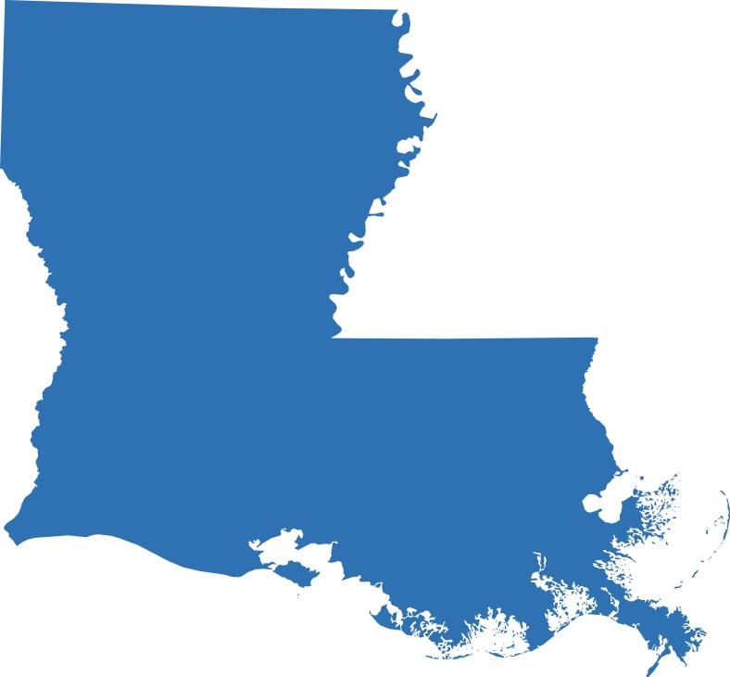
Engage a Champion to Provide Support
Louisiana Comprehensive Cancer Control Program
City Councilwoman championed efforts to enact a citywide smoke-free air law
“A public health ‘champion’ is an influential figure who uses his or her expertise and interpersonal skills to promote the use of evidence-based practices and to bridge the gap between research and programming.”
Action4PSEChange, 2016c.
Notes:
In New Orleans, for example, the Louisiana Comprehensive Cancer Control Program and its partners successfully worked with a city councilwoman who championed efforts to enact a citywide smoke-free air law.
Source:
Action4PSEChange. (2016c). New Orleans Smoke-Free Ordinance. Retrieved from http://action4psechange.org/new-orleans-smoke-free-ordinance/

Slide 130
What Resources Are Still Needed?
Can you combine efforts to maximize resources?
PSE change process is flexible, it is never too late to look for additional partners to share work
This will relieve the burden on comprehensive cancer control program staff, allowing each partner to make unique contributions to overall PSE change effort.
Notes:
Perhaps you have catalogued the resources offered by your partners, but as part of your review you recognize that you still lack critical assets. If others are pursuing similar goals, can you combine efforts to maximize resources? Remember that the PSE change process is flexible; it’s never too late to look for additional partners to share the work. This will relieve the burden on comprehensive cancer control program staff, while allowing each partner to make a unique contribution to the overall PSE change effort.

Slide 131
What Are the Barriers?
Barriers to PSE change vary widely
Opposition from a school system that received sales revenue
Do your research to identify revenue streams to replace potential losses and make allies as you anticipate and manage opponents
Action4PSEChange, 2016b.
Notes:
What are the barriers to implementing the PSE change? Can they be overcome? Barriers to PSE change vary widely, depending on the type of change you seek. For example, an attempt to remove sugar-sweetened beverages from school vending machines may encounter opposition from a school system that has received sales revenue from those machines. Before trying to implement your initiative, do your research to identify revenue streams to replace potential losses and make allies as you anticipate and manage opponents.
Source:
Action4PSEChange. (2016b). Minnesota Sugar-Sweetened Beverage Reduction Initiative. Retrieved from http://action4psechange.org/minnesota-sugar-sweetened-beverage-reduction-initiative/
iStock:
http://www.istockphoto.com/photo/sugar-in-food-gm492728532-76475569?st=_p_sugar%20beverage

Slide 132
Refine Goals and Objectives
If you encounter barriers that can’t be completely resolved, try to scale the PSE change initiative accordingly
Can you revise your plan to launch it in stages?
Can you add more time to educate stakeholders?
Cherokee Nation Cancer Program
Worked with small groups of schools until the program launched throughout the system.
Action4PSEChange, 2017.
Notes:
As part of review, it is important to check if the original goals and objectives need to be refined based on barriers identified. If you encounter barriers that can’t be completely resolved, then try to scale your PSE change initiative accordingly. For example, can you revise your plan to launch it in stages? Can you add more time to educate stakeholders?
Instead of targeting smoke-free policies in all schools in a district simultaneously, the Cherokee Nation Cancer Program worked with small groups of schools in turn until the program launched throughout the system
Source:
Action4PSEChange. (2017). Cherokee County Tobacco-Free Schools. Retrieved from http://action4psechange.org/cherokee-county-tobacco-free-schools/

Slide 133
Kentucky State Colon Cancer Screening Program
In 2008, Kentucky enacted law to establish Kentucky Colon Cancer Screening Program
In 2010, Colon Cancer Screening Program Fund was legislatively established
Cancer Consortium’s Colon Cancer Prevention Committee
Comprised of 20 cancer control organizations
Assessed state political climate
Engaged Governor, Lieutenant Governor and Chair of the Joint Health & Welfare Committee as advocates and champions
bit.ly/KentColonCan
Action4PSEChange, 2016a.
Notes:
Kentucky successfully pursued the establishment of a state colon cancer screening program, as well as a fund to sustain the program. The Cancer Consortium’s Colon Cancer Prevention Committee, comprised of 20 cancer control organizations, worked together for more than five years. In 2008, Kentucky enacted a law to establish the Kentucky Colon Cancer Screening Program. The Committee then worked to secure funding for the program, and in 2010, the Colon Cancer Screening Program Fund was legislatively established.
As part of its review, the Committee assessed the state political climate and were able to engage the Governor, Lieutenant Governor, and Chair of the Joint Health & Welfare Committee as advocates and champions. Get complete information about the Cancer Consortium’s review of required assets in its Resource Plan, which is linked at the end of this lesson.
Source:
Action4PSEChange. (2016a). Kentucky Colon Cancer Screening Program Fund. Retrieved from http://action4psechange.org/kentucky-colon-cancer-screening-program-fund/

Slide 134
Recap
Discussed feasibility based on the current environment
Highlighted the importance of identifying champions to support effort
Looked at capacity to implement PSE change
Emphasized the importance of identifying and attempting to counter barriers
Notes:
Let’s summarize the concepts we’ve covered in this lesson that will help assess the feasibility of your PSE change intervention. We discussed feasibility based on the current environment and highlighted the importance of identifying champions to support your effort. We looked at capacity to implement PSE change, based on available and outstanding resources. And we emphasized the importance of identifying and attempting to counter barriers you may encounter.
Now thinking about your planned PSE change effort, are the goals and objectives feasible? If by the end of your review, your answer is “yes”, then you are ready to move to the next step of the PSE change process.

Slide 135
Resources
Policy, Systems and Environmental Change Resource Guide
Kentucky Cancer Consortium Resource Plan
Research Utilization: An Annotated Bibliography
Notes:
Here are some readings and resources to access on the topic of reviewing the feasibility of your intervention. These and other resources are included in the learning management system.

Slide 136
Conclusion
Describe the process of a feasibility review, including an assessment of the political and economic climate
Evaluate capacity for change, including identifying the resources necessary to meet goals and objectives
Assess community readiness and explain the importance of this step to stakeholders
Notes:
In this lesson, you learned to:
Describe the process of a feasibility review, including an assessment of the political and economic climate;
Evaluate capacity for change, including identifying the resources necessary to meet goals and objectives; and
Assess community readiness and explain the importance of this step to stakeholders.

Slide 137
References
Action4PSEChange. (2016a). Kentucky Colon Cancer Screening Program Fund. Retrieved from http://action4psechange.org/kentucky-colon- cancer-screening-program-fund/
Action4PSEChange. (2016b). Minnesota Sugar-Sweetened Beverage Reduction Initiative. Retrieved from http://action4psechange.org/minnesota-sugar-sweetened-beverage-reduction-initiative/
Action4PSEChange. (2016c). New Orleans Smoke-Free Ordinance. Retrieved from http://action4psechange.org/new-orleans-smoke-free-ordinance/
Action4PSEChange. (2017). Cherokee County Tobacco-Free Schools. Retrieved from http://action4psechange.org/cherokee-county-tobacco-free-schools/
March of Dimes Foundation. (2007). Making Community Partnerships Work: A Toolkit. Retrieved from http://www.aapcho.org/wp/wp-content/uploads/2012/02/Giachello-MakingCommunityPartnershipsWorkToolkit.pdf
Notes:
Here is the full reference list of sources cited in this lesson.

Slide 138
Action for Policy, Systems and Environmental (PSE) Change: A Training
Lesson 5: Promote Awareness, Communicate and Educate
Notes:
Welcome to Lesson 5: Promote Awareness, Communicate and Educate. In this lesson, we will cover the fifth step in PSE change, which is Promote. We will discuss questions that need to be asked to help you educate and build support of stakeholders and the public for PSE change. This lesson will take approximately 20 minutes to complete.

Slide 139
Acknowledgements
This work was supported by Cooperative Agreement #1U38DP004972-04 from the Centers for Disease Control and Prevention. Its contents are solely the responsibility of the authors and do not necessarily represent the official views of the Centers for Disease Control and Prevention.
We would also like to thank the American Cancer Society and the Comprehensive Cancer Control National Partnership for the use of their Policy, Systems and Environmental Change Resource Guide, upon which the seven steps of the PSE process are based.
Notes:
We would like to acknowledge the Centers for Disease Control and Prevention for supporting this work. We would also like to thank the American Cancer Society and the Comprehensive Cancer Control National Partnership for the use of their Policy, Systems and Environmental Change Resource Guide, upon which the seven steps of the PSE process are based.

Slide 140
Competency
Identify, develop, and deliver messages using a variety of communication strategies, methods, and techniques
Notes:
The competencies in this training are based on the Seven Areas of Responsibility for Health Education Specialists, 2015. This lesson will address the following competency: Identify, develop, and deliver messages using a variety of communication strategies, methods, and techniques

Slide 141
Learning Objectives
Communicate the need for PSE change
Identify various modes of communication appropriate for PSE change
Identify the context in which to develop a communication plan and explain the importance of this step to stakeholders
Notes:
After completing this lesson, you will be able to:
Communicate the need for PSE change.
Identify various modes of communication appropriate for PSE change.
Identify the context in which to develop a communication plan and explain the importance of this step to stakeholders.

Slide 142
A Look Back at Previous Steps
Review
Assess
Scan
Engage
Notes:
In Lesson 1 of this training, we discussed the importance of forming partnerships with a broad range of individuals and organizations.
Lesson 2 addressed conducting an environmental scan in order to identify the drivers and challenges to your potential PSE change effort.
In Lesson 3, we emphasized the need for data to support your efforts and the importance of developing SMART objectives to ensure successful implementation.
Lesson 4 focused on the feasibility of your objectives in the current economic and political environment. We discussed the capacity for implementing the selected PSE change effort, including resources needed and barriers that may be faced.
At this point in the process, you are ready to promote and communicate the need for PSE change.

Slide 143
Why Promote Awareness, Communicate and Educate?
Notes:
So why is this step necessary and what is the goal of communicating about your intended PSE change at this early stage? Primarily, communicating the need for PSE change to all stakeholders before implementation should help lessen potential resistance. Depending on who you’ve defined as key stakeholders, your communication efforts may be limited internally or be public and broad in scope. You will likely share much of the data you gathered earlier in the PSE change planning process and should leverage partnerships to reach stakeholders through relevant channels. Depending on the specific PSE change you’re planning you may also need to communicate progress and ultimate success to improve the chances of a smooth roll out and change adoption or uptake by the intended audience. For the remainder of this lesson we’ll discuss how you can think through how to tailor your messages and frame the need for PSE change to build support among stakeholders and the public, when appropriate.
Images:
http://www.istockphoto.com/vector/business-management-graphic-gm496849764-78792483
http://www.istockphoto.com/vector/icon-flat-style-concept-target-audience-gm509365002-85745911

Slide 144
Ask Questions About Your Intended Audience
What are your intended audience’s strengths and how can those be incorporated into
your messaging?
What do they get out of your intended PSE change?
What cultural and/or community norms can be incorporated to strengthen the
message?
Notes:
The first thing you should think about before promoting your PSE change effort is: who is your audience? Who are the stakeholders you need to build support from? Use primary data, such as data from your own research through focus groups or key-informant interviews at town hall meetings, or secondary data (like data presented in peer-reviewed publications) to be able to answer questions about the intended audience such as:
What do they get out of your proposed PSE change? - You’re trying to generate buy-in
What are your intended audience’s strengths and how can those be incorporated into your messaging? – Help them feel empowered to work toward the PSE change
What cultural and/or community norms can be incorporated to strengthen the message and make it more relevant for each audience? – Do not make assumptions. Work with gatekeepers to inform your messaging. Remember that gatekeepers are individuals or entities that can influence their communities.
Whether your promotion efforts are focused on stakeholders and the public prior to the PSE change intervention or part of the implementation of your PSE change effort, it is always important to be able to answer questions about the intended audience. You’ll likely need different communication strategies for different stakeholder groups.

Slide 145
Tailoring Your Message
Know your audience
Understand your data
Develop key messages
Select appropriate channels
Notes:
What is it you want your audience to do? How can your message be best tailored to each stakeholder audience?
Having an understanding of your intended audience and the data supporting the PSE change will help you develop key messages and select the appropriate channels that promote your objectives and reach the intended audience.
Tailor your message based on information you gained through your scan, data assessment and feasibility study. Don’t rely on stereotypes or preconceived notions around stakeholders or communities; talk to members of your intended audience in order to genuinely understand their perspectives and values. This knowledge is crucial to developing authentic messages that resonate with the audience and inspire stakeholders to support your PSE change (before implementation); or motivate individuals and communities to change their attitudes and behaviors around the PSE issue (as a result of implementation). Having this information is another benefit of involving stakeholders or community members as part of your taskforce and in your initial research and planning process.
Istock:
http://www.istockphoto.com/photo/crowed-of-diversity-people-friendship-happiness-concept-gm475733404-65515853

Slide 146
Matching Your Message to Your Intended Audiences
Highlight LGBTQ smoking rates are higher than for other groups
LGBTQ community members
Highlight stories of former bar patrons who no longer go due to smoke hazard
Bar owners
Notes:
As you determine who your intended audiences are, consider how you use the information and data obtained in the previous steps to determine what stakeholders need or want to hear and understand. The secret to effective communication comes from matching your message to your audience.
Selection of the intended audience should be driven by population needs as evidenced by data, which you would have assessed in Step 3. Perhaps data indicate that lesbian, gay, bisexual, transgender and queer, or LGBTQ, individuals in your region smoke at higher rates than other groups. You may have also identified that bar culture perpetuates smoking and secondhand smoke exposure for this population because smoking is permitted in bars in your city. The SMART objectives you developed would be based on this information. Perhaps your goal is to eliminate smoking in bars through local legislation, or through a tax incentive program for bars opting to ban indoor smoking. Prior to rolling out the PSE change, you will need to raise awareness of the need and generate buy-in from stakeholders, which should include but are not limited to LGBTQ organizations and bars, as well as individuals and community members who can offer their expertise on the strategies and activities of your PSE change objectives.
For messaging, when communicating to LGBTQ community members you might focus on smoking statistics or raising awareness about differential marketing by big tobacco toward their community. For bar owners, you might highlight potential lost revenue through stories about LGBTQ patrons who no longer frequent bars that allow indoor smoking due to the secondhand smoke hazard. For store owners selling tobacco, messaging can focus on how certain groups are targeted by tobacco marketing and are more affected by tobacco use such as LGBTQ youth.

Slide 147
Motivating Your Audience to Adopt and Act on Your Message
Community Tool Box, n.d.; UN Women, n.d..
Notes:
Consider what will motivate your audience to adopt and act on your message. “Framing” helps answer this question. Just as a picture frame can direct the viewer toward a particular aspect of a painting or photo, framing a message helps tailor it to your specific audience. Framing structures the audience’s thinking about what the problem is and how to address it. It affects how they see the issue.
Think about what you would like your message to emphasize.
You can highlight quantitative data you collected earlier.
You can focus on individual narratives and combine statistics and anecdotes.
You can emphasize the health benefits of adopting the PSE change, or the danger of not adjusting.
Let’s look more closely at framing.
Community Tool Box. Chapter 32, Section 5. Reframing the Issue. (n.d.). Accessed April 10, 2017. http://ctb.ku.edu/en/table-of-contents/advocacy/encouragement-education/reframe-the-debate/main
UN Women, United Nations Entity for Gender Equality and the Empowerment of Women. (n.d.). Advocacy Toolkit for Women in Politics, 2. Framing an Advocacy Message. Accessed April 10, 2017. http://www.ipsnews.net/publications/framinganadvocacymessage.pdf.
istock:
http://www.istockphoto.com/photo/blank-picture-frames-on-the-wooden-wall-room-gm517417318-89479743
http://www.istockphoto.com/photo/many-graphs-gm495226588-77875403
http://www.istockphoto.com/photo/chat-symbol-and-quotation-mark-gm517899146-89721381
http://www.istockphoto.com/photo/success-in-majestic-sunset-gm509181684-82699109

Slide 148
Framing Your Message
It’s Bad For Your Health
Notes:
Consider how to frame your message differently for each of your audiences. This step allows you to communicate to these audiences why your effort is important in order to gain their support before you implement your PSE change initiative.
Think beyond what it is you want them to do or an opinion you are trying to change. How can you frame your message so the audience hears what’s in it for them? How can you frame the message to leverage community strengths or cultural factors to make them feel ownership and empowerment around the issue?
For example, before launching PSE efforts to limit smoking in bars, you could introduce a communication campaign to raise awareness among LGBTQ individuals of the dangers of smoking and encouraging them to consider quitting. This may or may not have any effect.
Alternatively, you could model your campaign after the Food and Drug Administration’s “This Free Life” campaign, which focuses on the positive culture in the LGBTQ community. Sample messages include, “What I’ve overcome won’t be undone (by tobacco).” One campaign theme addresses tobacco’s disproportionate affect on the community, and how this adds to the injustices the community has faced. Other themes relate to the threat to freedoms because of addiction, and the damage to one’s physical appearance. This campaign leverages community strengths to help the audience feel empowered to quit. It would likely garner support prior to introducing the concept of restricting smoking in bars.
istock:
http://www.istockphoto.com/photo/mock-up-billboard-light-box-at-bus-station-in-city-gm500906474-81054633
Red vector art: http://www.istockphoto.com/vector/no-smoking-poster-man-with-skull-and-cross-bones-gm505918062-83924289
I got the “This Free Life” image from here https://www.usnews.com/news/business/articles/2016-05-02/fda-effort-aims-to-curb-smoking-in-lgbt-community BUT it is HHS FDA

Slide 149
Communication Strategies
Public relations
Mass media promotions
Advertising
Public service announcements
Paid messages
Education entertainment
Entertainment and news programs
Entertainment industry support
Individual and group instruction
Interventions to counsel and educate
Paid, earned and social media
Advertising
Editorial influence
Grassroots media
Owned media
Fully-owned media
Partially-owned media
Centers for Disease Control and Prevention, 2014; Myers, n.d.; National Cancer Institute, 2004.
Notes:
A communication or media plan provides the outline for your message delivery. This is a helpful tool to use to maximize your communication efforts for your PSE change initiative. According to the CDC, a communication plan “generally contains a wide range of strategies that could include the following:
Public relations - Public relations includes all mass media promotions about a health issue or problem. Examples of mass media include radio, network and cable TV, magazines, direct mail, billboards, transit cards and newspapers.
Advertising - Advertising refers to public service or paid messages about a service or product as a form of endorsement or public education
Education entertainment - In education entertainment, the health promotion message is included in entertainment and news programs, including efforts to remove conflicting messages about the health issue. For example, during a local daytime talk show, a smoking cessation program may provide information on how to quit smoking. The campaign may be compromised if advertisements for e-cigarettes are shown on the same TV station, so you may seek support to remove those ads. Education entertainment can also include support for a particular health message by the entertainment industry and weaving of the key messages into the script of a TV program, like two Law and Order: SVU episodes in 2009 and 2015 that centered on parents who refuse to vaccinate their children.
Individual and group instruction - Individual instruction and group instruction are interventions to counsel and provide education to improve skills and encourage behavior change. This might be part of a broader PSE change if for example, your community is installing bike lanes and your organization wants to offer free bike safety clinics.
Paid, earned and social media - Paid media refers to forms of advertising that were purchased. Earned media is free media, often achieved by editorial influence, in which media outlets already have an awareness of a product, service or brand. Social media includes grassroots media, especially on the Internet. Grassroots media, also called grassroots marketing, targets influential small groups or individuals to deliver a message, with the hopes of reaching a larger audience through the natural spread of information.
Owned media - Owned media are media channels that you own or have control over. Fully-owned media could be your website. Examples of partially owned media are Facebook fan pages or Twitter profiles. According to the CDC, “Owned media creates brand portability,” or the capability of your message to be accessed on more than one device, such as on a computer or a smart phone.
[Source for grassroots marketing: Centers for Disease Control and Prevention. 2014; National Cancer Institute. 2004; Myers. N.d.]
istock:
http://www.istockphoto.com/vector/mass-media-isometric-concept-gm500538022-80825117
http://www.istockphoto.com/vector/cinema-movie-film-and-video-media-industry-gm484771006-71536957
http://www.istockphoto.com/vector/obesity-crisis-headline-newspaper-isolated-on-white-background-gm612420164-105497163
http://www.istockphoto.com/vector/hand-holding-megaphone-with-bubble-speech-gm522333922-91590699
http://www.istockphoto.com/vector/business-meeting-in-top-view-gm520708387-50123026http://www.istockphoto.com/vector/news-on-tablet-pc-gm164415824-15581502

Slide 150
Media Platforms
EARNED
Media
SOCIAL/ SHARED
Media
OWNED
Media
PAID
Media
Letters to the editor
Editorials
Stories from journalists
Posts on others’
Twitter
Facebook
Instagram
YouTube
LinkedIn
Google+
Polls on Twitter
Posters/banners
Paid TV/radio spots
Posts on your….
Twitter
Facebook
Instagram
YouTube
LinkedIn
Google+
Website
Webinars
Videos and podcasts
Success stories
Expert-generated content
Iliff, 2014.
Notes:
As you develop your communication or media plan, determine which media platform(s) are best suited to promoting your PSE change message and why. It is important to understand your audience’s media habits and consider which channels are most likely to reach each audience.
You will likely need resources to use some of these platforms. Resources necessary to support your communication efforts will, of course, vary with the channels you’ve chosen. Some platforms require financial resources, such as buying social media ads to reach a young audience, while others require knowledge of the local media market, such as submitting a letter to the editor or earning a feature story in the newspaper known to be read by most state congressional staffers.
Your audience’s media habits should be balanced with your staff, financial and technological capacity. There are advantages and disadvantages in terms of cost, reach, time and the amount of information you can convey via each media channel, whether it is newspapers, magazines, blogs, newsletters, TV, radio or social media.
More detailed information on media planning can be found in the Media Planning and Media Resource Guide available in the Learning Management System.
Iliff, R. (December 5, 2014). Why PR is Embracing the PESO Model. Retrieved from http://mashable.com/2014/12/05/public-relations-industry/#XNjfFL5D0OqY

Slide 151
Matching Your Media Platform to Your Audience
Crush, n.d..
Notes:
Coming back to our example, if you are trying to reach LGBTQ young adults with messaging about the consequences of smoking, you may try a combination of distribution channels, including print and electronic.
For example, the Southern Nevada Health District’s marketing initiative included distribution of educational materials at sponsored events at bars and nightclubs, as well as using electronic media and social media.
Source: Crush. (n.d.). Retrieved from Crush Online Campaign website http://www.socrush.com/

Slide 152
Task Force Member Resources
Connections with local media partners
Communication Experience
Knowledge of local grant funding or grant-writing skills
Notes:
At this point, look again at the composition of your task force. Do any of your stakeholders have communication experience? If so, engage them to help lead these efforts. Do any of your partner organizations have large networks? Enlist their help in disseminating information. If your task force or coalition lacks these resources, can you identify additional partners with relevant experience? Are there small pockets of local grant dollars you could apply for collectively to support this effort?
http://www.istockphoto.com/photo/teamwork-meeting-concept-gm621228604-108428237

Slide 153
Step 5 Example: New Orleans
Action4PSEChange, 2016.
Notes:
Click on the image to listen to an example about how a coalition with diverse skills and resources took on Step 5: Promote.
In New Orleans, the SmokeFree NOLA Coalition worked to communicate the need for a citywide smoke-free air law. The coalition was broad in its membership and included statewide and national health groups and anti-tobacco advocates like the Louisiana Comprehensive Cancer Control Program, Geographic Health Equity Alliance and Campaign for Tobacco Free Kids, among many others.
Messages were framed by enlisting a casino employee and musicians to talk about the personal impact of secondhand smoke exposure in their workplaces. The coalition promoted its effort by using strategies that incorporated local communities and cultural elements, acknowledging the fun-loving atmosphere in New Orleans. Stories in local media outlets promoted awareness of the initiative and educated stakeholders. They also used a unique platform – the Smoke-Free NOLA parade that traveled through the city streets to promote the message.
These efforts paid off, as the New Orleans City Council unanimously approved a comprehensive smoke-free air law in 2015 and public support for the law was overwhelmingly positive 6-months after its roll-out. https://smokefreenola.files.wordpress.com/2015/10/10_22_15_memo.pdf
istock:
http://www.istockphoto.com/photo/drum-on-stage-gm537386974-95259489
Maybe for the photo we could also use this one: http://www.imgrum.org/media/1236415331758375295_186479991

Slide 154
Recap
Discussed the importance of framing your message for each of your stakeholder audiences
Talked about incorporating strengths, cultural and/or community norms
Looked at the types of media platforms that are best suited to different audiences
Talked about engaging your stakeholders in these efforts
Notes:
In this lesson, we have discussed the importance of tailoring and framing your message for each of your stakeholder audiences.
We have talked about incorporating audience strengths and cultural or community norms to strengthen the message and make it more acceptable to your intended audiences.
We have looked at the types of media platforms that are best suited to different audiences, as well as the resources necessary to use them.
We have also talked about engaging your stakeholders in these efforts.

Slide 155
Conclusion
Communicate the need for PSE change
Identify various modes of communication appropriate for PSE change
Identify the context in which to develop a communication plan and explain the importance this step to stakeholders
Notes:
In this lesson, you learned to:
Communicate the need for PSE change.
Identify various modes of communication appropriate for PSE change.
Identify the context in which to develop a communication plan and explain the importance of this step to stakeholders.

Slide 156
Resources
Definition of Grassroots Marketing
Community Tool Box
Advocacy Toolkit for Women in Politics, 2. Framing an Advocacy Message
More than a message: framing public health advocacy to change corporate practices
Notes:
Here are some further readings and resources to access on the topic of promote awareness, communicate and educate. These and other resources are included in the learning management system.

Slide 157
Supplemental Learning Opportunity
Notes:
Now that you understand how to frame your communication messages and tailor them based on your intended audience, visit the Educating Stakeholders module to learn more about the activities that are permissible or not permissible for CDC grantees engaged in educating stakeholders on the need to support your PSE change initiative.
istock:
http://www.istockphoto.com/photo/what-you-need-to-know-gm493182594-76757665

Slide 158
Communication and Media Planning
Notes:
For more in-depth communications training, consider enrolling in our Communication Training for Comprehensive Cancer Control Professionals 101: Media Planning and Media Relations and 102: Making Communication Campaigns Evidence-Based. Both are available through our Online Academy.

Slide 159
References
Action4PSEChange. (2016). New Orleans Smoke-Free Ordinance. Retrieved from http://action4psechange.org/new-orleans-smoke-free-ordinance/
Centers for Disease Control and Prevention. (2014). Media plan guidance: How to create and implement an effective media plan. Retrieved from https://smhs.gwu.edu/cancercontroltap/sites/cancercontroltap/files/Media%20Plan%20Guidance%20%20%2007%2008%202014.pdf
Community Tool Box. Chapter 32, Section 5. Reframing the Issue. (n.d.). Retrieved from http://ctb.ku.edu/en/table-of-contents/advocacy/encouragement-education/reframe-the-debate/main
Crush. (n.d.). Crush Online Campaign image. Retrieved from http://www.socrush.com/
Iliff, R. (2014). Why PR is Embracing the PESO Model. Retrieved from http://mashable.com/2014/12/05/public-relations-industry/#XNjfFL5D0OqY
Myers, C. (n.d.). Definition of Grassroots Marketing. Houston Chronicle. Retrieved from http://smallbusiness.chron.com/definition-grassroots-marketing-23210.html
National Cancer Institute. (2004). Making Health Communication Programs Work: A Planner’s Guide. Bethesda, MD: U.S. Department of Health and Human Services.
UN Women, United Nations Entity for Gender Equality and the Empowerment of Women. (n.d.). Advocacy Toolkit for Women in Politics, 2. Framing an Advocacy Message. Retrieved from http://www.ipsnews.net/publications/framinganadvocacymessage.pdf
Notes:
Here is the full reference list of sources cited in this lesson.

Slide 160
Action for Policy, Systems and Environmental (PSE) Change: A Training
Supplemental Lesson
Educating Stakeholders
Notes:
Welcome to our supplemental lesson: Educating Stakeholders. In this lesson, we will provide an overview regarding activities that are permissible or not permissible for CDC grantees engaged in educating stakeholders on your PSE change initiative. This lesson will take approximately 20 minutes to complete.

Slide 161
Acknowledgments
This work was supported by Cooperative Agreement #1U38DP004972-04 from the Centers for Disease Control and Prevention. Its contents are solely the responsibility of the authors and do not necessarily represent the official views of the Centers for Disease Control and Prevention.
We would also like to thank the American Cancer Society and the Comprehensive Cancer Control National Partnership for the use of their Policy, Systems and Environmental Change Resource Guide, upon which the seven steps of the PSE process are based.
Notes:
We would like to acknowledge the Centers for Disease Control and Prevention for supporting this work. We would also like to thank the American Cancer Society and the Comprehensive Cancer Control National Partnership for the use of their Policy, Systems and Environmental Change Resource Guide, upon which the seven steps of the PSE process are based.

Slide 162
Type of Activity
Education
Presentation of objective, factual information
“An attempt to influence specific legislation by communicating views to legislators or asking people to contact their legislators.”
Lobbying
Alliance for Justice, n.d., SOPHE, n.d.
Notes:
We’ll begin by defining two types of activities: education and lobbying. It is important to clearly understand the difference between educating decision-makers and lobbying for a particular legislative outcome.
Education is the presentation of objective, factual information. Examples include preparing a paper detailing the findings of a study or communicating the impact of tobacco tax increases on tobacco sales. Taking a position in favor of or against a legislative measure is NOT education. Some individuals or organizations use the term “advocacy” to describe education and awareness-raising efforts. However, we prefer the term “education”, particularly in relation to CDC and other government-funded efforts, as it more accurately describes the activities involved.
Lobbying is “an attempt to influence specific legislation by communicating views to legislators or asking people to contact their legislators.”
Lobbying can further be categorized as direct or grassroots. We will talk more about these concepts shortly.
Slide Citation:
Bolder Advocacy, Glossary, accessed 3-8-17 at http://www.bolderadvocacy.org/afj-on-advocacy/glossary.
SOPHE, Chapter 2, Policy and the Role of Public Health Professionals, accessed 5-15-17 at https://www.yumpu.com/en/document/view/30857409/chapter-2-society-for-public-health-education

Slide 163
Anti-Lobbying Rules
Federal law
State law
Factors:
Type of activity you plan to pursue
Whether you receive federal funds directly from CDC
Classification of your organization by the IRS
Please be aware that the GW Cancer Center provides this material for informational purposes only.
Notes:
In planning to communicate the need for PSE change, it is important to be aware of anti-lobbying rules. These rules come from difference sources, including Federal law enacted by the US Congress, and rules and regulations issued by Federal agencies, such as the Federal Election Commission and Internal Revenue Service, or IRS. In addition, state laws impose restrictions on the use of state funds. To ensure compliance, you must take into account all requirements that apply to your situation.
Different factors come into play when determining your organization’s treatment under these rules. We will discuss three of them: the type of activity you plan to pursue, whether you receive federal funds directly from the CDC and the classification of your organization by the IRS.
This is a complex topic, and distinctions between permissible and forbidden activities can be subtle. While we will summarize information and provide helpful resources, please be aware that the George Washington University Cancer Center provides this material for informational purposes only. We do not provide legal guidance, and the examples we provide may not apply to your circumstances. We suggest that you seek legal guidance about your specific situation if you have questions or concerns.

Slide 164
Receipt of Federal Funds
PROCEDURES
Anti-Lobbying Restrictions for CDC Grantees, which summarizes provisions of Section 503, Division F, Title V, FY 12 Consolidated Appropriations Act
Anti-Lobbying Restrictions for CDC Grantees, 2012.
Notes:
Let’s look at guidance that the CDC has issued to assist their grantees, again remembering that this information is not definitive legal guidance. Information is presented in a document entitled Anti-Lobbying Restrictions for CDC Grantees, which summarizes provisions of Section 503, Division F, Title V, FY 12 Consolidated Appropriations Act.
During this lesson, we’ll refer to this guidance as CDC’s Anti-Lobbying Restrictions. The document also includes Additional Requirement 12, which provides further guidance about the application of Section 503 to CDC grantees. Because time limitations prevent us from fully exploring this guidance here, we recommend consulting the document, available in our Learning Management System, for more complete information.
istock: http://www.istockphoto.com/photo/policies-procedure-gm522801246-91800013

Slide 165
Types of CDC Grantees
State or Local Government Agencies
Non-Government Entities
Anti-Lobbying Restrictions for CDC Grantees, 2012.
Notes:
CDC grantees fall into two different categories. They are either state or local government agencies, or they are non-government entities. We will begin our discussion by reviewing examples of allowable activities for state and local agencies, and then we will look at activities allowed for non-government entities. We will also review examples of prohibited activities for both groups.

Slide 166
Allowed Activities for State and Local Agencies
Provide education to the public
Work on policy-related issues across equivalent branches of government
Anti-Lobbying Restrictions for CDC Grantees, 2012.
Notes:
State and local agencies funded by CDC may provide education to the public. An additional allowable activity that is unique to these agencies is the ability to work on policy-related issues across equivalent branches of government. That is, as members of the executive branch of government, they may engage with members of the legislative branch. This exception does not apply to non-government entities.
istock: http://www.istockphoto.com/photo/marker-with-check-mark-and-box-gm118921584-11999319

Slide 167
Examples of Allowed Activities for State and Local Agencies
Educating the public on personal health behaviors and choices, health issues and their public health consequences and the evidence associated with potential policy solutions to health issues
Research on policy alternatives and their impact
Working with their own state or local government’s legislative body on policy approaches to health issues
Anti-Lobbying Restrictions for CDC Grantees, 2012.
Notes:
Let’s review some examples of allowed activities for agencies. Please see CDC’s Anti-Lobbying Restrictions for a more complete list. Examples include:
Educating the public on personal health behaviors and choices, health issues and their public health consequences and the evidence associated with potential policy solutions to health issues
Research on policy alternatives and their impact
Working with their own state or local government’s legislative body on policy approaches to health issues, as part of normal executive-legislative relationships

Slide 168
Allowed Activities for Non-Government Entities
Highlight and translate public health evidence
Collect and analyze data
Publish and disseminate research results
Implement prevention strategies
Conduct community outreach services
Foster coalition building and consensus on public health initiatives by providing leadership and training
Foster safe and healthful environments
Anti-Lobbying Restrictions for CDC Grantees, 2012.
Notes:
Non-government grantees may also provide education and a variety of policy-related, non-lobbying activities.
These include “highlighting and translating public health evidence, collecting and analyzing data, publishing and disseminating results of research; implementing prevention strategies, conducting community outreach services; fostering coalition building and consensus on public health initiatives by providing leadership and training, and fostering safe and healthful environments.”
istock: http://www.istockphoto.com/photo/go-walk-gm178850721-25397677

Slide 169
Examples of Allowed Activities for Non-Government Entities
Educating the public on personal health behaviors and choices
Conducting research on policy alternatives and their impact
Providing public officials with technical advice or assistance concerning evidence of program or policy effectiveness
Identifying approaches for tracking and evaluating implementation of policy actions
Communicating with the public about health issues and potential policy solutions
Anti-Lobbying Restrictions for CDC Grantees, 2012.
Notes:
Now let’s look at some examples of allowed activities for non-government entities. See CDC’s Anti-Lobbying Restrictions for a more complete list. Examples include:
“Educating the public on personal health behaviors and choices
Conducting research on policy alternatives and their impact
Upon formal, written request, providing public officials with technical advice or assistance concerning evidence of program or policy effectiveness
Identifying approaches for tracking and evaluating implementation of policy actions
Communicating with the public about health issues and potential policy solutions.”
istock: http://www.istockphoto.com/photo/isolated-floating-black-pen-on-white-background-gm91516799-9091427

Slide 170
Prohibited Activities
Anti-Lobbying Restrictions for CDC Grantees, 2012.
Notes:
Now we’ll walk through some specific activities that cannot be conducted using federal funding.
istock: http://www.istockphoto.com/photo/stop-gm499403725-42478688

Slide 171
Prohibited Lobbying Activities
Grassroots Lobbying
“Activity directed at inducing members of the public to contact their elected representatives to urge support of, or opposition to, proposed or pending legislation or appropriations of any regulation, administrative action, or order issued by the executive branch of any Federal, state or local government.”
“Attempt to influence deliberations or actions by Federal, state, or local legislative or executive branches,” including communications that take a position on a specific legislative or executive measure.
Direct
Lobbying
Anti-Lobbying Restrictions for CDC Grantees, 2012.
Notes:
For both government agencies and non-government entities, the use of Federal funds to conduct grassroots lobbying or direct lobbying is prohibited.
CDC refers to grassroots lobbying as an “activity directed at inducing members of the public to contact their elected representatives to urge support of, or opposition to, proposed or pending legislation or appropriations or any regulation, administrative action, or order issued by the executive branch of any Federal, state or local government.”
Direct lobbying is the use of federal funds “to attempt to influence deliberations or actions by Federal, state, or local legislative or executive branches,” including communications that take a position on a specific legislative or executive measure.

Slide 172
Prohibited Activities for State and Local Government Grantees
Federal Government | State and Local Government | US Congress | State or Local Legislature
Encouraging the public to support or oppose specific action proposed or pending |  | Direct lobbying
Anti-Lobbying Restrictions for CDC Grantees, 2012.
Notes:
CDC’s Anti-Lobbying Restrictions also includes lists of activities its grantees cannot engage in. For state and local government grantees, these include:
“Encouraging the public to support or oppose specific action proposed or pending before the Federal government
Encouraging the public to support or oppose specific legislation or executive action proposed or pending before state or local government
Direct lobbying of the US Congress
Direct lobbying of a state or local legislature”
See CDC’s Anti-Lobbying Restrictions for a more complete list.

Slide 173
Prohibited Activities for Non-Government Grantees
US Congress | State or Local Legislature
Encouraging the public to support or oppose specific action proposed or pending
Direct lobbying in support (or in opposition) to a matter proposed or pending before a legislature, including executive orders or other administrative action
Anti-Lobbying Restrictions for CDC Grantees, 2012.
Notes:
FYI- for captivate purposes read this slide as one– but we will layer info on top of each other– for slides 14-15
For non-government grantees, prohibited activities include:
Encouraging the public to support or oppose specific action proposed or pending before the US Congress
Encouraging the public to support or oppose specific legislation or executive action by a state or local government
Direct lobbying in support of, or in opposition to, a matter proposed or pending before a legislature, including a state or local legislature or the US Congress, or to a proposed or pending decision by an executive agency (including regulations, executive orders or other administrative action)
Presenting materials relating to public policies that may require legislative or executive action that do not include an objective, balanced presentation of evidence
Presenting materials relating to public policies that may require legislative or executive action that are only made available to allies or a narrow audience
Developing and/or disseminating materials that exhibit all three of the following characteristics: (1) reference to specific legislation or other order; (2) reflecting a point of view on that legislation or other order; and (3) containing an overt call to action.”
See CDC’s Anti-Lobbying Restrictions for a more complete list.

Slide 174
Prohibited Activities for Non-Government Government Grantees
Presenting materials relating to public policies that may require legislative or executive action that:
Do not include an objective, balanced presentation of evidence
Are only made available to allies or a narrow audience
Developing and/or disseminating materials that exhibit all three of the following characteristics:
Reference to specific legislation or other order
Reflecting a point of view on that legislation or other order
Containing an overt call to action
Anti-Lobbying Restrictions for CDC Grantees, 2012.

Slide 175
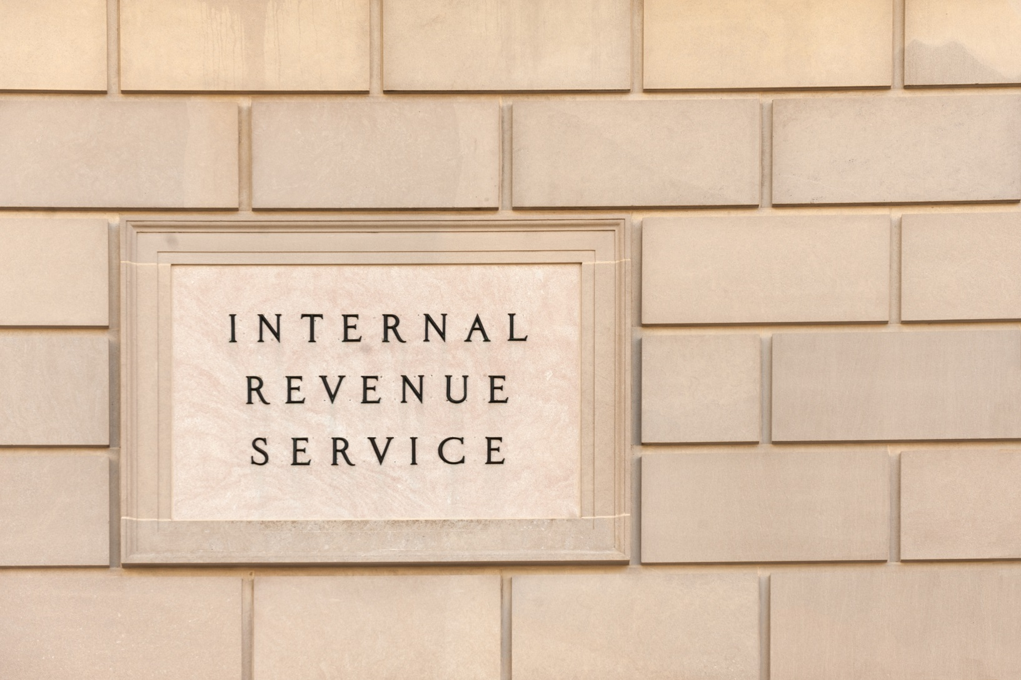
Classification of Your Organization
501(c)(4)
501(c)(3)
Notes:
Up to this point in the lesson, we’ve focused on guidance provided by CDC to help explain lobbying restrictions imposed by Section 503 of the Fiscal Year 2012 Consolidated Appropriations Act.
Now we’ll look briefly at 501(c)(3) and 501(c)(4) tax exempt organizations as categorized by the IRS and how these classifications can also affect lobbying activities.
We’ll also briefly review the capabilities of unincorporated voluntary organizations.
istock: http://www.istockphoto.com/photo/irs-building-gm636650478-113065039

Slide 176
501(c)(3)
Dedicated to educational, religious, scientific and other charitable endeavors, 501(c)(3) public charities are permitted to conduct limited lobbying in nonpartisan, election-related ways
Allowable Activities:
Conducting public education sessions about participating in the political process
Educating political candidates about public issues
Schadler, 2006.
Notes:
Dedicated to educational, religious, scientific and other charitable endeavors, 501(c)(3) public charities are permitted to conduct limited lobbying in nonpartisan, election-related ways. Allowable nonpartisan activities include conducting public education sessions about participating in the political process and educating political candidates about public issues.
To learn more about these rules, see Being a Player: A Guide to the IRS Lobbying Regulations for Advocacy Charities, linked at the end of the training.
Schadler, B. (2006). The Connection: Strategies for Creating and Operating 501(c)(3)s, 501(c)(4)s and Political Organizations (Alliance for Justice) accessed 3-13-17 at http://www.bolderadvocacy.org/wp-content/uploads/2012/01/The_Connection.pdf.

Slide 177
501(c)(4)
In contrast, 501(c)(4)s are organizations that primarily promote ‘social welfare’ – that is, “social improvement and civic betterment,” such as “education and lobbying on social and economic issues”
Example:
501(c)(4) organizations in Kentucky supported legislation to create the Colon Cancer Screening Fund
Allowable Activities:
Conducting some political activities, but only as a secondary activity
Schadler, 2006.
Notes:
In contrast, 501(c)(4)s are organizations that primarily promote ‘social welfare’ – that is, “social improvement and civic betterment,” such as “education and lobbying on social and economic issues.”
These organizations may conduct some political activities, but only as a secondary activity. Examples of allowable activities include participating in all of the lobbying activities that are permissible for 501(c)(3)s, but without limit, and distributing voter guides.
Often, 501(c)(3)s create affiliated 501(c)(4) organizations in order to enhance their ability to engage in advocacy. The American Cancer Society, or ACS, is one example. It is a 501(c)(3) organization, while the ACS Cancer Action Network, or CAN, is organized as a 501(c)(4). The mission of both organizations is to eliminate cancer as a major health problem.
Many comprehensive cancer control programs include ACS CAN or other 501(c)(4) partners in their consortium or PSE taskforce.
For example, Kentucky’s comprehensive cancer control consortium worked with key 501c4 advocacy partners who supported legislation to create the Colon Cancer Screening Program Fund.

Slide 178
Voluntary Unincorporated Organizations
No tax exempt status
Restrictions do not apply
W.K. Kellogg Foundation, n.d.
Notes:
Finally, let’s look at voluntary, unincorporated associations. These entities are run by volunteers and do not have tax exempt status. The restrictions on political activity that we have discussed do not apply to informal, voluntary associations that have not incorporated under state law.
Now let’s look at how the different classifications impact the activities of a comprehensive cancer coalition.
http://www.istockphoto.com/photo/community-initiative-or-volunteering-concept-hands-of-group-of-people-gm639469100-115265305

Slide 179
Comprehensive Cancer Coalitions
Coalition
CDC grantees
Partner organizations
Volunteers
Schadler, 2006.
Notes:
Your coalition may be made up of groups that represent the range of variations we’ve discussed – including CDC grantees and partners, 501(c)(3) and 501(c)(4) organizations, and volunteers. Your coalition itself may be a voluntary unincorporated organization or may have its own 501(c)(3) status.
The lobbying restrictions that affect an organization always apply, whether the organization is acting independently or as part of a larger coalition. This means that a tax-exempt organization can’t participate in a coalition activity that it couldn’t pursue on its own. If it does, the organization risks its tax-exempt status.
As you work toward PSE change, think critically about the structure of your coalition. Identify those who are permitted to engage in significant advocacy activities and those who are not, in order to appropriately engage all members. And to be safe, stick with permissible education activities described earlier.
{Citation on slide: Schadler, B. (2006). The Connection: Strategies for Creating and Operating 501(c)(3)s, 501(c)(4)s and Political Organizations (Alliance for Justice) accessed 3-13-17 at http://www.bolderadvocacy.org/wp-content/uploads/2012/01/The_Connection.pdf.}

Slide 180
Recap
Discussed characteristics of organizations that result in different limitation on the ability to lobby
Reviewed the type of activity you plan to pursue, whether you receive federal funds from the CDC
Talked about the different classification of your organization by the IRS
Notes:
In this lesson, we have discussed characteristics of organizations that result in different limitations on the ability to lobby. These include the type of activity you plan to pursue, whether you receive federal funds directly from the Centers for Disease Control and Prevention and the classification of your organization by the IRS. When dividing work among coalition members, keep in mind these distinctions to ensure that education is a principal activity in your PSE effort and any lobbying is pursued only by members permitted to do so.

Slide 181
Resources
Anti-Lobbying Restrictions for CDC Grantees
Complying with Anti-Lobbying Laws
Being a Player: A Guide to the IRS Lobbying Regulations for Advocacy Charities
Building Your Advocacy Toolbox: Advocacy vs. Lobbying
Families USA Webinar (2017, May 10). ACA Defense Webinar on Next Steps: How Non-Profits Can Elevate Advocacy. Retrieved from http://familiesusa.org/defending-health-care-2017-webinar-series
Internal Revenue Service, “Direct” and “Grass Roots” Lobbying Defined
Internal Revenue Service, Lobbying
The Connection: Strategies for Creating and Operating 501(c)(3)s and 501(c)(4)s and Political Organizations
W.K. Kellogg Foundation article: Is It Legal for Nonprofits to Advocate for Policy Change?
The NAACHO Advocacy Toolkit
Notes:
Here are some further readings and resources you can access on the topic of educating stakeholders and decision makers. These and other resources are included in the learning management system.

Slide 182
References
Anti-Lobbying Restrictions for CDC Grantees. (2012) Retrieved from https://www.cdc.gov/grants/documents/anti-lobbying_restrictions_for_cdc_grantees_july_2012.pdf
Alliance for Justice. (n.d.). Bolder Advocacy, Glossary page. Retrieved from http://www.bolderadvocacy.org/afj-on-advocacy/glossary
Schadler, B. (2006). The Connection: Strategies for Creating and Operating 501(c)(3)s, 501(c)4s and Political Organizations. Alliance for Justice. Retrieved from http://www.bolderadvocacy.org/wp-content/uploads/2012/01/The_Connection.pdf
SOPHE (n.d.). Chapter 2, Policy and the Role of Public Health Professionals. Retrieved from https://www.yumpu.com/en/document/view/30857409/chapter-2-society-for-public-health-education
W.K. Kellogg Foundation. (n.d.). Is it Legal for Nonprofits to Advocate for Policy Change? Retrieved from http://ww2.wkkf.org/advocacyhandbook/page2a.html
Notes:
Here is the full reference list of sources cited in this lesson.

Slide 183
Action for Policy, Systems and Environmental (PSE) Change: A Training
Lesson 6: Implement
Take Action
Notes:
Welcome to Lesson 6: Implement – Take Action. In this lesson, we will cover the sixth step in PSE change, which is Implement. We will discuss questions that need to be asked to help you take the necessary action to put your plan into motion. This lesson will take approximately 15 minutes to complete.

Slide 184
Acknowledgments
This work was supported by Cooperative Agreement #1U38DP004972-04 from the Centers for Disease Control and Prevention. Its contents are solely the responsibility of the authors and do not necessarily represent the official views of the Centers for Disease Control and Prevention.
We would also like to thank the American Cancer Society and the Comprehensive Cancer Control National Partnership for the use of their Policy, Systems and Environmental Change Resource Guide, upon which the seven steps of the PSE process are based.
Notes:
We would like to acknowledge the Centers for Disease Control and Prevention for supporting this work. We would also like to thank the American Cancer Society and the Comprehensive Cancer Control National Partnership for the use of their Policy, Systems and Environmental Change Resource Guide, upon which the seven steps of the PSE process are based.

Slide 185
Competencies
Use strategies that advance advocacy goals
Implement advocacy plans
Notes:
The competencies in this training are based on the Seven Areas of Responsibility for Health Education Specialists, 2015. This lesson will address the following competencies:
Use strategies that advance advocacy goals
Implement advocacy plans

Slide 186
Learning Objectives
Identify whether sufficient awareness and resources exist to support the successful implementation of the PSE change
Describe how to ensure successful implementation and explain the importance of this step to stakeholders
Notes:
After completing this lesson, you will be able to:
Identify whether sufficient awareness and resources exist to support the successful implementation of the PSE change
Describe how to ensure successful implementation and explain the importance of this step to stakeholders

Slide 187
Review of Previous Steps
Engage
Scan
Assess
Promote
Review
Notes:
In Lesson 1 of this training, we discussed the importance of forming partnerships with a broad range of individuals and organizations.
Lesson 2 addressed conducting an environmental scan in order to identify the drivers and challenges to your potential PSE change effort.
In Lesson 3, we emphasized the need for data to support your efforts and the importance of developing SMART objectives to ensure successful implementation.
Lesson 4 focused on the feasibility of your objectives in the current economic and political environment. We discussed the capacity for implementing the selected PSE change, including resources and barriers that may be faced.
In Lesson 5, we discussed strategies for promoting and communicating about your PSE change efforts to build support among your stakeholder audiences and facilitate smooth implementation.
At this point in the process, you are almost ready to take action. You have laid the groundwork for your PSE change initiative but still must make sure that you have a clear direction and complete understanding of what you’re trying to achieve. Before proceeding, let’s review some key concepts to ensure successful implementation.

Slide 188
PSE Agenda
Policy Agenda is “a plan to address local, regional or state issues of concern to the Comprehensive Control Programs and their partners”
Policy agenda includes:
Critical policy, systems or environmental outcomes
Key stakeholders that may be involved or affected by the outcomes
American Cancer Society, 2015.
Notes:
We have just reviewed the five PSE change actions leading up to Lesson 6. These are the same steps necessary to develop a PSE agenda and action plan that will help set priorities and guide your efforts. At this point in the PSE change process, you should be able to write a detailed PSE agenda (sometimes called a “policy agenda”). This is a tool that can help you organize your efforts before moving forward.
According to the American Cancer Society, or ACS, a policy agenda is “a plan to address local, regional or state issues of concern to the Comprehensive Cancer Control Programs and their partners. The policy agenda includes critical policy, systems or environmental outcomes and key stakeholders that may be involved or affected by the outcomes.”
This is a key activity in the PSE change approach.

Slide 189
https://youtu.be/DMzxE4GBATE
Click on the play button above to watch the video.
American Cancer Society, 2015.
Notes:
Here's a brief clip from ACS. In it, Dr. Jennifer Redmond Knight, University of Kentucky Assistant Professor & Co-Investigator for the Kentucky Cancer Consortium, and Kristian Wagner, Kentucky Cancer Consortium Health Policy Director, discuss lessons learned from developing a policy agenda.
To view the complete video from ACS, please visit their YouTube page https://youtu.be/DMzxE4GBATE.
Source:
ACS YouTube video: Developing and Implementing a Policy Agenda, https://www.youtube.com/watch?v=bh_V0hrs4-w&feature=youtu.be, start 17:10, end 19:28
<iframe width="560" height="315" src="https://www.youtube.com/embed/bh_V0hrs4-w?start=1030&end=1170" frameborder="0" allowfullscreen></iframe>
iStock:
http://www.istockphoto.com/photo/youtube-application-on-apple-ipad-air-gm494761447-41104688

Slide 190
Awareness
Awareness in Georgia:
Used multiple communication channels
Engaged stakeholders via email campaigns
Asked stakeholder organizations to mobilize members through legislative updates and calls to action
Awareness in Minnesota:
Encouraged health care organizations to help create healthier communities through policy
Offered local public health grantees on-site technical assistance to build awareness
Confirm that sufficient awareness about the PSE change has been established to ensure successful implementation
Notes:
In addition to having your PSE agenda in place, confirm that sufficient awareness about the PSE change has been established to ensure successful and seamless implementation.
In Georgia, for example, multiple channels were used to communicate the need for increasing the proportion of cancer patients receiving palliative care. Awareness was created by engaging stakeholders via email campaigns and updates; by asking stakeholder organizations to mobilize their members through legislative updates and calls to action; and by having appropriate stakeholder organizations and their members contact legislators.
Minnesota took a different approach. There, the comprehensive cancer control program encouraged health care organizations to help create healthier communities through policies, such as phasing out the sale of sugar-sweetened beverages, in order to combat obesity. Working with its partner, the Public Health Law Center, Minnesota’s cancer control coalition ensured sufficient awareness by offering local public health grantees on-site technical assistance to build awareness and engage with their local hospitals and health care systems on healthy beverage policies.

Slide 191
Stakeholder Commitment and Resources
Implement
Check in with your partners and stakeholders to verify their commitment to the PSE change
Ask whether sufficient resources have been established
If you have outstanding needs that partners can’t resolve, find other sources
Notes:
Before attempting to implement your initiative, be sure to take time to:
(1) Check in with your partners and stakeholders to verify their commitment to the PSE change.
(2) Ask whether sufficient resources have been established to ensure successful implementation and sustainability of the PSE change effort.
(3) If you have outstanding needs that the partners can’t resolve, find other sources. It’s not too late to add partners who can provide missing resources.

Slide 192
Facilitating PSE Change Success
Goals | Organizational Considerations | Constituency People Power | Decision Maker (Target) | Tactics
Long-Term What you really want. Example: Affordable housing for all. Intermediate What you are trying to win now. Example: State low-income housing trust fund. Short-Term A step to the Intermediate Goal. Example: Create an environment more amenable to affordable housing. Goals are always concrete improvements in people’s lives! | What resources can you put in now? Number of people? Social media lists? How much time? Meeting space, copiers, etc. Money? Be Specific! How will you build your organization? New members Money to raise? New Leaders Public recognition How much? How many? Be specific! Internal problems in the way? How to solve? | Who cares about the issue? Whose problem is it most directly? Who else will be an ally on this issue? What power do they have over the Decision Maker? What do they gain if they win? What risks are they taking? How are they organized; where can you find them? How many? Be specific! Opponents? Can you neutralize or divide any opponents? | The person who has the power to give you what you want! Elected or appointed or corporate? Do you have electoral or consumer power? Analyze your potential power over them very concretely so that you can use it strategically! Always a person with a name, not an institution! Secondary Target Someone over whom you have power, who has power over the Decision Maker | How you will show power to the target so s/he will say yes to the goals. 1. Show power directly to the Decision Maker Social Media Tactics Group Visits to Decision Makers Media Events Rallies Actions Public Forums, etc. 2. Public Education and Organization Building Rallies/Banners Social Media Media events, etc.
Strategy Chart used with permission from the Midwest Academy, http://www.midwestacademy.com/
Notes:
Before moving ahead, it is important to focus on the details of your PSE change intervention. Think logistically. For example, you have assembled partners that can help implement your initiative, but do they each have a specific role to play? If not, assign each partner tasks to help further your efforts.
Consider using a template to help visualize your overarching plan. The Midwest Academy Strategy Chart, pictured here, provides a way to keep up with each component of your PSE change initiative, while still keeping an eye on your objectives. A roadmap such as this allows you to summarize your goals, important considerations, stakeholders, decision-makers and concrete steps to achieve your goals, all in one place. As you work through your PSE change initiative, check your roadmap frequently to ensure that your actions align with your objectives.
Source: Midwest Academy, www.midwestacademy.com

Slide 193
Improving Access to Cancer Care for DC Medicaid Beneficiaries
Goals | Organizational Considerations | Constituents, Allies & Opponents | Decision Makers | Key steps to take to move toward goals
Long-term objective: Improved health outcomes for D.C. Medicaid beneficiaries diagnosed with cancer by 2025. Intermediate objective: Increase access to continuum of cancer care services for Medicaid beneficiaries in D.C. by 30% by 2020. Short-term objective: Eliminate three barriers that impede access to cancer care services by June 1, 2017. | GW Cancer Center resources: Staff Research facility Meeting space Preexisting relationships with: DC Dept. of Health Care Finance DC Department of Health, CCC Pharmaceutical companies Health plans Local media | Constituents: Medicaid beneficiaries and their families Allies: DC Dept. of Health Care Finance DC Department of Health, CCC Medicaid managed care organizations Health plans Clinicians Patient navigators Patient advocacy organizations Cancer survivors Cancer care givers Opponents: Lack of support for Medicaid program by Federal decision makers, and/or the public | Short-term and intermediate: DC Dept. of Health Care Finance Medicaid managed care organizations Health plans Long-term: US Congress Federal Executive Branch The public | Short-term and intermediate: Convene policy summit of stakeholders Initiate meetings with DC Dept. of Health Care Finance leadership to raise awareness of challenges for Medicaid patients Secure support of leadership at GW Cancer Center and DC Dept. of Health Care Finance Long-term: Provide education to Federal decision makers and the public about the importance of the Medicaid program
Strategy Chart used with permission from the Midwest Academy, http://www.midwestacademy.com/
Notes:
Here’s a sample strategy chart that has been filled in, using details from a PSE change initiative that took place in Washington, DC. (We will review this case study in its entirety in Lesson 8.)
Medicaid patients in the nation’s capital have historically faced delayed and fragmented cancer care across a variety of health care providers and systems. In 2014, The George Washington University, or GW, Cancer Center began a PSE change effort to improve access to the continuum of cancer care services for Medicaid beneficiaries in Washington, DC.
Accordingly, the first column of the strategy chart includes the long-term, intermediate, and short-term goals of this PSE change initiative. Each is a SMART objective. Let’s use the intermediate objective as an example. The specific PSE change desired is to increase access to the continuum of cancer care services for Medicaid beneficiaries in Washington. With knowledge of the number of Medicaid beneficiaries accessing services before and after the initiative, it is possible to measure the results of the initiative. Completing the step 4 feasibility review of the PSE change process revealed the existence of resources necessary to attain the goal. By engaging stakeholders interested in Medicaid access to services, it is clear that the goal is relevant to all. Finally, the objective includes a timeframe—the year 2020—as the deadline for accomplishing the change. This exercise can be completed for the long-term and short-term objectives, as well.
The next column contains the resources to be contributed by the GW Cancer Center. As you can see, these include tangible resources, such as staff and physical space, as well as the intangible resource of relationships with stakeholders and decision-makers. GW began the process of identifying resources early in the PSE change process, as it contemplated engaging stakeholders in step 1 through step 4, when it assessed the feasibility of the initiative.
The third column reflects stakeholders affected by or involved with changes to access to cancer care by Medicaid beneficiaries. GW cast a broad net in defining this group, as it includes the office of specific allies, such as the DC Department of Health Care Finance and Department of Health, as well as the broadest group of constituents, which is Medicaid beneficiaries and their families. In the fourth column are the decision-makers with the power to impact access. Again, GW took a broad view in defining this group. While the short-term and intermediate goals of eliminating barriers to access hinged on the decisions of local government entities, Medicaid managed care organizations, and health plans, the long-term maintenance of these gains depends on the actions of Federal decision-makers. Think expansively when compiling this information for your own PSE change initiative.
Finally, the fifth column lists specific short-term, intermediate, and long-term actions to take in furtherance of the initiative. These steps relate directly to the goals listed in the first column and provide a mini-blueprint for achieving the stated objectives.
While entering this level of detail may seem overwhelming at first, thorough planning like this will pave the way to easier implementation.
Source: Midwest Academy, http://www.midwestacademy.com/

Slide 194
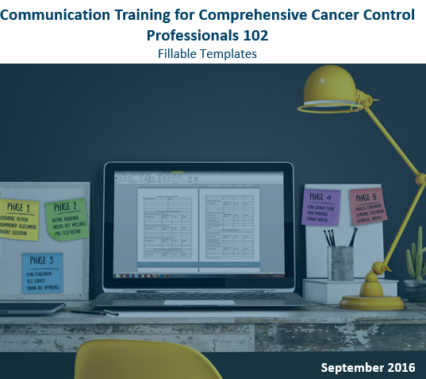
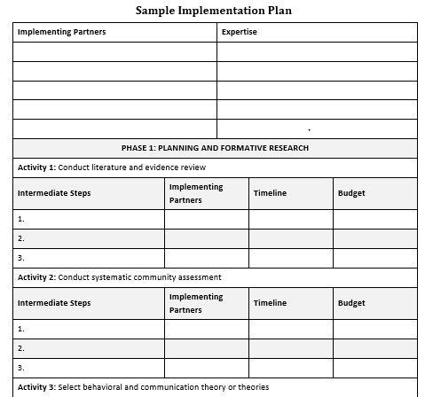
Facilitating PSE Change Success
bit.ly/Comm102Guide
Notes:
Another implementation template is available through GW’s Communication Training for Comprehensive Cancer Control Professionals 102: Making Communication Campaigns Evidence-Based. While this fillable template focuses on media campaigns, it provides a step-by-step guide that can easily be adapted to help promote and implement PSE change. It also serves as a reminder to continue communicating about your PSE change throughout the entire process.
For example, if your coalition’s long-term goal is the passage of a local ordinance, your initial communications will focus on identifying partners who share your objective. Once you have found partners, your communication efforts may shift to securing a champion to further your cause. You may then focus on building stakeholder support. If a councilmember introduces your bill, communications might focus on garnering support for its passage or simply educating stakeholders about the dangers of the risk factor or benefits of the proposed solution. And when the bill passes, you will need to communicate about your success and how to institutionalize the changes represented by the bill. This example highlights the importance of focusing your messaging throughout the life of your PSE change process, as well as including it in your plan.

Slide 195
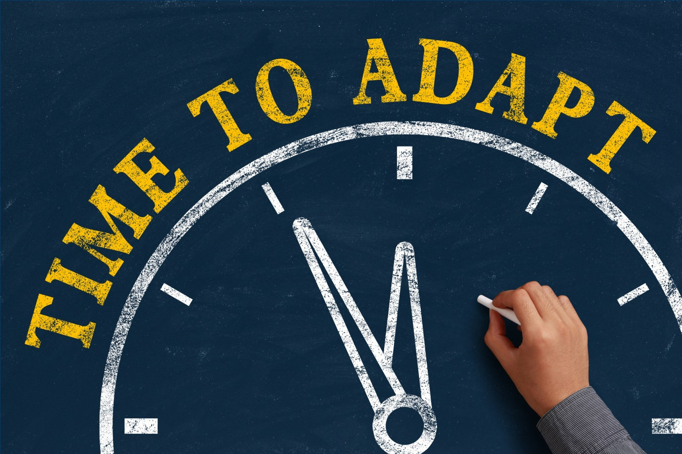
Adapting to Change
In order to adapt to a changing environment, it is important that you and your partners
continue to scan
Notes:
As you proceed with your initiative, also keep in mind that the surrounding environment will not remain static. [fade in] The economic, legal, political and social factors we discussed in Lesson 2 will continue to evolve. In order to adapt to a changing environment, it is important that you and your partners continue to scan the environment. This will keep you current on external factors that could impact your work and allow you to adjust as necessary.
Now let’s look at a state example that illustrates successful implementation of PSE change.
iStock: http://www.istockphoto.com/photo/time-to-adapt-gm468250220-60871824

Slide 196
Example of Implementation: Minnesota
Provided local public health grantees with technical assistance
Developed a toolkit that addressed challenges to implementing healthy beverage policies
Key partner, Minnesota Hospital Association, promoted the policy to its member hospitals via conferences and training videos
Key partner, Public Health Law Center, developed the toolkit and provided the technical assistance
Public Health Law Center, n.d.
Notes:
Also mentioned earlier in this lesson, Minnesota undertook a successful PSE change initiative to combat obesity that encouraged health care organizations to help create healthier communities by phasing out the sale of sugar-sweetened beverages. It provides an apt example of how thorough planning helped ensure successful implementation. Awareness was established by providing local public health grantees with technical assistance, developing a toolkit that addressed challenges to implementing healthy beverage policies, and by the participation of the Minnesota Hospital Association. The Hospital Association promoted the policy to its member hospitals using educational methods including conferences and training videos. The comprehensive cancer control program worked creatively with available financial resources by funding the Public Health Law Center to develop the toolkit and provide the technical assistance.
Image source: http://www.publichealthlawcenter.org/sites/default/files/Healthy-Beverages-in-Healthcare-Toolkit-Collection-2014.pdf?src=CancerPolicyMap

Slide 197
Recap
Discussed the precursors to implementing your PSE change which include:
Developing a PSE agenda
Generating sufficient awareness
Maintaining stakeholder commitment
Assessing your resources
Planning thoroughly in order to facilitate implementation
Adapting to change
Notes:
In this lesson, we have discussed the necessary elements for implementing your PSE change.
These include developing a PSE agenda, generating sufficient awareness, maintaining stakeholder commitment, assessing your resources, planning thoroughly in order to facilitate implementation, and adapting to change.

Slide 198
Resources
The Midwest Academy Strategy Chart
Practice Article – How to Implement Change in [an Oncology] Practice
Research Article – The Mobilizing Action Toward Community Health Partnership Study: Multisector Partnerships in US Counties with Improving Health Metrics
The GW Cancer Center’s Communication Training for Comprehensive Cancer Control Professionals 102: Guide to Making Communication Campaigns Evidence-Based
Notes:
Here are some further readings and resources to access for more information about PSE implementation. These and other resources are included in the learning management system.

Slide 199
Conclusion
Identify whether sufficient awareness and resources exist to support the successful implementation of the PSE change
Describe how to ensure successful implementation and explain the importance of this step to stakeholders
Notes:
Now that you have completed this lesson, you are able to:
Identify whether sufficient awareness and resources exist to support the successful implementation of the PSE change
Describe how to ensure successful implementation and explain the importance of this step to stakeholders

Slide 200
References
American Cancer Society. (2015). Developing and Implementing a Policy Agenda. [YouTube]. Retrieved from https://www.youtube.com/watch?v=bh_V0hrs4-w&feature=youtu.be
Public Health Law Center. (n.d.). Building Blocks for Success: A Guide for Developing a Healthy Beverage Program. Retrieved from http://www.publichealthlawcenter.org/sites/default/files/Healthy-Beverages-in-Healthcare-Toolkit-Collection-2014.pdf?src=CancerPolicyMap
Notes:
Here is the full reference list of sources cited in this lesson.

Slide 201
Action for Policy, Systems and Environmental (PSE) Change: A Training
Lesson 7: Evaluate
Measure Your Success
Notes:
Welcome to Lesson 7: Evaluate – Measure Your Success. In this lesson, we will cover the seventh step in PSE change, which is Evaluate. We will discuss ways to measure the effect of your PSE change activities and communicate your results. This lesson will take approximately 30 minutes to complete.

Slide 202
Acknowledgments
This work was supported by Cooperative Agreement #1U38DP004972-04 from the Centers for Disease Control and Prevention. Its contents are solely the responsibility of the authors and do not necessarily represent the official views of the Centers for Disease Control and Prevention.
We would also like to thank the American Cancer Society and the Comprehensive Cancer Control National Partnership for the use of their Policy, Systems and Environmental Change Resource Guide, upon which the seven steps of the PSE process are based.
Notes:
We would like to acknowledge the Centers for Disease Control and Prevention for supporting this work. We would also like to thank the American Cancer Society and the Comprehensive Cancer Control National Partnership for the use of their Policy, Systems and Environmental Change Resource Guide, upon which the seven steps of the PSE change process are based.

Slide 203
Competency
Evaluate advocacy efforts
Notes:
The competencies in this training are based on the Seven Areas of Responsibility for Health Education Specialists, 2015. This lesson will address the following competency: Evaluate advocacy efforts.

Slide 204
Learning Objectives
Describe the types of evaluation that can be used to measure a PSE change intervention and explain the importance of this step to stakeholders
Develop new goals and objectives and plan strategic next steps following PSE change
Notes:
After completing this lesson, you will be able to:
Describe the types of evaluation that can be used to measure a PSE change intervention and explain the importance of this step to stakeholders; and
Develop new goals and objectives and plan strategic next steps following PSE change

Slide 205
A Look Back at Previous Steps
Engage
Scan
Review
Assess
Promote
Implement
Evaluate
Notes:
In Lesson 1 of this training, we discussed the importance of forming partnerships with a broad range of individuals and organizations. Lesson 2 addressed conducting an environmental scan in order to identify the drivers and challenges to your potential PSE change effort. In Lesson 3, we emphasized the need for data to support your efforts and the importance of developing SMART objectives to gauge your progress.
Lesson 4 focused on the feasibility of your objectives in the current economic and political environment. In Lesson 5, we discussed the importance of framing your message for each of your stakeholder audiences. Lesson 6 covered the importance of having commitment and resources in place before beginning implementation and tools that can help with the implementation of PSE change.
Now it’s time to measure the effect of your efforts.

Slide 206
Using an Evaluation Framework
Short-term
Objectives
Complete vision of success
Intermediate
Objectives
Long-term
Objectives
Notes:
In previous lessons, we talked about the importance of constructing a complete vision of success – one that includes short-term, intermediate and long-term objectives, as all three categories of results are meaningful to an evaluation. As you develop your PSE change objectives, you also set targets for the outputs and outcomes based on the baseline data or on a desired magnitude of change. This early planning allows for a smooth transition to the evaluation portion of your intervention.

Slide 207
Using an Evaluation Framework
RE-AIM
Reach – number of individuals who will be positively affected by your initiative
Effectiveness – examines the outcomes/impact of your initiative
Adoption – willingness to adopt intervention
Implementation – asks if the intervention/initiative was implemented as planned
Maintenance – assess overall sustainability of your initiative
Reach
Effectiveness
Adoption
Implementation
Maintenance
RE-AIM.org, 2017.
Notes:
Again, you may be more familiar with evaluating interventions that are focused on individual or group level behavior change. However, as discussed throughout this training, PSE Change is different. Therefore, it requires a different evaluation approach. Having a framework in place to guide your PSE efforts— for planning, implementation and evaluation—is helpful.
One framework that lends itself to evaluating PSE change is RE-AIM, which “stands for Reach, Effectiveness, Adoption, Implementation, and Maintenance which together determine public health impact.”
More specifically:
Reach looks at number of individuals who will be positively affected by your initiative
Effectiveness examines the outcomes and/or impact of your initiative
Adoption looks at willingness to adopt intervention; Implementation asks if the intervention or initiative was implemented as planned, and Maintenance assesses the overall sustainability of your initiative once it is executed.
Citation:
RE-AIM.org. (2017). What is RE-AIM? Retrieved from http://re-aim.org/about/what-is-re-aim/

Slide 208
Formative Evaluation
Process Evaluation
Outcome Evaluation
Continuous Engagement of Stakeholders, Intended Users
Inputs
Problems
Assessment data
Solutions
Content experts
Evidence-based approaches
Existing policies
Model policies
Politics
Policy makers
Stakeholders
Advocates/champions
Political will
Other
Administrative structures
Staffing
Material resources
Monitoring/ enforcement systems
Activities
Throughout process
Engage stakeholders
Raise awareness
Advocate for change
Outputs
Throughout process
Media coverage
Other marketing/ communication
Awareness
Engagement
Political will
Outcomes/Effectiveness
Results or changes for individuals, groups, organizations, communities, or systems
Short-term
Environment
Physical
Economic
Social
Communication
Intermediate
Social norms
Behaviors
Dietary intake
Physical activity
Screen time
Breastfeeding
Unintended consequences
Long term
Public health impact
Effective in achieving population-level health outcomes
Equitable distribution of improvements across population subgroups, particularly those at greatest risk
Cost effective in achieving improvements
1. Formulation
Prioritize problems
Review evidence
Select approaches
Draft policy solutions
Policy agenda
Proposed policies
2. Enactment
Engage policy maker champions
Enact policy
Policy enacted
Type and number of resources leveraged
3. Implementation
Develop rules and/or plan for implementation
Distribute resources
Train and support implementers
Implement rules and/or plan
Reach to intended population
Adoption by settings/ sectors
Implementation as intended and acceptability/ feasibility costs
Enforcement
4. Maintenance/ Modification
Maintain
Monitor/enforce
Modify
Maintenance of funding, partnerships, implementation, enforcement & reach
Modifications
Describe the program
Focus the evaluation design
Gather credible evidence
Justify conclusions
Disseminate and utilize findings
Leeman et al., 2012.
Notes:
Another framework to consider adapting for your PSE change initiative is the policy evaluation framework, shown here, which was developed by the Center of Excellence for Training and Research Translation (Center TRT). The Center TRT’s evaluation framework incorporates RE-AIM and other change theories.
Of note, you can see the development of a policy agenda is included as an output in this framework. We will review and use the Center TRT’s framework as we talk about the different types of evaluation to consider for your PSE change initiative, including process, fidelity monitoring and outcome and/or impact.
For more information on evaluating PSE promotion and communication efforts specifically, review the Guide to Making Communication Campaigns Evidence-Based and Communication Training for Comprehensive Cancer Control Professionals 102.
Citations:
Leeman, J., Sommers, J., Vu, M., Jernigan, J., Payne, G.,…Ammerman, A. (2012). An Evaluation Framework for Obesity Prevention Policy Interventions. Preventing Chronic Disease, 9(6), 110322. Retrieved from: http://dx.doi.org/10.5888/pcd9.110322.

Slide 209
Indicators
Metrics or measurements that allow us to quantify the results of the intervention.
“Input indicators measure the contributions necessary to engage the program to be implemented.
Process indicators measure program’s activities and outputs
Outcome indicators measure whether the program is achieving the expected effects/changes in the short, intermediate, and long term.”
Centers for Disease Control and Prevention (CDC) Program Performance and Evaluation Office (PPEO), 2016.
Notes:
But how do we actually measure success? Indicators!
Just as “meters” are an indicator of length and “grams” measure weight, indicators in an evaluation are metrics, or measurements, that allow us to quantify the results of the intervention. There are three common categories of indicators, as defined by the Centers for Disease Control and Prevention, or CDC:
“Input indicators measure the contributions necessary to enable the program to be implemented (for example, funding, staff, key partners, infrastructure). Process indicators measure the program’s activities and outputs (direct products of the activities). Outcome indicators measure whether the program is achieving the expected effects and/or changes in the short, intermediate, and long term.”
Source:
Centers for Disease Control and Prevention (CDC) Program Performance and Evaluation Office (PPEO). (2016). Indicators. Retrieved from https://www.cdc.gov/eval/indicators/index.htm

Slide 210
Farm-to-School Policy Logic Model
Inputs
Data on obesity
Data on dietary intake
Other state policies
Local activity
School gardens
Farmers marketing to schools
Stakeholders
US Dept. of Agriculture
US Dept. of Education
Farmers Association
Ecological advocacy organization
Public health
Parent/teacher association
Students
Legislators
Other
Structure to distribute food
Staffing
Resources
Activities
Formulation
Create a coalition
Recruit legislators
Generate press releases
Testify to legislature
Organize grassroots
Collect endorsements
Write policy briefs
Outputs
# of partners engaged in advocacy
Media coverage
Public awareness
Public support
Policymaker support
Policy drafted
Outcomes
Short-term
Access to healthier foods
Intermediate
Intake of healthier foods
Long-term
Equitably distributed improvements in body mass index
Policy enacted
# of participating schools
# of participating farmers
Cost to schools
# of schools with gardens
# of children reached
Enact
Implement
Maintain
Leeman et al., 2012.
Notes:
Here’s the Center TRT’s logic model for their farm-to-school policy initiative, which was guided by their framework. The logic model includes sections for inputs, activities, and indicators– or specific outputs and outcomes.
The left side of the model lists inputs, or “the resources and contextual factors that support and influence each step in the policy-making process.” Inputs for the farm-to-school PSE change include:
Assessment data on the prevalence of obesity among school-aged children,
Solutions, such as evidence-based approaches and model farm-to-school policies from other states, and
Politics, including the attitudes of stakeholder groups and policy makers.
The “Other” category of inputs comes into play after a policy is enacted, as these components are necessary to implement and monitor enforcement of the policy. These include the systems through which food is purchased and distributed to schools.
The activities listed in the second column are “the actions or events that engage and transform inputs to produce outputs and outcomes.” Certain activities—such as engaging stakeholders and raising awareness—occur throughout the policy-making process. Others occur only at specific stages. The farm-to-school PSE change activities include:
Formulation, such as reviewing evidence about the problem, obtaining stakeholder agreement on the problem and identifying preferred approaches, and drafting the policy.
Enactment. Activities involved in this step include engaging policy makers who support the policy, and officially enacting the policy.
Implementation. The activities surrounding implementation may occur at multiple levels. With regard to a farm-to-school policy, for example, the Department of Education might allocate funds and develop new rules regarding state-wide implementation.
Maintenance and/or Modification. These activities focus on maintaining policy implementation and sustaining it through monitoring, enforcement and future modification.
Outputs are listed in the third column. These are “the direct, tangible results of activities” and include media coverage, marketing, and other communication; as well as evidence of “increased stakeholders’ awareness of the problem, engagement in the policy-making process and political will to take action.” However, the primary outputs are the actual policies that are proposed and enacted. Other outputs, following the RE-AIM framework included number of children reached, number of schools with gardens and cost to schools.
In the fourth column of the logic model are outcomes, including short-term, intermediate, and long-term. For example, as a result of the implementation of a new farm-to-school policy, the short-term outcome is increased access to healthier foods in school cafeterias. We will discuss outcomes in greater detail shortly.
With this framework in mind, let’s take a closer look at the different evaluation methods.

Slide 211
Process Evaluation
Measures the extent to which the PSE change initiative was implemented as planned. Gives you information to make necessary adjustments.
Community Tool Box, n.d.; Leeman et al., 2012.
Notes:
Process evaluation answers the question: “are you actually doing the things you planned to do?” By measuring outputs, or results of your activities, it assesses the extent to which your initiative was implemented as planned and gives you information to make necessary adjustments. Process evaluation measurements range from the amount of media coverage to the number of people educated about the issue.
Sources:
Community Tool Box. (n.d.) Section 2. PRECEDE/PROCEED. Retrieved from http://ctb.ku.edu/en/table-contents/overview/other-models-promoting community-health-and development/preceder-proceder/main
The George Washington University Cancer Center (2016). Communication Training for Comprehensive Cancer Control Professionals 102 Guide to Making Communication Campaigns Evidence-Based. Retrieved from https://smhs.gwu.edu/cancercontroltap/sites/cancercontroltap/files/Comm%20102%20Guide%20%20Making%20Communication%20Campaigns%20Evidence-Based.pdf
Istock- http://www.istockphoto.com/vector/set-of-flat-line-design-web-banners-for-business-process-gm520776016-91102311

Slide 212
Fidelity Monitoring
“Faithfulness with which a program is implemented; that is, how well the program is implemented without compromising the program’s core components.”
Ideally, both process evaluation and fidelity monitoring should be conducted throughout the entire PSE change implementation phase.
Department of Health and Human Services (HHS) Family and Youth Services Bureau, n.d.
Notes:
Fidelity is “the faithfulness with which a program is implemented; that is, how well the program is implemented without compromising the program’s core components.” Fidelity monitoring is important particularly if your efforts include implementation or adaptation of evidence-based programs, strategies or policies. Knowing if you were able to implement your PSE initiative without compromising core components can help you identify barriers and lessons learned. Ideally, both process evaluation and fidelity monitoring should be conducted throughout the entire PSE change implementation phase.
Source:
Department of Health and Human Services (HHS) Family and Youth Services Bureau. (n.d.) Fidelity Monitoring Tip Sheet. Retrieved from https://www.acf.hhs.gov/sites/default/files/fysb/prep-fidelity-monitoring-ts.pdf

Slide 213
Stakeholder’s Feedback
How have stakeholders responded?
Are they still positive and engaged?
Do they have constructive criticism or suggestions?
Notes:
As part of process evaluation and fidelity monitoring, you can engage stakeholders to provide qualitative feedback. Now that your PSE change action is being implemented, how have the stakeholders responded? Are they still positive and engaged? Do they have constructive criticism and or suggestions?
In order to answer these questions, ask your stakeholders. Soliciting feedback through key informant interviews, for example, is an excellent way to both engage stakeholders and tap into a rich source of information. Organize these results by theme in order to address them most efficiently.
iStock:
http://www.istockphoto.com/photo/business-people-team-teamwork-working-meeting-concept-gm508208412-85129749?st=_p_diverse%20workforce

Slide 214
Barriers and Lessons Learned
Regularly review results from quantitative and qualitative data
Use data to better understand any barriers encountered during the implementation of the PSE change
Prioritize the order in which to address these barriers
Notes:
As you obtain both quantitative and qualitative data as part of your evaluation during the implementation phase, you should regularly review your results. Use the data to better understand any barriers you are encountering during PSE change implementation. If barriers are identified, you can then prioritize, based on your timeline and available resources, the order in which to address these barriers.
At the same time, think carefully about lessons learned. What can you apply next time that may lead to a different outcome?

Slide 215
Contingency Plans
What happens if data reveal things are not going as planned?
Consider having a contingency plan in place
Where did your effort succeed? Where did it not?
Make adjustments
Notes:
What happens if the data reveal things are not going as planned? Consider having a contingency plan in place in case your PSE change effort is not succeeding. In thinking about contingencies, consider where your effort succeeded and where it didn’t, and make the necessary adjustments.
For example, if evaluation data reveal that you are not successfully educating decision makers as planned, what other methods or strategies should you use so you can achieve your desired outcomes?

Slide 216
Adjusting Goals and Objectives
Revisit your goals and objectives
Think critically about areas that are successful and those that are less successful
Ask: What is going well? What is not going well? What could be done better?
Involve stakeholders in analysis
Notes:
If your PSE change initiative is not going as planned, you may need to also revisit your goals and objectives. Think critically about areas that are successful and those that are less successful. Ask: what is going well? What isn’t going well? What could be done better? Involve your stakeholders in this analysis.
Don’t automatically assume that you must adjust your goal. Perhaps an important factor was missed during the environmental scan, or a method of data collection was less efficient than expected. Maybe additional champions are needed to further the effort.

Slide 217
Outcomes Evaluation
Short-Term Outcomes
Intermediate Outcomes
Long-Term Outcomes/Impact
Implementation of specific changes in policies, systems, environment
Align with behavioral objectives
Changes in audiences’ behavior
Align with health objectives and correspond with comprehensive cancer control plan goals
Desired changes in audiences’ health status
Leeman et al., 2012.
Notes:
Now let’s discuss outcomes evaluation.
Outcomes are “the desired and unanticipated results” of a PSE change intervention. Outcomes evaluation measures the short-term, intermediate and long-term results of your initiative, along with its impact. While the ideal outcome would be to achieve each objective you set, real-world factors may intervene, and your initiative may result only in short-term outcomes. As we noted previously in this training, population-level health outcomes require numerous initiatives and may take years to achieve.
Short-term outcomes are changes you want to enact that promote healthier behaviors. Such changes may occur in the following areas:
“Physical (for example, proximity to healthier food and spaces for physical activity)
Economic (such as, changes to prices or taxes)
Social (for example, changes to social networks)
Communication (such as, advertisements or point-of-decision prompts).”
For example, if your initiative focused on the elimination of food deserts, a short-term outcome could be securing a dedicated, highly trafficked space for a weekly farmers market.
Depending on the type of intervention, evaluation of short-term outcomes can happen during or shortly after implementation.
Intermediate outcomes align with behavioral changes that occur because of an initiative’s effect on the environment. These are actions you want the audience to engage in, or actions you want them to stop in response to your PSE change intervention. Evaluation of an intermediate outcome would be assessing the change in community members’ physical activity following the installation of walking paths and bike lanes, or the change in attitudes toward or consumption of sugary drinks following the passage of a city soda tax.
Long-term outcomes and or impact align with your health objectives and should correspond with your comprehensive cancer control plan goals. These outcomes are the desired changes in your audience’s health status that occur as a result of your intervention. They should be “effective, equitable and cost-effective at the population level.” One such example would be a change in cervical cancer incidence or mortality rates following health system improvements in access for vulnerable populations.

Slide 218
Building on Success
Will you continue with the initiative in current form or improve upon it?
Stay in touch with stakeholders
Communicate about successes
Maintain contact as evaluation results become available
Engage them in planning next phase
Help stakeholders maintain their commitment to improve and sustain outcomes and impact
Notes:
On the other hand, perhaps your PSE change initiative has been entirely successful – congratulations! You now are positioned to build on your success.
Will you continue the initiative in its current form or will you improve upon it? For example, if you were able to increase access to cancer care services locally— is it time to build on successes and lessons learned to expand services statewide? If you expand or change your goals and objectives, remember to keep them SMART.
It’s also important to stay in touch with your stakeholders to keep them engaged as you move ahead. Be sure to communicate about your successes – short-term, intermediate, long-term and impact. Maintain contact as evaluation results become available. Engage them in planning the next phase of your initiative. Help your stakeholders maintain their commitment to improve and sustain your outcomes and impact.
At the same time, if your task force convened for the sole purpose of implementing a PSE change initiative that has been successful, then it is perfectly acceptable for the task force to dissolve. Nothing is gained by attempting to continue the coalition beyond the purpose for which it was created.
iStock:
http://www.istockphoto.com/photo/success-gm465515915-33350638

Slide 219
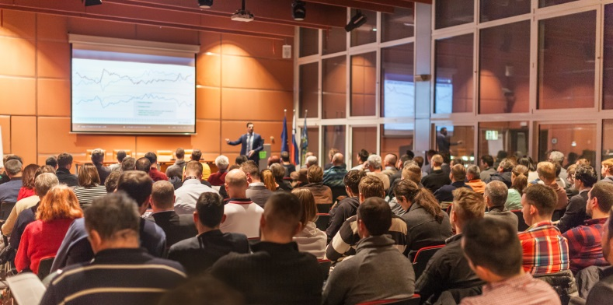
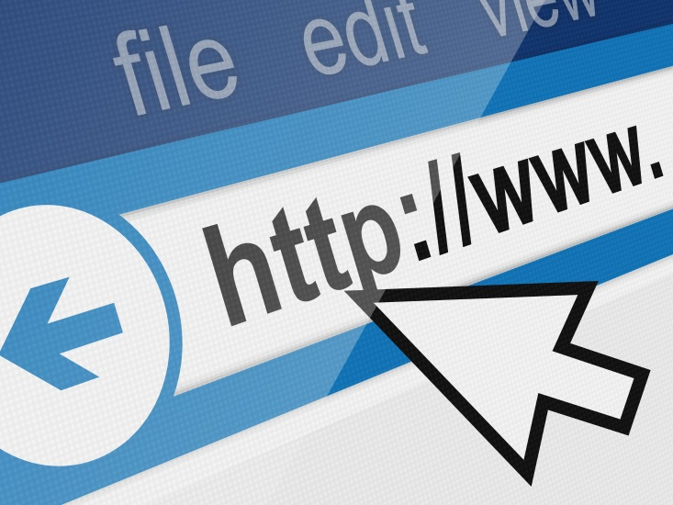
Communicating Outcomes
action4psechange.org/about-pse-change/pse-examples
Notes:
Communicating lessons learned and outcomes of your PSE change initiative is important not only for your stakeholders, but also for other public health professionals. Keeping stakeholders up to date about your efforts is key— as this provides additional opportunities for engagement and shows how their involvement in the initiative makes a difference.
Sharing lessons learned and outcomes with other public health professionals is vital because it will contribute to the PSE evidence base and can provide guidance to those looking to implement similar initiatives.
There are a number of ways to disseminate lessons learned and outcomes of your initiative to stakeholders and other public health professionals. Dissemination channels include:
· Meetings (informal or professional)
· Papers (reports, white papers, or peer-reviewed publications)
· Electronic (webinars, infographics, or websites), and
· Media (press releases, press conferences, interviews, or social media)
When disseminating information, consider using a number of different channels to maximize your reach to stakeholders and other audiences.
If your comprehensive cancer control PSE initiative is already underway, a place for immediate dissemination is the Action for PSE Change online platform. Submit your PSE change story via the link show here (http://action4psechange.org/about-pse-change/pse-examples/).
Now, let’s look at another example of a comprehensive PSE change evaluation from Utah.
iStock:
http://www.istockphoto.com/photo/business-speaker-giving-a-talk-in-conference-hall-gm628483496-111589691
http://www.istockphoto.com/photo/discussing-business-statistics-gm502225376-81788649
http://www.istockphoto.com/photo/hand-pressing-free-webinar-gm498504712-79686061
http://www.istockphoto.com/photo/web-page-access-gm503426092-82524687

Slide 220
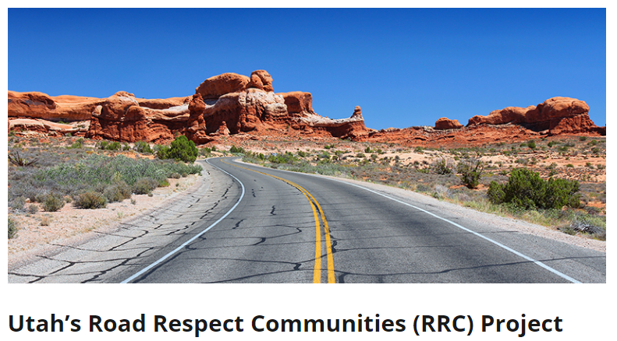
Evaluating Environmental Change Efforts: Utah
Action4PSEChange, 2017.
Notes:
The Utah Department of Transportation’s Road Respect Communities, or RRC, is a PSE initiative that supports three pilot communities in creating more bicycle and pedestrian friendly environments. The Utah Cancer Control Program, or UCCP, serves as a partner on the RRC initiative.
Source:
Action4PSEChange, Utah’s Road Respect Communities (RRC) Project, http://action4psechange.org/utahs-road-respect-communities-rrc-project/

Slide 221
Utah RRC Initiative
Short-Term Outcomes
Intermediate Outcomes
Long-Term Outcomes/Impact
At least one pilot community will achieve full RRC designation by 2015
Increase physical activity among RRC communities by 20% by 2020
Reduce the economic burden on the state by decreasing obesity-related health care costs by 3% by 2030
Note: The above outcomes were adapted from Utah’s RRC Initiative; dates and percentages do not reflect actual objectives from Utah’s cancer control plan.
Action4PSEChange, 2017.
Notes:
The initiatives’ outcomes are:
Short-term—At least one pilot community will achieve full RRC designation by 2015
Intermediate—Increase physical activity among RRC communities by 20% by 2020
Long-term and/or Impact—Reduce the economic burden on the state by decreasing obesity-related health care costs by 3% by 2030
iStock:
http://www.istockphoto.com/vector/flat-icon-check-gm496603666-78633601

Slide 222
Utah RRC Initiative
Level 1
Level 2
Level 3
Communities organize to begin planning
Communities develop active transportation plan
Communities adopt and implement their plan
Action4PSEChange, 2017.
Notes:
As participants in the RRC program, communities work toward achieving three successive levels of RRC status. At the first level, communities organize to begin active transportation planning. At the second level, communities begin to develop an active transportation plan. And at the third level, communities adopt and implement their plan.
Currently, the RRC initiative is in the process evaluation phase and moving into outcomes evaluation. As part of their evaluation efforts, UCCP and its partners developed baseline criteria for the health impact assessment, which will be critical to evaluating the long-term impact of RRC.
iStock:
http://www.istockphoto.com/vector/flat-icon-check-gm496603666-78633601

Slide 223
Utah RRC Initiative
Process evaluation: communities measured on completion of activities to achieve different levels of RRC status
First-Level Status
Community must complete three of the five activities required
Action4PSEChange, 2017.
Notes:
For process evaluation, communities are measured on the completion of activities to achieve the different levels of RRC status. To achieve first-level status, communities must complete three of the five activities required. Over three years, all three communities met and exceeded the goal of three activities to meet first-level designation and two communities continue to progress through the requirements to meet additional levels.
During this time, as part of process evaluation, the partners completed a questionnaire that revealed the importance of community support to the success of the project.

Slide 224
Utah RRC Initiative
First countywide RRC designation in fiscal year 2016
Directly funding city or county governments made it more likely that elected officials would support the project.
Action4PSEChange, 2017.
Notes:
While two communities are still in the process evaluation phase, the third community unexpectedly completed all three status levels, thereby achieving full RRC designation. They continued to work with their partners and champions to expand the RRC program to additional neighboring communities. Due to their efforts, these communities achieved the first countywide RRC designation in fiscal year 2016. For this community, outcomes evaluation will now begin.
An important lesson learned so far is that directly funding city or county governments made it more likely that elected officials would support the project. If they lacked planning expertise, the city or county then worked with a planning organization, as well as with local health departments, in order to benefit from their expertise in establishing baseline measures. This information is being used to inform the rollout of the program into additional communities.

Slide 225
Recap
Important to have set SMART goals and objectives when planning for evaluation
Evaluate the PSE change process – short-term, intermediate and long-term outcomes
Incorporate stakeholders’ feedback into evaluation
Use data to reduce barriers and communicate successes
Make adjustments to goals and objectives
Notes:
In this lesson, we reiterated the importance of having set SMART goals and objectives as you contemplate evaluation of your PSE change initiative. We discussed the need for evaluating the PSE change process, which includes incorporating stakeholders’ feedback into your evaluation, using data to reduce barriers and making adjustments to your goals and objectives if needed. We also discussed short-term, intermediate and long-term outcomes and ways to communicate successes to your stakeholders. Finally, we talked about building upon your success at the completion of your PSE change intervention.

Slide 226
Resources
An Evaluation Framework for Obesity Prevention Policy Interventions. Preventing Chronic Disease
Evaluating Policy, Systems, and Environmental Change Interventions: Lessons Learned From CDC’s Prevention Research Centers
Evaluation frameworks designed to measure public health impact: Applying the RE-AIM framework to evaluation of Policy, System, and Environmental changes in California SNAP-Ed
Policy, systems, and environmental change in the Mississippi Delta: Considerations for evaluation design
Visit the Cancer Control Technical Assistance Portal (TAP) Resource Repository for general evaluation resources from CDC
Notes:
Here are some further readings and resources on evaluation. These and other resources are included in the learning management system.

Slide 227
Conclusion
Describe the types of evaluation that can be used to measure a PSE change intervention and explain the importance of this step to stakeholders
Develop new goals and objectives and plan strategic next steps following PSE change
Notes:
Now that you have completed this lesson, you are able to:
Describe the types of evaluation that can be used to measure a PSE change intervention and explain the importance of this step to stakeholders; and
Develop new goals and objectives and plan strategic next steps following PSE change

Slide 228
References
Action4PSEChange. (2017). Utah’s Road Respect Communities (RRC) Project. Retrieved from http://action4psechange.org/utahs-road-respect-communities-rrc-project/
Centers for Disease Control and Prevention (CDC) Program Performance and Evaluation Office (PPEO). (2016). Indicators. Retrieved from https://www.cdc.gov/eval/indicators/index.htm
Community Tool Box. (n.d.) Section 2. PRECEDE/PROCEED. Retrieved from http://ctb.ku.edu/en/table-contents/overview/other-models-promoting-community-health-and development/preceder-proceder/main
Department of Health and Human Services (HHS) Family and Youth Services Bureau. (n.d.) Fidelity Monitoring Tip Sheet. Retrieved from https://www.acf.hhs.gov/sites/default/files/fysb/prep-fidelity- monitoring-ts.pdf
Leeman, J., Sommers, J., Vu, M., Jernigan, J., Payne, G.,…Ammerman, A. (2012). An Evaluation Framework for Obesity Prevention Policy Interventions. Preventing Chronic Disease, 9(6), 110322.
RE-AIM.org. (2017). What is RE-AIM? Retrieved from http://re-aim.org/about/what-is-re-aim/
Notes:
Here is the full reference list of sources cited in this lesson.

Slide 229
Action for Policy, Systems and Environmental (PSE) Change: A Training
Lesson 8: Real-World PSE Example
Notes:
Welcome to the final lesson of the training, Lesson 8: Real-World PSE Example. In this lesson, we will review all of the steps in the Policy, Systems and Environmental, or PSE, change process that were covered in Lessons 1 through 7. We will use the “D.C. Policy Advances to Improve Medicaid Access to Cancer Care” as a case study to highlight each of the seven steps in PSE Change. You may visit Action4PSEChange.org for more information. This lesson will take approximately 20 minutes to complete. When the blue button appears on your screen, click it when you are ready to advance the lesson.

Slide 230
Acknowledgments
This work was supported by Cooperative Agreement #1U38DP004972-04 from the Centers for Disease Control and Prevention. Its contents are solely the responsibility of the authors and do not necessarily represent the official views of the Centers for Disease Control and Prevention.
We would also like to thank the American Cancer Society and the Comprehensive Cancer Control National Partnership for the use of their Policy, Systems and Environmental Change Resource Guide, upon which the seven steps of the PSE change process are based.
Notes:
We would like to acknowledge the Centers for Disease Control and Prevention for supporting this work. We would also like to thank the American Cancer Society and the Comprehensive Cancer Control National Partnership for the use of their Policy, Systems and Environmental Change Resource Guide, upon which the seven steps of the PSE change process are based.

Slide 231
Competency
Use strategies that advance advocacy goals
Notes:
The competencies in this training are based on the Seven Areas of Responsibility for Health Education Specialists, 2015. This lesson will address the following competency: use strategies that advance advocacy goals.

Slide 232
Learning Objective
Describe the seven steps of PSE Change using a case study example
Notes:
After completing this lesson, you will be able to: describe the seven steps of PSE Change using a case study example.

Slide 233
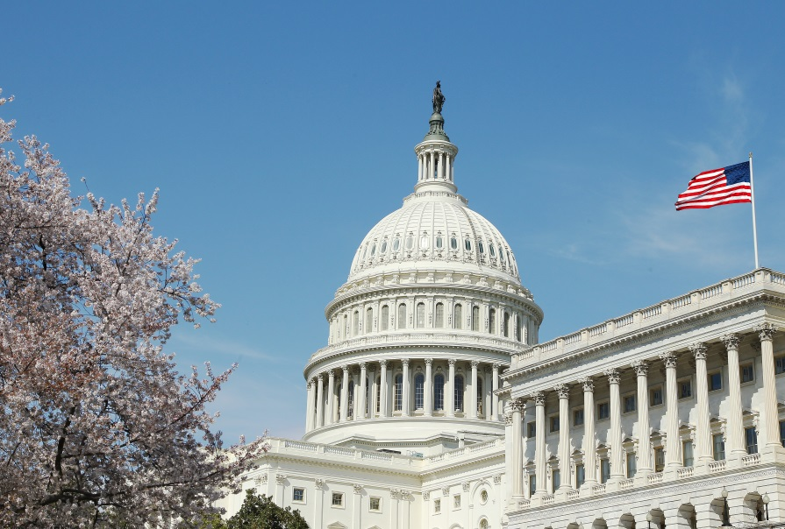
Medicaid in the Nation’s Capital
The George Washington University (GW) Cancer Center’s PSE change effort to improve access to the continuum of cancer care services for Medicaid beneficiaries in Washington, D.C.
Action4PSEChange, 2017.
Notes:
Medicaid patients in the nation’s capital have historically faced delayed and fragmented cancer care across a variety of health care providers and systems. In 2014, The George Washington University, or GW, Cancer Center began a PSE change effort to improve access to the continuum of cancer care services for Medicaid beneficiaries in Washington, DC.
In this lesson, we will describe how the GW Cancer Center used the seven PSE change steps to improve access to cancer care for Medicaid beneficiaries in DC. As we discuss the initiative, you will see that the steps are not linear. The engage, scan and assess steps overlap; and several steps are ongoing.
iStock:
http://www.istockphoto.com/photo/paper-with-medicaid-and-stethoscope-medical-insurance-concept-gm503399356-82509393
http://www.istockphoto.com/photo/capitol-building-u-s-congress-gm513391670-87580983

Slide 234
Step 1: Engage
Build partnerships with community stakeholders
Engage partners affected by the broad health issue identified
Ensure that the partnership includes stakeholders who can effectively implement evidence-based cancer control PSE change interventions
Action4PSEChange, 2017; The George Washington University Cancer Center, 2015a.
Notes:
As you learned in Lesson 1, engage is the first step of the PSE Change process. This involves:
Building partnerships with community stakeholders;
Engaging partners affected by the broad health issue identified; and
Ensuring that the partnership includes stakeholders who can effectively implement evidence-based cancer control PSE change interventions
Let’s look at the case study.
The GW Cancer Center has been engaging a coalition of stakeholders for over two and a half years to incrementally address the most challenging barriers to cancer care for Medicaid patients. Specifically, the GW Cancer Center initiated several meetings with the DC Department of Health Care Finance and convened two summits to gather input from nearly 60 stakeholders on May 11, 2015 and September 8, 2016.

Slide 235
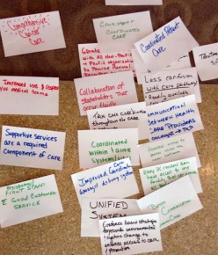
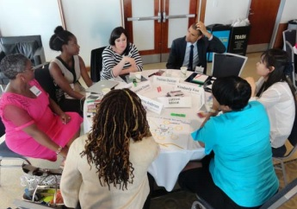
Engage
Stakeholders include:
DC Department of Health Care Finance
Managed Care Organizations (MCOs)
Cancer care clinicians and patient navigators
Patient advocacy organizations
Cancer survivors and caregivers
Action4PSEChange, 2017; The George Washington University Cancer Center, 2015a.
Notes:
These stakeholders include the DC Department of Health Care Finance, which administers the Medicaid program; Managed Care Organizations, or MCOs, that manage the majority of Medicaid cases; cancer care clinicians and patient navigators who face administrative challenges; patient advocacy organizations; and cancer survivors and caregivers who provided testimonies for needed change.
Each stakeholder came with a different perspective on Medicaid access to cancer care in Washington, DC. This was a significant challenge, since awareness that there was a problem was the most important first step in solving the problem. The GW Cancer Center needed additional resources and requested sponsorship from several pharmaceutical foundations and health plans, and recruited a local media partner to convene the initial stakeholders at a policy summit. Pictured here are snapshots of participant activities aimed at capturing and organizing the various opinions and issues raised during discussions.

Slide 236
Step 2: Scan and Step 3: Assess
Scan
Conduct an environmental scan to determine which actions should be taken
Identify gaps, trends and external factors affecting the political, social and economic context
Determine the appropriate actions for potential PSE change
Assess
Perform a thorough review and assessment of all available data to identify which specific aspect of the broad health issue can be addressed through PSE change
Review cancer surveillance data for your state, tribe or territory, cost-benefit data and other published research
Notes:
As you learned in Lesson 2, scan is the second step of the PSE Change process. This involves:
Conducting an environmental scan to determine which actions should be taken
Identifying gaps, trends and external factors affecting the political, social and economic context, and
Determining the appropriate actions for potential PSE change
Step 3: Assess involves:
Performing a thorough review and assessment of all available data to identify which specific aspect of the broad health issue can be addressed through PSE change, and
Reviewing cancer surveillance data for your state, tribe or territory, cost-benefit data and other published research

Slide 237
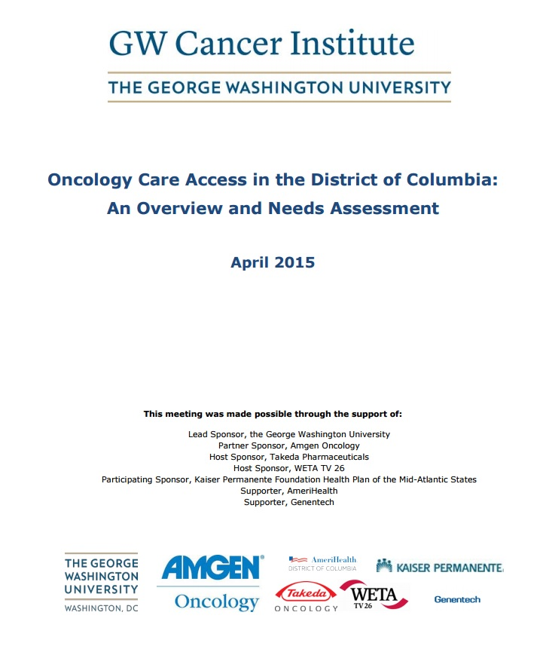
Scan and Assess
GW Cancer Center staff reviewed:
Published literature
Publicly available information
Action4PSEChange, 2017; The George Washington University Cancer Center, 2015b.
Notes:
During the scan and assess steps, staff at the GW Cancer Center reviewed published literature to identify trends in access to care challenges for Medicaid beneficiaries across the nation as well as publicly available information on coverage, benefits and provider network of Medicaid beneficiaries in Washington, DC. As a result, the GW Cancer Center finalized and publicly shared a needs assessment, Oncology Care Access in the District of Columbia: An Overview and Needs Assessment.
Based on the needs assessment at stakeholder meetings, priority PSE issues to address included a limited Medicaid network due to low reimbursement, and access challenges because of pre-authorization and referral requirements that often caused delays in treatment.

Slide 238
Scan and Assess
DC Department of Health Care Finance and GW Cancer Center found:
Chemotherapy was largely reimbursed by Medicaid below the drug acquisition cost
Hospitals that were not eligible for the Federal 340B Discount Drug Pricing Program were generally being reimbursed for less than the cost of drugs
Findings led to submission of a State Plan Amendment (SPA) to the Centers for Medicare and Medicaid Services (CMS) to adjust drug reimbursement to match Medicare reimbursement.
Submitted SPA approved with effective date of May 1, 2016.
Action4PSEChange, 2017.
Notes:
At the same time, the DC Department of Health Care Finance reviewed its Medicaid claims for trends, and the GW Cancer Center investigated why providers were not participating in the Medicaid network. The GW Cancer Center found that chemotherapy was largely reimbursed by Medicaid below the drug acquisition cost. Hospitals that were not eligible for the Federal 340B Discount Drug Pricing Program were generally being reimbursed for less than the cost of drugs.
Findings from the DC Department of Health Care Finance and GW Cancer Center led to submission of a State Plan Amendment, or SPA, to the Centers for Medicare and Medicaid Services to adjust drug reimbursement to match Medicare reimbursement. The submitted SPA was approved with an effective date of May 1, 2016.

Slide 239
Step 4: Review
Review project feasibility to determine if it can be implemented
Work with stakeholders to develop a strategy for turning your ideas, goals or objectives into action, including a discussion of the political climate and readiness
Ensure that key champions are lined up to provide support
Notes:
As discussed in Lesson 4, the fourth step of the PSE Change process is Review. This involves:
Reviewing project feasibility to determine if it can be implemented
Working with stakeholders to develop a strategy for turning your ideas, goals or objectives into action, including a discussion of the political climate and readiness, and
Ensuring that key champions are lined up to provide support

Slide 240
Review
Ongoing commitment of leadership at the GW Cancer Center and the DC Department of Health Care Finance to be successful.
Key Champion
Medicaid Director
Action4PSEChange, 2017.
Notes:
After the GW Cancer Center’s scan and assessment, a review of the environment revealed that this PSE change effort would require ongoing commitment of leadership at the GW Cancer Center and the DC Department of Health Care Finance to be successful. The Medicaid Director at the DC Department of Health Care Finance was identified as a key champion; her leadership was instrumental in driving change efforts.

Slide 241
Step 5: Promote
Communicate to all stakeholders the need for PSE change prior to implementation to help mitigate potential resistance
Incorporate and use various forms of media to educate and build support of stakeholders and the public, when appropriate
Notes:
Step 5, Promote, involves:
Communicating to all stakeholders the need for PSE change prior to implementation to help mitigate potential resistance, and
Incorporating and using various forms of media to educate and build support of stakeholders and the public, when appropriate

Slide 242
Promote
Communicate to stakeholders
Support is established through meetings
After SPA approval, communication to GW medical oncology and administration staff
Changes communicated more broadly to GW Cancer Center and citywide
Educate clinicians and pharmacies about policy change successes
Action4PSEChange, 2017.
Notes:
Initial promotion of the DC Medicaid initiative involved communicating to the stakeholders the importance of collaboratively identifying the most significant barrier in accessing cancer care services. Thereafter, additional support was established through meetings with the DC Department of Health Care Finance and subsequent stakeholder meetings.
After approval of the State Plan Amendment to adjust drug reimbursement rates, efforts to communicate about the new rates evolved to focus on GW medical oncology and administration staff. Changes then were communicated more broadly within the GW Cancer Center and citywide.
The GW Cancer Center is currently working on educating clinicians and pharmacies about policy change successes to continue to smooth access to care for patients. This promotion includes continuing review and assessment to focus on ongoing quality improvements.

Slide 243
Step 6: Implement
Implement PSE change interventions that link directly with goals and objectives in your cancer control plan
Policy Changes Implemented:
1. Adjustment to Medicaid drug reimbursement rates
2. Largest Medicaid MCO in the District eliminated requirement of pre-authorizations for cancer treatments for beneficiaries with documented diagnosis of cancer
3. Another Medicaid MCO eliminated need for primary care referrals for individuals needing access to specialists
Action4PSEChange, 2017; DC Cancer Consortium, 2013.
Notes:
Step 6: Implement involves:
Implementing PSE change interventions that link directly with goals and objectives in your cancer control plan
Regarding this PSE change effort, three policy changes in line with the effort’s intermediate objectives already have been implemented. The first, as mentioned, was the adjustment to Medicaid drug reimbursement rates. The second was the largest Medicaid MCO in the District eliminating the requirement of pre-authorizations for cancer treatments for beneficiaries with a documented diagnosis of cancer, effective July 2016. And third, another Medicaid MCO eliminated the need for primary care referrals for individuals needing to access specialists effective April 1, 2017. We expect this latest procedural change to shorten time from adverse screening to diagnostic resolution by removing a major challenge in obtaining primary care referrals after a patient has already accessed radiology.
These efforts relate most closely with Goal 2, Objective 1 of the District of Columbia Cancer Control Plan 2013-2018. “GOAL 2: Increase quality of care received by District residents. Objective 1: Remove barriers to care experienced by patients and increase self-efficacy of patients in navigating the health care system.”
District of Columbia Cancer Control Plan 2013-2018. ftp://ftp.cdc.gov/pub/Publications/Cancer/ccc/district_of_columbia_ccc_plan_2013_2018.pdf

Slide 244
Step 7: Evaluate
Evaluate processes and outcomes attributed to the implementation of the PSE change intervention
Notes:
As discussed in lesson 7, evaluate is the seventh step. This involves:
Evaluating processes and outcomes attributed to the implementation of the PSE change intervention

Slide 245
Evaluate
Timely payment from Medicaid for services rendered
Expanded volume of Medicaid patients
Anecdotal success noted by patient navigators and administrators
Ongoing communication with stakeholders
Action4PSEChange, 2017.
Notes:
Success for the GW Cancer Center initiative is going to be measured by expanded volume of Medicaid patients, timely payment from Medicaid for services rendered, ongoing communication with stakeholders and anecdotal success noted by patient navigators and administrators. In addition, the GW Cancer Center is continually reviewing and evaluating access to care challenges and the coalition is currently troubleshooting new challenges identified.

Slide 246
Looking Ahead
Assess
Promote
Review
Action4PSEChange, 2017.
Notes:
Continuing activities are moving ahead on different levels. We are engaged in ongoing review, assessment and identification of new quality improvement opportunities—that is, we are pursuing a continual cycle of steps 3 to 5: assess, review and promote. With that in mind, we continue to identify administrative challenges that delay care for Medicaid patients, including high volume of incorrect referrals from primary care providers, cumbersome pre-authorization processes, and confusion regarding Medicaid beneficiary coverage for Durable Medical Equipment. Throughout the process we maintain engagement with stakeholders and assess whether we need to bring new partners to the table to solve emerging issues.
For example: We are now working with the DC Department of Health Care Finance and several other cancer centers to pilot an urgent transportation program for cancer patients in need of same-day or next-day transportation. And the DC Department of Health Care Finance is independently conducting ongoing quality reviews to improve authorization policies and processes impacting cancer patients in need of inpatient hospital services.

Slide 247
Looking Ahead
Standardize procedures across Medicaid fee-for-service (FFS) and managed care organizations (MCOs)
Clarify coverage and procedures for Medicaid beneficiaries to obtain durable medical equipment (DME)
Improve authorization process for oral oncolytics
Refine urgent transportation pilot for Medicaid FFS beneficiaries to roll out to other beneficiaries without cancer
Action4PSEChange, 2017.
Notes:
As a result of ongoing review, next steps include trying to standardize our progress across payers. We mentioned that one MCO eliminated the need for primary care referrals to specialists when a patient has an adverse screening. A future goal is to expand upon that success so that Medicaid fee-for-service and MCO policies are consistent.
We are also working to clarify coverage and procedures for durable medical equipment, or DME. We have found that this primarily involves educating pharmacies on Medicaid coverage and procedures, since most DME is already a benefit, but not every pharmacy knows it.
The DC Department of Health Care Finance is internally examining policies and approval procedures on a regular basis to streamline paperwork and authorizations for services and treatments.
In addition, the DC Department of Health Care Finance, the GW Cancer Center, MCO leadership and other stakeholders continue to troubleshoot transportation challenges for Medicaid beneficiaries. After we pilot an urgent transportation process, we will attempt to expand that program to hospitals and outpatient centers citywide and not just for cancer patients. Medicaid’s transportation vendor has already taken steps to increase their capacity to be responsive to patient needs for transportation.

Slide 248
Looking Ahead
Quarterly meetings are optimal to share successes, identify challenges and maintain momentum
Retaining federal support of Medicaid is the determining factor regarding whether these changes will be sustained
Advocacy for Medicaid resources is critical to sustain incredible strides of collective efforts on access to care
Action4PSEChange, 2017.
Notes:
Additionally, stakeholders agree that quarterly meetings are optimal to share successes of policy and systems change and to continue to identify challenges and maintain momentum on solutions. The Project Manager for the Division of Managed Care at the DC Department of Health Care Finance agreed to convene these quarterly meetings. Critically, retaining federal support for the Medicaid program will be the determining factor regarding whether these changes will be sustained. Without adequate federal support, DC Medicaid will be forced to adjust provider payments and patient coverage to match available budget. Advocacy for Medicaid resources will be critical to sustaining the incredible strides of this collective access to care PSE effort.

Slide 249
Resources
Oncology Care Access in the District of Columbia: An Overview and Needs Assessment
Report: Access to Care Policy Summit, 2015
Report: Access to Care Policy Summit, 2016
DC Department of Health’s Cancer and Chronic Disease Policy Report
DC Cancer Control Plan 2013-2018
Notes:
Here are some further readings and resources you can access on the Washington, DC case study. These and other resources are included in the learning management system.

Slide 250
Conclusion
Describe the seven steps of PSE Change using a case study example
Notes:
In this lesson, you learned how to: describe the seven steps of PSE Change using a case study example.

Slide 251
References
Action4PSEChange. (2017). D.C. Policy Advances to Improve Medicaid Patient Access to Cancer Care. Retrieved from http://action4psechange.org/d-c-policy-advances-to-improve-medicaid-patient-access-to-cancer-care/
DC Cancer Consortium (2013). District of Columbia Cancer Control Plan, 2013-2018. Retrieved from ftp://ftp.cdc.gov/pub/Publications/Cancer/ccc/district_of_columbia_ccc_plan_2013_2018.pdf
The George Washington University Cancer Center. (2015a). Access to Care Policy Summit: Washington, DC. Retrieved from https://smhs.gwu.edu/gwci/sites/gwci/files/Access%20to%20Care%20Policy%20Summit%20Visual%20Report.pdf
The George Washington University Cancer Center. (2015b). Oncology Care Access in the District of Columbia: An Overview and Needs Assessment. Retrieved from https://smhs.gwu.edu/gwci/sites/gwci/files/May%2011%20Needs%20Assessment%20for%20Access%20to%20Care%20Policy%20Summit%204.24.15.pdf
Notes:
Here is the full reference list of sources cited in this lesson.

