Slide 1
This content may be used or adapted for noncommercial, educational purposes only. Please use the following citation:
This content was adapted from the GW Cancer Center the Oncology Patient Navigation Training: The Fundamentals (PI: Pratt-Chapman) developed and maintained by CDC cooperative agreements #NU38DP004972, #5NU58DP006461 and #NU58DP007539. The content added, changed, or adapted by our organization do not necessarily represent the views of the GW Cancer Center or the CDC.
If you have any questions about the following material or would like permission to use this material, please contact cancercontrol@gwu.edu

Slide 2
Advancing Patient-Centered Cancer Survivorship Care
Notes:
Welcome to the lesson on Advancing Patient-Centered Cancer Survivorship Care. The development of this lesson was funded through a Patient-Centered Outcomes Research Institute (PCORI) Eugene Washington PCORI Engagement Award.
Information covered in this lesson is complementary to other modules in the E-Learning Series.
This lesson focuses on a framework and tools available to help clinicians and health care organizations measure patient-reported priorities to inform quality cancer survivorship care. The tools presented in this lesson are intended to be used in conjunction with and complementary to clinical guidelines and other quality measures.

Slide 3
Disclosure
The development of this lesson was funded through a Patient-Centered Outcomes Research Institute (PCORI) Eugene Washington PCORI Engagement Award (EA #12744).
Notes:
The development of this lesson was funded through a PCORI engagement award.

Slide 4
Learning Outcome
Describe patient-reported priorities for cancer survivorship care
Notes:
In this lesson, you will be able to: Describe patient-reported priorities for cancer survivorship care.

Slide 5
Recommendations From Cancer Patient to Cancer Survivor: Lost in Transition
Establish Cancer Survivorship as Distinct Phase of Care
Provide Survivorship Care Plan
Use Evidence-Based Clinical Guidelines
Develop Quality Survivorship Care Measures
Demonstrate and Test Survivorship Care Programs
Include Survivorship in Comprehensive Cancer Control Plans
Provide Educational Opportunities to Health Care Providers
Access to Affordable Health Insurance and Address Employment Issues
Expand Funding for Survivorship Research
IOM, 2006.
Notes:
In 2005, the National Academy of Medicine, formerly the Institute of Medicine, published a seminal report: From Cancer Patient to Cancer Survivor: Lost in Transition. This report highlighted the unique needs of cancer survivors and provided cross-sector recommendations to improve care for survivors.
This report laid the foundation for much of the work that has taken place in the past 10 years. Further discussion of the 10 key recommendations are touched on in other lessons of the E-Learning Series.
For this lesson, we will focus on the development of quality survivorship care measures.

Slide 6
Quality Survivorship Care Measures
Quality Care
Notes:
The report states: Quality of survivorship care measures should be developed through public/private partnerships and quality assurance programs implemented by health systems to monitor and improve the care that all survivors receive.
While some progress has been made on developing quality survivorship care measures, there is still a need for additional research in this area as well as the dissemination of existing measures.

Slide 7
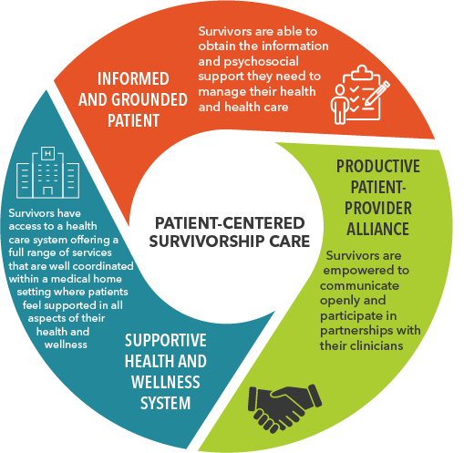
Patient-Centered Survivorship Care Framework
Notes:
To help meet this gap, in 2013, the George Washington University launched a PCORI-funded study called Evaluating Cancer Survivorship Care Models to understand the composition and impact of cancer survivorship care models across 32 cancer centers.
A result from this study was the development of the Patient-Centered Survivorship Care Framework and Patient-Centered Survivorship Care Index.
The framework and index were developed through extensive formative work with survivors, first through focus groups with 170 survivors participating and then a national survey with approximately 1200 survivors participating.
The framework synthesized patients’ definitions of quality survivorship care and its most important aspects, which then guided the development of the index. The index is a patient-centered tool that can be used to measure aspects of care important to patients, which then informs quality of care.
First, let’s take a look at the framework.
The framework depicts three important levels of the healthcare system, that, when organized well, can support the goal of providing high-quality, patient-centered care, and improve survivors’ ability to manage the lasting effects of cancer and advance their overall health.
These levels are:
1. Organizational (or supportive health and wellness system), which refers to survivors receiving the full spectrum of care and a care system that is coordinated
2. Interpersonal (or productive patient-provider alliance), which emphasizes the importance of partnerships between clinicians and patients
3. Intrapersonal (or informed and grounded patient), which focuses on the availability of resources to support survivors in managing their health and care needs

Slide 8
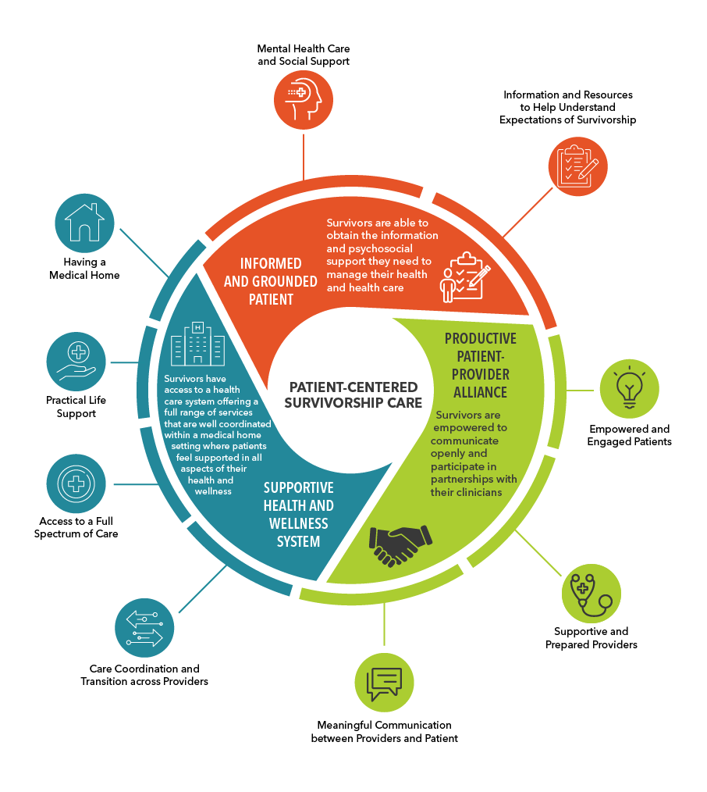
Patient-Centered Survivorship Care Framework
Notes:
The framework further specifies areas of care within each of these levels that survivors identified as essential for high quality survivorship care.
At the organizational level, it is important to survivors that:
care is coordinated across systems and there is a clear transition between primary care and oncology care providers.
they have a medical home.
receive the full spectrum of care.
and receive practical life support.
At the interpersonal level, it is important to survivors that:
they are empowered and engaged.
communication is meaningful with their providers.
and providers are supportive and prepared to provide care.
At the intrapersonal level, it is important to survivors that:
psychosocial issues are discussed and support is provided.
and information and resources are provided to help understand post-treatment expectations.
So how can health care systems and clinicians measure that they are meeting the needs of survivors? This brings us to the Patient-Centered Survivorship Care Index.

Slide 9
Patient-Centered Survivorship Care Index
Notes:
As mentioned earlier, the index addresses a gap in the field of survivorship care by creating a way to measure patient-centeredness to inform quality. The index is intended to be used in conjunction with and complementary to clinical guidelines and other quality measures.
Using the Patient-Centered Survivorship Care Index to measure care provided can help establish a care standard that is aligned and responsive to patient preferences and improve the care delivery system so it more directly addresses survivors’ needs.
The index is comprised of 41 items. These items help measure the different areas of care that survivors identified as essential for high quality survivorship care. Click on each of the icons to learn more about the items associated with that area of care.
Audio Button Clips:
Emotional and Social Support. This area is comprised of 4 items. These items are:
Talked about getting emotional/social support related to the impact of cancer and its treatment;
Talked about getting emotional/social support to deal with what life is like after cancer;
Talked about getting emotional/social support to manage relationships with partners and family
Referred to another doctor or specialist for any kind of emotional concern
Information and resources about expectations post-treatment
Discussed the need for regular follow-up and screening post-treatment
Discussed late/long-term side effects of cancer and treatment
Provided with written treatment summary
Provided with written assessment and follow-up care plan
Empowered and engaged patients
Felt included in all decisions about cancer-related follow-up care
Clinician asked about most important problems and engaged in problem-solving about these problems with the patient
Clinician and patient set goals to help manage follow-up care and improve health
Supportive and prepared clinicians
Clinician provided information and guidance on who to call when experiencing medical problems
Shared decision making on transitioning from oncologist to primary care provider (PCP)
Clinician helped patient make informed choices about follow-up care
Clinician shared responsibility for problem solving new health issues and setting goals for follow-up care
Meaningful communication between clinicians and patients
Clinician provided easy to understand instructions about follow-up care
Clinician always showed courtesy and respect for patient
Clinician explained reason for medical tests related to follow-up care after treatment
Patient had enough time to ask questions/voice concerns during visits
Clinician listened carefully to concerns related to cancer after treatment
Care coordination and transitions across care providers
Treatment clinician also provided post-treatment survivorship care
Clinicians were informed and up-to-date about care received during treatment
Clinicians had medical files on cancer care
Clinicians involved in care knew about and reviewed patient’s medication
Clinicians offered to arrange referrals and physician visits/tests needed
Clinician discussed with patient about whether ready to transition care to primary care provider
Patient received instructions on when and how to transition care from oncologist back to PCP
All clinicians stayed informed of patient health now that patient is receiving survivorship care
Provision of full spectrum of care
Regularly received a complete physical with medical history
Had regular access to exercise and physical activity services
Had regular access to nutrition and dietary services
Had regular access to risk reduction programs (e.g. weight loss, smoking cessation)
Clinicians provide referrals to specialty and other follow-up services
Health insurance issues/practical life support
Patient obtained help understanding insurance coverage options for medical services
Patient obtained help understanding insurance coverage options for prescription and over-the-counter drugs
Patient obtained help with insurance problems (e.g. rejected claims)
Providing a medical home
Survivorship care clinician/services provided complete medical care to meet follow-up care needs
Medical information is maintained through EHR
Patient can access own medical information through EHR to see lab/test results, recommendations for care
Patient has team of clinicians who all work together to address follow-up health care
Patient has point of contact to answer questions/concerns about follow-up care

Slide 10
Knowledge Check
Which of the following areas did survivors identify as essential for high quality survivorship care?
Supportive and prepared providers
Meaningful communication between patients and providers
Care coordination
Practical life support
Notes:
Which of the following areas did survivors identify as essential for high quality survivorship care?
Prompts
Correct– all of these areas were identified as essential for high quality survivorship care
Incorrect– all of these areas were identified as essential for high quality survivorship care
Note learner will be able to move on after one try regardless of correct or incorrect

Slide 11
Use the Advancing Patient-Centered Survivorship Care Toolkit
Notes:
Now that we have looked at the framework and index let’s discuss ways to use the Advancing Patient-Centered Survivorship Care Toolkit at your organization. The toolkit can be used in a variety of ways to assess survivorship care and institute quality improvement initiatives for post-treatment cancer survivors.
For example, what emotional and social support does your organization offer? Do patients receive treatment summaries after treatment ends? And to what extent are patients included in decision-making?
The activities in the toolkit can assist organizations in working through these questions and determining what is most feasible for their organization and most beneficial for their patients. The toolkit also includes patient and provider tip sheets and resources to conduct your own workshop. You can adapt any component of the toolkit to fit your community. The toolkit can be accessed in the learning management system.
To support these efforts, consider becoming a member of your state, tribe or territory's Comprehensive Cancer Control Coalition, if you are not already a member.
If you are not familiar with Comprehensive Cancer Control, in 1998 the Centers for Disease Control and Prevention (CDC) established the National Comprehensive Cancer Control Program.
Groups of stakeholders in all 50 states and the District of Columbia, 8 tribes and tribal organizations and 7 U.S. associated pacific islands and territories work together to address cancer burden and disparities in their geographic area.
Stakeholders include academic institutions, government organizations, public health programs, health care organizations, community-based organizations, physicians, cancer survivors, professional organizations and others.
The Cancer Control Coalition can be a great resource to learn about what is currently happening in your area to improve cancer survivorship care. Additional benefits to being involved in your coalition include connections to other potential partners, resources and data sources.
To learn more about what is happening in your area, visit the link shown on your screen (https://www.cdc.gov/cancer/ncccp/ccc_plans.htm)
Comprehensive Cancer Control Coalitions are also uniquely positioned to support Commission on Cancer (CoC) accredited institutions to maintain accreditation and to meet the survivorship standard.
For example, if your organization seeks to develop a survivorship program with a suite of services, your Coalition may have research, programmatic and/or evaluation expertise, connections to community-based organizations and other resources.
If you do not belong to a CoC accredited institution, you can still partner with your Coalition and implement the toolkit at your organization.

Slide 12
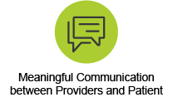
Connect with Others
gwcancercenter.forumbee.com
Notes:
How the toolkit is implemented may vary by organization. Yet, the GW Cancer Center has heard from learners about the importance of not “reinventing the wheel” and connecting with others working in the field of survivorship.
Therefore, in addition to the toolkit, the GW Cancer Center offers an online forum for people who are using the toolkit in practice. You can use the forum to ask questions, share your experiences, offer resources, and access peer insights about what works.
To connect to the forum, click on the link shown here on your screen (https://gwcancercenter.forumbee.com)
The field of cancer survivorship care is continuing to grow and evolve. As such, it is important to measure how care is delivered and identify opportunities for quality improvement.
We hope that you find the tools and resources presented here helpful to your practice as you continue to care for cancer survivors.

Slide 13
References
Institute of Medicine and National Research Council. (2006). From cancer patient to cancer survivor: Lost in transition. Washington, DC: The National Academies Press.
Mead K., Raskin S., Arem H., et al. (2019). Evaluating Different Types of Cancer Survivorship Care. Washington, DC: Patient‐Centered Outcomes Research Institute (PCORI). https://doi.org/10.25302/7.2019.IH.12115255.
Notes:
This concludes the lesson. Please continue to explore the remaining sections of the cancer survivorship e-learning series for primary care providers.

