Slide 1

This content may be used or adapted for noncommercial, educational purposes only. Please use the following citation:
George Washington University Cancer Center TAP. (2020). Cancer Survivorship Series [PowerPoint Slides]. GWU Cancer Center TAP. https://cme.smhs.gwu.edu/gw-cancer-center-/content/cancer-survivorship-series
This content was adapted from the GW Cancer Center the Oncology Patient Navigation Training: The Fundamentals (PI: Pratt-Chapman) developed and maintained by CDC cooperative agreements #NU38DP004972, #5NU58DP006461 and #NU58DP007539. The content added, changed, or adapted by our organization do not necessarily represent the views of the GW Cancer Center or the CDC.
If you have any questions about the following material or would like permission to use this material, please contact cancercontrol@gwu.edu

Slide 2
The Importance of Prevention in
Cancer Survivorship: Empowering Survivors to Live Well
Megan Slocum, PA-C
The George Washington University Medical Faculty Associates

Slide 3
Acknowledgment
This webinar was supported by Cooperative Agreement #NU58DP006461-03 from the Centers for Disease Control and Prevention (CDC).
The views expressed in written workshop materials or publications and by speakers and moderators do not necessarily reflect the official policies of the Department of Health and Human Services, nor does the mention of trade names, commercial practices, or organizations imply endorsement by the U.S. Government.
Notes:
This work was supported by cooperative agreement from the CDC. It’s contents are solely the responsibility of the authors and do not necessarily represent the official views of the CDC. No industry funding was used to support this work.

Slide 4
Learning Objectives
Describe guideline-supported recommendations to prevent second cancers (e.g. tobacco prevention/cessation, physical activity, nutrition, moderate alcohol intake, and sun protection)
Notes:
The main learning objective of this presentation is to be able to describe guideline-supported recommendations to prevent second cancers (e.g. tobacco prevention/cessation, physical activity, nutrition, moderate alcohol intake, sun protection).

Slide 5
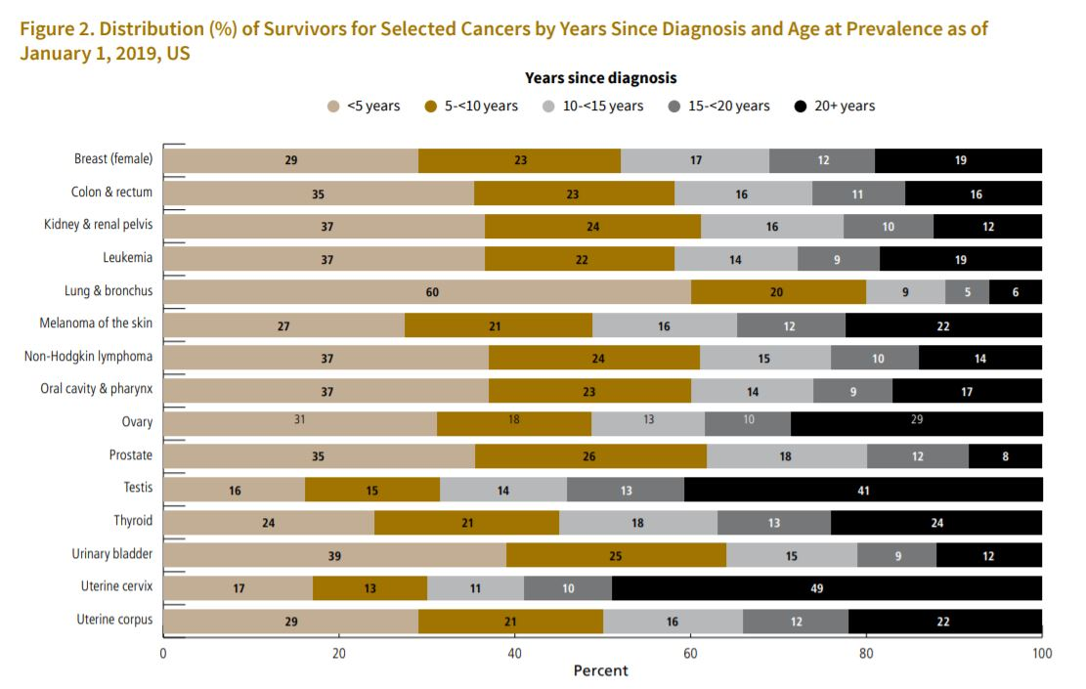
Cancer Survivors in the U.S.
American Cancer Society, 2019
National Cancer Institute, 2020
Notes:
While some of these elements mentioned on the previous slide are addressed by the primary care providers everyday, cancer survivors are a unique population that presents unique challenges.
The cancer survivor population has been growing significantly in the US. In 2019, the estimated number of cancer survivors living in the United States was about 16.9 million. It is projected that the number will increase to 22.2 million by 2030.

Slide 6

Empowering Survivors to Live Well
Prevention
  Cancer
  Co-morbidities
General Wellness
  Diet
  Exercise
  Weight management
  Psychological well-being
Surveillance and Screening
Notes:
There are a few important elements when it comes to empowering survivors to live well. This include prevention, prevention of the recurrence of cancer, prevention of another primary cancer, and also including co-morbidities related to the treatment or independent of the treatment.
Another elements is general wellness, and this includes diet, exercise, weight management, and psychological well-being.
A third element is surveillance and screening.

Slide 7
“Eight Ways to Stay Healthy After Cancer”
Don’t Smoke
Avoid secondhand smoke
Exercise regularly
Avoid weight gain
Eat healthy
Limit alcohol consumption
Screening and check-ups
Stay connected
Wolin et al., 2013
Notes:
Wolin and his colleagues released evidence based recommendations called “Eight Ways to Stay Healthy After Cancer”. This includes the following:
Don't smoke
Avoid secondhand smoke
Follow recommended screening and check-ups
Stay connected
Exercise regularly
Avoid weight gain
Eat healthy
Limit alcohol consumption

Slide 8
Perils of Smoking
Increased risk of cancer
Reduced effectiveness of cancer treatment
Reduced quality of life
Increased mortality
Cessation improves outcomes
Cancer Treatment Centers of America, 2020; Tseng, 2012
Notes:
Regardless of the increased risk for chronic health conditions and premature death, some cancer survivors continue using tobacco even after their cancer diagnosis. This is not surprising due to the highly addictive nature of nicotine. According to NHANES data collected between 1999–2008, only 36% of the smokers quit after being diagnosed with cancer.
Tobacco use can affect the following:
- Increase the risk of cancer, independent of prior cancers, especially upper airway or mucosal tumors, head and neck cancers, may impact bladder and kidney cancers
- Even though the researchers do not have clear reasons why, smoking can make cancer treatment less effective, and may increase cardiovascular side effects of radiation or chemotherapy
- It can lead to a reduced quality of life, especially while going through cancer treatment
- It can lead to increased mortality
- And we know smoking cessation improves outcomes

Slide 9
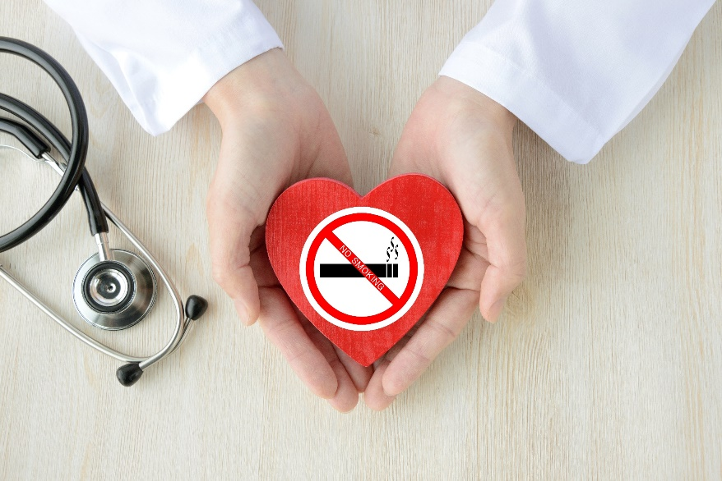
Smoking and Cancer
NCCN Clinical Practice Guidelines In Oncology (NCCN Guidelines®)
Provides recommendations to address smoking in patients and interventions for smoking cessation:
Including pharmacotherapy and behavior therapy combination
  Close follow-up is encouraged after initiation of pharmacotherapies
Referenced with permission from the NCCN Clinical Practice Guidelines in Oncology (NCCN Guidelines®) for Smoking Cessation Guideline V.2.2019. © National Comprehensive Cancer Network, Inc. 2019. All rights reserved. Accessed [May 21, 2021]. To view the most recent and complete version of the guideline, go online to NCCN.org.
Notes:
Providers should use evidence based strategies to help people with a history of cancer to quit using tobacco. The National Comprehensive Cancer Network Clinical Practice Guidelines in Oncology provide recommendations on how to address smoking in patients and interventions for smoking cessation.

Slide 10
Smoking Cessation Resources
Resources for patients:
American Cancer Society
SmokeFree.gov
American Indian Commercial Tobacco Program
ASCO Stopping Tobacco Use After Cancer Diagnosis
MSK Cancer Center Tobacco Treatment Guide: For Patients and Their Families
Resources for providers:
American Academy of Family Physicians
NACCHO Tobacco Cessation for Cancer Survivors
NCI Tobacco and Smoking Cessation Fact Sheet
Notes:
In addition to NCCN resources, there are resources that could be used by providers and patients:
For Patients:
The American Cancer Society has a wide range of resources from tips on how to stop using different tobacco products to assistance in staying tobacco free.
SmokeFree.gov has tools and tips to help patients quit.
The American Indian Commercial Tobacco Program has programs specifically designed to address American Indian communities preserving traditions.
The ASCO Stopping Tobacco Use After Cancer Diagnosis is a resource for patients to learn about tobacco cessation strategies and assistance in planning for quitting
The MSK Cancer Center Tobacco Treatment Guide is for patients and their families and describes the benefits of tobacco cessation and provides tips on how to cope with smoking urges
For Providers:
The American Academy of Family Physicians has a tobacco cessation telehealth guide and treating tobacco dependence manual
The NACCHO Tobacco Cessation for Cancer Survivors is a resource guide for local health departments developed by National Association of County and City Health Officials
The NCI Tobacco and Smoking Cessation Fact Sheet provides information about tobacco use and cancer

Slide 11
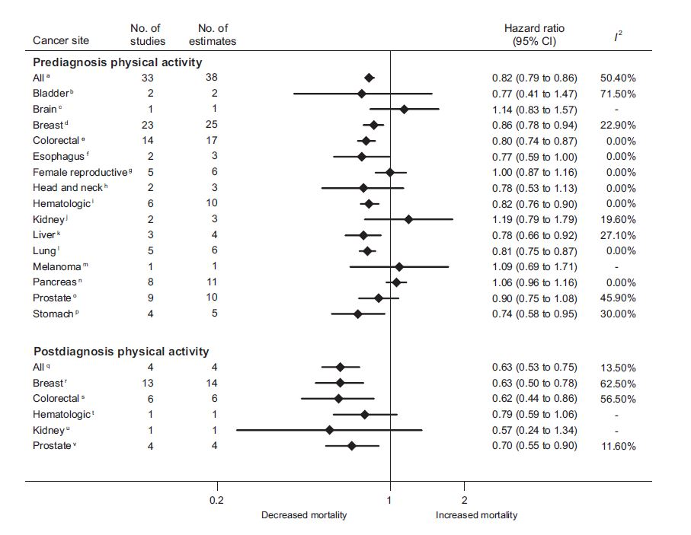
Physical Activity and Mortality in All Cancers
Friedenreich et al., 2020
Notes:
Physical activity is another way to improve health outcomes of people with a history of cancer. Physical activity can reduce cancer fatigue, increase quality of life and improve psychosocial wellbeing for cancer survivors.
Friedenreich and colleagues performed a meta-analysis study on physical activity and mortality in cancer survivors. The researchers aimed to investigate the relationship between prediagnosis and postdiagnosis physical activity (PA) and cancer-specific mortality by cancer site. Overall, they found reduced hazards of mortality for those in the highest vs. lowest PA levels for both prediagnosis and postdiagnosis. Decreased/increased mortality varied among people diagnosed with different cancers and PA before/after diagnosis. People diagnosed with breast or colorectal cancer showed greater reductions in mortality for postdiagnosis PA (HR¼ 0.58–0.63) compared with prediagnosis PA (HR¼ 0.80–0.86) for cancer-specific and all-cause mortality.

Slide 12
Exercise/Diet and Survivorship
American College of Sports Medicine, 2019
Notes:
The American College of Sports Medicine has released exercise guidelines for cancer survivors. Please review these guidelines. The providers should always inquire about the physical activity of their patients and encourage them to increase appropriate exercise to meet these recommendations.

Slide 13
American Cancer Society Nutrition and Physical Activity Guidelines
Achieve and maintain a healthy body weight
Keep body weight within the health range and avoid weight gain in adult life.
Be physically active
Adults should engage in 150-300 minutes of moderate-intensity physical activity per week or 75-150 minutes of vigorous-intensity
Limit sedentary behavior
Follow a healthy eating pattern at all ages
Foods high in nutrients, including a variety of vegetables, fruits, and whole grains
Limit red and processed meats, sugar-sweetened beverages, or highly processed foods
Limit or do not drink alcohol
Limit consumption to no more than 1 drink per day for women and 2 drinks per day for men.
Rock et al., 2020
Notes:
The American Cancer Society Nutrition and Physical Activity guidelines include recommendations and evidence of how body weight, physical activity, eating and alcohol consumption should be managed by cancer survivors.
The first recommendation is to achieve and maintain a healthy body weight. It's important to keep body weight within the healthy range and avoid weight gain in adult life.
The second recommendation is to be physically active. Adults should engage in 150-300 minutes of moderate-intensity physical activity per week or 75-150 minutes of vigorous-intensity activity. It's also important to limit sedentary behavior.
The third recommendation is to follow a healthy eating pattern at all ages. It's important to include foods high in nutrients, including a variety of vegetables, fruits, and whole grains. Limit red and processed meats, sugar-sweetened beverages, or highly processed foods.
The fourth recommendation is to limit or not to drink alcohol. It's important to limit consumption to no more than 1 drink per day for women and 2 drinks per day for men.

Slide 14
Weight and Cancer
Weight at diagnosis vs. after treatment
Obesity is BMI > 30 kg/m²
  Increased risk in breast, prostate, colorectal, endometrial, esophageal, ovarian cancer
Weight gain after breast cancer diagnosis may have a poorer outcome
Avgerinos et al., 2018
Notes:
There is no consensus on patient weight outcomes at diagnosis, after cancer treatment and outcomes related to cancer. Obesity is defined as BMI > 30 kg/m2. It is associated with an increased risk of a number of cancer types, such as breast, prostate, colorectal, endometrial, esophageal, and ovarian.
It has been shown that weight gain after breast cancer diagnosis may have a poorer outcome.

Slide 15
Weight and Cancer
Prevalence of obesity after breast cancer diagnosis (n=309).
63.7% of patients reported weight gain after diagnosis, half experienced the weight gain during the first year of diagnosis
Relationship between weight gain and mortality for breast cancer patients (n = 23 832).
No association with all-cause and breast cancer specific mortality and weight gain between 5-10%
Weight gain greater than 10% was associated with a higher hazard ratio for both all-cause mortality and breast cancer specific mortality
Ee et al., 2020
Playdon et al., 2015
Notes:
A study in Australia looked at the prevalence of obesity after diagnosis of breast cancer patients. In this study, 63.7% of patient reported weight gain after diagnosis, half experienced the weight gain during the first year of diagnosis.
Another study looked into the relationship between weight gain and mortality for breast cancer patients. They found no association with all-cause and breast cancer specific mortality and weight gain between 5 and 10%. Weight gain greater than 10% was associated with a higher hazard ratio for both all-cause mortality and breast cancer specific mortality.

Slide 16
Recommendations for Patients
Minimum 5 servings of fruits and vegetables per day
Limit processed foods, red meats and beverages high in sugar
Choose a rich diet, that involves lean proteins, healthy oils, vegetables, fruits, whole grains
Remind patients that food is the best source of vitamins, not supplements
Maintain healthy weight
Notes:
Important recommendations for patients include
Getting a minimum of 5 servings of fruits and vegetables per day
Limiting processed foods, red meats and beverages high in sugar
Choosing a rich diet that involves lean proteins, healthy oils, vegetables, fruits, whole grains
It's important to remind patients that food is the best source of vitamins, not supplements
It's also important to maintain a healthy weight

Slide 17
Patient Resources
National Comprehensive Cancer Network: Survivorship Care for Healthy Living
Cancer Support Community: Diet and Nutrition for Cancer Survivors
American Cancer Society: Weight Management Tools
Referenced with permission from the NCCN Clinical Practice Guidelines in Oncology (NCCN Guidelines®) for Survivorship V.1.2021. © National Comprehensive Cancer Network, Inc. 2021. All rights reserved. Accessed [May 21, 2021]. To view the most recent and complete version of the guideline, go online to NCCN.org.
Notes:
Resources for patients addressing cancer survivorship and diet:
- The National Comprehensive Cancer Network: Survivorship Care for Healthy Living provides guidelines for cancer survivors on diet, healthy weight, physical activity and more;
- The Cancer Support Community: Diet and Nutrition for Cancer Survivors contains various suggestions on diet and nutrition, including recipes for healthy eating
- The American Cancer Society: Weight Management Tools contains tips ranging from how to calculate your BMI to eating healthy at a restaurant

Slide 18
Alcohol Use and Cancer
 | Women | Men
Moderate Alcohol Drinking | One drink per day | Two drinks per day
Heavy Alcohol Drinking | 4 or more drinks on any day OR 8 or more drinks per week | 5 or more drinks on any day OR 15 or more drinks per week
Binge Drinking | 4 or more drinks in one sitting (typically in about 2 hours) | 5 or more drinks in one sitting (typically in about 2 hours)
American Cancer Society, nd.;
Chen et al., 2011; National Cancer Institute, 2018
Notes:
Research has provided evidence that alcohol can cause various types of cancer, such as breast, liver, mouth and others. The more alcohol is consumed over the years, the higher the risk of cancer, especially if consumed on a regular basis. However, breast, oral, and esophageal cancer risk may be elevated with even a small amount of alcohol.
These are the guidelines to help determine what is moderate, heavy and binge drinking.
Moderate alcohol drinking is defined as one drink per day for women and two drinks per day for men. Heavy alcohol drinking is defined as 4 or more drinks on any day or 8 or more drinks per week for women. And 5 or more drinks on any day or 15 or more drinks per week for men. Binge drinking is defined as 4 or more drinks in one sitting, typically in about 2 hours, for women. And 5 or more drinks in one sitting, typically in about 2 hours, for men.

Slide 19
Approaches to Reducing Alcohol Consumption
Screening and Counseling
Tools and resources
  Planning and Implementing Screening and Brief Intervention for Risky Alcohol Use
  Screening and Behavioral Counseling Interventions
Eng et al., 2018
Notes:
Health care providers should screen their patients for excessive alcohol consumption, especially around the time of diagnosis, and recommend assistance in managing it, such as providing referrals to brief counseling interventions.
Interventions based on Health Belief model and self-efficacy theory can help target the motivation to reduce drinking.
The Planning and Implementing Screening and Brief Intervention for Risky Alcohol Use provides guidance on implementing alcohol screening and brief intervention into primary care setting
Screening and Behavioral Counseling Interventions includes screening recommendations and interventions for unhealthy alcohol use in adolescents and adults

Slide 20
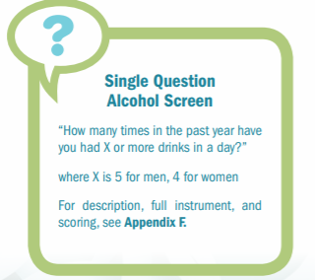
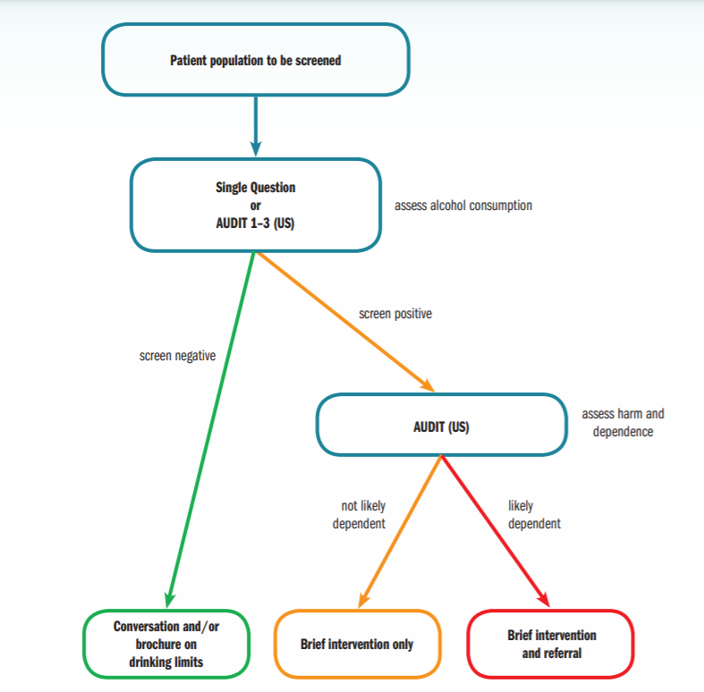
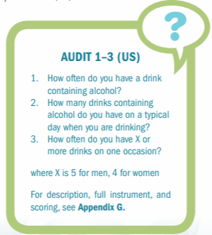
Alcohol screening and brief intervention
CDC, 2014
Notes:
This diagram provides screening guidance for determining interventions based on individual’s drinking behavior.

Slide 21

Psychosocial Well-being
Fatigue
Cognitive changes
Depression
Anxiety
Sleep disturbances
Sexual dysfunction
Yi, J.C. & Syrjala, K.L., 2017; Joly, F. et al., 2019; Strollo, S. E. et al., 2020
American Cancer Society, 2020
Notes:
Cancer survivors may experience a wide range of psychological effects on their well-being. Concern of cancer recurrence may cause PTSD, depression, anxiety or fear. The most research on psychosocial wellbeing has been conducted on people with a history of breast cancer. More research is needed to understand how people diagnosed with other types of cancer are affected in terms of psychosocial well-being. However, it is known that the people most vulnerable to psychosocial effects of intensive treatments are women, adolescents and young adults.
Cancer related fatigue and cognitive changes caused by cancer treatment might be temporal, and last for a few months. Some survivors may experience cognitive difficulties that are more persistent and last for years which can effect their quality of life.
Cancer survivors should be screened for depression and anxiety and be referred to appropriate mental health professionals for treatment.
People with a history of cancer may also suffer from sleep challenges. Almost 2000 people who had survived nine years after a cancer diagnosed participated in a study that aimed to determine the prevalence of sleep difficulties. The results indicated that 20% of the participants experienced poor sleep quality, 51% high sleep disturbance and almost one fifth of the sample have experienced both. Almost one third of the participants reported using sleep medication to help them with sleep issues.
Lastly, cancer treatment may cause sexual dysfunction due to side effects, such as fatigue, pain or decreased libido. In addition, change of appearance may cause body image and sexuality challenges. Providers are in a unique position to screen and provide referrals to improve sexual health and wellbeing for people with a history of cancer.

Slide 22
Mental Health
Clinical Practice Guidelines:
- American Society of Clinical Oncology: depressive symptoms and anxiety:
Assessment throughout the cancer continuum
Special circumstances in the assessment
Patients identified as high risk of harm for themselves or others - refer for emergency evaluation
Consider comorbidities with other disorders
American Society of Clinical Oncology, 2014
Notes:
Clinicians should screen for depressive symptoms at various points of cancer continuum, from initial diagnosis, during treatment, to post-treatment or when dying. There are special circumstances in the assessment:
It's important to use culturally sensitive assessments when possible
Making sure the assessment is accessible for those with learning disabilities or cognitive impairments
Be aware that it might be difficult to detect depression in older adults
Patients identified as high risk of harm for themselves or others should be referred for emergency evaluation. It's important to consider other comorbidities with other disorders.

Slide 23
Mental Health
Guidelines and resources for patients:
National Comprehensive Cancer Network Distress During Cancer Care Guidelines for Patients:
NCCN Distress Thermometer and Problem list
Patients can be referred to other specialists
ACS Tips for Distress Management
Referenced with permission from the NCCN Clinical Practice Guidelines in Oncology (NCCN Guidelines®) for Distress Management V.2.2021. © National Comprehensive Cancer Network, Inc. 2021. All rights reserved. Accessed [May 21, 2021]. To view the most recent and complete version of the guideline, go online to NCCN.org; ACS, 2020
Notes:
We recommend the following guidelines and resources for patients.
The National Comprehensive Cancer Network Distress During Cancer Care Guidelines present standards of care for distress management. The guidelines also include distress screening tools widely used by cancer care providers, such as NCCN Distress Thermometer and Problem list. The Distress Thermometer measures stress on a scale that ranges from 0 – no distress to 10 – extreme distress. The Problem lists helps the cancer care providers to understand the primary reasons that cause the distress. With the help of these two tools, the cancer care providers will be able to refer patients to other specialists.
The ACS Tips for Distress Management includes suggestions for patients on how to manage distress.
Please note that cancer care teams usually assist patients with mild distress. More severe types of distress should be addressed by chaplains, social workers, or mental health providers.

Slide 24
Sexual Dysfunction
Screening tools:
For breast cancer patients:
Arizona Sexual Experience Scale, Female Sexual Functioning Index, and Sexual Problems Scale
Guidelines:
NCCN Survivorship Guidelines
Referenced with permission from the NCCN Clinical Practice Guidelines in Oncology (NCCN Guidelines®) for Survivorship V.1.2021. © National Comprehensive Cancer Network, Inc. 2021. All rights reserved. Accessed [May 21, 2021]. To view the most recent and complete version of the guideline, go online to NCCN.org; Bartula, 2013
Notes:
There is still no consensus on which sexual dysfunction screening tools should be used for cancer survivors. A systematic review of different screening tools for sexual dysfunction among breast cancer patients was done and the authors found that three scales met psychometric criteria that measure DSM-5 and ICD-10 dimensions of sexual dysfunction, that include desire, arousal, orgasm, pain and distress. The scales that were considered to have acceptable psychometric criteria were the Arizona Sexual Experience Scale, the Female Sexual Functioning Index, and Sexual Problems Scale.
We suggest looking into the NCCN Survivorship care guidelines the include diagnostic evaluation for assessing sexual function among cancer survivors. These guidelines provide description of sexual dysfunction symptoms, evaluation and treatment options.

Slide 25
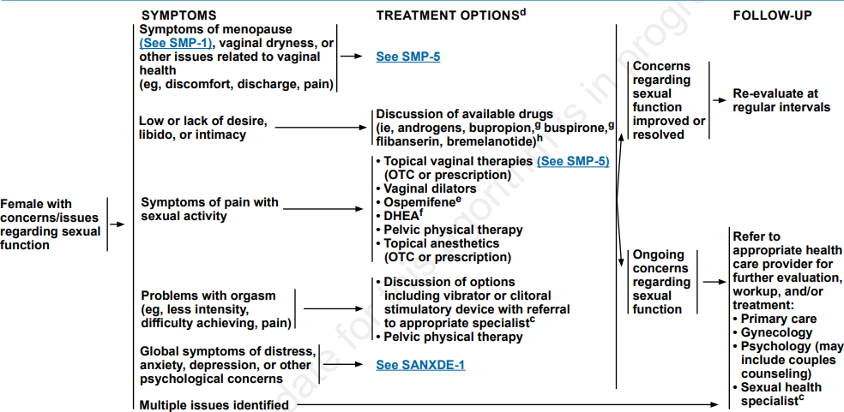
NCCN Guidelines Version 1.2021
Survivorship: Sexual Function (Female)
Reproduced with permission from the NCCN Clinical Practice Guidelines in Oncology (NCCN Guidelines®) for Survivorship V.1.2021. © 2021 National Comprehensive Cancer Network, Inc. All rights reserved. The NCCN Guidelines® and illustrations herein may not be reproduced in any form for any purpose without the express written permission of NCCN. To view the most recent and complete version of the NCCN Guidelines, go online to NCCN.org. The NCCN Guidelines are a work in progress that may be refined as often as new significant data becomes available.
Notes:
NCCN provides an algorithm for assessing cisgender woman and men for sexual dysfunction. Please take a moment to review these guidelines.

Slide 26
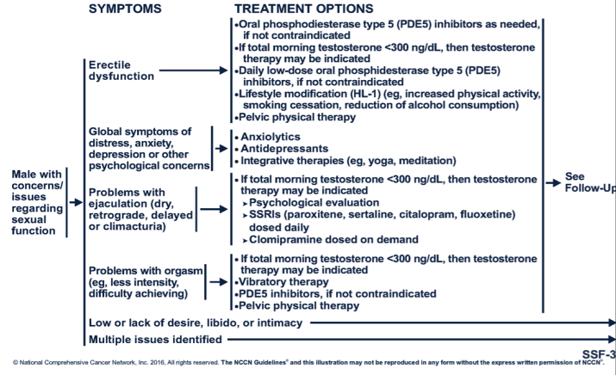
NCCN Guidelines Version 1.2021
Survivorship: Sexual Function (Male)
Reproduced with permission from the NCCN Clinical Practice Guidelines in Oncology (NCCN Guidelines®) for Survivorship V.1.2021. © 2021 National Comprehensive Cancer Network, Inc. All rights reserved. The NCCN Guidelines® and illustrations herein may not be reproduced in any form for any purpose without the express written permission of NCCN. To view the most recent and complete version of the NCCN Guidelines, go online to NCCN.org. The NCCN Guidelines are a work in progress that may be refined as often as new significant data becomes available.

Slide 27
Surveillance for Recurrence
Clinical Practice Guidelines
  American Society of Clinical Oncology
  National Comprehensive Cancer Network
  National Cancer Survivorship Resource Center
Referenced with permission from the NCCN Clinical Practice Guidelines in Oncology (NCCN Guidelines®). © 2021 National Comprehensive Cancer Network, Inc. All rights reserved. The NCCN Guidelines® and illustrations herein may not be reproduced in any form for any purpose without the express written permission of NCCN. To view the most recent and complete version of the NCCN Guidelines, go online to NCCN.org. The NCCN Guidelines are a work in progress that may be refined as often as new significant data becomes available.
Notes:
Surveillance refers to the search for a recurrence or tumor that patients have been initially diagnosed with. The surveillance depends on the individual, the type of tumor and the risk that each of the patients may have. These are some clinical guidelines that target surveillance for recurrence.
- The American Society of Clinical Oncology guidelines provide recommendations based on cancer type.
- The National Comprehensive Cancer Network includes guidelines for treatment by cancer site, detection and prevention, and supportive care.
- The National Cancer Survivorship Resource Center has resources for implementing American Cancer Society survivorship care guidelines by primary care providers, oncology providers, Comprehensive Cancer Control professionals, and patient navigators.

Slide 28
Risk of Secondary Cancers
 | Risk for Secondary Cancer
Chemotherapy | Increased risk with higher drug doses, longer treatment time, and higher dose intensity Early to late risk of leukemia and solid tumors
Radiation Therapy | - Increased risk with dose of radiation, area treated, age at treatment, chemotherapy, and smoking. Most cancers not seen for at least 10 years after radiation Thyroid cancer Lung cancer Breast cancer GI malignancies Bladder/GU cancer GYN malignancies Skin cancers
American Cancer Society, n.d.
Notes:
Patients may be at risk of secondary cancer because of their treatment.
Chemotherapy can increase the risk for secondary cancer. This risk is increased with higher drug doses and intensity, and longer treatment time. Secondary cancers associated with chemotherapy include leukemia and solid tumors.
There is also an increased risk for secondary cancer with radiation therapy. This risk depends on the dose of radiation, area treated, age at treatment, whether or not chemotherapy is included, and smoking habits. Most cancers are not seen for at least 10 years after radiation is completed. Secondary cancers associated with radiation therapy include thyroid cancer, lung cancer, breast cancer, gastrointestinal malignancies, bladder and GU cancer, gynecologic malignancies, and skin cancers.

Slide 29
Screening For Secondary Malignancies
Consensus based guidelines
  Children’s Oncology Group
  National Comprehensive Cancer Network
  American Cancer Society
Earlier screening based on risk
Patients and physicians to be vigilant about symptoms and address them appropriately
Referenced with permission from the NCCN Clinical Practice Guidelines in Oncology (NCCN Guidelines®) for Survivorship V.1.2021. © National Comprehensive Cancer Network, Inc. 2021. All rights reserved. Accessed [June 21, 2021]. To view the most recent and complete version of the guideline, go online to NCCN.org.
Notes:
When it comes to screening for secondary malignancies, the Children's Oncology Group, the National Comprehensive Cancer Network, and the American Cancer Society have all consensus-based guidelines. It important for patients and physicians to be vigilant about symptoms and address them appropriately.

Slide 30
Cancer Screening for Other Primary Tumors
Breast
Colon
Skin
Gynecologic (Cervical)
Lung (if high risk smoker)
Thyroid (exam)
Notes:
It is also important to screen for primary tumors as you would do with people without a history of cancer. These include breast cancer, colon cancer, skin cancer, cervical cancer, lung cancer, and thyroid cancer. Generally, using the traditional primary cancer screening is a good start, however the providers should keep in mind the genetic predisposition of different patients which means screening for those cancer types may need to be more aggressive.

Slide 31
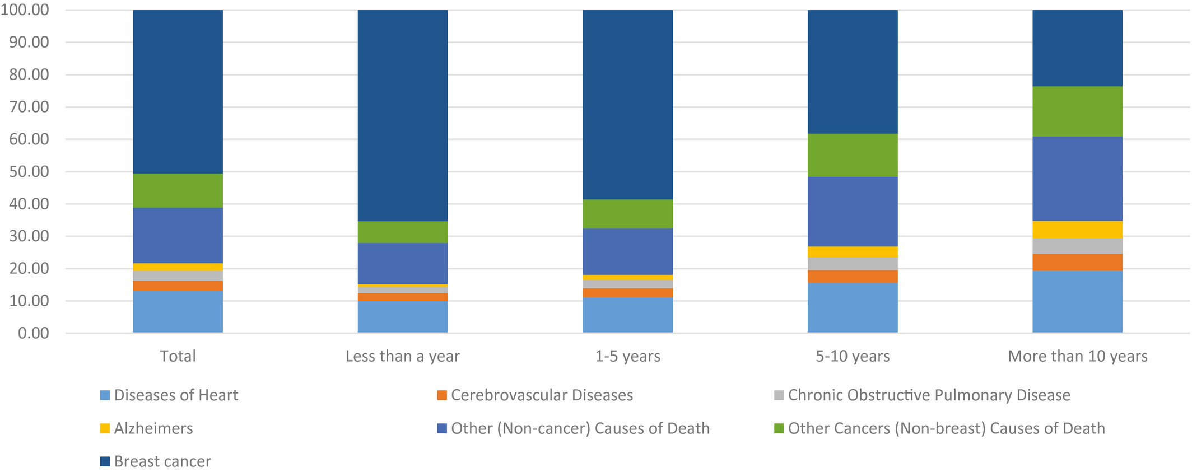
Cancer and Comorbidities
Causes of death in each latency period following breast cancer diagnosis
Afifi et al., 2019
Notes:
A recent study looked into causes of death after breast cancer diagnosis. 754,270 women who received a breast cancer diagnosis between 2000 and 2015 participated in this study. Regardless of the latency period, breast cancer was the leading cause of mortality in the sample, except when the person had lived for more than 10 years after diagnosis. The leading non-cancer causes of death were heart and cerebrovascular diseases. >10 years after diagnosis, the most common non-cancer causes of death were heart disease followed by Alzheimer disease.
In the largest proportion of deaths, almost half, occurred within 1 to 5 years after diagnoses. The main cause of death was breast cancer itself or other cancers. The number of death rate due to breast cancer decreased as more years passed after the diagnosis.
It is important for the providers to consider the range of comorbidities that people with a history of cancer may be managing in order to provide comprehensive care.

Slide 32
Cancer Treatment and Cardiovascular Disease
Type of Cancer Treatment | Type of Cardiovascular Conditions | Example Conditions
Chemotherapy or Radiation Exposure | Vascular | Atherosclerosis Hypertension Carotid Artery Stenosis
Radiation Therapy | Structural | Valvular Heart Disease Pericardial Disease (Effusion/Constriction) Conduction Abnormalities
Myocardial Dysfunction |  | Anthracyclines Trastuzumab Radiation
Lenihan & Cardinale, 2012
Okwousa, T.M. et al., 2016
Notes:
Some types of cancer treatment, such as radiation and certain chemotherapies increase the risk of cardiovascular disease. Some of the effects are long-lasting and may remain for years after the treatment had occurred. The follow up protocol for such therapies should include screening for cardiovascular and cardiovascular risk factors. Referral to onco-cardiology for further management of cardiovascular risk in these survivors is based on a patient's cardiovascular risk level and the type, amount and duration of cancer therapies received during the patient's lifetime.
While preventive measures, such as screening and different types of medications are important, it is also important to remind patients that maintaining healthy life style is just as important.

Slide 33
Risk Factors for Radiation-Induced Coronary Artery Disease
Age at exposure, specifically those 25 or younger
Total radiation dose (greater than 30 Gy)
Volume of tissue exposed
Lack of cardiac shielding techniques
Underlying structural heart disease
Traditional cardiac risk factors, such as smoking and obesity
Borges & Kapadia, 2018
Desai et al., 2018
Notes:
The risk factors for radiation-induced coronary artery disease include:
Age at expsure, specifically those 25 or younger
The total radiation dose
Volume of tissue exposed
Lack of cardiac shielding techniques
Underlying structural heart disease
Traditional cardiac risk factors, such as smoking and obesity

Slide 34
Risk Factors for Cancer Therapy Related Cardiac Dysfunction (CTRCD)
High dose anthracycline chemotherapy
High dose radiotherapy (>30 gy) where the heart is in the treatment field
Multiple cardiovascular risk factors (tobacco use, obesity, etc.)
Older age (> 60)
Known heart disease (heart failure, MI)
Treatment with anthracycline chemotherapy followed by Trastuzumab
Armenian et al., 2016
Notes:
In general, risk factors for cancer therapy related cardiac dysfunction
High dose anthracycline chemotherapy
High dose radiotherapy, where the heart is in the treatment field
Multiple cardiovascular risk factors
Older age
Known heart disease
Treatment with anthracycline chemotherapy followed by Trastuzumab

Slide 35
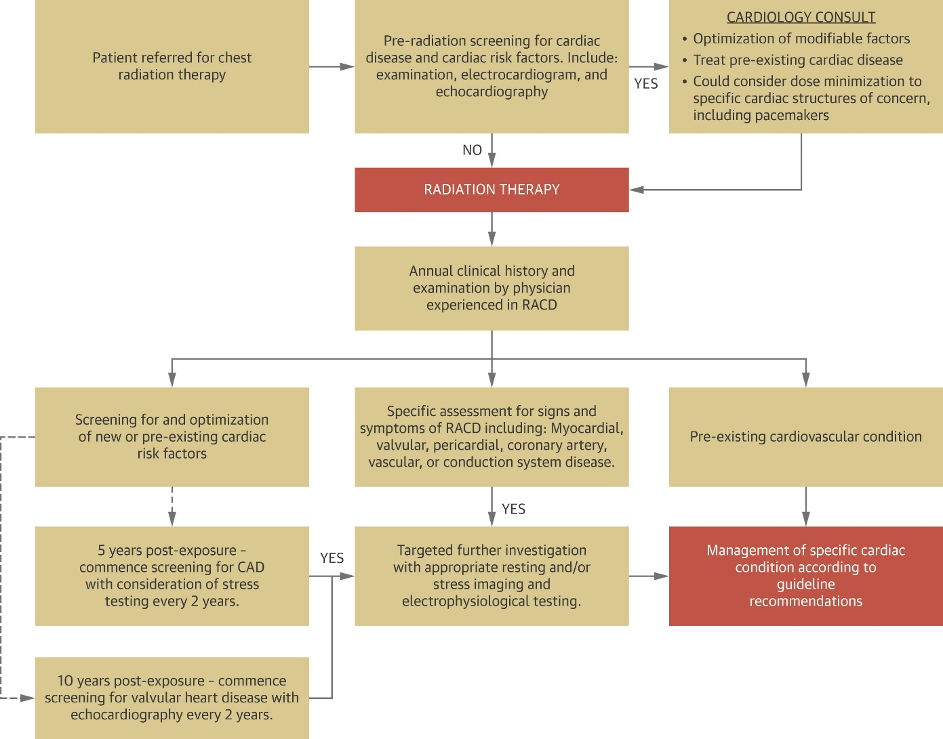
Screening Algorithm for RACD (Radiation-Associated Cardiac Disease)
Desai et al., 2018
Notes:
This is an example of a screening algorithm developed for patients who are receiving for chest radiation. Please take a moment to review the screening algorithm.

Slide 36
Cardiac Surveillance
Clinical Practice Guidelines
NCCN.org
ASCO
Risk stratification and cardiac surveillance guidelines
Notes:
We recommend reviewing the Clinical Practice Guidelines by the NCCN and ASCO. These are risk stratification and cardiac surveillance guidelines.

Slide 37
Bone Health
Hormonal agents may impact bone health
  Aromatase inhibitors, androgen deprivation
Adequate calcium and vitamin D intake
Encourage weight bearing exercise 2-3 times weekly
Bone density measurement (DEXA) for appropriate patients
MD Anderson Cancer Center, n.d.
Notes:
People with a history of cancer, particularly those diagnosed with breast or prostate cancer, also need to be assessed for bone health. The bone loss due to cancer and its treatment can be caused by the following:
- Certain types of chemotherapy drugs
- Radiation therapy, specifically when it is received to the pelvic area in women 65 years or older
- When the primary cancer spreads to the bones
- Hormone therapy for prostate patients when the testosterone is suppressed
- Steroid treatments
Hormonal agents may particularly impact bone health. These include Aromatase inhibitors and androgen deprivation therapy. Clinicians should include the following in assessments or interventions:
Assess and encourage adequate calcium and vitamin D intake
Encourage weight bearing exercises 2-3 times weekly
Take bone density measurements for appropriate patients.
Clinicians should consider the follow up evaluation of cancer treatment-induced bone loss.

Slide 38
Immunizations and Cancer Survivors
Best if given at least 2 weeks prior to initiation of cancer treatment
Safe:
  Inactivated or purified antigens
    Flu, pneumococcus, menigococcus, Td/Tdap, Hep A, Haemophilus influenza type B
  Recombinant viral antigens
    Hep B, HPV, recombinant trivalent influenza vaccine, Zoster
Avoid if immunosuppressed:
  Live attenuated vaccines
Referenced with permission from the NCCN Clinical Practice Guidelines in Oncology (NCCN Guidelines®) for Survivorship V.1.2021. © National Comprehensive Cancer Network, Inc. 2021. All rights reserved. Accessed [June 8, 2021]. To view the most recent and complete version of the guideline, go online to NCCN.org; Ariza-Heredia, 2015; American Cancer Society, 2021
Notes:
Cancer treatments weaken the immune system, therefore immunizations are crucial for cancer survivors. It is important to consider a few important factors, such as the type of cancer the patient had or has, treatment and type of vaccine the patient should get.
It's best if the immunization is given at least 2 weeks prior to initiation of cancer treatment. The following immunizations are considered safe in cancer patients: inactivation or purified antigens and recombinant viral antigens.
It's important to avoid live attenuated vaccines if immunosuppressed.

Slide 39
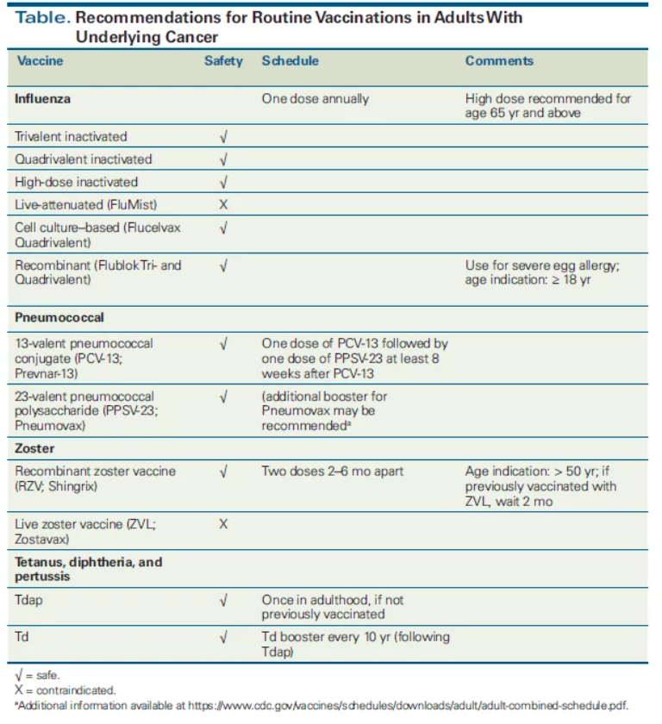
Shah, 2018
Notes:
In order to maximize the immune response, inactivated vaccines should be given at least 2 weeks before the start of chemotherapy or other immunosuppressive therapy. It is recommended to keep the 2 week mark since immunization during chemotherapy or radiation therapy may cause antibody responses to be suboptimal.
Vaccination after chemotherapy is recommended only 3 months after the chemotherapy regimen is finished, 6 months are recommended for anti-B-cell antibodies therapy. Additionally, only live attenuated vaccines should be administered for individuals projected to start immunosuppressive therapy.
This list provides recommendations for routine vaccinations for cancer patients.

Slide 40
Primary Care Provider’s Role in Cancer Survivorship
Acknowledge impact of cancer and cancer treatment side effects
Enforce appropriate screening and surveillance for cancer
Educate patients on medical comorbidities
Empower patients to address overall health and wellness
  Routine preventive health
Screen and refer for psychosocial needs
Notes:
The primary care provider has an important role in cancer survivorship and includes the following:
Acknowledging impact of cancer and cancer treatment side effects
Enforcing appropriate screening and surveillance for cancer
Educating patients on medical comorbidities
Empowering patients to address overall health and wellness, including routine preventative health
And screening and referring for psychosocial needs

Slide 41
References
Afifi, A. M., Saad, A. M., Al-Husseini, M. J., Elmehrath, A. O., Northfelt, D. W., & Sonbol, M. B. (2019). Causes of death after breast
cancer diagnosis: A US population-based analysis. Cancer, 126(7), 1559-1567. doi: 10.1002/cncr.32648.
American Cancer Society (n.d.). Alcohol Use and Cancer. Retrieved from: https://www.cancer.org/cancer/cancer-causes/diet-physical-
activity/alcohol-use-and-cancer.html
American Cancer Society. (2019). Cancer Treatment & Survivorship Facts & Figures 2019-2021. Retrieved from
https://www.cancer.org/research/cancer-facts-statistics/survivor-facts-figures.html.
American Cancer Society. (2021). COVID-19 vaccines in people with cancer. Retrieved from
https://www.cancer.org/treatment/treatments-and-side-effects/physical-side-effects/low-blood-counts/infections/covid-19-vaccines-in-people-
with-cancer.html.
American Cancer Society. (2020). How cancer and cancer treatment can affect sexuality. Retrieved from
https://www.cancer.org/treatment/treatments-and-side-effects/physical-side-effects/fertility-and-sexual-side-effects/how-cancer-affects-
sexuality.html.
American Cancer Society. (n.d.). Second cancers. Retrieved from https://www.cancer.org/treatment/treatments-and-side-effects/physical-side-
effects/second-cancers-in-adults.html
American College of Sports Medicine. (2019). New infographic available: Exercise guidelines for cancer patients and survivors. Retrieved from
https://www.acsm.org/read-research/newsroom/news-releases/news-detail/2019/11/27/new-infographic-available-exercise-guidelines-
cancer-patients-survivors.
American Society of Clinical Oncology. (2014). ASCO Guidelines: Screening, assessment, and care of anxiety and depressive symptoms in
adults with cancer. https://www.asco.org/sites/new-www.asco.org/files/content-files/practice-and-guidelines/documents/depression-anxiety-
summary-of-recs-table.pdf
American Urological Association. (2018). Erectile dysfunction: AUA guideline (2018). https://www.auanet.org/guidelines/erectile-dysfunction-
(ed)-guideline.

Slide 42
References
Ariza-Heredia, E. J., & Chemaly, R. F. (2015). Practical review of immunizations in adult patients with cancer. Human vaccines &
immunotherapeutics, 11(11), 2606–2614. https://doi.org/10.1080/21645515.2015.1062189
Avgerinos, K., Spyrou, N., Mantzoros, C. S., & Dalamaga. (2019). Obesity and cancer risk: Emerging biological mechanisms and perspectives.
Metabolism, 92, 121-135. doi: 10.1016/j.metabol.2018.11.001
Bartula, I. & Sherman, K. A. (2013). Screening for sexual dysfunction in women diagnosed with breast cancer: Systemic review and
recommendations. Breast Cancer Research and Treatment, 141(2), 173-185. doi: 10.1007/s10549-013-2685-9.
Borges, N., & Kapadia, S. R. (2018, May 25). Radiation-induced CAD: Incidence, diagnosis, and management outcome. American College of
Cardiology. https://www.acc.org/latest-in-cardiology/articles/2018/05/24/01/44/radiation-induced-
cad#:~:text=Risk%20factors%20for%20radiation%2Dinduced,lack%20of%20cardiac%20shielding%20techniques
Cancer Treatment Centers of America. (2020). Continued smoking may affect cancer patients’ treatments, symptoms and side effects.
Retrieved from https://www.cancercenter.com/community/blog/2020/11/cancer-patients-smoking.
Centers for Disease Control and Prevention. (2014). Planning and Implementing Screening and Brief Intervention for Risky Alcohol Use: A Step
by-Step Guide for Primary Care Practices. Retrieved from:
https://www.cdc.gov/ncbddd/fasd/documents/AlcoholSBIImplementationGuide.pdf
Chen, W. Y., Rosner, B., Hankinson, S. E., Colditz, G. A., & Willett, W. C. (2011). Moderate alcohol consumption during adult life, drinking
patterns, and breast cancer. JAMA, 306(17), 1884-1890. doi: 10.1001/jama.2011.1590.
Eng, L., Pringle, D., Su, J., Espin-Garcia, O., Niu, C., Mahler., M., … & Liu, G. (2018). Patterns, perceptions and their association with changes
in alcohol consumption in cancer survivors. European Journal of Cancer Care, 28(1), e12933.
doi: https://doi-org.proxygw.wrlc.org/10.1111/ecc.12933.
Friedenreich, C. M., Stone, C. R. Cheung, W. Y., & Hayes, S. C. (2020). Physical activity and mortality in cancer survivors: A systematic review
and meta-analysis. Journal of the National Institute Cancer Spectrum, 4(1). doi: https://doi.org/10.1093/jncics/pkz080.

Slide 43
References
Joly, F., Lange, M., Dos Santos, M., Vaz-Luis, I., & Di Meglio, A. (2019). Long-term fatigue and cognitive disorders in breast cancer survivors.
Cancers, 11(12). doi: 10.3390/cancers11121896.
Lenihan, D. J., & Cardinale, D. M. (2012). Late cardiac effects of cancer treatment. Journal of Clinical Oncology, 30(30), 3657-3664.
doi: 10.1200/JCO.2012.45.2938.
MD Anderson Cancer Center. (n.d.). Bone health and cancer treatment. Retrieved from https://www.mdanderson.org/patients-family/diagnosis-
treatment/emotional-physical-effects/bone-health.html
National Cancer Institute. (2018). Alcohol and cancer risk. Retrieved from https://www.cancer.gov/about-cancer/causes-
prevention/risk/alcohol/alcohol-fact-sheet.
National Cancer Institute. (2020). Cancer Statistics. Retrieved from https://www.cancer.gov/about-
cancer/understanding/statistics#:~:text=As%20of%20January%202019%2C%20there,to%2022.2%20million%20by%202030
National Comprehensive Cancer Network. (2020). Guidelines for Patients Distress During Cancer Care. Retrieved from
https://www.nccn.org/patients/guidelines/content/PDF/distress-patient.pdf Referenced with permission from the NCCN Clinical Practice Guidelines in Oncology (NCCN Guidelines®) for Distress Management V.2.2021. © National Comprehensive Cancer Network, Inc. 2021. All rights reserved. Accessed [May 21, 2021]. To view the most recent and complete version of the guideline, go online to NCCN.org. NCCN makes no warranties of any kind whatsoever regarding their content, use or application and disclaims any responsibility for their application or use in any way.
National Comprehensive Cancer Network. (2021). Guidelines for Smoking Cessation. Retrieved from
https://www.nccn.org/guidelines/guidelines-detail?category=3&id=1463. Referenced with permission from the NCCN Clinical Practice Guidelines in Oncology (NCCN Guidelines®) for Smoking Cessation Guideline V.2.2019. © National Comprehensive Cancer Network, Inc. 2019. All rights reserved. Accessed [May 21, 2021]. To view the most recent and complete version of the guideline, go online to NCCN.org. NCCN makes no warranties of any kind whatsoever regarding their content, use or application and disclaims any responsibility for their application or use in any way.

Slide 44
References
National Comprehensive Cancer Network. (2021). Guidelines for Survivorship. Retrieved from
https://www.nccn.org/guidelines/guidelines-detail?category=3&id=1466. Referenced with permission from the NCCN Clinical Practice Guidelines in Oncology (NCCN Guidelines®) © National Comprehensive Cancer Network, Inc. 2019. All rights reserved. Accessed [May 21, 2021]. To view the most recent and complete version of the guideline, go online to NCCN.org. NCCN makes no warranties of any kind whatsoever regarding their content, use or application and disclaims any responsibility for their application or use in any way.
National Comprehensive Cancer Network. (2020). Survivorship care for cancer-related late and long-term effects. Retrieved from
https://www.nccn.org/patients/guidelines/content/PDF/survivorship-crl-patient.pdf. Referenced with permission from the NCCN Clinical Practice Guidelines in Oncology (NCCN Guidelines®) for Survivorship V.1.2021. © National Comprehensive Cancer Network, Inc. 2021. All rights reserved. Accessed [May 21, 2021]. To view the most recent and complete version of the guideline, go online to NCCN.org. NCCN makes no warranties of any kind whatsoever regarding their content, use or application and disclaims any responsibility for their application or use in any way.
National Comprehensive Cancer Network. (2020). Survivorship care for healthy living. Retrieved from
https://www.nccn.org/patients/guidelines/content/PDF/survivorship-hl-patient.pdf. Referenced with permission from the NCCN Clinical Practice Guidelines in Oncology (NCCN Guidelines®) for Survivorship V.1.2021. © National Comprehensive Cancer Network, Inc. 2021. All rights reserved. Accessed [May 21, 2021]. To view the most recent and complete version of the guideline, go online to NCCN.org. NCCN makes no warranties of any kind whatsoever regarding their content, use or application and disclaims any responsibility for their application or use in any way.
Okwousa, T.M., Anzevino, S., & Rao, R. (2016). Cardiovascular disease in cancer survivors. Postgraduate Medical Journal, 93(1096), 82-90.
doi: :10.1136/postgradmedj-2016-134417.
Playdon, M. C., Bracken, M. B., Sanft, T. B., Ligibel, J. A., Harrigan, M., & Irwin, M. L. (2015). Weight gain after breast cancer diagnosis and all-
cause mortality: Systematic review and meta-analysis. Journal of the National Cancer Institute, 107(12).
doi: https://doi.org/10.1093/jnci/djv275.

Slide 45
References
Rock, C. L., Thomson, C., Gansler, T., Gapstur, S. M., McCullough, M. L., Patel, A. V., Andrews, K. S., Bandera, E. V., Spees, C. K., Robien,
K., Hartman, S., Sullivan, K., Grant, B. L., Hamilton, K. K., Kushi, L. H., Caan, B., J., Kibbe, D., Black, J. D., Wiedt, T. L., … Doyle, C.
(2020).
American Cancer Society guideline for diet and physical activity for cancer prevention. A Cancer Journal for Clinicians, 70(4).
doi: https://doi.org/10.3322/caac.21591.
Shah, M.K., & Kamboj, M. (2018). Immunizing Cancer Patients: Which Patients? Which Vaccines? When to Give? Retrieved from
https://www.cancernetwork.com/view/immunizing-cancer-patients-which-patients-which-vaccines-when-give
Strollo, S. E., Fallon, E. A., Gapstur, S. M, & Smith, T. G. (2020). Cancer-related problems, sleep quality, and sleep distrurbance among long-
term cancer survivors at 9-years post diagnosis. Sleep Medicine, 65, 177-185. doi: https://doi.org/10.1016/j.sleep.2019.10.008.
Tseng, T-S., Lin, H-Y., Moody-Thomas, S., Martin, M., & Chen, T. (2012). Who tended to continue smoking after cancer diagnosis: The national
health and nutrition examination survey 1999-2008. BMC Public Health,12(784).
Wolin, K. Y., Dart, H., & Colditz, G. A. (2013). Eight ways to stay healthy after cancer: An evidence-based message. Cancer Causes & Control,
24, 827-837. doi: https://doi.org/10.1007/s10552-013-0179-z.
Yi, J.C. & Syrjala, K.L. (2017). Anxiety and depression in cancer survivors. The Medical Clinics of North America, 101(6), 1099-1113.
doi: 10.1016/j.mcna.2017.06.005

Slide 46

Thank you!
Follow us on Twitter: @GWCancer
www.gwcancercenter.org
Sign-up for the GW Cancer Center’s Patient Navigation
and Survivorship E-Newsletter: bit.ly/PNSurvEnews
Sign-up for the GW Cancer Center’s Cancer Control
Technical Assistance E-Newsletter: bit.ly/TAPenews

Slide 47
The Importance of Health and Wellness in Cancer Survivorship:
Empowering Survivors to Live Well
Jason Morrow, RN, BSN, OCN
Prisma Health-Upstate Cancer Institute
Center for Integrative Oncology & Survivorship
Notes:
Welcome to the presentation on The Importance of Health and Wellness in Cancer Survivorship: Empowering Survivors to Live Well.
I am Jason Morrow, Nursing Supervisor, Oncology Rehabilitation at Prisma Health and Center for Integrative Oncology & Survivorship.

Slide 48
Acknowledgment
This webinar was supported by Cooperative Agreement #NU58DP006461-03 from the Centers for Disease Control and Prevention (CDC).
The views expressed in written workshop materials or publications and by speakers and moderators do not necessarily reflect the official policies of the Department of Health and Human Services, nor does the mention of trade names, commercial practices, or organizations imply endorsement by the U.S. Government.
Notes:
This work was supported by cooperative agreement from the CDC. It’s contents are solely the responsibility of the authors and do not necessarily represent the official views of the CDC. No industry funding was used to support this work.

Slide 49
Learning Objectives
Describe behaviors that increase risk of cancer recurrence and secondary cancers
Identify strategies for people with a history of cancer to reduce risk of secondary cancers
Identify psychosocial and physical challenges experienced by many cancer survivors
Notes:
At the end of this presentation, you will be able to:
Describe behaviors that increase risk of cancer recurrence and secondary cancers
Identify strategies for people with a history of cancer to reduce risk of secondary cancers
Identify psychosocial and physical challenges experienced by many cancer survivors

Slide 50

Cancer Survivorship
16.9 million people in the United States have a past cancer diagnosis
Cancer Treatment and Survivorship Facts and Figures, 2019-2021, 2019
Notes:
The number of cancer survivors has been increasing in the U.S., and globally. In 2019, it was estimated that there were 16.9 million cancer survivors in the U.S, with 67% having survived for at least 5 years after diagnosis and almost a quarter for at least 20 years after diagnosis of cancer. Due to an aging population, it is expected that the number of cancer survivors will increase to 22.1 million by 2030.
Currently, cancers of the prostate, colorectum, and melanoma of the skin are the three most prevalent among males. Breast, uterine, and colorectum are most prevalent among females.
The literature (published by the American Cancer Society) is a great resource for both providers and cancer survivors. It provides excellent information on; cancer staging, cancer treatment and common side effects, cancer survival and access to care, and information and statistical data on specific cancer types. The literature also covers important topics such as; navigating the cancer experience (treatment and supportive care), cancer rehabilitation, psychosocial care, palliative care, and long-term cancer survivorship.
The literature also includes recommendations on regaining and improving health after cancer treatment which in turn decrease a survivor’s risk of a second cancer.

Slide 51
Risk Factors for Second Cancers
Aging (biggest risk factor)
Cancer treatment: Radiation & certain chemotherapies
Tobacco (cigarette smoking/tobacco use)
Diet (high-fat, high-sugar diets)
Alcohol: limit to 1 drink/day (women) or 2 drinks/day (men)
Physical Inactivity being overweight, or obese
Environmental risk factors (sun (UV), sunbed tanning, diesel fumes, radon gas, etc. )
Family history and genetics
Lack of follow-up care
NCI, 2021; ACS, 2021
Notes:
Cancer survivors may be at greater risk for developing secondary cancers and other chronic diseases, such as cardiovascular diseases and diabetes due to:
the (late) effects of treatment
lifestyle behaviors
family history
American Cancer Society has estimated that ½ of all cancer deaths could be prevented if people followed risk reduction and screening guidelines.
Aging: When you have a first cancer can matter too. For example, survivors of childhood cancers can develop second cancers from some effects of treatment or because of hereditary or genetic problems. And, because a person's risk for cancer generally goes up as they age, an unrelated new cancer may develop later in a cancer survivor's life.
Cancer Treatment: some chemotherapy drugs are toxic to the heart and lungs and ongoing monitoring is recommended based on drug and dosage delivered. Ionizing radiation including radon gas in homes, medical radiation used in diagnostic studies, and treatment radiation all can potentially cause a secondary cancer
Tobacco: Scientists believe that cigarette smoking causes about 30% of all cancer deaths in the United States. Tobacco use of any kind can raise the risk of developing cancer, and for those undergoing treatment it can potentially lower the effectiveness of treatment
Diet: Although research has shown that cancer cells consume more sugar (glucose) than normal cells, no studies have shown that eating sugar will make your cancer worse or that, if you stop eating sugar, your cancer will shrink or disappear. However, a high-sugar diet may contribute to excess weight gain, and obesity is associated with an increased risk of developing several types of cancer.
Alcohol: studies show drinking alcohol is linked to an increased risk of oral, esophageal, breast, liver, and colorectal cancer
Physical Inactivity: Studies show that people who are physically active have a lower risk of certain cancers than those who are not. Obesity is linked to higher risk of post-menopausal breast, colorectal, esophageal, endometrial, kidney, pancreatic, liver, and gallbladder cancers.
Environmental: Being exposed to chemicals and other substances in the environment has been linked to some cancers. Links between air pollution and cancer risk have been found. These include links between lung cancer and second-hand smoke, outdoor air pollution, and asbestos
Family History/Genetics: In some cases, cancer is driven by a genetic mutation that puts patients at higher risk for other types of cancer, so it's important to know whether they have that risk. For example, if there is a personal or family history of breast cancer and they carry the BRCA2 mutation a plan for additional cancer screening across the lifespan would be warranted.
Lack of follow-up care: Multi-factorial
Clinicians can play a key role in helping cancer survivors reduce their risks.

Slide 52
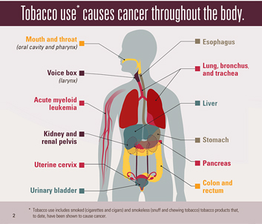
Tobacco-Related Cancers
Mouth and throat
Esophagus
Larynx
Lung
Liver
Stomach
Urinary bladder
Colon and rectum
Uterine cervix
Pancreas
Kidney
Acute myeloid leukemia
NCI, 2021; CDC, 2016 (Image)
Notes:
Tobacco use is strongly linked to an increased risk for many kinds of cancer. Smoking cigarettes is the leading cause of the following types of cancer:
Mouth and throat
Esophagus
Larynx
Lung
Liver
Stomach
Urinary bladder
Colon and rectum
Uterine cervix
Pancreas
Kidney
Acute myeloid leukemia

Slide 53
Tobacco-Related Cardiovascular Diseases
Cerebrovascular Diseases (Stroke)
Peripheral Arterial Disease
Atherosclerosis
Coronary Heart Disease
Aneurism
Roy et al., 2017; CDC, n.d.
Notes:
Tobacco has detrimental effects on health and may cause various types of cardiovascular diseases, such as:
Cerebrovascular Diseases (Stroke)
Peripheral Arterial Disease
Coronary Heart Disease
Atherosclerosis
Aneurism
Cardiovascular disease is the single largest cause of death in the United States, it has been reported that it kills more than 800,000 people a year.

Slide 54
Tobacco-Related Respiratory Diseases
Chronic obstructive pulmonary disease
Tuberculosis
Asthma
Lung cancer
CDC, 2020; CDC(n.d.); WHO, 2019
Notes:
Tobacco may also cause the following respiratory diseases:
COPD: is usually caused by lung injury due to smoking.
Lung cancer: tobacco is the primary cause of lung cancer, and it is estimated that it contributes to 2/3 of lung cancer deaths worldwide.
Tuberculosis: while tuberculosis or TB is not as prevalent in the U.S., there is still a high number of people suffering from this disease all over the world. The researchers have found a clear association between smoking and TB.
Asthma: finally, exposure to smoking at an early age may lead to asthma later in life.

Slide 55

Secondhand Smoke
Causes lung cancer in nonsmokers
Linked to other cancers in nonsmokers exposed
Physiological effects: increased arterial thickening and decreased coronary flow
Non-smokers exposed to secondhand smoke have a 20-30% higher risk of stroke
7300 lung cancer deaths per year caused by secondhand smoke
CDC, 2021
Notes:
When non-smokers are exposed to secondhand smoke it is called involuntary or passive smoking. Non-smokers breathe in the same nicotine and toxic chemicals a smoker does. Secondhand smoke causes lung cancer in people who have never smoked. There is evidence that secondhand smoke can be linked to larynx, nasopharynx, nasal sinus, and breast cancers.
Secondhand smoke has physiological effects similar to those of active smoke: increased arterial thickening and decreased coronary flow. In addition, secondhand smoke increases the risk for stroke by 20-30% and causes more than 8,000 deaths from stroke annually
In the United States, more than 7,300 nonsmokers die each year from lung cancer caused by secondhand smoke.

Slide 56
Impact of Tobacco Use
  Reduces effectiveness of treatment
  Worsens side effects
  Contributes to complications post-surgery (.e.g., poor wound healing)
  Increases risk of primary cancer recurrence and second cancers
  Reduces quality of life and survival
  Contributes to financial burden: cost is approximately $11,000/year per smoking patient
Jassem, 2019; CDC n.d.,; Warren, 2019
Notes:
Impact of tobacco use on cancer survivors:
Reduces effectiveness of treatment: Poisons in cigarette smoke can weaken the body’s immune system, making it harder to kill cancer cells.
Worsens side effects
Contributes to complications post-surgery (.e.g., poor wound healing)
Increases risk of primary cancer recurrence and second cancers: Poisons in tobacco smoke can damage or change a cell’s DNA. When DNA is damaged, a cell can begin growing out of control and create a cancer tumor
Reduces quality of life and survival
Contributes to financial burden: cost is approximately $11,000/year per smoking patient

Slide 57
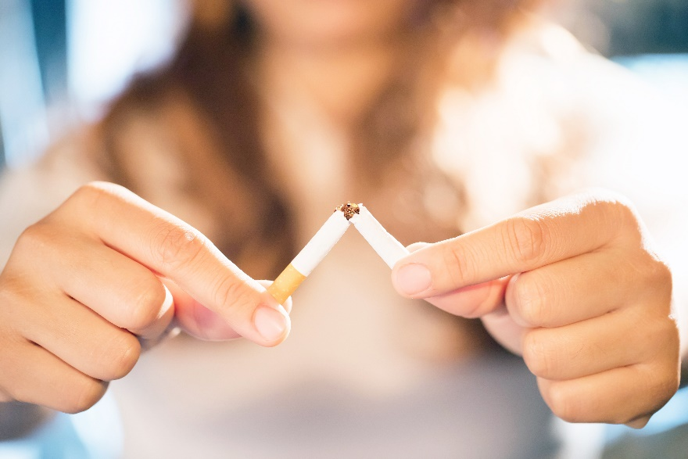
Recommendations for Providers
Clarify risk of tobacco and assess willingness to quit
Provide cessation tools
Screen for distress and assess challenges
Follow-up
CDC, 2020
Notes:
The following are recommendations for providers to address tobacco use in cancer survivors:
Clarify the risk of tobacco use after cancer diagnosis and assess the willingness to quit
Provide patients with cessation tools:
Tools:
Medications to reduce cravings to smoke (patches, gum, lozenges)
FDA-approved cessation medication such as Buproprion and Varenicline
Referral to counseling services (behavioral therapy) to provide support and strategies for coping with craving and withdrawal (face to face, group setting, virtual, or phone)
Free resources: 1-800- QUIT-NOW and smoke-free.gov
- Screen for distress and assess life challenges that may be connected to tobacco dependence
- Follow-up with the patient

Slide 58

Diet: Foods to Eat
  Plant foods, including vegetables, fruit and whole grains (at least 5 servings/day)
  Lean protein: fish, poultry and tofu
  Low-fat dairy: low fat milk, yogurt
  Healthy fats: avocados, nuts
  Benefits include:
  Aid in blocking the development of cancer
  Protect cells from unstable molecules
  Help manage weight
ACS, n.d.; NCCN, “Nutrition for cancer survivors”, n.d.
Notes:
Individuals with history of cancer should be encouraged to eat a healthy diet consistent with the ACS guidelines – mostly plant-based; variety of vegetables (dark green, red and orange, fiber-rich legumes) and fruit (a variety of colors); emphasis on whole rather than refined grains; choice of lean proteins and low-fat diary and use of healthy fats; limited amount of red and processed meats.
Recent reviews suggest that diet and food choices may affect cancer progression, risk for recurrence, and overall survival among a variety of cancer survivor groups. In addition, eating healthy may help manage weight, therefore it is important to achieve a dietary pattern that emphasizes nutritious, low calorie, plant foods, including vegetables, fruit and whole grains.
Please note that the majority of these studies have focused on breast cancer, but more evidence has also emerged relative to colorectal and prostate cancer survivors.
ACS Recommendations for Individual Choices
1. Eat a variety of healthful foods, with an emphasis on plant sources.
· Eat five or more servings of a variety of vegetables and fruits each day.
· Eat other foods from plant sources several times each day.
· Limit consumption of red meats, especially those high in fat and processed.
· Choose foods that maintain a healthful weight.

Slide 59

Diet: Foods to Limit or Avoid
  Processed foods: bacon, sausages, hot dogs
  Red meats: beef, pork, lamb
  Foods/beverages high in sugar: sugary deserts, soft drinks, fruit drinks
  Highly processed foods: French fries, frozen entrées like pizza
  Refined grain products: white bread and white rice
ACS, n.d.
Notes:
ACS guidelines recommend that the following foods should be limited or avoided for cancer survivors.
Processed foods: bacon, sausages, hot dogs
Red meats: beef, pork, lamb
Foods/beverages high in sugar: sugary deserts, soft drinks, fruit drinks
Highly processed foods: French fries, frozen entrées like pizza
Refined grain products: white bread and white rice
ACS Recommendations for Individual Choices
1. Eat a variety of healthful foods, with an emphasis on plant sources.
· Eat five or more servings of a variety of vegetables and fruits each day.
· Eat other foods from plant sources several times each day.
· Limit consumption of red meats, especially those high in fat and processed.
· Choose foods that maintain a healthful weight.

Slide 60
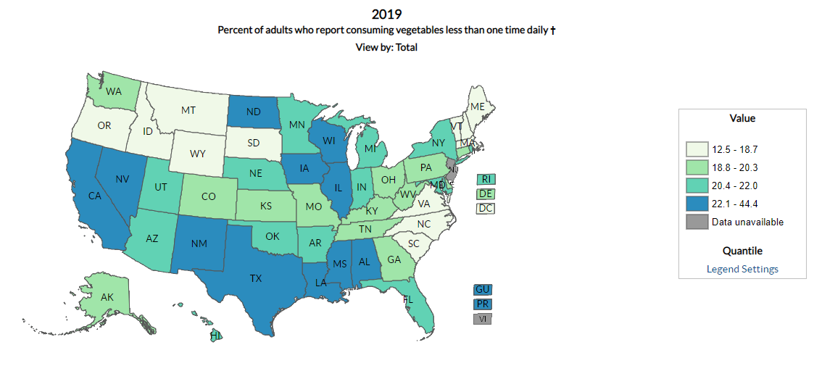
Vegetable Intake in U.S.
CDC DNPAO, 2019
Notes:
CDC Division of Nutrition, Physical Activity, and Obesity (DNPAO) Data, 2019
Eating a diet rich in fruits and vegetables can help reduce the risk of many leading causes of illness and death, such as cardiovascular disease, type 2 diabetes, some cancers, and obesity. Despite these positive health benefits, few adults meet the recommendations.
Only 9% of adults ate the recommended amount of vegetables and 12% of adults ate the recommended amount of fruit
The federal fruit and vegetable recommendations vary by age and sex:
For cancer risk reduction:
Adult women need at least 1½ cups of fruit and 2½ cups of vegetables each day
Adult men need at least 2 cups of fruit and 3½ cups of vegetables each day.

Slide 61
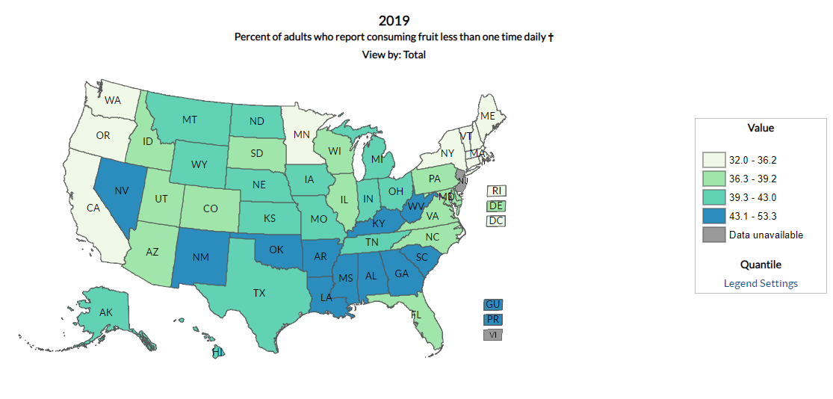
Fruit Intake in the U.S.
CDC DNPAO, 2019
Notes:
CDC Division of Nutrition, Physical Activity, and Obesity (DNPAO) Data, 2019
You can see similar trends in the US fruit intake.

Slide 62

Diet Types and Cancer
Plant based (vegan)
- No animal products
Mainly fruits, vegetables, nuts
Mediterranean
Fruits and vegetables
Fish
Olive oil
Meat
Dairy products
Whole grains
Molina-Montes, 2020; Inglis, 2018
Mentella et al., 2019
Notes:
But what about other diet types?
Plant-based diet has been attracting high numbers of followers in the recent years. While this diet has some elements of dietary pattern recommended for cancer survivors, it is a very strict diet limiting important sources of healthy fats or other nutrients/minerals. Even though, a meta-analysis done in 2020 confirmed that there is no sufficient evidence to state that vegan diet helps prevent negative cancer outcomes and there is more research to be done to investigate that connection; there is a growing number of studies showing that plant-based diet can be beneficial for cancer survivors. The results of qualitative review on various clinical trials targeted to reduce cancer related fatigue showed that vegan diet reduces inflammation in cancer survivors, therefore reducing the level of fatigue.
Mediterranean diet may contribute to the reduction of cancer onset since it's characterized by food of antioxidant and anti-inflammatory properties. In a recent breast cancer study on diet, the diet decreased the BC incidence by 6% in cases of high diet adherence. A high diet adherence reduced risk of colorectal cancer by 30% in men and 45% in women. A high MD adherence associated with a low incidence of prostate cancer and lower cancer malignancy. A high MD adherence also had beneficial effects in other cancers, such as lung, bladder, and head and neck cancer.

Slide 63
Dietary Supplements
Supplement Use
Top Supplemented Vitamins/Minerals
Vitamin D
Vitamin C
Reasons for Supplement Use
Improve health
Maintain health
70.4% report dietary supplement use
48.9% supplement multivitamins/minerals
Calcium
Vitamin E
Vitamin B-12
Improve bone health
Du et al., 2020
Notes:
Sometimes patients think that they can get additional vitamins and nutrients from various supplements instead of the meals they consume. More than 70% of cancer survivors report dietary supplement use and almost half use supplement vitamins and minerals. The most commonly used supplements are vitamins B-12, C, D, E and calcium. The main reasons for such supplement use are improving and maintaining health or hoping to improve bone health.
Recommendation: Ask your patients about supplement use to be sure that they are safe and appropriate for that patient’s clinical case.
From 2003-2016 NHANES

Slide 64

Alcohol and Cancer
Notes:
Another key element to prevent cancer recurrence is limiting alcohol consumption. Yet 56.5% of cancer survivors self-reported as current drinkers. 34.9% of current drinkers exceeded moderate drinking levels and 21% engage in binge drinking.

Slide 65
Limit Consumption of Alcoholic Beverages
Guidelines
Women: no more than one drink per day
Standard Drink
12 oz of beer
Men: no more than two drinks per day
5 oz of wine
1.5 oz of liquor
CDC, 2021; Dietary Guidelines for
Americans 2020-2025, n.d.
Notes:
The Dietary Guidelines for Americans recommends that adults who choose to drink should do so in moderation. Alcohol consumption should be limited to 2 drinks or less in a day for men or 1 drink or less in a day for women, on days when alcohol is consumed.
How do I know if my patient drinks excessively?
Binge Drinking:
Women: Four or more drinks during a single occasion
Men: 5 or more drinks in a single occasion
Heavy Drinking:
Women: 8 or more drinks per week
Men: 15 or more drinks per week
ACS Recommendations for Individual Choices
1. Eat a variety of healthful foods, with an emphasis on plant sources.
· Eat five or more servings of a variety of vegetables and fruits each day.
· Eat other foods from plant sources several times each day.
· Limit consumption of red meats, especially those high in fat and processed.
· Choose foods that maintain a healthful weight.

Slide 66
Alcohol and Cancer
Drinking alcohol increases risk of cancer:
Chronic Diseases
Learning and Memory Problems
Mental Health Issues
Social Problems
Alcohol Use Disorders
CDC, Alcohol Use and Your Health, 2021
Notes:
Besides being linked to the development of certain cancers, long-term alcohol consumption also contributes to the development of other health issues, such as chronic diseases (high-blood pressure, heart and liver disease, and stroke), learning and memory problems, mental health issues (depression, anxiety), social problems (unemployment, family problems), and alcohol use disorders.

Slide 67

Physical Activity: Weight Management and Risk Reduction
Notes:
Other ways to reduce cancer recurrence or second cancers include weight management, eating a diet high in fiber and low in fat, and being physically active.

Slide 68
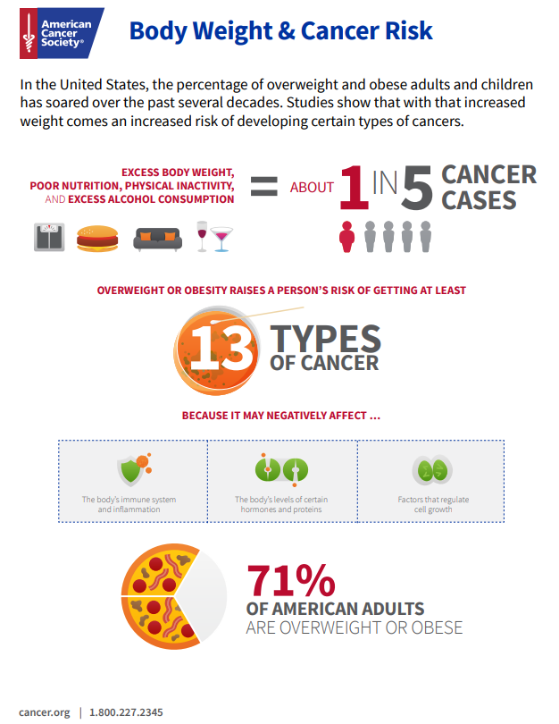
Body Weight and Cancer Risk
Body Weight Cancer Risk Infographic, ACS, 2021
Notes:
As you see in this infographic, excess body weight, poor nutrition, physical inactivity, and excess alcohol consumption has a positive correlation to 1 in 5 cancer cases.
Being overweight or obese raises one’s risk of getting thirteen different types of cancer.
71% of American adults are considered overweight or obese.

Slide 69
Reversing Weight Loss
Frequent small meals instead of fewer larger ones throughout the day
Light meals before chemotherapy
Map out eating schedule
Other types of therapies: medication, IV nutrient therapy
Referral to a nutritionist or dietitian
Cancer.net, 2020
Notes:
Weight loss is not always a good thing. Sometimes weight loss can occur due to cancer treatment or the disease itself. The main features of such weight loss are changes in metabolism, loss of skeletal muscle, fatigue, lack of appetite, decreased quality of life. These are recommendations to help increase and/or prevent a further loss of weight in patients:
Eat frequent small meals instead of fewer larger ones throughout the day
Light meals before chemotherapy
Map out eating schedule
Suggest your patient other types of therapies: medication, IV nutrient therapy
Refer the patient to a nutritionist or dietitian if needed

Slide 70
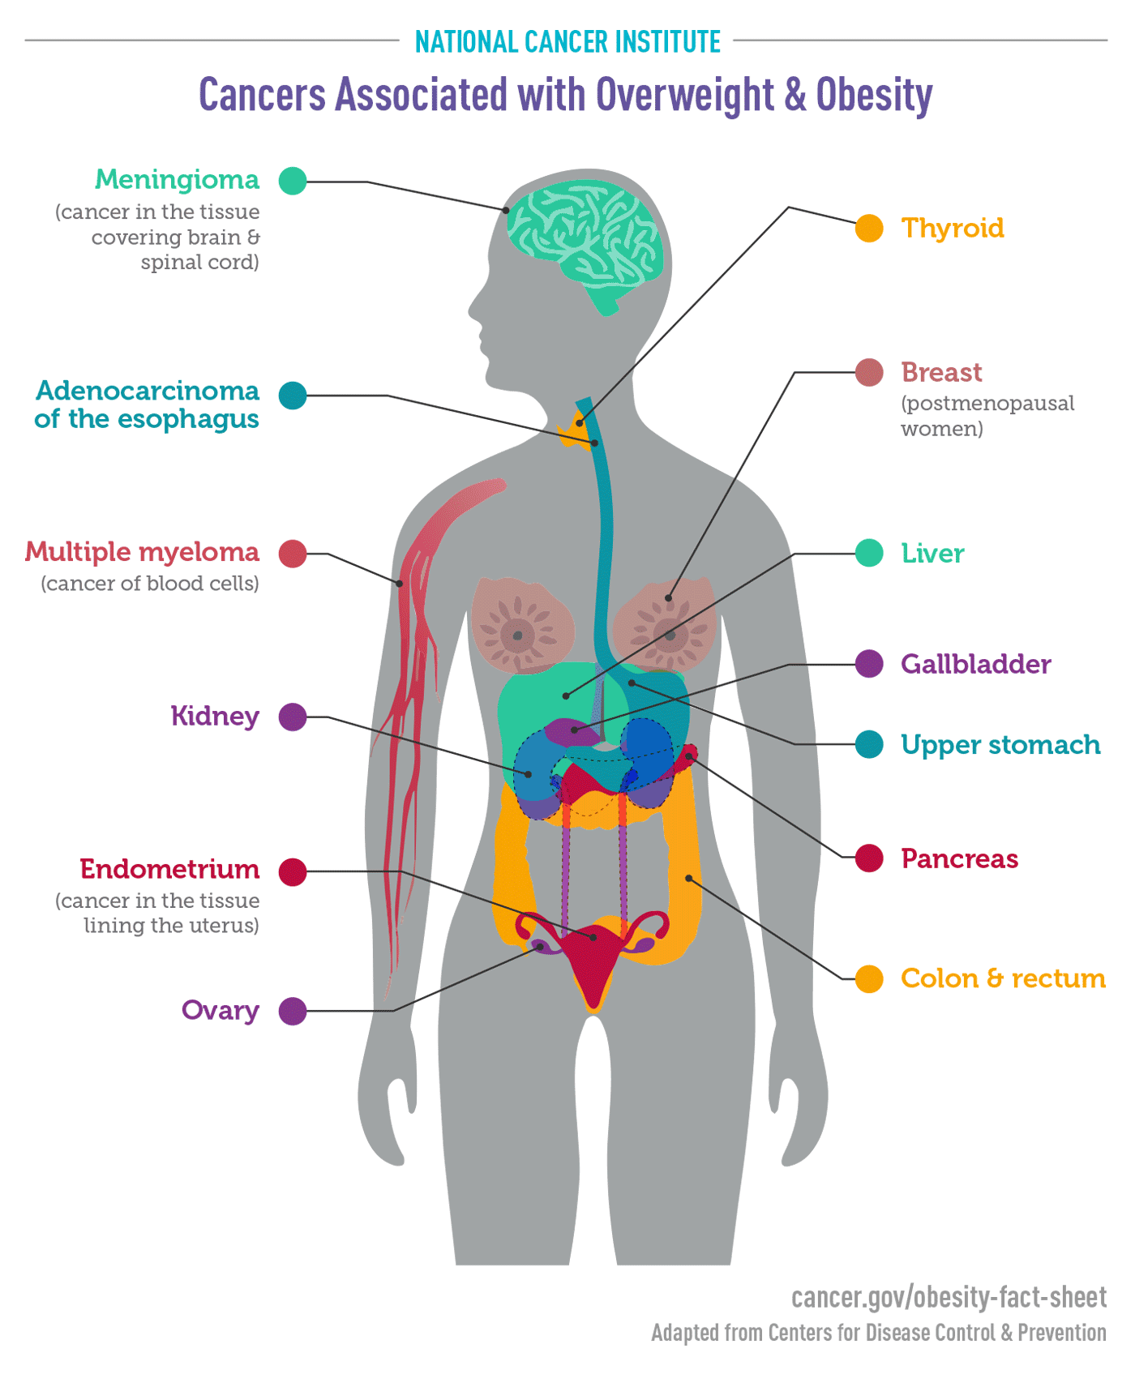
High Body Fat and Excess Weight
Increases risk for primary cancer recurrence
Reduces likelihood of disease-free and overall survival
Calle, et al, 2013NCI, n.d. (image), TFAH, 2020; Rock et al., 2012; Schmitz et al, 2013
Notes:
A healthy weight typically is a Body-Mass-Index between 18.5-24.9, though this can fluctuate based on body type. Help patients focus on being as physically active as they can be while developing healthy nutrition choices and reducing consumption of high calorie foods, sugar-sweetened beverages and alcohol.
High body fat is associated with increased risk of recurrence and decreased survival among people with a history of breast, prostate, or colorectal cancer.
Because breast cancer survivors make up the largest group of people living with a history of cancer, it should come as no surprise that most of the research in this area comes from studies of breast cancer survivors, but evidence is accumulating for other survivor groups – primarily prostate and colorectal cancer survivors.

Slide 71
Weight gain common with treatment for certain cancers or conditions:
Breast
Prostate
Ovarian
Hormone changes
Lymphedema
Certain types of therapy
ACS, 2021
Notes:
Some people with cancer find they don’t lose weight during treatment. They may even gain weight. This is particularly true for people with breast, prostate or ovarian cancer who are taking certain medicines or getting hormone therapy or certain kinds of chemotherapy or targeted therapy.
Many women with breast cancer gain weight during treatment, sometimes due to changes in hormone levels. Some may notice a weight gain if they have lymphedema.
People with certain kinds of cancer might have swelling in the abdomen that causes weight gain. Or weight gain due to certain anti-cancer drugs that cause the body to hold on to extra fluid.
.

Slide 72
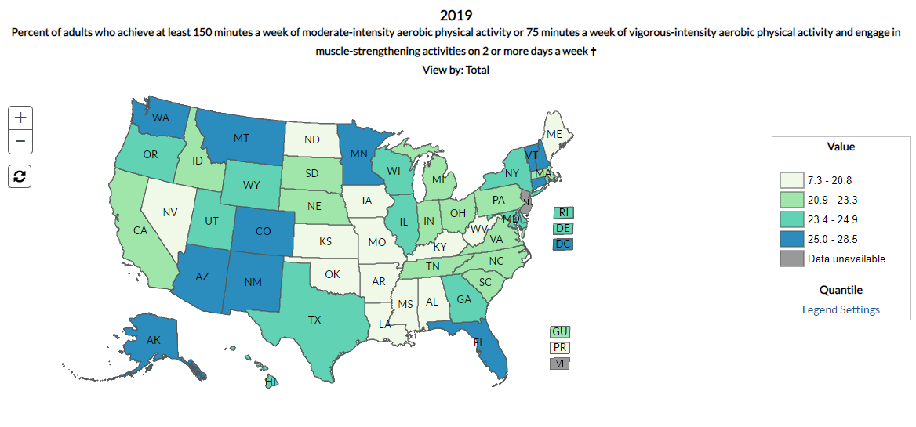
Physical Activity Levels in U.S.
Notes:
Percent of adults (age 18 years and older) in the United States who achieve at least 150 minutes a week of moderate-intensity aerobic physical activity or 75 minutes a week of vigorous-intensity aerobic physical activity and engage in muscle-strengthening activities on 2 or more days a week was equal to 7.3-28.5%. So approximately 70% of adults (without a cancer diagnosis) are already not even meeting the recommended criteria. (CDC Division of Nutrition, Physical Activity, and Obesity (DNPAO) Data, 2019)
Statistics from NCI show that in 2018 34.0% of adult cancer survivors in the U.S. (18 years and more) reported no physical activity in 2018. Growing number of research indicates that physical activity is crucial not only for preventing the recurrence of cancer, but for overall wellbeing as well. (NCI, 2018, Cancer.net, 2018)

Slide 73

Benefits of physical activity
Evidence linking higher physical activity are linked to lower risk of several types of cancers (e.g., bladder, breast, colon, endometrial, esophageal, gastric, and renal)
Eases physical side effects; fatigue, neuropathy, lymphedema, and osteoporosis
Reduces excess weight gain and obesity
Reduces risk of other health issues (diabetes, heart disease)
Reduces the risk of depression and anxiety
Improves sleep
Improves quality of life
ACS, n.d., McTiernan et al, 2019;
Notes:
Staying active has a lot of health benefits:
According to a 2019 systematic review of hundreds of studies, physical activity reduces risk of bladder, breast, colon, endometrial, esophageal adenocarcinoma, renal, and gastric cancers
Eases physical side effects; fatigue, neuropathy, lymphedema, and osteoporosis
Reduces the excess weight that can contribute to developing cancers related to high BMI (breast, colon, rectal cancers)
Reduces risk of other health issues (heart disease, diabetes)
Reduces the risk of depression and anxiety
Physically active individuals sleep better, feel better, and function better

Slide 74

Physical Activity Guidelines for Cancer Survivors
  Avoid inactivity
  Return to normal daily activities as soon as possible
  150-300 minutes of moderate (or 75-150 minutes of vigorous) activity per week
  Strength training exercises at least twice per week
ACS, n.d., American College of Sports Medicine, 2019
Notes:
Avoid inactivity, even a moderate amount of exercise daily has been proven to be beneficial
Return to normal daily activities as soon as possible
Aim for 150-300 minutes of moderate intensity (or 75-150 minutes of vigorous intensity) activity per week. Getting to, or exceeding the upper limit of 300 minutes is ideal
Include strength training exercises at least twice per week
Safe environment (labs should be normalized before exercising in a public gym)
Address limitations or dysfunction that is not improved with exercise (consider referral to specialist i.e., physical therapist, acupuncturist, massage therapist, neurologist, etc.)
.

Slide 75
Precautions During/Post-Treatment
No exercise if anemic
Compromised immune function – avoid gyms
Severe fatigue – light aerobic exercise for 10 min daily
Radiation – avoid chlorine
Indwelling catheter – avoid swimming, resistance training in area of catheter
Arthritis and neuropathy – watch balance (stationary bike instead of treadmill)
ACS, (n.d.), NCI (n.d.)
Notes:
It is always important to discuss with patient what kind of exercise they would like to engage into. However, there are a few criteria to be aware of:
No exercise if anemic: different sources have different suggestions for patients with anemia; some insist that anemic patients would not engage into any exercise, others suggest reduced activity that needs to be balanced with rest, such as short walks and naps. Each provider should consider each individual case of anemic patients in order to provide them with the best option;
If the immune function is compromised – avoid gyms
For severe fatigue – light aerobic exercise for 10min daily is recommended. As mentioned earlier, research has showed that physical activity helps fight fatigue, therefore each patient should be consulted individually, however very light aerobic activity should be considered.
Radiation – avoid chlorine for skin irritation
Indwelling catheter – avoid swimming in the pool, ocean, lake and resistance training in area of catheter
Arthritis and neuropathy – watch balance (stationary bike instead of treadmill)
As mentioned earlier, each patient needs to be evaluated individually and in addition to the criteria mentioned on this slide, it is important to let patient know that they shouldn’t push themselves to do any physical activity, especially if they are in pain, if sodium or potassium levels are low (due to excessive vomiting and diarrhea) or due to any of symptoms that are concerning.

Slide 76

Recommendation for the Providers
Discuss/assess/educate regarding patient nutritional habits (including alcohol)
Discuss/assess/educate regarding patient exercise habits
Consider a referral to Registered Dietician (if appropriate)
Consider a referral to outpatient therapies (physical therapy, lymphedema, occupational therapy, etc.)
Assess supplemental use for safety
Follow-up
Notes:
Recommendations for providers in regard to nutrition and physical activity:
Discuss/assess/educate on nutrition habits. Consider a referral to Registered Dietician for continued weight loss or weight gain depending on the situation.
Discuss patient physical activity level and their readiness for change (pre-contemplative, contemplative, preparation, action, or maintenance stage) if not meeting current guidelines. Discuss the health benefits of regular physical activity particularly related to that patient’s unique health concerns and needs. Consider a referral to a local fitness specialist or program if patient is ready (LiveStrong at the YMCA, Exercise Is Medicine, etc.)
Consider a referral to outpatient therapies if appropriate based on patient assessment. Patients may present with issues with gait and balance, cording, lymphedema, or severe fatigue, etc.
Assess supplemental use for safety
Follow-up with patients

Slide 77

Sun Protection
ACS, 2021
Notes:
Sunlight is the main source of UV radiation, even though UV rays make up only a small portion of the sun’s rays.
People can also be exposed to man-made sources of UV rays. These include sunlamps and sunbeds, phototherapy, black-light lamps, mercury-vapor lamps, high xenon arc lamps, plasma torches, and welding arcs.
Studies show basal and squamous cell skin cancers are linked to certain behaviors that put people in the sun, as well as a number of markers of sun exposure, such as:
Spending time in the sun for recreation (including going to the beach)
Spending a lot of time in the sun in a swimsuit
Living in an area that gets a lot of sunlight
Having had serious sunburns in the past (with more sunburns linked to a higher risk)
Having signs of sun damage to the skin, such as liver spots, actinic keratoses (rough skin patches that can be precancerous), and solar elastosis (thickened, dry, wrinkled skin caused by sun exposure) on the neck
Skin cancer survivors are 13 times (men) and 16 times (women) more likely to develop additional skin cancers
Survivors who have undergone radiation therapy are at increased risk of skin cancer

Slide 78
Sun Safety Recommendations
Limit UV exposure
Wear sunglasses that block UV radiation to protect skin around your eyes
Avoid tanning beds
Wear long sleeves and long pants
Use sunscreen products with a sun protection factor (SPF) of at least 30. Apply every 2 hours
Wear a hat that shades your face, neck, and ears
NCI, “Sunlight”, 2020; ACS 2021
Notes:
Sun Safety Recommendations:
Limit time in the sun between the hours of 10am and 4pm when UV rays are the strongest. If you are going to be out it is recommended one wears sunscreen with a sun protection factor of at least 30 and apply every two hours.
Reminder regarding sunscreen: Not all UV rays are blocked. It should not be used as a way to increase your time in the sun. Most sunscreens are good for two to three years after purchase.
Wear a hat that shades the face, neck, and ears. Wear long sleeves and pants and use sunglasses that block UV radiation to protect skin around your eyes.
Avoid tanning beds. Studies have found that people who use tanning beds have a higher risk of skin cancer, including melanoma and squamous and basal cell skin cancers. The risk of melanoma is higher if the person started indoor tanning before age 30 or 35, and the risk of basal and squamous cell skin cancer is higher if indoor tanning started before age 25.

Slide 79

Sexual Health
Notes:
Cancer treatment may cause severe side effects and affect patient’s sexual health.

Slide 80
Sexual Dysfunction
Most common side effects:
Painful intercourse
Body image distortion
Lower libido
Difficulty reaching climax
Erectile dysfunction for men
Vaginal dryness for women
ACS 2021
Notes:
Sex, sexuality, and intimacy are just as important for people with cancer as they are for people who don’t have cancer. In fact, sexuality and intimacy have been shown to help people face cancer by helping them deal with feelings of distress and when going through treatment. Sexual problems often develop because of physical and psychological side effects of cancer and cancer treatments. Some surgeries and treatments might have very little effect on a person's sexuality, sexual desire, and sexual function. Others can affect how a certain body part works, change hormone levels, or damage nerve function that can cause changes in a person's sexual function. Certain types of treatments have side effects such as fatigue, nausea, bowel or bladder problems, pain, and skin problems or other changes in appearance that might cause problems with sexuality. Some sexual problems get better or go away over time, but some are long-lasting and can be lifelong.
The most common side effects reported by the patients are the following: painful intercourse, body image distortion, lower libido, difficulty reaching climax, erectile dysfunction for men and vaginal dryness for women.

Slide 81
Woman at High Risk for Sexual Dysfunction
Cancer Treatments That Increase Risk | Sexual Problem | Mechanism
High-dose chemotherapy, Aromatase Inhibitors, Immunotherapy | Loss of desire for sex, trouble feeling aroused | Possible damage to brain centers Secondary endocrine changes Chronic fatigue, chronic pain syndromes, nausea, distress, body image issues
Abrupt, premature ovarian failure (chemotherapy, pelvic XRT, bilateral oophorectomy), Exacerbation of normal menopause (aromatase inhibitors), Pelvic radiation therapy | Genitourinary atrophy, dryness, pain | Severe estrogen deprivation and genitourinary atrophy Direct scarring, loss of elasticity, and loss of blood supply to genitals Scar tissue from pelvic surgery
Damage to spinal cord from tumor, surgery or radiation Loss of erotic breast sensation | Difficulty experiencing pleasure and reaching orgasm | Loss of physiologic sensation Secondary effects of low desire/arousal and pain
Creation of ostomy, Pelvic radiation therapy, Surgery for pelvic cancer | Urinary or bowel incontinence | Trouble managing ostomy during sex Scarring and contraction of organs Changed anatomy
ACS, 2021
Notes:
Please take a closer look at the table that represents sexual problems related to the cancer treatments and affected mechanism for women.
Hysterectomy shortens the vagina and may cause numbness in the genital area. Sex problems are likely to be somewhat worse and last longer for women who have pelvic radiation along with radical hysterectomy.
Some women may notice vaginal dryness, especially if their ovaries were removed. If so, a water-based gel lubricant can help make vaginal sex more comfortable. If scar tissue narrows the entrance to the vagina, penetration may be painful. Vaginal dilators can sometimes help stretch the opening. When scarring is severe, the surgeon may use skin grafts to widen the entrance. Vaginal moisturizers on the external genital area can also be very helpful and promote comfort.

Slide 82
Men at High Risk for Sexual Dysfunction
Cancer Treatments That Increase Risk | Sexual Problem | Mechanism
High-dose chemotherapy, Aromatase Inhibitors, Immunotherapy | Loss of desire for sex, trouble feeling aroused | Possible damage to brain centers Possible damage to nerve tissues Secondary endocrine changes Chronic fatigue, chronic pain syndromes, nausea, distress, body image issues
Pelvic radiation therapy | Genitourinary atrophy | Direct scarring, loss of elasticity, and loss of blood supply to genitals Scar tissue from pelvic surgery
Damage to spinal cord from tumor, surgery or radiation | Difficulty experiencing pleasure and reaching orgasm | Loss of physiologic sensation Secondary effects of low desire/arousal and pain
Creation of ostomy, Pelvic/abdominal surgery (radical prostatectomy, abdominoperineal resection, radical cystectomy) | Urinary or bowel incontinence | Trouble managing ostomy during sex Scarring and contraction of organs Changed anatomy
ACS, 2021
Notes:
Please take a few moments to look at the table that represents sexual problems related to the cancer treatments and affected mechanism for men.
Most men who had surgery for cancer will have some difficulty with erections (called erectile dysfunction or ED). Some men will be able to have erections firm enough for penetration, but probably not as firm as they were before. Others may not be able to get erections.
Prostate, bladder, colon, and rectal cancer are sometimes treated with radiation to the pelvis. This can cause problems with erections. The higher the total dose of radiation and the wider the section of the pelvis treated, the greater the chance of erection problems later.
Hormone treatment is commonly given for prostate cancer. Men given androgen deprivation therapy (ADT) are at a high risk for sexual problems, including loss of sexual desire and erectile dysfunction. Erections may or may not recover when ADT is stopped. Erectile dysfunction drugs do not usually work in these cases because they don't help with the loss of sexual desire.
Some chemo drugs (cisplatin, vincristine, paclitaxel, bortezomib, and thalidomide) can damage parts of the nervous system, usually the small nerves of the hands and feet. These drugs have not been found to directly injure the nerve bundles that allow erection. But some people have concerns because the drugs are known to affect nerve tissue, and there are many nerves involved in sexual function.
Stem cell transplant involves getting very high doses of chemotherapy drugs. One complication of a transplant is graft-versus-host disease. Men who have had graft-versus-host disease are more likely to have a long-lasting loss of testosterone. In some cases, these men may need testosterone replacement therapy to regain sexual desire and erections.
Some types of chemo can also cause short-term or life-long infertility.

Slide 83
Recommendations for Providers
Don't assume patient will ask you about these and other concerns about sexuality. Start the conversation
Ask permission to talk about the patient’s sexual health
Let patient know that treatment is available
Don’t assume sex is not important at different life stages
Share tip sheets and resources
Make appropriate referrals if needed (sex educator, counselor, or therapist)
Create an atmosphere of acceptance and inclusivity in the office
Klose, 2016; Taylor, 2020; ACS, 2021
Notes:
Again, sex, sexuality, and intimacy are just as important for people with cancer as they are for people who don’t have cancer.
Sexual dysfunction is a difficult topic for patients to talk about and for providers to bring up. A recent study showed that 87% of cancer survivors experienced sexual side effects of cancer treatment, however only 28% of the patients were specifically inquired about by the providers, males significantly more than females (53% vs 22%). In addition, the participants of this study reported the following side effects: painful intercourse (73%), body image distortion (54%), and inability to achieve orgasm (42%).
The following recommendations are for providers to talk about sexual health with their patients:
Don’t assume patient will ask you about these and other concerns about sexuality. Start the conversation.
Always ask permission to talk about the patient’s sexual health
Let patient know that treatment is available
Don’t assume sex or sexuality is not important at different stages of the cancer survivor's life.
Share tip sheets and resources
Make appropriate referrals if needed (sex educator, counselor, or therapist)
Create an atmosphere of acceptance and inclusivity in the office
Palliative care can help address sexuality and other quality of life concerns. Ask members of the palliative care team to help manage sexual problems. This team of professionals can help manage symptoms at any time from the point of diagnosis, throughout treatment, and beyond for people living with a serious illness, such as cancer.

Slide 84

Mental Health

Slide 85

Psychological Distress
People with history of cancer experience serious psychological distress twice as likely
Breast cancer survivors are at higher risk of anxiety, depression and suicide
Fear of cancer recurrence, psychological distress, anxiety, depression and PTSD are common psychological issues among cancer survivors
Hoffman, 2009; Carreira, 2018; Recklitis, 2017
Notes:
Compared to individuals who have never had cancer, cancer survivors experience serious psychological distress twice as likely (5.6% vs 3.0%).
Based on a recent systematic review it has been found that breast cancer survivors are at higher risk of anxiety, depression and suicide compared to women without cancer.
Cancer survivors identify the following psychological issues as the most important: fear of cancer recurrence, psychological distress, anxiety, depression and PTSD.

Slide 86
Effective Interventions
Internet-delivered cognitive behavioral therapy (iCBT)
Mindfulness
Relaxation techniques
Counseling
Group therapy
Yoga
Mental imagery
Stanton, 2015; Murphy 2020; Beatty, 2015; Mehta, 2019; NCI, 2019
Notes:
Patients should be assessed for distress, anxiety and depression or other mental health concerns throughout the cancer continuum (diagnosis, treatment, post-treatment, survivorship).
The following are effective evidence based interventions for improving mental health in cancer survivors:
Evidence has showed that internet-delivered cognitive behavioral therapy (iCBT) has been effective in reducing depression, anxiety, distress.
According to research, mindfulness reduces the toxicity of cancer diagnosis and its treatment.
Other types of strategies include: relaxation techniques, counselling, group therapy, meditation, yoga, mental imagery exercises and others.

Slide 87

Genetics and Family History
Only 5-10% of all cancers result directly from gene defects (mutations) inherited from a parent
Mutations in genes can affect how the gene works. It may stop the gene from working, or keep the gene turned on even when it is not needed
Many cancers in a family is often due do to chance, or common risk factors, such as smoking
Family Cancer Syndromes, ACS, 2021
Notes:
Gene mutations can be either inherited or acquired.
An inherited gene mutation is present from birth. When the egg is fertilized by the sperm, it creates one cell that then divides many times and eventually becomes a baby. Since all the cells come from this first cell, this kind of mutation is in every cell and so can be passed on to the next generation.
An acquired (somatic) mutation does not come from a parent but is acquired some time later. It starts in one cell, and then is passed on to any new cells that are created from that cell. This kind of mutation is not present in egg or sperm cells, so it is not passed on to the next generation. Acquired mutations are much more common than inherited mutations. Most cancers are caused by acquired mutations.
You have 2 copies of most genes – one from each parent. One might inherit a mutation in one gene, but still be okay because the other gene copy works fine. If though, the other gene stops working (because of an acquired mutation for example) then the gene’s function is lost altogether. If the gene that stops working happens to be a tumor suppressor gene, cells can grow out of control and lead to cancer.

Slide 88

Family Cancer Syndromes
Many cases of the same cancer in a family (especially if uncommon or rare cancer)
  Hereditary breast and ovarian cancer (HBOC)
  Lynch syndrome (HNPCC)
  - Li-Fraumeni syndrome
Family Cancer Syndromes, ACS, 2021
Notes:
Less often, cancers in a family are strongly linked to an inherited gene mutation that is part of a family cancer syndrome.
We have a few examples here, but this is by no means a complete list:
HBOC is caused by an inherited mutation in either the BRCA1 or BRCA2 gene, and risk of cancer in these individuals is very high. HBOC are cancers typically found in woman who are younger than the usual age these cancers are found in. Women can have cancer in both breasts, or both breast and ovarian cancer. If someone has a BRCA mutation, it means that their close relatives (parents, siblings, and children) have a 50% chance of having a mutation as well.
Lynch syndrome (hereditary non-polyposis colorectal cancer) is most common inherited syndrome that increases a person’s risk for colon cancer. Typically develop before age 50. Lynch syndrome can be caused by a mutation in any of several mismatch repair genes that are involved in repairing damaged DNA. Those with lynch syndrome are at high risk for endometrial, ovarian, stomach, small intestine, pancreas, kidney, and brain cancer.
Li-Fraumeni syndrome is a rare inherited syndrome that can lead to the development of a number of cancers, including sarcoma (such as osteosarcoma and soft-tissue sarcomas, leukemia, brain (central nervous system) cancers, cancer of the adrenal cortex and breast cancer. These cancers often develop when people are relatively young. This syndrome is often caused by inherited mutations in the TP53 gene, which is a tumor suppressor gene, but can also be caused by mutation in another tumor suppressor gene known as CHEK2.

Slide 89
Recommendations for Providers
1 in 3 people in the United States will develop cancer during their lifetime
Patients with certain gene mutations are at higher risk for a second primary cancer as they age
Refer to NCCN guidelines for recommendations on surveillance
Family Cancer Syndromes, ACS, 2021
Notes:
Recommendations and reminders for providers:
1 in 3 people in the United States will develop cancer during their lifetime. Not uncommon to have many cancers in a family
There are those patients that will have had genetic testing and carry gene mutations that place them at higher risk for another primary cancer during their lifetime. Increased surveillance is warranted for his population along with providing education on risk reduction strategies like those covered in this presentation. A great resource for providers on surveillance guidelines would be NCCN (National Comprehensive Cancer Network)

Slide 90
How You Can Help
Encourage
Smoking
Cessation
Encourage
sun safety
Promote
Healthy Eating
Clinicians
Support Mental
Wellbeing
Encourage
Activity
Be A
Good
Role
Model
Notes:
Routine and recommended follow-up care should be encouraged. Assessing barriers to follow-up care should be addressed (financial hardship, transportation, fear of recurrence, etc.).
It is important to encourage the general public and cancer survivors to adopt a healthy lifestyle: don’t use tobacco; eat well, be active, watch your weight; limit alcohol consumption; practice sun safety and take care of your mental health.
Cancer mortality rates are dropping, and with all of our combined efforts, we can continue to see those rates drop. It will take all of us encouraging and supporting individuals in making lasting behavior changes, and advocating for changes in our communities, schools, workplaces that make it easier for people to do that.

Slide 91
References
American Cancer Society. (2019). Cancer treatment & survivorship facts & figures 2019-2021. Retrieved from
https://www.cancer.org/research/cancer-facts-statistics/survivor-facts-figures.html
American Cancer Society. (n.d.). Emotional, mental health, and mood changes. Retrieved from
https://www.cancer.org/treatment/treatments-and-side-effects/physical-side-effects/emotional-mood-changes.html
American Cancer Society. (n.d.). Family and sexual side effects in people with cancer. Retrieved from
https://www.cancer.org/treatment/treatments-and-side-effects/physical-side-effects/fertility-and-sexual-side-effects.html
American Cancer Society. (2017). More than 4 in 10 Cancers and Cancer Deaths Linked to Modifiable Risk Factors. Retrieved from: https://www.cancer.org/latest-news/more-than-4-in-10-cancers-and-cancer-deaths-linked-to-modifiable-risk-factors.html
American Cancer Society. (n.d.). Nutrition and Physical Activity Guidelines for Cancer Survivors. Retrieved from: https://www.cancer.org/health-care-professionals/american-cancer-society-prevention-early-detection-guidelines/nupa-guidelines-for-cancer-survivors.html
American Cancer Society. (n.d.). Physical activity and the cancer patient. Retrieved from
https://www.cancer.org/treatment/survivorship-during-and-after-treatment/staying-active/physical-activity-and-the-cancer-
patient.html#:~:text=The%20American%20Cancer%20Society%20recommends,least%20150%20minutes%20per%20week.
American College of Sports Medicine. (2019). New infographic available: Exercise guidelines for cancer patients and survivors.
Retrieved from https://www.acsm.org/read-research/newsroom/news-releases/news-detail/2019/11/27/new-infographic-
available-exercise-guidelines-cancer-patients-survivors.
Anderson, A.S., Martin, R.M., Renehan, A.G. et al. (2021). Cancer survivorship, excess body fatness and weight-loss intervention—where are we in 2020?. British Journal of Cancer, 124, 1057–1065 (2021). https://doi.org/10.1038/s41416-020-01155-2
Notes:
American Cancer Society. (2021). Family Cancer Syndromes. Retrieved from https://www.cancer.org/cancer/cancer-causes/genetics/family-cancer-syndromes.html
American Cancer Society. (2021). Sex and the Adult Male with Cancer. Retrieved from https://www.cancer.org/treatment/treatments-and-side-effects/physical-side-effects/fertility-and-sexual-side-effects/sexuality-for-men-with-cancer.html
American Cancer Society. (2021). Sex and the Adult Female with Cancer. Retrieved from https://www.cancer.org/treatment/treatments-and-side-effects/physical-side-effects/fertility-and-sexual-side-effects/sexuality-for-women-with-cancer.html
American Cancer Society. (2021). Fertility and Sexual Side Effects in People with Cancer. Retrieved from https://www.cancer.org/treatment/treatments-and-side-effects/physical-side-effects/fertility-and-sexual-side-effects.html
American Cancer Society. (2021). How Do I Protect Myself From Ultraviolet (UV) Rays?. Retrieved from https://www.cancer.org/healthy/be-safe-in-sun/uv-protection.html
American Cancer Society. (2021). Ultraviolet (UV) Radiation. Retrieved from https://www.cancer.org/cancer/cancer-causes/radiation-exposure/uv-radiation.html
CDC Division of Nutrition, Physical Activity, and Obesity (DNPAO). (2021). Data Trends and Maps: Adults Aerobically Active 150 minutes in 2019. Retrieved from https://nccd.cdc.gov/dnpao_dtm/rdPage.aspx?rdReport=DNPAO_DTM.ExploreByTopic&islClass=PA&islTopic=PA1&islYear=20192019
CDC Division of Nutrition, Physical Activity, and Obesity (DNPAO). (2021). Data Trends and Maps: Percentage of adults consuming fruit less than one time per day - 2019. Retrieved from https://nccd.cdc.gov/dnpao_dtm/rdPage.aspx?rdReport=DNPAO_DTM.ExploreByTopic&islClass=PA&islTopic=PA1&islYear=20192019
CDC Division of Nutrition, Physical Activity, and Obesity (DNPAO). (2021). Data Trends and Maps: Percentage of adults who report consuming fruit less than one time per day - 2019. Retrieved from https://nccd.cdc.gov/dnpao_dtm/rdPage.aspx?rdReport=DNPAO_DTM.ExploreByTopic&islClass=PA&islTopic=PA1&islYear=20192019
CDC Division of Nutrition, Physical Activity, and Obesity (DNPAO). (2021). Data Trends and Maps: Percentage of adults who report consuming vegetables less than one time per day - 2019. https://nccd.cdc.gov/dnpao_dtm/rdPage.aspx?rdReport=DNPAO_DTM.ExploreByTopic&islClass=PA&islTopic=PA1&islYear=20192019
American Cancer Society. (2021). Infographic: Body Weight and Cancer Risk. Retrieved from https://www.cancer.org/cancer/cancer-causes/diet-physical-activity/body-weight-and-cancer-risk/infographic.html
CDC. (2021). Alcohol Use and Your Health. Retrieved from https://www.cdc.gov/alcohol/pdfs/alcoholyourhealth.pdf
CDC. (2021). Alcohol and Public Health. Retrieved from https://www.cdc.gov/alcohol/fact-sheets/alcohol-use.htm
CDC. (2021). Caring for Cancer Survivors Who Use Tobacco. Retrieved from https://www.cdc.gov/cancer/survivors/health-care-providers/tobacco-use.htm
NCI. (2021). Cancer Prevention Overview (PDQ®)–Health Professional Version. Retrieved from https://www.cancer.gov/about-cancer/causes-prevention/hp-prevention-overview-pdq?cid=eb_govdel#_127_toc
American Cancer Society. Cancer Treatment & Survivorship Facts & Figures 2019-2021. Atlanta: American Cancer Society; 2019.

Slide 92
References
Barbor, M. (2018). Obesity in cancer survivors: Identifying teachable moments. The ASCO Post. Retrieved from:
https://ascopost.com/issues/may-10-2018/obesity-in-cancer-survivors/
Beatty, L., Koczwara, B., & Wade, T. (2016). Evaluating the efficacy of a self-guided web-based CBT intervention for reducing
cancer-distress: A randomised controlled trial. Supportive Care in Cancer : Official Journal of the Multinational Association of
Supportive Care in Cancer, 24(3), 1043–1051. https://doi.org/10.1007/s00520-015-2867-6
Cancer.net. (2018). An exercise program for you: 5 tips for people with cancer. Retrieved from:
https://www.cancer.net/blog/2018-09/exercise-program-you-5-tips-people-with-cancer.
Cancer.net. (2020). Weight loss. Retrieved from: https://www.cancer.net/coping-with-cancer/physical-emotional-and-social-
effects-cancer/managing-physical-side-effects/weight-loss
Carter, J., Lacchetti, C.,& Rowland, J. H. (2017). Interventions to address sexual problems in people with cancer: American
Society of Clinical Oncology practice guideline adaption summary. Journal of Oncology Practice, 14(3), 173-180.
doi: https://doi.org/10.1200/JOP.
Calle, E. E., Rodriguez, C., Walker-Thurmond, K., & Thun, M. J. (2003). Overweight, obesity, and mortality from cancer in a
prospectively studied cohort of U.S. adults. New England Journal of Medicine 348(17):1625-1638.
Carreira, H., Williams, R., Müller, M., Harewood, R., Stanway, S., & Bhaskaran, K. (2018). Associations between breast cancer
survivorship and adverse mental health outcomes: A systematic review [published correction appears in J Natl Cancer Inst.
2020 Jan 1;112(1):118]. Journal of the National Cancer Institute 110(12):1311-1327. doi:10.1093/jnci/djy177
Centers for Disease Control and Prevention. (n.d.). Smoking and cardiovascular disease. Retrieved from:
https://www.cdc.gov/tobacco/data_statistics/sgr/50th-anniversary/pdfs/fs_smoking_CVD_508.pdf

Slide 93
References
Centers for Disease Control and Prevention. (2019). Cancer: Alcohol and cancer. Retrieved
from https://www.cdc.gov/cancer/alcohol/index.htm.
Centers for Disease Control and Prevention. (2016). Cancers linked to tobacco use make up 40% of all cancers diagnosed in the
United States. Retrieved from https://www.cdc.gov/media/releases/2016/p1110-vital-signs-cancer-
tobacco.html#:~:text=Tobacco%20use%20is%20the%20leading,leukemia%20(acute%20myeloid%20leukemia).
Centers for Disease Control and Prevention. (2020). Cancer survivors: Information for healthcare providers. Retrieved from
https://www.cdc.gov/cancer/survivors/health-care-providers/index.htm
Centers for Disease Control and Prevention.(2020). Caring for cancer survivors who use tobacco. Retrieved from:
http://www.cdc.gov/cancer/survivors/health-care-providers/tobacco-
use.htm#:~:text=What%20are%20the%20health%20risks,18%25%20of%20survivors%20smoke%20cigarettes.&text=A%20
higher%20percentage%20of%20survivors,cigarettes%20compared%20with%20older%20survivors.
Centers for Disease Control and Prevention. (2020). Smoking and tobacco use: Health effects of secondhand smoke. Retrieved
from https://www.cdc.gov/tobacco/data_statistics/fact_sheets/secondhand_smoke/health_effects/index.htm.
Centers for Disease Control and Prevention. (2021). Smoking and heart disease and stroke. Retrieved from:
https://www.cdc.gov/tobacco/campaign/tips/diseases/heart-disease-stroke.html
Centers for Disease Control and Prevention.(n.d.). Smoking and respiratory diseases. Retrieved from:
https://www.cdc.gov/tobacco/data_statistics/sgr/50th-anniversary/pdfs/fs_smoking_respiratory_508.pdf

Slide 94
References
Dietary Guidelines for Americans 2015-2020. (n.d.). Appendix 9. Alcohol. Retrieved from https://health.gov/our-work/food-
nutrition/2015-2020-dietary-guidelines/guidelines/appendix-9/.
Doleman, B., Mills, K. T., Lim, S., Zelhart, M. D., & Gagliardi, G. (2016). Body mass index and colorectal cancer prognosis: a systematic review and meta-analysis. Techniques in coloproctology, 20(8), 517–535. https://doi.org/10.1007/s10151-016-1498-3
Du, M., Luo, H., Blumberg, J. B., Rogers, G., Chen, F., Ruan, M., Shan, Z., Biever, E., & Zhang, F. F. (2020) Dietary supplement
use among adult cancer survivors in the United States. The Journal of Nutrition, 150(6), 1499-1508.
Hoffman, K. E., McCarthy, E. P., Recklitis, C. J., & Ng, A. K. (2009). Psychological distress in long-term survivors of adult-onset
cancer results from a national survey. Archives of Internal Medicine 169(14):1274-1281. doi: 10.1001/archinternmed.2009.179
Inglis, J. E., Lin, P. J., Kerns, S. L., Kleckner, I. R., Kleckner, A. S., Castillo, D. A., Mustian, K. M, & Peppone, K. J.
(2018). Nutritional interventions for treating cancer-related fatigue: A qualitative review. Nutrition and Cancer 71, 21-40. doi:
https://doi.org/10.1080/01635581.2018.1513046
Jassem J. (2019). Tobacco smoking after diagnosis of cancer: clinical aspects. Translational lung cancer research, 8(Suppl 1),
S50–S58. https://doi.org/10.21037/tlcr.2019.04.01
Jochems, S. H. J., Van Osch, F. H. M., Bryan, R. T., Wesselius, A., van Schooten, F. J., Cheng, K. K., & Zeegers, M. P. (2018).
Impact of dietary patterns and the main food groups on mortality and recurrence in cancer survivors: a systematic review of
current epidemiological literature. BMJ Open 8(2), e014530. doi: 10.1136/bmjopen-2016-014530
Kosko, K. (2016). Expert shares tips for talking sexual health with cancer survivors. Oncology Nursing News. Retrieved from:
https://www.oncnursingnews.com/view/expert-shares-tips-for-talking-sexual-health-with-cancer-survivors

Slide 95
References
McTiernan, A., Friedenreich, C. M., Katzmarzyk, P.T., Powell, K. E., Macko, R., Buchner, D., Pescatello, L. S., Bloodgood, B.,
Tennant, B., Vaux-Bjerke, A., George, S. M., Troiano, R. P., & Piercy, K. L. (2019). Physical activity in cancer prevention and
survival: A systematic review. Medicine and Science in Sports and Exercise 51(6): 1252–1261. doi:
10.1249/MSS.0000000000001937
Mehta, R., Sharma, K., Potters, L., Wernicke, A. G., & Parashar, B. (2019). Evidence for the role of mindfulness in cancer:
Benefits and techniques. Cureus, 11(5), e4629. https://doi.org/10.7759/cureus.4629
Mentella, M. C., Scaldaferri, F., Ricci, C., Gasbarrini, A., & Miggiano, G. A. D. (2019) Cancer and mediterranean diet: A review.
Nutrients, 11(9), 2059. doi: https://dx.doi.org/10.3390%2Fnu11092059.
Meyerhardt, J. A., Niedzwiecki, D., & Hollis, D. (2007). Association of dietary patterns with cancer recurrence and survival
in patients with stage III colon cancer. The Journal of the American Medical Association, 298(7), 754-
764. doi: 10.1001/jama.298.7.754.
Molina-Montes E., Salamanca-Fernández E., Garcia-Villanova B., Sánchez M. J. (2020). Nutrients 12(7),
2010 doi: https://doi.org/10.3390/nu12072010
Morales-Oyarvide, V., Yuan, C., Babic, A., Zhang, S., Niedzwiecki, D., Brand-Miller, J. C., Sampson-Kent, L., Ye, X., Li, Y., Saltz,
L. B., Mayer, R. J., Mowat, R. B., Whittom, R., Hantel, A., Benson, A., Atienza, D., Messino, M., Kindler, H., Venook, A., … &
Ng, K. (2019). Dietary insulin load and cancer recurrence and survival in patients with stage III colon cancer: Findings from
CALGB 89803 (Alliance). Journal of the National Cancer Institute 111(2), 170–179, https://doi.org/10.1093/jnci/djy098
Murphy, M. J., Newby, J. M., Butow, P., Loughnan, S. A., Joubert, A. E., Kirsten, L., Allison, K., Shaw, J., Shepherd, H. L., Smith,
J., & Andrews, G. (2020). Randomised controlled trial of internet-delivered cognitive behaviour therapy for clinical depression
and/or anxiety in cancer survivors (iCanADAPT Early). Psycho-oncology, 29(1), 76–85. https://doi.org/10.1002/pon.5267

Slide 96
References
National Comprehensive Cancer Network. (n.d.) Exercise during cancer treatment. Retrieved
from https://www.nccn.org/patients/resources/life_with_cancer/exercise.aspx.
National Comprehensive Cancer Network. (n.d). Nutrition for cancer survivors. Retrieved
from https://www.nccn.org/patient/resources/life_after_cancer/nutrition.aspx#:~:text=Nevertheless%2C%20there%20is%20
strong%20evidence,breast%2C%20colon%20and%20stomach%20cancers.
National Cancer Institute. (2019). Adjustment to cancer: Anxiety and distress (PDQ®)–Patient version. Retrieved from:
https://www.cancer.gov/about-cancer/coping/feelings/anxiety-distress-pdq
National Cancer Institute. (2018). Alcohol and cancer risk. Retrieved from: https://www.cancer.gov/about-cancer/causes-
prevention/risk/alcohol/alcohol-fact-sheet#how-does-the-combination-of-alcohol-and-tobacco-affect-cancer-risk
National Cancer Institute. (2018). Cancer trends report. Retrieved from: https://progressreport.cancer.gov/after/physical_activity
National Cancer Institute. (2015). Risk factors for cancer. Retrieved from
https://www.cancer.gov/about-cancer/causes-prevention/risk.
National Cancer Institute. (n.d.). Anemia and cancer treatment. Retrieved at
https://www.cancer.gov/about-cancer/treatment/side-effects/anemia
National Cancer Institute. (2020). Sunlight. Retrieved from https://www.cancer.gov/about-cancer/causes-prevention/risk/sunlight.
National Cancer Institute. (2017). Tobacco. Retrieved from https://www.cancer.gov/about-cancer/causes-prevention/risk/tobacco.
Overholser, L. S. & Callaway, C. (2018). Preventive health in cancer survivors: What should we be recommending? Journal of the
National Comprehensive Cancer Network, 16(10), 1251-1258. doi: https://doi.org/10.6004/jnccn.2018.7083.

Slide 97
References
Park, E. R., Perez, G. K., Regan, S., Muzikansky, A., Levy, D. E., Temel, J. S., Rigotti, N. A., Pirl, W. F., Irwin, K. E., Partridge, A.
H., Cooley, M. E., Friedman, E. R., Rabin, J., Ponzani, C., Hyland, K. A., Holland, S., Borderud, S., Sprunck, K., Kwon, D.,
Peterson, L., … Ostroff, J. S. (2020). Effect of sustained smoking cessation counseling and provision of medication vs
shorter-term counseling and medication advice on smoking abstinence in patients recently diagnosed with cancer: A
randomized clinical trial. JAMA, 324(14), 1406–1418. https://doi.org/10.1001/jama.2020.14581
Playdon, M. C., Bracken, M. B., Sanft, T. B., Ligibel, J. A., Harrigan, M., & Irwin, M. L. (2015). Weight gain after
breast cancer diagnosis and all-cause mortality: Systematic review and meta-analysis. Journal of the National Cancer
Institute, 107(12). doi: https://doi.org/10.1093/jnci/djv275.
Recklitis, C. J., & Syrjala, K. L. (2017). Provision of integrated psychosocial services for cancer survivors post-treatment. The
Lancet: Oncology, 18(1), e39–e50. https://doi.org/10.1016/S1470-2045(16)30659-3
Rock, C. L., Doyle, C., Demark-Wahnefried, W., Meyerhardt, J., Courneya, K. S., Schwartz, A. L., Bandera, E. V., Hamilton, K. K.,
Grant, B., McCullough, M., Byers, T., & Gansler, T. (2012). Nutrition and physical activity guidelines for cancer survivors. A
Cancer Journal for Clinicians, 62(4). doi: https://doi.org/10.3322/caac.21142.
Rock, C. L., Flatt, S. W., Byers, T. E., Colditz, G. A., Demark-Wahnefried, W., Ganz, P. A., Wolin, K. Y., Elias, A., Krontiras, H.,
Lui, J., Naughton, M., Pakiz, B., Parker, B. A., Sedjo, R. L., Wyatt, H. (2015). Results of the Exercise and Nutrition to Enhance
Recovery and Good Health for You (ENERGY) trial: A behavioral weight loss intervention in overweight or obese breast cancer
survivors. Journal of Clinical Oncology, 33(28), 3169-3176.

Slide 98
References
Roy, A., Rawal, I., Jabbour, A., et al. (2017). Tobacco and cardiovascular disease: A summary of evidence. In Prabhakaran, D.,
Anand, S., Gaziano, T. A., et al. (Eds), Cardiovascular, respiratory, and related disorders. The International Bank
for Reconstruction and Development / The World Bank. Available
from https://www.ncbi.nlm.nih.gov/books/NBK525170/ doi: 10.1596/978-1-4648-0518-9_ch4.
Rutledge, L. & Demark-Wahnefried, W. (2016). Weight management and exercise for cancer survivors. Clinical
Journal of Oncology Nursing, 20(2), 129-132. doi: https://doi.org/10.1188/16.CJON.129-132.
Sanford, N. N., Sher, D. J., Xu, X., Ahn, C., D’Amico, A. V., Aizer, A. A., Mahal, B. A. (2020). Alcohol use among patients with
cancer and survivors in the United States, 2000-2017. Journal of the National Comprehensive Cancer Network, 18(1), 69-
79. doi: https://doi.org/10.6004/jnccn.2019.7341.
Schmitz, K. H., Neuhouser, M. L., Agurs-Collins, T., Zanetti, K. A., Cadmus-Bertram, L., Dean, L. T., & Drake, B. F. (2013). Impact
of obesity on cancer survivorship and the potential relevance of race and ethnicity. Journal of the National Cancer Institute
105(18), 1344-1354.
Schwedhelm, C., Boeing, H., Hoffmann, G., Aleksandrova, K., & Schwingshackl, L. (2016). Effect of diet on mortality and cancer
recurrenve among cancer survivors: A systematic review and meta-analysis of cohort studies. Nutrition Reviews, 74(12), 737-
748. doi: 10.1093/nutrit/nuw045.
Sheehan, P., Denieffe, S., Murphy, N. M. , Harrison, M. (2020). Exercise is more effective than health education
in reducing fatigue in fatigued cancer survivors. Supportive Care in Cancer 28, 4953–4962.
Simon, S. (2017). 6 steps to help lower your cancer risk. American Cancer Society. Retrieved from
https://www.cancer.org/latest-news/6-steps-to-help-lower-your-cancer-risk.html

Slide 99
References
Stanton, A. L., Rowland, J. H., & Ganz, P. A. (2015). Life after diagnosis and treatment of cancer in adulthood: contributions from
psychosocial oncology research. The American Psychologist 70(2):159-174. doi: 10.1037/a0037875.
Taylor, J., Ruggiero, M., Maity, A., Ko, K., Greenberger, B., Donofree, D., Sherif, K., Lazar, M., Jaslow, R., Richard, S., Mitchell,
E., Anne, P. R., Trabulsi, E.,. Leader, A., & Simone, N.L. (2020). Sexual health toxicity in cancer survivors: Is there a gender
disparity in physician evaluation and intervention? Internal Journal of Radiation Oncology, 108(3), Supplement, S136. doi:
https://doi.org/10.1016/j.ijrobp.2020.07.872
Trust for America’s Health. The state of obesity 2020: Better policies for a healthier America.
Retrieved from: https://www.tfah.org/report-details/state-of-obesity-2020.
Warren, G. W., Cartmell, K. B., Garrett-Mayer, E., Salloum, R. G., & Cummings, K. M. (2019). Attributable failure of first-line
cancer treatment and incremental costs associated with smoking by patients with cancer. JAMA Network Open, 2(4),
e191703. https://doi.org/10.1001/jamanetworkopen.2019.1703
World Health Organization. (2019). WHO highlights huge scale of tobacco-related lung disease deaths. Retrieved from: https://www.who.int/news/item/29-05-2019-who-highlights-huge-scale-of-tobacco-related-lung-disease-deaths
Zhou, E. S., Nekhlyudov, L., & Bober, S. L. (2015). The primary health care physician and the cancer patient: tips and strategies
for managing sexual health. Translational Andrology and Urology, 4(2), 218–231.
https://doi.org/10.3978/j.issn.22234683.2014.11.07

Slide 100
Thank you!
Follow us on Twitter: @GWCancer
www.gwcancercenter.org
Sign-up for the GW Cancer Center’s Patient Navigation
and Survivorship E-Newsletter: bit.ly/PNSurvEnews
Sign-up for the GW Cancer Center’s Cancer Control
Technical Assistance E-Newsletter: bit.ly/TAPenews

