Slide 1
This content may be used or adapted for noncommercial, educational purposes only. Please use the following citation:
George Washington University Cancer Center TAP. (2020). Cancer Survivorship Series [PowerPoint Slides]. GWU Cancer Center TAP. https://cme.smhs.gwu.edu/gw-cancer-center-/content/cancer-survivorship-series
This content was adapted from the GW Cancer Center the Oncology Patient Navigation Training: The Fundamentals (PI: Pratt-Chapman) developed and maintained by CDC cooperative agreements #NU38DP004972, #5NU58DP006461 and #NU58DP007539. The content added, changed, or adapted by our organization do not necessarily represent the views of the GW Cancer Center or the CDC.
If you have any questions about the following material or would like permission to use this material, please contact cancercontrol@gwu.edu

Slide 2
Summary of Common Long-term & Late Effects of Prostate Cancer and its Treatment
Ted A. Skolarus, MD, MPH
Associate Professor of Urology
Department of Urology
University of Michigan
VA HSR&D Center for Clinical Management Research
VA Ann Arbor Healthcare System
Notes:
Hello and welcome to a presentation on: A Summary of Common Long-term and Late Effects of Prostate Cancer and its Treatment
I am (Name).
We are pleased to offer this educational session through the National Cancer Survivorship Resource Center, a collaboration between the American Cancer Society and the GW Cancer Institute funded by a five year cooperative agreement from the Centers for Disease Control and Prevention.

Slide 3
Disclosures
VA HSR&D Career Development Award - 2 (CDA 12-171) for work outside of the current study
UpToDate™ author royalties for prostate cancer survivorship section

Slide 4
This presentation was developed from the following manuscript:
Skolarus TA, Wolf A, Cowens-Alvarado, R et al. American Cancer Society Prostate Cancer Survivorship Guidelines. Cancer. 2014

Slide 5
Learning Objective
The participant will be able to:
Describe the common long-term and late effects of prostate cancer treatment.

Slide 6
Prostate Cancer Survivorship
1 in 5 of all cancer survivors
Over 4 in 10 male cancer survivors in the U.S.
170,000 US men are diagnosed each year
Source: Siegel R, et al. CA Cancer J Clin. 2012.
Survival Rates (at all stages of Prostate Cancer)
5 years | 99%
10 years | 98%
15 years | 96%

Slide 7
Prostate Cancer Survivorship
High survival rates are due to a combination of:
Early detection
Increasingly effective treatment of localized and advanced disease
Lead time bias
Overdiagnosis
Sources: Siegel R, et al. CA Cancer J Clin. 2012; Ganz PA. Prim Care. 2009; Etzioni R, et al. Cancer. 2012; Draisma G, et al. J Natl Cancer Inst. 2009.
Notes:
Each year, approximately 170,000 US men are diagnosed with prostate cancer and begin their journey into prostate cancer survivorship.

Slide 8
Importance of ACS Cancer Survivorship Clinical Practice Guidelines
PCPs inevitably participate in the care of prostate cancer survivors.
It is often unclear who has principal responsibility for prostate cancer survivorship care and what it entails.
The ACS guidelines provides focused recommendations on the role of PCPs in the treatment of patients experiencing the long-term and late effects of prostate cancer.

Slide 9
Overview of Guideline Development Process
The guidelines are based on the American Cancer Society Prostate Cancer Survivorship Guidelines published in July 2014.
The guidelines panel represented a diverse group of providers, including oncologists, surgeons, primary care providers, psychosocial providers, etc. to avoid the appearance of professional conflicts.
ACS staff conducted preliminary systematic evidence reviews to develop a foundation for expert panelists. Expert panelists were divided into topic focused subgroups and conducted additional literature review and analysis to serve as the basis for all guidelines.
468 articles met the inclusion criteria for the literature review, and 222 were included as citations to support the guidelines.
Before publication, all draft survivorship guidelines were vetted by internal experts, the Priority Mission Outcomes Committee, National Board of Directors, and relevant external experts, organizations, and societies.
Notes:
The guidelines featured in this module are based on the American Cancer Society Prostate Cancer Survivorship Guidelines published in July 2014.
The guidelines panel represented a diverse group of providers, including oncologists, surgeons, primary care providers, psychosocial providers, etc. to avoid the appearance of professional conflicts.
ACS staff conducted preliminary systematic evidence reviews to develop a foundation for expert panelists. Expert panelists were divided into topic focused subgroups and conducted additional literature review and analysis to serve as the basis for all guidelines.
Where applicable, existing guidelines for health promotion, screening, surveillance, and psychosocial care were leveraged.
468 articles met the inclusion criteria for the literature review, and 222 were included as citations to support the guidelines.
Before publication, all draft survivorship guidelines were vetted by internal experts, the Priority Mission Outcomes Committee, National Board of Directors, and relevant external experts, organizations, and societies.
Moving forward, ACS survivorship guidelines will be briefly updated as needed including an annual online update with relevant new studies. Guidelines are schedule to be rewritten every 5 years.

Slide 10
Prostate Cancer Diagnosis and Treatment
Treatment type may vary based on different factors such as comorbidity, patient and provider preferences, disease progression, patient’s age, race, ethnicity, access to care, and socioeconomic status.
Treatment options include:
Sources: Dall’era MA, et al. J Urol. 2009; Cooperberg MR, et al. J Clin Oncol. 2010; Latini DM, et al. Cancer. 2006; Porten SP, et al. J Urol. 2010.
Surgery
Radiation
Hormonal therapy
Expectant management

Slide 11
Long-term and Late Effects
Common long-term and late effects of the disease and its treatment include:
Urinary incontinence
Sexual dysfunction
Bowel issues
Adverse psychosocial and relationship effects, including treatment regret (20%)
Varies by treatment modality
Sources: Sanda MG, et al. N Engl J Med. 2008; Michaelson MD, et al. CA Cancer J Clin. 2008; Gore JL, et al. J Natl Cancer Inst. 2009; Resnick MJ, et al. N Engl J Med. 2013; Darwish-Yassine M, et al. J Cancer Surviv. 2014.
Notes:
Many prostate cancer survivors experience long-term and late effects of the disease and its treatment, including:
Urinary incontinence
Sexual dysfunction
Bowel issues
Adverse psychosocial and relationship effects, including treatment regret (20%)
Comorbidities may further influence these long-term and late effects.

Slide 12
Surgery
Radical prostatectomy (open, laparoscopic, or robotic-assisted)
PSA drops to an undetectable level within a 2 month period.
Results in neurovascular injury and fibrosis.
Many men do not return to their prior level of sexual function after surgery. Those at greater risk include:
Older men
Those w/ preexisting ED
Patients who do not have nerve-sparing surgery
Early penile rehabilitation after prostate cancer surgery may improve sexual function outcomes.
Sources: Stephenson AJ, et al. J Clin Oncol. 2006; Morgan TM, et al. Prostate Cancer Prostatic Dis. 2014; Akbal C, et al. Int Urol Nephrol. 2008; Stember DS and Mulhall JP. Brachytherapy. 2012.

Slide 13
Surgery
Long-term Effects (lingering)
Urinary Dysfunction Urinary incontinence (stress) Urinary symptoms (urgency, frequency, nocturia, dribbling) Urethral stricture formation (scarring at the urethra) Sexual Dysfunction Erectile dysfunction (ED) Lack of ejaculation Orgasm changes (w/o erection, associated w/incontinence) Penile shortening
Sources: Michaelson MD, et al. CA Cancer J Clin. 2008; Radomski SB. Can Urol Assoc J. 2013; Kopp RP, et al. Eur Urol. 2013.

Slide 14
Radiation
External Beam or Brachytherapy
PSA slowly falls; reaches lowest level after 6 months to several years.
“PSA bounce” may occur within 2 years.
Small increased risk for secondary malignancies compared to men receiving surgery (bowel, bladder).
Sources: Roach M 3rd, et al. Int J Radiation Oncology Biol Phys. 2006; Crook J, et al. Int J Radiat Oncol Biol Phys. 2007; Thompson A, et al. Int J Radiat Oncol Biol Phys. 2010; Mehta NH, et al. Int J Radiat Oncol Biol Phys. 2013; Sountoulides P, et al. Ther Adv Urol. 2010; Musunuru H, et al. Clin Oncol (R Coll Radiol). 2014; Murray L, et al. Radiother Oncol. 2014.

Slide 15
Radiation
Long-term Effects (lingering) | Late Effects (delayed)
Urinary Dysfunction Urinary incontinence Urinary symptoms (dysuria, urgency, frequency, nocturia, dribbling) Hematuria Urethral stricture Sexual Dysfunction Progressive ED Decreased semen volume Bowel Dysfunction Fecal urgency, frequency, incontinence Blood in stool Rectal inflammation, pain | Urinary Dysfunction Urethral stricture Hematuria due to small blood vessel changes Sexual Dysfunction ED can be delayed in onset 6-36 months after therapy Bowel Dysfunction Rectal bleeding secondary to thinning/small blood vessel changes of anterior rectal wall mucosa
Sources: Richter JM, et al. Aliment Pharmacol Ther. 2012; Do NL, Gastroenterol Res Pract. 2011; Hampson NB, et al. Cancer. 2012.

Slide 16
Androgen Deprivation Therapy (ADT)
‘Hormone treatment’, testosterone suppression or blockade
PSA rate of decline and nadir varies with the patient.
Overarching PSA goal is <0.05 or 0.1 ng/dl.
Decline within 6-8 weeks, depending on the level at ADT initiation
Results in a normochronic normocytic anemia and rapid loss in bone density.
Sources: Roach M 3rd, et al. Int J Radiation Oncology Biol Phys. 2006; Grossmann M and Zajac JD. Asian J Androl. 2012.

Slide 17
Hormone (ADT)
Long-term Effects (lingering) | Late Effects (delayed)
Sexual Dysfunction Loss of libido Erectile dysfunction Other Hot flushes/sweats Weight gain, abdominal obesity Change in body image Excessive emotional reactions and frequent mood changes Depression Fatigue/decreased activity Gynecomastia Anemia Body hair loss Dry eyes | Osteoporosis, fractures Metabolic syndrome Cardiovascular disease – possible increased risk of myocardial infarction Diabetes; decreased sensitivity to insulin and oral glycemic agents Increased cholesterol Increased fat mass and decreased lean muscle mass/muscle wasting Venous thromboembolism Vertigo Cognitive dysfunction
Sources: Ahmadi H and Daneshmand S. BJU Int. 2013; Levine GN, et al. CA Cancer J Clin. 2010; Eastham JA. J Urol. 2007; Choong K and Basaria S. Aging Male. 2010; VanderWalde A and Hurria A. CA Cancer J Clin. 2011; Saylor PJ and Smith MR. J Urol. 2013.

Slide 18
Expectant Management
Active surveillance:
Watchful waiting:
Closely watching a patient’s condition but not giving treatment unless symptoms appear or change.
Closely following a patient’s condition but not giving treatment unless there are changes in test results.
Increasingly common in low risk prostate cancer settings
Typically used for patients with multiple comorbidities, advanced age
Source: National Cancer Institute Dictionary of Cancer Terms. http://www.cancer.gov/dictionary.
Notes:
Active Surveillance
Active surveillance may avoid or delay the need for radiation or surgery.
It is used to find early signs that the condition is getting worse.
During active surveillance, certain exams and tests, including biopsies, are done on a regular schedule.
Watchful Waiting
Sometimes used in conditions that progress slowly.
Also used when the risks of treatment are greater than the possible benefits.
Patients may be given certain tests and exams.

Slide 19
Long-term Effects of Expectant Management
30% of prostate cancer patients experience clinically relevant general distress.
25% have increased anxiety.
10% experience major depressive disorder.
Distress may diminish in the first five (5) years after treatment for some patients.
Sources: Carlson LE, et al. Br J Cancer. 2004; Korfage IJ, et al. Br J Cancer. 2006; Jayadevappa R, et al. Psychooncology. 2012; Punnen S, et al. BJU Int. 2013.

Slide 20
Expectant Management
Long-term Effects (lingering) | Late Effects (delayed)
Stress, anxiety, worry Risks associated with repeat biopsy (active surveillance), PSAs, and DREs Symptoms associated with disease progression | Disease progression

Slide 21
General Psychosocial Long-term & Late Effects
Depression, depressive symptoms
Distress
Fear of recurrence
Pain-related concerns
End of life concerns: death and dying
Changes in sexual function and/or desire
Challenges with body image (secondary to surgery, hormonal therapy)
Challenges with self-image
Relationship and other social role difficulties
Return to work concerns and financial challenges
Worry, anxiety, PSA anxiety
Notes:
Distress – multi-factorial unpleasant experience of psychological, social, and/or spiritual nature

Slide 22
Key Risk Factors for Distress in Men
Being single/unmarried
Low education
Advanced disease
Low physical or cognitive functioning
Younger age
Medical comorbidities
Psychiatric history
Poor coping skills
Source: Nelson CJ, et al. J Sex Med. 2011.

Slide 23
Conclusion
Long-term and late impacts of cancer vary for prostate cancer survivors.
Providers should screen for and provide support for urinary, sexual, psychosocial, bowel and overall general health issues.
Coordination of care between primary and specialty care providers is critical to quality cancer survivorship care.

Slide 24
Acknowledgment
We are grateful for the support of CDC cooperative agreement #5U55DPOO3O54.
Notes:
Thank you (Presenter) for your presentation and for sharing your expertise on this important topic.
This concludes this section of this lesson.

Slide 25
Prostate Cancer Survivorship Guidelines for Primary Care Providers
Andrew M.D. Wolf, MD Associate Professor of Medicine University of Virginia School of Medicine

Slide 26
Disclosures
Dr. Wolf served on the ACS Prostate Cancer Survivorship Guidelines Committee
No financial disclosures

Slide 27
This presentation was developed from the following manuscript:
Skolarus,T., Wolf, A., Erb, N., et al. (2014), American Cancer Society Prostate Cancer Survivorship Care Guidelines. CA: A Cancer Journal for Clinicians. doi: 10.3322/caac.21234

Slide 28
Learning Objectives
The participant will be able to:
Describe how to care for prostate cancer survivors as outlined in the new American Cancer Society-approved Survivorship Center Prostate Guidelines.
Demonstrate understanding of a PCP’s role in providing follow-up care to prostate cancer survivors.

Slide 29
American Cancer Society Prostate Cancer Survivorship Guidelines
Health Promotion
Surveillance for Prostate Cancer Recurrence
Screening and Early Detection of Second Primary Cancers
Assessment and Management of Physical and Psychosocial Long-Term and Late Effects
Care Coordination

Slide 30
Guidelines for Health Promotion
The following recommendations address:
Meeting information needs
Obesity and weight management to improve health outcomes
Physical activity
Nutrition and alcohol consumption
Smoking cessation
Assess information needs related to prostate cancer and treatment, side effects, other health concerns, and available support services, and provide or refer survivors to appropriate resources to meet these needs.

Slide 31
Weight Management and Physical Activity
Counsel survivors to achieve & maintain a healthy weight by limiting intake of high-calorie foods and beverages and increasing physical activity.
Educate survivors regarding the association between physical activity and lower overall prostate cancer-specific mortality.
Counsel survivors to engage in at least 150 minutes per week of physical activity, which may include weight-bearing exercises.
Provide regular evaluation to determine appropriate levels of participation, health promotion, and lifestyle modification programs.
Sources: Rock CL, et al. CA Cancer J Clin. 2012; Chan JM, et al. Curr Opin Urol. 2014; Kenfield SA, et al. J Clin Oncol. 2011; Demark-Wahnefried W, et al. J Clin Oncol. 2012; Santa Mina D, et al. J Cancer Surviv. 2013.
Burger image from: http://www.foodielovesfitness.com/2013/07/29/revamping-fast-food-san-diegos-natural-selections/

Slide 32
Nutrition
Counsel survivors to achieve a dietary pattern that is high in fruits and vegetables and whole grains.
Refer survivors with nutrition-related challenges to a registered dietitian.
Dietary recommendations:
Micronutrient-and phytochemical-rich vegetables and fruits
Low amounts of saturated fat
At least 600 IU of vitamin D per day
Adequate dietary calcium (not to exceed 1,200 mg/day)
DASH diet contains these elements
Sources: Rock CL, et al. CA Cancer J Clin. 2012; NHLBI. www.nhlbi.nih.gov/health/public/heart/hbp/dash/dash_brief.pdf. 2006.

Slide 33
Alcohol and Tobacco Use
Alcohol consumption should be limited to no more than 2 drinks per day.
Survivors should avoid tobacco products or be referred to cessation counseling and resources.
Sources: Rock CL, et al. CA Cancer J Clin. 2012; Chan JM, et al. Curr Opin Urol. 2014.

Slide 34
Guidelines for Surveillance for Prostate Cancer Recurrence
Measure serum PSA level every 6 to 12 months for the first 5 years, then recheck annually thereafter.
Refer survivors with elevated PSA level back to the primary treating specialist for follow-up and, if indicated, further treatment.
Perform an annual DRE in coordination with cancer specialist to avoid duplication.
Sources: National Comprehensive Cancer Netowrk, Inc. http://www.nccn.org/professionals/physician_gls/pdf/prostate.pdf; Stephenson AJ, et al. J Clin Oncol. 2006; Morgan TM, et al. Prostate Cancer Prostatic Dis. 2014.

Slide 35
Guidelines for Screening and Early Detection of Second Primary Cancers
Adhere to American Cancer Society screening and early detection guidelines.
For survivors presenting with hematuria:
Perform a thorough evaluation to rule-out bladder cancer which includes urologist referral for cystoscopy.
For survivors presenting with persistent rectal bleeding, pain, or other symptoms:
Refer to the appropriate specialist as well as the treating radiation oncologist to conduct a thorough evaluation for rectal cancer.
Source: American Cancer Society Prevention, Early Detection, and Survivorship Guidelines. http://www.cancer.org/healthy/informationforhealthcareprofessionals/acsguidelines/index.

Slide 36
Physical and Psychosocial Assessment
Assess for physical (e.g., urinary, sexual, bowel) and psychosocial effects of prostate cancer and its treatment.
Tailor to the type of cancer treatment received and current disease state to trigger appropriate self- and clinical management strategies for support and therapy.
Use validated surveys and more comprehensive measures of prostate cancer health-related quality of life (HRQOL) such as the Expanded Prostate Cancer Index Composite (EPIC).
Sources: Szymanski KM, et al. Urology. 2012; Chang P, et al. J Urol. 2011.
Notes:
Assessing baseline patient-reported health-related quality of life (HRQOL) and tracking this measure over time is an important element of high quality survivorship care.
While varying levels of evidence exist to demonstrate the presence of these effects during survivorship, there is limited information on the time interval post-treatment or the prevalence of these effects among survivors.
The guidelines combine available evidence with expert consensus to assist PCPs in managing prostate cancer survivorship.

Slide 37
Physical and Psychosocial Longterm & Late Effects
The following may be experienced by prostate cancer survivors:
Anemia
Bowel Dysfunction
Cardiovascular Metabolic Effects
Distress/ Depression/ PSA Anxiety
Hip Fracture And Osteoporosis
Sexual Dysfunction/ Body Image
Urinary Dysfunction
Vasomotor Symptoms

Slide 38
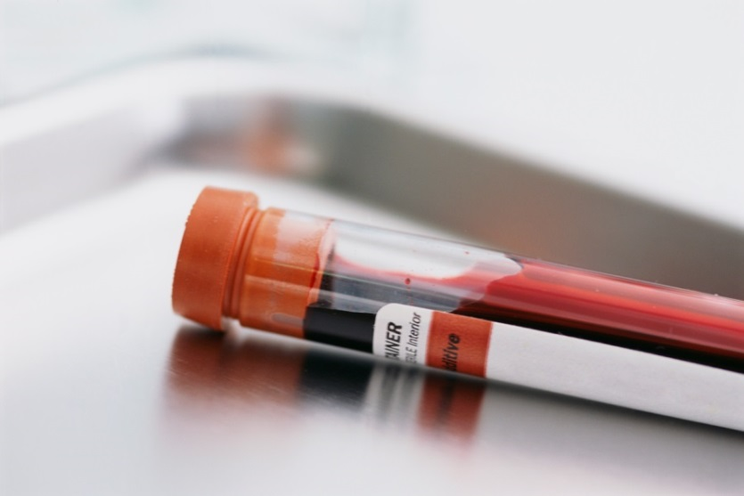
Anemia
Common complication of androgen deprivation therapy (ADT).
Perform annual complete blood count (CBC) to monitor hemoglobin levels.
Evaluate with focus on potential causes other than ADT.
Sources: Grossmann M and Zajac JD. Asian J Androl. 2012; Grossmann M and Zajac JD. Endocrinol Metab Clin North Am. 2011.

Slide 39
Bowel Dysfunction
Discuss bowel function and symptoms (e.g., rectal bleeding, urgency, frequency, incontinence) with survivors.
For mild-moderate symptoms of chronic radiation proctitis, prescribe stool softeners +/- prn hydrocortisone enemas or suppositories.
Refer survivors with persistent or severe rectal symptoms to the appropriate specialist.
Sources: Richter JM, et al. Aliment Pharmacol Ther. 2012; Do NL, et al. Gastroenterol Res Pract. 2011.

Slide 40
Cardiovascular and Metabolic Effects
PCPs should be aware of the effect of ADT on cardiovascular disease and diabetes in prostate cancer survivors.
Periodic evaluation and screening is recommended for:
Cardiac risk factors
Blood pressure monitoring
Lipid profiles
Serum glucose or hemoglobin A1c
Follow USPSTF guidelines for evaluation and screening for cardiovascular risk factors, blood pressure monitoring, lipid profiles, and serum glucose.
Sources: Grossmann M and Zajac JD. Clin Endocrinol (Oxf). 2011; Levine GN, et al. CA Cancer J Clin. 2010; U.S. Preventive Services Task Force. Screening for Coronary Heart Disease: Recommendation Statement. 2004.

Slide 41
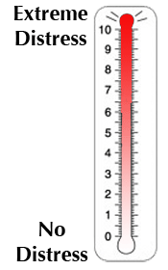
Distress/Depression/PSA Anxiety
Assess for distress/depression/PSA anxiety at least annually using a simple screening tool, such as the NCCN Distress Thermometer, across all stages of survivorship.
Partners & family members often provide valuable insights into survivor distress.
Manage distress/depression using in-office counseling resources or pharmacotherapy as appropriate.
If office-based management is insufficient, refer survivors experiencing distress/depression to appropriate specialists.
Sources: Carlson LE, et al. J Clin Oncol. 2010; Mitchell AJ. J Natl Compr Canc Netw. 2010; NCCN Guidelines for Distress Management. http://www.nccn.org. 2013; Chamers SK, et al. Psychooncology. 2014; Hart SL, et al. J Natl Cancer Inst. 2012.

Slide 42
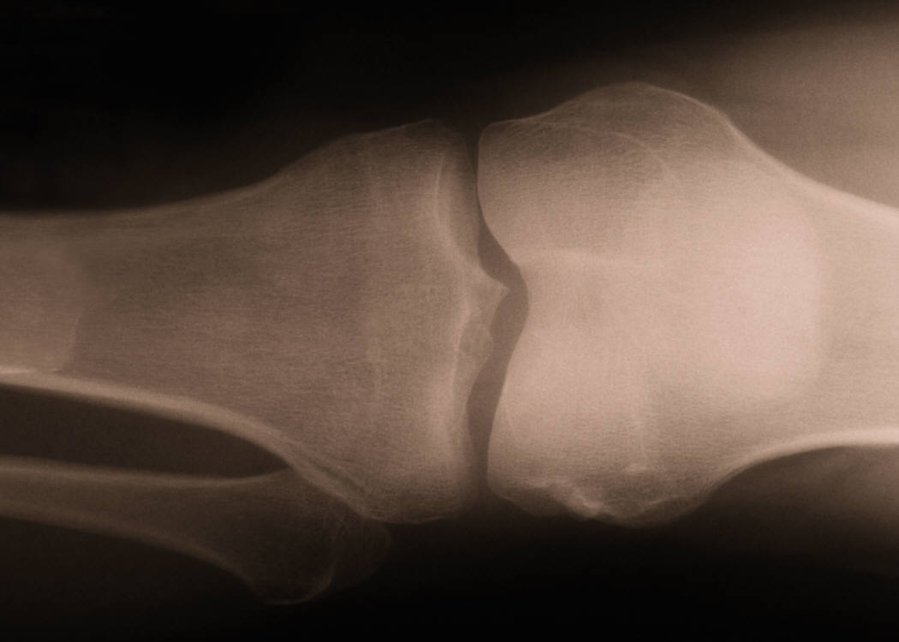
Hip Fracture/Osteoporosis
Assess risk of fracture, for men treated with ADT or older radiation techniques with a baseline DEXA scan and calculation of a FRAX score.
For men determined to be high risk, prescribe weekly bisphosphonate therapy (oral alendronate 70 mg) or annual intravenous zoledronic acid 5 mg to increase bone density.
Further guidance is available through the NCCN’s Bone Health in Cancer Care report and the Endocrine Society’s Guidelines for the management of osteoporosis in men.
Sources: Gralow JR, et al. J Natl Compr Canc Netw. 2009; Saylor PJ, et al. J Urol. 2010; Freeland SJ, et al. JAMA. 2005; Saylor PJ, Prostate Cancer Prostatic Dis. 2010; Watta NB, et al. J Clin Endocrinol Metab. 2012.

Slide 43
Sexual Dysfunction/Body Image
Screen all survivors for sexual dysfunction.
Ideally, use validated tools, such as the Sexual Health Inventory for Men (SHIM), to monitor erectile function over time.
Erectile dysfunction may be addressed through a variety of options, including prescription of phosphodiesterase type 5 inhibitors or penile rehabilitation.
Refer men with persistent sexual dysfunction to a urologist, sexual health specialist, or psychotherapist to review treatment and counseling options.
Assess for distress due to sexual changes and make appropriate referrals for managing the psychosocial aspects of sexuality.
Sources: Cappelleri JC and Rosen RC. Int J Impot Res. 2005; Yuan J, et al. Int J Impot Res. 2010; Pahlajani G, et al. J Sex Med. 2012; Brison D, et al. J Sex Med. 2013. Porst H, et al. J Sex Med. 2013; De Sousa A, et al. Prostate Cancer Prostatic Dis. 2012.

Slide 44
Sexual Intimacy
Both the patient’s and partner’s sexual concerns should be considered during survivorship care.
Encourage couples to discuss their sexual intimacy and refer to counseling or support services as appropriate.
Instruct couples on the use of sexual aids to improve erectile dysfunction for men/male partners and to address post-menopausal symptoms for women.*
*More research is needed to understand and address the unique needs and concerns of same-sex couples.
Sources: Ko CM, et al. Support Care Cancer. 2005; Reese JB, et al. Support Care Cancer. 2010; Couper J, et al. Psycho-oncology. 2006.
Image Source: http://motionmedication.com/Stock-Images/Older%20Couple%20Piggyback.jpg

Slide 45
Urinary Dysfunction
Screen all survivors for urinary dysfunction and incontinence.
Consider timed voiding, or prescribing anti-cholinergic medications to address issues such as nocturia, frequency, or urgency. Consider alpha-blockers for slow stream.
Refer survivors with post-prostatectomy incontinence to a physical therapist for pelvic floor rehabilitation; at a minimum, instruct survivors about Kegel exercises.
Refer men with persistent leakage or other urinary symptoms to a urologist for further evaluation and discussion of treatment options, including surgical placement of a male urethral sling or artificial urinary sphincter for incontinence.
Sources: Goode PS, et al. JAMA. 2011; Campbell SE, et al. Cochrane Database Syst Rev. 2012; Comiter CV, Curr Opin Urol. 2010; Rai BP, et al. Cochrane Database Syst Rev. 2012; Chung E and Cartmill R. BJU Int. 2013; Herschorn S. Can Urol Assoc J. 2013.

Slide 46
Vasomotor Symptoms
ADT is associated with a number of adverse physical effects including vasomotor symptoms (e.g., hot flushes), fatigue, sexual dysfunction, and decreased libido.
Although not FDA-approved for this indication, prescription of selective serotonin or noradrenergic reuptake inhibitors or gabapentin may offer symptom relief.
Sources: Grossmann M and Zajac JD. Clin Endocrinol (Oxf). 2011; Saylor PJ and Smith MR. J Urol. 2013; Ahmadi H and Daneshmand S. BJU Int. 2013; Fisher WI, et al. CA Cancer J Clin. 2013; Alekshun TJ and Patterson SG. Support Cancer Ther. 2006.

Slide 47
Guidelines for Care Coordination
PCPs should maintain their role as general medical care coordinator throughout the spectrum of prostate cancer detection, treatment, and aftercare.
When survivorship care is transferred to the primary care provider, the primary treating specialist is encouraged to:
Provide a treatment summary and survivorship care plan to the PCP.
Clarify the need for and frequency of PSA monitoring.
Establish thresholds for referral back.
Annually assess for the presence of long-term or late effects of prostate cancer and its treatment. Refer survivors to appropriate community-based and peer support resources.
Sources: Hewitt M, et al. Washington, DC: National Academies Press. 2006; American College of Surgeons. Commission on Cancer. Cancer Program Standards 2012. http://www.facs.org.

Slide 48
Conclusion
PCPs should play an active role in the care coordination of survivors by:
Promoting healthy behaviors,
Assisting in the surveillance for cancer recurrence and second primary cancers,
Assessing and managing physical and psychosocial long-term and late effects,
Clarifying care roles when needed with other members of the prostate cancer treatment team.
The ACS guidelines provide recommendations on the role of PCPs in caring for prostate cancer survivors.

Slide 49
Case Study
You are seeing a 73 year old African American man now 3 years out from external beam radiation for locally advanced prostate cancer.
PMH: Hypertension, knee osteoarthritis
Medications: ADT (Lupron) from his urologist, hydrochlorothiazide, amlodipine, acetaminophen
Social History: married for over 40 years; no tobacco or alcohol
Review of Systems positive for urinary urgency with occasional leakage, erectile dysfunction
Blood pressure 134/92, BMI 28

Slide 50
Case Question #1
Which of the following health promotion interventions would you recommend?
A. walking 30 minutes 3 days a week
B. the DASH diet
C. calcium carbonate 750mg twice daily
D. Vitamin D 400 International Units daily

Slide 51
Case Question #1 Discussion
Which of the following health promotion interventions would you recommend?
A. walking 30 minutes 3 days a week
A minimum of 150 minutes of physical activity weekly or 30 minutes daily is recommended
B. the DASH diet
The DASH diet is rich in fruits, vegetables, whole grains and legumes, has been shown to help lower blood pressure, BMI, waist circumference as well as other risk factors associated with metabolic syndrome*
C. calcium carbonate 750mg twice daily
Calcium should be obtained through dietary sources, not supplements (due to concern re increased coronary risk); the recommended maximum is 1200mg/d
D. Vitamin D 400 International Units daily
The recommended amount of Vitamin D is at least 600 IU/d
*Sources: Appel LI, et al. JAMA 2003; NHLBI. www.nhlbi.nih.gov/health/public/heart/hbp/dash/dash_brief.pdf. 2006.

Slide 52
Case Question #2
For the patient’s genitourinary symptoms, which of the following could be appropriate interventions?
A. a phosphodiesterase type 5 inhibitor
B. testosterone replacement therapy
C. urology referral for alternative erectile dysfunction management strategies
D. A or C

Slide 53
Case Question #2 Discussion
For the patient’s genitourinary symptoms, which of the following could be appropriate interventions?
A. a phosphodiesterase type 5 inhibitor
Most men on ADT experience both loss of libido and erectile dysfunction (ED). Some men & their partners wish to continue sexual activity while on ADT. The PDE-5 inhibitors may be effective in managing ED in these men.
B. testosterone replacement therapy
Testosterone replacement is both ineffective and contraindicated for men on ADT
C. urology referral for alternative erectile dysfunction management strategies
For men in whom PDE-5 inhibitor treatment is inadequate, urology referral is appropriate to explore alternative management strategies.
D. A or C

Slide 54
Case Question #3
Which of the following tests is recommended for this patient?
Cardiac stress testing
DEXA
Abdominal aortic aneurysm screening
All of the above

Slide 55
Case Question #3 Discussion
Which of the following tests is recommended for this patient?
A. Cardiac stress testing
Although patients on ADT are at increased cardiovascular risk, there is no evidence for testing asymptomatic men
B. DEXA
Men on ADT are at significant risk for osteoporosis and should undergo DEXA scanning; a FRAX score should be calculated and men at high risk should be offered bisphosphonate therapy
C. Abdominal aortic aneurysm screening
Per USPSTF guidelines, only male ever-smokers 65-75 years should undergo AAA screening
D. All of the above

Slide 56
Acknowledgment
We are grateful for the support of CDC cooperative agreement #5U55DPOO3O54.
Notes:
Thank you (Presenter) for your presentation and for sharing your expertise on this important topic.
This concludes the webinar, please continue to explore the remaining sections of the cancer survivorship e-learning series for primary care providers.
Thank you.

